Slide 1

Arduino
LED Blink
Homework

Slide 2


OpenAI ChatGPT-4
Software Development Capabilities
Skilled in creating and assisting with software programming, from basic scripts to complex applications.

Slide 3
Code Generation & Analysis
Capable of in multiple programming languages.
  Writing
  Analyzing
  Debugging code

Slide 4
ChatGPT-4 supports Arduino
Assist with Arduino code & concepts
ChatGPT-4 can provide code snippets or guidance, but you would need to copy this code into the Arduino IDE to compile and upload it to your Arduino hardware.

Slide 5
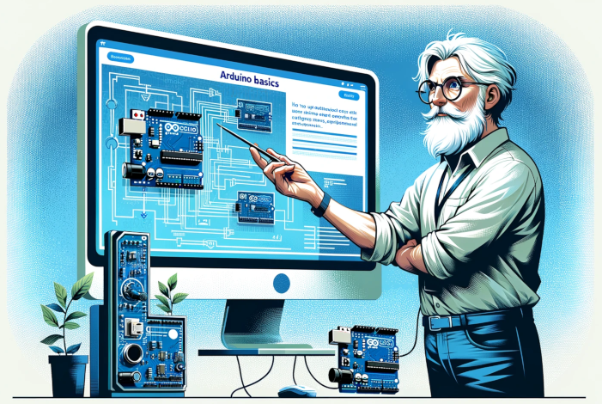
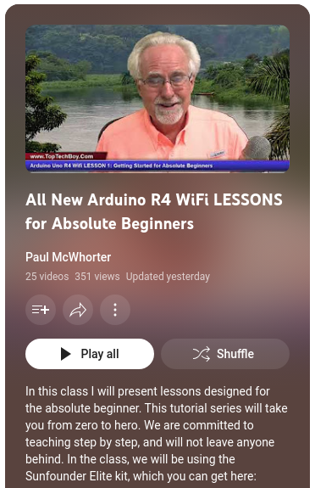
Paul McWhorter Arduino Lesson 1

Slide 6
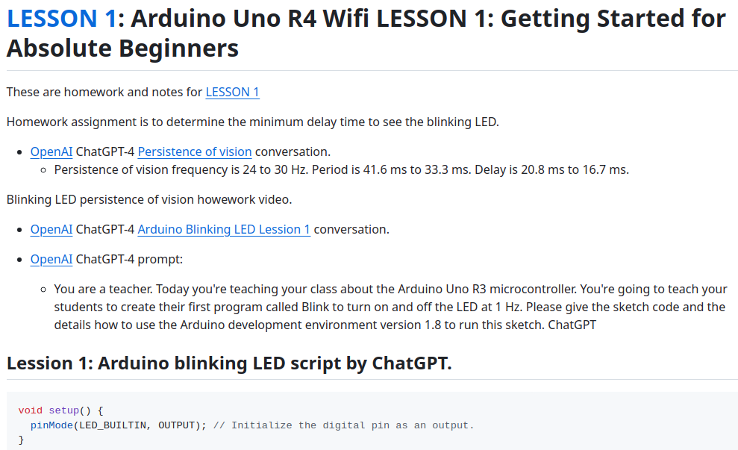

David WA9ONY Lesson 1 Homework

Slide 7
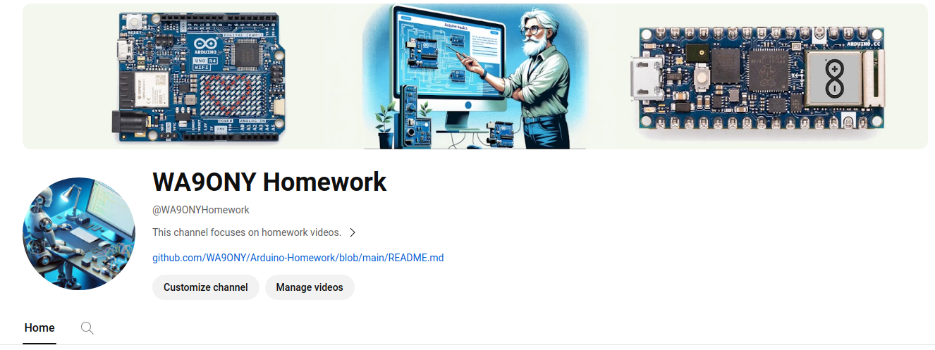

David WA9ONY Lesson 1 Homework

Slide 8

Summary
LED
  Persistence of vision
Use ChatGPT to
  Code
  Explore
  Analyze

