Slide 1

Arduino
Lesson 1
LED Blink
Homework
David
Haworth
WA9ONY

Slide 2
Agenda
ChatGPT create LED blink sketch
LED blink delay homework
Maximum blink frequency
David Haworth, WA9ONY

Slide 3

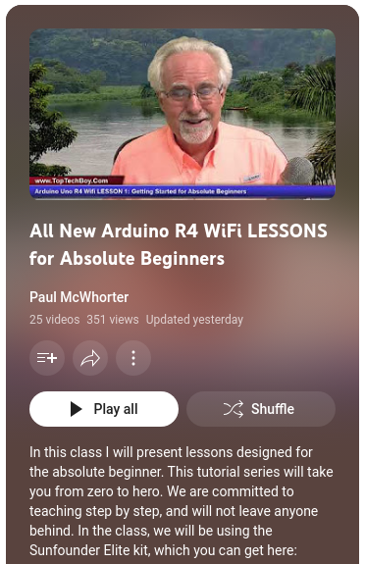
Paul McWhorter Arduino Lesson 1
LED delay flashing to steady

Slide 4


OpenAI ChatGPT-4
Software Development Capabilities
Skilled in creating and assisting with software programming, from basic scripts to complex applications.

Slide 5
Code Generation & Analysis
Capable of in multiple programming languages.
  Writing
  Analyzing
  Debugging code

Slide 6
ChatGPT-4 supports Arduino
Assist with Arduino code & concepts
ChatGPT-4 can provide code snippets or guidance,
  but you would need to copy this code into the Arduino IDE to compile and upload it to your Arduino hardware.

Slide 7
ChatGPT Demo
Create blink LED Arduino UNO sketch
Share ChatGPT conversation

Slide 8
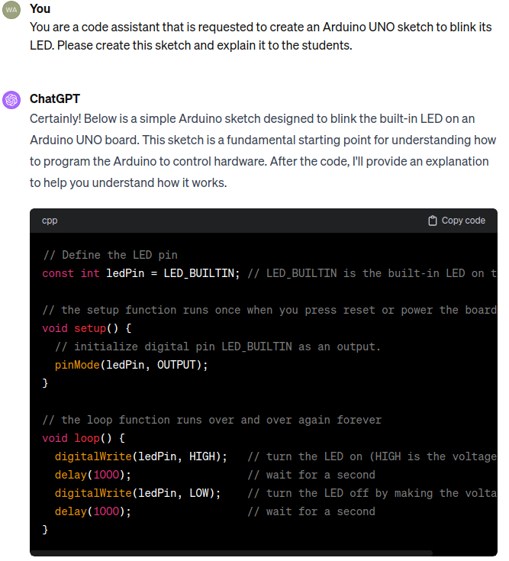

Slide 9
Homework Assignment Video
Find the blink delay value between flickering and steady LED
Delay | Frequency | Visual | Cam Aliasing
15 mil-sec | 31.9 Hz | Steady | 1.9 Hz
16 mil-sec | 29.9 Hz | Flickering | 0.1 Hz
17 mil-sec | 28.1 Hz | Flickering | 1.9 Hz

Slide 10
Maximum Blink Frequency Demo
Comment the delay functions
Arduino UNO R4 WiFi, 48 MHz 3.0 X faster
  ~585 kHz with jitter 4.0 X faster
Arduino UNO R3, 16 MHz
  147.9 kHz dim LED

Slide 11
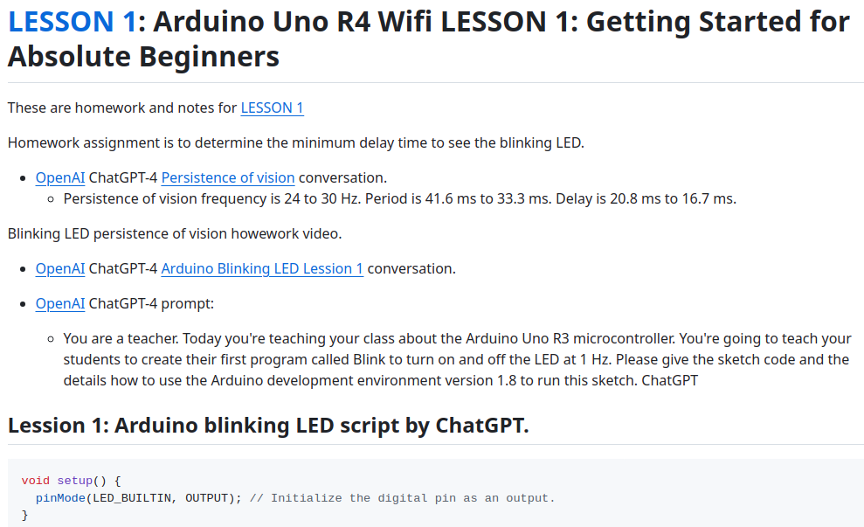

David WA9ONY Lesson 1 Homework

Slide 12
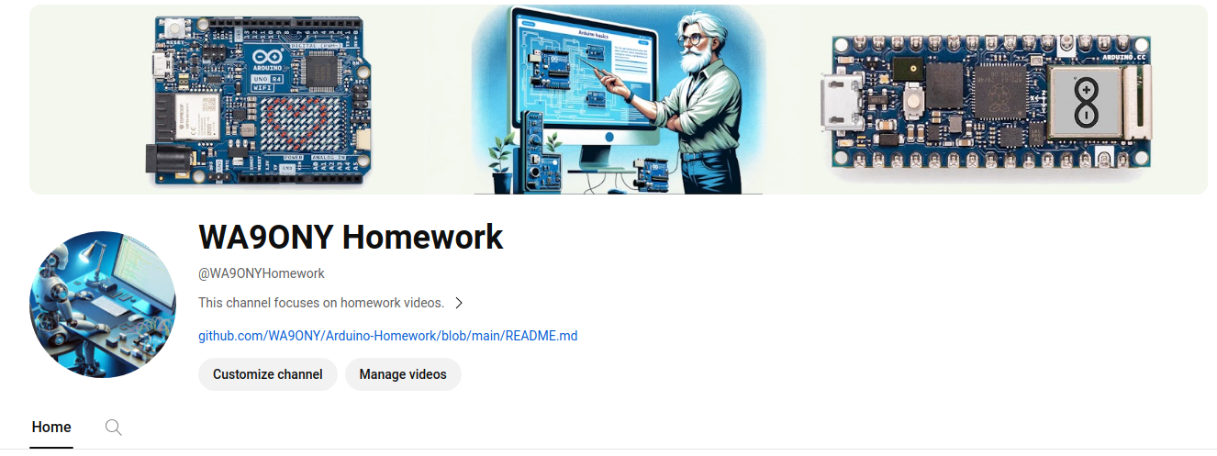

David WA9ONY Lesson 1 Homework

Slide 13

Summary
Arduino LED blink
  Persistence of vision
  Maximum frequency
ChatGPT
  Create code

