Slide 1

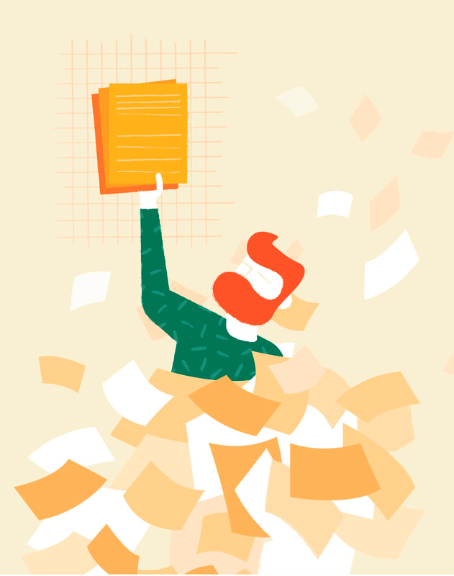
ISB WAGademy
Session 1 · Intro to WAG — why accountability works
Short winter days, big thesis progress.
Fri 7 Aug · 9:00 am – 12:30 pm · 78-411
Notes:
Welcome! Quick icebreaker while people settle: name, thesis topic in one sentence, one thing you're stuck on. Keep tight — 5 min max, the whole intro is 15 min so the timer starts at 9:20. Frame: this is not a seminar, it's a doing group. We finish at 12:00 sharp — everyone makes the seminar on time.

Slide 2




A PhD is a productivity trap
Nobody designed it this way — but the conditions of HDR life are exactly the ones that stall work.
No real deadlines
Isolation
Milestones are months apart. Nothing is due tomorrow, so nothing happens today.
You work alone, on a problem nobody else is working on, often at home in winter.
Slow feedback
Perfectionism
Weeks between supervisor meetings. Effort and reward are completely decoupled.
“I'll write once I've read enough” — the reading is never enough.
Notes:
Discussion opener — don't lecture. Ask: 'What's your biggest barrier to protected research time?' Collect 3-4 answers, then show the slide: their answers will map onto these four. Point: these are structural, not personal failings. ~4 min.

Slide 3



The WAG loop
A Working Accountability Group adds back the three things a PhD removes: deadlines, witnesses, and feedback.
→
→
1 · Commit
2 · Work
3 · Report
Say your session goals out loud (and post them on the board).
Three 45–50 min pomodoros, phones away, alongside your peers.
Did you hit it? What got in the way? No judgment — it's data.
That's the whole trick. We repeat it six times, and the reporting from one week feeds the commitment of the next.
Notes:
Keep this fast — the loop is intuitive. Emphasise: not a support group, not a shut-up-and-write clone; the commit and report steps are what make it different from just co-working. ~2 min.

Slide 4




Why saying it out loud works
Social facilitation
We work measurably harder when others are present — even silently.
43% → 76%
Implementation intentions
Deciding when, where and what beats vague intentions to “work more”.
goal achievement when goals are written down and progress is reported to a peer
Public commitment
A goal someone else heard is much harder to quietly drop.
Timeboxing
Matthews, Dominican University goals study
50 focused minutes beats 3 hours of willpower. Breaks are part of the method.
Notes:
2-3 min. The stat: Gail Matthews' goals study — participants who wrote goals, made action commitments and sent weekly progress to a friend achieved ~76% vs ~43% for those who merely thought about goals. Don't oversell the numbers; the direction of the effect is what matters and everyone recognises it from experience.

Slide 5
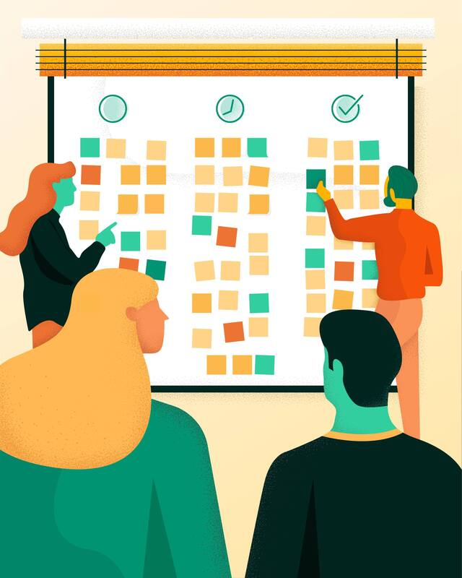
How today runs
9:00
Discussion (15 min) + post your 3 objectives on the board
9:20
Pomodoro 1 — 45 min deep work
10:05
Break — coffee, snacks, quick check-in
10:15
Pomodoro 2 — 45 min
11:00
Quick break
11:05
Pomodoro 3 — 45 min
11:50
Report back: wins, blockers, next week's intention
12:00
Done — at the seminar on time
Notes:
1 min. Point out breaks are for talking, pomodoros are not. Coffee/hot water/snacks at the back — grab during breaks. TODAY ONLY is compressed (15-min discussion, timer at 9:20, 45-min pomodoros, done 12:00 for the seminar). Every other session — Thursdays and later Fridays — runs full 50-min blocks, exactly the rhythm Thesez-vous uses for group academic writing (50 min work + 10 min pause).

Slide 6


Writing objectives that actually work
Vague = invisible failure
Specific = checkable
“Work on my thesis”
“Draft 300 words of the methods intro”
“Read some papers”
“Read + take notes on 3 papers about X”
“Do analysis”
“Code the data-cleaning step for dataset Y”
At 11:50 you should be able to answer “did I do it?” with yes or no — never “sort of”.
Notes:
3-4 min, interactive: put up 'work on my thesis' and ask what's wrong with it. Key point: vague goals can't fail, which is exactly why they don't work — there's nothing to be accountable FOR. ~1 objective per pomodoro is the right size.

Slide 7

The objective formula
VERB
DELIVERABLE
SIZE
+
+
draft · code · plot · outline · revise · annotate
the thing a stranger could point at
sized to one pomodoro (45–50 min)
Example: “Revise (verb) two paragraphs (size) of discussion §4.2 (deliverable) using Tuesday's feedback”
The stranger test: could someone who isn't you verify it got done? If not, sharpen it.
Verb bank by phase (adapted from Thésez-vous): explore — list · note · annotate · define · sketch | review — identify · classify · summarise · link | pre-write — plan · scope · order · outline | write — introduce · elaborate · illustrate · conclude | rewrite — reformulate · question · compare · tighten | revise — check · correct · standardise
Notes:
2 min. Have everyone silently draft their 3 objectives NOW using the formula, before you show the board. Walk around and sharpen a couple of vague ones out loud (with permission) — it teaches the whole room.

Slide 8
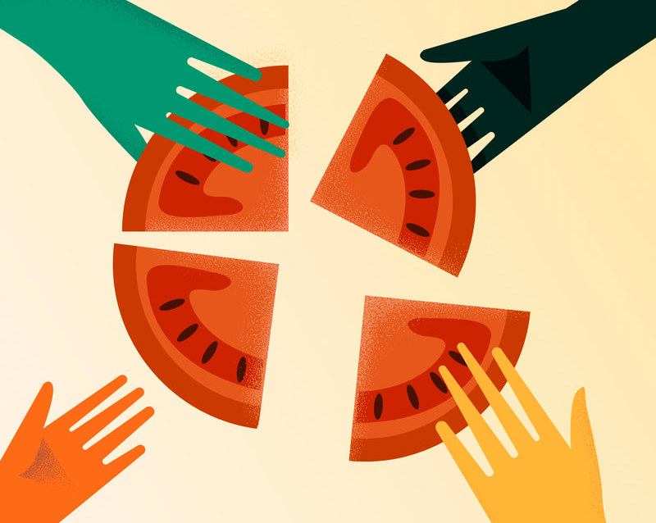
One board, everyone's goals
Claim a sticky colour — that's you for the series.
Post one sticky per objective (3 per session) in To do before 9:20.
Drag them across as you work — moving a sticky to Done is the dopamine hit.
The board stays up all 6 weeks: it becomes a visible log of everything this group shipped.
How it works
TO DO
ONGOING
DONE
Draft 300w methods — Alex
Revise fig. 3 caption — Jo
Annotate 3 papers — Wei
Clean dataset Y — Sam
Outline lit review §2 — Priya
Notes:
2 min. Share the Miro link in the calendar invite and drop it in the chat now; QR on the next slide too if you add one. Model it: post YOUR three stickies first, live.

Slide 9
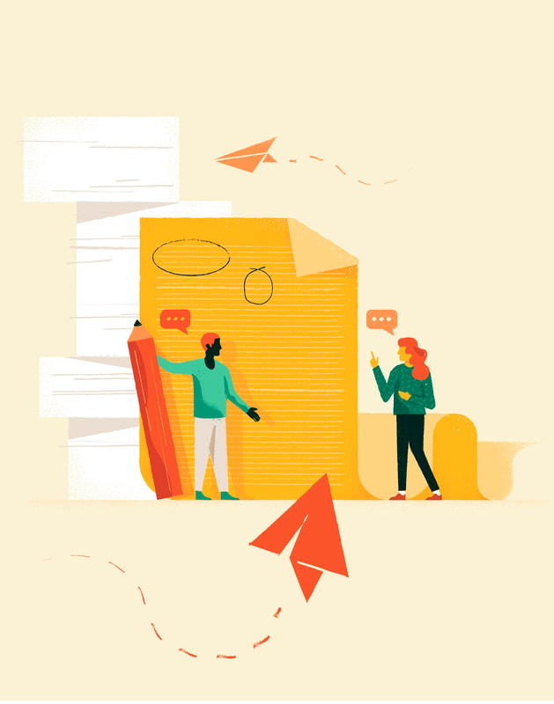

Your turn
1
Write 3 objectives — one per pomodoro, formula-checked.
2
Post them on the Miro board (link in the calendar invite).
3
Say one out loud to the person next to you.
Use the strategy on your own between sessions: https://pomofocus.io — pick your length, go.
Timer starts at 9:20 sharp. Let's make winter productive.
Notes:
Give them 5 quiet minutes to write and post objectives, then quick round: each person reads ONE objective aloud. Start the visible timer at 9:20 exactly — punctuality on day one sets the norm for the series, and it gets everyone to the 12pm seminar on time.

