Slide 1

MSBRDM - Group Project
Maximilian Bader, Dominik Urbaniak, Hanyu Wang, Kazuki Zjalic
Technical University of Munich
Department of Electrical and Computer Engineering
Chair of Cognitive Systems
Munich, January 14th 2020

Slide 2
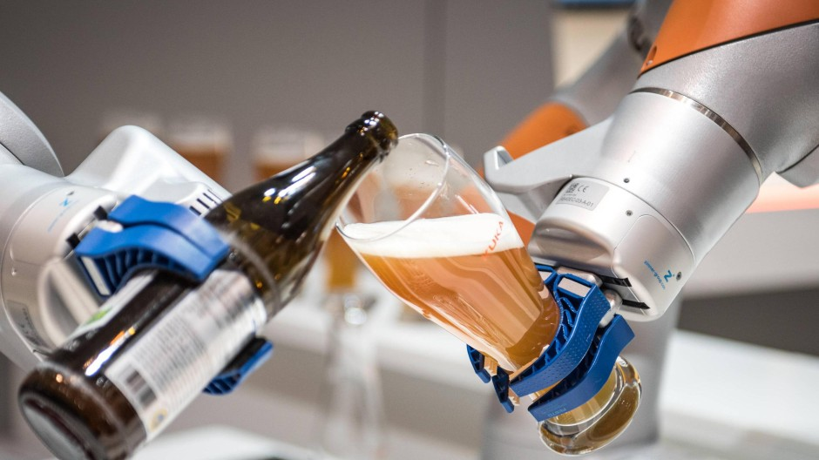
Bartender‘s Little Helper
1. Motivation
Customized Drinks
Transparent pricing
-> Safe human-robot interaction with robot skin
Image source: https://www.augsburger-allgemeine.de/wirtschaft/Hat-Kuka-die-
Zukunft-verschlafen-id52970466.html [Accessed: 01/13/2019]

Slide 3
Bartender‘s Little Helper
2. Functionalities

Slide 4
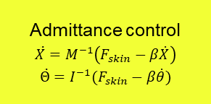














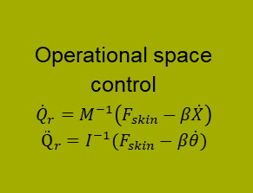












Bartender‘s Little Helper
3. Block Diagram
$${state}_{ctrl}$$
$$F_{skin}$$
$$F_{skin}$$
Admittance control
$$\ddot{X}=M^{−1}\left(F_{skin}−β\dot{X}\right)$$
$$\ddot{Θ}=I^{−1}(F_{skin}−β\dot{θ})$$
$${\ddot{X}}_{d}$$
$$\int{dt}$$
$${\dot{X}}_{d}$$
Operational space control
$${\dot{Q}}_{r}=M^{−1}\left(F_{skin}−β\dot{X}\right)$$
$${\ddot{Q}}_{r}=I^{−1}(F_{skin}−β\dot{θ})$$
$$Fmanual$$
Skin sensor
Filter
$${∆d}_{prox}$$
Filter
$$\dot{X}$$
$${\ddot{Θ}}_{d}$$
$$\int{dt}$$
$${\dot{Θ}}_{d}$$
$$\dot{Θ}$$
-
$$∆\dot{X}$$
$$Q$$
$$Q$$
$$X$$
-
$$∆\dot{Θ}$$
Filter
Forward kinematics
$$Θ$$
$$\int{dt}$$
$$X_{d}$$
$$∆X$$
-
Dynamic model
$$\int{dt}$$
$$Θ_{d}$$
-
$$∆Θ$$
$$\ddot{Q}$$
$$\int{dt}$$
$$\dot{Q}$$
$$τ$$
Filter
$$τ$$
$$Q$$
Notes:
Questions:
Can we measure joint velocities & accelerations with sensors? (Or do we define a dynamic model?)
Sign of skin force correct?
Transformation of F_{skin} -> F_{EF} with homogeneous transformation, but (4,4) entry of matrix =0?
How do we change the active controller?

