Slide 1

MSBRDM - Group Project
Maximilian Bader, Dominik Urbaniak, Hanyu Wang, Kazuki Zjalic
Technical University of Munich
Department of Electrical and Computer Engineering
Chair of Cognitive Systems
Munich, January 14th 2020

Slide 2
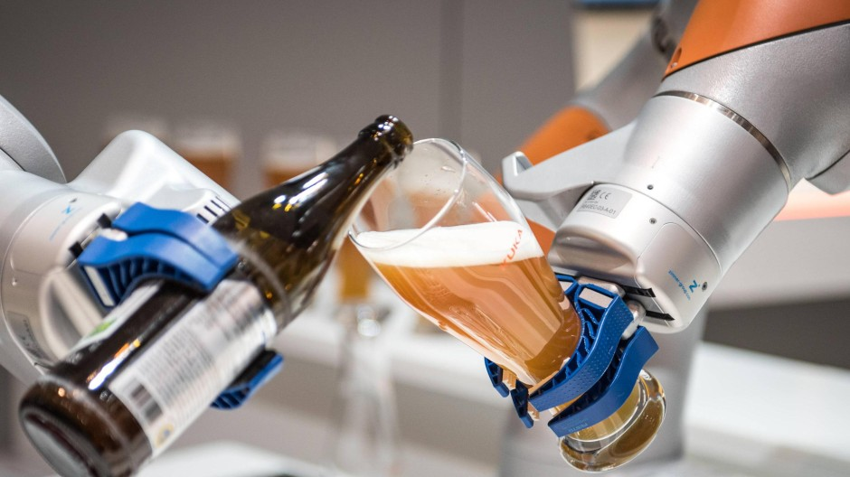
Bartender‘s Little Helper
1. Motivation
Image source: https://www.augsburger-allgemeine.de/wirtschaft/Hat-Kuka-die-
Zukunft-verschlafen-id52970466.html [Accessed: 01/13/2019]

Slide 3
Bartender‘s Little Helper
2. Functionalities
Teaching task
Set end effector’s position to the object (position & orientation fixed)
Switch the state by touching the skin sensor and set the orientation
Store the pose information at the grasping position
Movement task
Set initial position of the robot arm and calculate desired trajectory
Compensate the influences of outer force
Pouring task
Grasp object and pour drink into a cup (position & orientation fixed)
Advanced option : Computer vision
Improve robustness e.g. detect orientation & position of object & cup, then compute trajectory to move and pour drink
Notes:
When the arm is pushed by someone, skin sensor detect the forces and the arm tries to go back to the desired trajectory
Question.
Object and cups info is fixed or not??
How we compensate outer force?
Force sensor – gravity compensation
Skin sensor – detecting outer force??

Slide 4
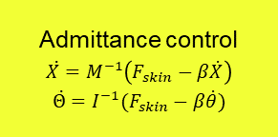














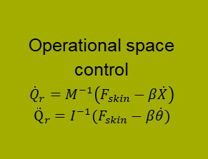












Bartender‘s Little Helper
3. Block Diagram
$${state}_{ctrl}$$
$$F_{skin}$$
$$F_{skin}$$
Admittance control
$$\ddot{X}=M^{−1}\left(F_{skin}−β\dot{X}\right)$$
$$\ddot{Θ}=I^{−1}(F_{skin}−β\dot{θ})$$
$${\ddot{X}}_{d}$$
$$\int{dt}$$
$${\dot{X}}_{d}$$
Operational space control
$${\dot{Q}}_{r}=M^{−1}\left(F_{skin}−β\dot{X}\right)$$
$${\ddot{Q}}_{r}=I^{−1}(F_{skin}−β\dot{θ})$$
$$Fmanual$$
Skin sensor
Filter
$${∆d}_{prox}$$
Filter
$$\dot{X}$$
$${\ddot{Θ}}_{d}$$
$$\int{dt}$$
$${\dot{Θ}}_{d}$$
$$\dot{Θ}$$
-
$$∆\dot{X}$$
$$Q$$
$$Q$$
$$X$$
-
$$∆\dot{Θ}$$
Filter
Forward kinematics
$$Θ$$
$$\int{dt}$$
$$X_{d}$$
$$∆X$$
-
Dynamic model
$$\int{dt}$$
$$Θ_{d}$$
-
$$∆Θ$$
$$\ddot{Q}$$
$$\int{dt}$$
$$\dot{Q}$$
$$τ$$
Filter
$$τ$$
$$Q$$
Notes:
Questions:
Can we measure joint velocities & accelerations with sensors? (Or do we define a dynamic model?)
Sign of skin force correct?
Transformation of F_{skin} -> F_{EF} with homogeneous transformation, but (4,4) entry of matrix =0?
How do we change the active controller?

