Slide 1

MSBRDM - Group Project
Maximilian Bader, Dominik Urbaniak, Hanyu Wang, Kazuki Zjalic
Technical University of Munich
Department of Electrical and Computer Engineering
Chair of Cognitive Systems
Munich, January 14th 2020

Slide 2
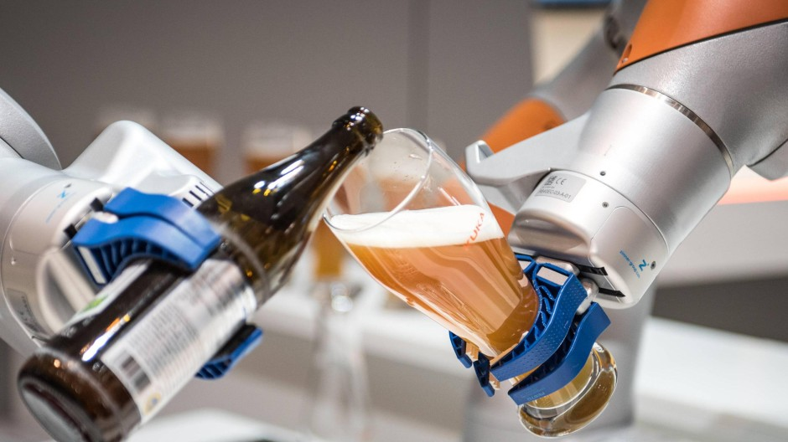
Bartender‘s Little Helper
1. Motivation
Ever waited too long for your drink in a bar?
Ever got a awful mixture from your barkeeper?
Here comes „Bartender‘s Little Helper“
Fast & customized drinks
Transparent pricing
Safe human-robot interaction utilizing robot skin
Image source: https://www.augsburger-allgemeine.de/wirtschaft/Hat-Kuka-die-
Zukunft-verschlafen-id52970466.html [Accessed: 01/13/2019]

Slide 3
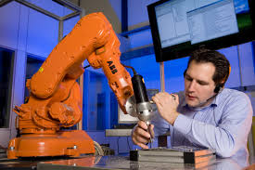
Bartender‘s Little Helper
2. Functionalities
Teaching task
Moving end effector to desired position & orientation (separate adjustability)
Switching between states by intuitive skin handling
Storing of grasping position & orientation
Movement task
Movement along trajectory to stored position
Compensation of outer force influences
Pouring task
Grasp bottle & pour drink into cup (position & orientation fixed)
Advanced option: Computer vision
Improved robustness (e.g. visual based detection of orientation & position)
Image source: http://www.abb.de/cawp/seitp202/143b844927 b6e0bcc125738b00348d1b.aspx [Accessed: 01/13/2019]

Slide 4













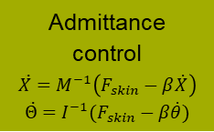




















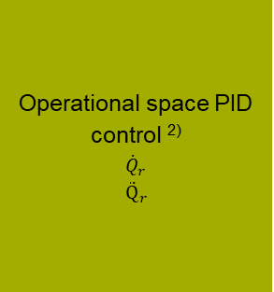


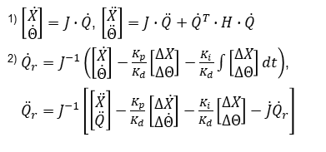




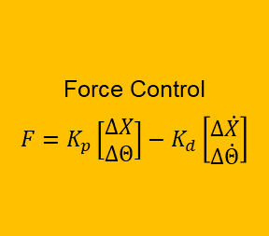

Bartender‘s Little Helper
3. Block Diagram (1)
$${state}_{ctrl}$$
$$F_{skin}$$
$$F_{skin}$$
Admittance control
$$\ddot{X}=M^{−1}\left(F_{skin}−β\dot{X}\right)$$
$$\ddot{Θ}=I^{−1}(F_{skin}−β\dot{θ})$$
$${\ddot{X}}_{d}$$
$$\int{dt}$$
$${\dot{X}}_{d}$$
Operational space PID control ²⁾
$${\dot{Q}}_{r}$$
$${\ddot{Q}}_{r}$$
$$Fmanual$$
Skin sensor
Filter
$${∆d}_{prox}$$
Filter
$$\dot{X}$$
$${\ddot{Θ}}_{d}$$
$$\int{dt}$$
$${\dot{Θ}}_{d}$$
$${\dot{Q}}_{r}$$
$$\dot{Θ}$$
-
$$∆\dot{X}$$
$$Q$$
$$Q$$
$$X$$
-
$$∆\dot{Θ}$$
Filter
Forward ki-nematics ¹⁾
$$Θ$$
$$\int{dt}$$
$$X_{d}$$
$$∆X$$
$${\ddot{Q}}_{r}$$
-
Poses
$$\int{dt}$$
Dynamic model
$$\ddot{Q}$$
$$\int{dt}$$
$$\dot{Q}$$
$$\int{dt}$$
$$Θ_{d}$$
-
$$∆Θ$$
$$τ$$
Filter
$$τ$$
$$\int{dt}$$
$${state}_{ctrl}$$
$$Q$$
Trajectory
Computation
$$X_{d}$$
-
$$∆X$$
Force Control
$$F=K_{p}\left[\begin{matrix}∆X \\ ∆Θ\end{matrix}\right]−K_{d}\left[\begin{matrix}∆\dot{X} \\ ∆\dot{Θ}\end{matrix}\right]$$
¹⁾ $\left[\begin{matrix}\dot{X} \\ \dot{Θ}\end{matrix}\right]=J∙\dot{Q}$, $\left[\begin{matrix}\ddot{X} \\ \ddot{Θ}\end{matrix}\right]=J∙\ddot{Q}+{\dot{Q}}^{T}∙H∙\dot{Q}$
²⁾ ${\dot{Q}}_{r}=J^{−1}\left(\left[\begin{matrix}\dot{X} \\ \dot{Θ}\end{matrix}\right]−\frac{K_{p}}{K_{d}}\left[\begin{matrix}∆X \\ ∆Θ\end{matrix}\right]−\frac{K_{i}}{K_{d}}\int{\left[\begin{matrix}∆X \\ ∆Θ\end{matrix}\right]dt}\right)$, ${\ddot{Q}}_{r}=J^{−1}\left[\left[\begin{matrix}\ddot{X} \\ \ddot{Q}\end{matrix}\right]−\frac{K_{p}}{K_{d}}\left[\begin{matrix}∆\dot{X} \\ ∆\dot{Θ}\end{matrix}\right]−\frac{K_{i}}{K_{d}}\left[\begin{matrix}∆X \\ ∆Θ\end{matrix}\right]−\dot{J}{\dot{Q}}_{r}\right]$
$$Θ_{d}$$
-
$$∆Θ$$
$$F$$
$${\dot{X}}_{d}$$
-
$$∆\dot{X}$$
$${\dot{Θ}}_{d}$$
-
$$∆\dot{Θ}$$
Notes:
Questions:
Can we measure joint velocities & accelerations with sensors? (Or do we define a dynamic model?)
Sign of skin force correct?
Transformation of F_{skin} -> F_{EF} with homogeneous transformation, but (4,4) entry of matrix =0?
How do we change the active controller?
When do I have to recalculate the trajectory, if an outer force acts on the arm

Slide 5
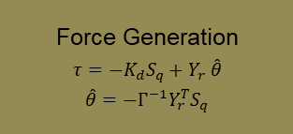

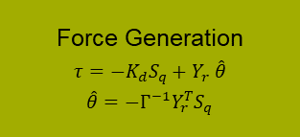




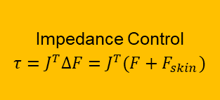
Bartender‘s Little Helper
3. Block Diagram (2)
$${\dot{Q}}_{r}$$
Force Generation
$$τ=−K_{d}S_{q}+Y_{r} \hat{θ}$$
$$\hat{θ}=−Γ^{−1}Y_{r}^{T}S_{q}$$
$${\ddot{Q}}_{r}$$
$$τ_{Teach}$$
$$Q$$
$${state}_{ctrl}$$
$$\dot{Q}$$
Force Generation
$$τ=−K_{d}S_{q}+Y_{r} \hat{θ}$$
$$\hat{θ}=−Γ^{−1}Y_{r}^{T}S_{q}$$
$$τ$$
Impedance Control
$$τ=J^{T}∆F=J^{T}(F+F_{skin})$$
$$F_{skin}$$
$$τ_{Move}$$
$$F$$

