Slide 1

MSBRDM - Group Project
Maximilian Bader, Dominik Urbaniak, Hanyu Wang, Kazuki Zjalic
Technical University of Munich
Department of Electrical and Computer Engineering
Chair of Cognitive Systems
Munich, January 14th 2020

Slide 2
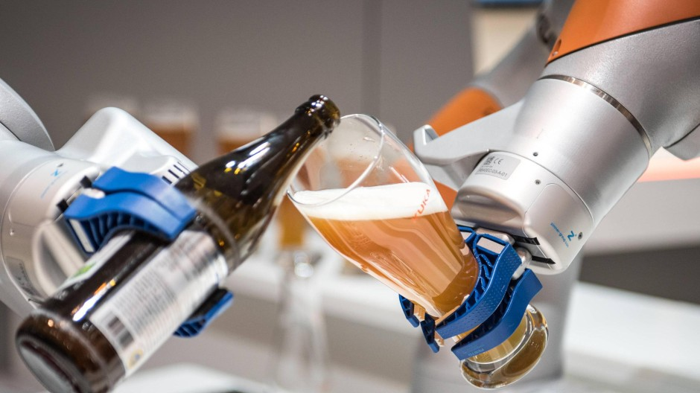
Bartender‘s Little Helper
1. Motivation
Image source: https://www.augsburger-allgemeine.de/wirtschaft/Hat-Kuka-die-
Zukunft-verschlafen-id52970466.html [Accessed: 01/13/2019]

Slide 3
Bartender‘s Little Helper
2. Functionalities
Teaching task
Set end effector’s orientations & positions separately with touching skin sensor to grasp object (bottle, cup…)
Store end effector’s orientations & positions at grasping position
Movement task
Set in start position and calculate trajectory
When the arm is pushed by someone, skin sensor detect the forces and the arm tries to go back to the desired trajectory
Pouring task
Grasp object(position fixed) and pour drink to a cup(position fixed)
Advanced option : Computer vision
Improve robustness about object e.g. detect orientation & position of object & cup, then compute trajectory to move and pour drink

Slide 4
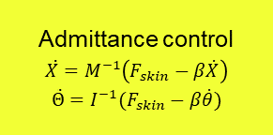














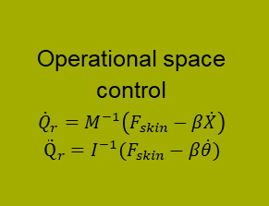












Bartender‘s Little Helper
3. Block Diagram
$${state}_{ctrl}$$
$$F_{skin}$$
$$F_{skin}$$
Admittance control
$$\ddot{X}=M^{−1}\left(F_{skin}−β\dot{X}\right)$$
$$\ddot{Θ}=I^{−1}(F_{skin}−β\dot{θ})$$
$${\ddot{X}}_{d}$$
$$\int{dt}$$
$${\dot{X}}_{d}$$
Operational space control
$${\dot{Q}}_{r}=M^{−1}\left(F_{skin}−β\dot{X}\right)$$
$${\ddot{Q}}_{r}=I^{−1}(F_{skin}−β\dot{θ})$$
$$Fmanual$$
Skin sensor
Filter
$${∆d}_{prox}$$
Filter
$$\dot{X}$$
$${\ddot{Θ}}_{d}$$
$$\int{dt}$$
$${\dot{Θ}}_{d}$$
$$\dot{Θ}$$
-
$$∆\dot{X}$$
$$Q$$
$$Q$$
$$X$$
-
$$∆\dot{Θ}$$
Filter
Forward kinematics
$$Θ$$
$$\int{dt}$$
$$X_{d}$$
$$∆X$$
-
Dynamic model
$$\int{dt}$$
$$Θ_{d}$$
-
$$∆Θ$$
$$\ddot{Q}$$
$$\int{dt}$$
$$\dot{Q}$$
$$τ$$
Filter
$$τ$$
$$Q$$
Notes:
Questions:
Can we measure joint velocities & accelerations with sensors? (Or do we define a dynamic model?)
Sign of skin force correct?
Transformation of F_{skin} -> F_{EF} with homogeneous transformation, but (4,4) entry of matrix =0?
How do we change the active controller?

