Slide 1
U.S. Metropolitan Statistical Area GDP over time
By Ginny Ulichney

Slide 2
Top 10 MSAs by mean GDP (millions of dollars) via Wikipedia, 2012-2023
MSA | Mean | SD
New York-Newark-Jersey City | 1748937.3 | 307735.53
Los Angeles-Long Beach-Anaheim | 1001487.5 | 171507.55
Chicago-Naperville-Elgin | 684905.5 | 111672.67
Washington-Arlington-Alexandria | 537186.7 | 93965.58
San Francisco-Oakland-Berkeley | 531183.8 | 147080.94
Dallas-Fort Worth-Arlington | 511866.6 | 125737.18
Houston-The Woodlands-Sugar Land | 492940.2 | 98923.36
Boston-Cambridge-Newton | 454910.5 | 88455.53
Philadelphia-Camden-Wilmington | 437052.8 | 63231.47
Atlanta-Sandy Springs-Roswell | 399632.0 | 94271.52

Slide 3
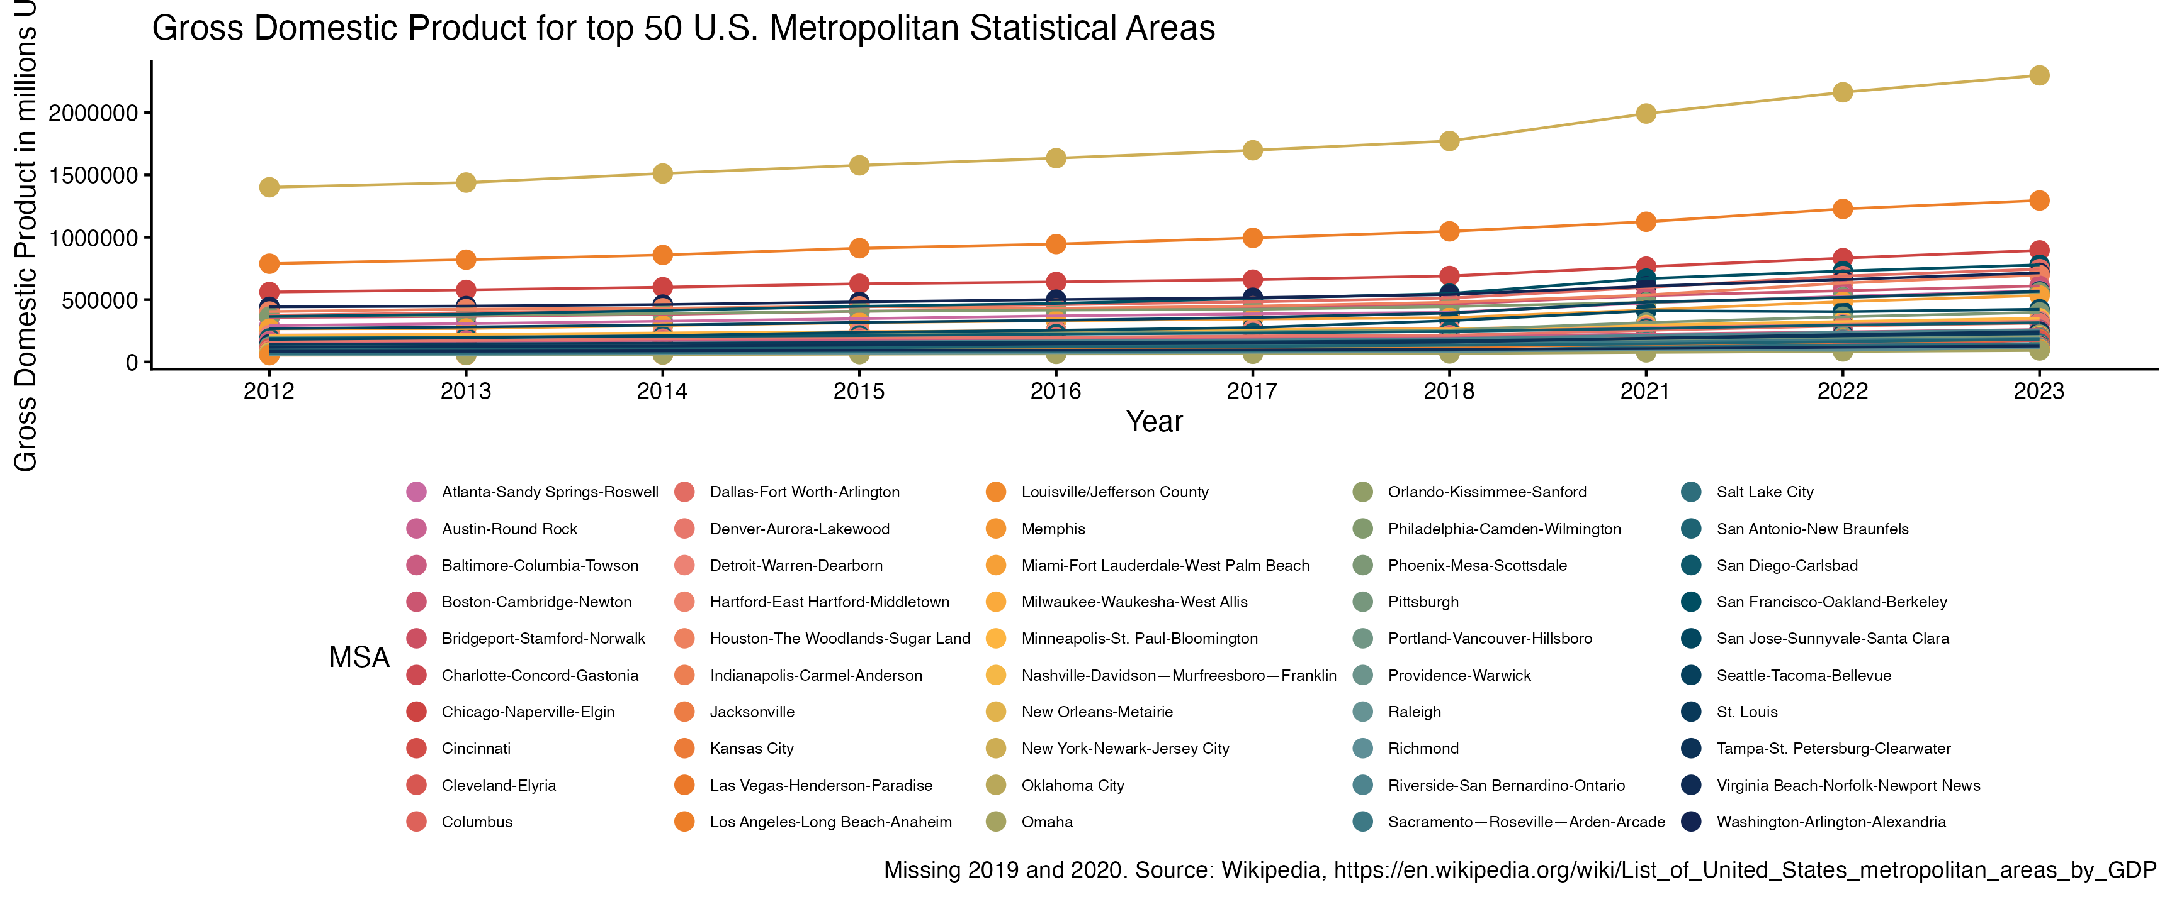
GDP increased over 2012-2023 for most U.S. Metropolitan Statistical Areas (top 50)

Slide 4
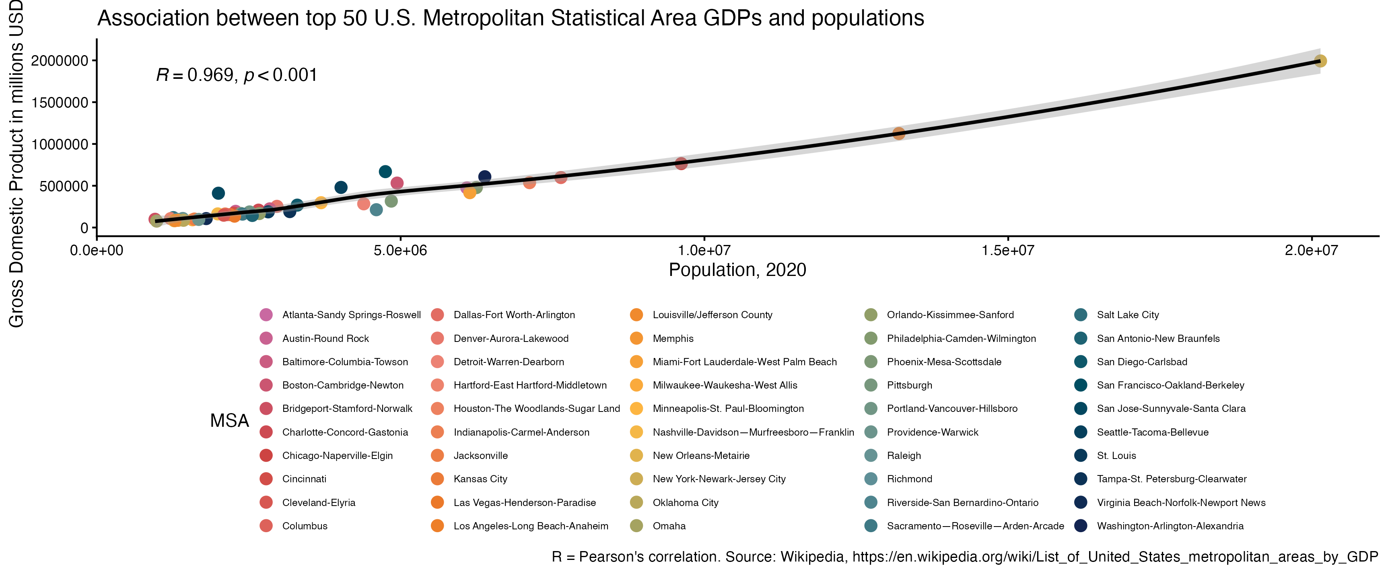
2020 Population and 2021 GDP were positively associated across U.S. Metropolitan Statistical Areas (top 50)

