Slide 1

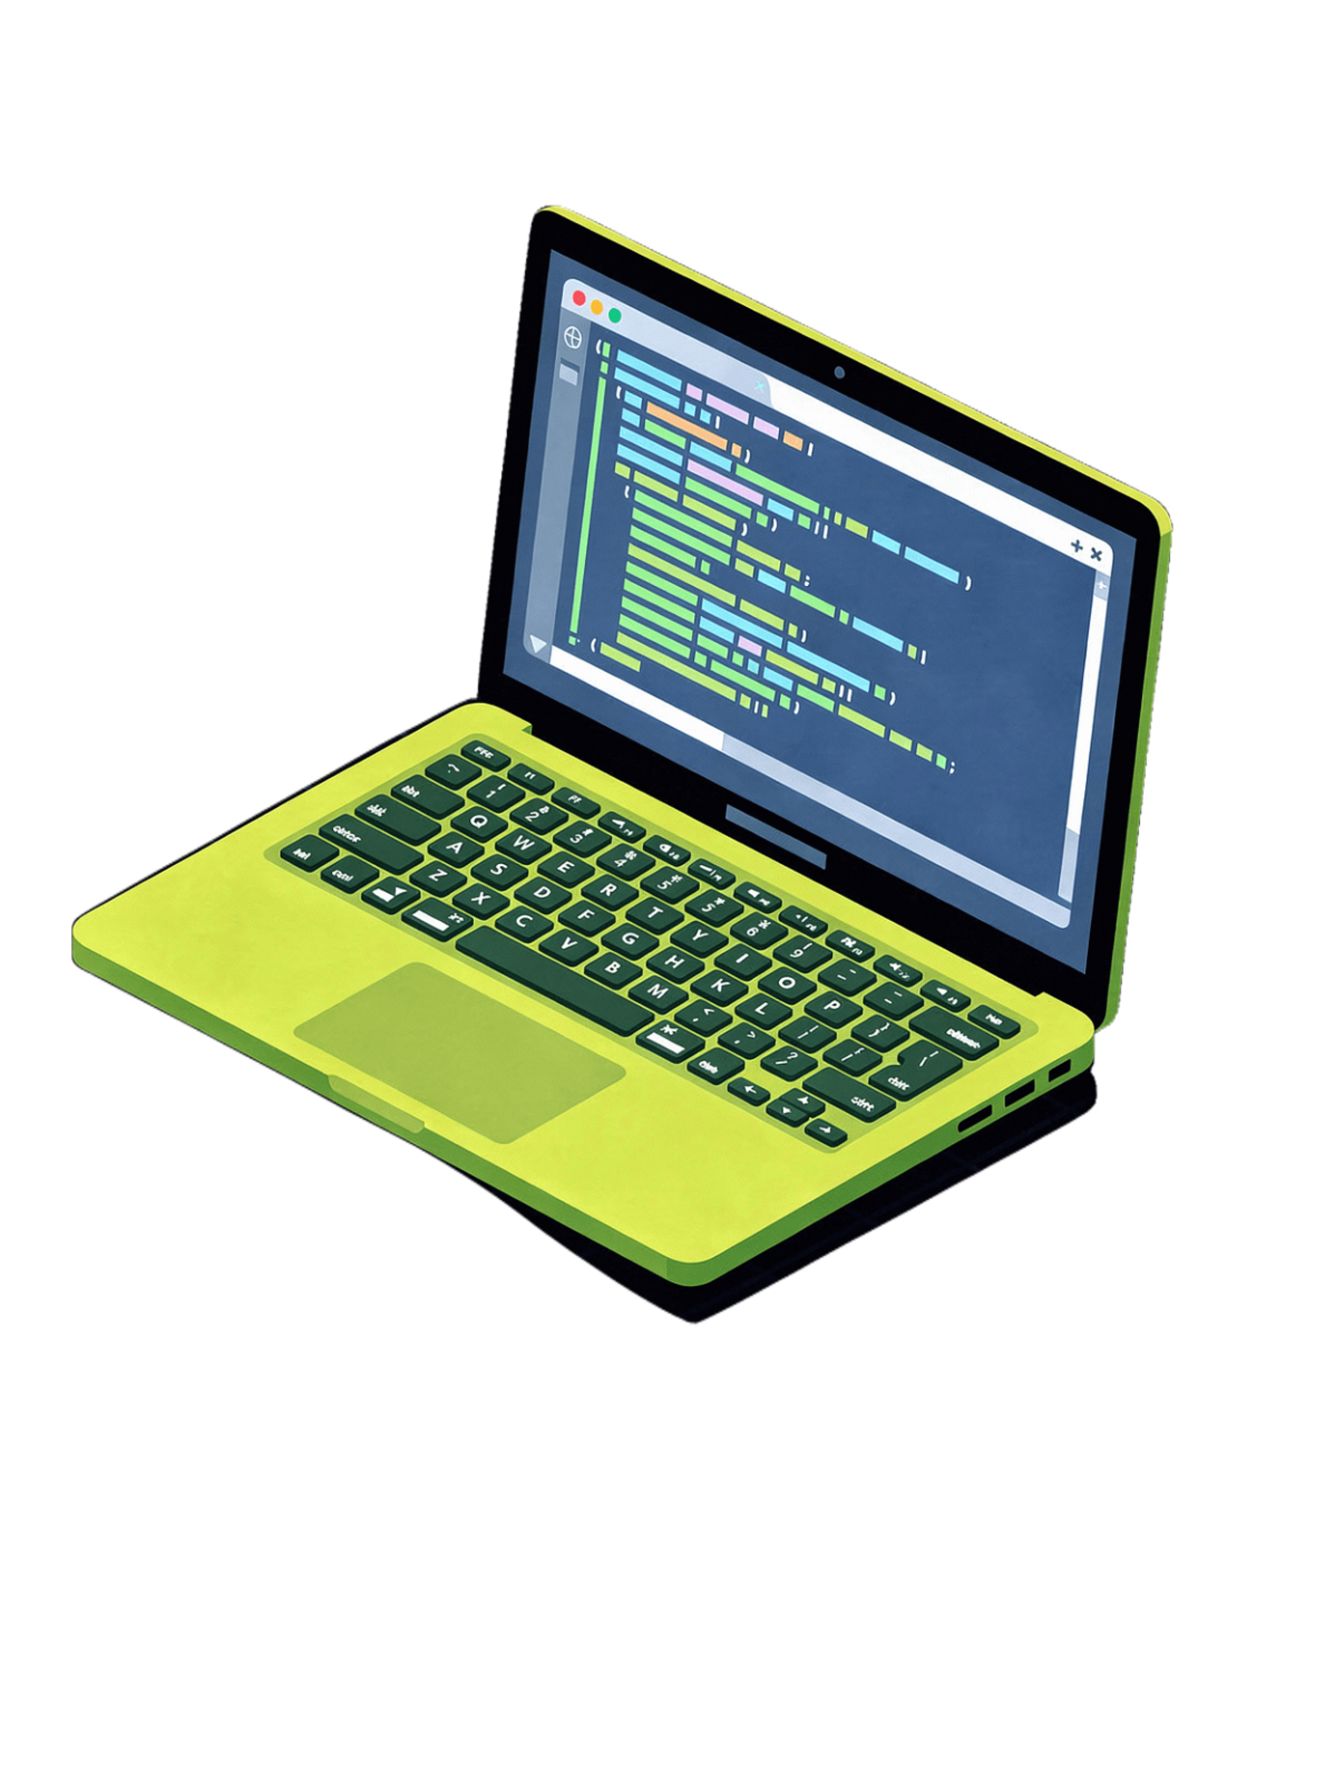
Welcome to Web Development
"This is not a class. This is the beginning of your career."
Lucky Nakola | Tech Pulse Insider
Concept → Understand → Practice → Build → Test → Deploy → Explain

Slide 2
The World Runs on Software
WHY SOFTWARE? WHY NOW?
Every Industry Is Being Rebuilt
Africa's Digital Economy Is Exploding
Highest-Paid Professionals on Earth
Banking, healthcare, agriculture, education, logistics — if you can build software, every door is open. The world does not run on oil anymore. It runs on code.
Africa has 1.4 billion people and a digital economy growing faster than any other region. The developers who build for Africa will define the next decade.
Software developers command top salaries globally — and the barrier to entry is just a laptop, internet, and the willingness to learn. That's it.
"You are not late. You are exactly on time."
Concept → Understand → Practice → Build → Test → Deploy → Explain

Slide 3

Why Start With the Web?
WHY WEB DEVELOPMENT SPECIFICALLY?
🌐 Universal Reach
🛠️ Lowest Barrier to Start
A website works on every device, every platform, every country. No app store approval. No installation. Just a URL — and the world can see your work.
A text editor and a browser. That is all you need to begin. No expensive equipment. No special lab. Just you and your machine.
🔗 Gateway to Everything
💼 Immediate Employability
Web development leads to mobile apps, AI interfaces, APIs, cloud services, and full-stack engineering. It is the on-ramp to the entire tech industry.
Freelance, agency, startup, corporate, remote — web skills are hired everywhere. You can be earning before you even finish this programme.
"Web development is not a niche skill. It is the foundation of the entire digital economy."
Concept → Understand → Practice → Build → Test → Deploy → Explain

Slide 4
This Is Bigger Than Code
THE 21ST CENTURY SKILLS YOU ARE BUILDING
🧠 Computational Thinking
🔍 Problem Solving
Break any problem into logical, solvable steps. This skill transfers to every domain of life.
Diagnose, research, iterate, and fix under pressure. This is what separates good developers from great ones.
🤝 Collaboration
🗣️ Communication
Build with teams, review code, and ship together. No great product was ever built alone.
Translate technical concepts for any audience. The developer who can explain is the developer who leads.
🎯 Attention to Detail
🔁 Continuous Learning
One missing semicolon can break everything. Precision is not optional — it is the job.
The tech stack changes; your learning habit is the constant. Build the habit now and it pays forever.
💡 Creativity & Design Thinking
🧪 Experimentation & Resilience
Build things people actually want to use. Technical skill without empathy builds tools nobody touches.
Fail fast, learn faster, ship better. Every bug is a lesson. Every crash is a teacher.
"Employers do not just hire people who can code. They hire people who can think, communicate, and build under pressure. This programme builds all of it."
Concept → Understand → Practice → Build → Test → Deploy → Explain

Slide 5
What We Are Building Toward
OUR GOAL TOGETHER
🧱 Foundation
Understand how the internet, web, and software actually work — from the ground up, no shortcuts.
🏗️ Build
Create real projects using HTML, CSS, JavaScript, PHP, and MySQL. Not toy exercises — real things.
🚀 Ship
Deploy live websites and applications that real people can use. Your work goes live on the internet.
💼 Portfolio
Graduate with a portfolio of work that proves your skills — not just a certificate, but evidence.
🌍 Career or Business
Enter the job market or launch your own tech product. Both paths are real. Both paths are yours.
"Our goal is not for you to finish this course. Our goal is for you to be dangerous — professionally dangerous."
Concept → Understand → Practice → Build → Test → Deploy → Explain

Slide 6

Building Your Professional Environment
WHAT YOU NEED: YOUR DEVELOPER SETUP
💻 The Machine
⚡ VS Code — Your Code Editor
Any reasonably modern laptop — Windows, Mac, or Linux. Minimum: 8GB RAM, 256GB SSD storage, stable internet. Your laptop is your workshop. Treat it like one. Keep it charged, backed up, and ready.
Free. Lightweight. Industry standard. Download at code.visualstudio.com. This is where you will spend the majority of your working hours. Learn it deeply — shortcuts, settings, and all.
🔌 Essential VS Code Extensions
🌐 Your Browser: Chrome DevTools
Prettier — Auto-formats your code so it stays clean
Live Server — Instant browser preview as you type
GitLens — Track every change with full history
Error Lens — Inline error highlights so nothing hides
Path Intellisense — Smart file path autocomplete
Use Google Chrome as your primary development browser. Master Chrome DevTools — it is your debugging headquarters, your inspector, your performance analyzer, and your best friend when things break.
Right-click → Inspect → you are now inside the machine.
Concept → Understand → Practice → Build → Test → Deploy → Explain

Slide 7
Version Control Is Not Optional
GIT & GITHUB: YOUR MOST IMPORTANT NON-CODING SKILL
😱 THE PROBLEM
🛡️ THE SOLUTION
You change your code. It breaks. You cannot remember what it looked like before. You panic. You delete things trying to fix it. You make it worse. Without version control, every change is a gamble — and you are always one bad edit away from losing everything.
Git tracks every change you ever make. GitHub stores it in the cloud. You can go back to any version, anytime, forever. No more panic. No more lost work. No more "I wish I hadn't changed that." You are always safe.
📁 Git — Local Control
☁️ GitHub — Cloud Portfolio
🤝 Collaboration at Scale
Runs on your machine. Tracks all changes with full history. Every save is a checkpoint you can return to.
Cloud storage for your code + your professional portfolio. Every employer will ask for your GitHub link. Start building it now.
Every real software team in the world uses Git. Learning it now puts you ahead of 90% of beginners before you write a single feature.
"Your GitHub profile is your CV as a developer. Start building it from Day 1."
Concept → Understand → Practice → Build → Test → Deploy → Explain

Slide 8
Your Network Is Your Net Worth
COMMUNITY: YOU CANNOT BUILD ALONE
👥 Your Cohort
🧑‍🏫 Your Instructor
The people in this room are your first team. Help each other. Debug together. Celebrate together. Your peers are your first professional network — and some will be your co-founders.
Ask questions. Every question you hold back is a gap that stays. There are no bad questions here — only questions you didn't ask and paid for later.
🌍 Online Communities
🔁 Give Back
Stack Overflow, GitHub, Dev.to, Twitter/X tech community, local developer meetups: Nairobi tech community, iHub, GDSC Kenya. The global dev community is open to you right now.
The fastest way to solidify your knowledge is to teach it. Write about what you learn. Help the person one step behind you. Teaching is the ultimate test of understanding.
"The best developers in the world are not the smartest — they are the most connected and the most consistent."
Concept → Understand → Practice → Build → Test → Deploy → Explain

Slide 9
Before You Write a Single Line of Code — Adopt This Mindset
THE DEVELOPER MINDSET: RULES TO LIVE BY
🔎 Be Curious
💪 Embrace Discomfort
Always ask WHY, not just HOW. Why does this work? What breaks it? What is it connected to? Curiosity is the engine of every great developer.
If you are not confused at least once a day, you are not learning fast enough. Confusion is not failure — it is the feeling of your brain growing.
🛠️ Build Something Every Day
🔁 Break Things on Purpose
Reading and watching tutorials is not learning. Doing is learning. Even if it's small. Even if it breaks. Build something every single day.
The best way to understand a system is to break it and figure out why. Controlled destruction is one of the most powerful learning tools you have.
🗣️ Explain It Simply
📈 Progress, Not Perfection
If you cannot explain a concept to a non-developer, you do not own it yet. Simplicity is the proof of mastery. Complexity is the hiding place of confusion.
Shipped and imperfect beats perfect and never finished. Always. The world rewards builders who ship, not perfectionists who wait.
Concept → Understand → Practice → Build → Test → Deploy → Explain

Slide 10
The Decision Is Already Made. Now Show Up.
"In five years, someone is going to be using something you built."
"The question is not whether you can do this."
"The question is whether you will show up — every day — and do the work."
"We will be here. Will you?"
Your First Three Actions — Start Today
01
02
03
Download VS Code
Create Your GitHub Account
Join the Community
Install all 5 essential extensions: Prettier, Live Server, GitLens, Error Lens, Path Intellisense. Your environment is your foundation.
Choose a professional username — this is your developer identity. Your GitHub profile is your CV. Build it from Day 1.
Join the class group and community channel. Introduce yourself. You are not alone in this — your cohort starts now.
Get Techy With Lucky | Lucky Nakola | Tech Pulse Insider

