Slide 1
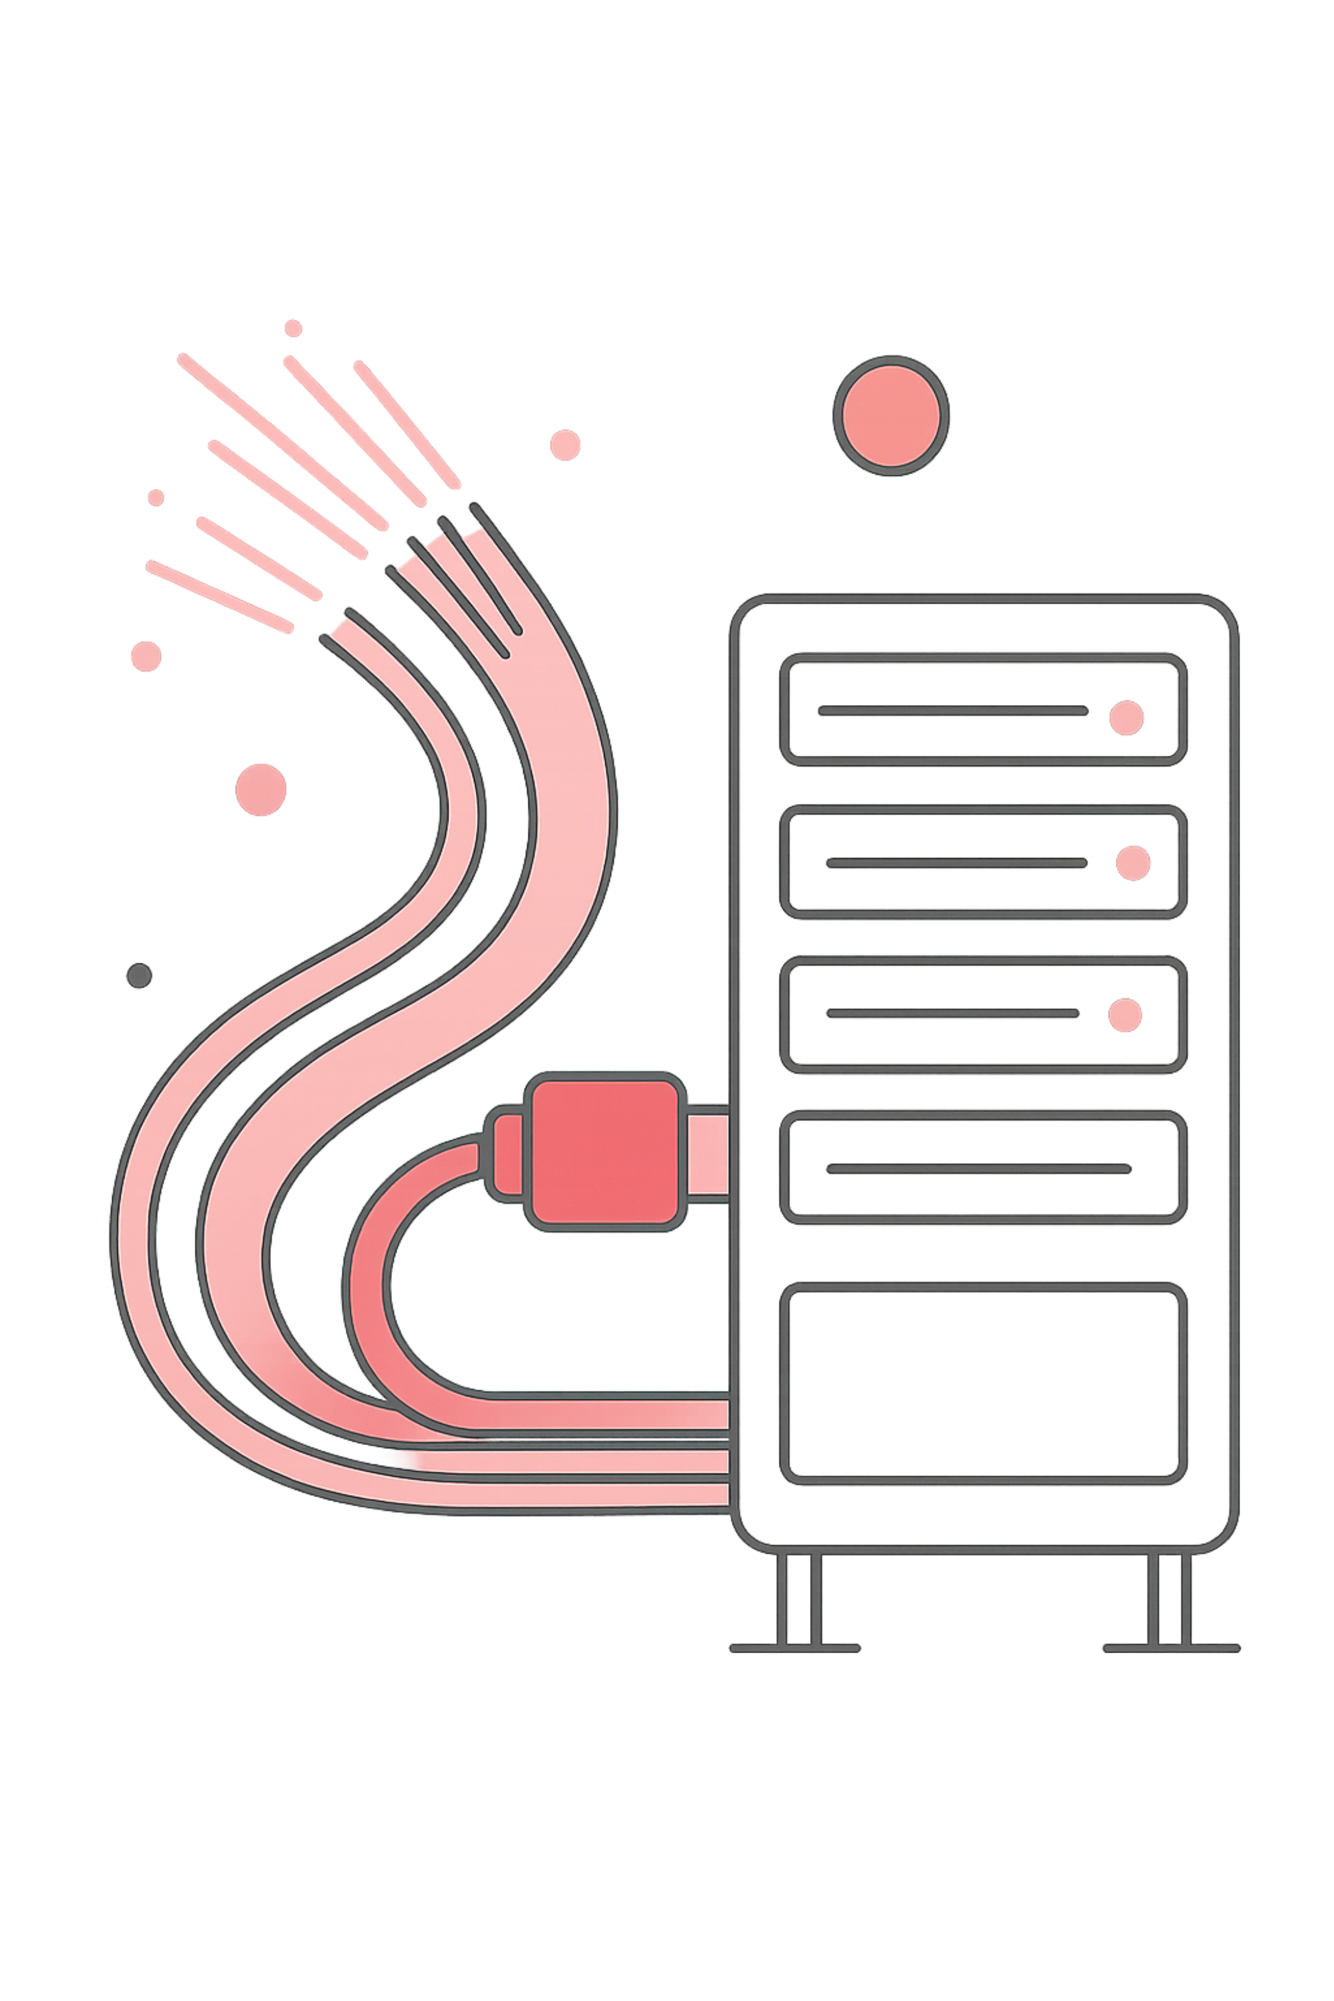
How the Internet & the Web Actually Work
The Engineer's Foundation — From Cables to Pixels
Lucky Nakola | Get Techy With Lucky / Tech Pulse Insider

Slide 2
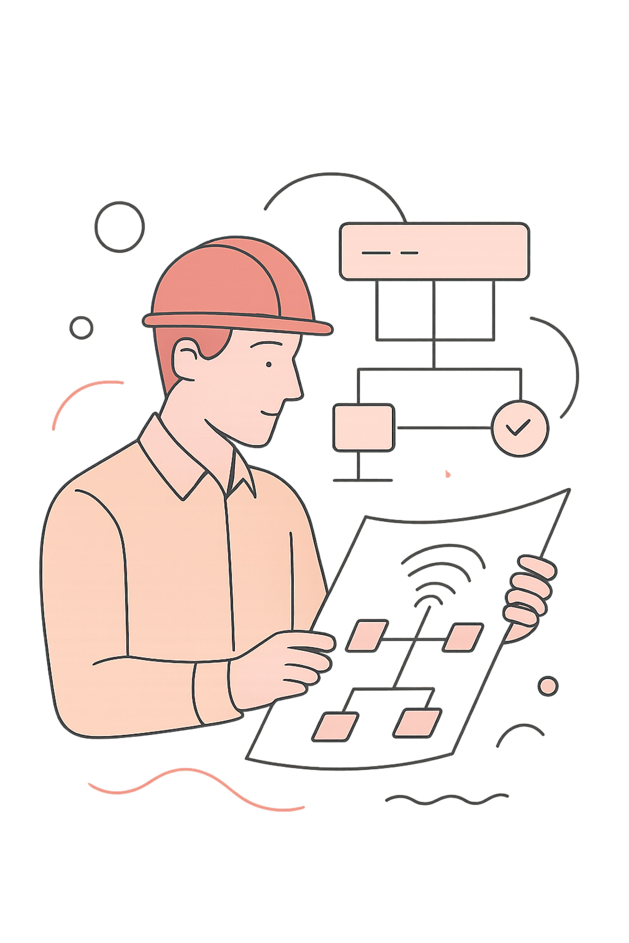
Before You Write a Single Line of Code...
🔧 It's Engineering
🌐 Every Site Lives Here
The internet is not magic — it is pure, structured engineering.
Every website you build lives inside this system. Know your environment.
⚡ 10x Better
Understanding the environment makes you a fundamentally stronger developer.
"Developers use the tools. Engineers understand the system."

Slide 3

Module 1: The Global Plumbing
Think of it like a post office — your data is cut into packets, each travels a different route, and reassembled at the destination.
📦 Packets — small numbered chunks of data traveling independently
🔌 Fibre-Optic Cables — light-speed data highways crisscrossing the globe
🌍 Submarine Cables — connect every continent on the ocean floor
TCP
UDP
Reliable delivery — every packet confirmed
Fast delivery — speed over perfection

Slide 4
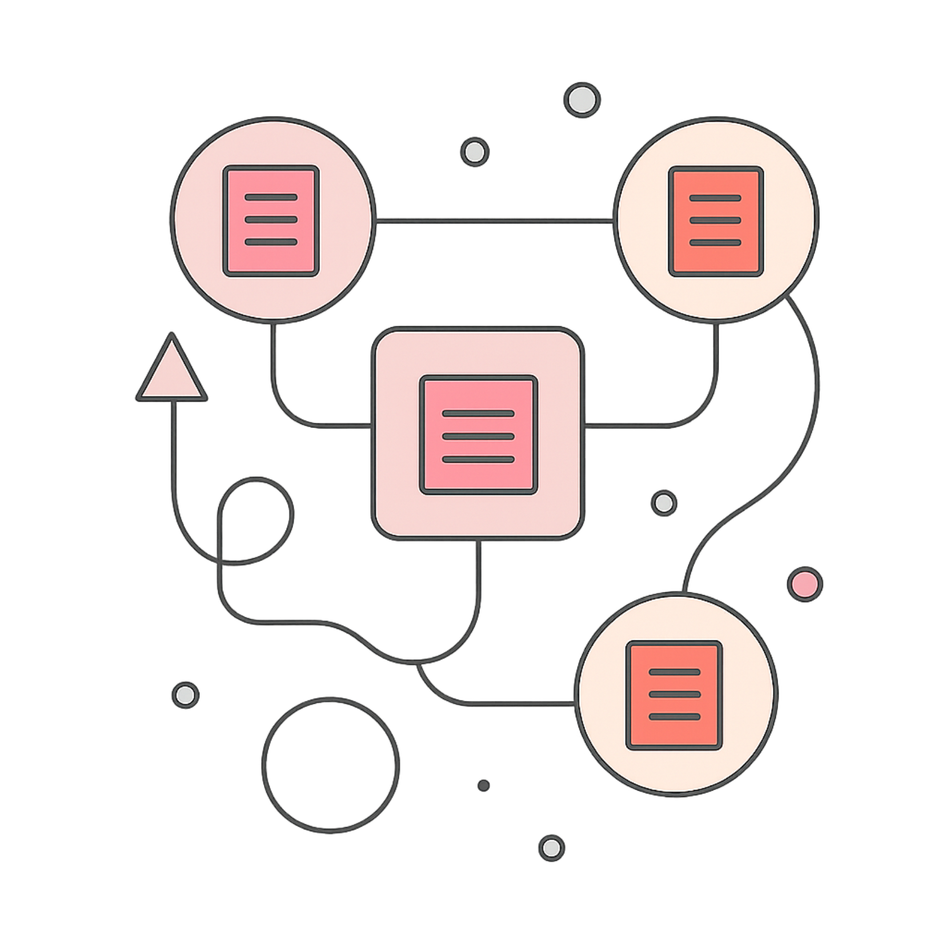

Every File You Send Is Broken Into Packets
Packet Structure
HEADER
PAYLOAD
Source IP | Destination IP | Packet Number | Checksum
The actual data content being transmitted
If one packet gets lost — only that packet is re-sent. Not the whole file.

Slide 5
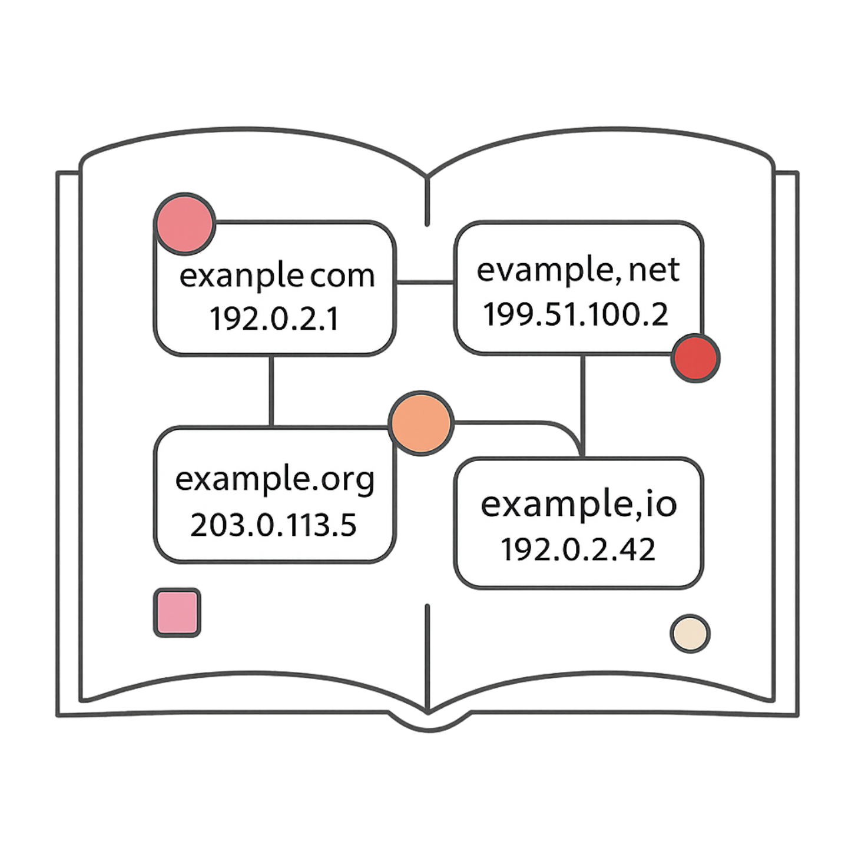
IP Addresses & DNS
DNS is the internet's phone book — it translates google.com into 142.250.74.78
How DNS Resolution Works
01
Browser Checks Cache
First looks locally — have we visited this site before?
02
Asks Recursive Resolver
Your ISP's resolver takes over the lookup on your behalf
03
Resolver Asks Root Server
Root server points to the right top-level domain (.com, .org...)
04
Root → TLD → Authoritative Server
Each server hands off to the next until the authoritative source is found
05
IP Returned, Browser Connects
The IP address is returned and your browser loads the page 🚀

Slide 6
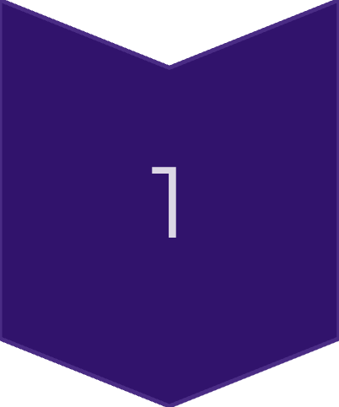
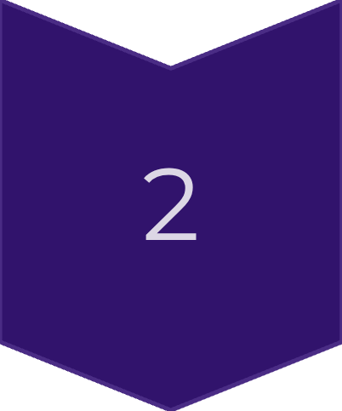
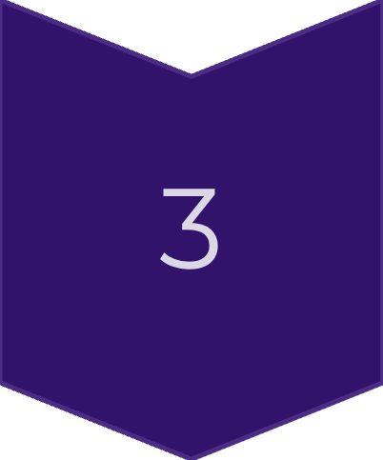
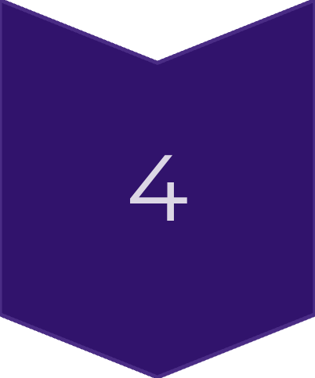
Anatomy of a Domain Name
Breaking Down: www.gettechy.co.ke
Key DNS Records
www
A Record
CNAME
Subdomain
Maps domain → IP address
Alias — one name points to another
gettechy
Your unique domain
MX Record
Points to the email server
co
Second-level TLD
ke
Country code (Kenya)

Slide 7


How Your Browser Talks to a Server
🧑 You (Client) → 🧾 HTTP Request → 🖥️ Server → 📦 HTTP Response → 🧑 You
Request Example
Response Example
GET /courses HTTP/1.1
Host: gettechy.co.ke
HTTP/1.1 200 OK
Content-Type: text/html
[HTML Body]
HTTP is the language. HTTPS is the same language — with encryption layered on top.

Slide 8
The Server's Vocabulary — Status Codes
🟢 2xx Success
🔵 3xx Redirect
200 OK — Request succeeded
201 Created — Resource created
301 Moved Permanently
304 Not Modified
🟡 4xx Client Error
🔴 5xx Server Error
404 Not Found
401 Unauthorised | 403 Forbidden
500 Internal Server Error
503 Service Unavailable
401 = Not logged in. 403 = Logged in, but wrong permissions. Know the difference.

Slide 9
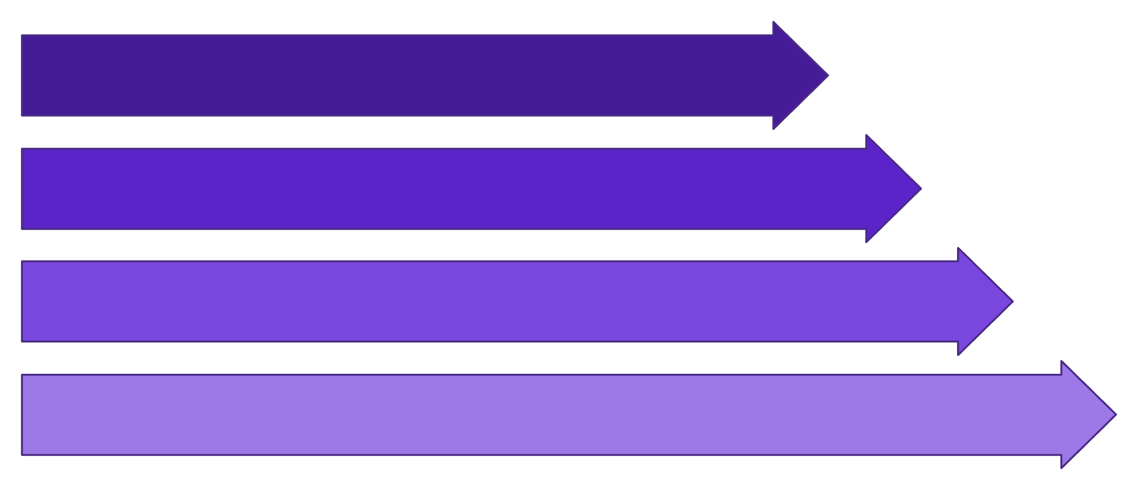

From Code to Pixels — The Critical Render Path
🏗️ HTML → DOM
Builds the Document Object Model — the structure of the page
The Render Pipeline
🎨 CSS → CSSOM
HTML → DOM
Builds the CSS Object Model — all the visual styling rules
CSS → CSSOM
⚡ JS → Interactivity
Render Tree
Adds dynamic behaviour and user interaction to the page
Layout → Paint → Composite
CSS is render-blocking. No CSS parsed = no page shown.

Slide 10

When Something Breaks — Trace the Layers
01
🌐 Network
Can I connect? Is there internet? Check physical and logical connectivity first.
02
📖 DNS
Is the domain resolving to the right IP? Run nslookup or dig.
03
🔁 HTTP
What status code is the server returning? Check Network tab in DevTools.
04
🖥️ Browser
Any errors in the Console? Is the DOM built correctly? Is JS blocking render?
Every problem has a layer. Find the layer. Fix the problem.
Get Techy With Lucky | Lucky Nakola

