Slide 1
The Art Of Android Hacking
by, Yang

Slide 2

./whoami
College Student
Security Researcher
NOT an expert
White Hat

Slide 3

Agenda
Android Basics
Android Architecture
Android Security Model
Understanding the APK
Reverse Engineering
Demo CVE-2013-4787

Slide 4
What is Android?
Android is an open source and Linux-based operating system for mobile devices such as smart phones and tablet computers.

Slide 5
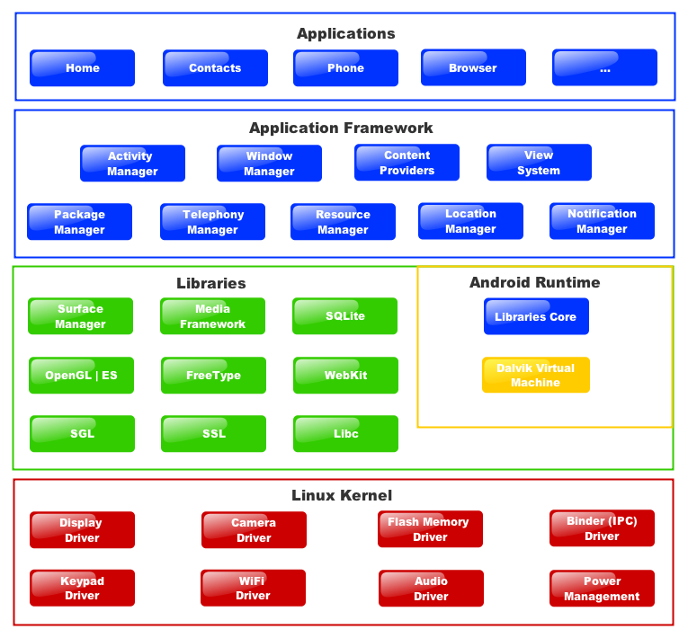
Android Architecture

Slide 6
Android Security Model
Application Sandboxing UID & GID
Permissions AndroidManifest.xml
IPC Binder
Code Signing and Platform Keys META-INF
Multi-User Support
SELinux

Slide 7
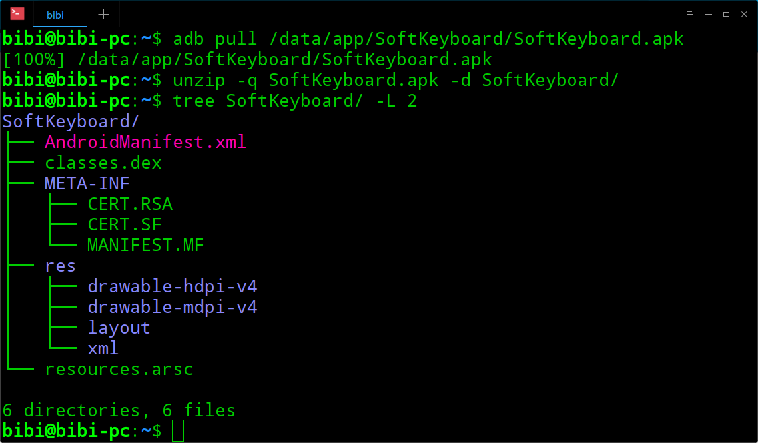
Understanding The APK

Slide 8
Making The APK
java
.java
Byte code
.class
Dalvik code
.dex

Slide 9
Reversing The APK
Dalvik code
.dex
java
.java

Slide 10
Tools
Emulators
Genymotion
Android Studio | AVD
ADB (Android Degub Brigde)
$ adb install
$ adb pull / push
Drozer
$ drozer console connect
Android Monitor / Logcat
APKTool
$ apktool d / b
Dex2Jar
$ dex2jar classes.dex
JD-GUI
JEB
DoridBox
signapk

Slide 11
Demo
CVE-2013-4787 (Master Key Vulnerability)
Explanation about CVE-2013-4787 with source code
Zip implementation of Android

Slide 12
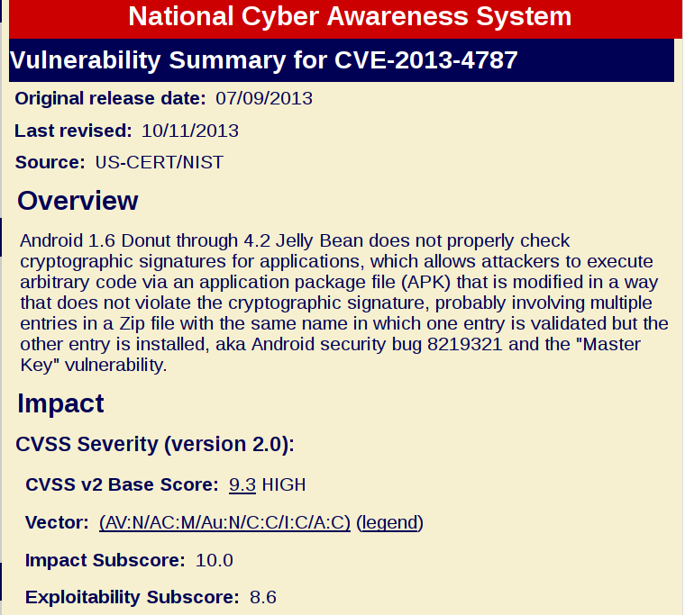
CVE-2013-4787 (Master Key Vulnerability)
Vulnerability in Android OS
The Attacker can inject any code into the app without changing the signature of target application.
huge impact & user can’t notice this attack.

Slide 13
Keywords
Apk file = Zip file
Zip file format
Confirming a signature of Apk

Slide 14
Zip Format
Local file header
File data
Local file header
File data
…
Central directory file header
Central directory file header
…
End of central directory record
Local File Header
file information
File Data
compressed data
Central Directory File Header
file name
file size
offset of file data
compression method
…

Slide 15
Confirming A Signature
All applications must be digitally signed
You can’t change any files in the Apk after signing.
Android checks the sign when user installs an new application.

Slide 16
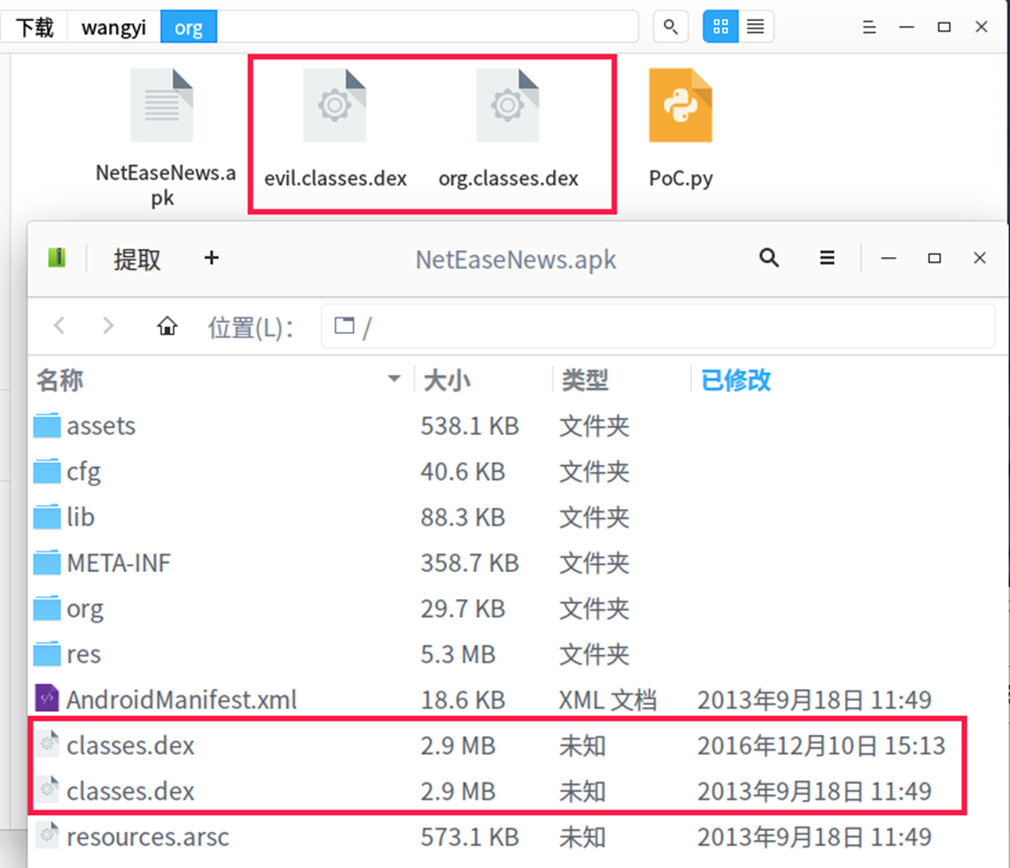
APK File
According to the specification, zip file can contain duplicated file name entries.
It’s the implementation problem.

Slide 17
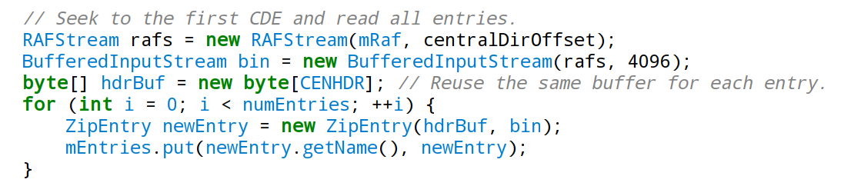
readCentralDir (ZipFile.java)

Slide 18
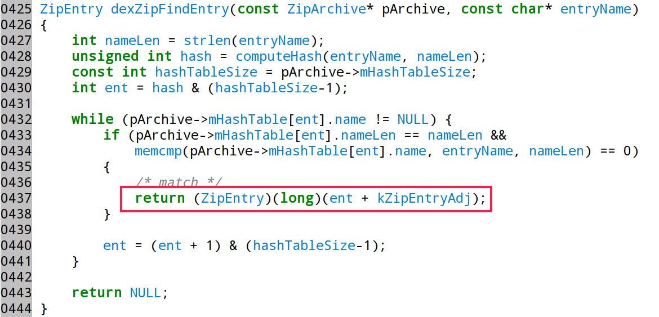
dexZipFindEntry (ZipArchieve.cpp)

Slide 19
…therefore
Checking signature → java.util.zip → use last item
org.classes.dex
Installing application → C++ → use first item
evil.classes.dex
The behavior differences between java and C++ implementation cause the issue when an Apk includes duplicate entries.

Slide 20

NOW
You can install the application includes another code with original signature!!!

Slide 21
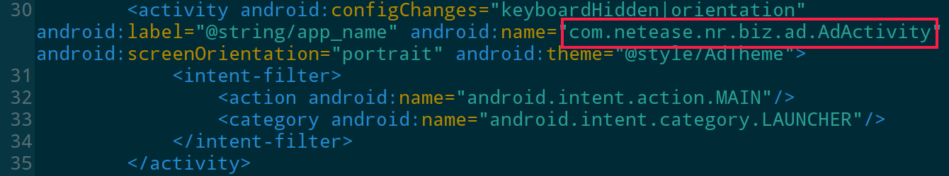
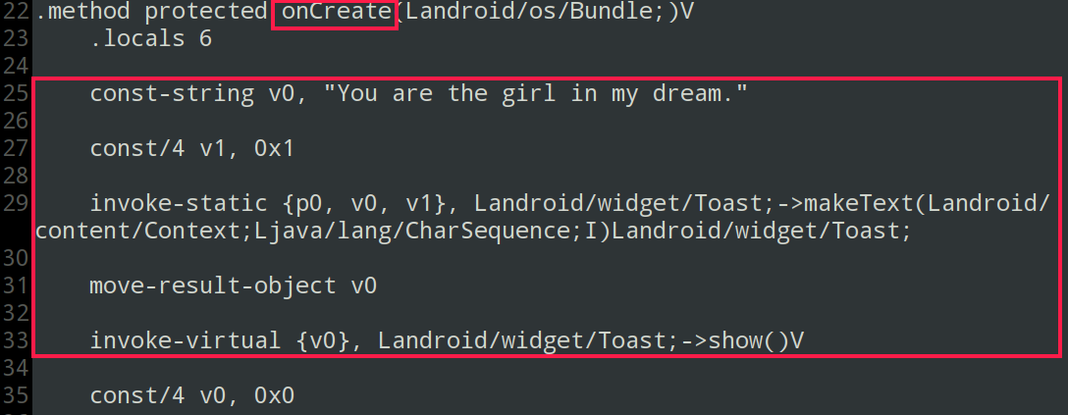
Hack It

Slide 22
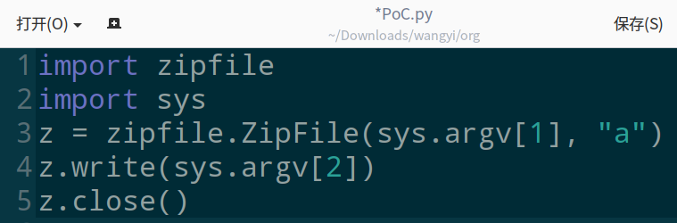
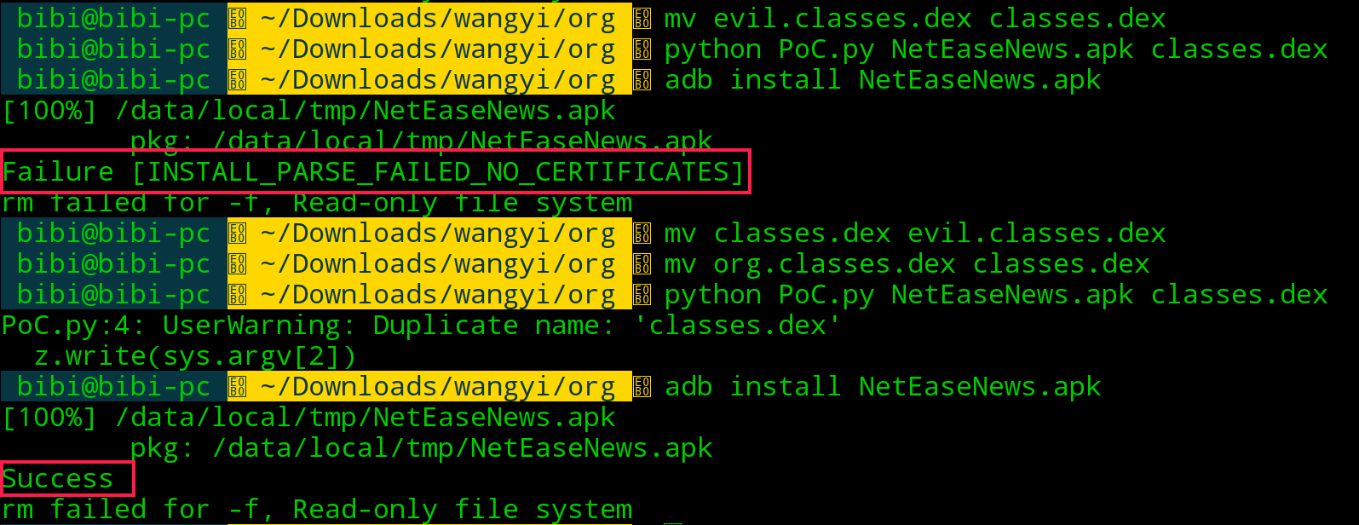
Hack It

Slide 23

Hack It
When you inject any classes.dex before the original in Apk, Android uses the injected.

Slide 24
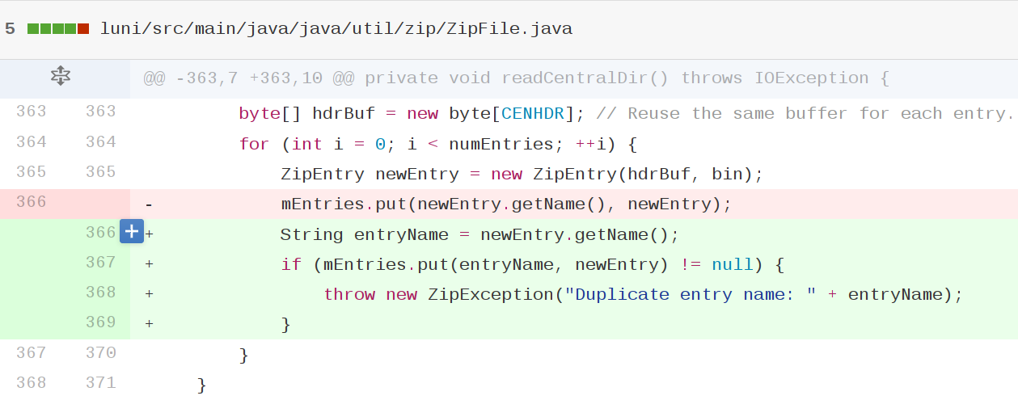
Patch (Android security bug 8219321)

Slide 25

Any Questions?

Slide 26
Thanks!
https://github.com/firmianay

