Slide 1

A Decentralized Polling System Using Ethereum Technology
Journal of Information Technology Management
Vivek Kapoor
Samarth Shakya
Devi Ahilya University

Slide 2

?
Do you trust traditional polling system? ?
corruption
system hacking
vote rigging
vote manipulation

Slide 3


Slide 4

introduction
Blockchain is the best technology for polling systems because it provides the failure to modify or remove information from blocks makes the polling system immutable.
Blockchain technology consists of a large number of interconnected nodes is supported by a distributed network. Nodes have their own copy of distributed ledger which have the record of all the transactions processed by the network. There will be no single authority that controls the network.
This network allows users to vote anonymously.
The Increase of voter lack of enthusiasm in recent years, especially among the younger generation which is more into computers and technology the e-voting is a potential solution to attract voters specially the young one.
In March 2018, the first country in the world used blockchain technology to verify votes in an election :
Sierra Leone

Slide 5
The problems with existing e-voting system
1. Centralized Architecture
2. Hacking of the centralized voting systems.
3. Election Manipulation.
4. Vote casting: Votes should be anonymous to everyone including the administrators.
5. Security problems: The DDoS attacks are well known attack in voting systems.
6. No transparency and trust: People usually do not trust when everything is online.

Slide 6
ETEREUM BLOCKCHAIN
decentralized
recorded transactions
addresses
Distributed computing platform
Open source
The most active and largest blockchain community

Slide 7
The background working of ethereum blockchain
a) Smart Contract: smart contract can contain the business logic or agreement between the two or more people directly written in the lines of code.
b) Publishing: After the creation, that smart contract is published on ethereum blockchain and to publish it some amount of ether is deducted from the connected blockchain account.
c) User: To use the decentralized application user has to pay some amount of ether. To do so user/client must have an active ethereum account with a private key. The user account must contain some amount of gas to process the transaction.

Slide 8
d) Miners: They verify or validate the transactions and add it to a new block these blocks together forms a ledger which is distributed among all the nodes. Based on a cryptographic hash algorithm they compete to solve a difficult mathematical problem and the solution is called the Proof-Of-Work. They are also rewarded with ether for each successful block.
e) Nodes: A infrastructure of blockchain is formed by nodes. They check a newly block and add it to the blockchain. Any proposed “new block” to the ledger must reference the previous version of the ledger, which creates a chain possess immutability.

Slide 9
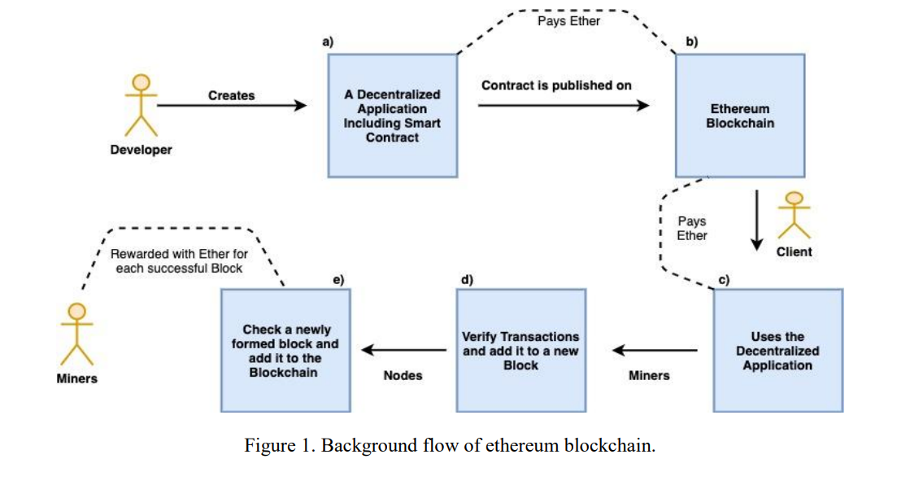

Slide 10
System Components
1) Smart Contract: This contract serves purpose to authenticate the voters and start the voting process. Polling contract increment the count of votes immediately when voted. It ensure the feature that only one vote is given with the private key.
2) Ganache: It is a personal blockchain deployed locally. We are going to use the ganache for the deployment of our polling contract and running tests.
3) Truffle Framework: Truffle is a tool used to develop ethereum blockchain while using the solidity programming language.
4) Metamask: If we want to use a user interface of any application our browser should support the connection to blockchain network. We can also manage our personal accounts in Metamask.

Slide 11
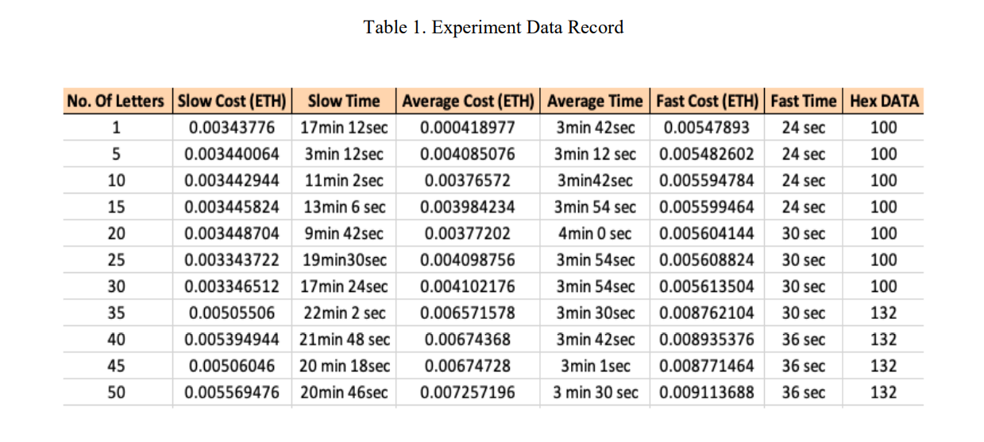
Experiment
For each transaction on ethereum blockchain, we have to pay a fee called gas (in ETH)

Slide 12
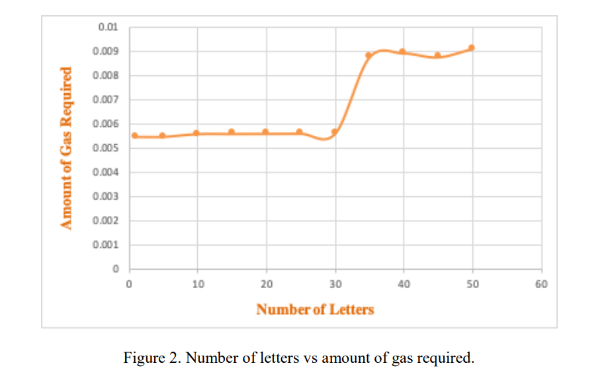
Results
Considering the Fast Cost (ETH) from the Table 1 we can see that the amount of ETH required is slightly increasing as we increase the number of letters in our transaction.

Slide 13
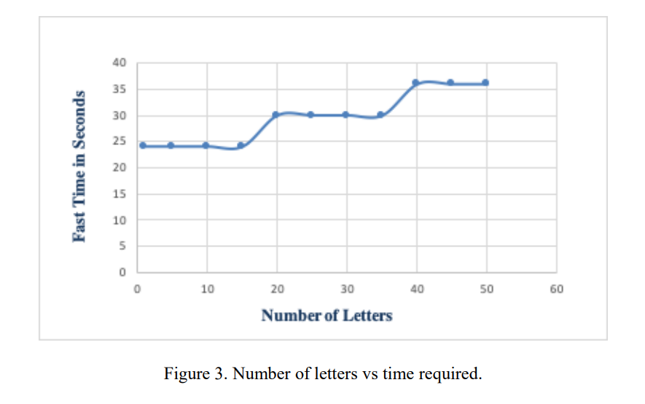
Considering the Fast Time (seconds) from Table 1 we can conclude that the time required to complete the transaction is directly proportional to the number of letters in the phrase.

Slide 14
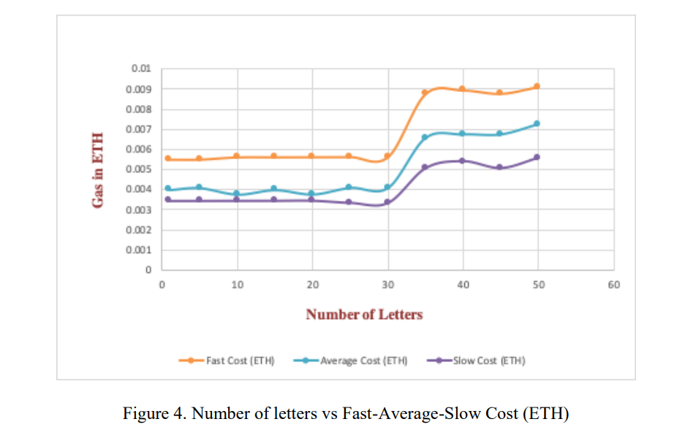
We can see that Fast transaction type is better than any other type as there is only a slight change in the ETH but the time difference is very high in all other transaction as shown in Table 1.

Slide 15
Conclusion
Traditional polling system
Ethereum technology
Efficient way to pay for transaction fee
Brief idea about tools used for the developing an ethereum blockchain

Slide 16
Thanks for your attention
Omid Omidian
spring 1401

Slide 17
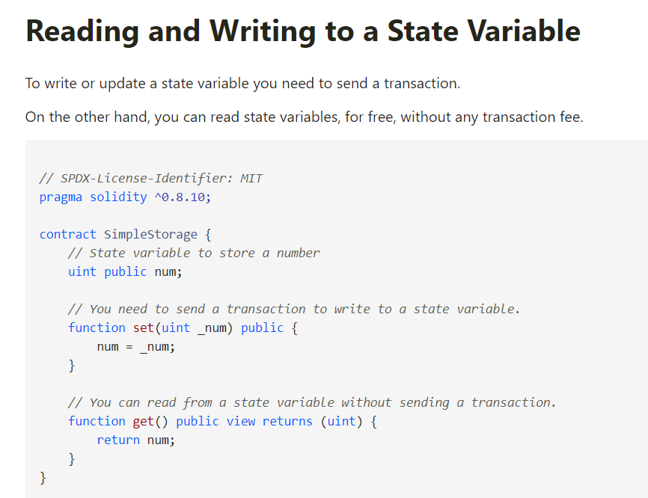

Slide 18
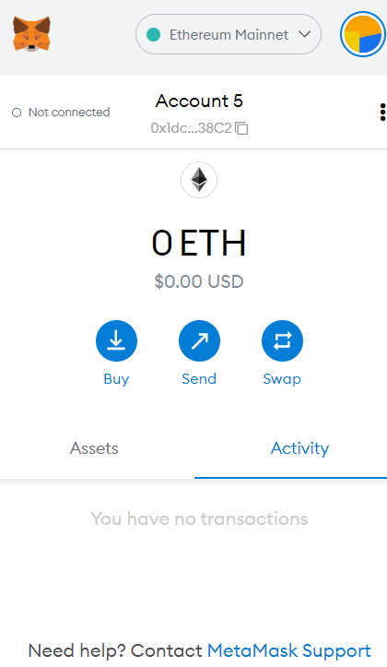

Slide 19
