Slide 1
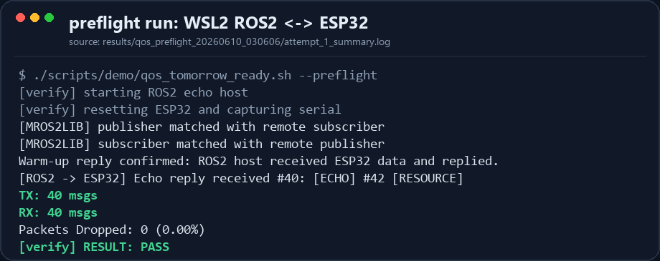
Real-hardware evidence
2026-06-10 | mROS2-ESP32 QoS progress
mROS2-ESP32 QoS Progress: Real-Hardware Results
Recent work moved the demo from “implemented” to “repeatable and evidence-led”: the preflight script now verifies bidirectional RELIABLE communication, ROS2 CLI QoS visibility, ESP32 behavior checks, and reset stress results.
What this screenshot proves
The ESP32 publisher matched the ROS2 subscriber, and the ESP32 subscriber matched the ROS2 publisher. The ROS2 host received ESP32 data and replied; the ESP32 received 40 replies with zero packet drops.
Presentation wording
TX means messages sent by ESP32. RX means replies received by ESP32 from ROS2. TX/RX 40/40 shows a real bidirectional hardware loop, not a local-only test.
PASS
RELIABLE x2
TX/RX 40/40
3/3 PASS
strict preflight completed
uplink and reply path
bidirectional echo loop
reset stress result
Log source: /home/wangpei/mros2/mros2-esp32/results/qos_preflight_20260610_030606

Slide 2
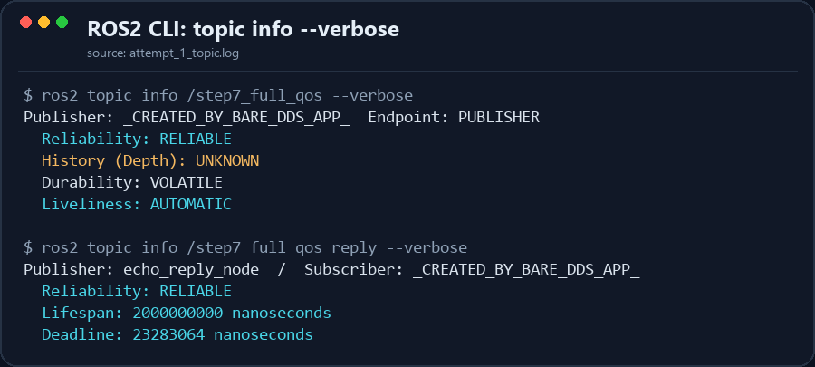
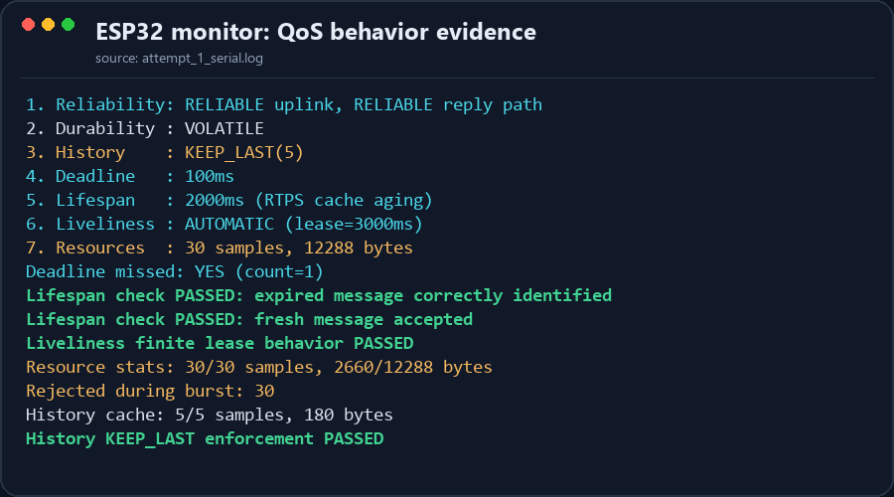
QoS evidence boundary
2026-06-10 | mROS2-ESP32 QoS progress
Seven QoS Evidence: ROS2 CLI + ESP32 Behavior
reset stress
3/3 PASS
Standard ROS2 CLI output directly proves the QoS policies visible through discovery. History depth and Resource Limits are validated through ESP32 monitor behavior logs. This makes the evidence stronger and keeps the prototype boundary honest.
ROS2 topic info --verbose
ESP32 monitor behavior
Directly visible in CLI
Reliability is RELIABLE in both directions. Durability is VOLATILE. Deadline / Lifespan finite values and Liveliness AUTOMATIC are visible. History appears in CLI, while Depth is shown as UNKNOWN in Humble.
Resource Limits and KEEP_LAST are validated by behavior logs: History cache 5/5, burst rejection 30, Resource stats 30/30.
Conclusion: the current demo can show bidirectional RELIABLE real-hardware communication and evidence for seven QoS classes. It is presented as a QoS extension prototype, not a complete product-grade DDS QoS implementation.

