Slide 1
CS303B-AI-ML
Clustering -- Clustering
Learning Outcomes
  Appreciate the problems of clustering
Be able to understand the principles of clustering (non parametric and parametric)
Be able to apply different clustering methods in applications, and analyse the results of clustering methods
Slides Adapted from L. Behera@ IITK and other resources

Slide 2
Outline
Motivation/Overview
Hierarchical Clustering (non-parametric)
  Agglomerative
  divisive
K-Means Clustering (non-parametric)
Gaussian mixture model (GMM) (parametric)
  Principles
  Learning – Expectation and Maximization Algorithms
Matlab Examples

Slide 3
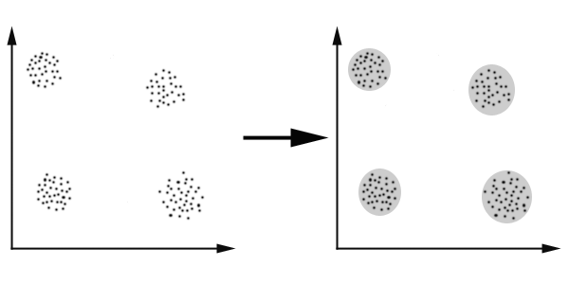
What is Clustering
Cluster: A group of ‘similar’ objects based on some similarity ‘criteria’. (other words: categories, classes etc. )
  Examples in life – red apple vs. green apple (color as the similarity)
  Kids Vs. Adult (age as the similarity)
The Goal of Clustering: To determine the intrinsic grouping in a set of unlabeled data.

Slide 4
Possible Applications
Marketing: finding groups of customers based on data with similar
  ‘buying records/habit’
  ‘Tends to complain’
Computer Vision: Color Skin detection. Background Extraction
Biology: classification of plants and animals given their features;
Insurance: identifying people with a high average claim cost; identifying frauds;
Internet: document classification; clustering weblog data to discover groups of similar access patterns. Spam email classification

Slide 5
Hierarchical Clustering
Clustering is the process of assigning objects (or data records) into groups or categories (we called it clusters) based on some similarity measures. Often the objects within one cluster are more similar than objects from different clusters.
The Hierarchical method works by grouping data objects(records) into a tree of clusters.
    Agglomerative Hierarchical Clustering
    Divisive Hierarchical Clustering
Similarity measure: Uses distance (similarity) matrix as clustering criteria.
Need a termination condition
http://en.wikipedia.org/wiki/Data_clustering

Slide 6
Agglomerative Hierarchical Clustering
A bottom-up approach.
At the beginning, each object is considered as a cluster, thus the number of clusters is the same as the number of objects.
Merge two clusters having largest similarity (or least dissimilarity), repeat, until
  all of the objects are in a single cluster
  or certain termination conditions are satisfied.
Termination conditions are normally specified by the user:
  the desired number of clusters.

Slide 7
Dendrogram- Agglomerative Clustering
  Decompose data objects into a several levels of nested partitioning (tree of clusters), called a dendrogram.
  A clustering of the data objects is obtained by cutting the dendrogram at the desired level, then each connected component forms a cluster.

Slide 8
AGNES/DIANA Hierarchical Clustering
Use distance matrix as clustering criteria. This method does not require the number of clusters k as an input, but needs a termination condition
Step 0
Step 1
Step 2
Step 3
Step 4
agglomerative
(AGNES)
a
a b
b
a b c d e
c
c d e
d
d e
e
divisive
(DIANA)
Step 4
Step 3
Step 2
Step 1
Step 0

Slide 9
Define Inter-Cluster Similarity
Similarity?
distance
MIN
MAX
Group Average

Slide 10
Define Inter-Cluster Similarity
distance = shortest distance, nearest neighbor clustering algorithm
MIN Linkage (also called single linkage)
MAX Linkage (also called complete linkage)
Group Average

Slide 11
Define Inter-Cluster Similarity
distance = longest distance , farthest neighbor clustering algorithm
MIN Linkage (also called single linkage)
MAX Linkage (also called complete linkage)
Group Average Linkage

Slide 12

Define Inter-Cluster Similarity
average-link clustering, distance = average distance
    MIN Linkage
    MAX Linkage
    Group Average Linkage

Slide 13
Single Linkage Hierarchical Clustering Example
At the beginning, every point is a cluster

Slide 14
Single Linkage Example
At the beginning, every point is a cluster
Find “most similar( distance)” pair of clusters

Slide 15
Single Linkage Hierarchical Clustering Example…
At the beginning, every point is a cluster
Find “most similar( distance)” pair of clusters
Merge it into a parent cluster

Slide 16
… CONT
At the beginning, every point is a cluster
Find “most similar( distance)” pair of clusters
Merge it into a parent cluster
Repeat

Slide 17
Hierarchical Tree Formed

Slide 18
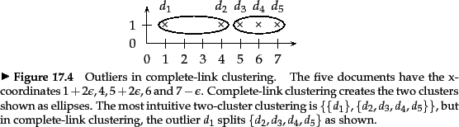
Single Linkage Vs. Complete Linkage
MIN (Single): pay attention solely to the area where the two clusters come closest to each other. Other, more distant parts of the cluster and the clusters' overall structure are not taken into account
Max (Complete): Resulted in clusters with small diameters over long, straggly clusters, but also causes sensitivity to outliers
http://nlp.stanford.edu/IR-book/html/htmledition/single-link-and-complete-link-clustering-1.html#fig:clinkoutlier

Slide 19
Divisive Hierarchical Clustering
1. All of the objects are considered as one cluster
2. Repeat until all of the clusters contain one object each
  Choose the cluster to split
    Split criterion
  Split the chosen cluster into sub-clusters
    Split into how many?
    How split?
    ‘reversing’ agglomerative – split into two

Slide 20
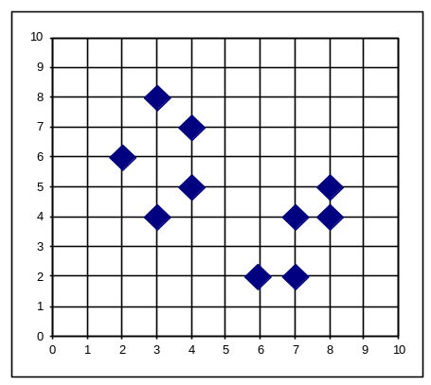

Divisive Hierarchical Clustering
Top-down approach
Inverse order of Agglomerative Clustering
Eventually each node forms a cluster on its own

Slide 21
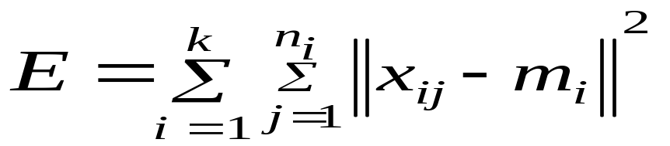
K-Means
The goal is to automatically find clusters
Optimize a function- square error criterion (most common):

Slide 22
K-Means
Given the number of clusters k, the k-means algorithm contains four 4 steps:
  Step 1: Randomly select k point as k clusters
  Step 2: Assign each object to the cluster with the nearest seed point. (Assignment)
  Step3: Compute the mean point as the centroids of the clusters of the current partition. (update)
  Go back to Step 2, stop when the mean point does not change for each new cluster.
  Step 4: Out put the final partition

Slide 23

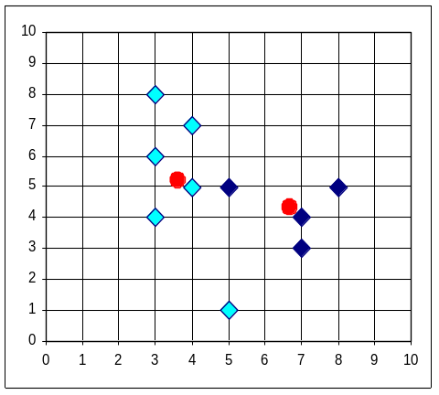


K-Means -- Examples

Slide 24
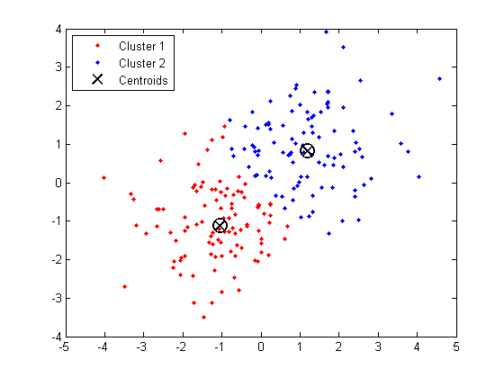
KMeans – Matlab Code Examples
http://www.mathworks.co.uk/help/stats/kmeans.html
Main Function: Kmeans

Slide 25
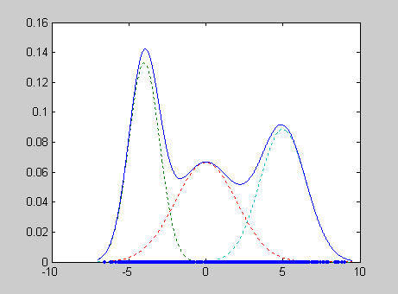
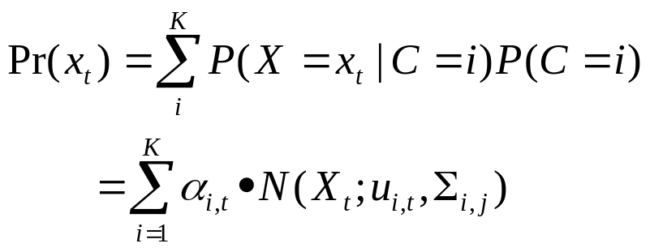
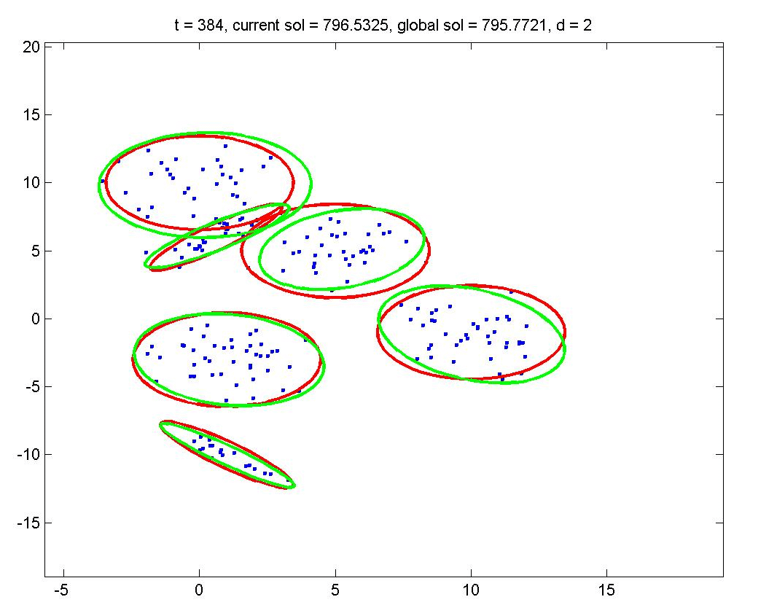
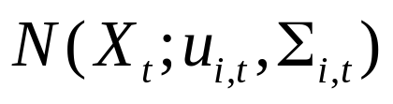
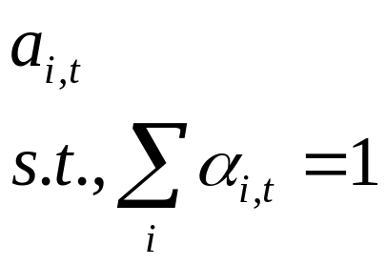
Gaussian Mixture Modeling
GMM
  Gaussian Component
  Weights of each component
1D Mixture of Gaussian
2 D Mixture of Gaussian

Slide 26



Motivating Example
Data:
-4
-3
-2
-1
0
1
2
3
4
5
OBJECTIVE: Fit mixture of Gaussian model with C=2 components
P(x|θ)
x

Slide 27
Probabilistic Model
Imagine model generating data
Need to introduce label, z, for each data point
Label is called a latent variable also called hidden, unobserved, missing
-4
-3
-2
-1
0
1
2
3
4
5
Simplifies the problem:
if we knew the labels, we can decouple the components as estimate parameters separately for each one
In practice, we do not know the labels. To find those Gaussians, we have to use Expectation-Maximization to pretend to know the labels in the iterations

Slide 28
Intuition of Expectation-Maximization
E-step: Compute a distribution on the labels of the points, using current parameters
M-step: Update parameters using current guess of label distribution.
E
M
E
M
E

Slide 29

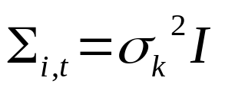
Gaussian Mixture Modeling
GMM
  Gaussian Component (covariance matrix diagonal– no correlation between different feature component)

Slide 30
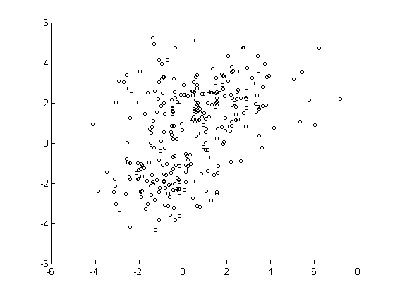
GMM- Examples – Two Clusters
Original Data
http://www.mathworks.co.uk/help/stats/gaussian-mixture-models.html

Slide 31
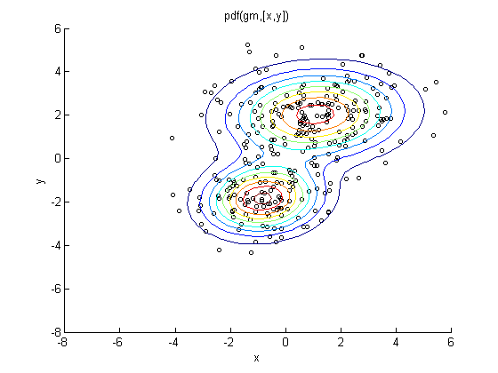
GMM – Examples
Mixture of Gaussian: level set of p(x), i.e., contours where p(x) is the same

Slide 32
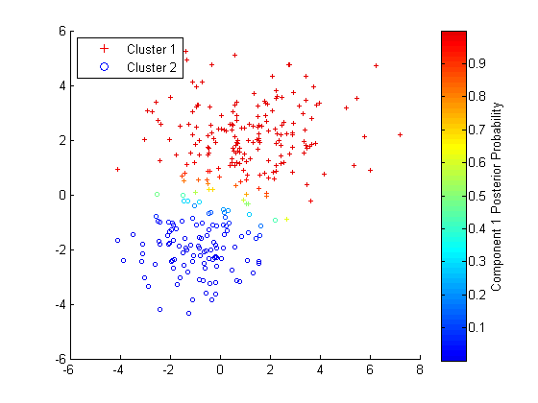
GMM – Examples – Final Clusters
Clustering based on the component probability p(c=1 | x) > 0.5 c=1 representing ‘red’ cluster (for 2 clusters). For more clusters need to maximize p(c|x) over the possible K components c=1,…K

Slide 33
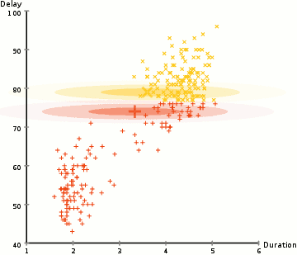
EM – GMM Clustering Example
http://en.wikipedia.org/wiki/File:EM_Clustering_of_Old_Faithful_data.gif
For detailed EM tutorial:
http://www.cs.duke.edu/courses/spring04/cps196.1/handouts/EM/tomasiEM.pdf

Slide 34
Summary of Clustering
Normally need to determine the number of Clusters
Agglomerative Hierarchical clustering
  Simple, and flexibility of handling different type of data,
  Just need a distance or similar matrix regardless of data record form
  Need to determine the termination criterion, e.g., the number of clusters
  Once the object is clustered, its cluster ownership cannot be changed
K-Means
  Fast, Simple, efficient, and need to work with numbers. That means need to covert object into data presentations.
  Each object only contribute to one cluster, it is hard clustering compared with GMM-EM.

Slide 35
Summary of Clustering
Gaussian Mixture Model:
  Mathematically sound model
  EM – Expectation and Maximization to optimize.
  Work well on low dimensional data.
  Not work well for high dimensional data, due to large number of parameters and limited data availability. (often called curse of dimensionality)
K-Means is a simplified (hard version) of GMM when using EM to optimize.
  The "assignment" step is also referred to as expectation step, the "update step" as maximization step

Slide 36
CS303B
More on Machine Learning -- Clustering
Learning Outcomes
  Appreciate the problems of clustering
Be able to understand the principles of clustering (non parametric and parametric)
Be able to apply different clustering methods in applications, and analyze the results of clustering methods

