Slide 1
CS303B - AI
Classification
Learning Outcomes
  Appreciate the problems of Classification
Be able to understand the principles of Nearest Neighbour Clustering, and KNN
Be able to apply different classification methods in applications
Be able to construct multi-class classifier from two-class classifier
Dr. Jianguo Zhang, RM: 122 Level 1, QMB
School of Computing

Slide 2
Some Popular Classifiers
Nearest neighbor
K nearest neighbor classifier
LDA as a classifier
SVM
Boosted Decision Trees
Neural networks
Naïve Bayes
Bayesian network
Logistic regression
Randomized Forests
RBMs etc..

Slide 3
Generative vs. Discriminative Classifiers
Generative Models
Represent both the data and the labels
Often, makes use of conditional independence and priors
Examples
  Naïve Bayes classifier
  Bayesian network
Models of data may apply to future prediction problems
Discriminative Models
Learn to directly predict the labels from the data
Often, assume a simple boundary (e.g., linear)
Examples
  Logistic regression
  SVM
  Boosted decision trees
Often easier to predict a label from the data than to model the data
Slide credit: D. Hoiem
Notes:
Generative classifiers try to model the data. Discriminative classifiers try to predict the label.

Slide 4
LDA as a Classifier
We have known that LDA is a supervised dimensionality reduction technique
It can be used as a binary classier by maximizing the Fisher separation criteria
Recall:
Slide credit: D. Hoiem

Slide 5
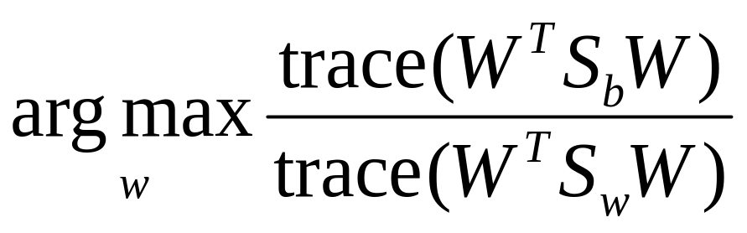


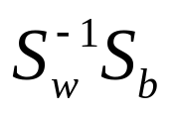
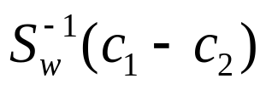
LDA - Discriminant criterion
Discriminant criterion in mathematical formulation
  Between-class scatter matrix
  Within-class scatter matrix
The optimal transformation is given by solving a generalized eigenvalue problem
For two classes: the optimal direction could be computed in a close form

Slide 6
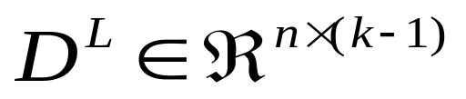




Graphical view of LDA classification
K-1
d
n
n
K-1
d
d
K-1
1
1
A test data point h
Find the nearest neighbor
Or nearest centroid

Slide 7


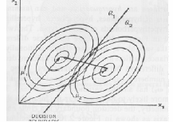
LDA Vs. Bayes Classifier
Example: two Gaussians with the same covariance and means
The Bayes classifier is a straight line whose normal is the Fisher Linear Discriminant direction w.

Slide 8
From Two Classes to Multiple Classes

Slide 9
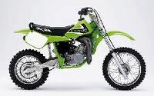

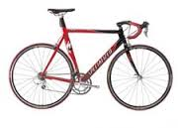
Creating a Multi-Class Classifier
Multi-Class Classifier SVM/LDA

Slide 10
Two Strategies
One vs. rest : eg. Airplane/non-airplane classifier
class labels: is airplane vs. Is not an airplane
One vs. One : eg. Airplane/bicyle classifier“
class labels: is an airplane vs. is a bicyle
We have set of binary classier, how can make a final decision?
Lets us focus on one vs. rest

Slide 11
One vs Rest Classification
Suppose we already have build a model of binary classifier such as LDA or SVM
Train a binary classifier:
  Take one class as a positive class ‘+1’
  The other class as negative class: ‘-1’
  Then train the classifier as a standard binary classifier
  Repeat the above steps until every class has ever served as positive class
Thus in total we have a set of binary classifiers f1 … fb. The total number is the same as the number of classes
For an unseen sample x, we use those b binary classifiers to classify this sample x. We have b outputs: f1(x), f2(x), … fb(x)

Slide 12
Hard Decision Vs. Soft decisions
f1 ..... fB, B; set of binary classifiers, can return
Hard decisions
{ -1, 1}
{“is airplane“,
“is no airplane“}
Soft decisions
eg. 2.0, 0.5, -2.0
{ `mostly a airplane` , `kind an airplane`, not an airplane“}
→ Confidence values

Slide 13
One vs Rest Classification - Example
One vs. rest
f1: is bike“ classifier
Motorbike
Airplane
Bicycle
Number of classifier = number of classes
Motorbike v. non Motorbike
Bicycle v. non Bicycle
Airplane v. non Air plane

Slide 14
One vs One Classification - Example
One vs. One
Motorbike
f1: is bike“ or motorbike
Airplane
Bicycle
Number of classifier = number of class pair
Motorbike v. bicycle
Bicycle v. airplane
Airplane v. motorbike

Slide 15
One vs Rest: The Ideal Output/target Matrix
One vs. Rest
The target matrix: combine binary classifiers in a matrix: matrix M: {-1,1}
 | Bike vs. rest | Airplane vs. rest | Motorbike vs. rest
bike | 1 | -1 | -1
Airplane | -1 | 1 | -1
Motorbike | -1 | -1 | 1
2
0
2
For an unseen test sample x: if the three classifiers output: {-1 , 1 , -1}, which class will this sample belong to?
-- An intuitive way to simply calculate the distance of between each row and the output (hamming distance)

Slide 16

One vs Rest Classification - Example
By comparing it with the target matrix, we say it is an airplane!
Sometime, not easy ….
  How about the three outputs for an unseen sample is: {1, -1, 1}
 | Bike vs. rest | Airplane vs. rest | Motorbike vs. rest
bike | 1 | -1 | -1
Airplane | -1 | 1 | -1
Motorbike | -1 | -1 | 1
1
3
1

Slide 17
One vs Rest Classification - Example
What shall we do?
  Make a random decision
  Are there any better option?
Hard decisions
{ -1, 1}
{“is airplane“,
“is no airplane“}
Soft decisions
eg. 2.0, 0.5, -2.0
{ `mostly a airplane` , `kind an airplane`, not an airplane“}
→ Confidence values
For an unseen sample, we have considered binary output, A ‘secrete ‘ thing to use the soft decisions:
f = {1, -1, 1}, f(x) = {9.0, -2.2, 5.3}

Slide 18
One vs Rest Classification - Example
Hard Decision: f = {1, -1, 1},
Soft Decision: f(x) = {9.0, -2.2, 5.3}
 | Bike vs. rest | Airplane vs. rest | Motorbike vs. rest
bike | 1 | -1 | -1
Airplane | -1 | 1 | -1
Motorbike | -1 | -1 | 1
1
3
1
We can see that the unseen sample is more like the bicycle rather than a Motorbike

Slide 19
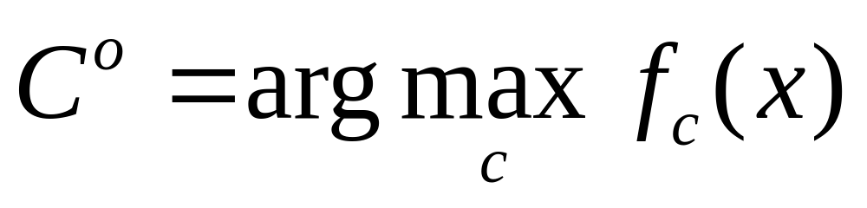
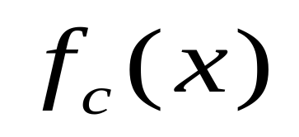
One vs Rest Classification – Max Win
Max win strategy: to summarize in an equation
is a binary classifier (for class C-vs –rest), but using the soft decisions
Who gives the Maximum output, who Wins !
For one verse one scheme: Choose the class that is selected by the most classifiers

Slide 20
Running Time
One vs. rest: you need as many classifiers as you have classes, Linear - O(N) : B = K
One vs. one: combinatorics Squared - O(N^2):
B =(K choose 2)
More comparison:
http://hal.archives-ouvertes.fr/docs/00/10/39/55/PDF/cr102875872670.pdf
Notes:
Aber more data in the first one. . So complexity is really not known. However the complexity is a lot more difficult to consider because the training sets are different. Really depends on the input. . . .

Slide 21
What to Remember about Classifiers
No free lunch: machine learning algorithms are tools, not dogmas
Try simple classifiers first
Better to have smart features and simple classifiers than simple features and smart classifiers
Use increasingly powerful classifiers with more training data (bias-variance tradeoff)
Slide credit: D. Hoiem

Slide 22
Some Machine Learning References
General
  Tom Mitchell, Machine Learning, McGraw Hill, 1997
  Christopher Bishop, Neural Networks for Pattern Recognition, Oxford University Press, 1995
SVMs
  http://www.support-vector.net/icml-tutorial.pdf
Slide credit: D. Hoiem

Slide 23
CS303B - AI
Classification
Learning Outcomes
  Appreciate the problems of Classificaiton
Be able to understand the principles of Nearest Neighbor Clustering, and KNN
Be able to apply different classification methods in applications
Dr. Jianguo Zhang, RM: 122 Level 1, QMB
School of Computing

