Slide 1
Computer Vision
Convolution and Spatial Filter
Learning Outcomes
  Understand the principles of convolution.
  Understand the principle of convolution and spatial filtering.
  Be able design and apply appropriate different filters on images
Notes:
Things you should look up:
Pressman - chapter’s 1 & 2

Slide 2
Outline
Convolution
  The basic operation
  Some theorem
Spatial Filter
  Mean Filter
  Median Filter
  Gaussian Filter
Image Noises

Slide 3
Local Operations
INPUT IMAGE
OUTPUT IMAGE
Output pixel depends on neighbourhood of corresponding pixel in input image

Slide 4
Convolution
Mask
m₁
m₂
m₃
m₄
m₅
m₆
p₁
p₂
p₃
m₇
m₈
m₉
p₄
p₆
h
p₅
p₇
p₈
p₉
Input Image
Output Image

Slide 5
Convolution: 3x3 Mean
1
1
1
1
1
1
1
1
1
Mask
1 2 0 2 2 0 1
- - - - - - -
- - - - - - -
1 0 3 1 0 2 0
- 18 27 34 23 13 -
- 2 3 4 3 1 -
1 0 10 9 7 0 1
- 27 46 61 50 31 -
- 3 5 7 6 3 -
1 2 9 12 10 9 2
- 36 63 92 77 52 -
- 4 7 10 9 6 -
0 1 12 8 15 7 1
- 37 65 96 85 58 -
- 4 7 11 9 6 -
1 2 9 10 11 3 0
- 27 45 69 57 39 -
- 3 5 8 6 4 -
1 0 1 2 1 0 1
- - - - - - -
- - - - - - -
Input Image
Unnormalised
Output Image

Slide 6



Gaussian (1-D)
σ
0
x

Slide 7
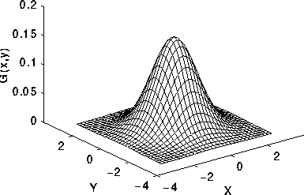

Gaussian (2-D)
That means 2D Gaussian could be separable in special cases

Slide 8
Gaussian Masks
1. Could be created directly from the Gaussian functions
2. Some discrete approximations to a Gaussian: But need to be normalised by the sum.
1 1 2 2 2 1 1
1 2 2 4 2 2 1
1
1 1 2 1 1
2 2 4 8 4 2 2
1 2 4 2 1
1 2 1
2 4 8 16 8 4 2
2 4 8 4 2
2 4 2
2 2 4 8 4 2 2
1 2 4 2 1
1 2 1
1 2 2 4 2 2 1
1 1 2 1 1
1 1 2 2 2 1 1

Slide 9
Convolution: 3x3 Gaussian
Mask
1
2
1
1 2 0 2 2 0 1
- - - - - - -
2
4
2
- 24 47 ? ? ? -
1 0 3 1 0 2 0
1
2
1
1 0 10 9 7 0 1
- 40 97 ? ? ? -
1 2 9 12 10 9 2
- ? ? ? ? ? -
0 1 12 8 15 7 1
- ? ? ? ? ? -
1 2 9 10 11 3 0
- ? ? ? ? ? -
1 0 1 2 1 0 1
- - - - - - -
Input Image
… and then a normalisation step…

Slide 10
Image Noise
Images are often corrupted by random variations in pixel values. Such variations are ‘noise’.
Some sources of noise:
  Random changes in the electrical signals used for transmission e.g. sunspot activity
  Camera electronics
  The inherently random nature of the recording process e.g. photon impinging on a surface

Slide 11
Common Noise Models
Salt and pepper noise: random occurrences of black and white values: impulse “spikes” of black or white.
Gaussian noise: variations in pixel values drawn from a Gaussian (or ‘normal’) distribution. Can be a reasonable model of sensor noise e.g. due to camera electronics.

Slide 12
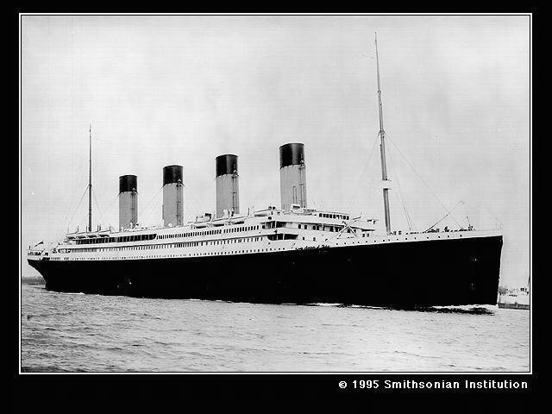
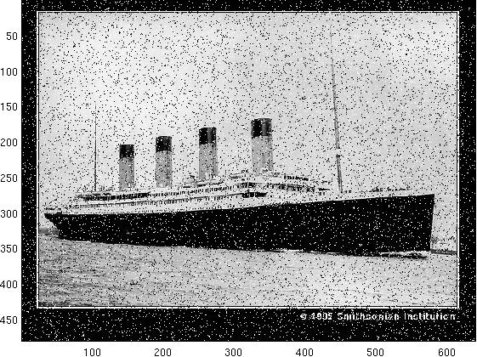
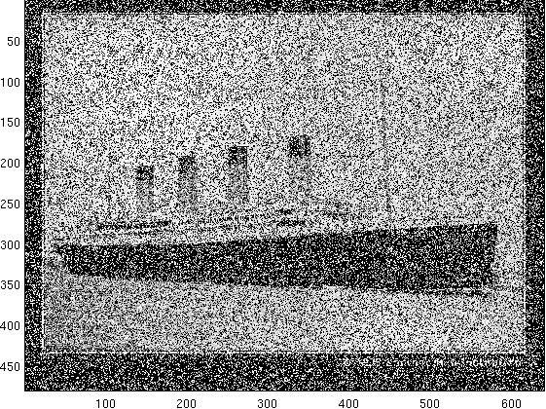
Creating Salt and Pepper Noise
Randomly sample a set of pixel locations, proportional to the whole number of pixels (e.g., 1%).
For each selected pixel location, setting its value either at while (255) or black (0) at 50% probability.
Original Image
Salt & Pepper Noise 0.1%
Salt & Pepper Noise 1%

Slide 13
Creating Gaussian Noise
p(x)
σ
For each pixel:
Sample a value x from this Gaussian distribution. (Zeros Mean) (values near zero are more likely).
Add x to the pixel’s grey-level value.
0
x

Slide 14
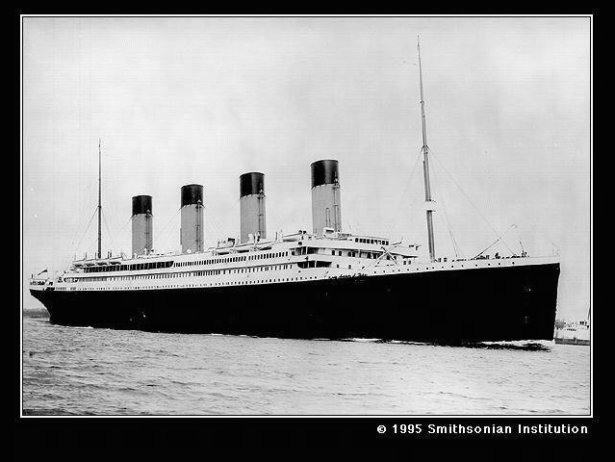
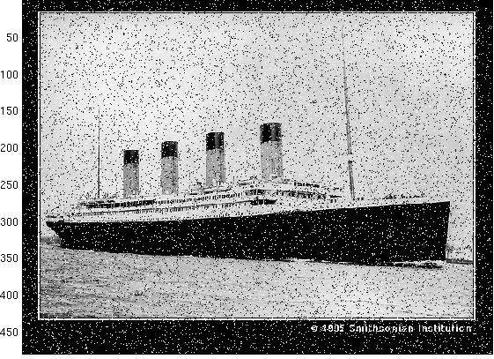
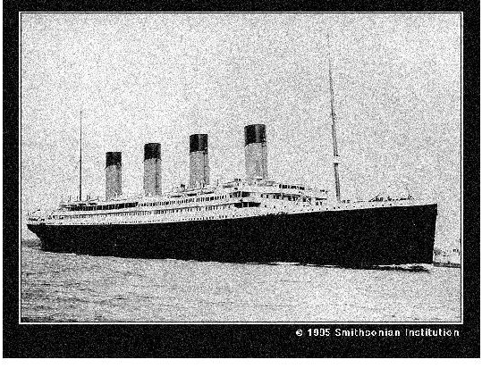

Examples of Noise Models
Original Image
Salt & Pepper Noise 0.1%

Slide 15
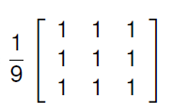
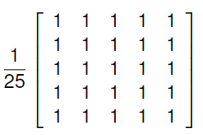
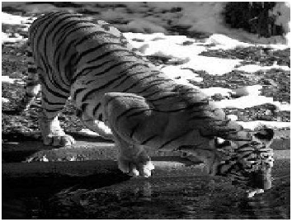
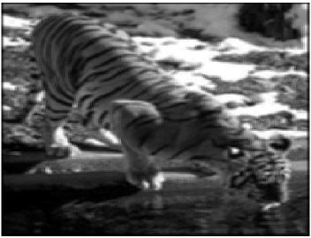
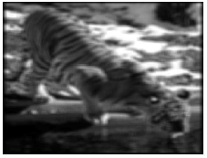
Low Pass Filtering – Mean Filtering
Normal Image
Mean Filtering 3x3
Mean Filtering 5x5

Slide 16
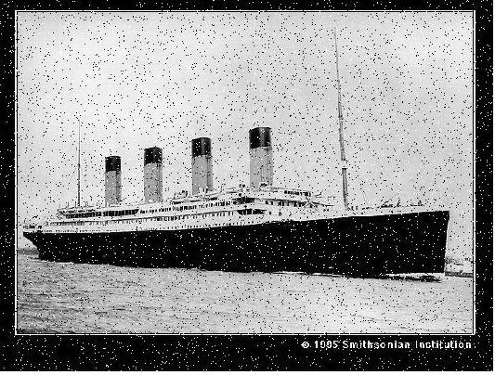
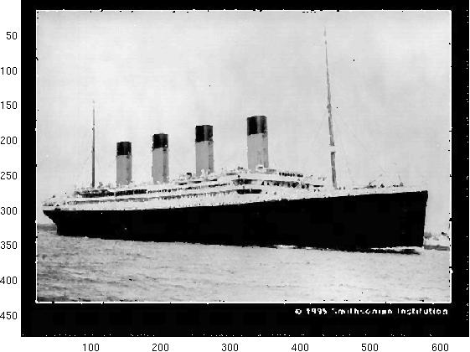
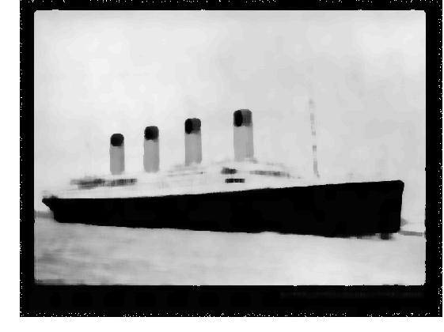
Median Filtering
Pixels are set to median of all pixels in N x N neighbourhood.
Original Image
Median 3x3
Media 11x11

Slide 17


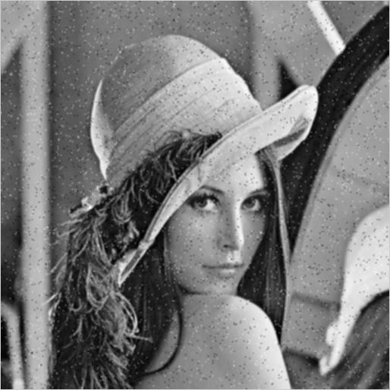
Salt & Pepper: Median Vs. Mean
Original Noise Image:
Median
Mean

Slide 18
Gaussian Filtering
Good for removing noise drawn from a Gaussian distribution! (This is not obvious)
Low-pass filter
  removes high frequency components i.e. sudden changes in grey-level
- Can vary σ to achieve desired compromise between:
  excessive blur (too much smoothing)
  excessive undesired variation due to noise and fine texture (too little smoothing)
- Efficient implementation possible due to separability ( will discuss later in edge detection)

Slide 19
Computer Vision
Convolution and Spatial Filter
Learning Outcomes
  Understand the principles of convolution.
  Understand the principle of convolution and spatial filtering.
  Be able design and apply appropriate different filters on images
Notes:
Things you should look up:
Pressman - chapter’s 1 & 2

