Slide 1
Computer Vision
Scale Space and Edge
Learning Outcomes
  Appreciate the problems of scale space and edge detection
  Understand the principles of edge detection
  Be able to apply different edge detectors for edge detection

Slide 2
Outline
Scale Space and Gaussian Pyramid
The Origins of Edge in Images
Image Gradient
Canny Edge Detector
  Slides adapted from Cordelia Schimid, S. LAZEBNIK

Slide 3
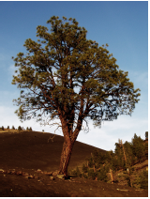
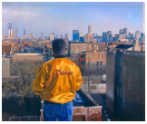
Scale Space
At what scale the scene or object to be analyzed
Image contain information at different scales
Best strategy: Representing image at different scales
Scale space: A set of images produced by convoluting with Gaussian at different scales. So it is a function of scale

Slide 4
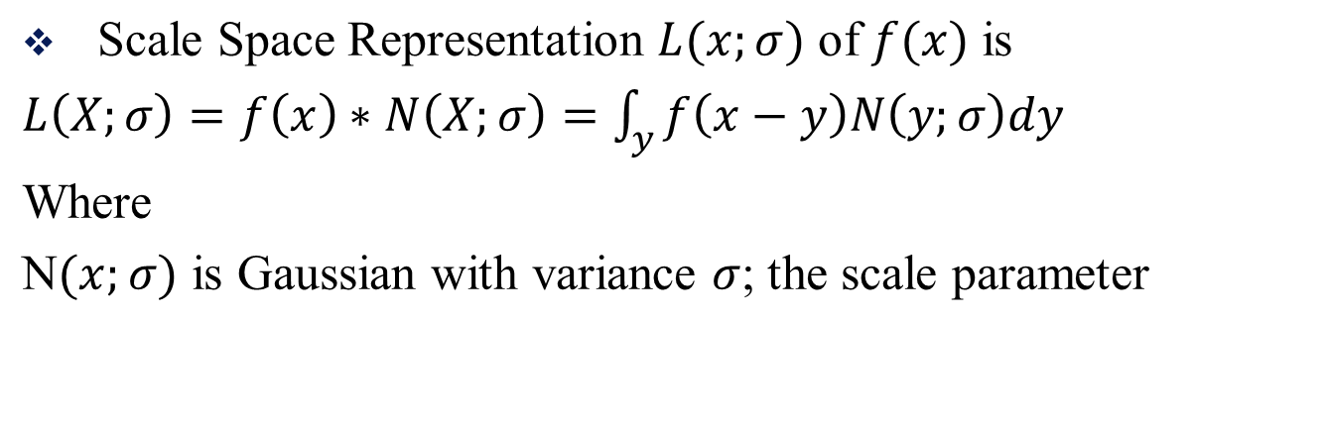
Scale Space

Slide 5
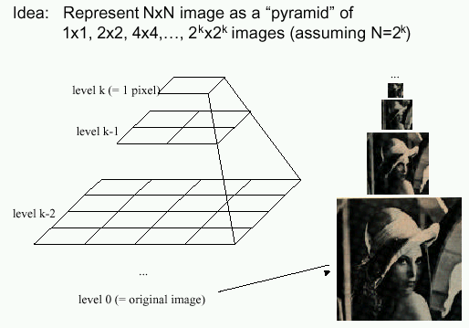
Gaussian Pyramid: many resolutions
Known as a Gaussian Pyramid [Burt and Adelson, 1983]
  A precursor to wavelet transform
Gaussian Pyramids have all sorts of applications in computer vision

Slide 6
Gaussian Pyramid Construction
filter kernel
Repeat
  Filter
  Subsample
Until minimum resolution reached
  can specify desired number of levels (e.g., 3-level pyramid)
The whole pyramid is only 4/3 the size of the original image!

Slide 7
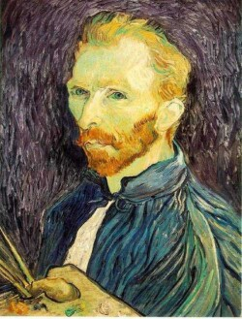
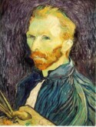

Subsampling with Gaussian pre-filtering
G 1/8
G 1/4
Gaussian 1/2
Filter the image, then subsample

Slide 8
Subsampling with Gaussian pre-filtering
Gaussian 1/2
G 1/4
G 1/8
Filter the image, then subsample

Slide 9



Subsampling without pre-filtering
1/2
1/4 (2x zoom)
1/8 (4x zoom)

Slide 10
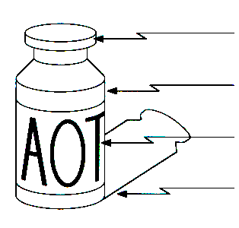
Origin of Edges
surface normal discontinuity
depth discontinuity
surface color discontinuity
illumination discontinuity
Edges are caused by a variety of factors
Source: Steve Seitz

Slide 11

Characterizing edges
An edge is a place of rapid change in the image intensity function
intensity function
(along horizontal scanline)
image
first derivative
edges correspond to
extrema of derivative

Slide 12
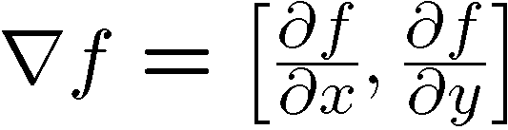



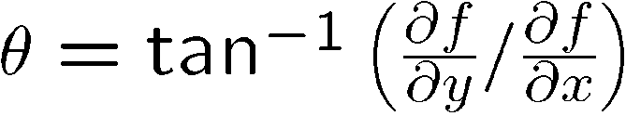
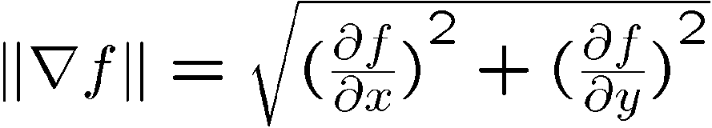
Image Gradient
The gradient of an image:
The gradient points in the direction of most rapid increase/decrease in intensity
The gradient direction is given by
  how does this relate to the direction of the edge?
The edge strength is given by the gradient magnitude
Source: Steve Seitz
Notes:
give definition of partial derivative: lim h->0 [f(x+h,y) – f(x,y)]/h

Slide 13
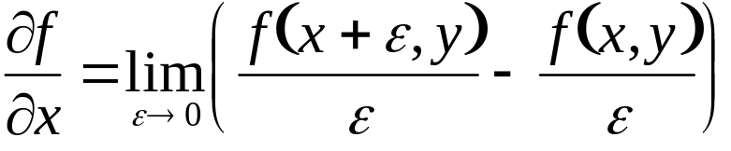
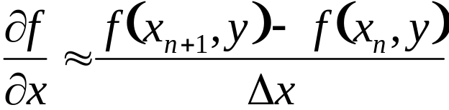
Differentiation and Convolution
Recall, for 2D function, f(x,y):
This is linear and shift invariant, so must be the result of a convolution.
We could approximate this as
(which is obviously a convolution)
-1 | 1
Source: D. Forsyth, D. Lowe

Slide 14
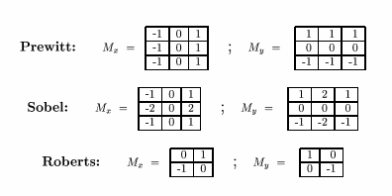
Finite difference filters
Other approximations of derivative filters exist:
Source: K. Grauman

Slide 15
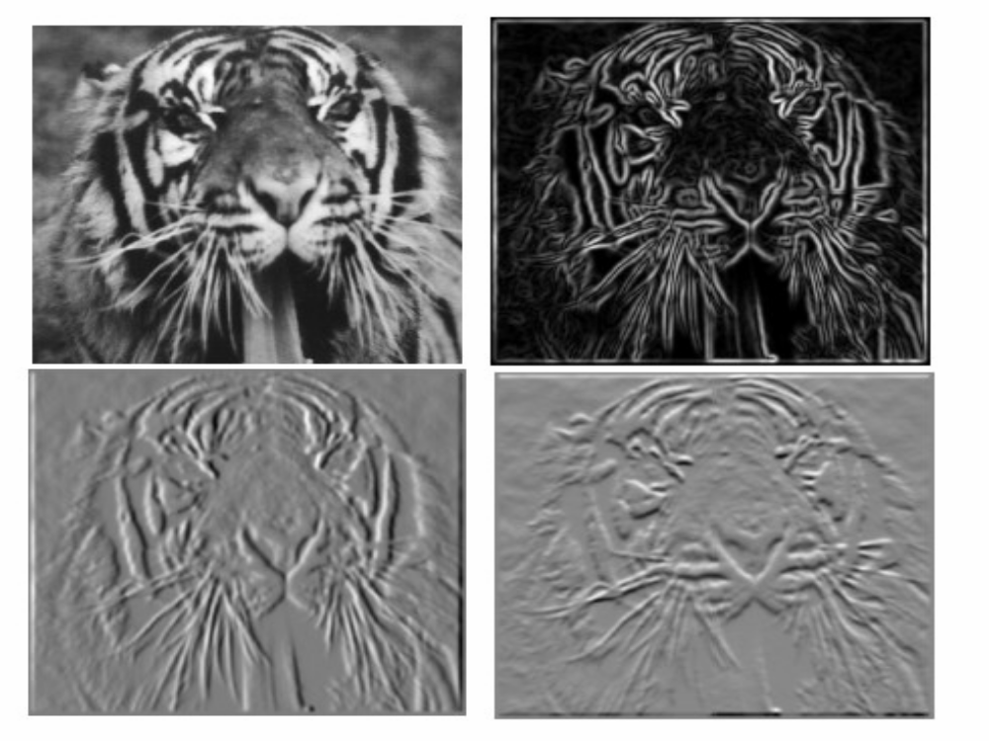
Finite differences: example
Which one is the gradient in the x-direction (resp. y-direction)?

Slide 16
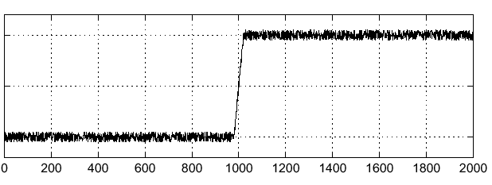

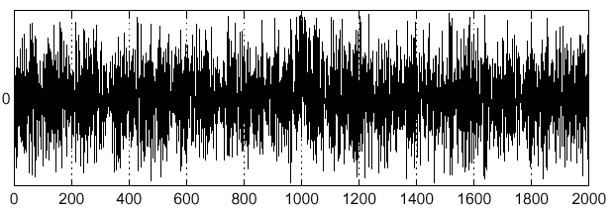
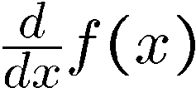
Effects of noise
Consider a single row or column of the image
  Plotting intensity as a function of position gives a signal
Where is the edge?
Source: S. Seitz
Notes:
How to fix?

Slide 17
Effects of noise
Finite difference filters respond strongly to noise
  Image noise results in pixels that look very different from their neighbors
  Generally, the larger the noise the stronger the response
What is to be done?
Source: D. Forsyth

Slide 18
Effects of noise
Finite difference filters respond strongly to noise
  Image noise results in pixels that look very different from their neighbors
  Generally, the larger the noise the stronger the response
What is to be done?
  Smoothing the image should help, by forcing pixels different to their neighbors (=noise pixels?) to look more like neighbors
Source: D. Forsyth

Slide 19
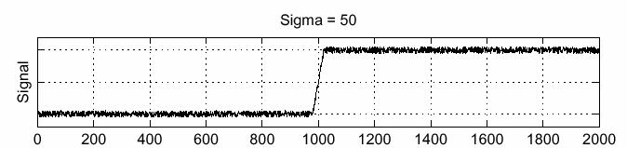
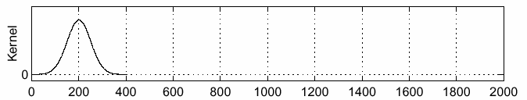
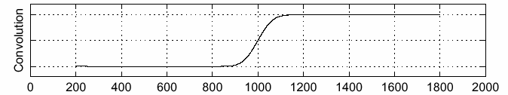
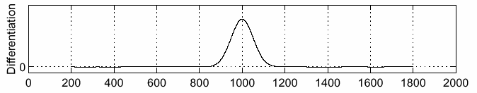
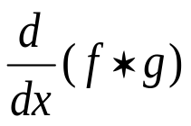

Solution: smooth first
f
g
f * g
To find edges, look for peaks in
Source: S. Seitz

Slide 20
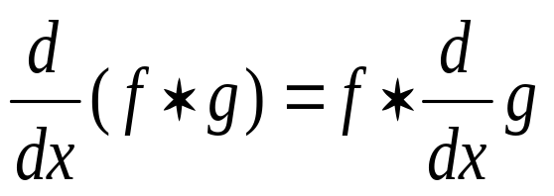
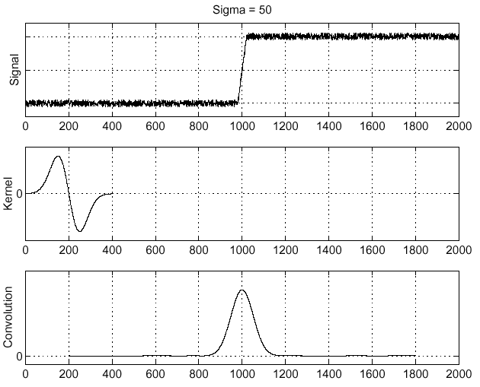
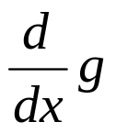
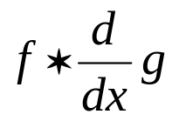
Derivative theorem of convolution
Differentiation is convolution, and convolution is associative:
This saves us one operation:
f
Source: S. Seitz

Slide 21
Discussion: If the Kernel is Gaussian
Can we reduce the computation cost? (5 Mins)
If the convoution kernel g is separable, i.e., g(x,y) = g(x)g(y), (look at edges.pdf in the reading list)
Convolution = Row convolution along x first and then perform column convolution along y.
How much can we save? (1 Mins)
Saving computation cost: O(N^2 -2N) per pixel operation if the size of the local kernel is NxN. For an image of size MxM, we could save O(MN^2-2MN) operations.

Slide 22
Canny’s Edge Detector
1. Image Smoothing
  Gaussian mask
2. Edge Enhancement
  Estimate gradient magnitude and orientation images (convolution & polar transformation)
3. Edge Localisation
  Non-maximum Suppression
  Hysteresis Thresholding

Slide 23
Non-maximum Suppression
For each pixel I_{x,y} in the edge magnitude image:
1. Find the direction d∈{N,NW,W,SW} which best approximates the gradient orientation, θ_{x,y}
2. If I_{x,y} is smaller than at least one of its two neighbours along direction d, set I_{x,y} = 0
  2 2 2 2 2
  2 2 9 9 8
  2 9 1 6 7
  8 1 1 1 1
  0 0 0 0 0
  0 2 9 9 8
  0 9 0 0 0
  8 0 0 0 0
(Think of the magnitude image as consisting of ridges. After non-maximum suppression, the ridge tops remain but all pixels not on ridge tops are set to zero.)

Slide 24
Hysteresis Thresholding
Uses two thresholds: T_{high} and T_{low} (T_{high} > T_{low})
For all remaining edge points:
1. Locate next unvisited edge pixel > T_{high}
2. Follow chain of connected local maxima in both directions as long as these are > T_{low}. Mark each visited point as an edge point.
This finds connected contours. Tracking can only start on a ridge higher than T_{high} and continues until the ridge falls below T_{low}. Reduces number of false contours and helps to avoid gaps in contours.

Slide 25
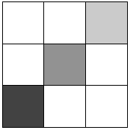
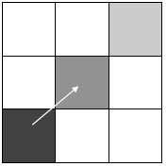
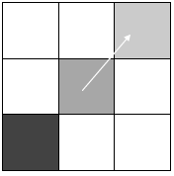
Hysteresis Thresholding
Very strong edge response
Let us start from here
Weaker response but connected to a stronger one. Let us keep it
Continue
Note: Darker squares means stronger gradient magnitude

Slide 26
Hysteresis Thresholding
  0 0 0 0 0 9 0 0 0 0 0 0
  0 1 2 0 0 7 0 0 0 0 7 8
  0 0 1 0 0 4 0 1 0 9 0 0
  0 0 0 0 7 0 0 0 0 6 0 0
  0 0 0 9 0 0 0 0 0 2 0 0
  9 8 6 0 0 0 5 0 0 8 0 0
  0 0 0 0 0 0 0 0 0 0 4 9
  0 0 0 1 0 0 0 0 0 0 0 0
There are two object contours in this noisy image.
Try detecting them with a single threshold.
Now try with hysteresis thresholding.

Slide 27
Canny Edge Detector
The most popular edge detectors till date
Assume images are corrupted by additive Gaussian noise
Canny has shown that the first derivative of the Gaussian closely approximates the operator that optimizes the product of signal-to-noise ratio and localization
J. Canny, A Computational Approach To Edge Detection, IEEE Trans. Pattern Analysis and Machine Intelligence, 8:679-714, 1986.
Source: L. Fei-Fei

Slide 28
Canny edge detector – Steps Summary
Filter image with derivative of Gaussian
Find magnitude and orientation of gradient
Non-maximum suppression:
  Thin multi-pixel wide “ridges” down to single pixel width (local peak detection in the gradient direction)
Linking and thresholding (hysteresis):
  Define two thresholds: low and high
  Use the high threshold to start edge curves and the low threshold to continue them
MATLAB: edge(image, ‘canny’)
Source: D. Lowe, L. Fei-Fei

Slide 29
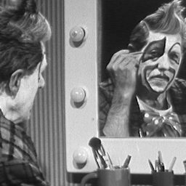
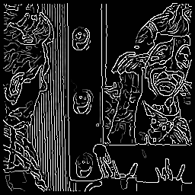
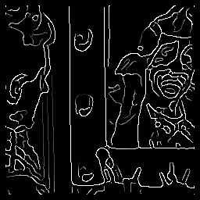
Canny Example
Gaussian
σ = 1.0
Gaussian
σ = 2.0

Slide 30
Computer Vision
Scale Space and Edge
Learning Outcomes
  Appreciate the problems of scale space and edge detection
  Understand the principles of edge detection
  Be able to apply different edge detectors for edge detection

