Slide 1
Computer Vision
Optical Flow
Learning Outcomes
  Understand the principles of motion field, optical flow and their relationships, and applications
  Be able to compute optical flow from images
Notes:
Things you should look up:
Pressman - chapter’s 1 & 2

Slide 2
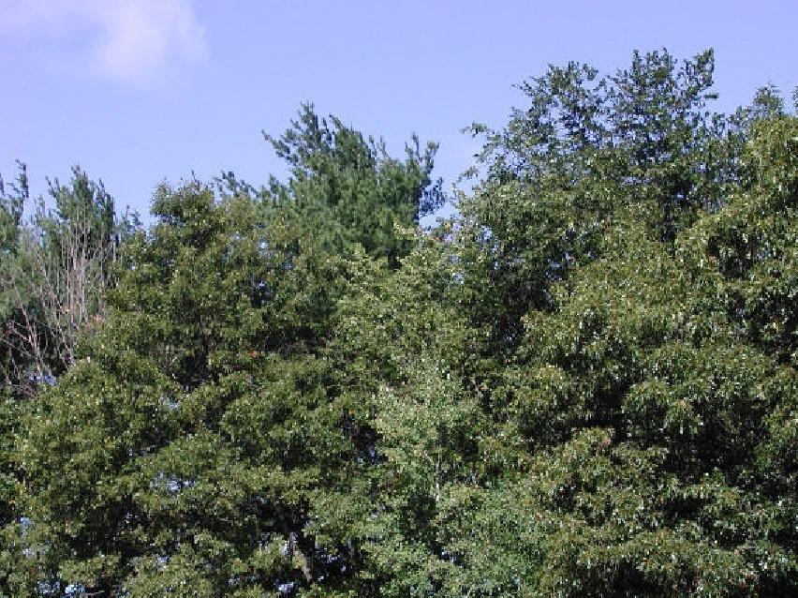
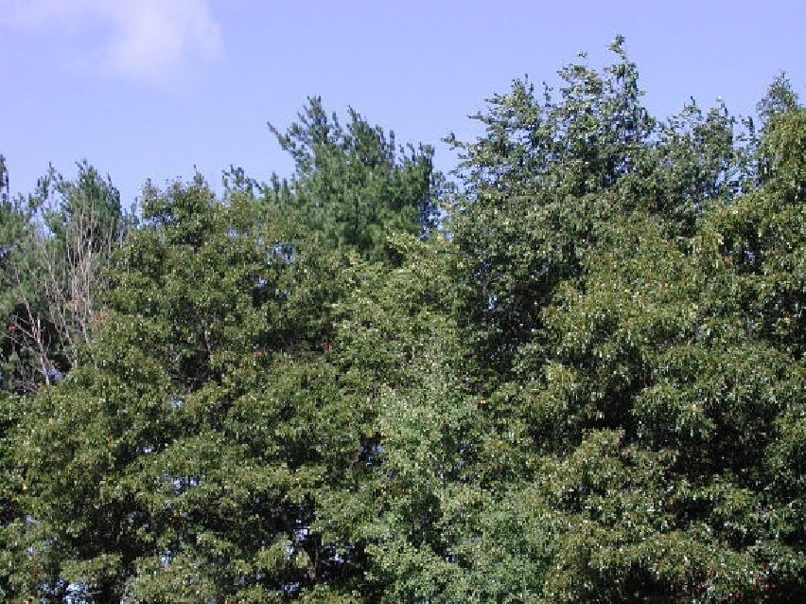
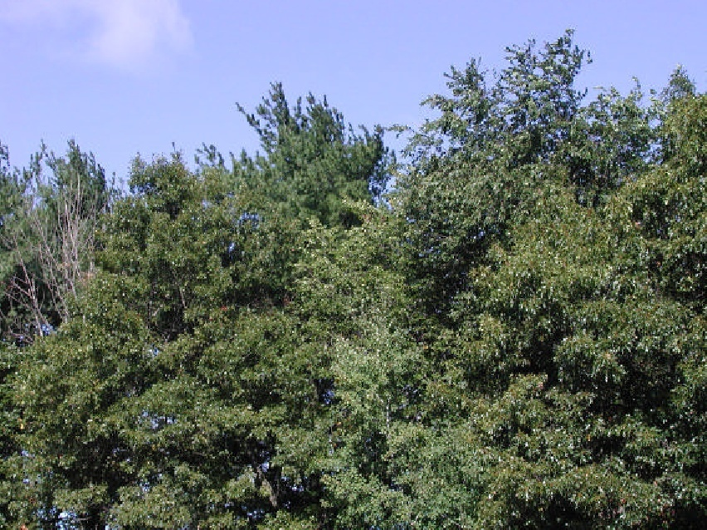
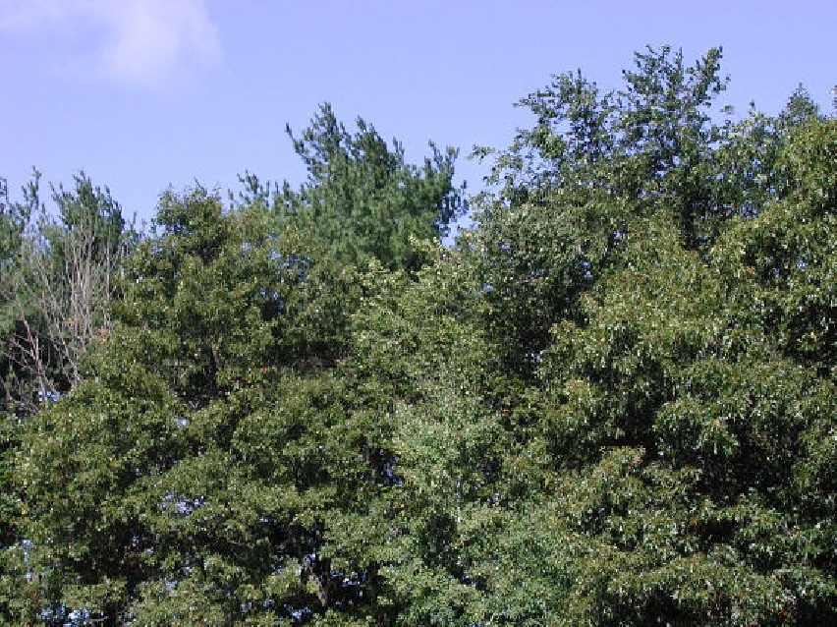
Visual motion
Many slides adapted from S. Seitz, R. Szeliski, M. Pollefeys

Slide 3
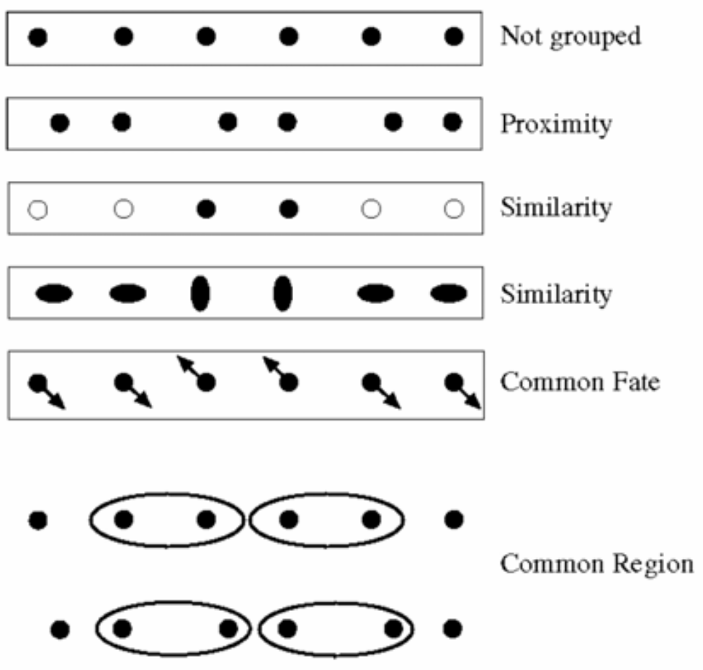
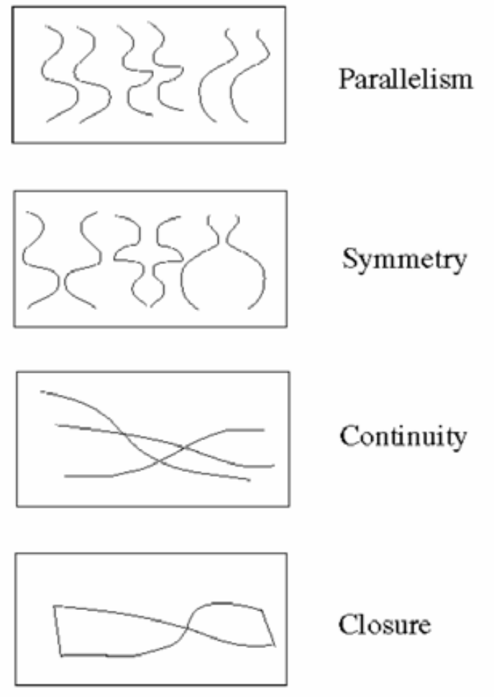
Motion and perceptual organization
Sometimes, motion is the only cue

Slide 4
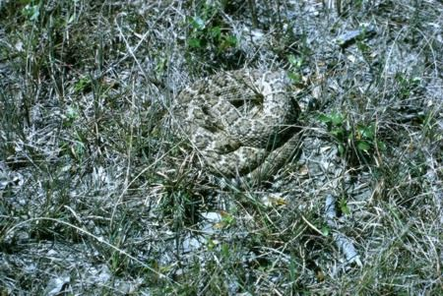
Motion and perceptual organization
Sometimes, motion is the most obvious cue

Slide 5
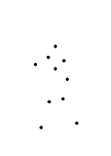
Motion and perceptual organization
Even “impoverished” motion data can evoke a strong percept
G. Johansson, “Visual Perception of Biological Motion and a Model For Its Analysis", Perception and Psychophysics 14, 201-211, 1973.

Slide 6
Motion and perceptual organization
Even “impoverished” motion data can evoke a strong percept
G. Johansson, “Visual Perception of Biological Motion and a Model For Its Analysis", Perception and Psychophysics 14, 201-211, 1973.

Slide 7
Uses of motion
Estimating 3D structure
Segmenting objects based on motion cues
Learning and tracking dynamical models
Recognizing events and activities

Slide 8
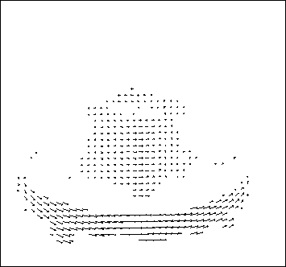
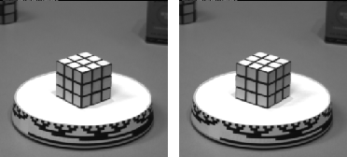
Motion field
The motion field is the projection of the 3D scene motion into the image

Slide 9
Motion field and parallax
V
X(t+dt)
X(t)
X(t) is a moving 3D point
Velocity of scene point: V = dX/dt
x(t) = (x(t),y(t)) is the projection of X in the image
Apparent velocity v in the image: given by components v_{x} = dx/dt and v_{y} = dy/dt
These components are known as the motion field of the image
v
x(t+dt)
x(t)

Slide 10
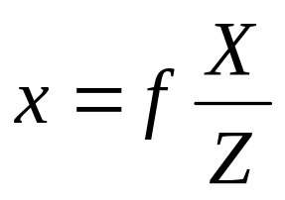
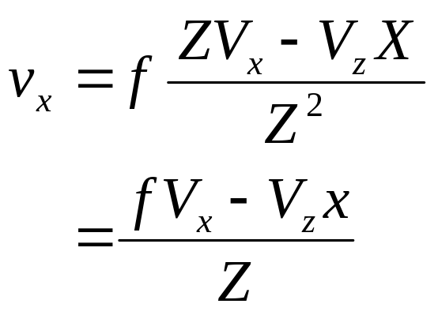
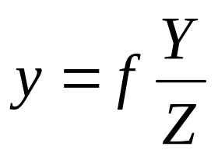
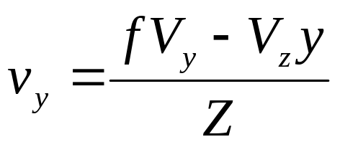
Motion Field and Parallax
V
X(t+dt)
To find image velocity v, differentiate x=(x,y) with respect to t (using quotient rule):
X(t)
v
x(t+dt)
x(t)
Image motion is a function of both the 3D motion (V) and the
depth of the 3D point (Z)
Notes:
Quotient rule for differentiation: D(f/g) = (g f’ – g’ f)/g^2

Slide 11
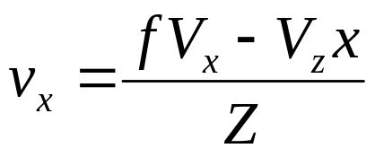
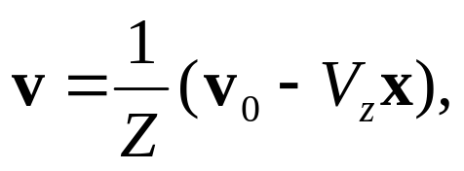
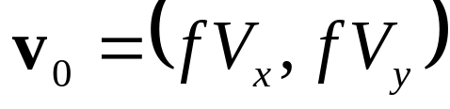

Motion field and parallax
Pure translation: V is constant everywhere

Slide 12
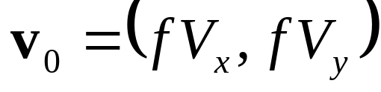
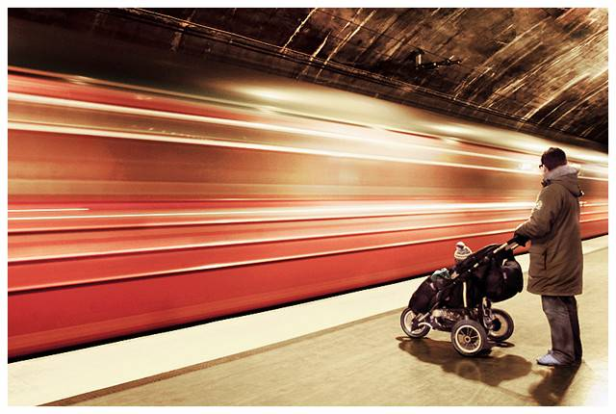
Motion field and parallax
Pure translation: V is constant everywhere
The length of the motion vectors is inversely proportional to the depth Z
V_{z} is nonzero:
  Every motion vector points toward (or away from) the vanishing point of the translation direction
Notes:
At the vanishing point of the motion location, the visual motion is zero
We have v = 0 when V_z x = v_0 or x = (f V_x / V_z, f V_y / V_z)

Slide 13
Motion field and parallax
Pure translation: V is constant everywhere
The length of the motion vectors is inversely proportional to the depth Z
V_{z} is nonzero:
  Every motion vector points toward (or away from) the vanishing point of the translation direction
V_{z} is zero:
  Motion is parallel to the image plane, all the motion vectors are parallel

Slide 14
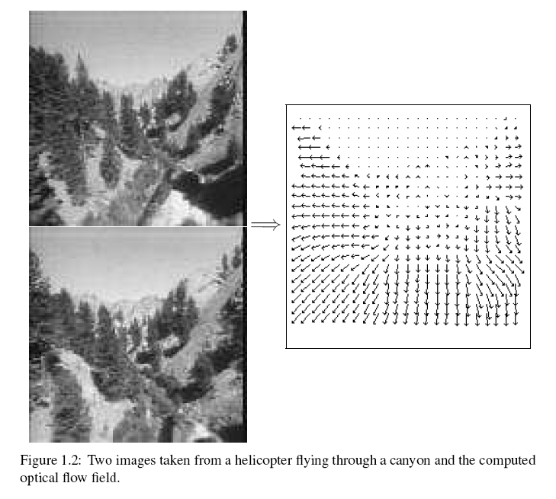
Motion field + camera motion
Length of flow vectors inversely proportional to depth Z of 3d point
points closer to the camera move more quickly across the image plane
Figure from Michael Black, Ph.D. Thesis

Slide 15
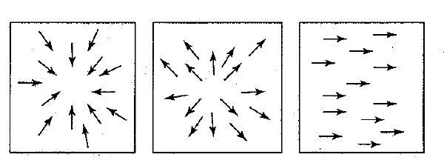
Motion field + camera motion
Zoom out
Zoom in
Pan right to left

Slide 16
Motion analysis using optical flow
Motion in video is often a combination of:
  Translation at constant depth
  Translation in depth
  Rotation at constant depth (about view axis)
  Rotation of a planar object in depth
These motion patterns can be recognized from optical flow using quite simple operators

Slide 17

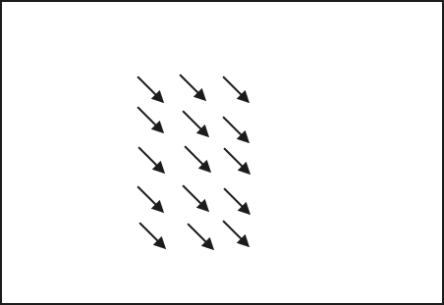
Translation at constant depth
I(t)
Parallel motion vectors

Slide 18
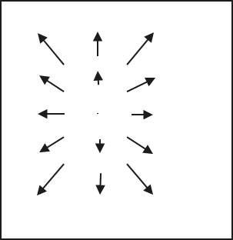
Translation in depth
I(t)
I(t+dt)
Motion vectors have a
Focus of Expansion

Slide 19
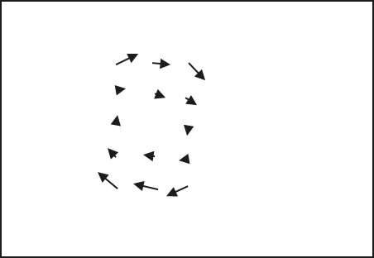
Rotation at constant depth
I(t)
I(t+dt)
Concentric motion vectors

Slide 20
Rotation in depth
I(t)
I(t+dt)

Slide 21
Optical flow
Definition: optical flow is the apparent motion of brightness patterns in the image
Ideally, optical flow would be the same as the motion field
Have to be careful: apparent motion can be caused by lighting changes without any actual motion
  Think of a uniform rotating sphere under fixed lighting
  vs. a stationary sphere under moving illumination

Slide 22
Estimating optical flow
I(x,y,t–1)
I(x,y,t)
Given two subsequent frames, estimate the apparent motion field u(x,y) and v(x,y) between them
Key assumptions
  Brightness constancy: projection of the same point looks the same in every frame
  Small motion: points do not move very far
  Spatial coherence: points move like their neighbors

Slide 23


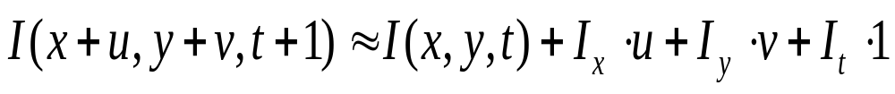
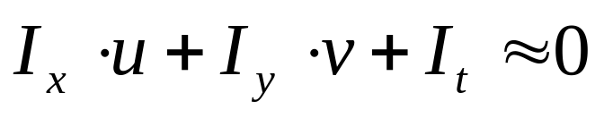
The brightness constancy constraint
I(x,y,t)
I(x,y,t+1)
Brightness Constancy Equation:
Linearizing the right side using Taylor expansion:
Hence,

Slide 24
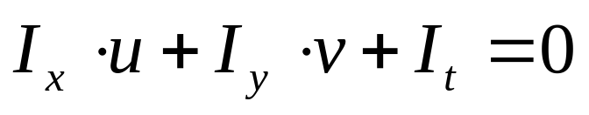
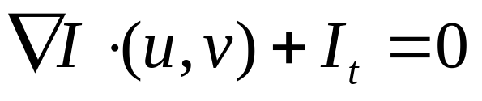
The brightness constancy constraint
How many equations and unknowns per pixel?
  One equation, two unknowns
Intuitively, what does this constraint mean?
The component of the flow perpendicular to the gradient (i.e., parallel to the edge) is unknown
Notes:
A: u and v are unknown, 1 equation

Slide 25

The brightness constancy constraint
How many equations and unknowns per pixel?
  One equation, two unknowns
Intuitively, what does this constraint mean?
The component of the flow perpendicular to the gradient (i.e., parallel to the edge) is unknown
gradient
(u,v)
  If (u, v) satisfies the equation,
  so does (u+u’, v+v’) if
(u’,v’)
(u+u’,v+v’)
edge
Notes:
A: u and v are unknown, 1 equation

Slide 26
The aperture problem
Perceived motion

Slide 27
The aperture problem
Actual motion

Slide 28

The barber pole illusion
http://en.wikipedia.org/wiki/Barberpole_illusion

Slide 29

The barber pole illusion
http://en.wikipedia.org/wiki/Barberpole_illusion

Slide 30

The barber pole illusion
http://en.wikipedia.org/wiki/Barberpole_illusion

Slide 31
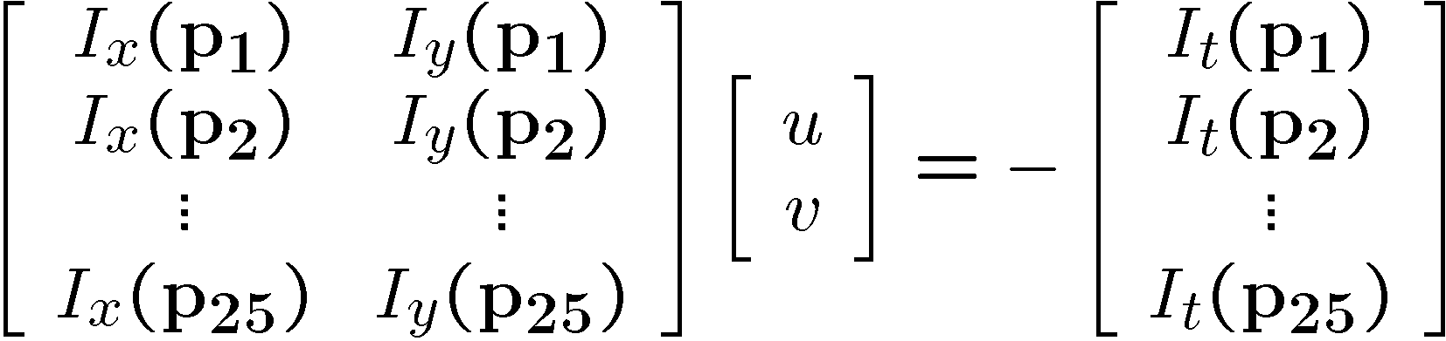
Solving the aperture problem
How to get more equations for a pixel?
Spatial coherence constraint: pretend the pixel’s neighbors have the same (u,v)
  If we use a 5x5 window, that gives us 25 equations per pixel
B. Lucas and T. Kanade. An iterative image registration technique with an application to
stereo vision. In Proceedings of the International Joint Conference on Artificial Intelligence, pp. 674–679, 1981.

Slide 32
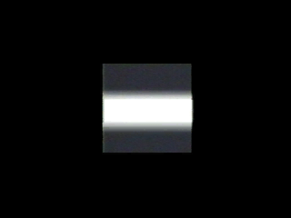
Conditions for solvability
“Bad” case: single straight edge

Slide 33
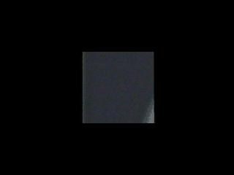
Conditions for solvability
“Good” case

Slide 34
Computer Vision
Optical Flow
Learning Outcomes
  Understand the principles of motion field, optical flow and their relationships, and applicatoins
  Be able to compute optical flow from images
Notes:
Things you should look up:
Pressman - chapter’s 1 & 2

