Slide 1
NN and Support Vector Machine
Learning Outcomes
  Appreciate the problems of classification
  Understand the principles of linear classifier, and support vector machine
  Be able apply support vector machine for classification problem..

Slide 2
A List of Common Classifiers
Nearest Neighbours Classifies (NN) (Non-parametric)
K-Nearest Neighbours (Non-parametric)
Support Vector Machine
Neural Networks
Discriminative analysis – LDA
Bayesian Classifies
Logistic regression
Adaboost
Decision Trees
Rule based Approaches
….

Slide 3
This lecture
Classification
K Nearest Neighbor
Linear Classifiers
Support Vector Machines (SVM)
Variant of SVMs
  Linear SVM
  Kernel SVM
Application of SVMs

Slide 4
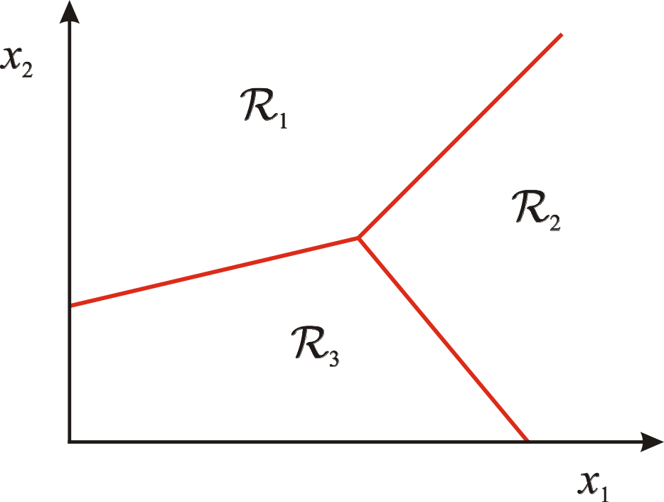
Classification
Assign an input vector to one of two or more classes
Any decision rule divides input space into decision regions separated by decision boundaries
Slide credit: L. Lazebnik

Slide 5
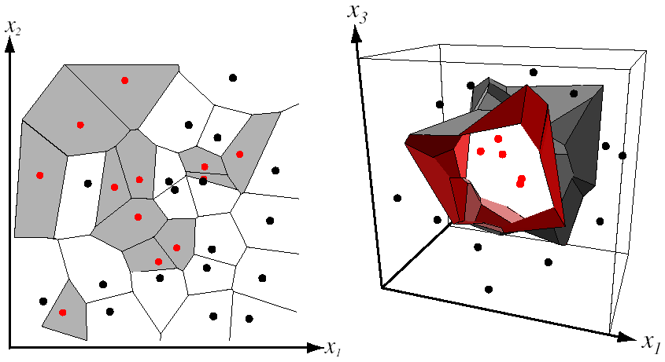
Nearest Neighbor Classifier
Assign label of nearest training data point to each test data point
from Duda et al.
Voronoi partitioning of feature space
for two-category 2D and 3D data
http://en.wikipedia.org/wiki/Voronoi_diagram
Source: D. Lowe

Slide 6
K-Nearest Neighbor Classifiers
Each Class is represented by several instances
Then determine how to assign a new instance to a class
Learning by Analogy:
Tell me who your friends are and I’ll tell you who you are. A new example is assigned to the most common class among the (K) examples that are most similar to it.

Slide 7
K-nearest neighbor
x
x
x
o
x
x
x
+
o
o
x
x
o
o
+
o
o
x2
x1

Slide 8

1-nearest neighbor
x
x
x
o
x
x
x
+
o
o
x
x
o
o
+
o
o
x2
x1

Slide 9
3-nearest neighbor
x
x
x
o
x
x
x
+
o
o
x
x
o
o
+
o
o
x2
x1

Slide 10
5-nearest neighbor
x
x
x
o
x
x
x
+
o
o
x
x
o
o
+
o
o
x2
x1

Slide 11
Linear Classifier
α
x
f
y^{est}
denotes +1
denotes -1
w x + b>0
f(x,w,b) = sign(w x + b)
w x + b=0
How would you classify this data?
w x + b<0

Slide 12
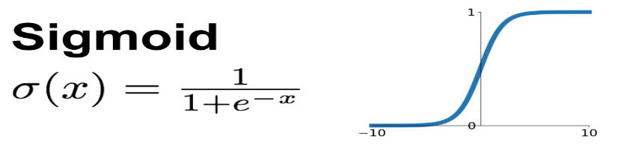
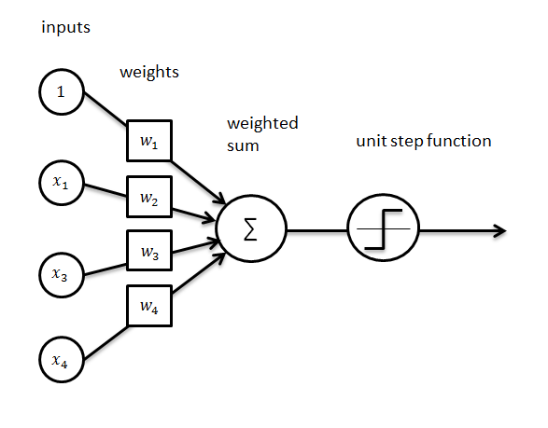
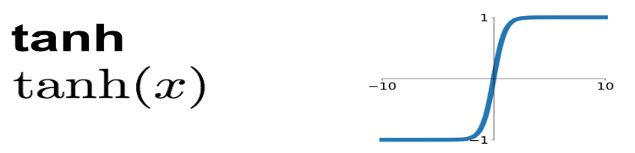
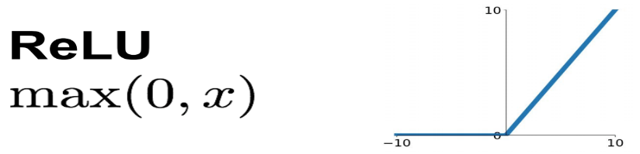
Linear Classifier
α
x
f
y^{est}
f(x,w,b) = sign(w x + b)

Slide 13
Linear Classifier
α
x
f
y^{est}
f(x,w,b) = sign(w x + b)
Linear Perceptron (Hinge loss)
Logistic regression (ML – or cross entropy loss)
Neural network (any loss function)
Linear regression (mean square error)

Slide 14

Single Layer – Single Node
Input
Weights
x₁
w₁
x₂
w₂
Output: g(w⋅x + b)
x₃
w₃
.
.
.
w_{D}
x_{D}

Slide 15
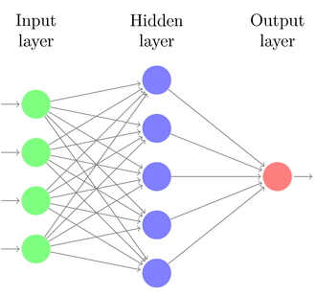







Single-Hidden Layer (Multi-nodes)

Slide 16
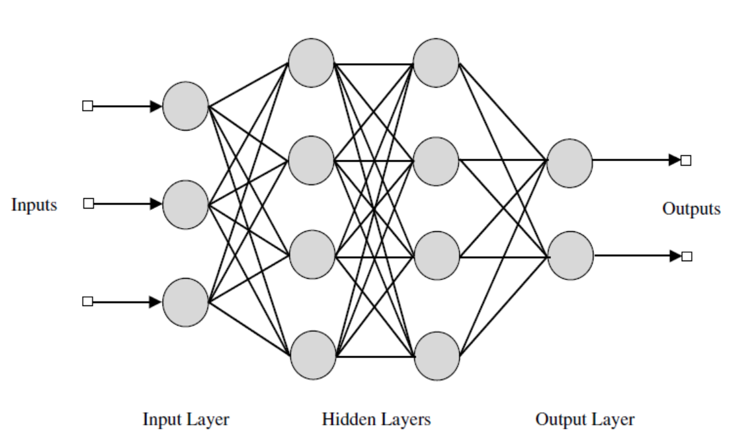
Two-Hidden Layer Neural Network
Neural network is a stack of Logistic regressions

Slide 17
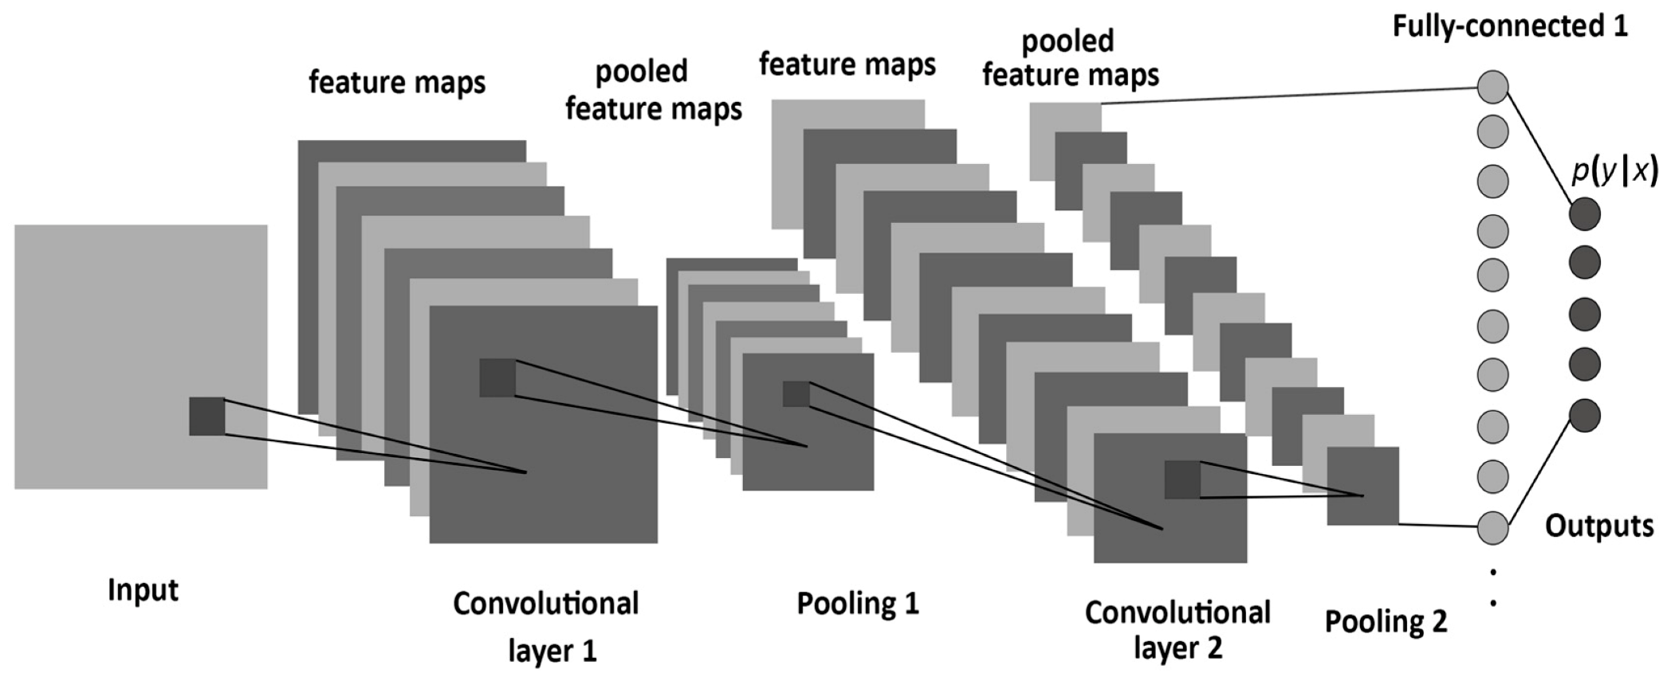
Neural Network (CNN)

Slide 18
From Linear Classifier to SVM

Slide 19
Linear Classifier - SVM
α
x
f
y^{est}
f(x,w,b) = sign(w x + b)
denotes +1
denotes -1
How would you classify this data?

Slide 20
Linear Classifier
α
x
f
y^{est}
f(x,w,b) = sign(w x + b)
denotes +1
denotes -1
How would you classify this data?

Slide 21
Linear Classifier
α
x
f
y^{est}
f(x,w,b) = sign(w x + b)
denotes +1
denotes -1
Any of these would be fine..
..but which is best?

Slide 22
Linear Classifier
α
x
f
y^{est}
f(x,w,b) = sign(w x + b)
denotes +1
denotes -1
How would you classify this data?
Misclassified
to +1 class

Slide 23
Classifier Margin
α
α
x
x
f
f
y^{est}
y^{est}
f(x,w,b) = sign(w x + b)
f(x,w,b) = sign(w x + b)
denotes +1
denotes -1
denotes +1
denotes -1
Define the margin of a linear classifier as the width that the boundary could be increased by before hitting a datapoint.
Define the margin of a linear classifier as the width that the boundary could be increased by before hitting a datapoint.

Slide 24
Maximum Margin
α
x
f
y^{est}
Maximizing the margin is good according to intuition and PAC theory
Implies that only support vectors are important; other training examples are ignorable.
Empirically it works very well.
f(x,w,b) = sign(w x + b)
denotes +1
denotes -1
The maximum margin linear classifier is the linear classifier with the, um, maximum margin.
This is the simplest kind of SVM (Called an Linear SVM)
Support Vectors are those datapoints that the margin pushes up against

Slide 25

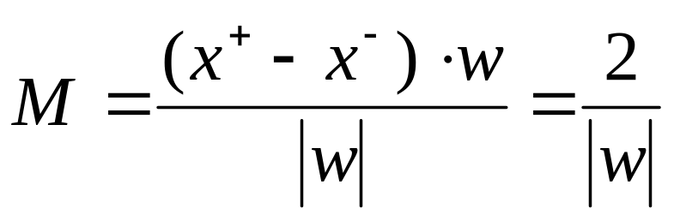
Linear SVM Mathematically
x⁺
M=Margin Width
“Predict Class = +1” zone
X⁻
wx+b=1
“Predict Class = -1” zone
wx+b=0
wx+b=-1
For support vectors,
What we know:
w . x⁺ + b = +1
w . x⁻ + b = -1
w . (x⁺-x⁻⁾ = 2

Slide 26
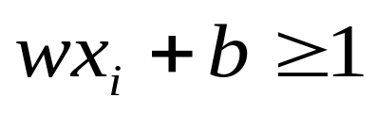
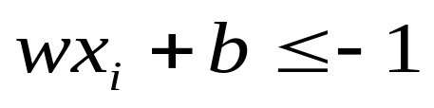
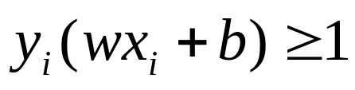
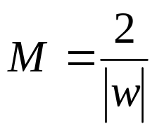
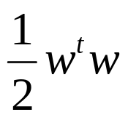
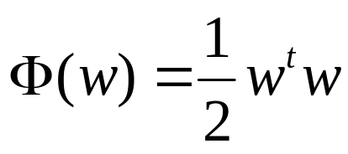


Linear SVM Mathematically
Goal: 1) Correctly classify all training data
if y_{i} = +1
if y_{i} = -1
for all i
2) Maximize the Margin
same as minimize
We can formulate a Quadratic Optimization Problem and solve for w and b
Minimize
subject to

Slide 27
Solving the Optimization Problem
Find w and b such that
Φ(w) =½ w^{T}w is minimized;
and for all {(x_{i} ,y_{i})}: y_{i} (w^{T}x_{i} + b) ≥ 1
Need to optimize a quadratic function subject to linear constraints.
Quadratic optimization problems are a well-known class of mathematical programming problems, and many (rather intricate) algorithms exist for solving them.
The solution involves constructing a dual problem where a Lagrange multiplier α_{i} is associated with every constraint in the primary problem:
Find α₁…α_{N} such that
Q(α) =Σα_{i} - ½ΣΣα_{i}α_{j}y_{i}y_{j}x_{i}^{T}x_{j} is maximized and
(1) Σα_{i}y_{i} = 0
(2) α_{i} ≥ 0 for all α_{i}

Slide 28
The Optimization Problem Solution
The solution has the form:
Each non-zero α_{i} indicates that corresponding x_{i} is a support vector.
Then the classifying function will have the form:
Notice that it relies on an inner product between the test point x and the support vectors x_{i} – we will return to this later.
Also keep in mind that solving the optimization problem involved computing the inner products x_{i}^{T}x_{j} between all pairs of training points.
w =Σα_{i}y_{i}x_{i} b= y_{k}- w^{T}x_{k} for any x_{k} such that α_{k}≠ 0
f(x) = Σα_{i}y_{i}x_{i}^{T}x + b

Slide 29
Dataset with noise
denotes +1
denotes -1
Hard Margin: So far we require all data points be classified correctly
- No training error
What if the training set is noisy?
- Solution 1: use very powerful kernels
OVERFITTING!

Slide 30
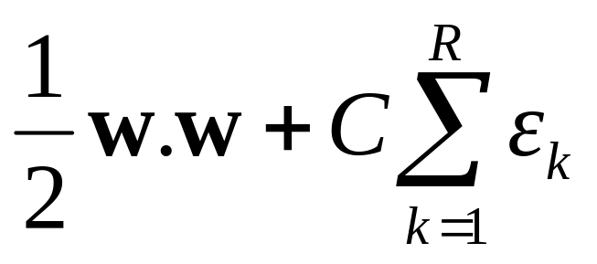
Soft Margin Classification
Slack variables ξi can be added to allow misclassification of difficult or noisy examples.
What should our quadratic optimization criterion be?
Minimize
ε₁₁
ε₂
wx+b=1
ε₇
wx+b=0
wx+b=-1

Slide 31
Hard Margin v.s. Soft Margin
The old formulation:
The new formulation incorporating slack variables:
Parameter C can be viewed as a way to control overfitting.
Find w and b such that
Φ(w) =½ w^{T}w is minimized and for all {(x_{i} ,y_{i})}
y_{i} (w^{T}x_{i} + b) ≥ 1
Find w and b such that
Φ(w) =½ w^{T}w + CΣξ_{i} is minimized and for all {(x_{i} ,y_{i})}
y_{i} (w^{T}x_{i} + b) ≥ 1- ξ_{i} and ξ_{i} ≥ 0 for all i

Slide 32
Linear SVMs: Overview
The classifier is a separating hyperplane.
Most “important” training points are support vectors; they define the hyperplane.
Quadratic optimization algorithms can identify which training points x_{i} are support vectors with non-zero Lagrangian multipliers α_{i}.
Both in the dual formulation of the problem and in the solution training points appear only inside dot products:
Find α₁…α_{N} such that
Q(α) =Σα_{i} - ½ΣΣα_{i}α_{j}y_{i}y_{j}x_{i}^{T}x_{j} is maximized and
(1) Σα_{i}y_{i} = 0
(2) 0 ≤ α_{i} ≤ C for all α_{i}
f(x) = Σα_{i}y_{i}x_{i}^{T}x + b

Slide 33
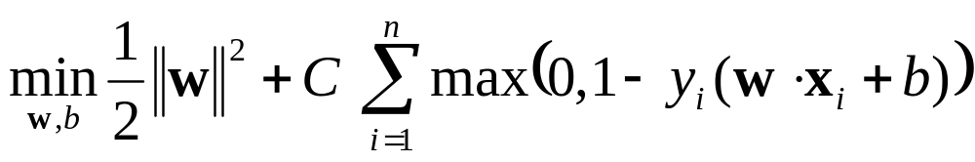
What if the data is not linearly separable?
Maximize margin
Minimize classification mistakes

Slide 34
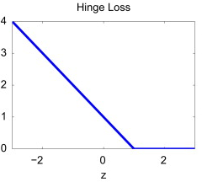
What if the data is not linearly separable?
+1
Margin
0
-1
Demo: http://cs.stanford.edu/people/karpathy/svmjs/demo

Slide 35
Nonlinear SVMs
Datasets that are linearly separable work out great:
But what if the dataset is just too hard?
We can map it to a higher-dimensional space:
0
x
0
x
x²
0
x
Slide credit: Andrew Moore

Slide 36
Nonlinear SVMs
General idea: the original input space can always be mapped to some higher-dimensional feature space where the training set is linearly separable:
Φ: x → φ(x)
Slide credit: Andrew Moore

Slide 37
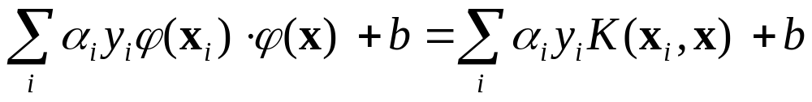
Nonlinear SVMs
The kernel trick: instead of explicitly computing the lifting transformation φ(x), define a kernel function K such that
K(x , y) = φ(x) · φ(y)
(to be valid, the kernel function must satisfy Mercer’s condition)
This gives a nonlinear decision boundary in the original feature space:
C. Burges, A Tutorial on Support Vector Machines for Pattern Recognition, Data Mining and Knowledge Discovery, 1998

Slide 38
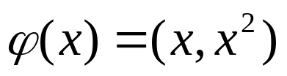
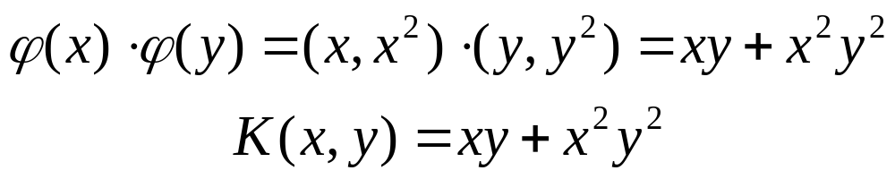
Nonlinear kernel: Example
Consider the mapping
x²

Slide 39
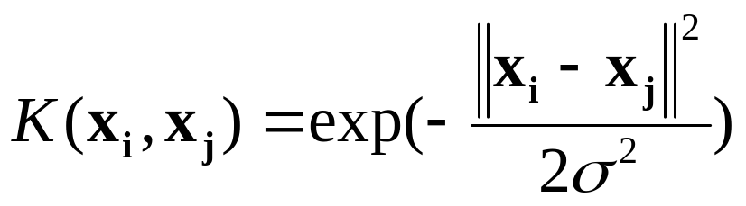
Commonly Used Kernel Functions
Linear: K(x_{i},x_{j})= x_{i} ^{T}x_{j}
Polynomial of power p: K(x_{i},x_{j})= (c+ x_{i} ^{T}x_{j})^{p}
Gaussian (radial-basis function network):
Sigmod: K(x_{i},x_{j})= tanh(β₀x_{i} ^{T}x_{j} + β₁)

Slide 40
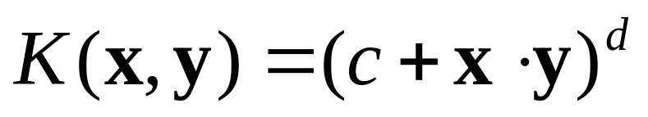
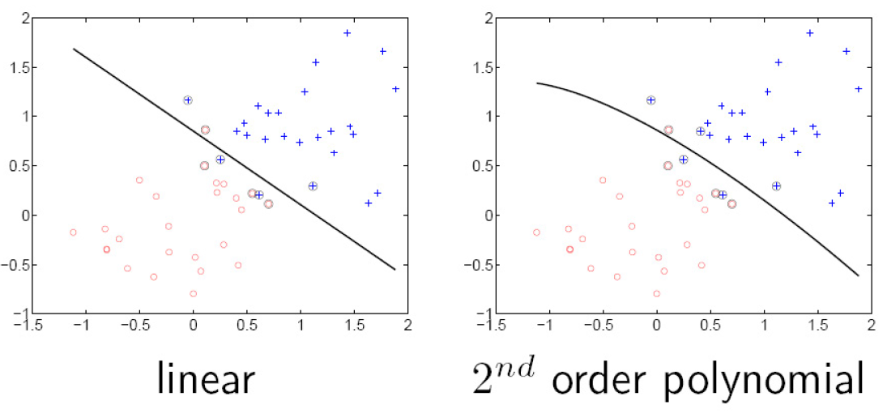
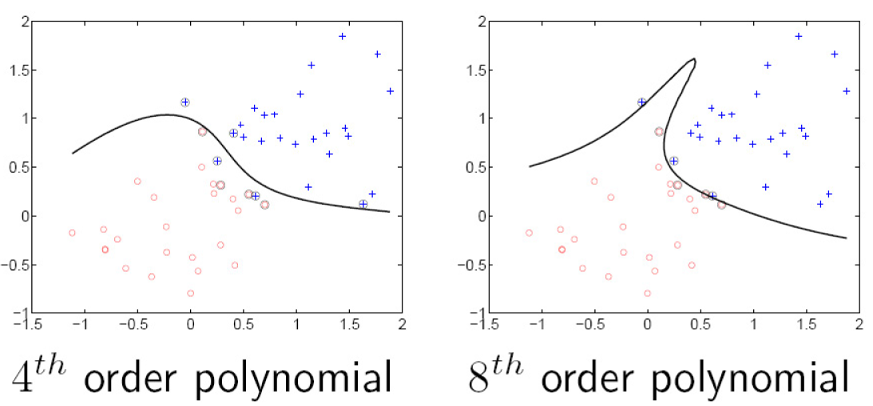
Polynomial Kernel:

Slide 41
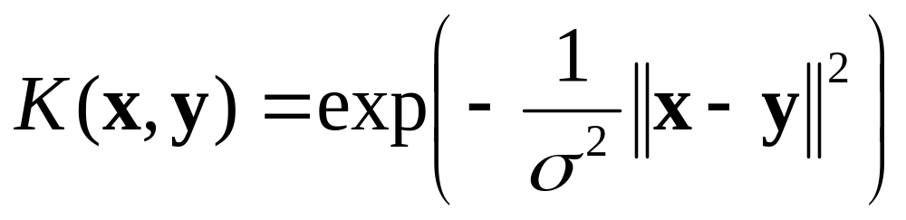
Gaussian kernel
Also known as the radial basis function (RBF) kernel:
The corresponding mapping φ(x) is infinite-dimensional!

Slide 42
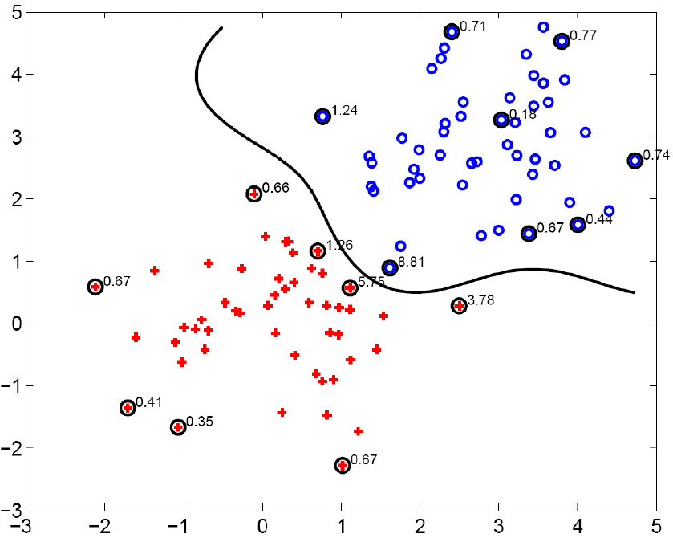
Gaussian kernel
SV’s

Slide 43
Gaussian kernel
Also known as the radial basis function (RBF) kernel:
The corresponding mapping φ(x) is infinite-dimensional!
What is the role of parameter σ?
  What if σ is close to zero?
  What if σ is very large?

Slide 44
Summary: SVMs for classification
Construct an data representation (usually each data point is represented by a vector).
Try Linear SVM first for classification.
Pick a kernel function for that representation
Compute the matrix of kernel values between every pair of training examples
Feed the kernel matrix into your favorite SVM solver to obtain support vectors and weights.
At test time: compute kernel values for your test example and each support vector, and combine them with the learned weights to get the value of the decision function

Slide 45
What about multi-class SVMs?
There are “definitive” multi-class SVM formulation presented in K. Crammer and Y. Singer. On the Algorithmic Implementation of Multi-class SVMs, JMLR, 2001., but not commonly used.
In practice, we usually obtain a multi-class SVM by combining multiple two-class SVMs
One vs. others
  Training: learn an SVM for each class vs. the others
  Testing: apply each SVM to test example and assign to it the class of the SVM that returns the highest decision value
One vs. one
  Training: learn an SVM for each pair of classes
  Testing: each learned SVM “votes” for a class to assign to the test example

Slide 46
Kernel SVMs: Pros and cons
Pros
  Many publicly available SVM packages:
  http://www.kernel-machines.org/software
  Kernel-based framework is very powerful, flexible
  SVMs work very well in practice, even with very small training sample sizes
Cons (for Kernel base SVM)
  Computation, memory
    During training time, must compute matrix of kernel values for every pair of examples
    Learning can take a very long time for large-scale problems
Now there is a LIBLINEAR package to address the large scale problems

Slide 47
SVMs for large-scale datasets
Efficient linear solvers
  LIBLINEAR,
Explicit approximate embeddings: define an explicit mapping φ(x) such that φ(x) · φ(y) approximates K(x , y) and train a linear SVM on top of that embedding
  Random Fourier features for the Gaussian kernel
  (Rahimi and Recht, 2007)
  Embeddings for additive kernels, e.g., histogram intersection (Maji et al., 2013, Vedaldi and Zisserman, 2012)

Slide 48
SVMs Software
Two most popular ones:
  LibSVM (C++) used in our Lab
  SVMLight (c language)
Others:
  Torch (c++1)
  Spider (Matlab)
  Weka (Java)
All of those softwares available through: kernel-machines.org

Slide 49
Summary: Classifiers
Linear classifiers
Support vector machines
  Margin maximization
  Linear SVM
  Non-separable case
  The kernel trick
  Multi-class SVMs
  Large-scale SVMs
Of course, there are many other classifiers out there
  Neural networks, boosting, decision trees/forests, …

