Slide 1
基本指令流水线
流水线的基本概念
RISC指令流水线
数据冒险与控制冒险
精确中断的实现
多周期操作与深度流水线
动态调度之记分板
Notes:
Review today, not so fast in future

Slide 2
Pipelining: Its Natural!
Laundry Example
Ann, Brian, Cathy, Dave each have one load of clothes to wash, dry, and fold
Washer takes 30 minutes
Dryer takes 40 minutes
Folder takes 20 minutes
A
B
C
D

Slide 3
Sequential Laundry
6 PM
7
8
9
10
11
Midnight
Time
30
40
20
30
40
20
30
40
20
30
40
20
T
a
s
k
O
r
d
e
r
A
B
C
D
Sequential laundry takes 6 hours for 4 loads
If they learned pipelining, how long would laundry take?

Slide 4
Pipelined Laundry：Start work ASAP
6 PM
7
8
9
10
11
Midnight
Time
30
40
40
40
40
20
T
a
s
k
O
r
d
e
r
A
并发、时间重叠、同期
Overlap in time, concurrent
B
C
D
Pipelined laundry takes 3.5 hours for 4 loads

Slide 5
Another Laundry：More Investment
6 PM
7
8
9
10
11
Midnight
Time
30
40
20
T
a
s
k
O
r
d
e
r
A
真并行、空间重复、同时
Duplicate in space
Simultaneous
B
C
D
Parallel laundry takes 1.5 hours for 4 loads

Slide 6
Pipelining Lessons
6 PM
7
8
9
Pipelining doesn’t help latency of single task, it helps throughput of entire workload
Pipeline rate limited by slowest pipeline stage
Multiple tasks operating simultaneously
Potential speedup = Number of pipe stages
Unbalanced lengths of pipe stages reduces speedup
Time
T
a
s
k
O
r
d
e
r
30
40
40
40
40
20
A
B
C
D
Time to fill pipeline and time to drain it reduces speedup

Slide 7
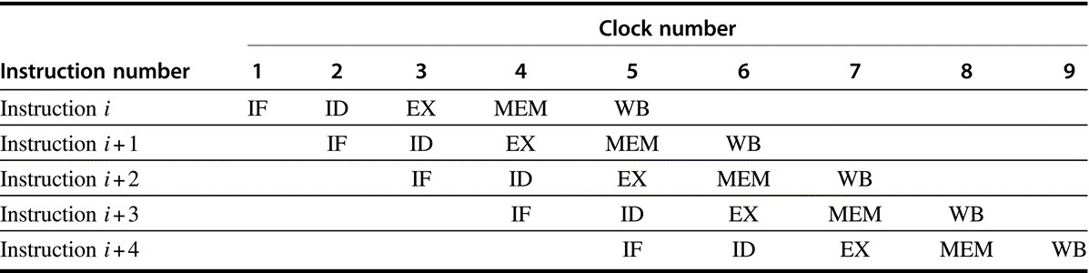
Computer Pipelines
Execute billions of instructions, so throughput is what matters
What is desirable in instruction sets for pipelining?
Variable length instructions vs. all instructions same length?
Memory operands part of any operation vs. memory operands only in loads or stores?
Register operand many places in instruction format vs. registers located in same place?

Slide 8
A "Typical" RISC
32-bit fixed format instruction (3 formats)
Memory access only via load/store instrutions
32 32-bit GPR (R0 contains zero, DP take pair)
3-address, reg-reg arithmetic instruction; registers in same place
Single address mode for load/store: base + displacement
no indirection
Simple branch conditions
see: SPARC, MIPS, HP PA-Risc, DEC Alpha, IBM PowerPC, RISC-V
CDC 6600, CDC 7600, Cray-1, Cray-2, Cray-3

Slide 9
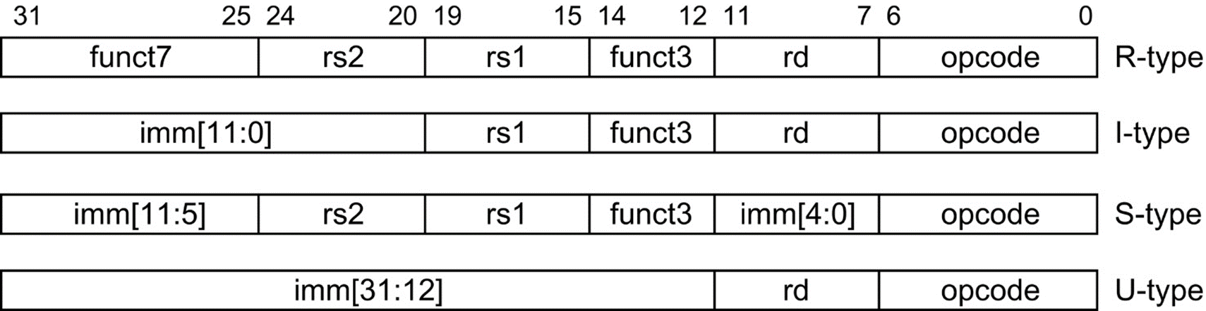
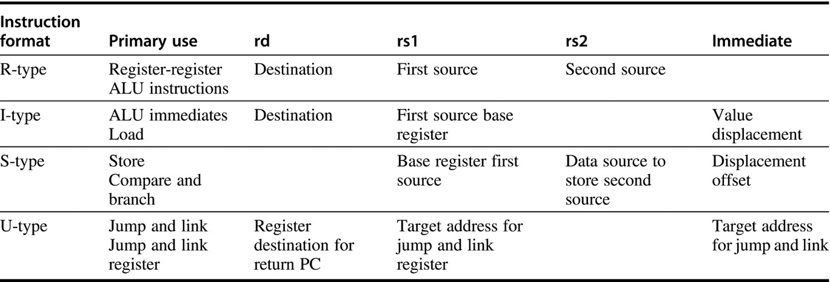
RISC-V Note register location

Slide 10
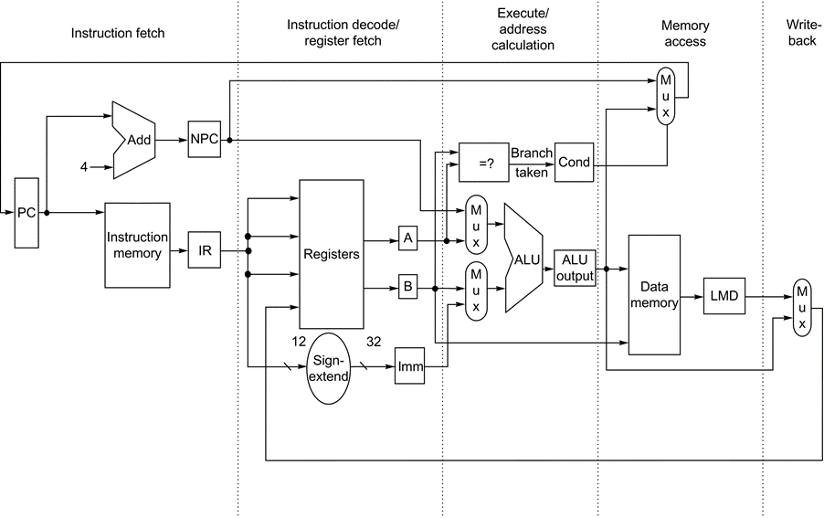
The implementation of the simple RISC V integer data path
Notes:
Although the PC is shown in the portion of the data path that is used in instruction fetch and the registers are shown in the portion of the data path that is used in instruction decode/register fetch, both of these functional units are read as well as written by an instruction. Although we show these functional units in the cycle corresponding to where they are read, the PC is written during the memory access clock cycle and the registers are written during the write-back clock cycle. In both cases, the writes in later pipe stages are indicated by the multiplexer output (in memory access or write-back), which carries a value back to the PC or registers. These backward-flowing signals introduce much of the complexity of pipelining, because they indicate the possibility of hazards.

Slide 11
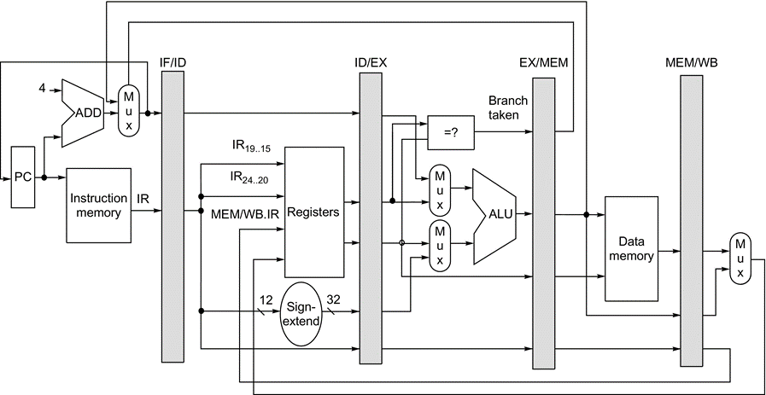
The data path is pipelined by adding a set of registers
Notes:
The registers serve to convey values and control information from one stage to the next. We can also think of the PC as a pipeline register, which sits before the IF stage of the pipeline, leading to one pipeline register for each pipe stage. Recall that the PC is an edge-triggered register written at the end of the clock cycle; hence, there is no race condition in writing the PC. The selection multiplexer for the PC has been moved so that the PC is written in exactly one stage (IF). If we didn’t move it, there would be a conflict when a branch occurred, because two instructions would try to write different values into the PC. Most of the data paths flow from left to right, which is from earlier in time to later. The paths flowing from right to left (which carry the register write-back information and PC information on a branch) introduce complications into our pipeline.

Slide 12
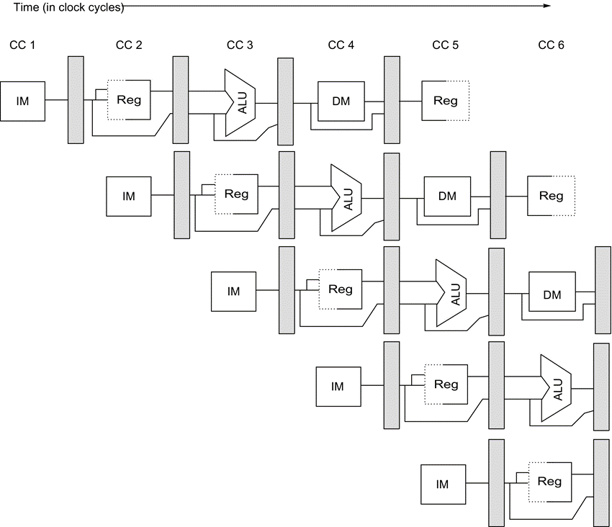
Pipeline registers between successive pipeline stages
The registers prevent interference between two different instructions in adjacent stages in the pipeline
The registers also play the critical role of carrying data for a given instruction from one stage to the other
The edge-triggered property of registers is critical
the values change instantaneously on a clock
Otherwise, the data from one instruction could interfere with the execution of another

Slide 13
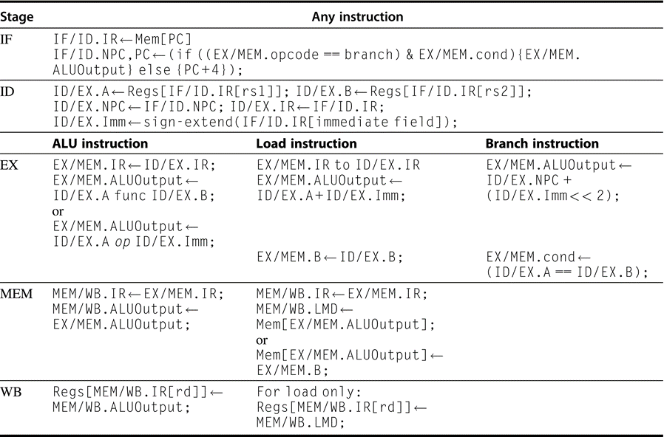
Events on every pipe stage of the RISC V pipeline
IF: Next PC
ID: Read register sign extension
EX
ALU arithmetic
Mem Address Calc
Branch addr Calc
MEM: access Mem
WB: Write register
Notes:
. Let’s review the actions in the stages that are specific to the pipeline organization. In IF, in addition to fetching the instruction and computing the new PC, we store the incremented PC both into the PC and into a pipeline register (NPC) for later use in computing the branch-target address. This structure is the same as the organization in Figure C.19, where the PC is updated in IF from one of two sources. In ID, we fetch the registers, extend the sign of the 12 bits of the IR (the immediate field), and pass along the IR and NPC. During EX, we perform an ALU operation or an address calculation; we pass along the IR and the B register (if the instruction is a store). We also set the value of cond to 1 if the instruction is a taken branch. During the MEM phase, we cycle the memory, write the PC if needed, and pass along values needed in the final pipe stage. Finally, during WB, we update the register field from either the ALU output or the loaded value. For simplicity we always pass the entire IR from one stage to the next, although as an instruction proceeds down the pipeline, less and less of the IR is needed.

Slide 14
Visualizing Pipelining: as a series of data paths shifted in time
在第5周期，流水线进入稳定状态
ID读寄存器，WB写寄存器，故Reg在同个周期要用两次
读在上半周期
写在下半周期
存储器呢？
IF要用
MEM也要用
Time (clock cycles)
Cycle 1
Cycle 2
Cycle 3
Cycle 4
Cycle 5
Cycle 6
Cycle 7
Cycle 8
I
n
s
t
r.
O
r
d
e
r
Ifetch
Reg
ALU
DMem
Reg
Ifetch
Reg
ALU
DMem
Reg
Ifetch
Reg
ALU
DMem
Reg
Ifetch
Reg
ALU
DMem
Reg
Ifetch
Reg
ALU
DMem
Reg

Slide 15
Its Not That Easy for Computers
Limits to pipelining: Hazards prevent next instruction from executing during its designated clock cycle
Structural hazards: HW cannot support this combination of instructions (single person to fold and put clothes away)
Data hazards: Instruction depends on result of prior instruction still in the pipeline (missing sock)
Control hazards: Pipelining of branches & other instructions
Common solution is to stall the pipeline until the hazard bubbles? in the pipeline

Slide 16
One Memory Port/Structural Hazards
Time (clock cycles)
Cycle 1
Cycle 2
Cycle 3
Cycle 4
Cycle 5
Cycle 6
Cycle 7
I
n
s
t
r.
O
r
d
e
r
Load
Ifetch
Reg
ALU
DMem
Reg
Instr 1
Ifetch
Reg
ALU
DMem
Reg
Instr 2
Ifetch
Reg
ALU
DMem
Reg
Instr 3
Ifetch
Reg
ALU
DMem
Reg
Instr 4
Ifetch
Reg
ALU
DMem
Reg

Slide 17
One Memory Port/Structural Hazards
Time (clock cycles)
Cycle 1
Cycle 2
Cycle 3
Cycle 4
Cycle 5
Cycle 6
Cycle 7
I
n
s
t
r.
O
r
d
e
r
Load
Ifetch
Reg
ALU
DMem
Reg
Instr 1
Ifetch
Reg
ALU
DMem
Reg
Instr 2
Ifetch
Reg
ALU
DMem
Reg
Stall
Bubble
Bubble
Bubble
Bubble
Bubble
Instr 3
Ifetch
Reg
ALU
DMem
Reg

Slide 18
Speed Up Equation for Pipelining
CPI_{pipelined} = Ideal CPI + Pipeline stall clock cycles per instr
Speedup = Ideal CPI x Pipeline depth Clock Cycle_{unpipelined}
Ideal CPI + Pipeline stall CPI Clock Cycle_{pipelined}
Speedup = Pipeline depth Clock Cycle_{unpipelined}
1 + Pipeline stall CPI Clock Cycle_{pipelined}
x
x

Slide 19
Example: Dual-port vs. Single-port
Machine A: Dual ported memory
Machine B: Single ported memory, but its pipelined implementation has a 1.05 times faster clock rate
Ideal CPI = 1 for both
Loads are 40% of instructions executed
SpeedUp_{A} = Pipeline Depth/(1 + 0) x (clock_{unpipe}/clock_{pipe})
= Pipeline Depth
SpeedUp_{B} = Pipeline Depth/(1 + 0.4 x 1) x (clock_{unpipe}/(clock_{unpipe} / 1.05)
= (Pipeline Depth/1.4) x 1.05
= 0.75 x Pipeline Depth
SpeedUp_{A} / SpeedUp_{B} = Pipeline Depth/(0.75 x Pipeline Depth) = 1.33
Machine A is 1.33 times faster

Slide 20
Data Hazard on R1
Time (clock cycles)
IF
ID/RF
EX
MEM
WB
The use of the result of the add instruction in the next three instructions causes a hazard, because the register is not written until after those instructions read it
I
n
s
t
r.
O
r
d
e
r
add r1,r2,r3
Reg
Ifetch
Reg
ALU
DMem
sub r4,r1,r3
Ifetch
Reg
ALU
DMem
Reg
and r6,r1,r7
Ifetch
Reg
ALU
DMem
Reg
or r8,r1,r9
Ifetch
Reg
ALU
DMem
Reg
xor r10,r1,r11
Ifetch
Reg
ALU
DMem
Reg

Slide 21
Three Generic Data Hazards
Read After Write (RAW) Instr_{J} tries to read operand before Instr_{I} writes it Caused by a “Dependence” (in compiler nomenclature) 依赖、相关
This hazard results from an actual need for data communication
I: add r1,r2,r3
J: sub r4,r1,r3

Slide 22
Three Generic Data Hazards
Write After Read (WAR) Instr_{J} writes operand before Instr_{I} reads it
Called an “anti-dependence” by compiler writers，反依赖 This results from reuse of the name “r1”.
Can’t happen in MIPS 5 stage pipeline because:
All instructions take 5 stages, and
Reads are always in stage 2, and
Writes are always in stage 5
I: sub r4,r1,r3
J: add r1,r2,r3
K: mul r6,r1,r7

Slide 23
Three Generic Data Hazards
Write After Write (WAW) Instr_{J} writes operand before Instr_{I} writes it.
Called an “output dependence” by compiler writers This also results from the reuse of name “r1”.
Can’t happen in MIPS 5 stage pipeline because:
All instructions take 5 stages, and
Writes are always in stage 5
Will see WAR and WAW in later more complicated pipes
I: sub r1,r4,r3
J: add r1,r2,r3
K: mul r6,r1,r7

Slide 24
Forwarding to Avoid Data Hazard
The inputs for the sub and and instructions forward from the pipeline registers to the first ALU input. The or receives its result by forwarding through the register file. Notice that the forwarded result can go to either ALU input
Time (clock cycles)
I
n
s
t
r.
O
r
d
e
r
add r1,r2,r3
Ifetch
Reg
ALU
DMem
Reg
sub r4,r1,r3
Ifetch
Reg
ALU
DMem
Reg
and r6,r1,r7
Ifetch
Reg
ALU
DMem
Reg
or r8,r1,r9
Ifetch
Reg
ALU
DMem
Reg
xor r10,r1,r11
Ifetch
Reg
ALU
DMem
Reg

Slide 25
Data Hazard Even with Forwarding
Time (clock cycles)
I
n
s
t
r.
O
r
d
e
r
lw r1, 0(r2)
Ifetch
Reg
ALU
DMem
Reg
sub r4,r1,r6
Ifetch
Reg
ALU
DMem
Reg
and r6,r1,r7
Ifetch
Reg
ALU
DMem
Reg
or r8,r1,r9
Ifetch
Reg
ALU
DMem
Reg
The load instruction can bypass its results to the and and or instructions, but not to the sub, because that would mean forwarding the result in “negative time.”
Notes:
MIPS actutally didn’t interlecok: MPU without Interlocked Pipelined Stages

Slide 26
Data Hazard Even with Forwarding
Time (clock cycles)
I
n
s
t
r.
O
r
d
e
r
lw r1, 0(r2)
Ifetch
Reg
ALU
DMem
Reg
Bubble
sub r4,r1,r6
Ifetch
Reg
ALU
DMem
Reg
Bubble
and r6,r1,r7
Ifetch
Reg
ALU
DMem
Reg
Bubble
or r8,r1,r9
Ifetch
Reg
ALU
DMem

Slide 27
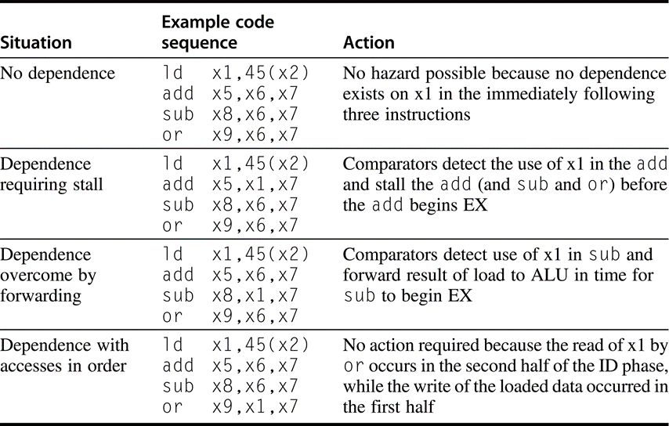
Hazard detection by comparing the dest and sour registers of adjacent instructions
Notes:
This table indicates that the only comparison needed is between the destination and the sources on the two instructions following the instruction that wrote the destination. In the case of a stall, the pipeline dependences will look like the third case once execution continues (dependence overcome by forwarding). Of course, hazards that involve x0 can be ignored because the register always contains 0, and the preceding test could be extended to do this.

Slide 28
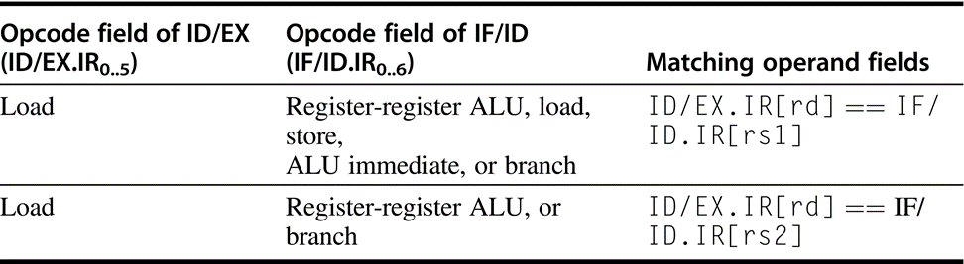
Logic to detect the need for load interlocks
During the ID stage of an instruction, requires two comparisons, one for each possible source.
Remember that the IF/ID register holds the state of the instruction in ID, which potentially uses the load result, while ID/EX holds the state of the instruction in EX, which is the load instruction

Slide 29
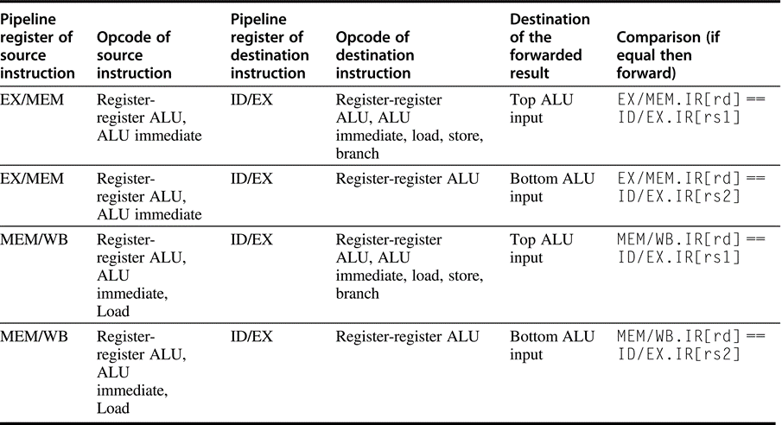
Forwarding of data to the two ALU inputs
Notes:
Forwarding of data to the two ALU inputs (for the instruction in EX) can occur from the ALU result (in EX/MEM or in MEM/WB) or from the load result in MEM/WB. There are 10 separate comparisons needed to tell whether a forwarding operation should occur. The top and bottom ALU inputs refer to the inputs corresponding to the first and second ALU source operands, respectively, and are shown explicitly in Figure C.18 on page C.30 and in Figure C.24 on page C.36. Remember that the pipeline latch for destination instruction in EX is ID/EX, while the source values come from the ALUOutput portion of EX/MEM or MEM/WB or the LMD portion of MEM/WB. There is one complication not addressed by this logic: dealing with multiple instructions that write the same register. For example, during the code sequence add x1, x2, x3; addi x1, x1, 2; sub x4, x3, x1, the logic must ensure that the sub instruction uses the result of the addi instruction rather than the result of the add instruction. The logic shown here can be extended to handle this case by simply testing that forwarding from MEM/WB is enabled only when forwarding from EX/MEM is not enabled for the same input. Because the addi result will be in EX/MEM, it will be forwarded, rather than the add result in MEM/WB.

Slide 30
HW Change for Forwarding of ALUinputs
NextPC
ID/EX
EX/MEM
MEM/WR
mux
Registers
ALU
Data
Memory
mux
mux
Immediate

Slide 31
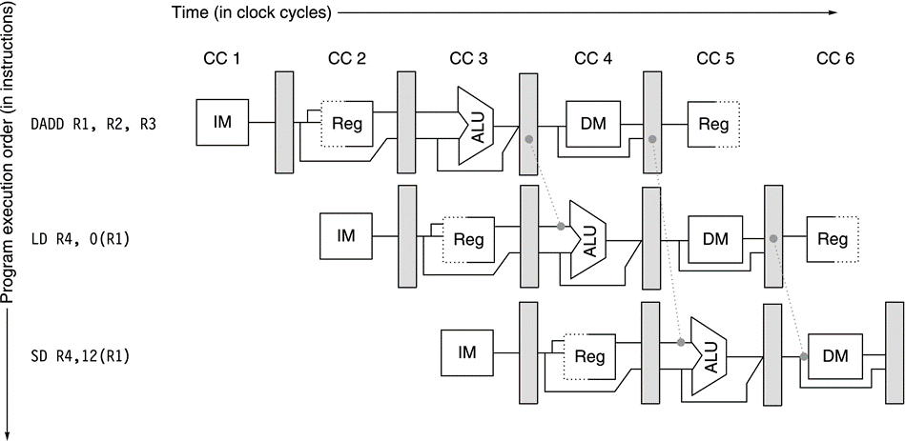
Forwarding of operand required by stores during MEM
The result of the load is forwarded from the memory output to the memory input to be stored
In addition, the ALU output is forwarded to the ALU input for the address calculation of both the load and the store.
If the store depended on an immediately preceding ALU operation (not shown herein), the result would need to be forwarded to prevent a stall.

Slide 32
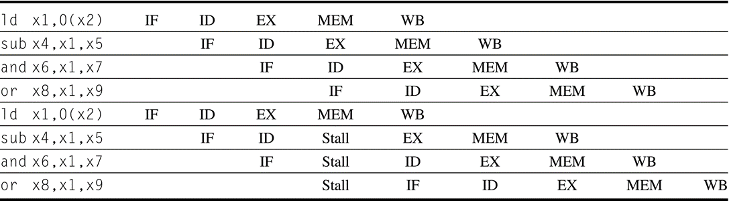
Memory Stall
In the top half, we can see why a stall is needed: the MEM cycle of the load produces a value that is needed in the EX cycle of the sub, which occurs at the same time
This problem is solved by inserting a stall, as shown in the bottom half

Slide 33
Software Scheduling to Avoid Load Hazards
Try producing fast code for
a = b + c;
d = e - f;
assuming a, b, c, d ,e, and f in memory.
Slow code:
LW Rb,b
LW Rc,c
ADD Ra,Rb, Rc
SW a,Ra
LW Re,e
LW Rf,f
SUB Rd,Re,Rf
SW d,Rd
Fast code:
LW Rb,b
LW Rc,c
LW Re,e
ADD Ra,Rb,Rc
LW Rf,f
SW a,Ra
SUB Rd,Re,Rf
SW d,Rd

Slide 34
Control Hazard on Branches Three Stage Stall
10: beq r1,r3,36
Ifetch
Reg
ALU
DMem
Reg
14: and r2,r3,r5
Ifetch
Reg
ALU
DMem
Reg
18: or r6,r1,r7
Ifetch
Reg
ALU
DMem
Reg
22: add r8,r1,r9
Ifetch
Reg
ALU
DMem
Reg
36: xor r10,r1,r11
Ifetch
Reg
ALU
DMem
Reg
原因：在EX阶段比较转移条件，并计算分支地址；MEM阶段送回新PC

Slide 35
5 Steps of Pipelined MIPS Datapath
Instruction
Fetch
Instr. Decode
Reg. Fetch
Execute
Addr. Calc
Memory
Access
Write
Back
Next PC
IF/ID
ID/EX
EX/MEM
MUX
MEM/WB
Next SEQ PC
Next SEQ PC
Adder
4
Zero?
RS1
Reg File
Address
MUX
Memory
RS2
ALU
Data
Memory
MUX
MUX
Sign
Extend
Imm
WB Data
RD
RD
RD
Data stationary control
local decode for each instruction phase / pipeline stage

Slide 36
Branch Stall Impact
If CPI = 1, 30% branch, Stall 3 cycles => new CPI = 1.9!
Two part solution:
Determine branch taken or not sooner, AND
Compute taken branch address earlier
Simple branch test: if register = 0 or not 0
The Solution:
Move Zero test to ID/RF stage
Use another adder to calculate new PC in ID/RF stage
1 clock cycle penalty for branch versus 3

Slide 37
MIPS Pipeline with one branch stall
Instruction
Fetch
Instr. Decode
Reg. Fetch
Execute
Addr. Calc
Memory
Access
Write
Back
Next PC
Next SEQ PC
ID/EX
EX/MEM
MEM/WB
MUX
IF/ID
Adder
Adder
4
Zero?
RS1
Address
Reg File
Memory
RS2
ALU
Data
Memory
MUX
MUX
Sign
Extend
Imm
WB Data
RD
RD
RD
Data stationary control
local decode for each instruction phase / pipeline stage

Slide 38
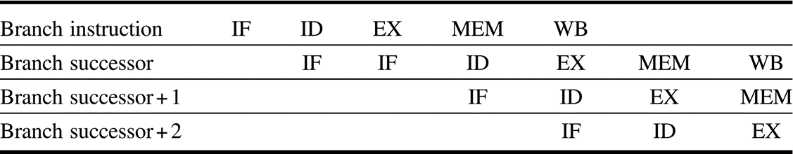
A branch causes a one-cycle stall in the five-stage pipeline
The instruction after the branch is fetched, but the instruction is ignored, and the fetch is restarted once the branch target is known. It is probably obvious that if the branch is not taken, the second IF for branch successor is redundant

Slide 39
Compare in ID brings new hazard
10: and r3,r2,r5
Ifetch
Reg
ALU
DMem
Reg
14: beq r1,r3,36
Ifetch
Reg
ALU
DMem
Reg
18: or r6,r1,r7
Ifetch
Reg
ALU
DMem
Reg
22: add r8,r1,r9
Ifetch
Reg
ALU
DMem
Reg
36: xor r10,r1,r11
Ifetch
Reg
ALU
DMem
Reg
An ALU operation to a register followed by a conditional branch based on that register leads to a data hazard.

Slide 40
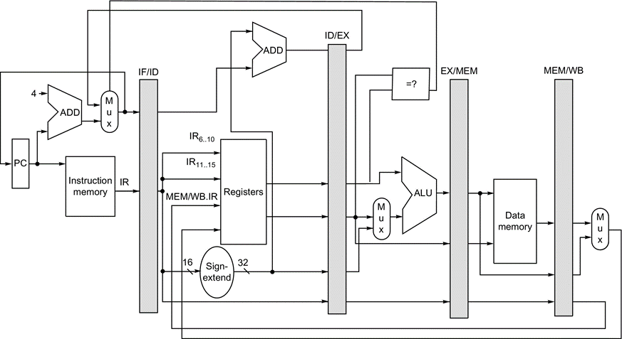
RISC-V Do conditional test in EX
Increase branch delay to 2 cycles

Slide 41
Four Branch Hazard Alternatives
#1: Stall or flush the pipeline until branch direction is clear
#2: Predict Branch Not Taken
Execute successor instructions in sequence
Squash the instructions in pipeline if branch actually taken
Advantage of late pipeline state update
47% branches not taken on average
PC+4 already calculated, so use it to get next instruction
#3: Predict Branch Taken
53% branches taken on average
But haven’t calculated branch target address
Still incurs 1 cycle branch penalty
Other machines: branch target known before outcome

Slide 42
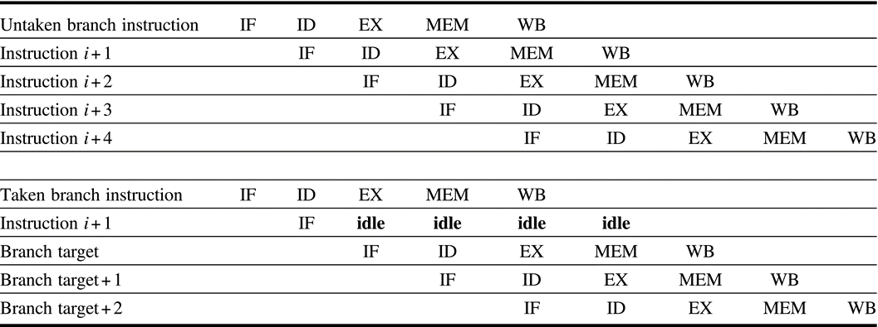
The predicted-not-taken scheme
The pipeline sequence when the branch is untaken (top) and taken (bottom)
When the branch is untaken, determined during ID, we fetch the fall-through and just continue.
If the branch is taken during ID, we restart the fetch at the branch target. This causes all instructions following the branch to stall 1 clock cycle.

Slide 43
Four Branch Hazard Alternatives
#4: Delayed Branch
Define branch to take place AFTER a following instruction branch instruction sequential successor_1 sequential successor_2 ........ sequential successor_n
branch target if taken
1 slot delay allows proper decision of the branch target address in 5 stage pipeline
MIPS uses this
Branch delay of length n
n maybe # of branch stall

Slide 44
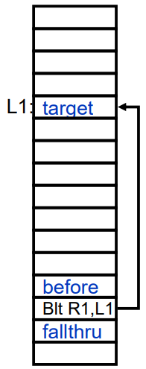
Delayed Branch
Where to get instructions to fill branch delay slot?
Before branch instruction
From the target address: only valuable when branch taken
From fall through: only valuable when branch not taken
Compiler effectiveness for single branch delay slot:
Fills about 60% of branch delay slots
About 80% of instructions executed in branch delay slots useful in computation
About 50% (60% x 80%) of slots usefully filled
Delayed Branch downside: 7-8 stage pipelines, multiple instructions issued per clock (superscalar)

Slide 45
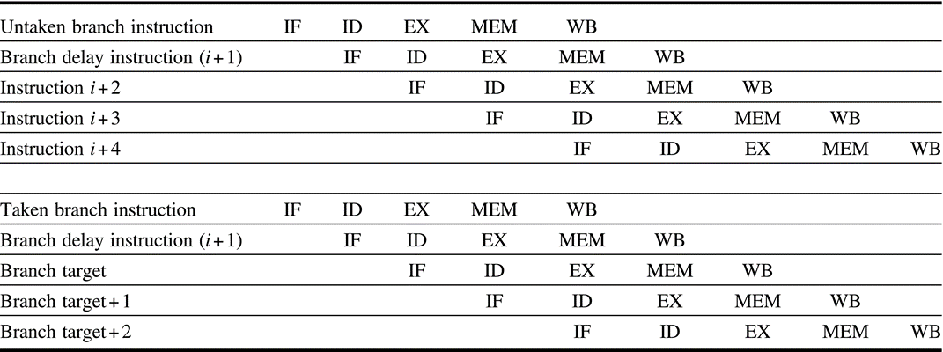
The behavior of a delayed branch
When the instruction in the branch delay slot is also a branch, the meaning is unclear
Because of this confusion, architectures with delay branches often disallow putting a branch in the delay slot

Slide 46
Evaluating Branch Alternatives
Scheduling Branch CPI speedup v. speedup v.
scheme penalty unpipelined stall
Stall pipeline 3 1.42 3.5 1.0
Predict taken 1 1.14 4.4 1.26
Predict not taken 1 1.09 4.5 1.29
Delayed branch 0.5 1.07 4.6 1.31
Conditional & Unconditional = 14%, 65% change PC

Slide 47

When is pipelining hard?
Interrupts: 5 instructions executing in 5 stage pipeline
How to stop the pipeline? How to restart the pipeline?
Who caused the interrupt?
Possible interrupt sources in pipeline stages
IF: Page fault on instruction fetch; misaligned memory access; memory protection violation
ID: Undefined or illegal opcode (instruction)
Ex: Arithmetic exceptions
MEM: Page fault on data fetch; misaligned memory access; memory protection violation
Load with data page fault, and Add with instruction page fault?
Solution 1: interrupt vector/instruction, check last stage
Solution 2: interrupt ASAP, restart everything incomplete

Slide 48


Exceptions and Interrupts

Slide 49
Example: Device Interrupt (Say, arrival of network message)
Raise priority
Reenable All Ints
Save registers
…
lw r1,20(r0)
lw r2,0(r1)
addi r3,r0,#5
sw 0(r1),r3
…
Restore registers
Clear current Int
Disable All Ints
Restore priority
RTE
PC saved
Disable All Ints
Supervisor Mode
…
add r1,r2,r3
subi r4,r1,#4
slli r4,r4,#2
Hiccup(!)
lw r2,0(r4)
lw r3,4(r4)
add r2,r2,r3
sw 8(r4),r2
…
External Interrupt
“Interrupt Handler”
Restore PC
User Mode

Slide 50
Alternative: Polling (again, for arrival of network message)
Disable Network Intr
…
subi r4,r1,#4
slli r4,r4,#2
lw r2,0(r4)
lw r3,4(r4)
add r2,r2,r3
sw 8(r4),r2
lw r1,12(r0)
beq r1,no_mess
lw r1,20(r0)
lw r2,0(r1)
addi r3,r0,#5
sw 0(r1),r3
Clear Network Intr
…
External Interrupt
Polling Point
(check device register)
“Handler”
no_mess:

Slide 51
Polling is faster/slower than Interrupts
Polling is faster than interrupts because
Compiler knows which registers in use at polling point. Hence, do not need to save and restore registers (or not as many).
Other interrupt overhead avoided (pipeline flush, trap priorities, etc).
Polling is slower than interrupts because
Overhead of polling instructions is incurred regardless of whether or not handler is run. This could add to inner-loop delay.
Device may have to wait for service for a long time.
When to use one or the other? A multi-axis tradeoff:
Frequent/regular events good for polling, as long as device can be controlled at user level.
Interrupts good for infrequent/irregular events
Interrupts good for ensuring regular/predictable service of events.

Slide 52
Exception/Interrupt classifications
Exceptions: relevant to the current process
Faults, arithmetic traps, and synchronous traps
Invoke software on behalf of the currently executing process
Interrupts: caused by asynchronous, outside events
I/O devices requiring service (DISK, network)
Clock interrupts (real time scheduling)
Machine Checks: caused by serious hardware failure
Not always restartable
Indicate that bad things have happened.
Non-recoverable ECC error
Machine room fire
Power outage

Slide 53
A related classification: Synchronous vs. Asynchronous
Synchronous: means related to the instruction stream, i.e. during the execution of an instruction
Must stop an instruction that is currently executing
Page fault on load or store instruction
Arithmetic exception; Software Trap Instructions
Asynchronous: means unrelated to the instruction stream, i.e. caused by an outside event.
Does not have to disrupt instructions that are already executing
Interrupts are asynchronous; Machine checks are asynchronous
SemiSynchronous (or high-availability interrupts):
Caused by external event but may have to disrupt current instructions in order to guarantee service

Slide 54
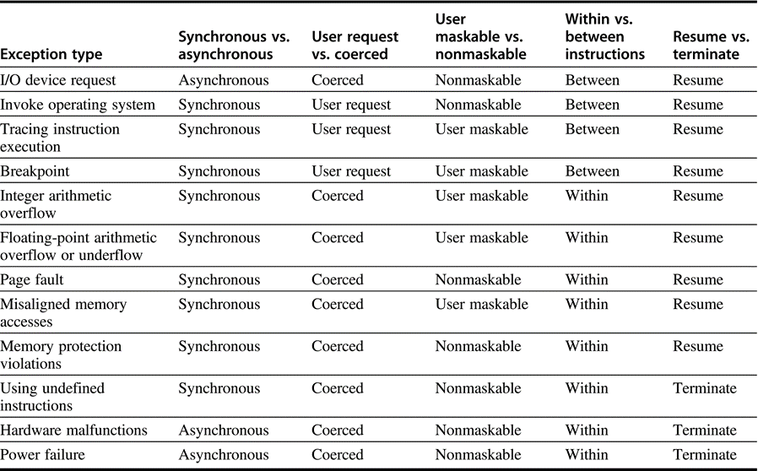
Five categories of exceptions

Slide 55
Interrupt Priorities Must be Handled
Raise priority
Reenable All Ints
Save registers
…
lw r1,20(r0)
lw r2,0(r1)
addi r3,r0,#5
sw 0(r1),r3
…
Restore registers
Clear current Int
Disable All Ints
Restore priority
RTE
PC saved
Disable All Ints
Supervisor Mode
…
add r1,r2,r3
subi r4,r1,#4
slli r4,r4,#2
Hiccup(!)
lw r2,0(r4)
lw r3,4(r4)
add r2,r2,r3
sw 8(r4),r2
…
Network Interrupt
Could be interrupted by disk
Restore PC
User Mode
Note that priority must be raised to avoid recursive interrupts!

Slide 56
Interrupt controller hardware and mask levels
Operating system constructs a hierarchy of masks that reflects some form of interrupt priority.
For instance:
This reflects the an order of urgency to interrupts
For instance, this ordering says that disk events can interrupt the interrupt handlers for network interrupts.

Slide 57
Can we have fast interrupts?
Raise priority
Reenable All Ints
Save registers
…
lw r1,20(r0)
lw r2,0(r1)
addi r3,r0,#5
sw 0(r1),r3
…
Restore registers
Clear current Int
Disable All Ints
Restore priority
RTE
PC saved
Disable All Ints
Supervisor Mode
…
add r1,r2,r3
subi r4,r1,#4
slli r4,r4,#2
Hiccup(!)
lw r2,0(r4)
lw r3,4(r4)
add r2,r2,r3
sw 8(r4),r2
…
Fine Grain Interrupt
Could be interrupted by disk
Restore PC
User Mode
Pipeline Drain: Can be very Expensive
Priority Manipulations
Register Save/Restore
128 registers + cache misses + etc.

Slide 58
SPARC (and RISC I) had register windows
On interrupt or procedure call, simply switch to a different set of registers
Really saves on interrupt overhead
Interrupts can happen at any point in the execution, so compiler cannot help with knowledge of live registers.
Conservative handlers must save all registers
Short handlers might be able to save only a few, but this analysis is complicated
Not as big a deal with procedure calls
Good compilers can allocate registers across procedure boundaries
Good compilers know what registers are live at any one time
Many other processors have shadow registers for interrupts

Slide 59
Supervisor State
Typically, processors have some amount of state that user programs are not allowed to touch.
Page mapping hardware/TLB, prevents one user from accessing memory of another, and prevents user from modifying mappings
Interrupt controllers -- User code prevented from crashing machine by disabling interrupts. Ignoring device interrupts, etc.
Real-time clock interrupts ensure that users cannot lockup/crash machine even if they run code that goes into a loop:
“Preemptive Multitasking” vs “non-preemptive multitasking”
Access to hardware devices restricted
Prevents malicious user from stealing network packets
Prevents user from writing over disk blocks
Distinction made with at least two-levels: User/System (1 mode bit)

Slide 60
Entry into Supervisor Mode
Entry into supervisor mode typically happens on interrupts, exceptions, and special trap instructions.
Change to supervisor mode, then jump (indirectly) through table of instructions in kernel (interrupt vector table)
OS “System Calls” are just trap instructions: read(fd,buffer,count) => st 20(r0),r1 st 24(r0),r2 st 28(r0),r3 trap $READ
OS overhead can be serious concern for achieving fast interrupt behavior.
intvec: j handle_int0 j handle_int1 … j handle_fp_except0 … j handle_trap0 j handle_trap1

Slide 61
Precise Interrupts/Exceptions
An interrupt or exception is considered precise if there is a single instruction (or interrupt point) for which:
All instructions before that have committed their state
No following instructions (including the interrupting instruction) have modified any state.
This means, that you can restart execution at the interrupt point and “get the right answer”
Implicit in our previous example of a device interrupt:
Interrupt point is at first lw instruction
Precise interrupt is easy for computers without pipeline
PC saved
Disable All Ints
Supervisor Mode
…
add r1,r2,r3
subi r4,r1,#4
slli r4,r4,#2
lw r2,0(r4)
lw r3,4(r4)
add r2,r2,r3
sw 8(r4),r2
…
External Interrupt
Int handler
Restore PC
User Mode

Slide 62
With pipelining, Precise interrupt point may require multiple PCs
addi r4,r3,#4
sub r1,r2,r3
bne r1,there
and r2,r3,r5
<other insts>
PC:
Interrupt point described as <PC,PC+4>
PC+4:
addi r4,r3,#4
sub r1,r2,r3
bne r1,there
and r2,r3,r5
<other insts>
Interrupt point described as:
<PC+4,there> (branch was taken) or
<PC+4,PC+8> (branch was not taken)
PC:
PC+4:
On SPARC, interrupt hardware produces “pc” and “npc” (next pc)
On MIPS, only “pc” – must fix point in software

Slide 63
Why are precise interrupts desirable?
Many types of interrupts/exceptions need to be restartable. Easier to figure out what actually happened:
I.e. TLB faults. Need to fix translation, then restart load/store
IEEE gradual underflow, illegal operation, etc.: e.g. Suppose you are computing: Then, for , Want to take exception, replace NaN with 1, then restart.
Restartability doesn’t require preciseness. However, preciseness makes it a lot easier to restart.
Simplify the task of the operating system a lot
Less state needs to be saved away if unloading process.
Quick to restart (making for fast interrupts)

Slide 64
Approximations to precise interrupts
Hardware has imprecise state at time of interrupt
Exception handler must figure out how to find a precise PC at which to restart program.
Emulate instructions that may remain in pipeline
Example: SPARC allows limited parallelism between FP and integer core:
possible that integer instructions #1 - #4 have already executed at time that the first floating instruction gets a recoverable exception
Interrupt handler code must fixup <float 1>, then emulate both <float 1> and <float 2>
At that point, precise interrupt point is integer instruction #5.
Vax had string move instructions that could be in middle at time that page-fault occurred.
Could be arbitrary processor state that needs to be restored to restart execution.
<float 1>
<int 1>
<int 2>
<int 3>
<float 2>
<int 4>
<int 5>

Slide 65
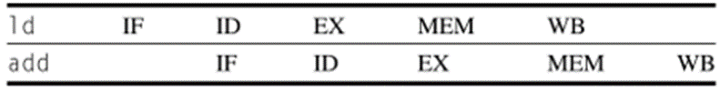
Precise Exceptions in simple 5-stage pipeline:
Exceptions may occur at different stages in pipeline (I.e. out of order):
Arithmetic exceptions occur in execution stage
TLB faults can occur in instruction fetch or memory stage
What about interrupts? The doctor’s mandate of “do no harm” applies here: try to interrupt the pipeline as little as possible
All of this solved by tagging instructions in pipeline as “cause exception or not” and wait until end of memory stage to flag exception
Interrupts become marked NOPs (like bubbles) that are placed into pipeline instead of an instruction.
Assume that interrupt condition persists in case NOP flushed
Clever instruction fetch might start fetching instructions from interrupt vector, but this is complicated by need for supervisor mode switch, saving of one or more PCs, etc

Slide 66
Another look at the exception problem
Time
Data TLB
IFetch
Dcd
Exec
Mem
WB
Bad Inst
IFetch
Dcd
Exec
Mem
WB
Inst TLB fault
IFetch
Dcd
Exec
Mem
WB
Program Flow
Overflow
IFetch
Dcd
Exec
Mem
WB
Use pipeline to sort this out!
Pass exception status along with instruction; Keep track of PCs for every instruction in pipeline; Don’t act on exception until it reaches WB stage
Handle interrupts through “faulting noop” in IF stage
When instruction reaches WB stage:
Save PC ⇒ EPC, Interrupt vector addr ⇒ PC
Turn all instructions in earlier stages into noops!

Slide 67
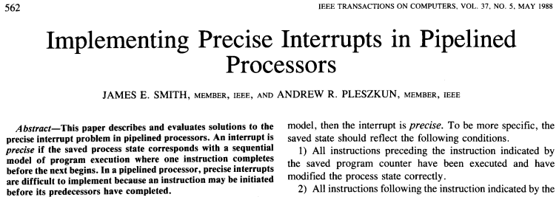
How to achieve precise interrupts when instructions executing in arbitrary order?
Jim Smith’s classic paper discusses several methods for getting precise interrupts, e.g.,
In-order instruction completion
Reorder buffer, History buffer, Future buffer
We will discuss reorder buffer after we see the advantages of out-of-order execution.

Slide 68
4 approaches for interrupt handling
Ignore the issue, settle with imprecise exceptions
Buffer the results of an operation until all earlier instructions completes
History File: Keep track the original values of registers; When exception occurs, use history file to roll back machine states
Future File: Keep the new value of registers; When all earlier instructions complete, update the main register file with future file
Allow exception to become somewhat imprecise, let trap-handler create a precise sequence of the exception
Need enough information about uncompleted instructions
Allow issuing new instructions only when it is certain that all early instructions will not incur exception
Early determination of possible exceptions in FP operations

Slide 69
Summary
Interrupts and Exceptions either interrupt the current instruction or happen between instructions
Possibly large quantities of state must be saved before interrupting
Machines with precise exceptions provide one single point in the program to restart execution
All instructions before that point have completed
No instructions after or including that point have completed
Hardware techniques exist for precise exceptions even in the face of out-of-order execution!
Important enabling factor for out-of-order execution

Slide 70
When is pipelining hard?
Complex Addressing Modes and Instructions
Address modes: Autoincrement causes registers change during instruction execution
Interrupts?
Adds WAR and WAW hazards since writes no longer at last stage
Memory-memory move instructions
Multiple page faults
Make progress?
Floating-point: long execution time
Many FP units, allow multiple outstanding FP operations in parallel
Adds WAR and WAW hazards since pipeline no longer same length
Interrupts or exceptions possible in many stages

Slide 71
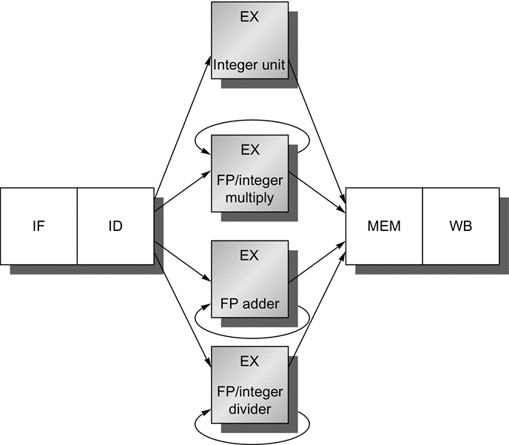
The RISC V pipeline with 3+ functional units
Multiply, FP adder, and Divider
Because only one instruction issues on every clock cycle, all instructions go through the standard pipeline for integer operations
The FP operations simply loop when they reach the EX stage.
After they have finished the EX stage, they proceed to MEM and WB to complete execution

Slide 72
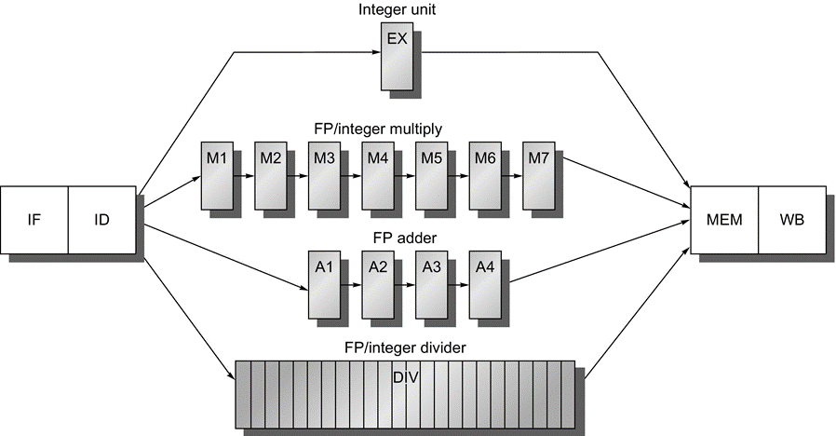
A pipeline that supports multiple outstanding FP operations
Multiplier and adder are fully pipelined, 7 and 4 stages each
FP divider is not pipelined, but requires 24 clock cycles to complete

Slide 73
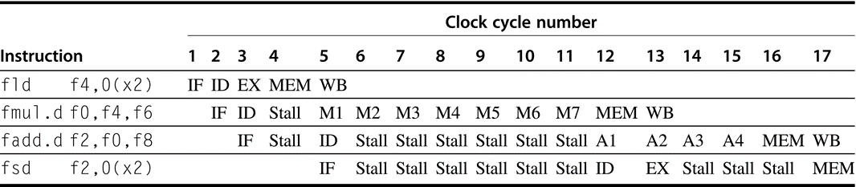
A typical FP code sequence showing the stalls arising from RAW hazards
The longer pipeline substantially raises the frequency of stalls
Each instruction in this sequence is dependent on the previous and proceeds as soon as data are available, which assumes the pipeline has full bypassing and forwarding
The fsd must be stalled an extra cycle so that its MEM does not conflict with the fadd.d. Extra hardware could easily handle this case.

Slide 74
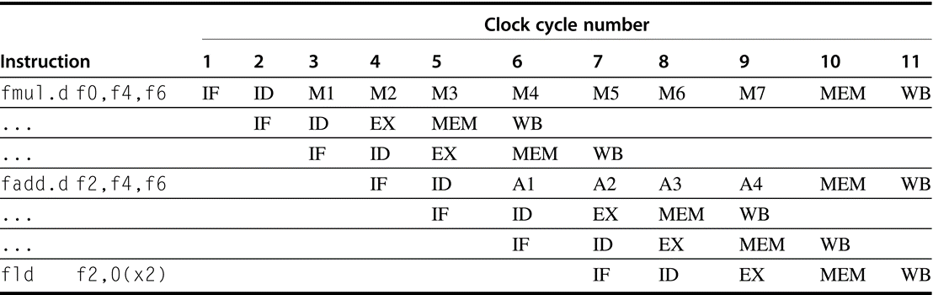
Three instructions want write-back to the FP register file simultaneously
As shown in clock cycle 11. This is not the worst case, because an earlier divide in the FP unit could also finish on the same clock
Note that although the fmul.d, fadd.d, and fld are in the MEM stage in clock cycle 10, only the fld actually uses the memory, so no structural hazard exists for MEM

Slide 75
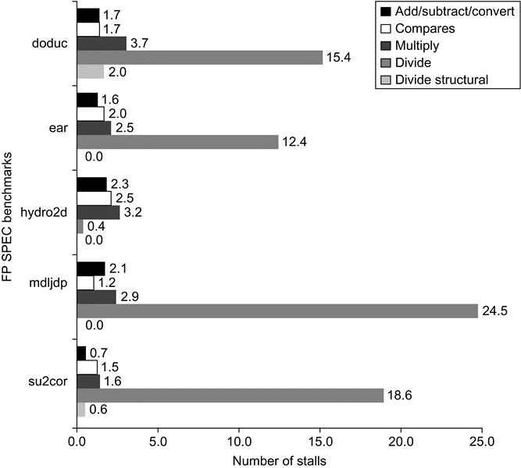
Stalls of FP operation for the SPEC89 FP benchmarks
The number of stalls from RAW hazards roughly tracks the latency of the FP unit
The average number of stalls per FP add, subtract, or convert is 1.7 cycles, or 56% of the latency (three cycles)
The average number of stalls for multiplies and divides are 2.8 and 14.2, respectively, or 46% and 59% of the corresponding latency
Structural hazards for divides are rare, because the divide frequency is low

Slide 76
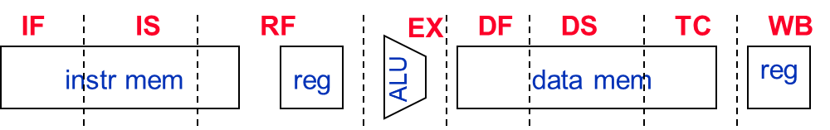
Case Study: MIPS R4000 (200 MHz)
8 Stage Pipeline:
IF–first half of fetching of instruction; PC selection happens here as well as initiation of instruction cache access.
IS–second half of access to instruction cache.
RF–instruction decode and register fetch, hazard checking and also instruction cache hit detection.
EX–execution, which includes effective address calculation, ALU operation, and branch target computation and condition evaluation.
DF–data fetch, first half of access to data cache.
DS–second half of access to data cache.
TC–tag check, determine whether the data cache access hit.
WB–write back for loads and register-register operations.
8 Stages: What is impact on Load delay? Branch delay? Why?
Notes:
Answer is 3 stages between branch and new instruction fetch and 2 stages between load and use (even though if looked at red insertions that it would be 3 for load and 2 for branch)
Reasons:
1) Load: TC just does tag check, data available after DS; thus supply the data & forward it, restarting the pipeline on a data cache miss
2) EX phase does the address calculation even though just added one phase; presumed reason is that since want fast clockc cycle don’t want to sitck RF phase with reading regisers AND testing for zero, so just moved it back on phase

Slide 77
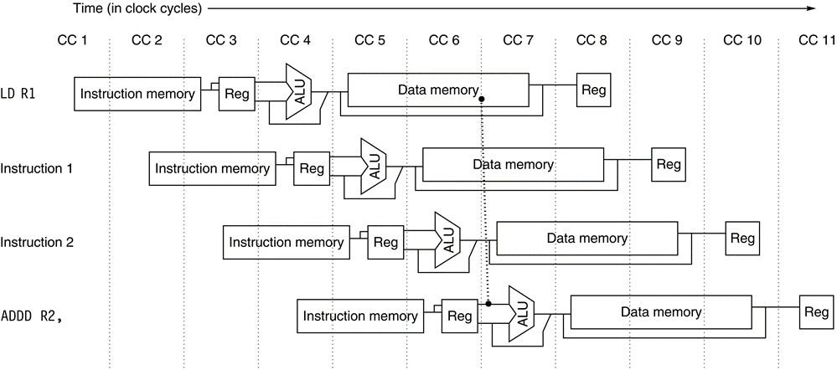
The structure of the R4000 integer pipeline leads to a x1 load delay
Two cycle delay is possible because the data value is available at the end of DS and can be bypassed. If the tag check in TC indicates a miss, the pipeline is backed up a cycle, when the correct data are available

Slide 78
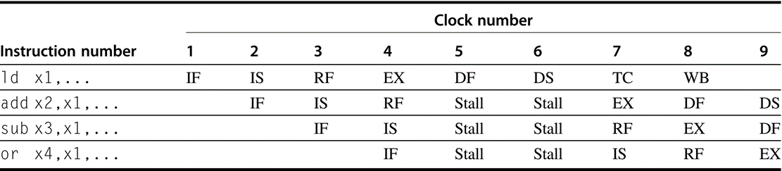
A load instruction followed by an immediate use results in a x1 stall
Normal forwarding paths can be used after two cycles, so the add and sub get the value by forwarding after the stall. The or instruction gets the value from the register file. Because the two instructions after the load could be independent and hence not stall, the bypass can be to instructions that are three or four cycles after the load.

Slide 79
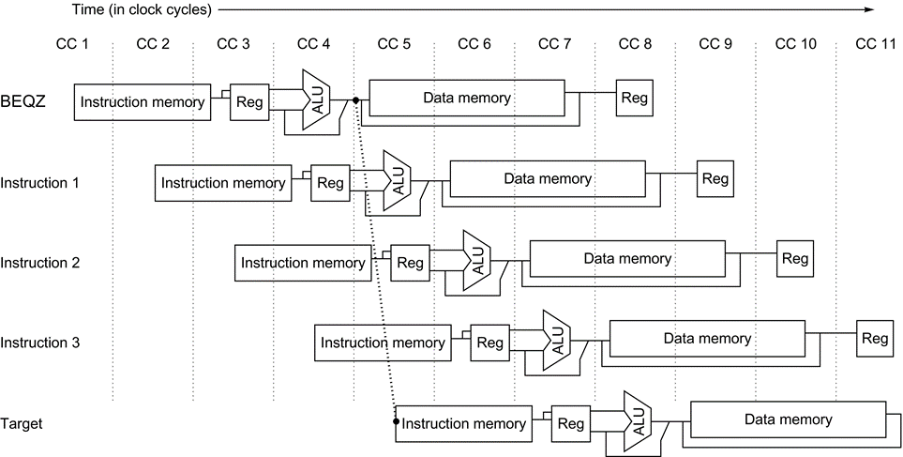
The basic branch delay is three cycles
Because the condition evaluation is performed during EX

Slide 80
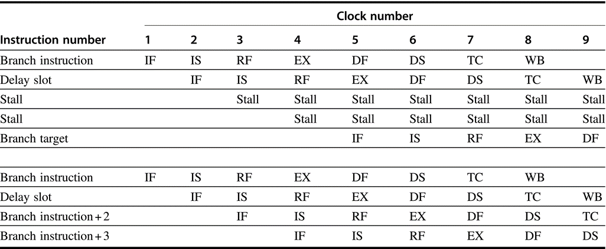
Branch in R4000
A taken branch, has a one-cycle delay slot followed by a x1 stall, while an untaken branch has simply a one-cycle delay slot
Branch-likely, which cancels the effect of the instruction in the delay slot if the branch is untaken
Taken
Branch
Untaken
Branch

Slide 81
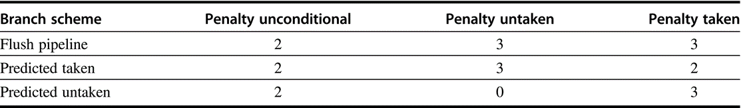
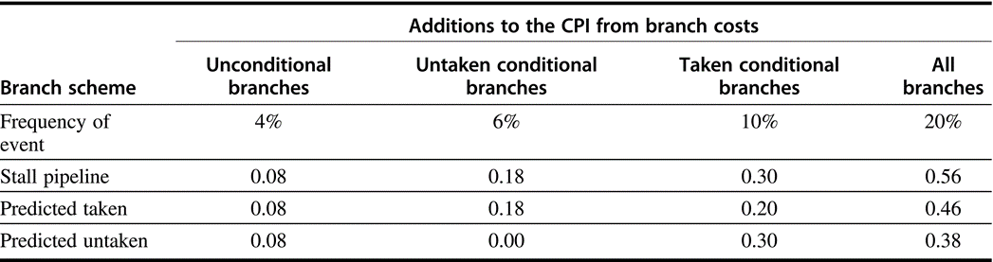
Deeper pipeline has 3 stage delay
Assume: Jump 4%, untaken branch 6%, taken branch 10%
CPI penalties for three branch schemes in the deeper pipeline

Slide 82
Branch Prediction Schemes
0. Static Branch Prediction
1-bit Branch history table (Branch-Prediction Buffer)
2-bit Branch history table (Branch-Prediction Buffer)
Correlating Branch Prediction Buffer
Tournament Branch Predictor
Branch Target Buffer
Integrated Instruction Fetch Units
Return Address Predictors

Slide 83
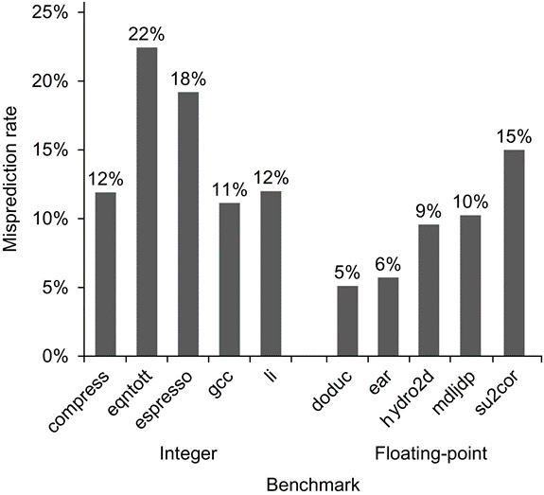
Misprediction rate on SPEC92 for a profile-based predictor
Floating-point programs have an average misprediction rate of 9% with a standard deviation of 4%
Integer programshave an average misprediction rate of 15% with a standard deviation of 5%
The actual performance depends on both the prediction accuracy and the branch frequency, which vary from 3% to 24%.

Slide 84
Dynamic Branch Prediction
Performance = ƒ(accuracy, cost of misprediction)
Branch History Table: Lower bits of PC address index a table of 1-bit values
Says whether or not branch taken last time; No address check
Saves HW, but may not be right branch
If instruction == BR, update table with outcome
Problem: in a loop, 1-bit BHT will cause 2 mispredictions
End of loop case, when it exits instead of looping as before
First time through loop on next time through code, when it predicts exit instead of looping
Average is 9 iterations before exit
Only 80% accuracy even if loop 90% of the time
BHT
PC

Slide 85
2-bit Dynamic Branch Prediction
2-bit scheme where change prediction only if get misprediction twice:
Green: stop, not taken; Red: go, taken
Adds hysteresis to decision making process
Generalize to n-bit saturating counter
T
NT
Predict Taken
Predict Taken
T
T
NT
NT
Predict Not
Taken
Predict Not
Taken
T
NT

Slide 86
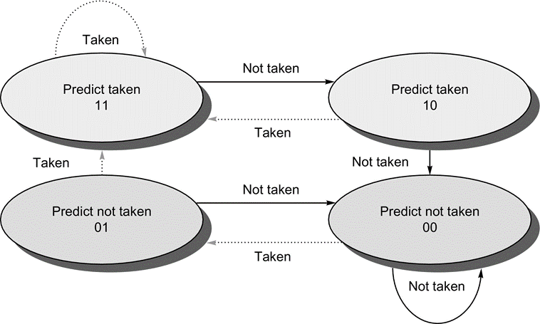
The states in a 2-bit prediction scheme
By using 2 bits rather than 1, a branch that strongly favors taken or not taken—as many branches do—will be mispredicted less often than with a 1-bit predictor.

Slide 87
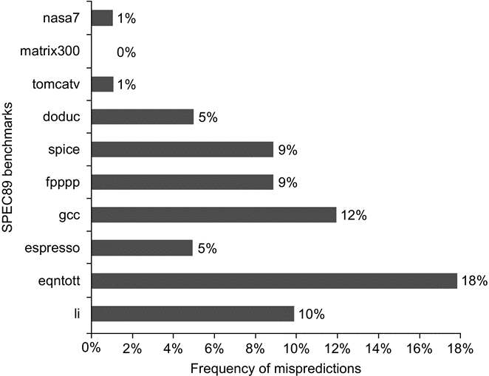
Prediction accuracy of a 4096-entry 2-bit BHT for the SPEC89 benchmarks
The misprediction rate for the integer benchmarks (gcc, espresso, eqntott, and li) is substantially higher (average of 11%) than that for the floating-point programs (average of 4%)
Although these data are for an older version of a subset of the SPEC benchmarks, the newer benchmarks are larger and would show slightly worse behavior, especially for the integer benchmarks.

Slide 88
Impact of BHT Size
Prediction accuracy of a 4096-entry 2-bit prediction buffer has the similar effect as an infinite buffer for the SPEC89 benchmarks

Slide 89
MIPS R4000 Floating Point
FP Adder, FP Multiplier, FP Divider
Last step of FP Multiplier/Divider uses FP Adder HW
8 kinds of stages in FP units:
Stage Functional unit Description
A FP adder Mantissa ADD stage
D FP divider Divide pipeline stage
E FP multiplier Exception test stage
M FP multiplier First stage of multiplier
N FP multiplier Second stage of multiplier
R FP adder Rounding stage
S FP adder Operand shift stage
U Unpack FP numbers

Slide 90
MIPS FP Pipe Stages
FP Instr 1 2 3 4 5 6 7 8 …
Add, Subtract U S+A A+R R+S
Multiply U E+M M M M N N+A R
Divide U A R D²⁸ … D+A D+R, D+R, D+A, D+R, A, R
Square root U E (A+R)¹⁰⁸ … A R
Negate U S
Absolute value U S
FP compare U A R
Stages:
M First stage of multiplier
N Second stage of multiplier
R Rounding stage
S Operand shift stage
U Unpack FP numbers
A Mantissa ADD stage
D Divide pipeline stage
E Exception test stage

Slide 91
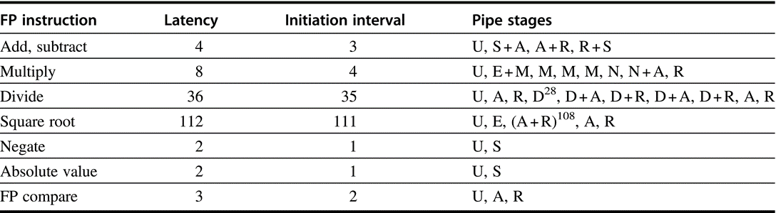
The latencies and initiation intervals for the FP operations
Depend on the FP unit stages that a given operation must use
The latencies are one cycle less when the destination is a store
The pipe stages are shown in the order in which they are used for any operation
The notation S + A indicates a clock cycle in which both the S and A stages are used. The notation D²⁸ indicates that the D stage is used 28 times in a row.

Slide 92
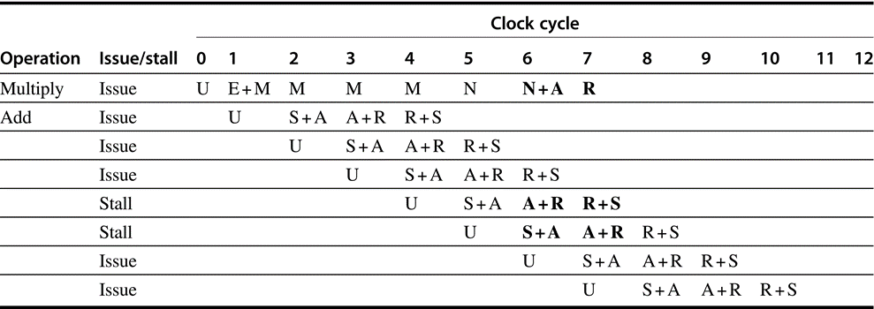
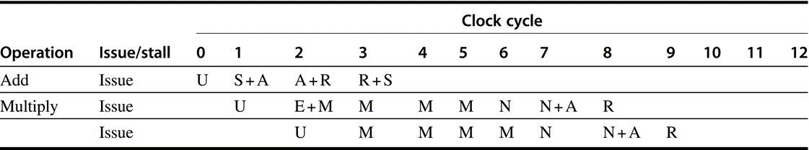
Structural Hazard between FP operations

Slide 93
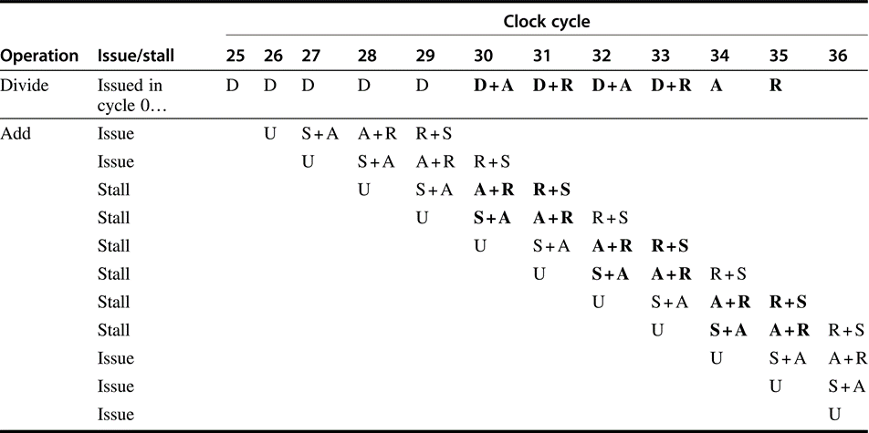
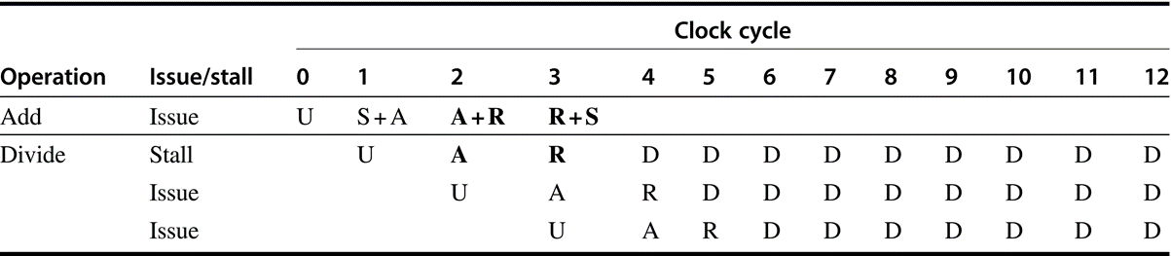
Structural Hazard between FP operations

Slide 94
R4000 Performance: Not ideal CPI of 1
Load stalls (1 or 2 clock cycles); Branch stalls (2 cycles + unfilled slots)
FP result stalls: RAW data hazard (latency)
FP structural stalls: Not enough FP hardware (parallelism)
For integer programs, branch delay is major impact to CPI
For FP programs, FP result stalls are the major contributor
Notes:
Integer programs, major delay is branch stalls
FP its structural stalls

Slide 95
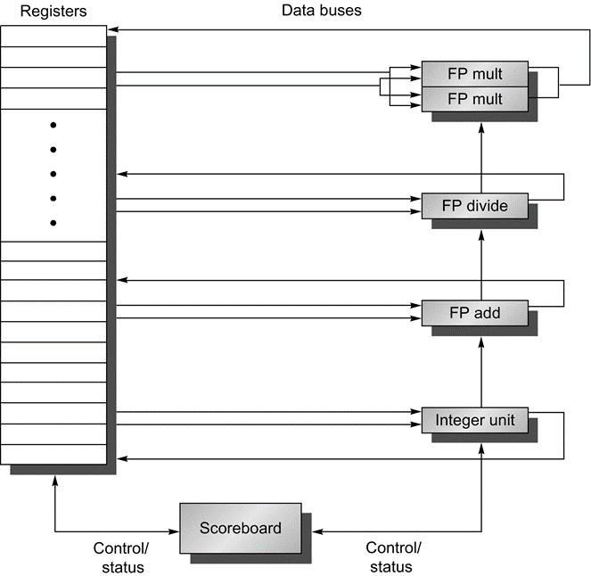
RISC V processor with a scoreboard
The scoreboard’s function is to control instruction execution (vertical control lines). All of the data flow between the register file and the functional units over the buses (the horizontal lines, called trunks in the CDC 6600). There are two FP multipliers, an FP divider, an FP adder, and an integer unit. One set of buses (two inputs and one output) serves a group of functional units

Slide 96
Scoreboard: a bookkeeping technique
Out-of-order execution divides ID stage:
1. Issue — decode instructions, check for structural hazards
2. Read operands — wait until no data hazards, then read operands
Scoreboards date to CDC6600 in 1963
Instructions execute whenever not dependent on previous instructions and no hazards.
CDC 6600: In order issue, out-of-order execution, out-of-order commit (or completion)
No forwarding!
Imprecise interrupt/exception model for now

Slide 97
Scoreboard Architecture (CDC 6600)
FP Mult
FP Mult
FP Divide
Registers
Functional Units
FP Add
Integer
SCOREBOARD
Memory

Slide 98
Four Stages of Scoreboard Control
Issue —decode instructions & check for structural hazards (ID1)
Instructions issued in program order (for hazard checking)
Don’t issue if structural hazard
Don’t issue if instruction is output dependent on any previously issued but uncompleted instruction (no WAW hazards)
Read operands —wait until no data hazards, then read operands (ID2)
All real dependencies (RAW hazards) resolved in this stage, since we wait for instructions to write back data.
No forwarding of data in this model!

Slide 99
Four Stages of Scoreboard Control
Execution —operate on operands (EX)
The functional unit begins execution upon receiving operands. When the result is ready, it notifies the scoreboard that it has completed execution.
Write result —finish execution (WB)
Stall until no WAR hazards with previous instructions: Example: DIVD F0,F2,F4 ADDD F10,F0,F8 SUBD F8,F8,F14 CDC 6600 scoreboard would stall SUBD until ADDD reads operands

Slide 100
Three Parts of the Scoreboard
Instruction status: Which of 4 steps the instruction is in
Functional unit status: —Indicates the state of the functional unit (FU). 9 fields for each functional unit Busy: Indicates whether the unit is busy or not Op: Operation to perform in the unit (e.g., + or –) Fi: Destination register Fj, Fk: Source-register numbers Qj, Qk: Functional units producing source registers Fj, Fk Rj, Rk: Flags indicating when Fj, Fk are ready
Register result status —Indicates which functional unit will write each register, if one exists
Blank when no pending instructions will write that register
Notes:
What you might have thought
1. 4 stages of instruction executino
2.Status of FU: Normal things to keep track of (RAW & structura for busyl):
Fi from instruction format of the mahine (Fi is dest)
Add unit can Add or Sub
Rj, Rk - status of registers (Yes means ready)
Qj,Qk - If a no in Rj, Rk, means waiting for a FU to write result; Qj, Qk means wihch FU waiting for it
3.Status of register result (WAW &WAR)s:
which FU is going to write into registers
Scoreboard on 6600 = size of FU
6.7, 6.8, 6.9, 6.12, 6.13, 6.16, 6.17
FU latencies: Add 2, Mult 10, Div 40 clocks

Slide 101
Detailed Scoreboard Pipeline Control
Instruction status
Wait until
Bookkeeping
Issue
Not busy (FU) and not result(D)
Busy(FU)← yes; Op(FU)← op; Fi(FU)← `D’; Fj(FU)← `S1’; Fk(FU)← `S2’; Qj← Result(‘S1’); Qk← Result(`S2’); Rj← not Qj; Rk← not Qk; Result(‘D’)← FU;
Read operands
Rj and Rk
Rj← No; Rk← No
Execution complete
Functional unit done
Write result
∀f((Fj(f)≠Fi(FU) or Rj(f)=No) & (Fk(f)≠Fi(FU) or Rk( f )=No))
∀f(if Qj(f)=FU then Rj(f)← Yes); ∀f(if Qk(f)=FU then Rj(f)← Yes); Result(Fi(FU))← 0; Busy(FU)← No
Notes:
1.Issue - if no structural haards AND non wAW (no Funtional Unit is going to write this destination register; 1 per clock cycle
2. Read -(RAW) if no instructions is going to write a source register of this instruction (alternatively, no write signal this clock cycle) +> gein exection of the instruction; many read ports, so can read many times
3. Execution Complete; multiple during clock cyle
4. Write result - (WAR) If no instructiion is watiing to read the destination register; assume multiple wriite ports; wait for clock cycle to write and tehn read the results; assume can oerlap issue & write
show clock cyclesneed 20 or so
Latency: minimum is 4 through 4 stages

Slide 102
Scoreboard Example

Slide 103
Scoreboard Example: Cycle 1

Slide 104
Scoreboard Example: Cycle 2
Issue 2nd LD?

Slide 105
Scoreboard Example: Cycle 3
Issue MULT?

Slide 106
Scoreboard Example: Cycle 4

Slide 107
Scoreboard Example: Cycle 5

Slide 108
Scoreboard Example: Cycle 6

Slide 109
Scoreboard Example: Cycle 7
Read multiply operands?

Slide 110
Scoreboard Example: Cycle 8a (First half of clock cycle)

Slide 111
Scoreboard Example: Cycle 8b (Second half of clock cycle)

Slide 112
Scoreboard Example: Cycle 9
Read operands for MULT & SUB?
Issue ADDD?
Note
Remaining

Slide 113
Scoreboard Example: Cycle 10

Slide 114
Scoreboard Example: Cycle 11

Slide 115
Scoreboard Example: Cycle 12
Read operands for DIVD?

Slide 116
Scoreboard Example: Cycle 13

Slide 117
Scoreboard Example: Cycle 14

Slide 118
Scoreboard Example: Cycle 15

Slide 119
Scoreboard Example: Cycle 16

Slide 120
Scoreboard Example: Cycle 17
Why not write result of ADD???
WAR Hazard!

Slide 121
Scoreboard Example: Cycle 18

Slide 122
Scoreboard Example: Cycle 19

Slide 123
Scoreboard Example: Cycle 20

Slide 124
Scoreboard Example: Cycle 21
WAR Hazard is now gone...

Slide 125
Scoreboard Example: Cycle 22

Slide 126
Faster than light computation (skip a couple of cycles)

Slide 127
Scoreboard Example: Cycle 61

Slide 128
Scoreboard Example: Cycle 62

Slide 129
Review: Scoreboard Example: Cycle 62
In-order issue; out-of-order execute & out-of-order complete

Slide 130
CDC 6600 Scoreboard
Speedup 1.7 from compiler; 2.5 by hand BUT slow memory (no cache) limits benefit
Limitations of 6600 scoreboard:
No forwarding hardware
Limited to instructions in basic block (small window)
Small number of functional units (structural hazards), especially integer/load store units
Do not issue on structural hazards
Wait for WAR hazards
Prevent WAW hazards

Slide 131
Pipelining Summary
Just overlap tasks, and easy if tasks are independent
Speed Up < Pipeline Depth; if ideal CPI is 1, then:
Hazards limit performance on computers:
Structural: need more HW resources
Data (RAW,WAR,WAW): need forwarding, compiler scheduling
Control: delayed branch, prediction
Introducing Dynamic Scheduling: Scoreboard
Pipeline Depth
Clock Cycle Unpipelined
Speedup =
X
1 + Pipeline stall CPI
Clock Cycle Pipelined

