Slide 1
指令级并行性 (ILP) Instruction Level Parallelism
ILP的概念和程序中的数据依赖关系
基于Tomasulo算法的动态调度
通过编译技术展现ILP
动态分支预测
推测执行机制
超标量和动态多发射
同时多线程(SMT)结构
超长指令字(VLIW)与显式并行(EPIC)

Slide 2
Introduction
Pipelining become universal technique in 1985
Overlaps execution of instructions
Exploits Elementary “Instruction Level Parallelism”
Beyond this, there are two main approaches for Advanced ILP:
SuperScalar, Hardware-based dynamic multi-issue approaches
Used in server and desktop processors
Not used as extensively in PMP processors
VLIW, Compiler-based static multi-issue approaches
Not as successful outside of scientific applications

Slide 3
Instruction-Level Parallelism
When exploiting instruction-level parallelism, goal is to minimize CPI (maximize IPC)
Pipeline CPI =
Ideal pipeline CPI +
Structural stalls +
Data hazard stalls +
Control stalls
Parallelism with basic block is limited
Typical size of basic block = 3-6 instructions
Must optimize across branches to get more ILP

Slide 4
Instruction-Level Parallelism (ILP)
Basic Block (BB) ILP is quite small
BB: a straight-line code sequence with no branches in except to the entry and no branches out except at the exit
average dynamic branch frequency 15% to 25% => 4 to 7 instructions execute between a pair of branches
Plus instructions in BB likely to depend on each other
To obtain substantial performance enhancements, we must exploit ILP across multiple basic blocks
Simplest: loop-level parallelism to exploit parallelism among iterations of a loop
Vector is one way, Use in SIMD (vector processors and GPUs)
If not vector, then either dynamic via branch prediction or static via loop unrolling by compiler

Slide 5
Data Dependence and Pipeline Hazards 数据依赖和流水线险象
Instr_{J} is data dependent on Instr_{I} Instr_{J} tries to read operand before Instr_{I} writes it
or Instr_{J} is data dependent on Instr_{K} which is dependent on Instr_{I}
Caused by a “True Dependence” (compiler term)
If true dependence caused a hazard in the pipeline, called a Read After Write (RAW) hazard
Dependent instructions cannot be executed simultaneously
I: add r1,r2,r3
J: sub r4,r1,r3

Slide 6
Data Dependence
Dependencies are a property of programs
Presence of dependence indicates potential for a hazard, but actual hazard and length of any stall is a property of the pipeline
Pipeline organization determines if dependence is detected and if it causes a stall
Data dependence conveys:
Possibility of a hazard
Order in which results must be calculated
Upper bound on exploitable instruction level parallelism
Dependencies that flow through memory locations are difficult to detect
E.g., 100(x4) may equal 20(x6); 20(x4) may be different from 20(x4)

Slide 7
Program order
Order instructions would execute in if executed sequentially 1 at a time as determined by original source program
HW/SW goal: exploit parallelism by preserving appearance of program order
Modify order in manner that cannot be observed by program
Must not affect the outcome of the program
Two instructions use the same name but no flow of information
Not a true data dependence, but is a problem when reordering instructions
Ex: Instructions involved in a name dependence can execute simultaneously if name used in instructions is changed so instructions do not conflict
Register renaming resolves name dependence for registers
Either by compiler or by HW

Slide 8
Name Dependence
Anti-dependence: Instr_{J} writes operand before Instr_{I} reads it
This results from reuse of the name “r1”
If anti-dependence caused a hazard in the pipeline, called a Write After Read (WAR) hazard
Output dependence: Instr_{J} writes operand before Instr_{I} writes it.
This also results from the reuse of name “r1”
If anti-dependence caused a hazard in the pipeline, called a Write After Write (WAW) hazard
I: sub r4,r1,r3
J: add r1,r2,r3
K: mul r6,r1,r7
I: sub r1,r4,r3
J: add r1,r2,r3
K: mul r6,r1,r7

Slide 9
Control Dependencies
Ordering of instruction i with respect to a branch instruction
Instruction control dependent on a branch cannot be moved before the branch so that its execution is no longer controlled by the branch
An instruction not control dependent on a branch cannot be moved after the branch so that its execution is controlled by the branch
Most instruction is control dependent on some set of branches, and, in general, these control dependencies must be preserved to preserve program order
S1 is control dependent on p1 S2 is control dependent on p2 but not on p1
Control dependence need not always be preserved
Willing to execute instructions that should not have been executed, thereby violating the control dependences, if can do so without affecting correctness of the program
if p1 {
S1;
};
if p2 {
S2;
}

Slide 10
Exception Behavior
2 properties critical to program correctness are exception behavior and data flow
Preserving exception behavior => any changes in instruction execution order must not change how exceptions are raised in program (=> no new exceptions)
Example: ADD x2,x3,x4 BEQ x2,x0,L1 LD x1,0(x2) L1:
Problem with moving LD before BEQ?
May cause a memory protection exception

Slide 11
Data Flow
Actual flow of data values among instructions that produce results and those that consume them
Branches make flow dynamic, determine which instruction is supplier of data. Program order is ensured by maintaining the control dependence
Example:
ADD x1,x2,x3 BEQ x4,x0,L SUB x1,x5,x6 L: … OR x7,x1,x8
Must preserve data flow on execution
SUB and OR control dependent on the branch BEQ
OR depends on ADD or SUB?
Both：taken OR use ADD result, untaken OR use SUB result

Slide 12
Situations of violating control dependence
Assume x4 isn’t used after skip
Possible to move sub before the branch
Liveness of values
Live: will be used
Dead: will not be used
Software Speculation
Ex: add x1,x2,x3
beq x12,x0,skip
sub x4,x5,x6
add x5,x4,x9
skip:
or x7,x8,x9

Slide 13
Dynamic Scheduling
In runtime, using hardware to rearrange order of instructions to reduce stalls while maintaining data flow
Advantages:
Handles cases when dependences unknown at compile time
(e.g., because they may involve a memory reference)
It simplifies the compiler, and allows code that compiled for one pipeline to run efficiently on a different pipeline
Hardware speculation, a technique with significant performance advantages, that builds on dynamic scheduling
Disadvantage:
Substantial increase in hardware complexity
Complicates exceptions

Slide 14
Dynamic Scheduling
Allow instructions behind stall to proceed, implies
Out-of-order execution, and Out-of-order completion
Example 1:
fdiv.d f0,f2,f4
fadd.d f10,f0,f8
fsub.d f12,f8,f14
fsub.d is not dependent, issue before fadd.d
Example 2:
fdiv.d f0,f2,f4
fmul.d f6,f0,f8
fadd.d f0,f10,f14
fadd.d is not dependent, but the anti-dependence makes it impossible to issue earlier without register renaming, and the output dependence

Slide 15
Dynamic Scheduling Step 1
Will distinguish when an instruction begins execution and when it completes execution
Between them, the instruction is in execution
In a dynamically scheduled pipeline, all instructions pass through issue stage in order (in-order issue)
Simple pipeline had 1 stage to check both structural and data hazards: Instruction Decode (ID), also called Instruction Issue
Split the ID pipe stage of simple 5-stage pipeline into 2 stages:
Issue — Decode instructions, check for structural hazards
Read operands — Wait until no data hazards, then read operands

Slide 16
A Dynamic Scheduling Algorithm: Tomasulo’s Algorithm
First proposed for IBM 360/91 (before caches!)
Goal: High Performance without special compilers
Small number of floating point registers (4 in 360) prevented interesting compiler scheduling of operations
This led Tomasulo to try to figure out how to get more effective registers — renaming in hardware!
Why Study 1966 Computer?
The descendants of this have flourished!
Alpha 21264, HP 8000, MIPS 10000, Pentium III, PowerPC 604, …

Slide 17
Tomasulo Algorithm
Control & buffers distributed with many Function Units (FU)
FU buffers called “reservation stations”; have pending operands
Registers in instructions replaced by values or pointers to reservation stations (RS);
form of register renaming; avoids WAR, WAW hazards
More reservation stations than registers, so can do optimizations compilers can’t
Results to FU from RS, not through registers, over Common Data Bus that broadcasts results to all FUs
Load and Stores treated as FUs with RSs as well
Integer instructions can go past branches, allowing FP ops beyond basic block in FP queue

Slide 18
Tomasulo Organization in IBM 360/91
From Mem
FP Op
Queue
FP Registers
Load Buffers
Load1
Load2
Load3
Load4
Load5
Load6
Store
Buffers
Add1
Add2
Add3
Mult1
Mult2
Reservation
Stations
To Mem
FP adders
FP multipliers
Common Data Bus (CDB)
Notes:
Resolve RAW memory conflict? (address in memory buffers)
Integer unit executes in parallel

Slide 19
Register Renaming
Example 3:
fdiv.d f0,f2,f4
fadd.d f6,f0,f8
fsd f6,0(x1)
fsub.d f8,f10,f14
fmul.d f6,f10,f8
Name dependence with f6 and f8
After Renaming:
fdiv.d f0,f2,f4
fadd.d S,f0,f8
fsd S,0(x1)
fsub.d T,f10,f14
fmul.d f6,f10,T
Now only RAW hazards remain, which can be strictly ordered

Slide 20
Tomasulo’s Register Renaming
Register renaming is provided by reservation stations (RS)
Contains the instruction, and buffered operand values (when available)
Reservation station number of instruction providing the operand values
RS fetches and buffers an operand as soon as it becomes available (not necessarily involving register file)
Pending instructions designate the RS to which they will send their output
Result values broadcast on a result bus, called the common data bus (CDB)
Only the last output updates the register file
As instructions are issued, the register specifiers are renamed with the reservation station
May be more reservation stations than registers
Load and store buffers
Contain data and addresses, act like reservation stations

Slide 21
Reservation Station Components
Op: Operation to perform in the unit (e.g., + or –)
Vj, Vk: Value of Source operands
Load/Store buffers have A field, information for the memory address calculation; Store buffers has V field, result to be stored
Qj, Qk: Reservation stations producing source registers (value to be written)
Note: Qj,Qk=0 => ready
Store buffers only have Qi for RS producing result
Busy: Indicates reservation station or FU is busy
Register result status — Indicates which functional unit will write each register, if one exists. Blank when no pending instructions that will write that register.
Notes:
What you might have thought
1. 4 stages of instruction executino
2.Status of FU: Normal things to keep track of (RAW & structura for busyl):
Fi from instruction format of the mahine (Fi is dest)
Add unit can Add or Sub
Rj, Rk - status of registers (Yes means ready)
Qj,Qk - If a no in Rj, Rk, means waiting for a FU to write result; Qj, Qk means wihch FU waiting for it
3.Status of register result (WAW &WAR)s:
which FU is going to write into registers
Scoreboard on 6600 = size of FU
6.7, 6.8, 6.9, 6.12, 6.13, 6.16, 6.17
FU latencies: Add 2, Mult 10, Div 40 clocks

Slide 22
Three Stages of Tomasulo Algorithm
Issue — get instruction from FP Op Queue
If reservation station free (no structural hazard), control issues instruction & sends operands to the RS (renames registers)
If operand values not available, stall the instruction
Execute — operate on operands (EX)
When both operands ready then execute; if not ready, watch Common Data Bus for result
Loads and store maintained in program order through effective address
No instruction allowed to initiate execution until all branches that proceed it in program order have completed
Write result — finish execution (WB)
Write on Common Data Bus to all awaiting units; mark reservation station available

Slide 23
Common Data Bus (CDB)
Normal data bus: data + destination (“go to” bus)
Common data bus: data + source (“come from” bus)
64 bits of data + 4 bits of Functional Unit source address
Write if matches expected Functional Unit (produces result)
Does the broadcast
Example speed: 3 clocks for FP add; 10 for multiply; 40 clks for division

Slide 24
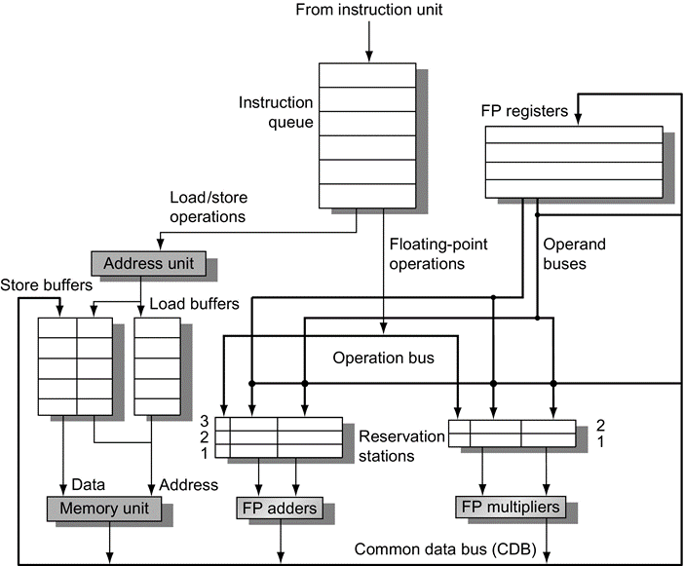
RISC-V floating-point unit using Tomasulo's algorithm
Load buffers
hold the components of the effective address until it is computed
track outstanding loads that are waiting on the memory
hold the results of completed loads that are waiting for the CDB
Store buffers
hold the components of the effective address
hold the destination memory addresses of outstanding stores that are waiting for the data value to store
hold the address and value to store until the memory unit is available
All results are put on the CDB, which goes to the FP register file as well as to the reservation stations and store buffers
Notes:
Figure 3.10 The basic structure of a RISC-V floating-point unit using Tomasulo's algorithm. Instructions are sent from the instruction unit into the instruction queue from which they are issued in first-in, first-out (FIFO) order. The reservation stations include the operation and the actual operands, as well as information used for detecting and resolving hazards. Load buffers have three functions: (1) hold the components of the effective address until it is computed, (2) track outstanding loads that are waiting on the memory, and (3) hold the results of completed loads that are waiting for the CDB. Similarly, store buffers have three functions: (1) hold the components of the effective address until it is computed, (2) hold the destination memory addresses of outstanding stores that are waiting for the data value to store, and (3) hold the address and value to store until the memory unit is available. All results from either the FP units or the load unit are put on the CDB, which goes to the FP register file as well as to the reservation stations and store buffers. The FP adders implement addition and subtraction, and the FP multipliers do multiplication and division.

Slide 25
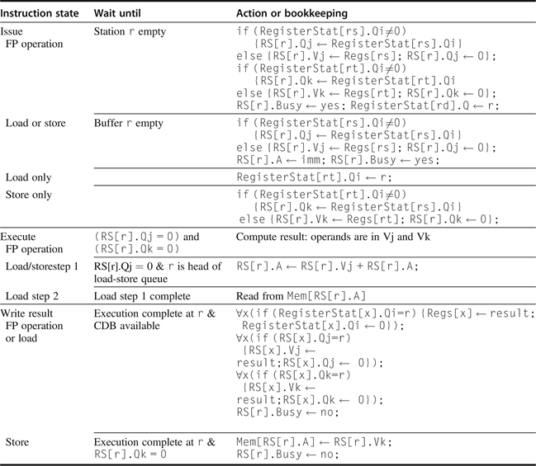
Steps in the algorithm and what is required for each step
Notes:
Figure 3.13 Steps in the algorithm and what is required for each step. For the issuing instruction, rd is the destination, rs and rt are the source register numbers, imm is the sign-extended immediate field, and r is the reservation station or buffer that the instruction is assigned to. RS is the reservation station data structure. The value returned by an FP unit or by the load unit is called result. RegisterStat is the register status data structure (not the register file, which is Regs[]). When an instruction is issued, the destination register has its Qi field set to the number of the buffer or reservation station to which the instruction is issued. If the operands are available in the registers, they are stored in the V fields. Otherwise, the Q fields are set to indicate the reservation station that will produce the values needed as source operands. The instruction waits at the reservation station until both its operands are available, indicated by zero in the Q fields. The Q fields are set to zero either when this instruction is issued or when an instruction on which this instruction depends completes and does its write back. When an instruction has finished execution and the CDB is available, it can do its write back. All the buffers, registers, and reservation stations whose values of Qj or Qk are the same as the completing reservation station update their values from the CDB and mark the Q fields to indicate that values have been received. Thus the CDB can broadcast its result to many destinations in a single clock cycle, and if the waiting instructions have their operands, they can all begin execution on the next clock cycle. Loads go through two steps in execute, and stores perform slightly differently during Write Result, where they may have to wait for the value to store. Remember that, to preserve exception behavior, instructions should not be allowed to execute if a branch that is earlier in program order has not yet completed. Because no concept of program order is maintained after the issue stage, this restriction is usually implemented by preventing any instruction from leaving the issue step if there is a pending branch already in the pipeline. In Section 3.6, we will see how speculation support removes this restriction.

Slide 26
Tomasulo Example
Example code:
LD F6, 34(R2) Blue line: true dependence;
LD F2, 45(R3)
MULTD F0, F2, F4
SUBD F8, F6, F2
DIVD F10, F0, F6 Red line: anti-dependence
ADDD F6, F8, F2

Slide 27
Tomasulo Example
Instruction stream
3 Load/Buffers
FU count
down
3 FP Adder R.S.
2 FP Mult R.S.
Clock cycle counter

Slide 28
Tomasulo Example Cycle 1

Slide 29
Tomasulo Example Cycle 2
Note: Can have multiple loads outstanding

Slide 30
Tomasulo Example Cycle 3
Note: registers names are removed (“renamed”) in RS; MULT issued
Load1 completing; what is waiting for Load1?

Slide 31
Tomasulo Example Cycle 4
Load2 completing; what is waiting for Load2?

Slide 32
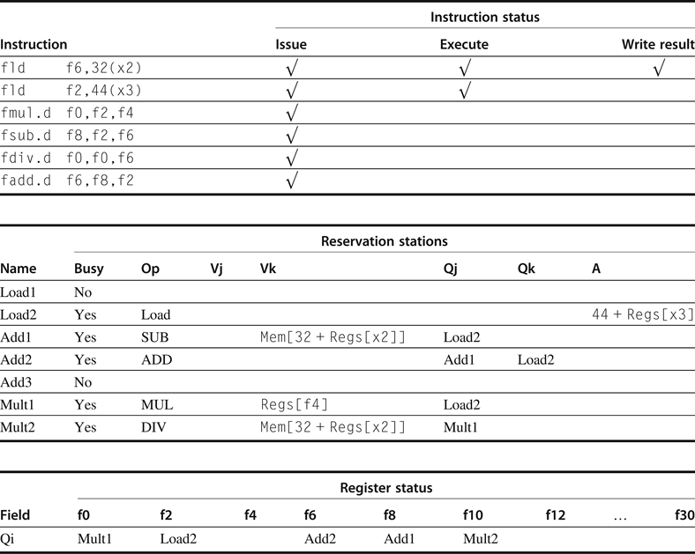
Reservation stations and register tags
All instructions issued
Only the first load instruction has completed and written its result to the CDB
The second load completed effective address calculation & waiting on the memory unit
The fadd.d instruction has a WAR hazard at the WB stage
has issued and could complete before the fdiv.d initiates.
Notes:
Figure 3.11 Reservation stations and register tags shown when all of the instructions have issued but only the first load instruction has completed and written its result to the CDB. The second load has completed effective address calculation but is waiting on the memory unit. We use the array Regs[ ] to refer to the register file and the array Mem[ ] to refer to the memory. Remember that an operand is specified by either a Q field or a V field at any time. Notice that the fadd.d instruction, which has a WAR hazard at the WB stage, has issued and could complete before the fdiv.d initiates.

Slide 33
Tomasulo Example Cycle 5
Timer starts down for Add1, Mult1

Slide 34
Tomasulo Example Cycle 6
Issue ADDD here despite name dependency on F6?

Slide 35
Tomasulo Example Cycle 7
Add1 (SUBD) completing; what is waiting for it?

Slide 36
Tomasulo Example Cycle 8

Slide 37
Tomasulo Example Cycle 9

Slide 38
Tomasulo Example Cycle 10
Add2 (ADDD) completing; what is waiting for it?

Slide 39
Tomasulo Example Cycle 11
Write result of ADDD here?
All quick instructions complete in this cycle!

Slide 40
Tomasulo Example Cycle 12

Slide 41
Tomasulo Example Cycle 13

Slide 42
Tomasulo Example Cycle 14

Slide 43
Tomasulo Example Cycle 15
Mult1 (MULTD) completing; what is waiting for it?

Slide 44
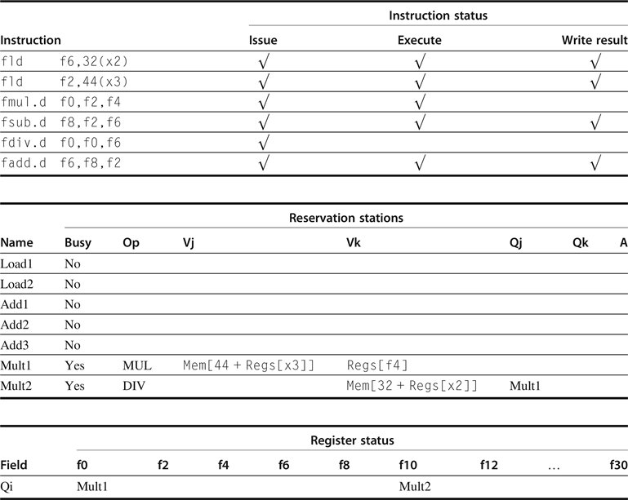
Reservation stations and register tags
Multiply and divide are the only instructions not finished
Notes:
Figure 3.12 Multiply and divide are the only instructions not finished.

Slide 45
Tomasulo Example Cycle 16
Just waiting for Mult2 (DIVD) to complete

Slide 46
Faster than light computation (skip a couple of cycles)

Slide 47
Tomasulo Example Cycle 55

Slide 48
Tomasulo Example Cycle 56
Mult2 (DIVD) is completing; what is waiting for it?

Slide 49
Tomasulo Example Cycle 57
Once again: In-order issue, out-of-order execution and out-of-order completion.

Slide 50
Tomasulo Drawbacks
Complexity
delays of 360/91, MIPS 10000, Alpha 21264, IBM PPC 620
Many associative stores (CDB) at high speed
Performance limited by Common Data Bus
Each CDB must go to multiple functional units ⇒high capacitance, high wiring density
Number of functional units that can complete per cycle limited to one!
Multiple CDBs ⇒ more FU logic for parallel assoc stores
How about precise interrupts?

Slide 51
Difficulties of interrupt handling
Dynamic scheduling with out-of-order completion must preserve exception behavior in the sense that exactly those exceptions that would arise if the program were executed in strict program order actually do arise
Dynamically scheduled processors could generate imprecise exceptions, because
The pipeline may have already completed instructions that are later in program order than the instruction causing the exception
The pipeline may have not yet completed some instructions that are earlier in program order than the instruction causing the exception
Imprecise exceptions make it difficult to restart execution after an exception
We will address the issue and the solution later

Slide 52
Tomasulo Loop Example
This time assume Multiply takes 4 clocks
Assume 1st load takes 8 clocks (L1 cache miss), 2nd load takes 1 clock (hit)
To be clear, will show clocks for SUBI, BNEZ
Reality: integer instructions ahead of Fl. Pt. Instructions
Show 2 iterations
Loop: LD F0 0 R1
MULTD F4 F0 F2
SD F4 0 R1
SUBI R1 R1 #8
BNEZ R1 Loop

Slide 53
Tomasulo Loop Example
Iter-
ation
Count
Added Store Buffers
Instruction Loop
Value of Register used for address, iteration control

Slide 54
Loop Example Cycle 1

Slide 55
Loop Example Cycle 2

Slide 56
Loop Example Cycle 3
Implicit renaming sets up data flow graph

Slide 57
Loop Example Cycle 4
Dispatching SUBI Instruction (not in FP queue)

Slide 58
Loop Example Cycle 5
And, BNEZ instruction (not in FP queue)

Slide 59
Loop Example Cycle 6
Notice that F0 never sees Load from location 80

Slide 60
Loop Example Cycle 7
Register file completely detached from computation
First and Second iteration completely overlapped

Slide 61
Loop Example Cycle 8

Slide 62
Loop Example Cycle 9
Load1 completing: who is waiting?
Note: Dispatching SUBI

Slide 63
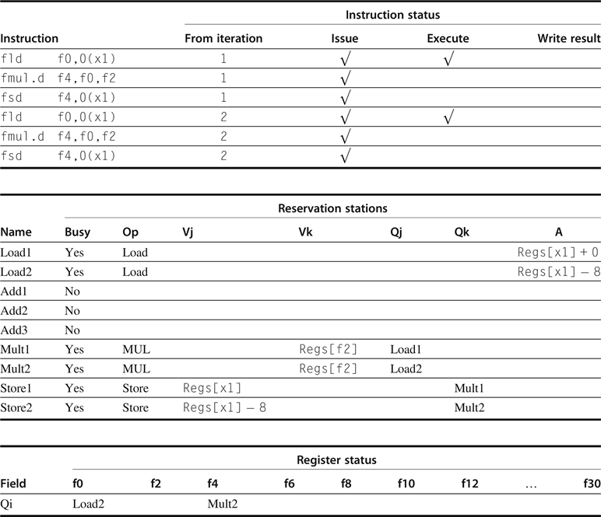
Entries in the multiplier reservation stations indicate that the outstanding loads are the sources
The store reservation stations indicate that the multiply destination is the source of the value to store
Notes:
Figure 3.14 Two active iterations of the loop with no instruction yet completed. Entries in the multiplier reservation stations indicate that the outstanding loads are the sources. The store reservation stations indicate that the multiply destination is the source of the value to store.

Slide 64
Loop Example Cycle 10
Load2 completing: who is waiting?
Note: Dispatching BNEZ

Slide 65
Loop Example Cycle 11
Next load in sequence

Slide 66
Loop Example Cycle 12
Why not issue third multiply?

Slide 67
Loop Example Cycle 13
Why not issue third store?

Slide 68
Loop Example Cycle 14
Mult1 completing. Who is waiting?

Slide 69
Loop Example Cycle 15
Mult2 completing. Who is waiting?

Slide 70
Loop Example Cycle 16

Slide 71
Loop Example Cycle 17

Slide 72
Loop Example Cycle 18

Slide 73
Loop Example Cycle 19

Slide 74
Loop Example Cycle 20
Once again: In-order issue, out-of-order execution and out-of-order completion.

Slide 75
Why can Tomasulo overlap iterations of loops?
Register renaming
Multiple iterations use different physical destinations for registers (dynamic loop unrolling).
Reservation stations
Permit instruction issue to advance past integer control flow operations
Also buffer old values of registers - totally avoiding the WAR stall that we saw in the scoreboard.
Other perspective: Tomasulo building data flow dependency graph on the fly.

Slide 76
Tomasulo’s scheme offers 2 major advantages
The distribution of the hazard detection logic
distributed reservation stations and the CDB
If multiple instructions waiting on single result, & each instruction has other operand, then instructions can be released simultaneously by broadcast on CDB
If a centralized register file were used, the units would have to read their results from the registers when register buses are available.
The elimination of stalls for WAW and WAR hazards

Slide 77
Summary
Reservations stations: implicit register renaming to larger set of registers + buffering source operands
Prevents registers as bottleneck
Avoids WAR, WAW hazards of Scoreboard
Allows loop unrolling in HW
Not limited to basic blocks (integer units gets ahead, beyond branches)
Today, helps cache misses as well
Don’t stall for L1 Data cache miss (insufficient ILP for L2 miss?)
Lasting Contributions
Dynamic scheduling, Register renaming, Load/store disambiguation
360/91 descendants are modern microprocessors

Slide 78
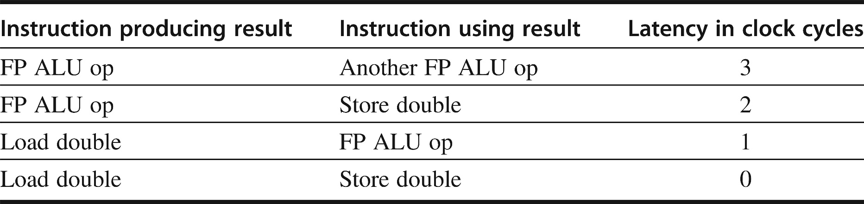
Compiler Techniques for Exposing ILP
Pipeline scheduling
Separate dependent instruction from the source instruction by the pipeline latency of the source instruction
Example:
for (i=999; i>=0; i=i-1)
x[i] = x[i] + s; // independent loop iterations
Assume the following number of intervening clock cycles needed to avoid a stall
Notes:
Figure 3.2 Latencies of FP operations used in this chapter. The last column is the number of intervening clock cycles needed to avoid a stall. These numbers are similar to the average latencies we would see on an FP unit. The latency of a floating-point load to a store is 0 because the result of the load can be bypassed without stalling the store. We will continue to assume an integer load latency of 1 and an integer ALU operation latency of 0 (which includes ALU operation to branch).

Slide 79
Pipeline Stalls
Assume: i in x1, -1 in x2
a in f2
Loop: fld f0,0(x1)
stall
fadd.d f4,f0,f2
stall
stall
fsd f4,0(x1)
addi x1,x1,-8
bne x1,x2,Loop
// 8 cycles/element
Loop: fld f0,0(x1)
addi x1,x1,-8
fadd.d f4,f0,f2
stall
stall
fsd f4,8(x1) bne x1,x2,Loop
// 7 cycles/element
Stall cannot be all eliminated by only scheduling instructions

Slide 80
Loop Unrolling（循环展开）
Unroll by a factor of 4
assume # elements is divisible by 4
Eliminate unnecessary instructions of loop control
Stall still exists between fld and fadd.d
and fadd.d and fsd
Totally 6x4+2=26 cycles
6.5 cycles/element
Loop: fld f0,0(x1)
fadd.d f4,f0,f2
fsd f4,0(x1) //drop addi & bne
fld f0,-8(x1)
fadd.d f4,f0,f2
fsd f4,-8(x1) //drop addi & bne
fld f0,-16(x1)
fadd.d f4,f0,f2
fsd f4,-16(x1) //drop addi & bne
fld f0,-24(x1)
fadd.d f4,f0,f2
fsd f4,-24(x1)
addi x1,x1,-32
bne x1,x2,Loop

Slide 81
Loop Unrolling
Eliminate unnecessary name dependence by register renaming
Note: number of live registers vs. original loop
Stall still exists between fld and fadd.d and fadd.d and fsd
Totally 6x4+2=26 cycles
6.5 cycles/element
Loop: fld f0,0(x1)
fadd.d f4,f0,f2
fsd f4,0(x1) //drop addi & bne
fld f6,-8(x1)
fadd.d f8,f6,f2
fsd f8,-8(x1) //drop addi & bne
fld f10,-16(x1)
fadd.d f12,f10,f2
fsd f12,-16(x1) //drop addi & bne
fld f14,-24(x1)
fadd.d f16,f14,f2
fsd f16,-24(x1)
addi x1,x1,-32
bne x1,x2,Loop

Slide 82
Loop Unrolling/Pipeline Scheduling
Pipeline schedule of the unrolled loop:
Total 14 cycles
3.5 cycles per element
# of unrolling limited by # of available registers
Loop: fld f0,0(x1)
fld f6,-8(x1)
fld f8,-16(x1)
fld f14,-24(x1)
fadd.d f4,f0,f2
fadd.d f8,f6,f2
fadd.d f12,f10,f2
fadd.d f16,f14,f2
fsd f4,0(x1)
fsd f8,-8(x1)
fsd f12,-16(x1)
fsd f16,-24(x1)
addi x1,x1,-32
bne x1,x2,Loop

Slide 83
Strip Mining
Do not usually know upper bound of loop
Suppose it is n, and we would like to unroll the loop to make k copies of the body
Instead of a single unrolled loop, we generate a pair of consecutive loops:
1st executes (n mod k) times and has a body that is the original loop
2nd is the unrolled body surrounded by an outer loop that iterates (n/k) times
For large values of n, most of the execution time will be spent in the unrolled loop
Also called “Strip Mining” in compiler term

Slide 84
Loop Unrolling Details
What assumptions made when moving code?
OK to move fsd past addi even though changes register
OK to move loads before stores: get right data?
When is it safe for compiler to do such changes?
Loop: fld f0,0(x1)
fadd.d f4,f0,f2
fsd f4,0(x1) //drop addi & bne
fld f6,-8(x1)
fadd.d f8,f6,f2
fsd f8,-8(x1) //drop addi & bne
fld f10,-16(x1)
fadd.d f12,f10,f2
fsd f12,-16(x1) //drop addi & bne
fld f14,-24(x1)
fadd.d f16,f14,f2
fsd f16,-24(x1)
addi x1,x1,-32
bne x1,x2,Loop

Slide 85
Compiler Perspectives on Code Movement
Compiler concerned about true dependencies in program
Whether or not a RAW hazard depends on pipeline
Try to schedule to avoid hazards that cause performance losses
Dependence is easy to determine for registers (fixed names)
Hard for memory (“memory disambiguation” problem):
Does 100(R4) = 20(R6)?
From different loop iterations, does 20(R6) = 20(R6)?
Our example requires compiler to know that if R1 doesn’t change then: 0(R1) ≠ -8(R1) ≠ -16(R1) ≠ -24(R1)
There were no dependencies between some loads and stores so they could be moved by each other

Slide 86
Steps Compiler Performed to Unroll
Finding the loop iterations were independent and unrolling is useful
Rename registers to avoid name dependencies
Eliminate extra test and branch instructions and adjust the loop termination and iteration code
Determine loads and stores in unrolled loop can be interchanged by observing that the loads and stores from different iterations are independent
Requires analyzing memory addresses and finding that they do not refer to the same address, and adjust load/store offset
Schedule the code, preserving any dependences needed to yield same result as the original code

Slide 87
Another possibility: Software Pipelining
Observation: if iterations from loops are independent, then can get more ILP by taking instructions from different iterations
Software pipelining: reorganizes loops so that each iteration is made from instructions chosen from different iterations of the original loop (~ Tomasulo in SW)

Slide 88
Software Pipelining Example
After: Software Pipelined
1 S.D 0(R1),F4 ; Stores M[i]
2 ADD.D F4,F0,F2 ; Adds to M[i-1]
3 L.D F0,-16(R1); Loads M[i-2]
4 DSUBUI R1,R1,#8
5 BNEZ R1,LOOP
Before: Unrolled 3 times
1 L.D F0,0(R1)
2 ADD.D F4,F0,F2
3 S.D 0(R1),F4
4 L.D F6,-8(R1)
5 ADD.D F8,F6,F2
6 S.D -8(R1),F8
7 L.D F10,-16(R1)
8 ADD.D F12,F10,F2
9 S.D -16(R1),F12
10 DSUBUI R1,R1,#24
11 BNEZ R1,LOOP
5 cycles per iteration, no stall
Symbolic Loop Unrolling
Maximize result-use distance
Less code space than unrolling
Loop control overhead once per iteration vs. once per each unrolled iteration in loop unrolling

Slide 89
When Safe to Unroll Loop?
Example: Where are data dependencies? (A,B,C distinct & nonoverlapping) for (i=0; i<100; i=i+1) { A[i+1] = A[i] + C[i]; /* S1 */ B[i+1] = B[i] + A[i+1]; /* S2 */}
1. S2 uses the value, A[i+1], computed by S1 in the same iteration.
2. S1 uses a value computed by S1 in an earlier iteration, since iteration i computes A[i+1] which is read in iteration i+1. The same is true of S2 for B[i] and B[i+1]. This is a “loop-carried dependence”: between iterations
For our prior example, each iteration was distinct
Implies that iterations can’t be executed in parallel, Right????

Slide 90
Does a loop-carried dependence mean there is no parallelism???
Consider: for (i=0; i< 8; i=i+1) { A = A + C[i]; /* S1 */ } Could compute: “Cycle 1”: temp0 = C[0] + C[1]; temp1 = C[2] + C[3]; temp2 = C[4] + C[5]; temp3 = C[6] + C[7]; “Cycle 2”: temp4 = temp0 + temp1; temp5 = temp2 + temp3; “Cycle 3”: A = temp4 + temp5;
Relies on associative nature of “+”.

Slide 91
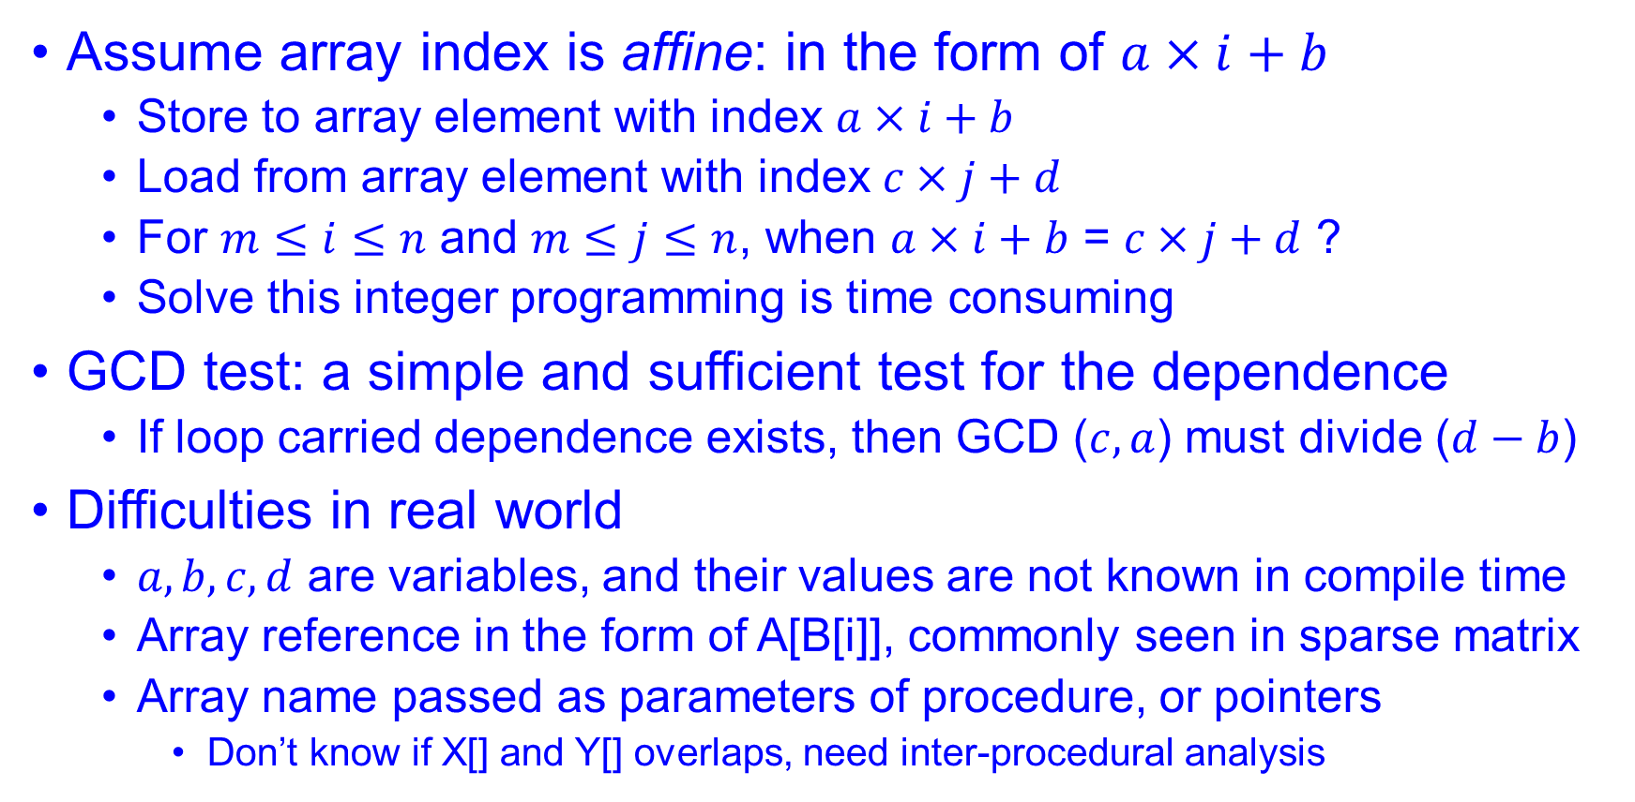
Simple test for loop carried dependence
Assume array index is affine: in the form of $a×i+b$
Store to array element with index $a×i+b$
Load from array element with index $c×j+d$
For $m≤i≤n$ and $m≤j≤n$, when $a×i+b$ = $c×j+d$ ?
Solve this integer programming is time consuming
GCD test: a simple and sufficient test for the dependence
If loop carried dependence exists, then GCD ($c,a$) must divide ($d−b$)
Difficulties in real world
$a, b, c, d$ are variables, and their values are not known in compile time
Array reference in the form of A[B[i]], commonly seen in sparse matrix
Array name passed as parameters of procedure, or pointers
Don’t know if X[] and Y[] overlaps, need inter-procedural analysis

Slide 92
Example of eliminating loop carried dependence by loop transformation
S1 uses the value assigned in the previous iteration by S2, so there is a loop-carried dependence between S2 and S1
The dependence is not circular: Neither statement depends on itself, and, although S1 depends on S2, S2 does not depend on S1
Transform the loop by conforming to the partial ordering
Interchanging the S1 and S2 will not affect the execution of S2
When i=1, S1 depends on the value of B[1] computed prior to initiating the loop
for (i=1; i<=100; i=i+1) {
A[i] = A[i] + B[i]; /* S1 */
B[i+1] = C[i] + D[i]; /* S2 */
}
A[1] = A[1] + B[1];
for (i=1; i<=99; i=i+1) {
B[i+1] = C[i] + D[i];
A[i+1] = A[i+1] + B[i+1];
}
B[101] = C[100] + D[100];

Slide 93
Hardware Support for Exposing More Parallelism at Compile-Time
Conditional or Predicated Instructions
Discussed before in context of branch prediction
Conditional instruction execution
First instruction slot Second instruction slot
LW R1,40(R2) ADD R3,R4,R5
ADD R6,R3,R7
BEQZ R10,L
LW R8,0(R10)
LW R9,0(R8)
Waste slot since 3rd LW dependent on result of 2nd LW

Slide 94
Predicated Execution
Avoid branch prediction by turning branches into conditionally executed instructions:
if (x) then A = B op C else NOP
If false, then neither store result nor cause exception
Expanded ISA of Alpha, MIPS, PowerPC, SPARC have conditional move; PA-RISC can annul any following instr.
IA-64: 64 1-bit condition fields selected so conditional execution of any instruction
This transformation is called “if-conversion”
Drawbacks to conditional instructions
Still takes a clock even if “annulled”
Stall if condition evaluated late
Complex conditions reduce effectiveness; condition becomes known late in pipeline
x
A = B op C

Slide 95
Hardware Support for Exposing More Parallelism at Compile-Time
Use predicated version load word (LWC)?
load occurs unless the third operand is 0
First instruction slot Second instruction slot
LW R1,40(R2) ADD R3,R4,R5
LWC R8,20(R10),R10 ADD R6,R3,R7
BEQZ R10,L
LW R9,0(R8)
If the sequence following the branch were short, the entire block of code might be converted to predicated execution, and the branch eliminated

Slide 96
Exception Behavior Support
Several mechanisms to ensure that speculation by compiler does not violate exception behavior
For example, cannot raise exceptions in predicated code if annulled
Prefetch does not cause exceptions

Slide 97
Hardware Support for Memory Reference Speculation
To compiler to move loads across stores, when it cannot be absolutely certain that such a movement is correct, a special instruction to check for address conflicts can be included in the architecture
The special instruction is left at the original location of the load and the load is moved up across stores
When a speculated load is executed, the hardware saves the address of the accessed memory location
If a subsequent store changes the location before the check instruction, then the speculation has failed
If only load instruction was speculated, then it suffices to redo the load at the point of the check instruction

Slide 98
Branch Prediction Schemes
0. Static Branch Prediction (profile-based predictor)
1-bit Branch history table (Branch-Prediction Buffer)
2-bit Branch history table (Branch-Prediction Buffer)
Correlating Branch Prediction Buffer
Tournament Branch Predictor
Branch Target Buffer
Integrated Instruction Fetch Units
Return Address Predictors

Slide 99
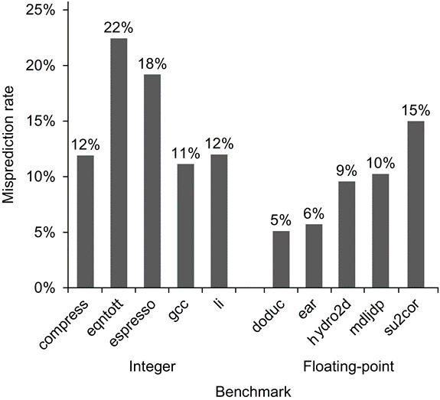
Misprediction rate on SPEC92 for a profile-based predictor
Floating-point programs have an average misprediction rate of 9% with a standard deviation of 4%
Integer programs have an average misprediction rate of 15% with a standard deviation of 5%
The actual performance depends on both the prediction accuracy and the branch frequency, which vary from 3% to 24%.

Slide 100
Dynamic Branch Prediction
Performance = ƒ(accuracy, cost of misprediction)
Branch History Table: Lower bits of PC address index a table of 1-bit values
Says whether or not branch taken last time; No address check
Saves HW, but may not be right branch
If instruction == BR, update table with outcome
Problem: in a loop, 1-bit BHT will cause 2 mispredictions
End of loop case, when it exits instead of looping as before
First time through loop on next time through code, when it predicts exit instead of looping
Average is 9 iterations before exit
Only 80% accuracy even if loop 90% of the time
BHT
PC

Slide 101
2-bit Dynamic Branch Prediction
2-bit scheme where change prediction only if get misprediction twice:
Green: stop, not taken; Red: go, taken
Adds hysteresis to decision making process
Generalize to n-bit saturating counter
T
NT
Predict Taken
Predict Taken
T
T
NT
NT
Predict Not
Taken
Predict Not
Taken
T
NT

Slide 102
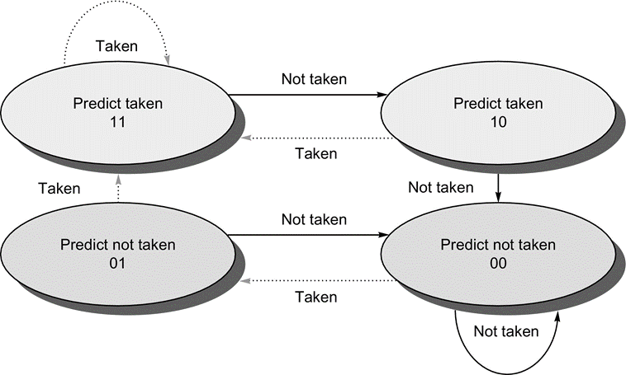
The states in a 2-bit prediction scheme
By using 2 bits rather than 1, a branch that strongly favors taken or not taken—as many branches do—will be mispredicted less often than with a 1-bit predictor.

Slide 103
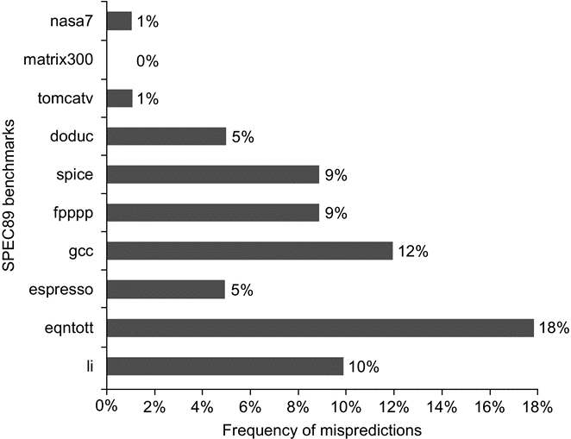
Prediction accuracy of a 4096-entry 2-bit BHT for the SPEC89 benchmarks
The misprediction rate for the integer benchmarks (gcc, espresso, eqntott, and li) is substantially higher (average of 11%) than that for the floating-point programs (average of 4%)
Although these data are for an older version of a subset of the SPEC benchmarks, the newer benchmarks are larger and would show slightly worse behavior, especially for the integer benchmarks.

Slide 104
Impact of BHT Size
Prediction accuracy of a 4096-entry 2-bit prediction buffer has the similar effect as an infinite buffer for the SPEC89 benchmarks

Slide 105
Branch Prediction
Basic 2-bit predictor:
For each branch:
Predict taken or not taken
If the prediction is wrong two consecutive times, change prediction
Correlating predictor:
Multiple 2-bit predictors for each branch
One for each possible combination of outcomes of preceding n branches
(m,n) predictor: behavior from last m branches to choose from 2m n-bit predictors
Tournament predictor:
Combine correlating predictor with local predictor

Slide 106
Correlated branch behavior
C code in left below, translates to the instructions in right
Label these branches b1, b2, and b3
The behavior of b3 is correlated with the behavior of b1 and b2
If neither b1 nor b2 are taken (i.e., if the conditions both evaluate to true and aa and bb are both assigned 0), then b3 will be taken
addi x3,x1,–2
bnez x3,L1 //branch b1 (aa!=2)
add x1,x0,x0 //aa=0
L1: addi x3,x2,–2
bnez x3,L2 //branch b2 (bb!=2)
add x2,x0,x0 //bb=0
L2: sub x3,x1,x2 //x3=aa-bb
beqz x3,L3 //branch b3 (aa==bb)
if (aa==2)
aa=0;
if (bb==2)
bb=0;
if (aa!=bb) {

Slide 107
Correlating Branches
Two-level Predictor
Idea: taken/not taken of recently executed branches is related to behavior of next branch (as well as the history of that branch behavior)
Then behavior of recent branches selects between, say, 4 predictions of next branch, updating just that prediction
(m,n) predictor m-bit global, n-bit local
The global history of the most recent m branches can be recorded in an m-bit shift register
Branch address (4 bits)
2-bits per branch local predictors
Prediction
2-bit global
branch history
(01 = not taken then taken)

Slide 108
Accuracy of Different BHT Schemes
Mispredict because either
Wrong guess for that branch
Got branch history of wrong branch when index the table
4096 entry table programs vary from 1% to 18%
For SPEC92, 4096 about as good as infinite table
4096 Entries 2-bit BHT
Unlimited Entries 2-bit BHT
1024 Entries (2,2) BHT
Frequency of Mispredictions

Slide 109
Re-evaluating Correlation
Several of the SPEC benchmarks have less than a dozen branches responsible for 90% of taken branches:
program branch % static # = 90%
compress 14% 236 13
eqntott 25% 494 5
gcc 15% 9531 2020
mpeg 10% 5598 532
real gcc 13% 17361 3214
Real programs + OS more like gcc
Small benefits beyond benchmarks for correlation? problems with branch aliases?

Slide 110
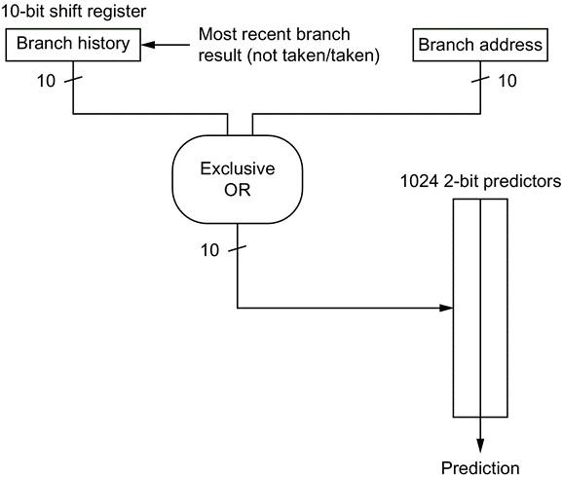
Gshare, a correlated branch predictor
In gshare the index is formed by combining the address of the branch and the most recent conditional branch outcomes using an exclusive-OR
Acts as a hash of the branch address and the branch history
The hashed result is used to index a prediction array of 2-bit counters
Gshare works remarkably well and is often used as the baseline for comparison
Predictors that combine local branch information and global branch history are also called alloyed predictors or hybrid predictors.
Notes:
Figure 3.4 A gshare predictor with 1024 entries, each being a standard 2-bit predictor.

Slide 111
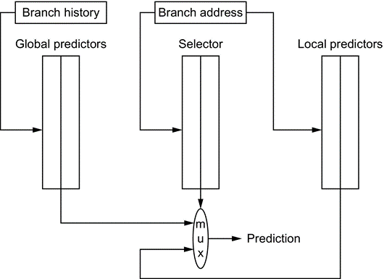
Tournament Predictors
Motivation for correlating branch predictors is 2-bit predictor failed on important branches; by adding global information, performance improved
Tournament predictors: use 2 predictors, 1 based on global information and 1 based on local information, and combine with a selector
Hopes to select right predictor for right branch
Notes:
Figure 3.5 A tournament predictor using the branch address to index a set of 2-bit selection counters, which choose between a local and a global predictor. In this case, the index to the selector table is the current branch address. The two tables are also 2-bit predictors that are indexed by the global history and branch address, respectively. The selector acts like a 2-bit predictor, changing the preferred predictor for a branch address when two mispredicts occur in a row. The number of bits of the branch address used to index the selector table and the local predictor table is equal to the length of the global branch history used to index the global prediction table. Note that misprediction is a bit tricky because we need to change both the selector table and either the global or local predictor.

Slide 112
Tournament Predictor in Alpha 21264
Pioneered in Alpha processors, followed by several AMD ones
4K 2-bit counters to choose from among a global predictor and a local predictor
Global predictor also has 4K entries and is indexed by the history of the last 12 branches; each entry in the global predictor is a standard 2-bit predictor
12-bit pattern:
i^{th} bit 0 => i^{th} prior branch not taken;
i^{th} bit 1 => i^{th} prior branch taken;

Slide 113
Tournament Predictor in Alpha 21264
Local predictor consists of a 2-level predictor:
Top level a local history table consisting of 1024 10-bit entries; each 10-bit entry corresponds to the most recent 10 branch outcomes for the entry. 10-bit history allows patterns 10 branches to be discovered and predicted.
Next level Selected entry from the local history table is used to index a table of 1K entries consisting a 3-bit saturating counters, which provide the local prediction
Total size: 4K*2 + 4K*2 + 1K*10 + 1K*3 = 29K bits! (~180,000 transistors)

Slide 114
% of predictions from local predictor in Tournament Prediction Scheme

Slide 115
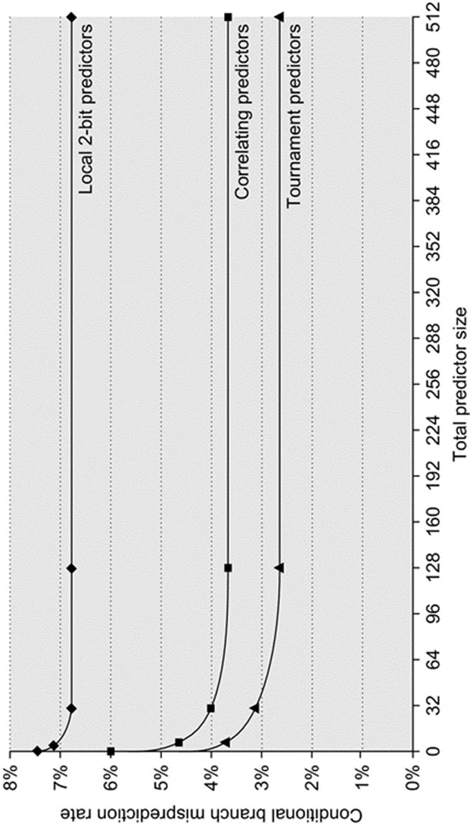
Accuracy v. Size (SPEC89)

Slide 116
Accuracy of Branch Prediction
Profile: branch profile from last execution (static in that in encoded in instruction, but profile)

Slide 117
Tagged Hybrid Predictors
Need to have predictor for each branch and related history
Problem: this implies huge tables
How to combine multiple predictors that track whether a prediction is likely to be associated with the current branch?
Solution:
Use hash tables, whose hash value is based on branch address and branch history
Longer histories may lead to increased chance of hash collision, so use multiple tables with increasingly shorter histories
Also named TAGE: TAgged GEometic predictors
Originated from algorithm for statistical compression called PPM (Prediction by Partial Matching)

Slide 118
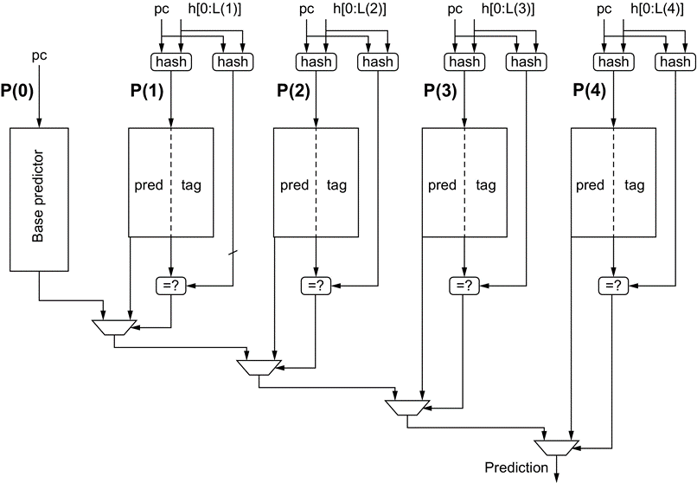
A five-component Tagged Hybrid Predictors
5 separate prediction tables
Indexed by a hash of the branch address and a segment of recent branch history of length 0–4 using the shift register “h”
The hash can be as simple as an exclusive-OR, as in gshare
Each predictor is a 2-bit (or possibly 3-bit) predictor
The tags are typically 4–8 bits
The chosen prediction is the one with the longest history where the tags also match
Notes:
Figure 3.7 A five-component tagged hybrid predictor has five separate prediction tables, indexed by a hash of the branch address and a segment of recent branch history of length 0–4 labeled “h” in this figure. The hash can be as simple as an exclusive-OR, as in gshare. Each predictor is a 2-bit (or possibly 3-bit) predictor. The tags are typically 4–8 bits. The chosen prediction is the one with the longest history where the tags also match.

Slide 119
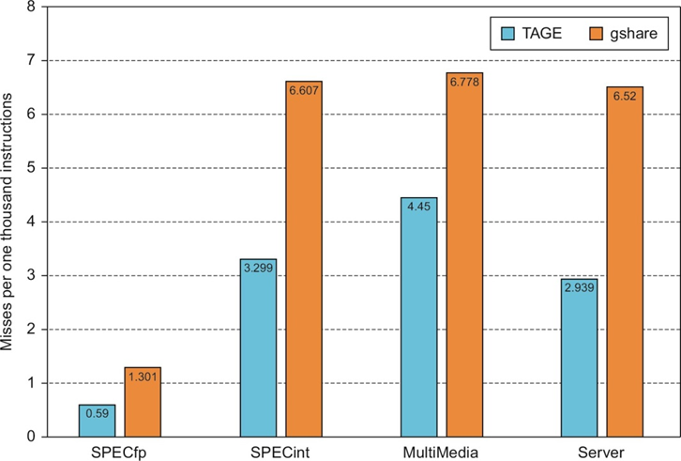
Comparison of tagged hybrid predictor versus gshare
The misprediction rate is measured as mispredicts per 1000 instructions executed
Both predictors use the same total number of bits, although tagged hybrid uses some of that storage for tags, while gshare contains no tags
Notes:
Figure 3.8 A comparison of the misprediction rate (measured as mispredicts per 1000 instructions executed) for tagged hybrid versus gshare. Both predictors use the same total number of bits, although tagged hybrid uses some of that storage for tags, while gshare contains no tags. The benchmarks consist of traces from SPECfp and SPECint, a series of multimedia and server benchmarks. The latter two behave more like SPECint.

Slide 120
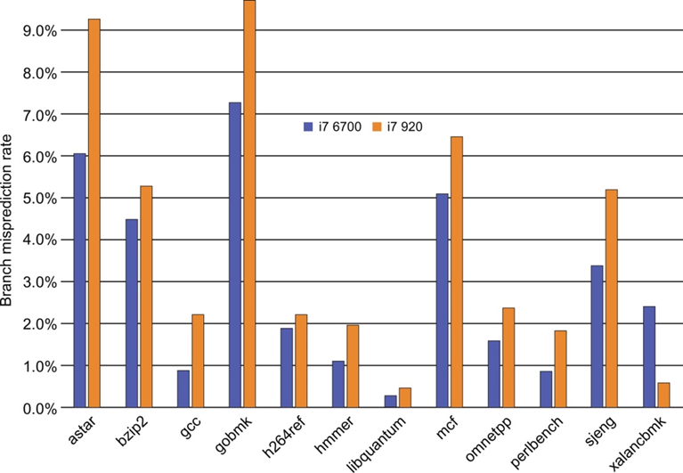
The misprediction rate on the Intel Core i7 920 and 6700
SPECCPU2006int
i7 920 Nehalem
Chosen from 3 different predictors by tracking the accuracy of each prediction
Simple 2-bit predictor
Global history predictor
Loop exit predictor
Like tournament predictor
i7 6700 Skylake
TAGE maybe
Notes:
Figure 3.9 The misprediction rate for the integer SPECCPU2006 benchmarks on the Intel Core i7 920 and 6700. The misprediction rate is computed as the ratio of completed branches that are mispredicted versus all completed branches. This could understate the misprediction rate somewhat because if a branch is mispredicted and led to another mispredicted branch (which should not have been executed), it will be counted as only one misprediction. On average, the i7 920 mispredicts branches 1.3 times as often as the i7 6700.

Slide 121
Need Address at Same Time as Prediction: Branch Target Buffer (BTB)
Also: Branch Target Cache: Use address of branch index to get prediction AND branch address (if taken)
Note: must check for branch match now, since can’t use wrong branch address
Support high instruction bandwidth
Branch-Target buffers
Next PC prediction buffer
Indexed by current PC
Branch PC
Predicted PC
PC of instruction
FETCH
=?
Extra
prediction state
bits
Yes: instruction is branch and use predicted PC as next PC
No: branch not
predicted, proceed normally
(Next PC = PC+4)

Slide 122
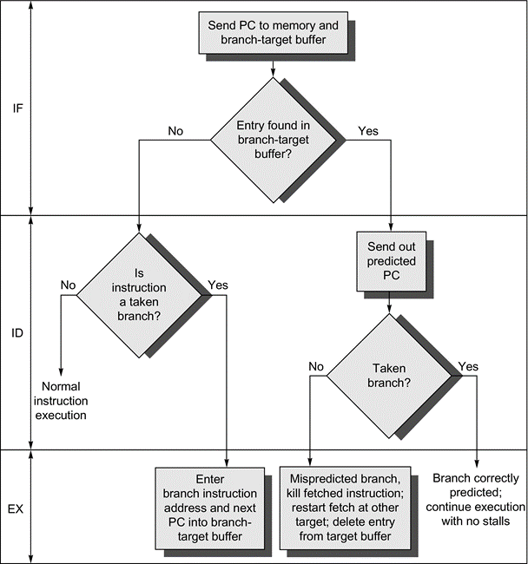
BTB Workflow
“Branch folding” Optimization
Larger branch-target buffer is more accurate, but needs longer decoding time
Put target instruction into buffer instead of target address
If multiple issue, put multiple target instructions in the buffer
Works best for unconditional jumps
0 cycle execution
Also good for conditional branches
Notes:
Figure 3.25 A branch-target buffer. The PC of the instruction being fetched is matched against a set of instruction addresses stored in the first column; these represent the addresses of known branches. If the PC matches one of these entries, then the instruction being fetched is a taken branch, and the second field, predicted PC, contains the prediction for the next PC after the branch. Fetching begins immediately at that address. The third field, which is optional, may be used for extra prediction state bits.
Figure 3.26 The steps involved in handling an instruction with a branch-target buffer.

Slide 123
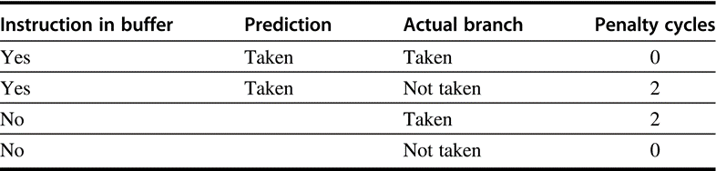
Penalties for BTB combinations
No branch penalty if everything is correctly predicted
If the branch is not correctly predicted, the penalty is equal to
1 clock cycle to update the buffer with the correct information and 1 clock cycle to restart fetching the next correct instruction for the branch
If the branch is not found and taken, a 2-cycle penalty is encountered, during which time the buffer is updated
Notes:
Figure 3.27 Penalties for all possible combinations of whether the branch is in the buffer and what it actually does, assuming we store only taken branches in the buffer. There is no branch penalty if everything is correctly predicted and the branch is found in the target buffer. If the branch is not correctly predicted, the penalty is equal to 1 clock cycle to update the buffer with the correct information (during which an instruction cannot be fetched) and 1 clock cycle, if needed, to restart fetching the next correct instruction for the branch. If the branch is not found and taken, a 2-cycle penalty is encountered, during which time the buffer is updated.

Slide 124
Special Case: Return Addresses
Register Indirect branch hard to predict address
In SPEC95, procedure returns account for more than 15% of the branches and the vast majority of the indirect jumps on average
an aggressive branch predictor achieves an accuracy of less than 60% for such return branches
Return Address Buffer (Stack)
Most unconditional branches come from function returns
The same procedure can be called from multiple sites
Causes the buffer to potentially forget about the return address from previous calls
Since stack discipline for procedures, save return address in small buffer that acts like a stack: 8 to 16 entries has small miss rate
Create return address buffer organized as a stack

Slide 125
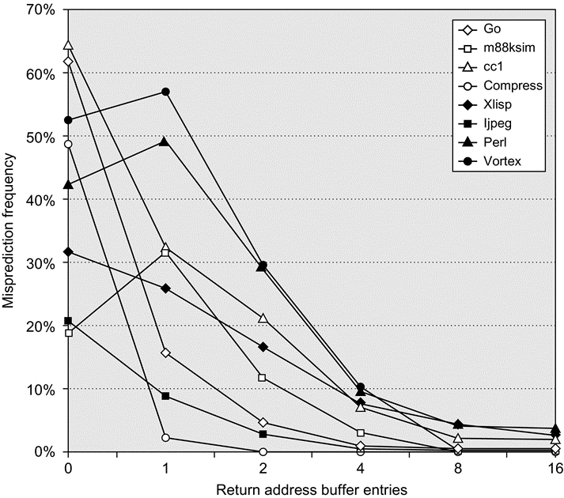
Return Address Predictor
A buffer of 0 entries implies that the standard branch prediction is used
Because call depths are typically not large, with some exceptions, a modest buffer works well
Notes:
Figure 3.28 Prediction accuracy for a return address buffer operated as a stack on a number of SPEC CPU95 benchmarks. The accuracy is the fraction of return addresses predicted correctly. A buffer of 0 entries implies that the standard branch prediction is used. Because call depths are typically not large, with some exceptions, a modest buffer works well. These data come from Skadron et al. (1999) and use a fix-up mechanism to prevent corruption of the cached return addresses.

Slide 126
Integrated Instruction Fetch Unit
Not as a simple pipeline stage as in 5 stage RISC pipeline
A monolithic unit that performs:
Constant branch prediction, to drive the fetch pipeline
Instruction prefetch, integrating it with branch prediction
Fetch ahead to deliver multiple instructions per clock
Instruction memory access and buffering
Deal with crossing cache lines, using prefetch to hide the cost of crossing cache blocks
Nowadays, all high-end processors use a separate instruction fetch unit connected to the rest of the pipeline by a buffer containing pending instructions

Slide 127
Dynamic Branch Prediction Summary
Prediction becoming important part of scalar execution
Branch History Table: 2 bits for loop accuracy
Correlation: Recently executed branches correlated with next branch
Either different branches
Or different executions of same branches
Tournament Predictor: more resources to competitive solutions and pick between them
Branch Target Buffer: include branch address & prediction
Predicated Execution can reduce number of branches, number of mispredicted branches
Return address stack for prediction of indirect jump

Slide 128
Pitfall: Sometimes bigger and dumber is better
21264 uses tournament predictor (29 Kbits)
Earlier 21164 uses a simple 2-bit predictor with 2K entries (or a total of 4 Kbits)
SPEC95 benchmarks, 21264 outperforms
21264 avg. 11.5 mispredictions per 1000 instructions
21164 avg. 16.5 mispredictions per 1000 instructions
Reversed for transaction processing (TP) !
21264 avg. 17 mispredictions per 1000 instructions
21164 avg. 15 mispredictions per 1000 instructions
TP code much larger & 21164 hold 2X branch predictions based on local behavior (2K vs. 1K local predictor in the 21264)

Slide 129
What about Precise Interrupts?
State of machine looks as if no instruction beyond faulting instructions has issued
Tomasulo had: In-order issue, out-of-order execution, and out-of-order completion
Need to “fix” the out-of-order completion aspect so that we can find precise breakpoint in instruction stream
Separate “execution complete” with “instruction commit”

Slide 130
Hardware-Based Speculation
Execute instructions along predicted execution paths but only commit the results if prediction was correct
Instruction commit: allowing an instruction to update the register file when instruction is no longer speculative
Need an additional piece of hardware to prevent any irrevocable action until an instruction commits
I.e. updating state or taking an execution
Remember “history file” and “future file” we discussed before
Now we need “Reorder Buffer”

Slide 131
Relationship between precise interrupts and specultation:
Speculation: guess and check
Important for branch prediction:
Need to “take our best shot” at predicting branch direction.
If we speculate and are wrong, need to back up and restart execution to point at which we predicted incorrectly:
This is exactly same as precise exceptions!
Technique for both precise interrupts/exceptions and speculation: in-order completion or commit

Slide 132
Reorder Buffer
Reorder buffer – holds the result of instruction between completion and commit. It has 4 fields:
Instruction type: branch/store/register
Destination field: register number
Value field: output value
Ready field: completed execution?
Modify reservation stations:
Operand source is now reorder buffer instead of functional unit
Register values and memory values are not written until an instruction commits
On misprediction: Speculated entries in ROB are cleared
Exceptions: Not recognized until it is ready to commit

Slide 133
HW support for precise interrupts
Use reorder buffer number instead of reservation station when execution completes
Supplies operands between execution complete & commit
Reorder buffer can be operand source => more registers like Reservation Stations
Instructions commit
Once instruction commits, result is put into register files
As a result, easy to undo speculated instructions on mispredicted branches or exceptions
Need HW buffer for results of uncommitted instructions: reorder buffer
Reorder
Buffer
FP
Op
Queue
FP Regs
Res Stations
Res Stations
FP Adder
FP Adder

Slide 134
Speculative Tomasulo Algorithm
1. Issue—get instruction from FP Op Queue
If reservation station and reorder buffer slot free, issue instr & send operands & reorder buffer no. for destination (this stage sometimes called “dispatch”)
2. Execution—operate on operands (EX)
When both operands ready then execute; if not ready, watch CDB for result; when both in reservation station, execute; checks RAW (sometimes called “issue”)
3. Write result—finish execution (WB)
Write on Common Data Bus to all awaiting FUs & reorder buffer; mark reservation station available.
4. Commit—update register with reorder result
When instr. at head of reorder buffer & result present, update register with result (or store to memory) and remove instr from reorder buffer. Mispredicted branch flushes reorder buffer (sometimes called “graduation”)

Slide 135
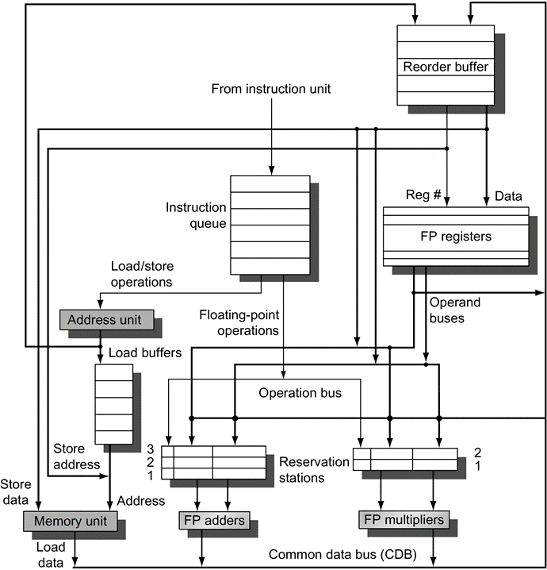
ROB Microarchitecture
The basic structure of a FP unit using Tomasulo's algorithm and extended to handle speculation
the addition of the ROB and the elimination of the store buffer, whose function is integrated into the ROB
This mechanism can be extended to allow multiple issues per clock by making the CDB wider to allow for multiple completions per clock
Notes:
Figure 3.15 The basic structure of a FP unit using Tomasulo's algorithm and extended to handle speculation. Comparing this to Figure 3.10 on page 198, which implemented Tomasulo's algorithm, we can see that the major change is the addition of the ROB and the elimination of the store buffer, whose function is integrated into the ROB. This mechanism can be extended to allow multiple issues per clock by making the CDB wider to allow for multiple completions per clock.

Slide 136
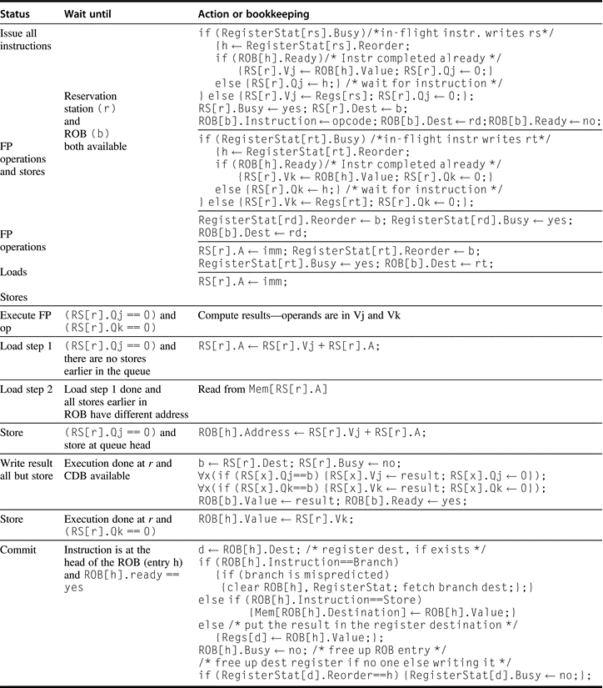
ROB Details
For the issuing instruction, rd is the destination, rs and rt are the sources, r is the reservation station allocated, b is the assigned ROB entry, and h is the head entry of the ROB. RS is the reservation station data structure
The value returned by a reservation station is called the result. Register-Stat is the register data structure, Regs represents the actual registers, and ROB is the reorder buffer data structure
Notes:
Figure 3.18 Steps in the algorithm and what is required for each step. For the issuing instruction, rd is the destination, rs and rt are the sources, r is the reservation station allocated, b is the assigned ROB entry, and h is the head entry of the ROB. RS is the reservation station data structure. The value returned by a reservation station is called the result. Register-Stat is the register data structure, Regs represents the actual registers, and ROB is the reorder buffer data structure.

Slide 137
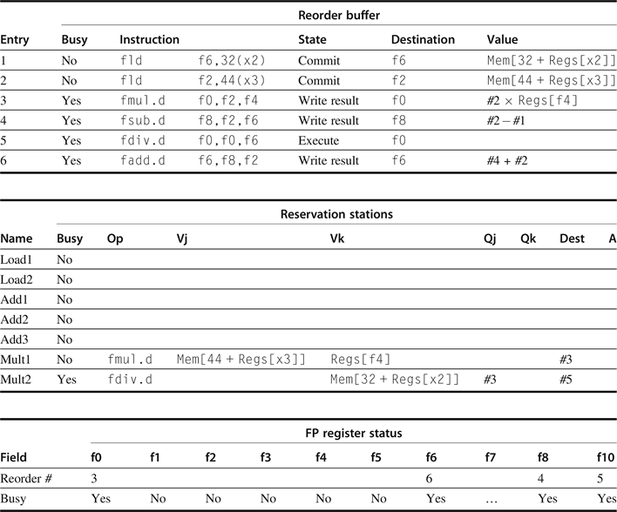
ROB Example
2 fld committed
fmul.d at the head
fsub.d & fadd.d complete execution, their results can be used for other instructions
fdiv.d in execution, but not complete due to its long latency
Notes:
Figure 3.16 At the time the fmul.d is ready to commit, only the two fld instructions have committed, although several others have completed execution. The fmul.d is at the head of the ROB, and the two fld instructions are there only to ease understanding. The fsub.d and fadd.d instructions will not commit until the fmul.d instruction commits, although the results of the instructions are available and can be used as sources for other instructions. The fdiv.d is in execution, but has not completed solely because of its longer latency than that of fmul.d. The Value column indicates the value being held; the format #X is used to refer to a value field of ROB entry X. Reorder buffers 1 and 2 are actually completed but are shown for informational purposes. We do not show the entries for the load/store queue, but these entries are kept in order.

Slide 138
Revisit the Tomasulo Loop Example
Assume that we have issued all the instructions in the loop twice
fld and fmul.d from the first iteration have committed and all other instructions have completed execution
Normally, the fsd would wait in the ROB for both the effective address operand (x1) and the value (f4). Because we are only considering the floating-point pipeline, assume the effective address for the store is computed by the time the instruction is issued
Loop: fld f0,0(x1)
fmul.d f4,f0,f2
fsd f4,0(x1)
addi x1,x1,-8
bne x1,x2,Loop //branches if x1≠x2

Slide 139
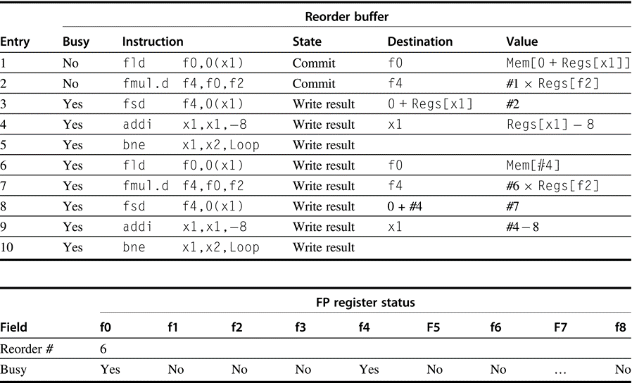
7
Notes:
Figure 3.17 Only the fld and fmul.d instructions have committed, although all the others have completed execution. Thus no reservation stations are busy and none are shown. The remaining instructions will be committed as quickly as possible. The first two reorder buffers are empty, but are shown for completeness.

Slide 140
What are the hardware complexities with Reorder Buffer (ROB)?
Need as many ports on ROB as register file
4-way issue needs 4 write ports and 8 read ports
How do you find the latest version of a register?
(As specified by Smith paper) need associative comparison network
Could use future file or just use the register result status buffer to track which specific reorder buffer has received the value
Compar network
Reorder
Buffer
FP
Op
Queue
Program Counter
FP Regs
Exceptions?
Dest Reg
Result
Valid
Reorder Table
Res Stations
Res Stations
FP Adder
FP Adder

Slide 141
Getting CPI < 1: Issuing Multiple Instructions/operations per Cycle
Vector Processing: Explicit coding of independent loops as operations on large vectors of numbers
Multimedia instructions being added to many processors
Superscalar: varying no. instructions/cycle (1 to 8), scheduled by compiler or by HW (Tomasulo-like)
IBM PowerPC, Sun UltraSparc, DEC Alpha, Pentium III/4
(Very) Long Instruction Words (V)LIW: fixed number of instructions (4-16) scheduled by the compiler; put ops into wide templates
Intel Architecture-64 (IA-64) 64-bit address
Renamed: “Explicitly Parallel Instruction Computer (EPIC)”
Anticipated success of multiple instructions lead to Instructions Per Clock cycle (IPC) vs. CPI

Slide 142
Multiple Issue: Achieve Real ILP
3 Solutions To achieve CPI < 1
Need to complete multiple instructions per clock cycle
Issue width: maximum number of instructions issued in a cycle
Statically scheduled superscalar processors
In order, if no dependence, issue one or more instructions
Need compiler to arrange independent instructions near together
Dynamically scheduled superscalar processors
Issue multiple instructions according to program order
Use hardware to maintain the true dependence between instructions
VLIW (very long instruction word) processors
Define wide instruction format or instruction bundle
Require compiler to fill in the parallel instructions or operations

Slide 143
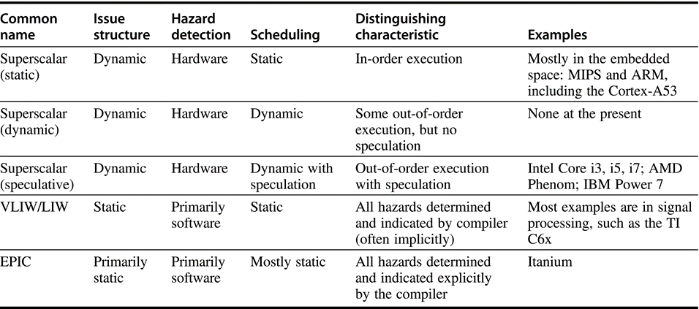
Multiple Issue Options
Notes:
Figure 3.19 The five primary approaches in use for multiple-issue processors and the primary characteristics that distinguish them. This chapter has focused on the hardware-intensive techniques, which are all some form of superscalar. Appendix H focuses on compiler-based approaches. The EPIC approach, as embodied in the IA-64 architecture, extends many of the concepts of the early VLIW approaches, providing a blend of static and dynamic approaches.

Slide 144
Modern Microprocessor Architecture
Dynamic scheduling + multiple issue + speculation
Two approaches:
In order issue: assign reservation stations and update pipeline control table in half clock cycles
Only supports 2 instructions/clock
Design complex logic to handle any possible dependencies between the 3 or more instructions issued in a cycle
Issue logic is often the bottleneck in dynamically scheduled superscalars

Slide 145
Dynamic Scheduling in Superscalar The easy way
How to issue two instructions and keep in-order instruction issue for Tomasulo?
Assume 1 integer + 1 floating point
1 Tomasulo control for integer, 1 for floating point
Issue 2X Clock Rate, so that issue remains in order
Only loads/stores might cause dependency between integer and FP issue:
Replace load reservation station with a load queue; operands must be read in the order they are fetched
Load checks addresses in Store Queue to avoid RAW violation
Store checks addresses in Load Queue to avoid WAR,WAW

Slide 146
Multiple Issue Issues
issue packet: group of instructions from fetch unit that could potentially issue in 1 clock
If instruction causes structural hazard or a data hazard either due to earlier instruction in execution or to earlier instruction in issue packet, then instruction does not issue
0 to N instruction issues per clock cycle, for N-issue
Performing issue checks in 1 cycle could limit clock cycle time: O(n²-n) comparisons
=> issue stage usually split and pipelined
1st stage decides how many instructions from within this packet can issue, 2nd stage examines hazards among selected instructions and those already been issued
=> higher branch penalties => prediction accuracy important

Slide 147
Multiple Issue Challenges
While Integer/FP split is simple for the HW, get CPI of 0.5 only for programs with:
Exactly 50% FP operations AND No hazards
If more instructions issue at same time, greater difficulty of decode and issue:
Even 2-scalar => examine 2 opcodes, 6 register specifiers, & decide if 1 or 2 instructions can issue; (N-issue ~O(N2-N) comparisons)
Register file: need 2x reads and 1x writes/cycle

Slide 148
Other Issues
Rename logic: must be able to rename same register multiple times in one cycle! For instance, consider 4-way issue:
add r1, r2, r3 add p11, p4, p7 sub r4, r1, r2 ⇒ sub p22, p11, p4 lw r1, 4(r4) lw p23, 4(p22) add r5, r1, r2 add p12, p23, p4
Imagine doing this transformation in a single cycle!
Result buses: Need to complete multiple instructions/cycle
So, need multiple buses with associated matching logic at every reservation station
Or, need multiple forwarding paths

Slide 149
Simple 2-issue SuperScalar
Superscalar RISC32: 2 instructions, 1 FP & 1 anything else
– Fetch 64-bits/clock cycle; Int on left, FP on right
– Can only issue 2nd instruction if 1st instruction issues
– More ports for FP registers to do FP load & FP op in a pair
Type Pipe Stages
Int. instruction IF ID EX MEM WB
FP instruction IF ID EX MEM WB
Int. instruction IF ID EX MEM WB
FP instruction IF ID EX MEM WB
Int. instruction IF ID EX MEM WB
FP instruction IF ID EX MEM WB
1 cycle load delay expands to 3 instructions in SS
instruction in right half can’t use it, nor instructions in next slot
Need speculated execution based on precise branch prediction

Slide 150
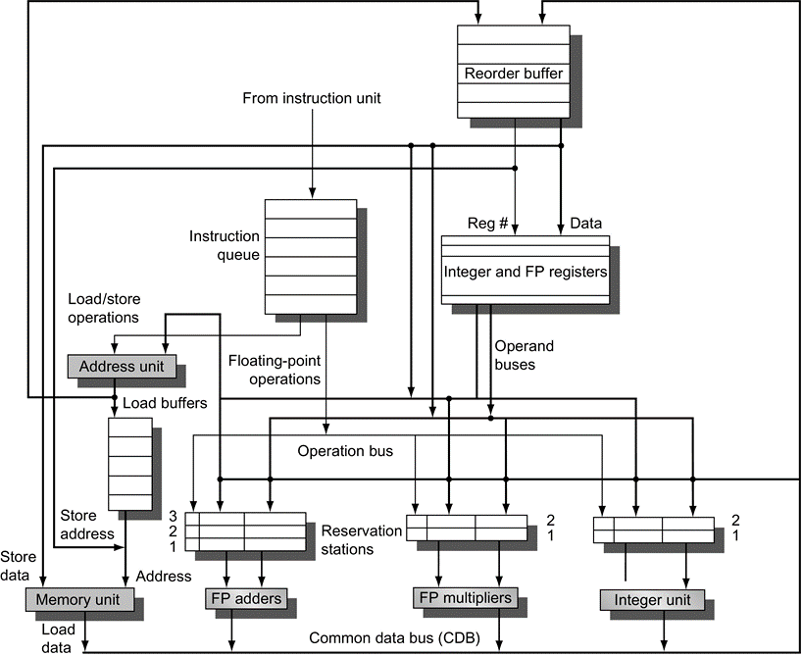
Multiple issue processor with speculation
The organization allows a FP multiply, FP add, integer, and load/store to all issues simultaneously
Assuming one issue per clock per functional unit)
Several datapaths must be widened to support multiple issues
CDB and the operand buses
Instruction issue logic not shown
Notes:
Figure 3.21 The basic organization of a multiple issue processor with speculation. In this case, the organization could allow a FP multiply, FP add, integer, and load/store to all issues simultaneously (assuming one issue per clock per functional unit). Note that several datapaths must be widened to support multiple issues: the CDB, the operand buses, and, critically, the instruction issue logic, which is not shown in this figure. The last is a difficult problem, as we discuss in the text.

Slide 151
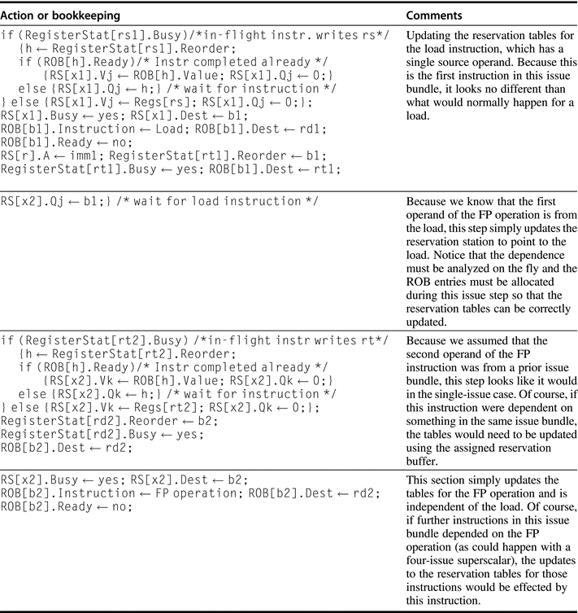
Issue Logic
For two dependent instructions
FP load
FP operation using load result
Notations
x1/x2: reservation stations
b1/b2: reorder buffer entries
rd1/rd2: destination registers
rs1/rs2/rt2: source registers
RS: reservation station data structure
Notes:
Figure 3.22 The issue steps for a pair of dependent instructions (called 1 and 2), where instruction 1 is FP load and instruction 2 is an FP operation whose first operand is the result of the load instruction; x1 and x2 are the assigned reservation stations for the instructions; and b1 and b2 are the assigned reorder buffer entries. For the issuing instructions, rd1 and rd2 are the destinations; rs1, rs2, and rt2 are the sources (the load has only one source); x1 and x2 are the reservation stations allocated; and b1 and b2 are the assigned ROB entries. RS is the reservation station data structure. RegisterStat is the register data structure, Regs represents the actual registers, and ROB is the reorder buffer data structure. Notice that we need to have assigned reorder buffer entries for this logic to operate properly, and recall that all these updates happen in a single clock cycle in parallel, not sequentially.

Slide 152
Multiple Issue Steps
Assign a reservation station and a reorder buffer for every instruction that might be issued in the next issue bundle
Examine all the dependencies among the instructions in the bundle. If dependencies exist in bundle, encode them in RS
If depends on an earlier instruction in the bundle, use the assigned ROB number to update the reservation table for the dependent instruction
Otherwise, use the existing reservation table and ROB information to update the reservation table entries for the issuing instruction
Also need to handle multiple completion/commit
To simplify RS allocation:
Limit the number of instructions of a given class that can be issued in a “bundle”, i.e. on FP, one integer, one load, one store

Slide 153
Example of a 2-issue processor
Loop increments each element of an integer array
Loop: ld x2,0(x1) //x2=array element
addi x2,x2,1 //increment x2 by 1
sd x2,0(x1) //store result
addi x1,x1,8 //increment pointer
bne x2,x3,Loop //branch if not last
Assume there are separate integer functional units for effective address calculation, for ALU operations, and for branch condition evaluation
Branch can be a critical performance limiter, speculation helps significantly

Slide 154
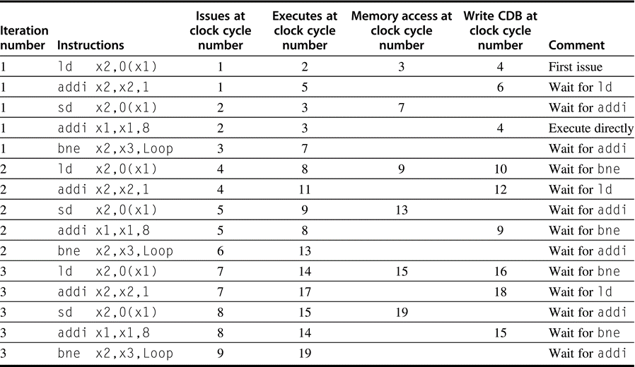
Example (No Speculation)
The ld following the bne cannot start execution earlier because it must wait until the branch outcome is determined
Notes:
Figure 3.23 The time of issue, execution, and writing result for a dual-issue version of our pipeline without speculation. Note that the ld following the bne cannot start execution earlier because it must wait until the branch outcome is determined. This type of program, with data-dependent branches that cannot be resolved earlier, shows the strength of speculation. Separate functional units for address calculation, ALU operations, and branch-condition evaluation allow multiple instructions to execute in the same cycle. Figure 3.24 shows this example with speculation.

Slide 155
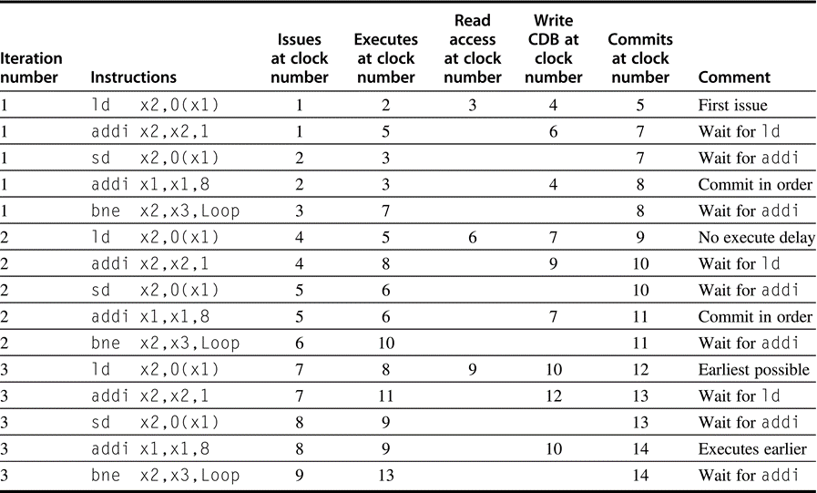
Example (with Speculation)
The ld following the bne can start execution early because it is speculative
Notes:
Figure 3.24 The time of issue, execution, and writing result for a dual-issue version of our pipeline with speculation. Note that the ld following the bne can start execution early because it is speculative.

Slide 156
Replace ROB with Renaming Registers
In Tomasulo’s algorithm, the values of the architecturally visible registers (x0, . . . r31 and f0, . . . f31) are contained in
Register file, and virtual registers in reservation stations and ROB
Instead of virtual registers from reservation stations and reorder buffer, create a single hardware register pool (physical register)
Contains all architectural visible registers and virtual registers
Maintain hardware-based map between architectural and physical registers
Still need a ROB-like queue to update the map table in order
During instruction issue
Use the map to locate physical registers corresponding to source architectural registers, and allocating a new unused register for the destination

Slide 157
Renaming Registers
WAW and WAR hazards are avoided by renaming of the destination register
Speculation recovery is handled because a physical register holding an instruction destination does not become the architectural register until the instruction commits
Renaming register simplifies commit:
Record that the mapping between architectural destination register and physical register is no longer speculative
Free up physical register used to hold older value
In other words: SWAP physical registers on commit
Leads to: the subset of physical registers contains architecturally visible registers is changing with time

Slide 158
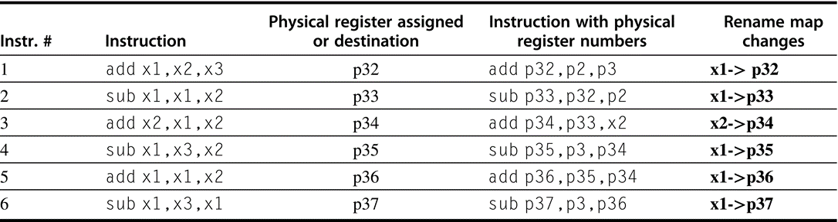
Example of 6-issue in a cycle
Combining instruction issue with register renaming in a cycle
Issue logic pre-reserves enough physical registers for the bundle
Issue logic finds dependencies within bundle, maps registers as necessary
Issue logic finds dependencies between current bundle and already in-flight bundles, maps registers as necessary
physical registers holding x1, x2, and x3 are initially p1, p2, and p3
Notes:
Figure 3.29 An example of six instructions to be issued in the same clock cycle and what has to happen. The instructions are shown in program order: 1–6; they are, however, issued in 1 clock cycle! The notation pi is used to refer to a physical register; the contents of that register at any point is determined by the renaming map. For simplicity, we assume that the physical registers holding the architectural registers x1, x2, and x3 are initially p1, p2, and p3 (they could be any physical register). The instructions are issued with physical register numbers, as shown in column four. The rename map, which appears in the last column, shows how the map would change if the instructions were issued sequentially. The difficulty is that all this renaming and replacement of architectural registers by physical renaming registers happens effectively in 1 cycle, not sequentially. The issue logic must find all the dependences and “rewrite” the instruction in parallel.

Slide 159
Renaming by mapping to physical registers
Physical register de-allocation is more difficult
Before free up a physical register, must know that it no longer corresponds to an architectural register
Renaming table no entry points to a particular physical register
And no further outstanding uses of it
Examine the source register specifiers of all instructions in the functional unit queues
Simple approach: simply wait until another instruction that writes the same architectural register commits (no further outstanding use)
Adds 40-80 extra registers: Alpha, Pentium,…
Size limits number of instructions in execution (used until commit)
In some systems or literatures, physical register is also called virtual register

Slide 160
Speculation Pros and Cons
Speculation Pro: uncover events that would otherwise stall the pipeline (cache misses, branches)
Speculation Con: speculate costly if exceptional event occurs when speculation was incorrect
Typical solution: speculation allows only low-cost exceptional events (1st-level cache miss)
When expensive exceptional event occurs, (2nd-level cache miss or TLB miss) processor waits until the instruction causing event is no longer speculative before handling the event
Assuming single branch per cycle: future may speculate across multiple branches!

Slide 161
How Much to Speculate?
Mis-speculation degrades performance and power relative to no speculation
May cause additional misses (cache, TLB)
Prevent speculative code from causing higher costing misses (e.g. L2)
Speculating through multiple branches
Complicates speculation recovery
Speculation and energy efficiency
Note: speculation is only energy efficient when it significantly improves performance
Speculation may lead to data leakage
Transient-Execution Attacks: A Computer Architect Perspective

Slide 162
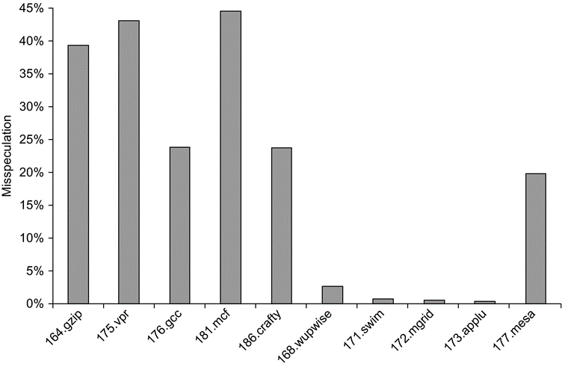
Effects of Speculation
integer
The fraction of instructions that are executed as a result of misspeculation is typically much higher for integer programs (the first five) versus FP programs (the last five)
(a subset of the SPEC2000)
Notes:
Figure 3.30 The fraction of instructions that are executed as a result of misspeculation is typically much higher for integer programs (the first five) versus FP programs (the last five).

Slide 163
Other Speculation Ideas
Address aliasing prediction
Determine if two stores or a load and a store reference the same address. If not, can change their order
Used in some processors to allow for reordering
Value prediction
Predict the value that will be produced by an instruction
Uses:
Loads that load from a constant pool
Instruction that produces a value from a small set of values
If highly accurate, can eliminate data flow restrictions and achieve higher rates of ILP
Still under investigation

Slide 164
Limits to ILP
Conflicting studies of amount
Benchmarks (vectorized Fortran FP vs. integer C programs)
Hardware sophistication
Compiler sophistication
How much ILP is available using existing mechanisms with increasing HW budgets?
Do we need to invent new HW/SW mechanisms to keep on processor performance curve?
Intel MMX, SSE (Streaming SIMD Extensions): 64 bit ints
Intel SSE2: 128 bit, including 2 64-bit Fl. Pt. per clock
Motorola AltaVec: 128 bit ints and FPs
Supersparc Multimedia ops, etc.

Slide 165
The approach of study
Initial HW Model here; MIPS compilers.
Assumptions for ideal/perfect machine to start:
1. Register renaming – infinite virtual registers => all register WAW & WAR hazards are avoided
2. Branch prediction – perfect; no mispredictions
3. Jump prediction – all jumps perfectly predicted 2 & 3 => machine with perfect speculation & an unbounded buffer of instructions available
4. Memory-address alias analysis – addresses are known & a store can be moved before a load provided addresses not equal
Also: unlimited number of instructions issued/clock cycle; perfect caches; 1 cycle latency for all instructions (FP *,/);

Slide 166
Upper Limit to ILP: Ideal Machine
FP: 75 - 150
Integer: 18 - 60
IPC

Slide 167
More Realistic HW: Branch Impact
FP: 15 - 45
Change from Infinite window to examine to 2000 and maximum issue of 64 instructions per clock cycle
Integer: 6 - 12
IPC
Perfect
Tournament
BHT (512)
Profile
No prediction

Slide 168
More Realistic HW: Renaming Register Impact
Change 2000 instr window, 64 instr issue, 8K 2 level Prediction
FP: 11 - 45
Integer: 5 - 15
IPC
Infinite
256
128
64
32
None

Slide 169
More Realistic HW: Memory Address Alias Impact
Change 2000 instr window, 64 instr issue, 8K 2 level Prediction, 256 renaming registers
FP: 4 - 45
(Fortran,
no heap)
Integer: 4 - 9
IPC
Perfect
Global/Stack perf; heap conflicts
Inspec. Assem.
None

Slide 170
Realistic HW for 2000: Window Impact
Perfect disambiguation (HW), 1K Selective Prediction, 16 entry return, 64 registers, issue as many as window
FP: 8 - 45
IPC
Integer: 6 - 12
Infinite
256
128
64
32
16
8
4

Slide 171
How to Exceed ILP Limits of this study?
WAR and WAW hazards through memory: eliminated WAW and WAR hazards through register renaming, but not in memory usage
Unnecessary dependences (compiler not unrolling loops so iteration variable dependence)
Overcoming the data flow limit: value prediction, predicting values and speculating on prediction
Address value prediction and speculation predicts addresses and speculates by reordering loads and stores; could provide better aliasing analysis, only need predict if addresses are equal

Slide 172
Another Approach: Mulithreaded Execution for Servers
Thread: light weight process with own instructions and data
Thread may be a process part of a parallel program of multiple processes, or it may be an independent program
Each thread has all the state (instructions, data, PC, register state, and so on) necessary to allow it to execute
Multithreading: multiple threads to share the functional units of 1 processor via overlapping
Processor must duplicate independent state of each thread e.g., a separate copy of register file and a separate PC
Memory shared through the virtual memory mechanisms
Threads execute overlapped, often interleaved
When a thread is stalled, perhaps for a cache miss, another thread can be executed, improving throughput

Slide 173
What if Can Change Instruction Set?
Superscalar processors decide on the fly how many instructions to issue
HW complexity of Number of instructions to issue O(n2)
Why not allow compiler to schedule instruction level parallelism explicitly?
Format the instructions in a potential issue packet so that HW need not check explicitly for dependences

Slide 174
LIW or VLIW Processors
Package multiple operations into one instruction
Example VLIW processor:
One integer instruction (or branch)
Two independent floating-point operations
Two independent memory references
Must be enough parallelism in code to fill the available slots
Disadvantages:
Statically finding parallelism
Code size
No hazard detection hardware
Binary code compatibility

Slide 175
VLIW: Very Long Instruction Word
Each “instruction” has explicit coding for multiple operations
In IA-64, grouping called a “packet”
In Transmeta, grouping called a “molecule” (with “atoms” as ops)
Tradeoff instruction space for simple decoding
The long instruction word has room for many operations
By definition, all the operations the compiler puts in the long instruction word are independent => execute in parallel
E.g., 2 integer operations, 2 FP ops, 2 Memory refs, 1 branch
16 to 24 bits per field => 7*16 or 112 bits to 7*24 or 168 bits wide
Need compiling technique that schedules across several branches

Slide 176
Recall: Unrolled Loop that Minimizes Stalls for Scalar
1 Loop: L.D F0,0(R1)
2 L.D F6,-8(R1)
3 L.D F10,-16(R1)
4 L.D F14,-24(R1)
5 ADD.D F4,F0,F2
6 ADD.D F8,F6,F2
7 ADD.D F12,F10,F2
8 ADD.D F16,F14,F2
9 S.D 0(R1),F4
10 S.D -8(R1),F8
11 S.D -16(R1),F12
12 DSUBUI R1,R1,#32
13 BNEZ R1,LOOP
14 S.D 8(R1),F16 ; 8-32 = -24
14 clock cycles, or 3.5 per iteration
L.D to ADD.D: 1 Cycle
ADD.D to S.D: 2 Cycles

Slide 177
Loop Unrolling in VLIW
Memory Memory FP FP Int. op/ Clock reference 1 reference 2 operation 1 op. 2 branch
L.D F0,0(R1) L.D F6,-8(R1) 1
L.D F10,-16(R1) L.D F14,-24(R1) 2
L.D F18,-32(R1) L.D F22,-40(R1) ADD.D F4,F0,F2 ADD.D F8,F6,F2 3
L.D F26,-48(R1) ADD.D F12,F10,F2 ADD.D F16,F14,F2 4
ADD.D F20,F18,F2 ADD.D F24,F22,F2 5
S.D 0(R1),F4 S.D -8(R1),F8 ADD.D F28,F26,F2 6
S.D -16(R1),F12 S.D -24(R1),F16 7
S.D -32(R1),F20 S.D -40(R1),F24 DSUBUI R1,R1,#48 8
S.D -0(R1),F28 BNEZ R1,LOOP 9
Unrolled 7 times to avoid delays
7 results in 9 clocks, or 1.3 clocks per iteration (1.8X)
Average: 2.5 ops per clock, 50% efficiency
Note: Need more registers in VLIW (15 vs. 6 in SuperScalar)

Slide 178
Recall: Software Pipelining
Observation: if iterations from loops are independent, then can get more ILP by taking instructions from different iterations
Software pipelining: reorganizes loops so that each iteration is made from instructions chosen from different iterations of the original loop (~ Tomasulo in SW)

Slide 179
Recall: Software Pipelining Example
After: Software Pipelined
1 S.D 0(R1),F4 ; Stores M[i]
2 ADD.D F4,F0,F2 ; Adds to M[i-1]
3 L.D F0,-16(R1); Loads M[i-2]
4 DSUBUI R1,R1,#8
5 BNEZ R1,LOOP
Before: Unrolled 3 times
1 L.D F0,0(R1)
2 ADD.D F4,F0,F2
3 S.D 0(R1),F4
4 L.D F6,-8(R1)
5 ADD.D F8,F6,F2
6 S.D -8(R1),F8
7 L.D F10,-16(R1)
8 ADD.D F12,F10,F2
9 S.D -16(R1),F12
10 DSUBUI R1,R1,#24
11 BNEZ R1,LOOP
5 cycles per iteration, no stall
Symbolic Loop Unrolling
Maximize result-use distance
Less code space than unrolling
Loop control overhead once per iteration vs. once per each unrolled iteration in loop unrolling

Slide 180
Software Pipelining with Loop Unrolling in VLIW
Memory Memory FP FP Int. op/ Clock
reference 1 reference 2 operation 1 op. 2 branch
L.D F0,-48(R1) ST 0(R1),F4 ADD.D F4,F0,F2 1
L.D F6,-56(R1) ST -8(R1),F8 ADD.D F8,F6,F2 DSUBUI R1,R1,#24 2
L.D F10,-40(R1) ST 8(R1),F12 ADD.D F12,F10,F2 BNEZ R1,LOOP 3
Software pipelined across 9 iterations of original loop
In each iteration of above loop, we:
Store to m,m-8,m-16 (iterations I-3,I-2,I-1)
Compute for m-24,m-32,m-40 (iterations I,I+1,I+2)
Load from m-48,m-56,m-64 (iterations I+3,I+4,I+5)
9 results in 9 cycles, or 1 clock per iteration
Average: 3.3 ops per clock, 66% efficiency
Note: Need fewer registers for software pipelining
(only using 7 registers here, was using 15)

Slide 181
Trace Scheduling
Parallelism across IF branches vs. LOOP branches?
Two steps:
Trace Selection
Find likely sequence of basic blocks (trace) of (statically predicted or profile predicted) long sequence of straight-line code
Trace Compaction
Squeeze trace into few VLIW instructions
Need bookkeeping code in case prediction is wrong
This is a form of compiler-generated speculation
Compiler must generate “fixup” code to handle cases in which trace is not the taken branch
Needs extra registers: undoes bad guess by discarding
Subtle compiler bugs mean wrong answer vs. poorer performance; no hardware interlocks

Slide 182
Advantages of HW (Tomasulo) vs. SW (VLIW) Speculation
HW advantages:
HW better at memory disambiguation since knows actual addresses
HW better at branch prediction since lower overhead
HW maintains precise exception model
HW does not execute bookkeeping instructions
Same software works across multiple implementations
Smaller code size (not as many nops filling blank instructions)
SW advantages:
Window size that is examined for parallelism much higher
Much less hardware involved in VLIW (unless you are Intel…!)
More involved types of speculation can be done more easily
Speculation can be based on large-scale program behavior, not just local information

Slide 183
Superscalar v. VLIW
Smaller code size
Binary compatibility across generations of hardware
Simplified Hardware for decoding, issuing instructions
No Interlock Hardware (compiler checks?)
More registers, but simplified Hardware for Register Ports (multiple independent register files?)

Slide 184
Problems with First Generation VLIW
Increase in code size
generating enough operations in a straight-line code fragment requires ambitiously unrolling loops
whenever VLIW instructions are not full, unused functional units translate to wasted bits in instruction encoding
Operated in lock-step; no hazard detection HW
a stall in any functional unit pipeline caused entire processor to stall, since all functional units must be kept synchronized
Compiler might prediction function units, but caches hard to predict
Binary code compatibility
Pure VLIW => different numbers of functional units and unit latencies require different versions of the code

Slide 185
Intel/HP IA-64 “Explicitly Parallel Instruction Computer (EPIC)”
IA-64: instruction set architecture; EPIC is type
EPIC = 2nd generation VLIW?
Itanium™ is name of first implementation (2001)
Highly parallel and deeply pipelined hardware at 800Mhz
6-wide, 10-stage pipeline at 800Mhz on 0.18 µ process
128 64-bit integer registers + 128 82-bit floating point registers
Not separate register files per functional unit as in old VLIW
Hardware checks dependencies (interlocks => binary compatibility over time)
Predicated execution (select 1 out of 64 1-bit flags) => 40% fewer mispredictions?

Slide 186
IA-64 Registers
The integer registers are configured to help accelerate procedure calls using a register stack
mechanism similar to that developed in the Berkeley RISC-I processor and used in the SPARC architecture.
Registers 0-31 are always accessible and addressed as 0-31
Registers 32-128 are used as a register stack and each procedure is allocated a set of registers (from 0 to 96)
The new register stack frame is created for a called procedure by renaming the registers in hardware;
a special register called the current frame pointer (CFM) points to the set of registers to be used by a given procedure
8 64-bit Branch registers used to hold branch destination addresses for indirect branches; 64 1-bit predict registers

Slide 187
IA-64 Registers
Both the integer and floating point registers support register rotation for registers 32-128.
Register rotation is designed to ease the task of allocating of registers in software pipelined loops
When combined with predication, possible to avoid the need for unrolling and for separate prologue and epilogue code for a software pipelined loop
makes the SW-pipelining usable for loops with smaller numbers of iterations, where the overheads would traditionally negate many of the advantages

Slide 188
EPIC: Explicitly Parallel Instruction Computer
Instruction group: a sequence of consecutive instructions with no register data dependences
All the instructions in a group could be executed in parallel, if sufficient hardware resources existed and if any dependences through memory were preserved
An instruction group can be arbitrarily long, but the compiler must explicitly indicate the boundary between one instruction group and another by placing a stop between 2 instructions that belong to different groups
IA-64 instructions are encoded in bundles, which are 128 bits wide.
Each bundle consists of a 5-bit template field and 3 instructions, each 41 bits in length
3 Instructions in 128 bit “groups”; field determines if instructions dependent or independent
Smaller code size than old VLIW, larger than x86/RISC
Groups can be linked to show independence > 3 instr

Slide 189
5 Types of Execution in Bundle
Execution Instruction Instruction Example Unit Slot type Description Instructions
I-unit A Integer ALU add, subtract, and, or, cmp
I Non-ALU Int shifts, bit tests, moves
M-unit A Integer ALU add, subtract, and, or, cmp
M Memory access Loads, stores for int/FP regs
F-unit F Floating point Floating point instructions
B-unit B Branches Conditional branches, calls
L+X L+X Extended Extended immediates, stops
5-bit template field within each bundle describes both the presence of any stops associated with the bundle and the execution unit type required by each instruction within the bundle

Slide 190
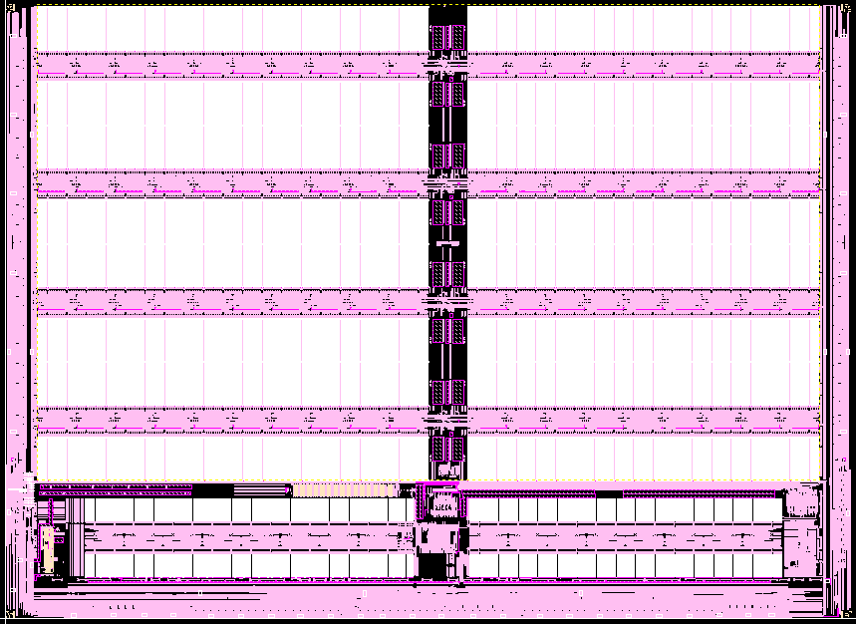
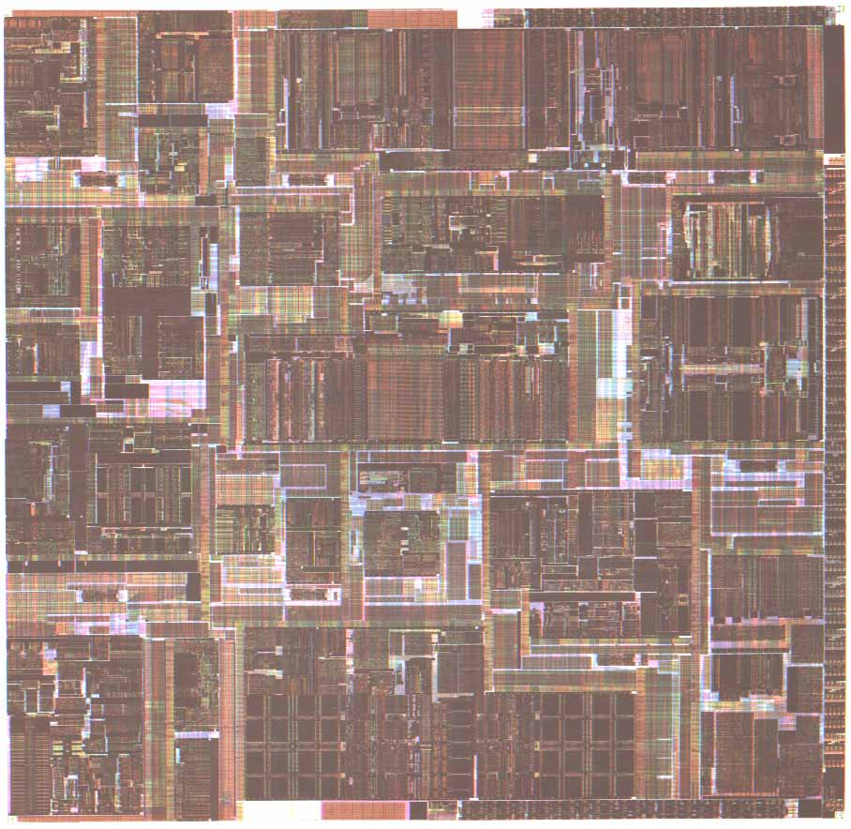
Itanium™ Processor Silicon (Copyright: Intel at Hotchips ’00)
IA-32
Control
FPU
IA-64 Control
TLB
Integer Units
Cache
Instr.
Fetch &
Decode
Cache
Bus
Core Processor Die
4 x 1MB L3 cache

Slide 191
Itanium™ Machine Characteristics (Copyright: Intel at Hotchips ’00)
Frequency
800 MHz
Transistor Count
25.4M CPU; 295M L3
Process
0.18u CMOS, 6 metal layer
Package
Organic Land Grid Array
Machine Width
6 insts/clock (4 ALU/MM, 2 Ld/St, 2 FP, 3 Br)
Registers
14 ported 128 GR & 128 FR; 64 Predicates
Speculation
32 entry ALAT, Exception Deferral
Branch Prediction
Multilevel 4-stage Prediction Hierarchy
FP Compute Bandwidth
3.2 GFlops (DP/EP); 6.4 GFlops (SP)
Memory -> FP Bandwidth
4 DP (8 SP) operands/clock
Virtual Memory Support
64 entry ITLB, 32/96 2-level DTLB, VHPT
L2/L1 Cache
Dual ported 96K Unified & 16KD; 16KI
L2/L1 Latency
6 / 2 clocks
L3 Cache
4MB, 4-way s.a., BW of 12.8 GB/sec;
System Bus
2.1 GB/sec; 4-way Glueless MP
Scalable to large (512+ proc) systems

Slide 192
Itanium™ EPIC Design Maximizes SW-HW Synergy
(Copyright: Intel at Hotchips ’00)
Architecture Features programmed by compiler:
Branch Hints
Explicit
Parallelism
Register Stack & Rotation
Memory Hints
Predication
Data & Control
Speculation
Micro-architecture Features in hardware:
Fetch
Issue
Register
Handling
Control
Parallel Resources
Memory Subsystem
4 Integer +
4 MMX Units
Instruction
Cache
& Branch Predictors
128 GR &
128 FR,
Register
Remap & Stack
Engine
Three levels of cache: L1, L2, L3
2 FMACs
(4 for SSE)
Fast, Simple 6-Issue
Bypasses & Dependencies
2 L.D/ST units
32 entry ALAT
Speculation Deferral Management

Slide 193
10 Stage In-Order Core Pipeline (Copyright: Intel at Hotchips ’00)
Instruction Pointer Generation
Fetch
Rotate
Expand
Rename
Word Line Decode
Register Read
Execute
Exception Detect
Write Back
Front End
Pre-fetch/Fetch of up to 6 instructions/cycle
Hierarchy of branch predictors
Decoupling buffer
Execution
4 single cycle ALUs, 2 ld/str
Advanced load control
Predicate delivery & branch
Nat/Exception//Retirement
EXPAND
RENAME
WORD-LINE
DECODE
REGISTER READ
IPG
FET
ROT
EXP
REN
WL.D
REG
EXE
DET
WRB
INST POINTER
GENERATION
FETCH
ROTATE
EXECUTE
EXCEPTION
DETECT
WRITE-BACK
Instruction Delivery
Dispersal of up to 6 instructions on 9 ports
Reg. remapping
Reg. stack engine
Operand Delivery
Reg read + Bypasses
Register scoreboard
Predicated dependencies

Slide 194
Itanium processor 10-stage pipeline
Front-end (stages IPG, Fetch, and Rotate): prefetches up to 32 bytes per clock (2 bundles) into a prefetch buffer, which can hold up to 8 bundles (24 instructions)
Branch prediction is done using a multilevel adaptive predictor like P6 microarchitecture
Instruction delivery (stages EXP and REN): distributes up to 6 instructions to the 9 functional units
Implements registers renaming for both rotation and register stacking.

Slide 195
Itanium processor 10-stage pipeline
Operand delivery (WLD and REG): accesses register file, performs register bypassing, accesses and updates a register scoreboard, and checks predicate dependences.
Scoreboard used to detect when individual instructions can proceed, so that a stall of 1 instruction in a bundle need not cause the entire bundle to stall
Execution (EXE, DET, and WRB): executes instructions through ALUs and load/store units, detects exceptions and posts NaTs, retires instructions and performs write-back
Deferred exception handling for speculative instructions is supported by providing the equivalent of poison bits, called NaTs for Not a Thing, for the GPRs (which makes the GPRs effectively 65 bits wide), and NaT Val (Not a Thing Value) for FPRs (already 82 bits wides)

Slide 196
Comments on Itanium
Remarkably, the Itanium has many of the features more commonly associated with the dynamically-scheduled pipelines
strong emphasis on branch prediction, register renaming, scoreboarding, a deep pipeline with many stages before execution (to handle instruction alignment, renaming, etc.), and several stages following execution to handle exception detection
Surprising that an approach whose goal is to rely on compiler technology and simpler HW seems to be at least as complex as dynamically scheduled processors!

Slide 197
Peformance of IA-64 Itanium?
Despite the existence of silicon, no significant standard benchmark results are available for the Itanium
Whether this approach will result in significantly higher performance than other recent processors is unclear
The clock rate of Itanium (733 MHz) is competitive but slower than the clock rates of several dynamically-scheduled machines, which are already available, including the Pentium III, Pentium 4 and AMD Athlon

Slide 198
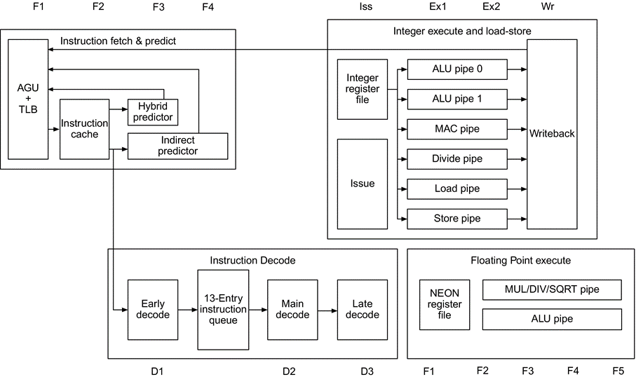
Case Study: ARM A53
8 stages:
F1 and F2 fetch the instruction
D1 and D2 do the basic decoding
D3 decodes some more complex instructions and is overlapped with the first stage of the execution pipeline (ISS)
Ex1, EX2, and WB stages complete the integer pipeline
Branches use four different predictors
Notes:
Figure 3.34 The basic structure of the A53 integer pipeline is 8 stages: F1 and F2 fetch the instruction, D1 and D2 do the basic decoding, and D3 decodes some more complex instructions and is overlapped with the first stage of the execution pipeline (ISS). After ISS, the Ex1, EX2, and WB stages complete the integer pipeline. Branches use four different predictors, depending on the type. The floating-point execution pipeline is 5 cycles deep, in addition to the 5 cycles needed for fetch and decode, yielding 10 stages in total.

Slide 199
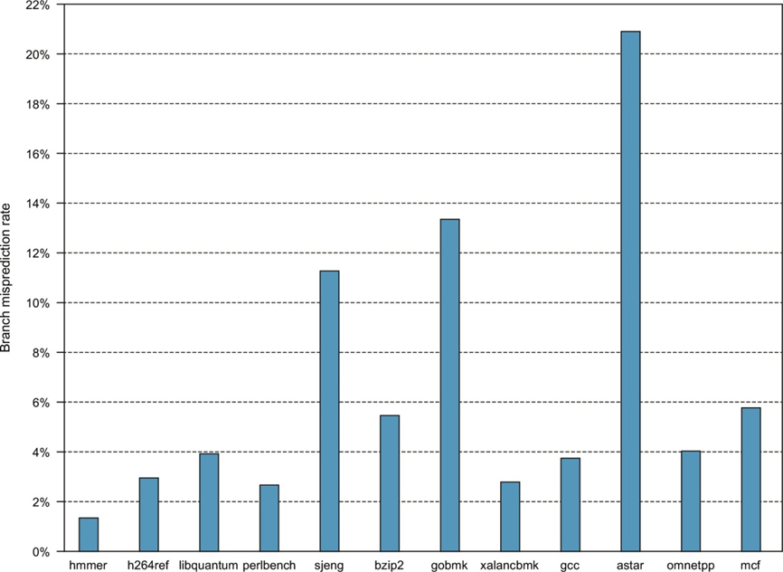
Misprediction rate of the A53 branch predictor for SPECint2006
Notes:
Figure 3.35 Misprediction rate of the A53 branch predictor for SPECint2006.

Slide 200
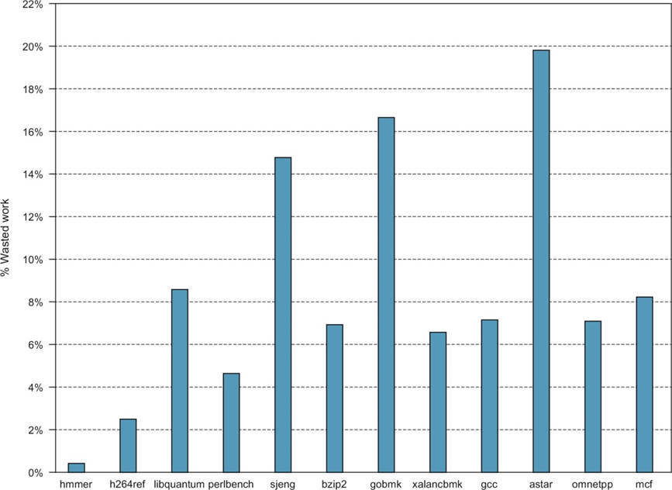
Wasted work due to branch misprediction on the A53
Notes:
Figure 3.36 Wasted work due to branch misprediction on the A53. Because the A53 is an in-order machine, the amount of wasted work depends on a variety of factors, including data dependences and cache misses, both of which will cause a stall.

Slide 201
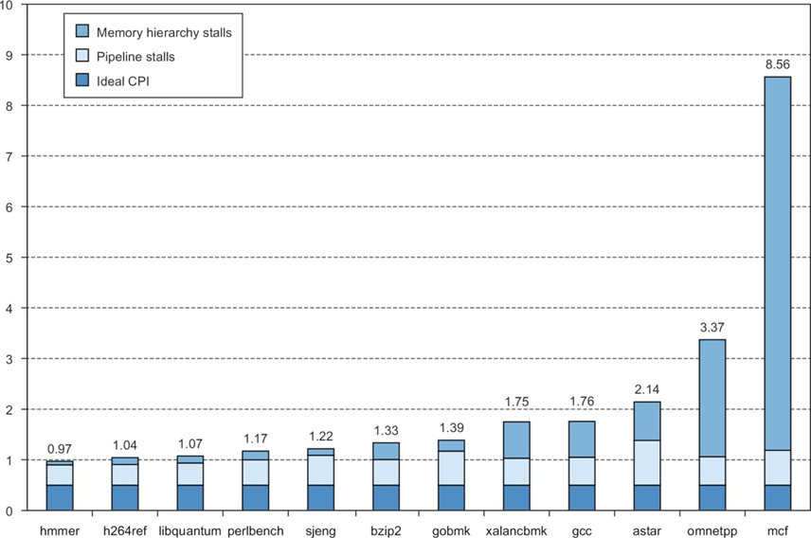
The estimated composition of the CPI on the ARM A53
Notes:
Figure 3.37 The estimated composition of the CPI on the ARM A53 shows that pipeline stalls are significant but are outweighed by cache misses in the poorest performing programs. This estimate is obtained by using the L1 and L2 miss rates and penalties to compute the L1 and L2 generated stalls per instruction. These are subtracted from the CPI measured by a detailed simulator to obtain the pipeline stalls. Pipeline stalls include all three hazards.

Slide 202
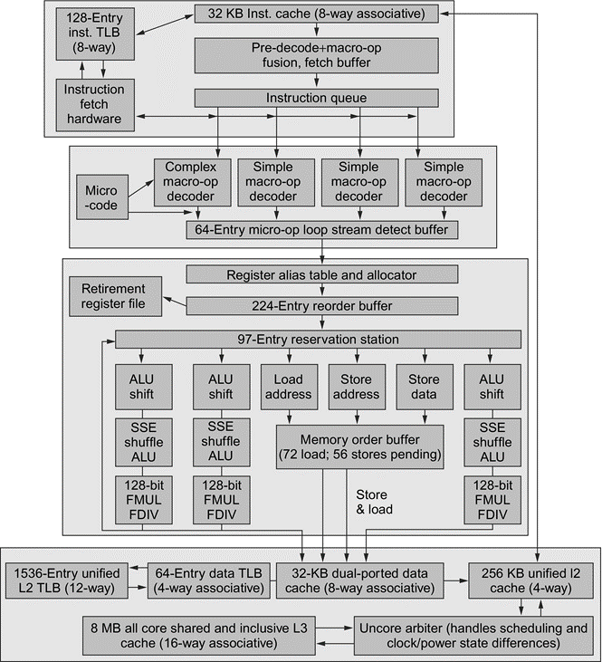
Intel Core i7
The total pipeline depth is 14 stages, with branch mispredictions typically costing 17 cycles, with the extra few cycles likely due to the time to reset the branch predictor
The six independent functional units can each begin execution of a ready micro-op in the same cycle. Up to four micro-ops can be processed in the register renaming table
Notes:
Figure 3.38 The Intel Core i7 pipeline structure shown with the memory system components. The total pipeline depth is 14 stages, with branch mispredictions typically costing 17 cycles, with the extra few cycles likely due to the time to reset the branch predictor. The six independent functional units can each begin execution of a ready micro-op in the same cycle. Up to four micro-ops can be processed in the register renaming table.

Slide 203
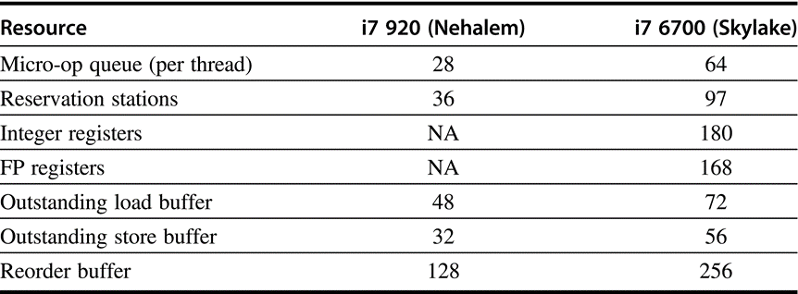
Buffer size in different i7 implementation
Notes:
Figure 3.39 The buffers and queues in the first generation i7 and the latest generation i7. Nehalem used a reservation station plus reorder buffer organization. In later microarchitectures, the reservation stations serve as scheduling resources, and register renaming is used rather than the reorder buffer; the reorder buffer in the Skylake microarchitecture serves only to buffer control information. The choices of the size of various buffers and renaming registers, while appearing sometimes arbitrary, are likely based on extensive simulation.

Slide 204
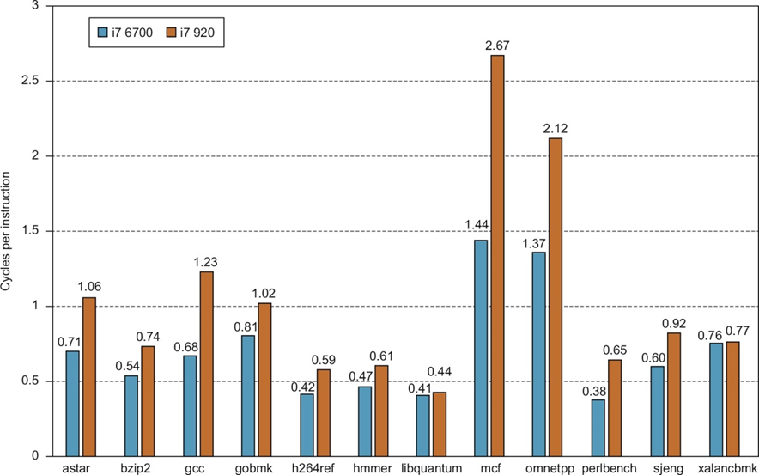
CPI of different i7 processors
SPECCPUint2006
Notes:
Figure 3.40 The CPI for the SPECCPUint2006 benchmarks on the i7 6700 and the i7 920. The data in this section were collected by Professor Lu Peng and PhD student Qun Liu, both of Louisiana State University.

Slide 205
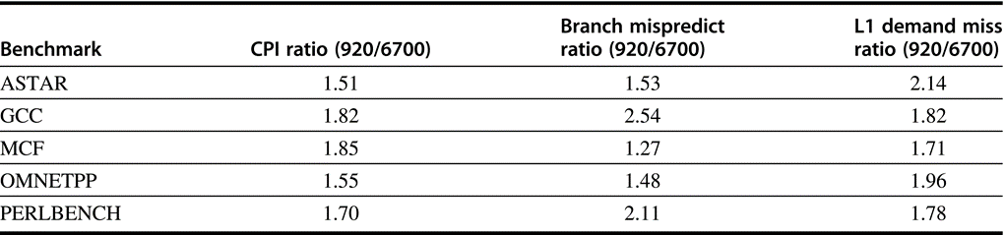
Comparison between i7/920 and i7/6700
Notes:
Figure 3.41 An analysis of the five integer benchmarks with the largest performance gap between the i7 6700 and 920. These five benchmarks show an improvement in the branch prediction rate and a reduction in the L1 demand miss rate.

Slide 206
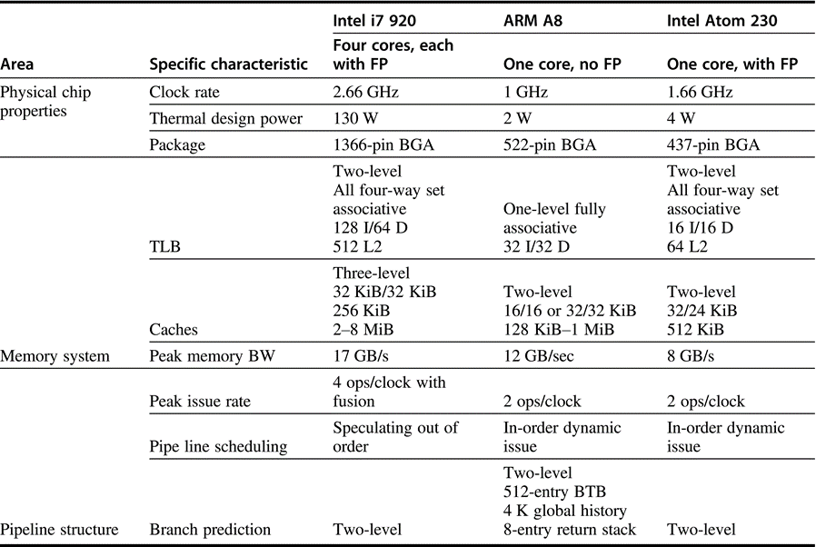
Desktop vs. Mobile Processor
都用45nm工艺
Notes:
Figure 3.42 An overview of the four-core Intel i7 920, an example of a typical ARM A8 processor chip (with a 256 MiB L2, 32 KiB L1s, and no floating point), and the Intel ARM 230, clearly showing the difference in design philosophy between a processor intended for the PMD (in the case of ARM) or netbook space (in the case of Atom) and a processor for use in servers and high-end desktops. Remember, the i7 includes four cores, each of which is higher in performance than the one-core A8 or Atom. All these processors are implemented in a comparable 45 nm technology.

Slide 207
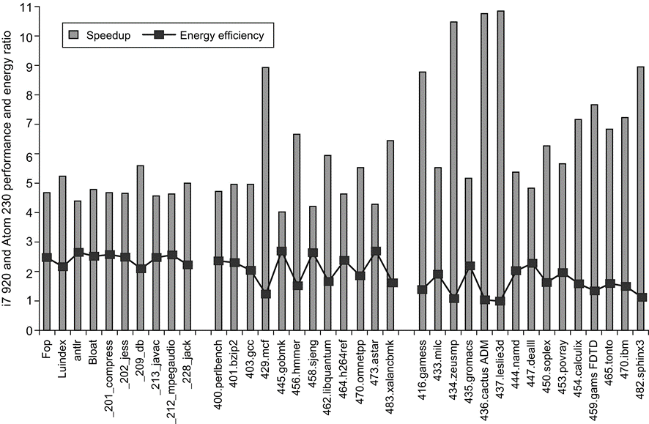
Fallacies and Pitfalls
It is easy to predict the performance/ energy efficiency of two different versions of the same ISA if we hold the technology constant
性能：4-10倍
能效：2倍左右
Notes:
Figure 3.43 The relative performance and energy efficiency for a set of single-threaded benchmarks shows the i7 920 is 4 to over 10 times faster than the Atom 230 but that it is about 2 times less power-efficient on average! Performance is shown in the columns as i7 relative to Atom, which is execution time (i7)/execution time (Atom). Energy is shown with the line as Energy (Atom)/Energy (i7). The i7 never beats the Atom in energy efficiency, although it is essentially as good on four benchmarks, three of which are floating point. The data shown here were collected by Esmaeilzadeh et al. (2011). The SPEC benchmarks were compiled with optimization using the standard Intel compiler, while the Java benchmarks use the Sun (Oracle) Hotspot Java VM. Only one core is active on the i7, and the rest are in deep power saving mode. Turbo Boost is used on the i7, which increases its performance advantage but slightly decreases its relative energy efficiency.

Slide 208
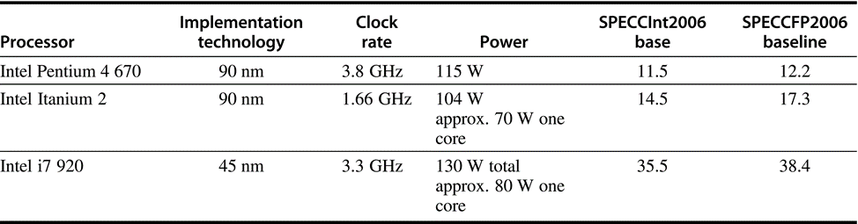
Fallacies and Pitfalls
Processors with lower CPIs / faster clock rates will also be faster
Three different Intel processors vary widely
Pentium 4 had higher clock, lower CPI
Itanium had same CPI, lower clock

Slide 209
Fallacies and Pitfalls
Sometimes bigger and dumber is better
Pentium 4 and Itanium were advanced designs, but could not achieve their peak instruction throughput because of relatively small caches as compared to i7
And sometimes smarter is better than bigger and dumber
TAGE branch predictor outperforms gshare with less stored predictions

Slide 210
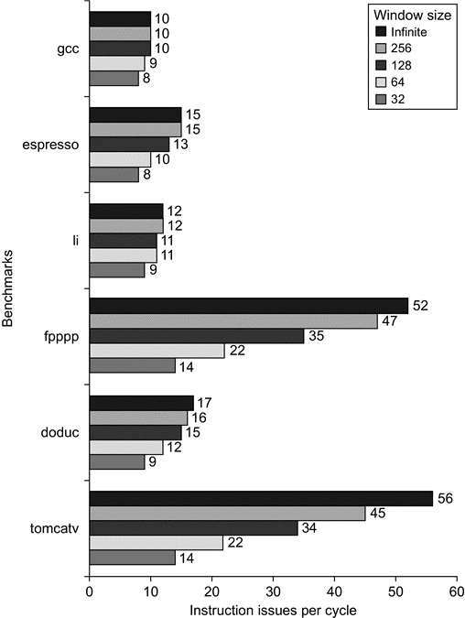
Fallacies and Pitfalls
Believing that there are large amounts of ILP available, if only we had the right techniques
Notes:
Figure 3.45 The amount of parallelism available versus the window size for a variety of integer and floating-point programs with up to 64 arbitrary instruction issues per clock. Although there are fewer renaming registers than the window size, the fact that all operations have 1-cycle latency and that the number of renaming registers equals the issue width allows the processor to exploit parallelism within the entire window.

Slide 211
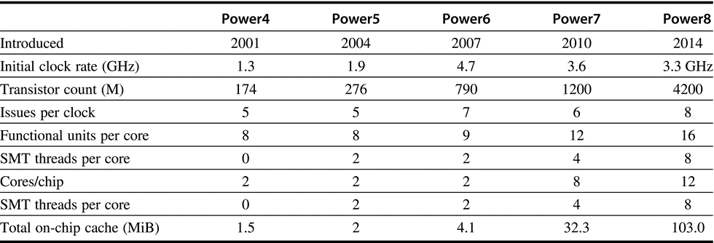
Characteristics of five generations of IBM Power processors
Notes:
Figure 3.46 Characteristics of five generations of IBM Power processors. All except the Power6, which is static and in-order, were dynamically scheduled; all the processors support two load/store pipelines. The Power6 has the same functional units as the Power5 except for a decimal unit. Power7 and Power8 use embedded DRAM for the L3 cache. Power9 has been described briefly; it further expands the caches and supports off-chip HBM.

