Slide 1
向量处理
向量的概念
流水线向量处理机
向量化方法
向量处理机的设计

Slide 2
Introduction
Introduction
SIMD architectures can exploit significant data-level parallelism for:
Matrix-oriented scientific computing
Media-oriented image and sound processors
SIMD is more energy efficient than MIMD
Only needs to fetch one instruction per data operation
Makes SIMD attractive for personal mobile devices
SIMD allows programmer to continue to think sequentially
Vector architectures, SIMD extensions, Graphics Processor Units (GPUs)
For x86 processors:
Expect two additional cores per chip per year
SIMD width to double every four years
Potential speedup from SIMD to be twice that from MIMD!

Slide 3
Problems with conventional ILP approach
High speed execution based on instruction level parallelism (ILP)
Potential of short instruction sequences to execute in parallel
Limits to conventional exploitation of ILP:
pipelined clock rate: at some point, each increase in clock rate has corresponding CPI increase (branches, other hazards)
instruction fetch and decode: at some point, its hard to fetch and decode more instructions per clock cycle
cache hit rate: some long-running (scientific) programs have very large data sets accessed with poor locality; others have continuous data streams (multimedia) and hence poor locality

Slide 4
Alternative Model: Vector Processing
Vector processors have high-level operations that work on linear arrays of numbers: “vectors”
A kind of new data type operated directly by instruction
Traditional processors operate on single value named “scalar”
Other possible data types for a collection of number
Matrix: 2 dimensional
Tensor: multi-dimensional
SCALAR
(1 operation)
VECTOR
(N operations)
r1
r2
v1
v2
+
+
r3
v3
vector
length
add r3, r1, r2
add.vv v3, v1, v2
Notes:
25

Slide 5
超级计算机(Supercomputer)
向量处理技术最早来自超级计算机
Supercomputer的经典定义
Fastest machine in world at given time
A device to turn a compute-bound problem into an I/O bound problem
Any machine costing $30M+
Any machine designed by Seymour Cray
CDC6600 (Cray, 1964) 被认为是最早的超级计算机

Slide 6
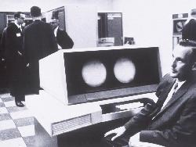
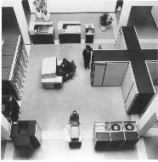
CDC 6600 Seymour Cray, 1963
A fast pipelined machine with 60-bit words
128 Kword main memory capacity, 32 banks
Ten functional units (parallel, unpipelined)
Floating Point: adder, 2 multipliers, divider
Integer: adder, 2 incrementers, ...
Hardwired control (no microcoding)
Scoreboard for dynamic scheduling of instructions
Ten Peripheral Processors for Input/Output
a fast multi-threaded 12-bit integer ALU
Very fast clock, 10 MHz (FP add in 4 clocks)
>400,000 transistors, 750 sq. ft., 5 tons, 150 kW, novel freon-based technology for cooling
Fastest machine in world for 5 years (until 7600)
over 100 sold ($7-10M each)

Slide 7
CDC 6600: A Load/Store Architecture
Separate instructions to manipulate three types of reg.
8 60-bit data registers (X)
8 18-bit address registers (A)
8 18-bit index registers (B)
All arithmetic and logic instructions are reg-to-reg
Only Load and Store instructions refer to memory!
Touching address registers 0 to 5 initiates a load
6 to 7 initiates a store
- very useful for vector operations
6
3
3
3
opcode i j k Ri ← (Rj) op (Rk)
opcode i j disp Ri ← M[(Rj) + disp]
6
3
3
18

Slide 8
CDC 6600: Datapath
Operand Regs
8 x 60-bit
operand
10 Functional
Units
result
Central
Memory
128K words,
32 banks,
1µs cycle
IR
Address Regs Index Regs
8 x 18-bit 8 x 18-bit
Inst. Stack
8 x 60-bit
operand
addr
result
addr

Slide 9
CDC 6600 ISA designed to simplify high performance implementation
Use of three-address, register-register ALU instructions simplifies pipelined implementation
Only 3-bit register-specifier fields checked for dependencies
No implicit dependencies between inputs and outputs
Decoupling setting of address register (Ar) from retrieving value from data register (Xr) simplifies providing multiple outstanding memory accesses
Address update instruction also issues implicit memory operation
Software can schedule load of address register before use of value
Can interleave independent instructions in between
CDC6600 has multiple parallel unpipelined functional units
E.g., 2 separate multipliers
Follow-on machine CDC7600 used pipelined functional units
Foreshadows later RISC designs

Slide 10
CDC6600: Vector Addition
B0 ← - n
loop: JZE B0, exit
A0 ← B0 + a0 ;load X0
A1 ← B0 + b0 ;load X1
X6 ← X0 + X1
A6 ← B0 + c0 ;store X6
B0 ← B0 + 1
jump loop
Ai = address register
Bi = index register
Xi = data register
通过标量运算的循环
完成向量运算

Slide 11
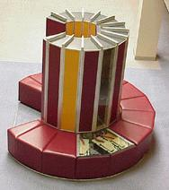
向量超级计算机
Cray-1是其典范
Scalar Unit
Load/Store Architecture
Vector Extension
Vector Registers
Vector Instructions
Implementation
Hardwired Control
Highly Pipelined Functional Units
Interleaved Memory System
No Data Caches
No Virtual Memory 中国的类似机器：757、YH-1

Slide 12
Cray-1 (1976)
V0
V_{i}
V. Mask
80 MHz
160 MFLOPS
ECL Small scale IC
2 NAND Gates
Gate delay 0.7ns
高密度组装
缩短线延迟
真空光速33ps/cm
印制线: ∼60ps/cm
液冷
冷媒：Freon
V1
64 Element Vector Registers
V2
V_{j}
V3
V. Length
V4
V_{k}
Single Port
Memory
16 banks of 64-bit words
+
8-bit SECDED
80MW/sec data load/store
320MW/sec instruction
buffer refill
V5
V6
V7
FP Add
S0
S_{j}
FP Mul
( (A_{h}) + j k m )
S1
S2
S_{k}
FP Recip
64
T Regs
S_{i}
S3
(A₀)
S4
S_{i}
Int Add
T_{jk}
S5
S6
Int Logic
S7
Int Shift
( (A_{h}) + j k m )
A0
Pop Cnt
A1
A_{i}
A2
A_{j}
(A₀)
64
B Regs
A3
A_{k}
Addr Add
B_{jk}
A4
A5
A_{i}
Addr Mul
A6
A7
64-bitx16
NIP
CIP
4 Instruction Buffers
LIP
memory bank cycle 50 ns processor cycle 12.5 ns (80MHz)

Slide 13
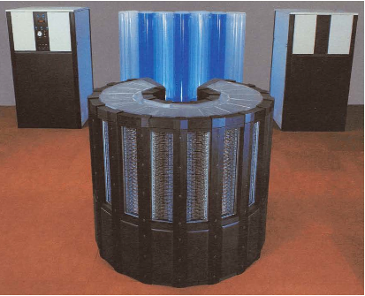
Cray-2 (1985)
243MHz with ECL logic, 4 vector processors sharing main memory
2GB DRAM main memory (128 banks of 16MB each)
Bank busy time 57 clocks!
Local memory of 128KB/core
1 foreground + 4 background vector processors
浸泡式液冷
fluorocarbon liquid
Core 0
Lane
Core 0
Lane
Core 0
Foreground CPU
Lane
Core 0
Local Memory
Lane
Local Memory
Local Memory
Local Memory
Shared Memory

Slide 14
Example Vector Machines
Machine Year Clock Regs Elements FUs LSUs
Cray 1 1976 80 MHz 8 64 6 1
Cray XMP 1983 120 MHz 8 64 8 2 L, 1 S
Cray YMP 1988 166 MHz 8 64 8 2 L, 1 S
Cray C-90 1991 240 MHz 8 128 8 4
Cray T-90 1996 455 MHz 8 128 8 4
Conv. C-1 1984 10 MHz 8 128 4 1
Conv. C-4 1994 133 MHz 16 128 3 1
Fuj. VP200 1982 133 MHz 8-256 32-1024 3 2
Fuj. VP300 1996 100 MHz 8-256 32-1024 3 2
NEC SX/2 1984 160 MHz 8+8K 256+var 16 8
NEC SX/3 1995 400 MHz 8+8K 256+var 16 8
Notes:
Cray 1; fastest scalar computer + 1st commercially successful vector computer, offered another 10X
6600 1st scoreboard
Cray XMP: 3 LSUs, Multiprocessor 4 way (not by Cray)
=> YMP, C-90, T-90; 2X processors, 1.5X clock
Cray 2 went to DRAM to get more memory, not so great
Like parallel teams as Intel (486, PPro, Pentium, next one)
Japan
Fujitsu, vary number of registers elements (8x1024 or 32x256)
NEC, 8x256 + 8K of varying elements

Slide 15
Vector Linpack Performance (MFLOPS)
Machine Year Clock 100x100 1kx1k Peak(Procs)
Cray 1 1976 80 MHz 12 110 160(1)
Cray XMP 1983 120 MHz 121 218 940(4)
Cray YMP 1988 166 MHz 150 307 2,667(8)
Cray C-90 1991 240 MHz 387 902 15,238(16)
Cray T-90 1996 455 MHz 705 1603 57,600(32)
Conv. C-1 1984 10 MHz 3 -- 20(1)
Conv. C-4 1994 135 MHz 160 2531 3240(4)
Fuj. VP200 1982 133 MHz 18 422 533(1)
NEC SX/2 1984 166 MHz 43 885 1300(1)
NEC SX/3 1995 400 MHz 368 2757 25,600(4)
Notes:
6X in 20 years; 32X in 20 years; Peak is 360X speedup
Weighed tons

Slide 16
Properties of Vector Processors
Each result independent of previous result => long pipeline, compiler ensures no dependencies => high clock rate
Vector instructions access memory with known pattern => highly interleaved memory => amortize memory latency of over 64 elements => no (data) caches required! (Do use instruction cache)
Reduces branches and branch problems in pipelines
Single vector instruction implies lots of work (loop) => fewer instruction fetches

Slide 17
Operation & Instruction Count: RISC vs. Vector Processor
Spec92fp Operations (Millions) Instructions (M)
Program RISC Vector R / V RISC Vector R / V
swim256 115 95 1.1x 115 0.8 142x
hydro2d 58 40 1.4x 58 0.8 71x
nasa7 69 41 1.7x 69 2.2 31x
su2cor 51 35 1.4x 51 1.8 29x
tomcatv 15 10 1.4x 15 1.3 11x
wave5 27 25 1.1x 27 7.2 4x
mdljdp2 32 52 0.6x 32 15.8 2x
Vector reduces ops by 1.2X, instructions by 20X

Slide 18
Styles of Vector Architectures
Scalar computing + Loop: traditional non-vector operations
横式向量加工
Memory-memory vector processors: all vector operations are memory to memory
纵式向量加工，如CDC Cyber 205
Vector-register processors: all vector operations between vector registers (except load and store)
纵橫式向量加工
Vector equivalent of load-store architectures
Includes all vector machines since late 1980s: Cray, Convex, Fujitsu, Hitachi, NEC
We assume vector-register for rest of lectures

Slide 19
Vector Register Architectures
Vector Architectures
Basic idea:
Read sets of data elements into “vector registers”
Operate on those registers
Disperse the results back into memory
Registers are controlled by compiler
Used to hide memory latency
Can be loaded from or written into memory in pipelined approach
Leverage memory bandwidth

Slide 20
Components of Vector Processor
Vector Register: fixed length bank holding a vector
has at least 2 read and 1 write ports
typically 8-32 vector registers, each holding 64-128 64-bit elements
Vector Functional Units (FUs): fully pipelined, start new operation every clock
typically 4 to 8 FUs: FP add, FP mult, FP reciprocal (1/X), integer add, logical, shift; may have multiple of same unit
Vector Load-Store Units (LSUs): fully pipelined unit to load or store a vector; may have multiple LSUs
Scalar registers: single element for FP scalar or address
Cross-bar to connect FUs , LSUs, registers

Slide 21
VMIPS
Vector Architectures
Example architecture: RV64V
Loosely based on Cray-1
32 64-bit vector registers
Register file has 16 read ports and 8 write ports
Vector functional units
Fully pipelined
Data and control hazards are detected
Vector load-store unit
Fully pipelined
One word per clock cycle after initial latency
Scalar registers
32 general-purpose registers
32 floating-point registers

Slide 22
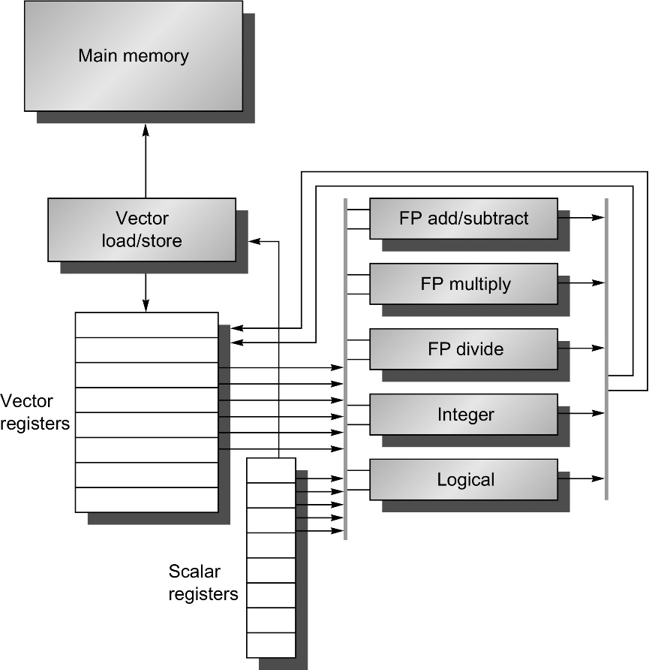
The vector architecture of RV64V
There are 32 vector registers, and all the functional units are vector functional units.
The vector and scalar registers have a significant number of read and write ports to allow multiple simultaneous vector operations
A set of crossbar switches (thick gray lines) connects these ports to the inputs and outputs of the vector functional units
Notes:
Figure 4.1 The basic structure of a vector architecture, RV64V, which includes a RISC-V scalar architecture. There are also 32 vector registers, and all the functional units are vector functional units. The vector and scalar registers have a significant number of read and write ports to allow multiple simultaneous vector operations. A set of crossbar switches (thick gray lines) connects these ports to the inputs and outputs of the vector functional units.

Slide 23
VMIPS Instructions
Vector Architectures
.vv: two vector operands
.vs and .sv: vector and scalar operands
LV/SV: vector load and vector store from address
Example: DAXPY
vsetdcfg 4*FP64 # Enable 4 DP FP vregs
fld f0,a # Load scalar a
vld v0,x5 # Load vector X
vmul v1,v0,f0 # Vector-scalar mult
vld v2,x6 # Load vector Y
vadd v3,v1,v2 # Vector-vector add
vst v3,x6 # Store the sum
vdisable # Disable vector regs
8 instructions, 258 for RV64V (scalar code)

Slide 24
Vector Instructions
Instr. Operands Operation Comment
ADDV V1,V2,V3 V1=V2+V3 vector + vector
ADDSV V1,F0,V2 V1=F0+V2 scalar + vector
MULTV V1,V2,V3 V1=V2xV3 vector x vector
MULSV V1,F0,V2 V1=F0xV2 scalar x vector
LV V1,R1 V1=M[R1..R1+63] load, stride=1
LVWS V1,R1,R2 V1=M[R1..R1+63*R2] load, stride=R2
LVI V1,R1,V2 V1=M[R1+V2i,i=0..63] indir.("gather")
CeqV VM,V1,V2 VMASKi = (V1i=V2i)? comp. setmask
MOV VLR,R1 Vec. Len. Reg. = R1 set vector length
MOV VM,R1 Vec. Mask = R1 set vector mask

Slide 25
DAXPY (Y = a * X + Y) Assuming vectors X, Y are of length 64
Scalar vs. Vector
LD F0,a ;load scalar a
LV V1,Rx ;load vector X
MULTS V2,F0,V1 ;vector-scalar mult.
LV V3,Ry ;load vector Y
ADDV V4,V2,V3 ;add
SV Ry,V4 ;store the result
LD F0,a
ADDI R4,Rx,#512 ;last address to load
loop: LD F2, 0(Rx) ;load X(i)
MULTD F2,F0,F2 ;a*X(i)
LD F4, 0(Ry) ;load Y(i)
ADDD F4,F2, F4 ;a*X(i) + Y(i)
SD F4 ,0(Ry) ;store into Y(i)
ADDI Rx,Rx,#8 ;increment index to X
ADDI Ry,Ry,#8 ;increment index to Y
SUB R20,R4,Rx ;compute bound
BNZ R20,loop ;check if done
578 (2+9*64) vs. 321 (1+5*64) ops (1.8X)
578 (2+9*64) vs. 6 instructions (96X)
64 operation vectors + no loop overhead
also 64X fewer pipeline hazards

Slide 26
Vector Execution Time
Time = f(vector length, data dependencies, structural hazards)
Initiation rate: rate that FU consumes vector elements, usually 1 on RV64V
Convoy: set of vector instructions that can begin execution in same clock (no struct. or data hazards)
Chime: approx. time for a vector operation, approximately the vector length
m convoys take m chimes; if each vector length is n, then they take approx. m x n clock cycles (ignores overhead; good approximation for long vectors)
1: LV V1,Rx ;load vector X
2: MULV V2,F0,V1 ;vector-scalar mult.
LV V3,Ry ;load vector Y
3: ADDV V4,V2,V3 ;add
4: SV Ry,V4 ;store the result
4 convoys, 1 lane, VL=64
=> 4 x 64 = 256 clocks
(or 4 clocks per result)

Slide 27
Vector Start-up Time
Start-up time: pipeline latency time (depth of FU pipeline); another sources of overhead
Operation Start-up penalty (from CRAY-1)
Vector load/store 12
Vector multply 7
Vector add 6
Assume convoys don't overlap; vector length = n:
Convoy Start 1st result last result
1. LV 0 12 11+n (12+n-1)
2. MULV, LV 12+n 12+n+12 23+2n Load start-up
3. ADDV 24+2n 24+2n+6 29+3n Wait convoy 2
4. SV 30+3n 30+3n+12 41+4n Wait convoy 3
Notes:
2. Starts at 12 because single LOAD/STORE unit, next convey must wait
3. starts 1 clock cycle after last result

Slide 28
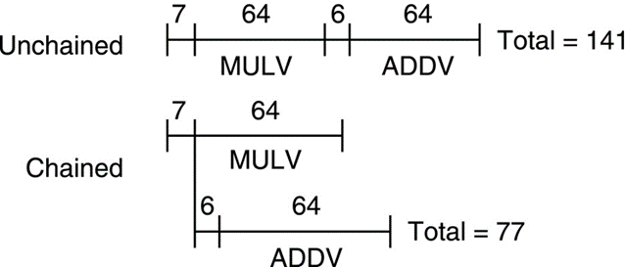
Vector Opt #1: Chaining
Suppose: MULV V1,V2,V3
ADDV V4,V1,V5 ; separate convoy?
chaining: vector register (V1) is not as a single entity but as a group of individual registers, then pipeline forwarding can work on individual elements of a vector
Flexible chaining: allow vector to chain to any other active vector operation =>
more read/write port
As long as enough HW, increases convoy size

Slide 29
Example Execution of Vector Code
Vector
Memory Pipeline
Vector
Multiply Pipeline
Vector
Adder Pipeline
Scalar
8 lanes, vector length 32,
chaining
Notes:
35

Slide 30
Chimes
Vector Architectures
Sequences with read-after-write dependency hazards placed in same convey via chaining
Chaining
Allows a vector operation to start as soon as the individual elements of its vector source operand become available
Chime
Unit of time to execute one convey
m conveys executes in m chimes for vector length n
For vector length of n, requires m x n clock cycles

Slide 31
Example
Vector Architectures
vld v0,x5 # Load vector X
vmul v1,v0,f0 # Vector-scalar multiply
vld v2,x6 # Load vector Y
vadd v3,v1,v2 # Vector-vector add
vst v3,x6 # Store the sum
Convoys with chaining:
1 vld vmul
2 vld vadd
3 vst
Totally 3 chimes, 2 FP ops per result, cycles per FLOP = 1.5
For 64 element vectors, requires 64 x 3 = 192 clock cycles

Slide 32
Challenges
Vector Architectures
Start up time
Latency of vector functional unit
Assume the same as Cray-1
Floating-point add => 6 clock cycles
Floating-point multiply => 7 clock cycles
Floating-point divide => 20 clock cycles
Vector load => 12 clock cycles
Improvements:
> 1 element per clock cycle
Non-64 wide vectors
IF statements in vector code
Memory system optimizations to support vector processors
Multiple dimensional matrices
Sparse matrices
Programming a vector computer

Slide 33
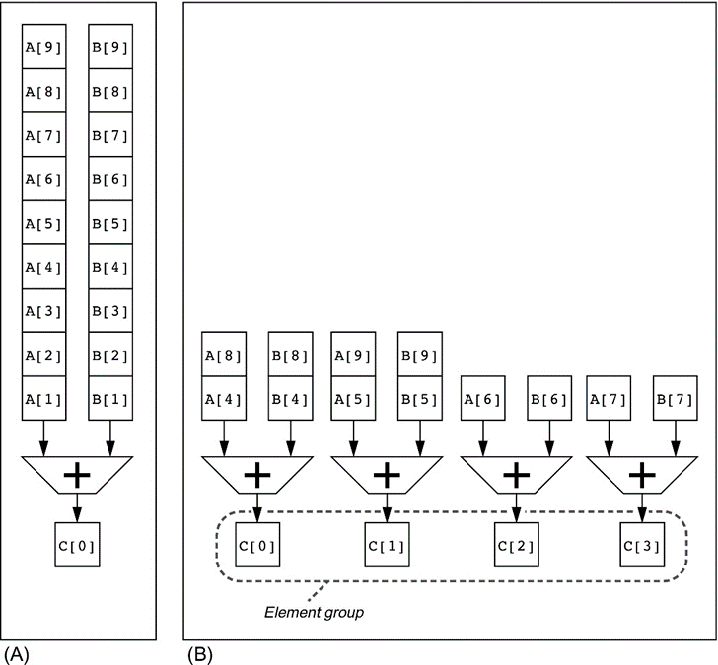
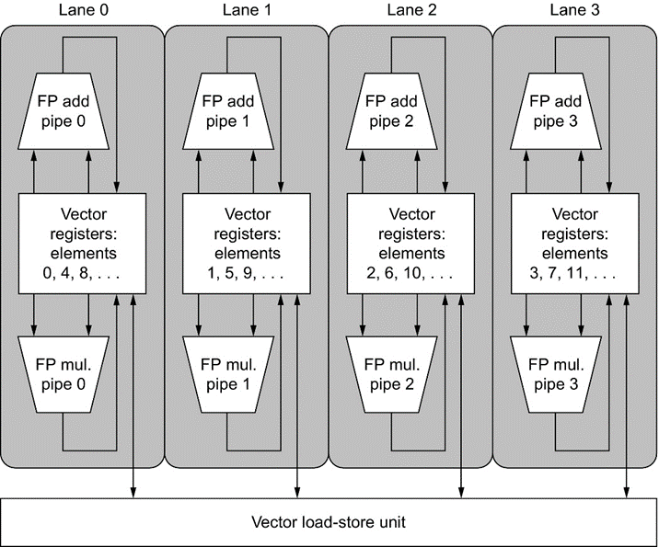
Multiple Lanes
Vector Architectures
Element n of vector register A is “hardwired” to element n of vector register B
Allows for multiple hardware lanes
Notes:
Figure 4.4 Using multiple functional units to improve the performance of a single vector add instruction, C = A + B. The vector processor (A) on the left has a single add pipeline and can complete one addition per clock cycle. The vector processor (B) on the right has four add pipelines and can complete four additions per clock cycle. The elements within a single vector add instruction are interleaved across the four pipelines. The set of elements that move through the pipelines together is termed an element group. Reproduced with permission from Asanovic, K., 1998. Vector Microprocessors (Ph.D. thesis). Computer Science Division, University of California, Berkeley.
Figure 4.5 Structure of a vector unit containing four lanes. The vector register memory is divided across the lanes, with each lane holding every fourth element of each vector register. The figure shows three vector functional units: an FP add, an FP multiply, and a load-store unit. Each of the vector arithmetic units contains four execution pipelines, one per lane, which act in concert to complete a single vector instruction. Note how each section of the vector register file needs to provide only enough ports for pipelines local to its lane. This figure does not show the path to provide the scalar operand for vector-scalar instructions, but the scalar processor (or Control Processor) broadcasts a scalar value to all lanes.

Slide 34
Vector Length
What to do when vector length is not exactly 64?
vector-length register (VLR) controls the length of any vector operation, including a vector load or store. (cannot be > the length of vector registers)
do 10 i = 1, n
10 Y(i) = a * X(i) + Y(i)
Don't know n until runtime! n > Max. Vector Length (MVL)?
Use Strip-Mining

Slide 35
Strip-mining for any Vector Length
Vector Architectures
for (i=0; i <n; i=i+1) Y[i] = a * X[i] + Y[i];
fld f0,a # Load scalar a loop: setvl t0,a0 # vl = t0 = min(mvl,n)
vld v0,x5 # Load vector X
slli t1,t0,3 # t1 = vl * 8 (in bytes)
add x5,x5,t1 # Increment pointer to X by vl*8
vmul v0,v0,f0 # Vector-scalar mult
vld v1,x6 # Load vector Y
vadd v1,v0,v1 # Vector-vector add
sub a0,a0,t0 # n -= vl (t0)
vst v1,x6 # Store the sum into Y
add x6,x6,t1 # Increment pointer to Y by vl*8
bnez a0,loop # Repeat if n != 0

Slide 36
Vector Opt #2: Conditional Execution
Suppose:
do 100 i = 1, 64
if (A(i) .ne. 0) then
A(i) = A(i) / B(i)
endif
100 continue
vector-mask control takes a Boolean vector: when vector-mask register is loaded from vector test, vector instructions operate only on vector elements whose corresponding entries in the vector-mask register are 1.
Still requires clock even if result not stored; if still performs operation, what about divide by 0?

Slide 37
Vector Mask Registers
Vector Architectures
Use predicate register p0 to “disable” elements:
vld v0,x5 # Load vector A into v0
vld v1,x6 # Load vector B into v1
fmv.d.x f0,x0 # Put (FP) zero into f0
vpne p0,v0,f0 # Set p0(i) to 1 if v0(i)!=f0
vdiv v0,v0,v1 # Subtract under vector mask
vst v0,x5 # Store the result in A

Slide 38
Memory Banks
Vector Architectures
Memory system must be designed to support high bandwidth for vector loads and stores
Spread accesses across multiple banks
Control bank addresses independently
Load or store non sequential words (need independent bank addressing)
Support multiple vector processors sharing the same memory
Example of Cray T90
32 processors, each generating 4 loads and 2 stores/cycle
Processor cycle time is 2.167 ns, SRAM cycle time is 15 ns
How many memory banks needed?
32x(4+2)x15/2.167 = ~1330 banks

Slide 39
Memory operations
Load/store operations move groups of data between registers and memory
Three types of addressing
Unit stride
Fastest
Non-unit (constant) stride
Indexed (gather-scatter)
Vector equivalent of register indirect
Good for sparse arrays of data
Increases number of programs that can be vectorized
Notes:
32

Slide 40
Non-unit Stride
Vector Architectures
Consider:
for (i = 0; i < 100; i=i+1)
for (j = 0; j < 100; j=j+1) {
A[i][j] = 0.0;
for (k = 0; k < 100; k=k+1)
A[i][j] = A[i][j] + B[i][k] * D[k][j];
}
Must vectorize multiplication of rows of B with columns of D
Use non-unit stride
Bank conflict (stall) occurs when the same bank is hit faster than bank busy time (e.g., stride = 32 and 16 banks) :
#banks / GCD(stride, #banks) < bank busy time

Slide 41
Access Vector with Stride
Suppose adjacent elements not sequential in memory
do 10 i = 1,100
do 10 j = 1,100
A(i,j) = 0.0
do 10 k = 1,100
10 A(i,j) = A(i,j)+B(i,k)*D(k,j)
Either B or D accesses not adjacent (800 bytes between)
stride: distance separating elements that are to be merged into a single vector (caches do unit stride) => LVWS (load vector with stride) instruction => STWS (store vector with stride) instruction

Slide 42
Vector Opt #3: Sparse Matrices
Suppose:
do 100 i = 1,n
100 A(K(i)) = A(K(i)) + C(M(i))
gather (LVI) operation takes an index vector and fetches the vector whose elements are at the addresses given by adding a base address to the offsets given in the index vector => a nonsparse vector in a vector register
After these elements are operated on in dense form, the sparse vector can be stored in expanded form by a scatter store (SVI), using the same index vector
Can't be done by compiler since can't know Ki elements distinct, no dependencies; by compiler directive
Use CVI to create index 0, 1xm, 2xm, ..., 63xm
Notes:
CVI gets used under mask

Slide 43
Example of Scatter-Gather
Vector Architectures
Consider: for (i = 0; i < n; i=i+1)
A[K[i]] = A[K[i]] + C[M[i]];
Use index vector:
vld v0, x7 # Load K[]
vldx v1, x5, v0 # Load A[K[]]
vld v2, x28 # Load M[]
vldi v3, x6, v2 # Load C[M[]]
vadd v1, v1, v3 # Add them
vstx v1, x5, v0 # Store A[K[]]

Slide 44
Sparse Matrix Performance
Cache (1993) vs. Vector (1988)
IBM RS6000 Cray YMP
Clock 72 MHz 167 MHz
Cache 256 KB 0.25 KB
Linpack 140 MFLOPS 160 (1.1)
Sparse Matrix 17 MFLOPS 125 (7.3) (Cholesky Blocked )
Cache: 1 address per cache block (32B to 64B)
Vector: 1 address per element (4B)

Slide 45
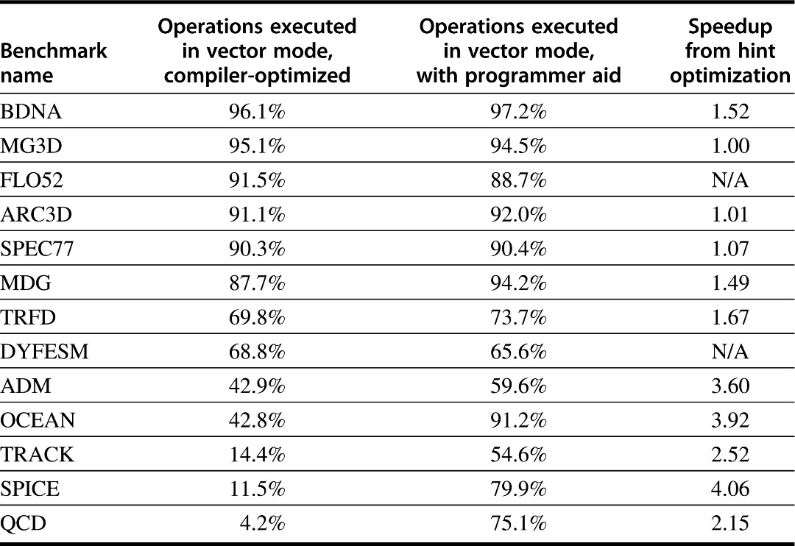
Programming Vec. Architectures
Vector Architectures
Compilers can provide feedback to programmers
Programmers can provide hints to compiler
Notes:
Figure 4.7 Level of vectorization among the Perfect Club benchmarks when executed on the Cray Y-MP (Vajapeyam, 1991). The first column shows the vectorization level obtained with the compiler without hints, and the second column shows the results after the codes have been improved with hints from a team of Cray Research programmers.

Slide 46
Vector Surprise
Use vectors for inner loop parallelism (no surprise)
One dimension of array: A[0, 0], A[0, 1], A[0, 2], ...
think of machine as, say, 32 vector regs each with 64 elements
1 instruction updates 64 elements of 1 vector register
and for outer loop parallelism!
1 element from each column: A[0,0], A[1,0], A[2,0], ...
think of machine as 64 Virtual processors?(VPs) each with 32 scalar registers! (multithreaded processor)
1 instruction updates 1 scalar register in 64 VPs
Hardware identical, just 2 compiler perspectives

Slide 47
Virtial Processor Vector Model
Vector operations are SIMD (single instruction multiple data)operations
Each element is computed by a virtual processor (VP)
Number of VPs given by vector length
vector control register
Notes:
26

Slide 48
Vector Architectural State
Virtual Processors ($vlr)
VP₀
VP₁
VP_{$vlr-1}
General
Purpose
Registers
vr₀
Control
Registers
vr₁
vr₃₁
vcr₀
64 bits
vcr₁
vf₀
Flag
Registers
(32)
vf₁
vcr₃₁
32 bits
vf₃₁
1 bit
Notes:
27

Slide 49
Vector Implementation
Vector register file
Each register is an array of elements
Size of each register determines maximum vector length
Vector length register determines vector length for a particular operation
Multiple parallel execution units = lanes (sometimes called pipelines or pipes)
33
Notes:
33

Slide 50
Vector Terminology: 4 lanes, 2 vector functional units
(Vector
Functional
Unit)
34
Notes:
34

Slide 51
Vector Load/Store Units & Memories
Start-up overheads usually longer fo LSUs
Memory system must sustain (# lanes x word) /clock cycle
Many Vector Procs. use banks (vs. simple interleaving):
1) support multiple loads/stores per cycle => multiple banks & address banks independently
2) support non-sequential accesses (see soon)
Note: No. memory banks > memory latency to avoid stalls
m banks => m words per memory lantecy l clocks
if m < l, then gap in memory pipeline:
clock: 0 ?l l+1 l+2 l+m- 1 l+m ?2 l
word: -- ?0 1 2 ? m-1 -- ?m
may have 1024 banks in SRAM

Slide 52
Strip Mining
Suppose Vector Length > Max. Vector Length (MVL)?
Strip mining: generation of code such that each vector operation is done for a size ?to the MVL
1st loop do short piece (n mod MVL), rest VL = MVL
low = 1 VL = (n mod MVL) /*find the odd size piece*/ do 1 j = 0,(n / MVL) /*outer loop*/
do 10 i = low,low+VL-1 /*runs for length VL*/ Y(i) = a*X(i) + Y(i) /*main operation*/ 10 continue low = low+VL /*start of next vector*/ VL = MVL /*reset the length to max*/ 1 continue

Slide 53
Common Vector Metrics
R: MFLOPS rate on an infinite-length vector
vector’s speed of light
Real problems do not have unlimited vector lengths, and the start-up penalties encountered in real problems will be larger
(R_{n} is the MFLOPS rate for a vector of length n)
N_{1/2}: The vector length needed to reach one-half of R
a good measure of the impact of start-up
N_{V}: The vector length needed to make vector mode faster than scalar mode
measures both start-up and speed of scalars relative to vectors, quality of connection of scalar unit to vector unit

Slide 54
Compiler Vectorization on Cray XMP
Benchmark %FP %FP in vector
ADM 23% 68%
DYFESM 26% 95%
FLO52 41% 100%
MDG 28% 27%
MG3D 31% 86%
OCEAN 28% 58%
QCD 14% 1%
SPICE 16% 7% (1% overall)
TRACK 9% 23%
TRFD 22% 10%

Slide 55
Vector Pitfalls
Pitfall: Concentrating on peak performance and ignoring start-up overhead: NV (length faster than scalar) > 100!
Pitfall: Increasing vector performance, without comparable increases in scalar performance (Amdahl's Law)
failure of Cray competitor from his former company
Pitfall: Good processor vector performance without providing good memory bandwidth
MMX?

Slide 56
Vector Advantages
Easy to get high performance; N operations:
are independent
use same functional unit
access disjoint registers
access registers in same order as previous instructions
access contiguous memory words or known pattern
can exploit large memory bandwidth
hide memory latency (and any other latency)
Scalable (get higher performance as more HW resources available)
Compact Describe N operations with 1 short instruction (v. VLIW)
Predictable (real-time) performance vs. statistical performance (cache)
Multimedia ready: choose N * 64b, 2N * 32b, 4N * 16b, 8N * 8b
Mature, developed compiler technology
Vector Disadvantage: Out of Fashion
Notes:
24
Why MPP? Best potential performance!
Few successes
Operator on vectors of registers
Its easier to vectorize than parallelize
Scales well: more hardware and slower clock rate
Crazy research

Slide 57
Vector Summary
Alternate model accomodates long memory latency, doesn’t rely on caches as does Out-Of-Order, superscalar/VLIW designs
Much easier for hardware: more powerful instructions, more predictable memory accesses, fewer harzards, fewer branches, fewer mispredicted branches, ...
What % of computation is vectorizable?
Is vector a good match to new apps such as multidemia, DSP?

Slide 58
Other Issues about Vector
Hard vector example
Vector vs. Superscalar
Designing a Vector Processor Issues
Vector vs. Superscalar: area, energy
Real-time vs. Average time

Slide 59
Vector Example with dependency
/* Multiply a[m][k] * b[k][n] to get c[m][n] */
for (i=1; i<m; i++)
{
for (j=1; j<n; j++)
{
sum = 0;
for (t=1; t<k; t++)
{
sum += a[i][t] * b[t][j];
}
c[i][j] = sum;
}
}

Slide 60
Straightforward Solution
Must sum of all the elements of a vector besides grabbing one element at a time from a vector register and putting it in the scalar unit?
e.g., shift all elements left 32 elements or collapse into a compact vector all elements not masked
In T0, the vector extract instruction, vext.v. This shifts elements within a vector
Called a reduction

Slide 61
Review: Vector Surprise
Use vectors for inner loop parallelism (no surprise)
One dimension of array: A[0, 0], A[0, 1], A[0, 2], ...
think of machine as, say, 16 vector regs each with 32 elements
1 instruction updates 32 elements of 1 vector register
and for outer loop parallelism!
1 element from each column: A[0,0], A[1,0], A[2,0], ...
think of machine as 32 Virtual processors?(VPs) each with 16 scalar registers! (?multithreaded processor)
1 instruction updates 1 scalar register in 64 VPs
Hardware identical, just 2 compiler perspectives

Slide 62
Novel Matrix Multiply Solution
You don't need to do reductions for matrix multiply
You can calculate multiple independent sums within one vector register
You can vectorize the j loop to perform 32 dot-products at the same time
Or you can think of each 32 Virtual Processor doing one of the dot products
(Assume Maximul Vector Length is 32)
Show it in C source code, but can imagine the assembly vector instructions from it

Slide 63
Original Vector Example with dependency
/* Multiply a[m][k] * b[k][n] to get c[m][n] */
for (i=1; i<m; i++)
{
for (j=1; j<n; j++)
{
sum = 0;
for (t=1; t<k; t++)
{
sum += a[i][t] * b[t][j];
}
c[i][j] = sum;
}
}

Slide 64
Optimized Vector Example
/* Multiply a[m][k] * b[k][n] to get c[m][n] */
for (i=1; i<m; i++)
{
for (j=1; j<n; j+=32)/* Step j 32 at a time. */
{
sum[0:31] = 0; /* Initialize a vector register to zeros. */
for (t=1; t<k; t++)
{
a_scalar = a[i][t]; /* Get scalar from a matrix. */
b_vector[0:31] = b[t][j:j+31]; /* Get vector from b matrix. */
prod[0:31] = b_vector[0:31]*a_scalar;
/* Do a vector-scalar multiply. */

Slide 65
Optimized Vector Example cont’d
/* Vector-vector add into results. */
sum[0:31] += prod[0:31];
}
/* Unit-stride store of vector of results. */
c[i][j:j+31] = sum[0:31];
}
}

Slide 66
Novel, Step #2
It's actually better to interchange the i and j loops, so that you only change vector length once during the whole matrix multiply
To get the absolute fastest code you have to do a little register blocking of the innermost loop.

Slide 67
Designing a Vector Processor
Changes to scalar
How Pick Vector Length?
How Pick Number of Vector Registers?
Context switch overhead
Exception handling
Masking and Flag Instructions

Slide 68
Changes to scalar processor to run vector instructions
Decode vector instructions
Send scalar registers to vector unit (vector-scalar ops)
Synchronization for results back from vector register, including exceptions
Things that don’t run in vector don’t have high ILP, so can make scalar CPU simple

Slide 69
How Pick Vector Length?
Vector length => Keep all VFUs busy:
vector length > (# lanes) X (# VFUs ) # Vector instructions/cycle

Slide 70
How Pick Vector Length?
Longer good because:
1) Hide vector startup
2) lower instruction bandwidth
3) tiled access to memory reduce scalar processor memory bandwidth needs
4) if know max length of app. is < max vector length, no strip mining overhead
5) Better spatial locality for memory access
Longer not much help because:
1) diminishing returns on overhead savings as keep doubling number of element
2) need natural app. vector length to match physical register length, or no help

Slide 71
How Pick Number of Vector Registers?
More Vector Registers:
1) Reduces vector register Spills?(save/restore)
20% reduction to 16 registers for su2cor and tomcatv
40% reduction to 32 registers for tomcatv
others 10%-15%
2) agressive scheduling of vector instructinons: better compiling to take advantage of ILP
Fewer:
Fewer bits in instruciton format (usually 3 fields)

Slide 72
Context switch overhead
Extra dirty bit per processor
If vector registers not written, don’t need to save on context switch
Extra valid bit per vector register, cleared on process start
Don’t need to restore on context switch until needed

Slide 73
Exception handling: External
If external exception, can just put pseudo-op into pipeline and wait for all vector ops to complete
Alternatively, can wait for scalar unit to complete and begin working on exception code assuming that vector unit will not cause exception and interrupt code does not use vector unit

Slide 74
Exception handling: Arithmetic
Arithmetic traps harder
Precise interrupts => large performance loss
Alternative model: arithmetic exceptions set vector flag registers, 1 flag bit per element
Software inserts trap barrier instructions from SW to check the flag bits as needed
IEEE Floating Point requires 5 flag bits

Slide 75
Exception handling: Page Faults
Page Faults must be precise
Instruction Page Faults not a problem
Data Page Faults harder
Option 1: Save/restore internal vector unit state
Freeze pipeline, dump vector state
perform needed ops
Restore state and continue vector pipeline

Slide 76
Exception handling: Page Faults
Option 2: expand memory pipeline to check addresses before send to memory + memory buffer between address check and registers
muiltiple queues to transfer from memory buffer to registers; check last address in queues before load 1st element from buffer.
Pre Adress Instruction Queue (PAIQ) which sends to TLB and memory while in parallel go to Address Check Instruction Queue (ACIQ)
When passes checks, instruction goes to Commited Instruction Queue (CIQ) to be there when data returns.
On page fault, only save intructions in PAIQ and ACIQ

Slide 77
Masking and Flag Instructions
Flag have multiple uses (conditional, arithmetic exceptions)
Alternative is conditional move/merge
Clear that fully masked is much more effiecient that with conditional moves
Not perform extra instructions, avoid exceptions
Downside is:
1) extra bits in instruction to specify the flag regsiter
2) extra interlock early in the pipeline for RAW hazards on Flag registers

Slide 78
Flag Instruction Ops
Do in scalar processor vs. in vector unit with vector ops?
Disadvantages to using scalar processor to do flag calculations (as in Cray):
1) if MVL > word size => multiple instructions; also limits MVL in future
2) scalar exposes memory latency
3) vector produces flag bits 1/clock, but scalar consumes at 64 per clock, so cannot chain together
Proposal: separate Vector Flag Functional Units and instructions in VU

Slide 79
Vectors Are Inexpensive
Scalar
N ops per cycle ⇒ Ο(Ν²) circuitry
HP PA-8000
4-way issue
reorder buffer: 850K transistors
incl. 6,720 5-bit register number comparators
Vector
N ops per cycle ⇒ Ο(Ν + εΝ²) circuitry
T0 vector micro
24 ops per cycle
730K transistors total
only 23 5-bit register number comparators
No floating point
Notes:
39

Slide 80
MIPS R10000 vs. T0
*See http://www.icsi.berkeley.edu/real/spert/t0-intro.html
Notes:
40

Slide 81
Vectors Lower Power
Single-issue Scalar
One instruction fetch, decode, dispatch per operation
Arbitrary register accesses, adds area and power
Loop unrolling and software pipelining for high performance increases instruction cache footprint
All data passes through cache; waste power if no temporal locality
One TLB lookup per load or store
Off-chip access in whole cache lines
Vector
One instruction fetch,decode, dispatch per vector
Structured register accesses
Smaller code for high performance, less power in instruction cache misses
Bypass cache
One TLB lookup per group of loads or stores
Move only necessary data across chip boundary
Notes:
41

Slide 82
Superscalar Energy Efficiency Even Worse
Superscalar
Control logic grows quad-ratically with issue width
Control logic consumes energy regardless of available parallelism
Speculation to increase visible parallelism wastes energy
Vector
Control logic grows linearly with issue width
Vector unit switches off when not in use
Vector instructions expose parallelism without speculation
Software control of speculation when desired:
Whether to use vector mask or compress/expand for conditionals
Notes:
42

Slide 83
New Architecture Directions
Media processing will become the dominant force in computer arch. & microprocessor design.
... new media-rich applications... involve significant real-time processing of continuous media streams, and make heavy use of vectors of packed 8-, 16-, and 32-bit integer and Floating Point.
Needs include high memory BW, high network BW, continuous media data types, real-time response, fine grain parallelism
Now Multimedia Workloads Will Change Processor Design? Diefendorff & Dubey, IEEE Computer (9/97)

Slide 84
Which is Faster: Statistical v. Real time v. SPEC Performance
Average
Statistical ⇒ Average ⇒ B
Real time ⇒ Worst ⇒ A
(SPEC ⇒ Best ⇒ C)
A
B
C
Worst Case
Best Case

Slide 85
VLIW/Out-of-Order vs. Modest Scalar+Vector
Vector
(Where are crossover points on these curves?)
VLIW/OOO
Modest Scalar
(Where are important
applications on this axis?)
Very Sequential
Very Parallel

Slide 86
Cost-performance of simple vs. OOO
MIPS MPUs R5000 R10000 10k/5k
Clock Rate 200 MHz 195 MHz 1.0x
On-Chip Caches 32K/32K 32K/32K 1.0x
Instructions/Cycle 1(+ FP) 4 4.0x
Pipe stages 5 5-7 1.2x
Model In-order Out-of-order ---
Die Size (mm²) 84 298 3.5x
without cache, TLB 32 205 6.3x
Development (man yr.) 60 300 5.0x
SPECint_base95 5.7 8.8 1.6x

Slide 87
Summary
Vector is alternative model for exploiting ILP
If code is vectorizable, then simpler hardware, more energy efficient, and better real-time model than Out-of-order machines
Design issues include number of lanes, number of functional units, number of vector registers, length of vector registers, exception handling, conditional operations
Will multimedia popularity revive vector architectures?

Slide 88
Applications: Limited to scientific computing?
Multimedia Processing (compress., graphics, audio synth, image proc.)
Standard benchmark kernels (Matrix Multiply, FFT, Convolution, Sort)
Lossy Compression (JPEG, MPEG video and audio)
Lossless Compression (Zero removal, RLE, Differencing, LZW)
Cryptography (RSA, DES/IDEA, SHA/MD5)
Speech and handwriting recognition
Operating systems/Networking (memcpy, memset, parity, checksum)
Databases (hash/join, data mining, image/video serving)
Language run-time support (stdlib, garbage collection)
even SPECint95
Notes:
43

Slide 89
Vector for Multimedia?
Intel MMX: 57 new 80x86 instructions (1st since 386)
similar to Intel 860, Mot. 88110, HP PA-71000LC, UltraSPARC
3 data types: 8 8-bit, 4 16-bit, 2 32-bit in 64bits
reuse 8 FP registers (FP and MMX cannot mix)
?short vector: load, add, store 8 8-bit operands
Claim: overall speedup 1.5 to 2X for 2D/3D graphics, audio, video, speech, comm., ...
use in drivers or added to library routines; no compiler
+

Slide 90
MMX Instructions
Move 32b, 64b
Add, Subtract in parallel: 8 8b, 4 16b, 2 32b
opt. signed/unsigned saturate (set to max) if overflow
Shifts (sll,srl, sra), And, And Not, Or, Xor in parallel: 8 8b, 4 16b, 2 32b
Multiply, Multiply-Add in parallel: 4 16b
Compare = , > in parallel: 8 8b, 4 16b, 2 32b
sets field to 0s (false) or 1s (true); removes branches
Pack/Unpack
Convert 32b<? 16b, 16b <? 8b
Pack saturates (set to max) if number is too large

Slide 91
Vectors and Variable Data Width
Programmer thinks in terms of vectors of data of some width (8, 16, 32, or 64 bits)
Good for multimedia; More elegant than MMX-style extensions
Don’t have to worry about how data stored in hardware
No need for explicit pack/unpack operations
Just think of more virtual processors operating on narrow data
Expand Maximum Vector Length with decreasing data width: 64 x 64bit, 128 x 32 bit, 256 x 16 bit, 512 x 8 bit
Notes:
28

Slide 92
Mediaprocesing: Vectorizable? Vector Lengths?
Kernel Vector length
Matrix transpose/multiply # vertices at once
DCT (video, communication) image width
FFT (audio) 256-1024
Motion estimation (video) image width, iw/16
Gamma correction (video) image width
Haar transform (media mining) image width
Median filter (image processing) image width
Separable convolution (img. proc.) image width
(from Pradeep Dubey - IBM,
http://www.research.ibm.com/people/p/pradeep/tutor.html)
Notes:
44

Slide 93
SIMD Extensions
Media applications operate on data types narrower than the native word size
Example: disconnect carry chains to “partition” adder
Limitations, compared to vector instructions:
Number of data operands encoded into op code
No sophisticated addressing modes (strided, scatter-gather)
No mask registers
SIMD Instruction Set Extensions for Multimedia

Slide 94
SIMD Implementations
Implementations:
Intel MMX (1996)
Eight 8-bit integer ops or four 16-bit integer ops
Streaming SIMD Extensions (SSE) (1999)
Eight 16-bit integer ops
Four 32-bit integer/fp ops or two 64-bit integer/fp ops
Advanced Vector Extensions (2010)
Four 64-bit integer/fp ops
AVX-512 (2017)
Eight 64-bit integer/fp ops
Operands must be consecutive and aligned memory locations
SIMD Instruction Set Extensions for Multimedia

Slide 95
Example SIMD Code
Example DXPY:
fld f0,a # Load scalar a
splat.4D f0,f0 # Make 4 copies of a
addi x28,x5,#256 # Last address to load
Loop: fld.4D f1,0(x5) # Load X[i] ... X[i+3]
fmul.4D f1,f1,f0 # a x X[i] ... a x X[i+3]
fld.4D f2,0(x6) # Load Y[i] ... Y[i+3]
fadd.4D f2,f2,f1 # a x X[i]+Y[i]...
# a x X[i+3]+Y[i+3]
fsd.4D f2,0(x6) # Store Y[i]... Y[i+3]
addi x5,x5,#32 # Increment index to X
addi x6,x6,#32 # Increment index to Y
bne x28,x5,Loop # Check if done
SIMD Instruction Set Extensions for Multimedia

Slide 96
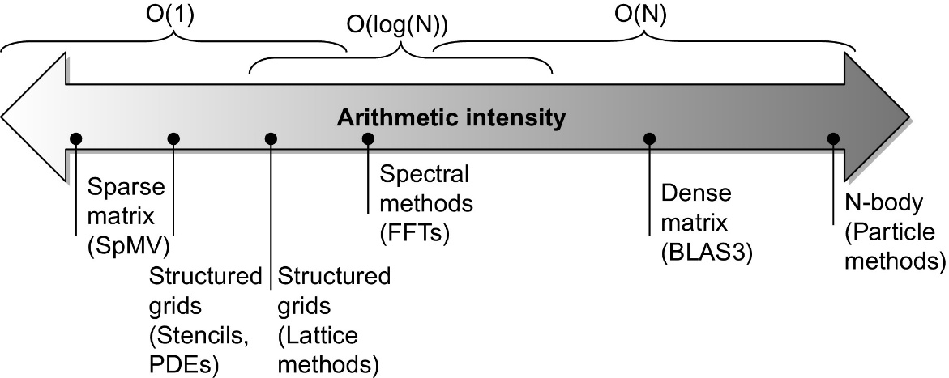
Roofline Performance Model
Basic idea:
Plot peak floating-point throughput as a function of arithmetic intensity
Ties together floating-point performance and memory performance for a target machine
Arithmetic intensity
Floating-point operations per byte read
SIMD Instruction Set Extensions for Multimedia
Notes:
Figure 4.10 Arithmetic intensity, specified as the number of floating-point operations to run the program divided by the number of bytes accessed in main memory (Williams et al., 2009). Some kernels have an arithmetic intensity that scales with problem size, such as a dense matrix, but there are many kernels with arithmetic intensities independent of problem size.

Slide 97
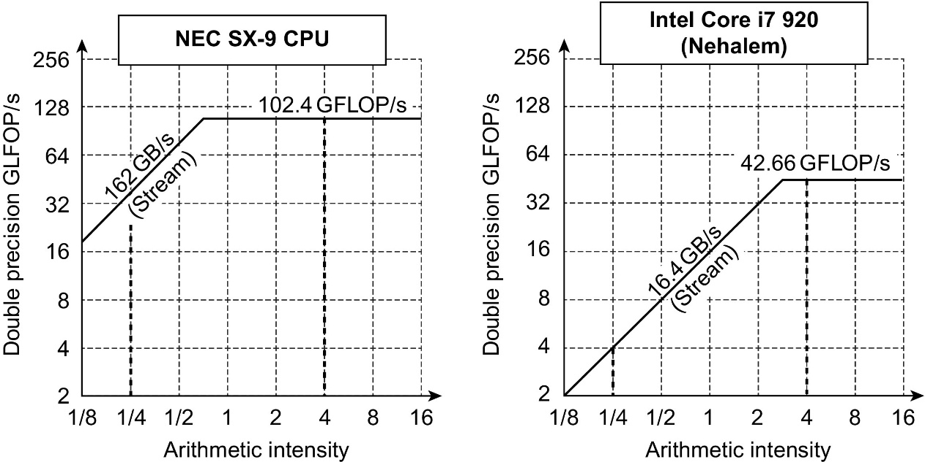
Examples
Attainable GFLOPs/sec = (Peak Memory BW × Arithmetic Intensity, Peak Floating Point Perf.)
SIMD Instruction Set Extensions for Multimedia
Notes:
Figure 4.11 Roofline model for one NEC SX-9 vector processor on the left and the Intel Core i7 920 multicore computer with SIMD extensions on the right (Williams et al., 2009). This Roofline is for unit-stride memory accesses and double-precision floating-point performance. NEC SX-9 is a vector supercomputer announced in 2008 that cost millions of dollars. It has a peak DP FP performance of 102.4 GFLOP/s and a peak memory bandwidth of 162 GB/s from the Stream benchmark. The Core i7 920 has a peak DP FP performance of 42.66 GFLOP/s and a peak memory bandwidth of 16.4 GB/s. The dashed vertical lines at an arithmetic intensity of 4 FLOP/byte show that both processors operate at peak performance. In this case, the SX-9 at 102.4 FLOP/s is 2.4 × faster than the Core i7 at 42.66 GFLOP/s. At an arithmetic intensity of 0.25 FLOP/byte, the SX-9 is 10 × faster at 40.5 GFLOP/s versus 4.1 GFLOP/s for the Core i7.

Slide 98
Graphical Processing Units
Graphical Processing Units
Basic idea:
Heterogeneous execution model
CPU is the host, GPU is the device
Develop a C-like programming language for GPU
Unify all forms of GPU parallelism as CUDA thread
Programming model is “Single Instruction Multiple Thread”

Slide 99
Threads and Blocks
Graphical Processing Units
A thread is associated with each data element
Threads are organized into blocks
Blocks are organized into a grid
GPU hardware handles thread management, not applications or OS

Slide 100
NVIDIA GPU Architecture
Graphical Processing Units
Similarities to vector machines:
Works well with data-level parallel problems
Scatter-gather transfers
Mask registers
Large register files
Differences:
No scalar processor
Uses multithreading to hide memory latency
Has many functional units, as opposed to a few deeply pipelined units like a vector processor

Slide 101
Example
Graphical Processing Units
Code that works over all elements is the grid
Thread blocks break this down into manageable sizes
512 threads per block
SIMD instruction executes 32 elements at a time
Thus grid size = 16 blocks
Block is analogous to a strip-mined vector loop with vector length of 32
Block is assigned to a multithreaded SIMD processor by the thread block scheduler
Current-generation GPUs have 7-15 multithreaded SIMD processors

Slide 102
Terminology
Graphical Processing Units
Each thread is limited to 64 registers
Groups of 32 threads combined into a SIMD thread or “warp”
Mapped to 16 physical lanes
Up to 32 warps are scheduled on a single SIMD processor
Each warp has its own PC
Thread scheduler uses scoreboard to dispatch warps
By definition, no data dependencies between warps
Dispatch warps into pipeline, hide memory latency
Thread block scheduler schedules blocks to SIMD processors
Within each SIMD processor:
32 SIMD lanes
Wide and shallow compared to vector processors

Slide 103
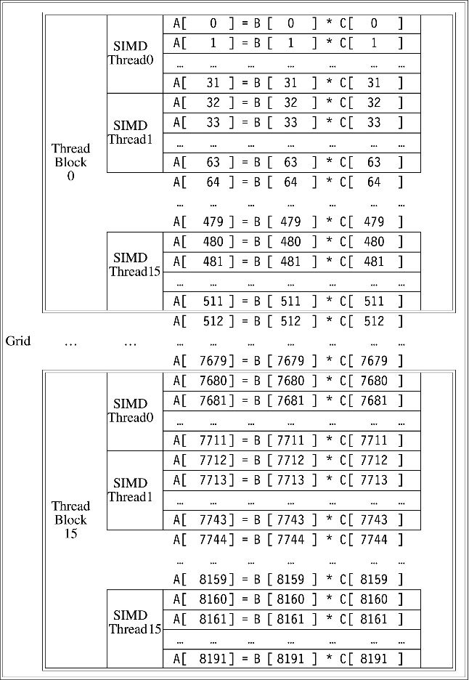
Example
Graphical Processing Units
Notes:
Figure 4.13 The mapping of a Grid (vectorizable loop), Thread Blocks (SIMD basic blocks), and threads of SIMD instructions to a vector-vector multiply, with each vector being 8192 elements long. Each thread of SIMD instructions calculates 32 elements per instruction, and in this example, each Thread Block contains 16 threads of SIMD instructions and the Grid contains 16 Thread Blocks. The hardware Thread Block Scheduler assigns Thread Blocks to multithreaded SIMD Processors, and the hardware Thread Scheduler picks which thread of SIMD instructions to run each clock cycle within a SIMD Processor. Only SIMD Threads in the same Thread Block can communicate via local memory. (The maximum number of SIMD Threads that can execute simultaneously per Thread Block is 32 for Pascal GPUs.)

Slide 104
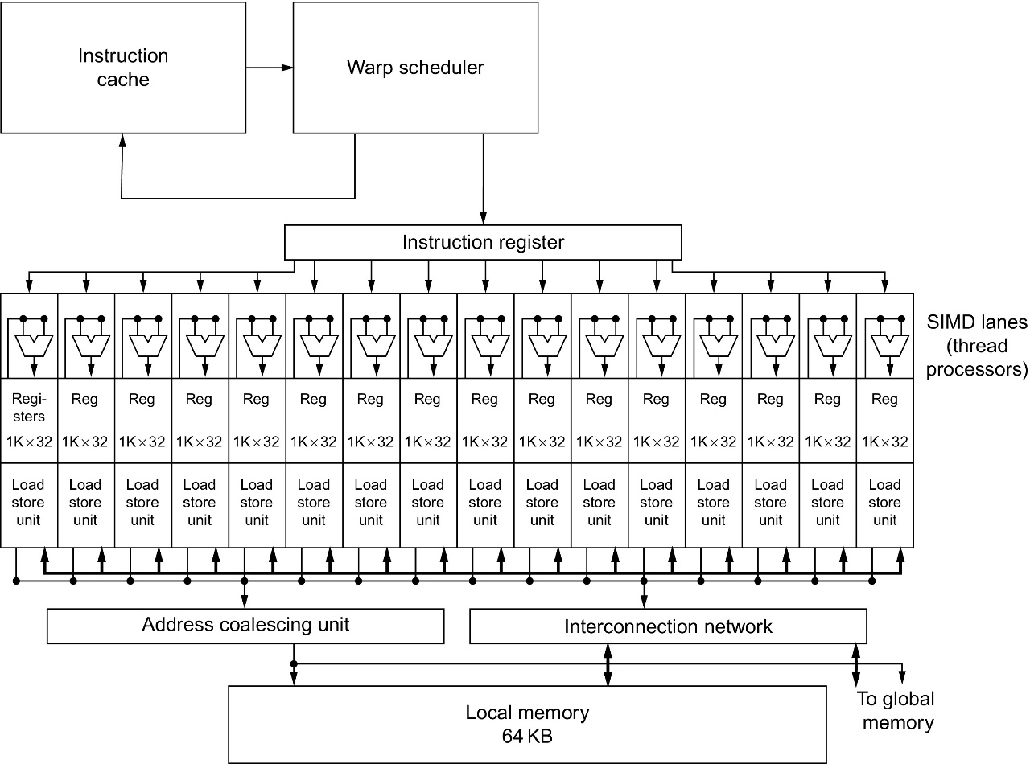
GPU Organization
Graphical Processing Units
Notes:
Figure 4.14 Simplified block diagram of a multithreaded SIMD Processor. It has 16 SIMD Lanes. The SIMD Thread Scheduler has, say, 64 independent threads of SIMD instructions that it schedules with a table of 64 program counters (PCs). Note that each lane has 1024 32-bit registers.

Slide 105
NVIDIA Instruction Set Arch.
Graphical Processing Units
ISA is an abstraction of the hardware instruction set
“Parallel Thread Execution (PTX)”
opcode.type d,a,b,c;
Uses virtual registers
Translation to machine code is performed in software
Example:
shl.s32 R8, blockIdx, 9 ; Thread Block ID * Block size (512 or 29)
add.s32 R8, R8, threadIdx ; R8 = i = my CUDA thread ID
ld.global.f64 RD0, [X+R8] ; RD0 = X[i]
ld.global.f64 RD2, [Y+R8] ; RD2 = Y[i]
mul.f64 R0D, RD0, RD4 ; Product in RD0 = RD0 * RD4 (scalar a)
add.f64 R0D, RD0, RD2 ; Sum in RD0 = RD0 + RD2 (Y[i])
st.global.f64 [Y+R8], RD0 ; Y[i] = sum (X[i]*a + Y[i])

Slide 106
Conditional Branching
Graphical Processing Units
Like vector architectures, GPU branch hardware uses internal masks
Also uses
Branch synchronization stack
Entries consist of masks for each SIMD lane
I.e. which threads commit their results (all threads execute)
Instruction markers to manage when a branch diverges into multiple execution paths
Push on divergent branch
…and when paths converge
Act as barriers
Pops stack
Per-thread-lane 1-bit predicate register, specified by programmer

Slide 107
Example
Graphical Processing Units
if (X[i] != 0)
X[i] = X[i] – Y[i];
else X[i] = Z[i];
ld.global.f64 RD0, [X+R8] ; RD0 = X[i]
setp.neq.s32 P1, RD0, #0 ; P1 is predicate register 1
@!P1, bra ELSE1, *Push ; Push old mask, set new mask bits
; if P1 false, go to ELSE1
ld.global.f64 RD2, [Y+R8] ; RD2 = Y[i]
sub.f64 RD0, RD0, RD2 ; Difference in RD0
st.global.f64 [X+R8], RD0 ; X[i] = RD0
@P1, bra ENDIF1, *Comp ; complement mask bits
; if P1 true, go to ENDIF1
ELSE1: ld.global.f64 RD0, [Z+R8] ; RD0 = Z[i]
st.global.f64 [X+R8], RD0 ; X[i] = RD0
ENDIF1: <next instruction>, *Pop ; pop to restore old mask

Slide 108
NVIDIA GPU Memory Structures
Graphical Processing Units
Each SIMD Lane has private section of off-chip DRAM
“Private memory”
Contains stack frame, spilling registers, and private variables
Each multithreaded SIMD processor also has local memory
Shared by SIMD lanes / threads within a block
Memory shared by SIMD processors is GPU Memory
Host can read and write GPU memory

Slide 109
Pascal Architecture Innovations
Graphical Processing Units
Each SIMD processor has
Two or four SIMD thread schedulers, two instruction dispatch units
16 SIMD lanes (SIMD width=32, chime=2 cycles), 16 load-store units, 4 special function units
Two threads of SIMD instructions are scheduled every two clock cycles
Fast single-, double-, and half-precision
High Bandwith Memory 2 (HBM2) at 732 GB/s
NVLink between multiple GPUs (20 GB/s in each direction)
Unified virtual memory and paging support

Slide 110
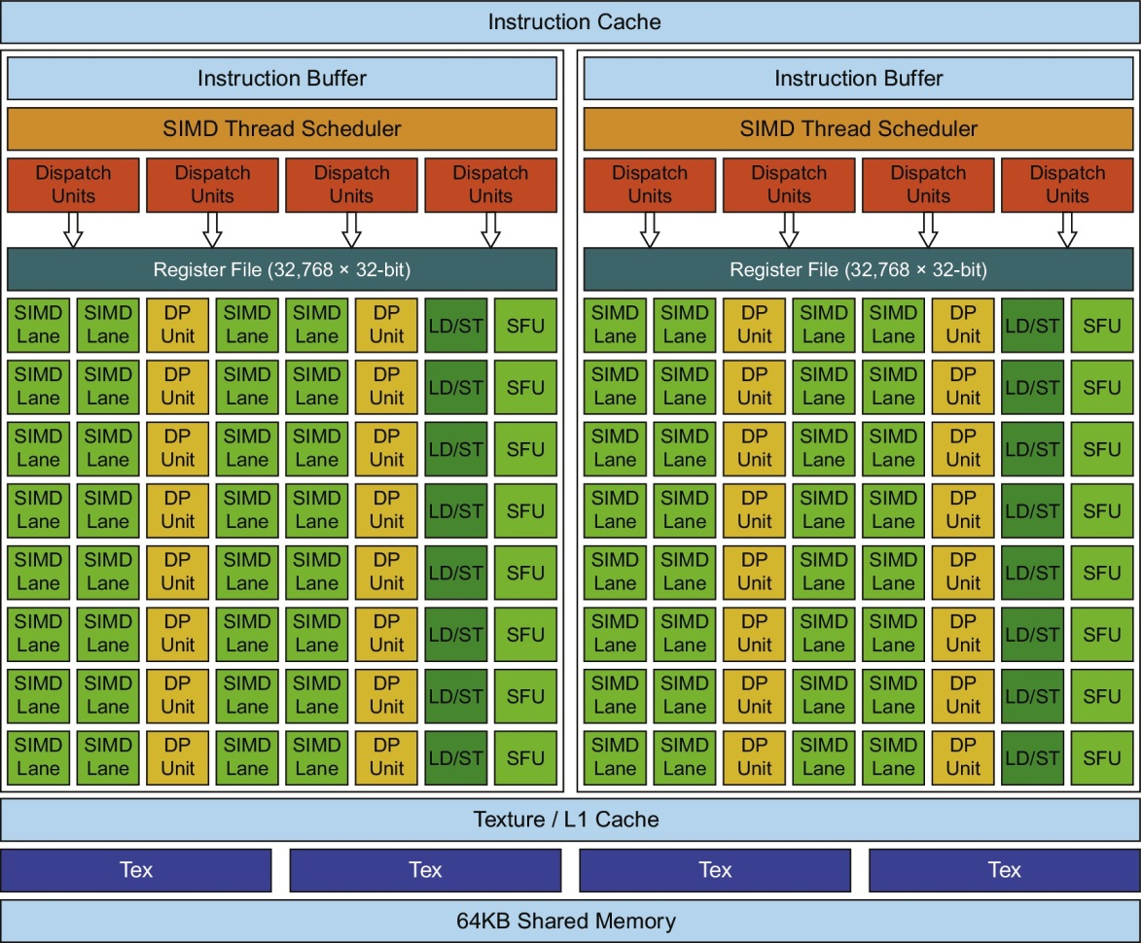
Pascal Multithreaded SIMD Proc.
Graphical Processing Units
Notes:
Figure 4.20 Block diagram of the multithreaded SIMD Processor of a Pascal GPU. Each of the 64 SIMD Lanes (cores) has a pipelined floating-point unit, a pipelined integer unit, some logic for dispatching instructions and operands to these units, and a queue for holding results. The 64 SIMD Lanes interact with 32 double-precision ALUs (DP units) that perform 64-bit floating-point arithmetic, 16 load-store units (LD/STs), and 16 special function units (SFUs) that calculate functions such as square roots, reciprocals, sines, and cosines.

Slide 111
Vector Architectures vs GPUs
Graphical Processing Units
SIMD processor analogous to vector processor, both have MIMD
Registers
RV64V register file holds entire vectors
GPU distributes vectors across the registers of SIMD lanes
RV64 has 32 vector registers of 32 elements (1024)
GPU has 256 registers with 32 elements each (8K)
RV64 has 2 to 8 lanes with vector length of 32, chime is 4 to 16 cycles
SIMD processor chime is 2 to 4 cycles
GPU vectorized loop is grid
All GPU loads are gather instructions and all GPU stores are scatter instructions

Slide 112
SIMD Architectures vs GPUs
Graphical Processing Units
GPUs have more SIMD lanes
GPUs have hardware support for more threads
Both have 2:1 ratio between double- and single-precision performance
Both have 64-bit addresses, but GPUs have smaller memory
SIMD architectures have no scatter-gather support

Slide 113
Loop-Level Parallelism
Focuses on determining whether data accesses in later iterations are dependent on data values produced in earlier iterations
Loop-carried dependence
Example 1:
for (i=999; i>=0; i=i-1)
x[i] = x[i] + s;
No loop-carried dependence
Detecting and Enhancing Loop-Level Parallelism

Slide 114
Loop-Level Parallelism
Example 2:
for (i=0; i<100; i=i+1) {
A[i+1] = A[i] + C[i]; /* S1 */
B[i+1] = B[i] + A[i+1]; /* S2 */
}
S1 and S2 use values computed by S1 in previous iteration
S2 uses value computed by S1 in same iteration
Detecting and Enhancing Loop-Level Parallelism

Slide 115
Loop-Level Parallelism
Example 3:
for (i=0; i<100; i=i+1) {
A[i] = A[i] + B[i]; /* S1 */
B[i+1] = C[i] + D[i]; /* S2 */
}
S1 uses value computed by S2 in previous iteration but dependence is not circular so loop is parallel
Transform to:
A[0] = A[0] + B[0];
for (i=0; i<99; i=i+1) {
B[i+1] = C[i] + D[i];
A[i+1] = A[i+1] + B[i+1];
}
B[100] = C[99] + D[99];
Detecting and Enhancing Loop-Level Parallelism

Slide 116
Loop-Level Parallelism
Example 4:
for (i=0;i<100;i=i+1) {
A[i] = B[i] + C[i];
D[i] = A[i] * E[i];
}
Example 5:
for (i=1;i<100;i=i+1) {
Y[i] = Y[i-1] + Y[i];
}
Detecting and Enhancing Loop-Level Parallelism

Slide 117
Finding dependencies
Assume indices are affine:
a x i + b (i is loop index)
Assume:
Store to a x i + b, then
Load from c x i + d
i runs from m to n
Dependence exists if:
Given j, k such that m ≤ j ≤ n, m ≤ k ≤ n
Store to a x j + b, load from a x k + d, and a x j + b = c x k + d
Detecting and Enhancing Loop-Level Parallelism

Slide 118
Finding dependencies
Generally cannot determine at compile time
Test for absence of a dependence:
GCD test:
If a dependency exists, GCD(c,a) must evenly divide (d-b)
Example:
for (i=0; i<100; i=i+1) {
X[2*i+3] = X[2*i] * 5.0;
}
Detecting and Enhancing Loop-Level Parallelism

Slide 119
Finding dependencies
Example 2:
for (i=0; i<100; i=i+1) {
Y[i] = X[i] / c; /* S1 */
X[i] = X[i] + c; /* S2 */
Z[i] = Y[i] + c; /* S3 */
Y[i] = c - Y[i]; /* S4 */
}
Watch for antidependencies and output dependencies
Detecting and Enhancing Loop-Level Parallelism

Slide 120
Finding dependencies
Example 2:
for (i=0; i<100; i=i+1) {
Y[i] = X[i] / c; /* S1 */
X[i] = X[i] + c; /* S2 */
Z[i] = Y[i] + c; /* S3 */
Y[i] = c - Y[i]; /* S4 */
}
Watch for antidependencies and output dependencies
Detecting and Enhancing Loop-Level Parallelism

Slide 121
Reductions
Reduction Operation:
for (i=9999; i>=0; i=i-1)
sum = sum + x[i] * y[i];
Transform to…
for (i=9999; i>=0; i=i-1)
sum [i] = x[i] * y[i];
for (i=9999; i>=0; i=i-1)
finalsum = finalsum + sum[i];
Do on p processors:
for (i=999; i>=0; i=i-1)
finalsum[p] = finalsum[p] + sum[i+1000*p];
Note: assumes associativity!
Detecting and Enhancing Loop-Level Parallelism

Slide 122
Fallacies and Pitfalls
Fallacies and Pitfalls
GPUs suffer from being coprocessors
GPUs have flexibility to change ISA
Concentrating on peak performance in vector architectures and ignoring start-up overhead
Overheads require long vector lengths to achieve speedup
Increasing vector performance without comparable increases in scalar performance
You can get good vector performance without providing memory bandwidth
On GPUs, just add more threads if you don’t have enough memory performance

Slide 123
Chapter 4
Data-Level Parallelism in
Vector, SIMD, and GPU
Architectures

Slide 124
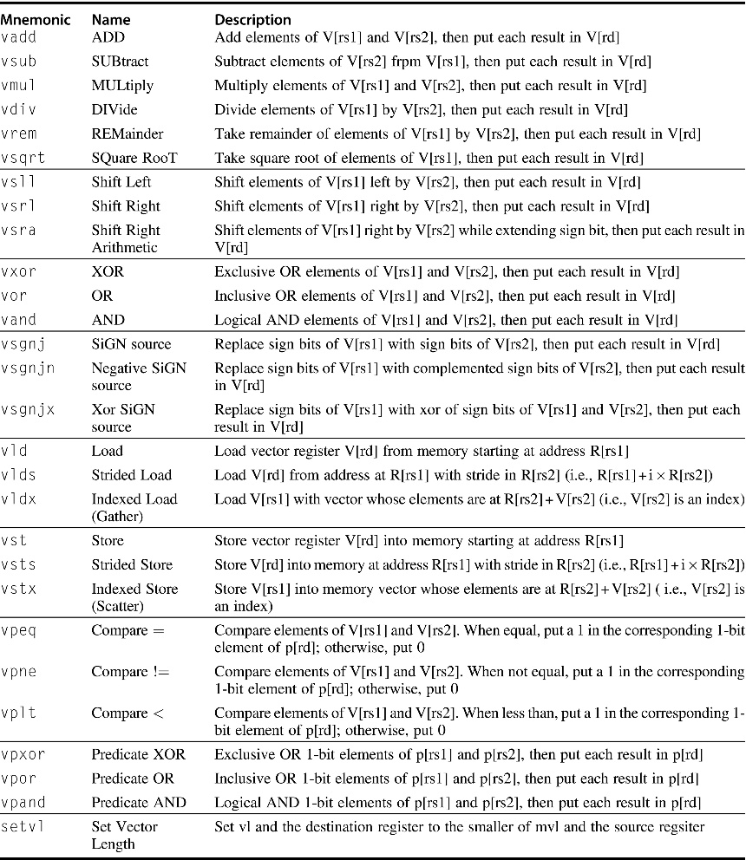
Figure 4.2 The RV64V vector instructions. All use the R instruction format. Each vector operation with two operands is shown with both operands being vector (.vv), but there are also versions where the second operand is a scalar register (.vs) and, when it makes a difference, where the first operand is a scalar register and the second is a vector register (.sv). The type and width of the operands are determined by configuring each vector register rather than being supplied by the instruction. In addition to the vector registers and predicate registers, there are two vector control and status registers (CSRs), vl and vctype, discussed below. The strided and indexed data transfers are also explained later. Once completed, RV64 will surely have more instructions, but the ones in this figure will be included.

Slide 125
Figure 4.3 Data sizes supported for RV64V assuming it also has the single- and double-precision floating-point extensions RVS and RVD. Adding RVV to such a RISC-V design means the scalar unit must also add RVH, which is a scalar instruction extension to support half-precision (16-bit) IEEE 754 floating point. Because RV32V would not have doubleword scalar operations, it could drop 64-bit integers from the vector unit. If a RISC-V implementation didn’t include RVS or RVD, it could omit the vector floating-point instructions.

Slide 126
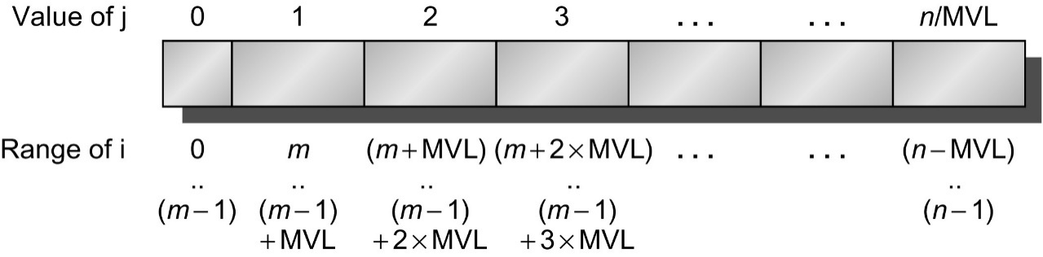
Figure 4.6 A vector of arbitrary length processed with strip mining. All blocks but the first are of length MVL, utilizing the full power of the vector processor. In this figure, we use the variable m for the expression (n % MVL). (The C operator % is modulo.)

Slide 127
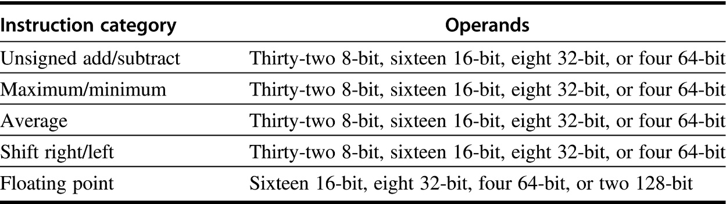
Figure 4.8 Summary of typical SIMD multimedia support for 256-bit-wide operations. Note that the IEEE 754-2008 floating-point standard added half-precision (16-bit) and quad-precision (128-bit) floating-point operations.

Slide 128
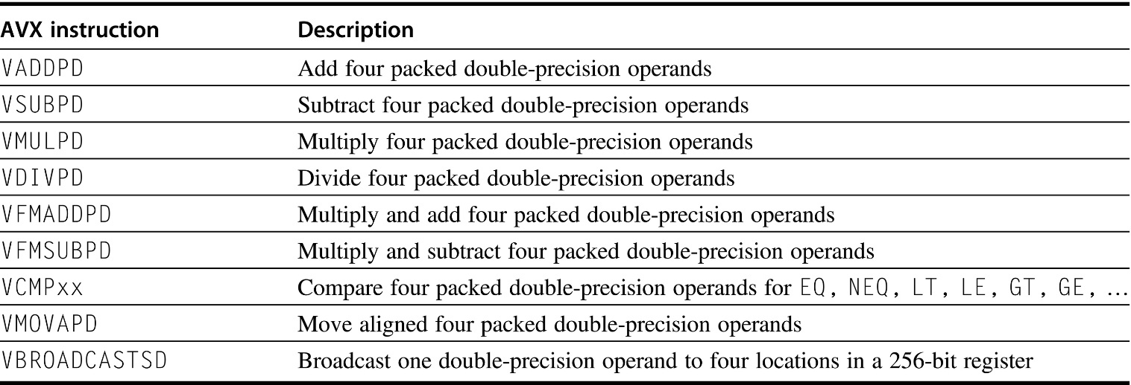
Figure 4.9 AVX instructions for x86 architecture useful in double-precision floating-point programs. Packed-double for 256-bit AVX means four 64-bit operands executed in SIMD mode. As the width increases with AVX, it is increasingly important to add data permutation instructions that allow combinations of narrow operands from different parts of the wide registers. AVX includes instructions that shuffle 32-bit, 64-bit, or 128-bit operands within a 256-bit register. For example, BROADCAST replicates a 64-bit operand four times in an AVX register. AVX also includes a large variety of fused multiply-add/subtract instructions; we show just two here.

Slide 129
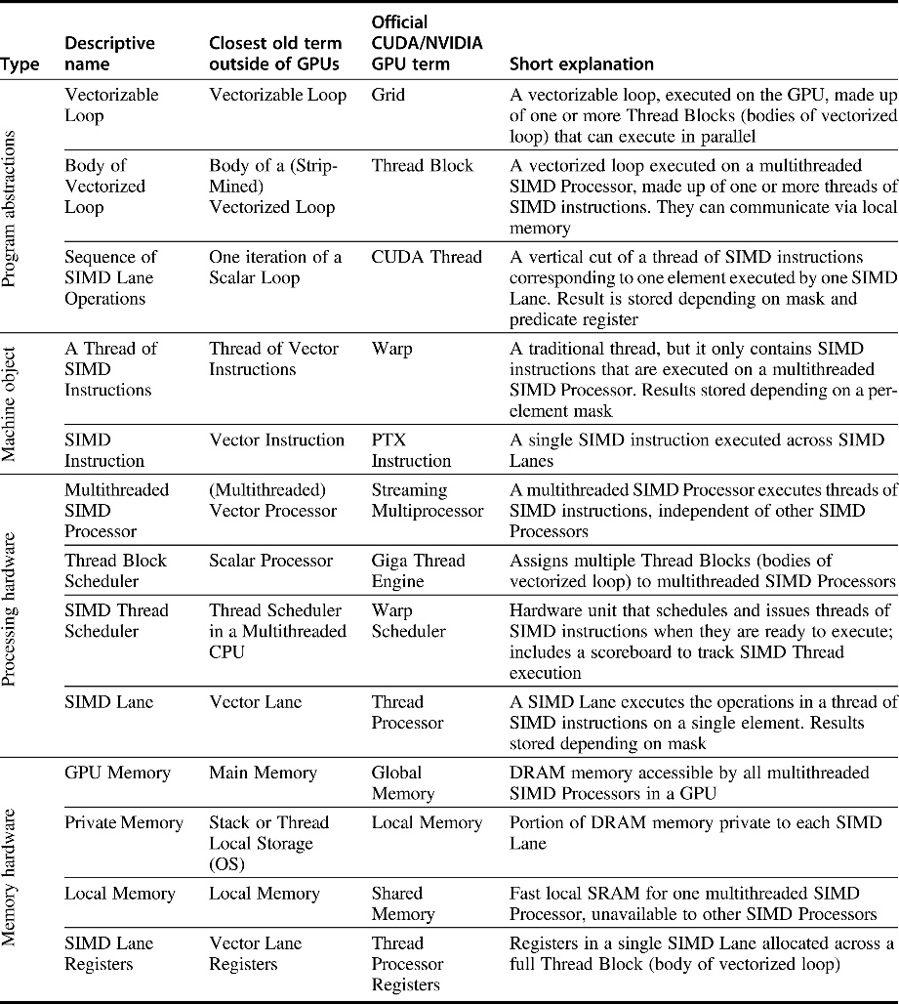
Figure 4.12 Quick guide to GPU terms used in this chapter. We use the first column for hardware terms. Four groups cluster these 11 terms. From top to bottom: program abstractions, machine objects, processing hardware, and memory hardware. Figure 4.21 on page 312 associates vector terms with the closest terms here, and Figure 4.24 on page 317 and Figure 4.25 on page 318 reveal the official CUDA/NVIDIA and AMD terms and definitions along with the terms used by OpenCL.

Slide 130
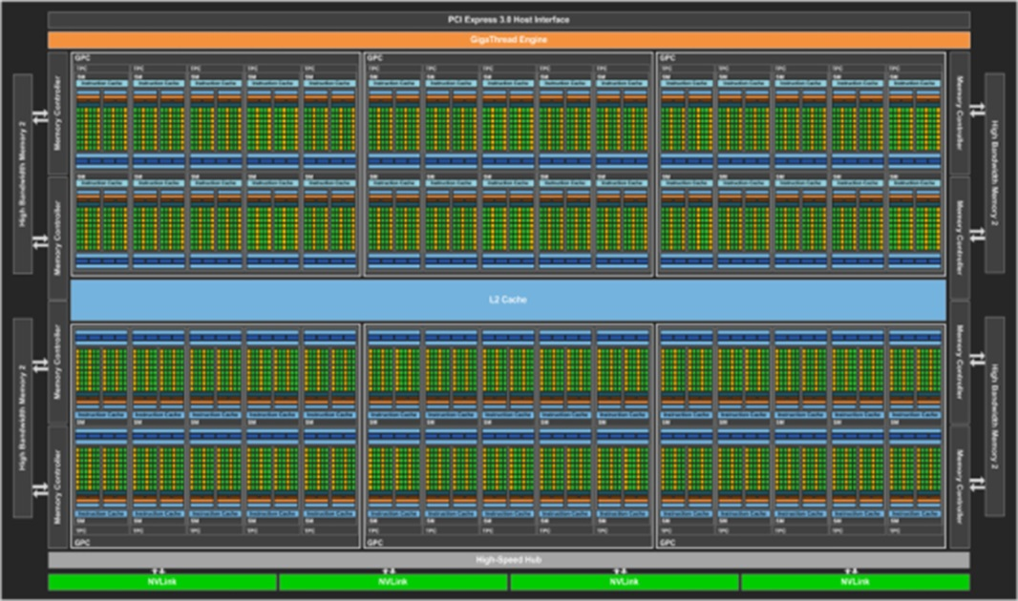
Figure 4.15 Full-chip block diagram of the Pascal P100 GPU. It has 56 multithreaded SIMD Processors, each with an L1 cache and local memory, 32 L2 units, and a memory-bus width of 4096 data wires. (It has 60 blocks, with four spares to improve yield.) The P100 has 4 HBM2 ports supporting up to 16 GB of capacity. It contains 15.4 billion transistors.

Slide 131
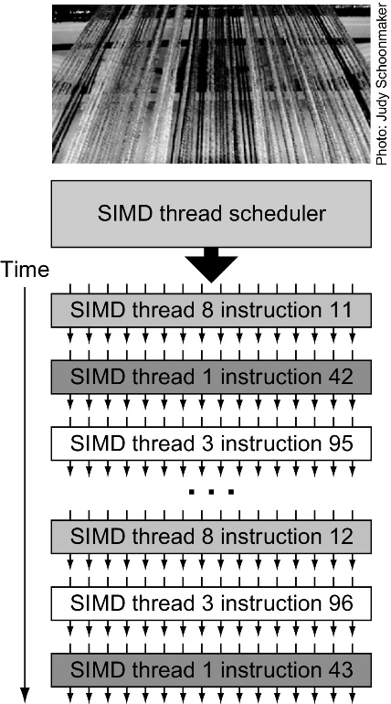
Figure 4.16 Scheduling of threads of SIMD instructions. The scheduler selects a ready thread of SIMD instructions and issues an instruction synchronously to all the SIMD Lanes executing the SIMD Thread. Because threads of SIMD instructions are independent, the scheduler may select a different SIMD Thread each time.

Slide 132
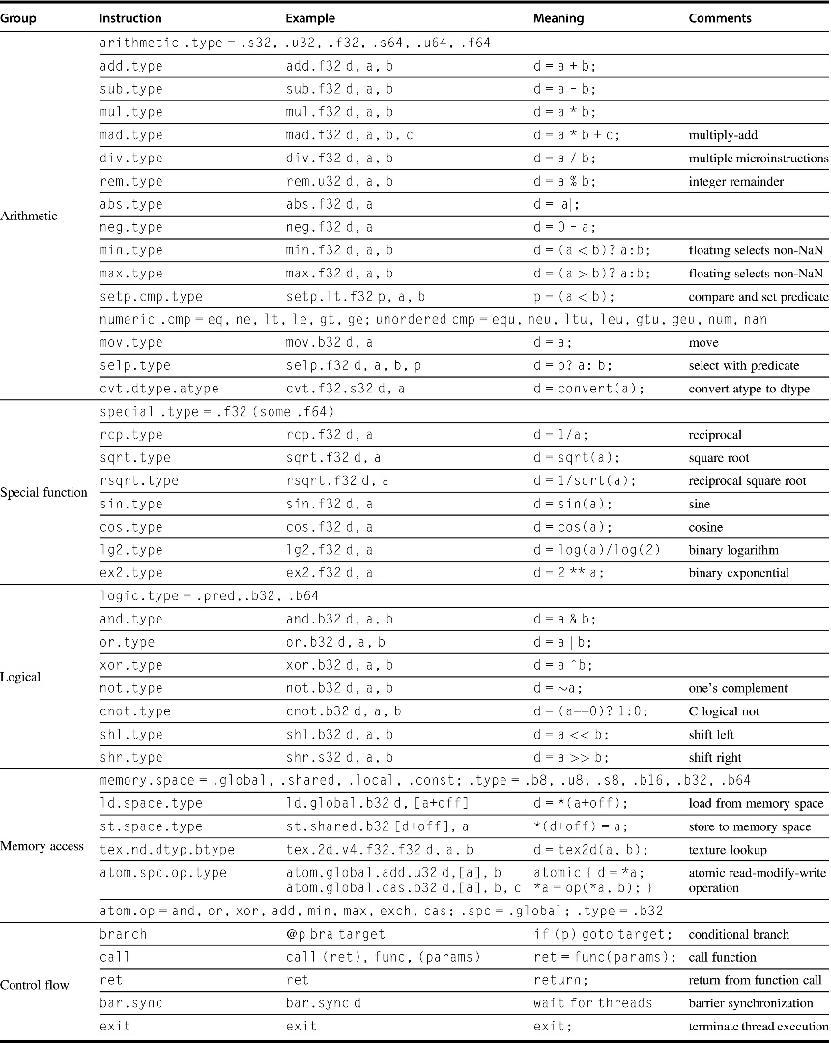
Figure 4.17 Basic PTX GPU thread instructions.

Slide 133
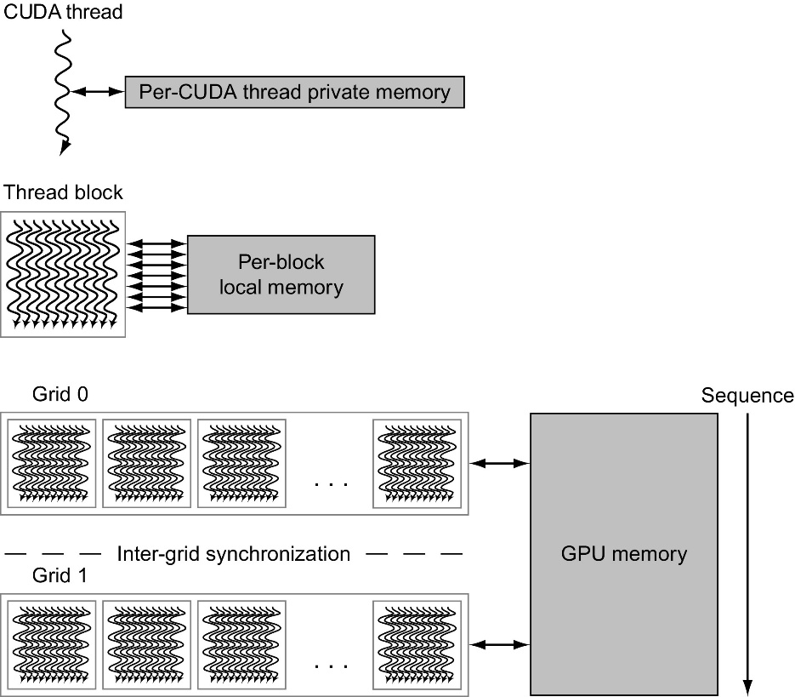
Figure 4.18 GPU memory structures. GPU memory is shared by all Grids (vectorized loops), local memory is shared by all threads of SIMD instructions within a Thread Block (body of a vectorized loop), and private memory is private to a single CUDA Thread. Pascal allows preemption of a Grid, which requires that all local and private memory be able to be saved in and restored from global memory. For completeness sake, the GPU can also access CPU memory via the PCIe bus. This path is commonly used for a final result when its address is in host memory. This option eliminates a final copy from the GPU memory to the host memory.

Slide 134
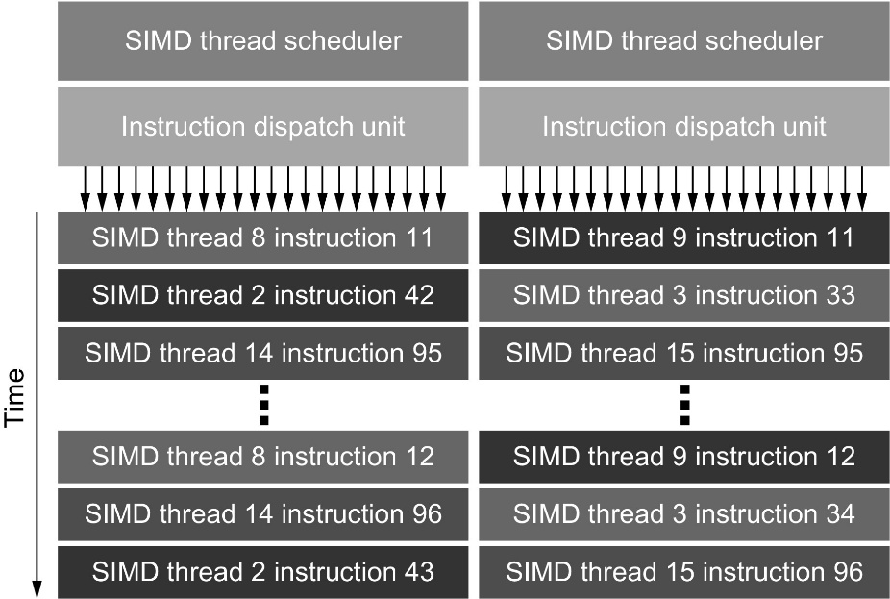
Figure 4.19 Block diagram of Pascal’s dual SIMD Thread scheduler. Compare this design to the single SIMD Thread design in Figure 4.16.

Slide 135
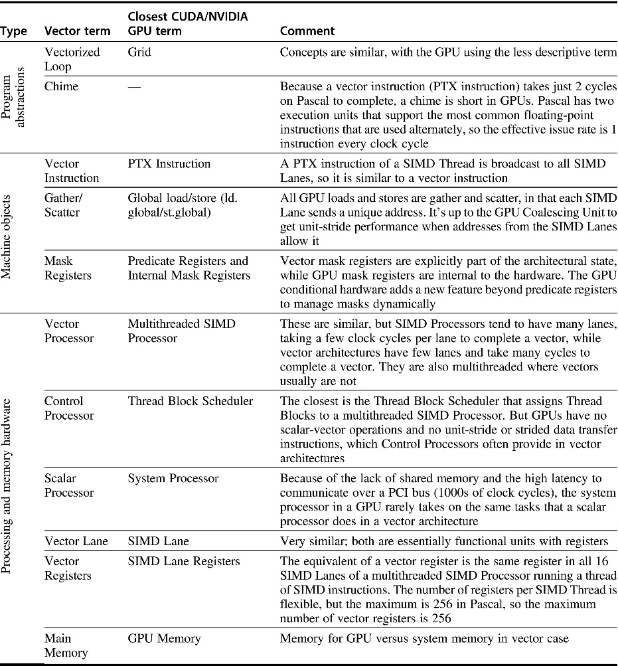
Figure 4.21 GPU equivalent to vector terms.

Slide 136
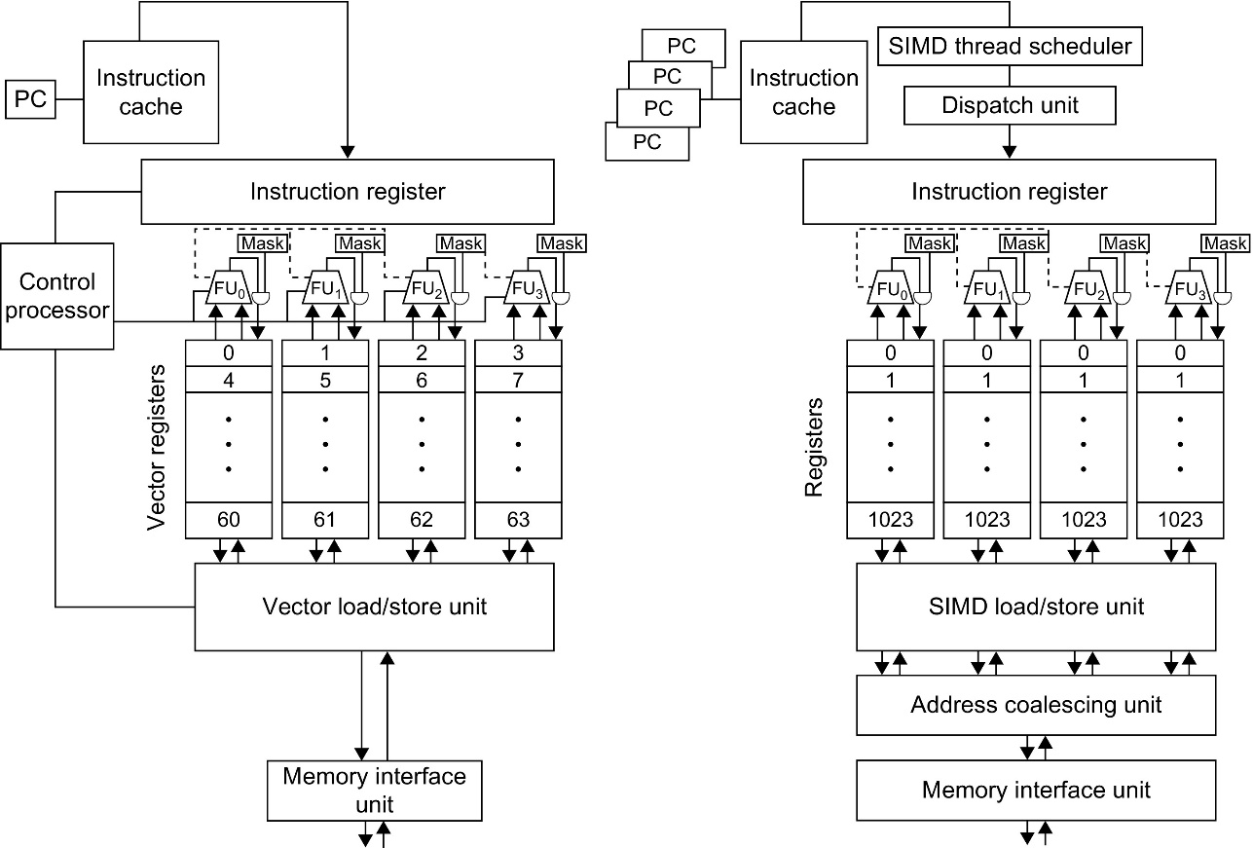
Figure 4.22 A vector processor with four lanes on the left and a multithreaded SIMD Processor of a GPU with four SIMD Lanes on the right. (GPUs typically have 16 or 32 SIMD Lanes.) The Control Processor supplies scalar operands for scalar-vector operations, increments addressing for unit and nonunit stride accesses to memory, and performs other accounting-type operations. Peak memory performance occurs only in a GPU when the Address Coalescing Unit can discover localized addressing. Similarly, peak computational performance occurs when all internal mask bits are set identically. Note that the SIMD Processor has one PC per SIMD Thread to help with multithreading.

Slide 137
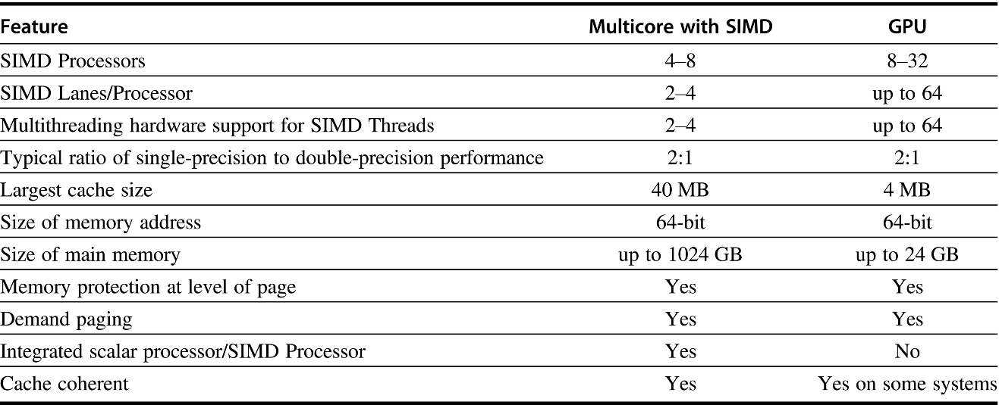
Figure 4.23 Similarities and differences between multicore with multimedia SIMD extensions and recent GPUs.

Slide 138
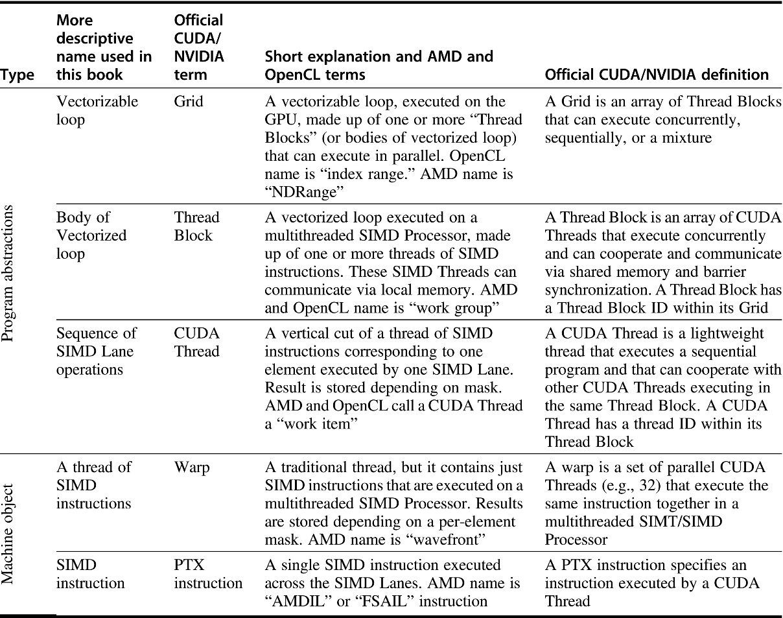
Figure 4.24 Conversion from terms used in this chapter to official NVIDIA/CUDA and AMD jargon. OpenCL names are given in the book’s definitions.

Slide 139
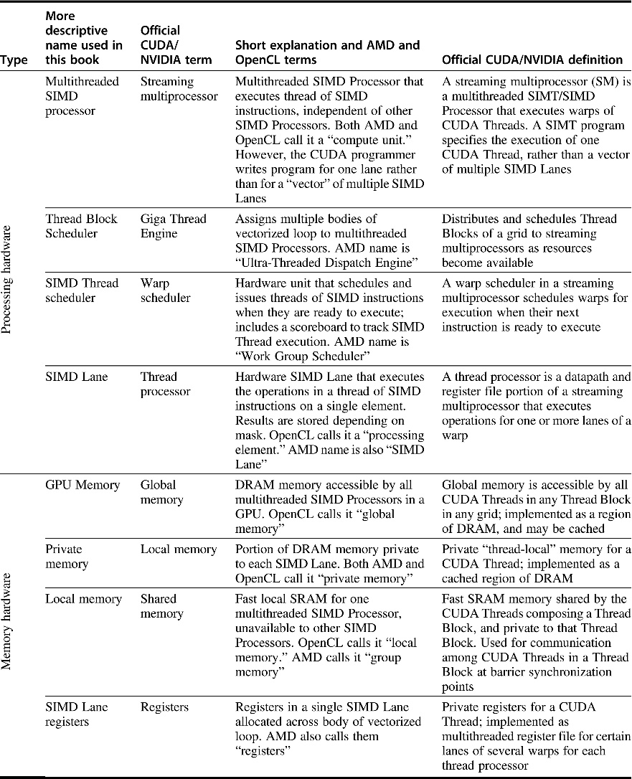
Figure 4.25 Conversion from terms used in this chapter to official NVIDIA/CUDA and AMD jargon. Note that our descriptive terms “local memory” and “private memory” use the OpenCL terminology. NVIDIA uses SIMT (single-instruction multiple-thread) rather than SIMD to describe a streaming multiprocessor. SIMT is preferred over SIMD because the per-thread branching and control flow are unlike any SIMD machine.

Slide 140
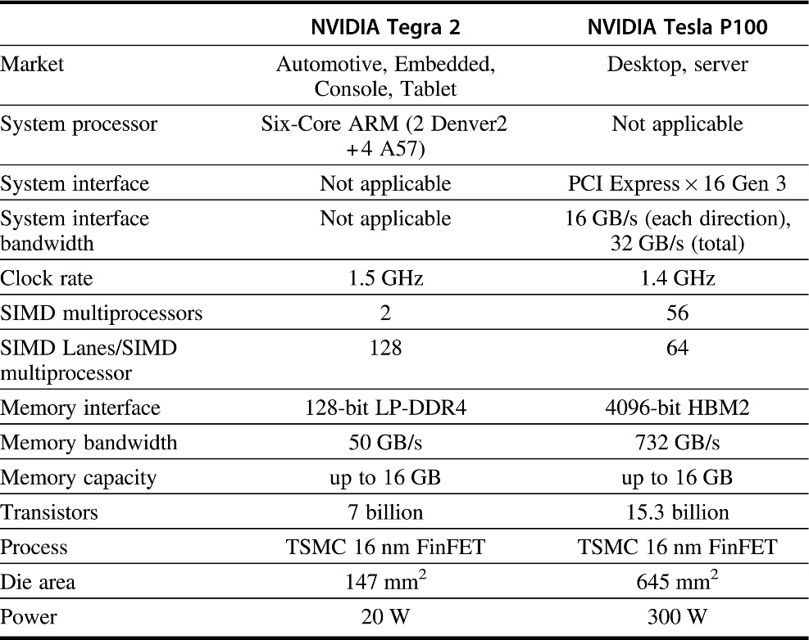
Figure 4.26 Key features of the GPUs for embedded clients and servers.

Slide 141
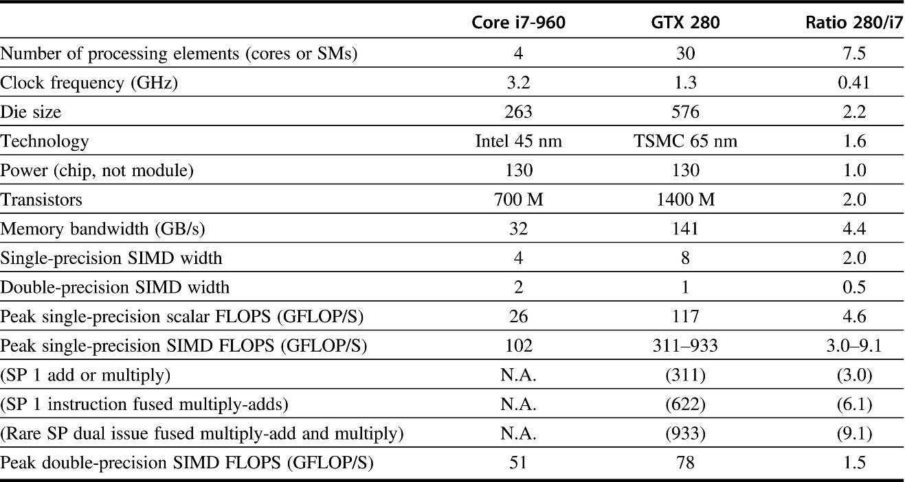
Figure 4.27 Intel Core i7-960 and NVIDIA GTX 280. The rightmost column shows the ratios of GTX 280 to Core i7. For single-precision SIMD FLOPS on the GTX 280, the higher speed (933) comes from a very rare case of dual issuing of fused multiply-add and multiply. More reasonable is 622 for single fused multiply-adds. Note that these memory bandwidths are higher than in Figure 4.28 because these are DRAM pin bandwidths and those in Figure 4.28 are at the processors as measured by a benchmark program. From Table 2 in Lee, W.V., et al., 2010. Debunking the 100 × GPU vs. CPU myth: an evaluation of throughput computing on CPU and GPU. In: Proc. 37th Annual Int’l. Symposium on Computer Architecture (ISCA), June 19–23, 2010, Saint-Malo, France.

Slide 142
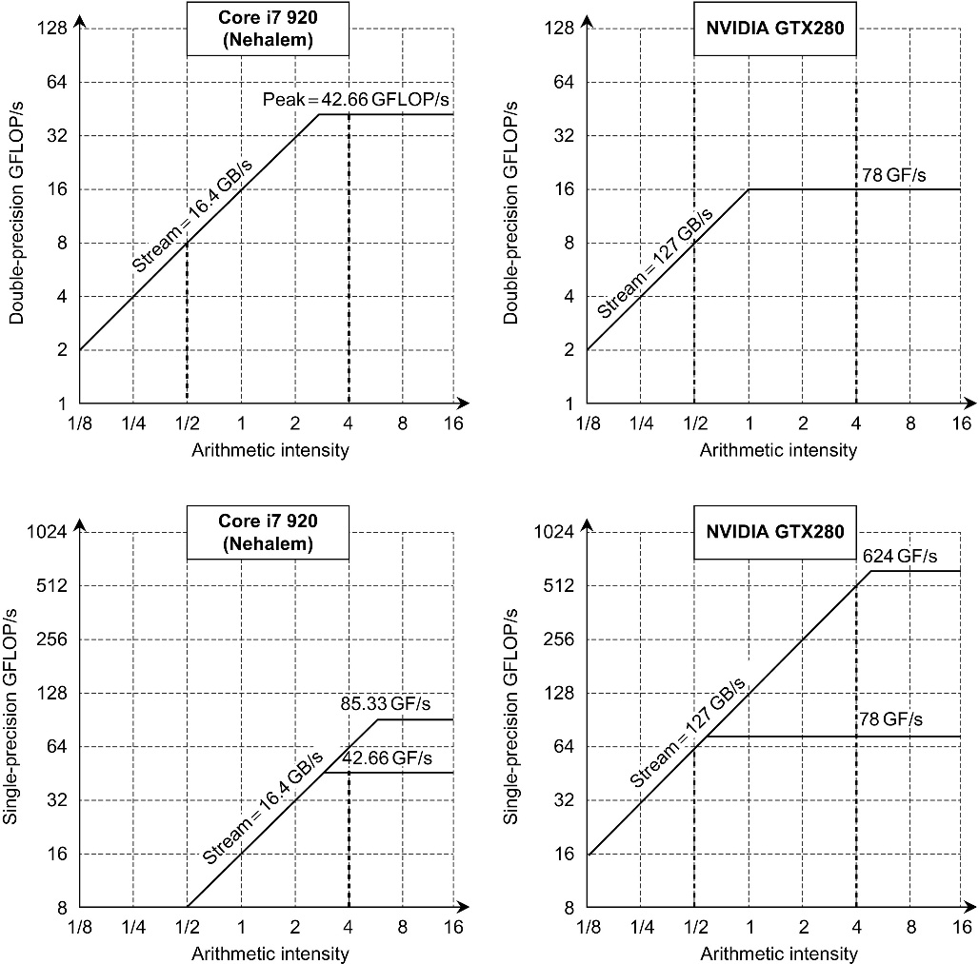
Figure 4.28 Roofline model (Williams et al. 2009). These rooflines show double-precision floating-point performance in the top row and single-precision performance in the bottom row. (The DP FP performance ceiling is also in the bottom row to give perspective.) The Core i7 920 on the left has a peak DP FP performance of 42.66 GFLOP/s, a SP FP peak of 85.33 GFLOP/s, and a peak memory bandwidth of 16.4 GB/s. The NVIDIA GTX 280 has a DP FP peak of 78 GFLOP/s, SP FP peak of 624 GFLOP/s, and 127 GB/s of memory bandwidth. The dashed vertical line on the left represents an arithmetic intensity of 0.5 FLOP/byte. It is limited by memory bandwidth to no more than 8 DP GFLOP/s or 8 SP GFLOP/s on the Core i7. The dashed vertical line to the right has an arithmetic intensity of 4 FLOP/byte. It is limited only computationally to 42.66 DP GFLOP/s and 64 SP GFLOP/s on the Core i7 and to 78 DP GFLOP/s and 512 DP GFLOP/s on the GTX 280. To hit the highest computation rate on the Core i7, you need to use all 4 cores and SSE instructions with an equal number of multiplies and adds. For the GTX 280, you need to use fused multiply-add instructions on all multithreaded SIMD Processors.

Slide 143
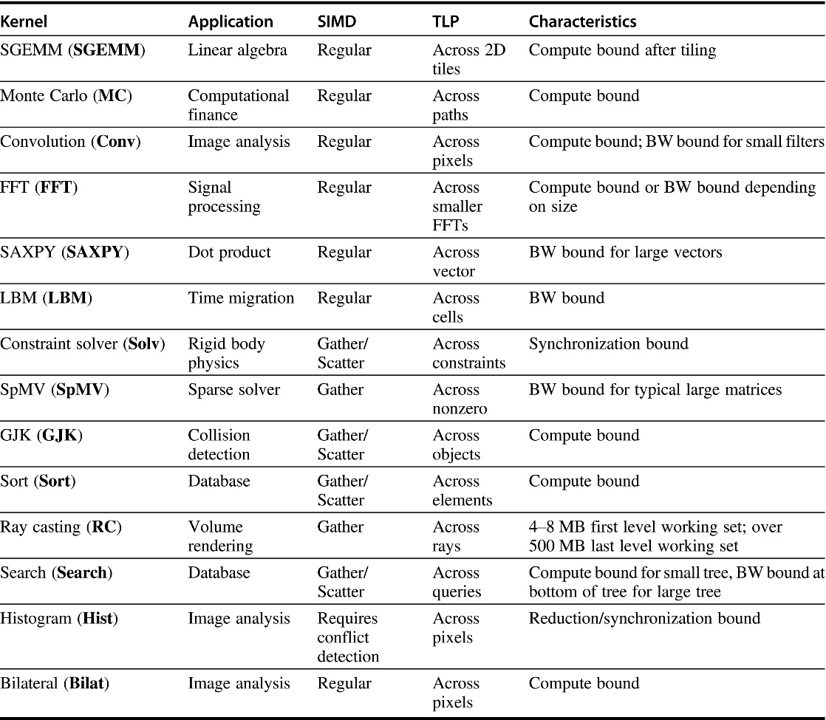
Figure 4.29 Throughput computing kernel characteristics. The name in parentheses identifies the benchmark name in this section. The authors suggest that code for both machines had equal optimization effort. From Table 1 in Lee, W.V., et al., 2010. Debunking the 100 × GPU vs. CPU myth: an evaluation of throughput computing on CPU and GPU. In: Proc. 37th Annual Int’l. Symposium on Computer Architecture (ISCA), June 19–23, 2010, Saint-Malo, France.

Slide 144
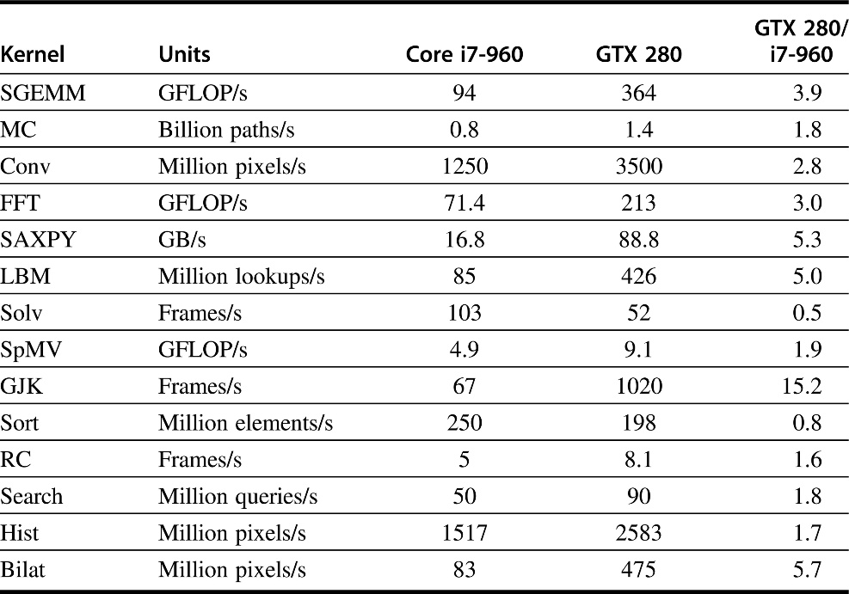
Figure 4.30 Raw and relative performance measured for the two platforms. In this study, SAXPY is used only as a measure of memory bandwidth, so the right unit is GB/s and not GFLOP/s. Based on Table 3 in Lee, W.V., et al., 2010. Debunking the 100 × GPU vs. CPU myth: an evaluation of throughput computing on CPU and GPU. In: Proc. 37th Annual Int’l. Symposium on Computer Architecture (ISCA), June 19–23, 2010, Saint-Malo, France.

Slide 145
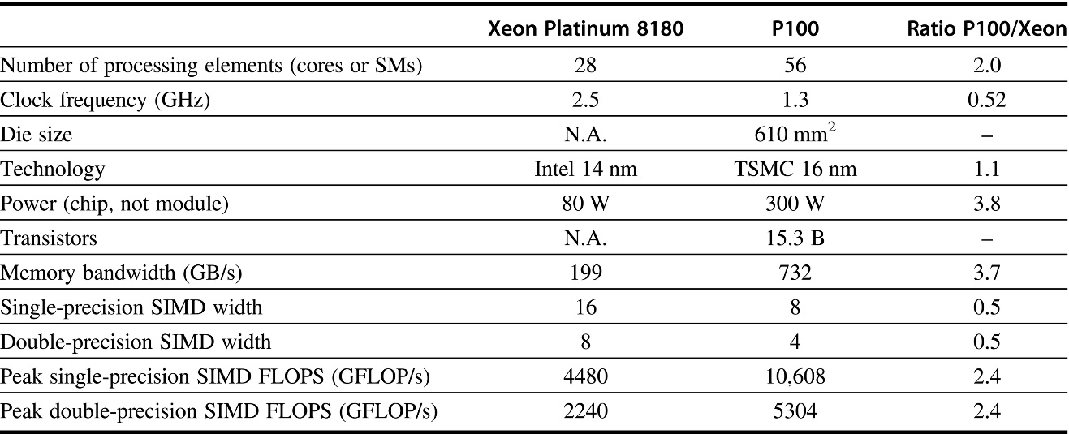
Figure 4.31 Intel Xeon ?? and NVIDIA P100. The rightmost column shows the ratios of P100 to the Xeon. Note that these memory bandwidths are higher than in Figure 4.28 because these are DRAM pin bandwidths and those in Figure 4.28 are at the processors as measured by a benchmark program.

Slide 146
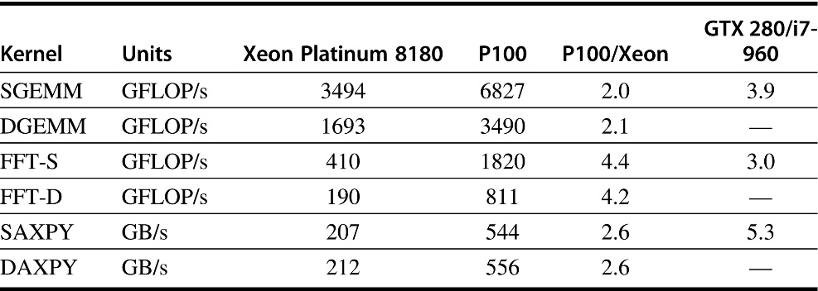
Figure 4.32 Raw and relative performance measured for modern versions of the two platforms as compared to the relative performance of the original platforms. Like Figure 4.30, SAXPY and DAXPY are used only as a measure of memory bandwidth, so the proper unit is GB/s and not GFLOP/s.

Slide 147
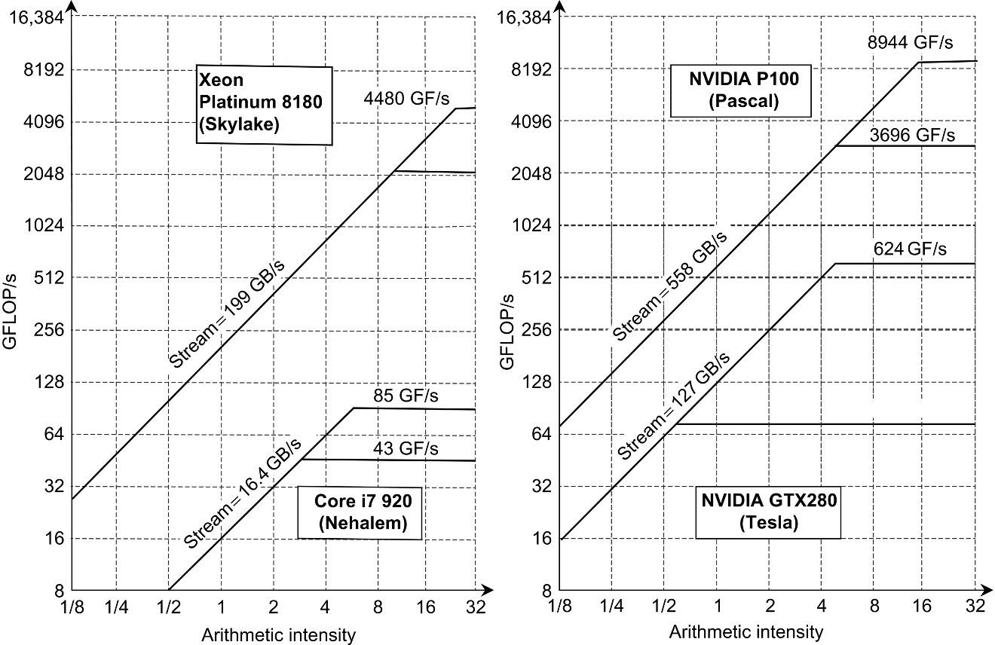
Figure 4.33 Roofline models of older and newer CPUs versus older and newer GPUs. The higher roofline for each computer is single-precision floating-point performance, and the lower one is double-precision performance.

Slide 148
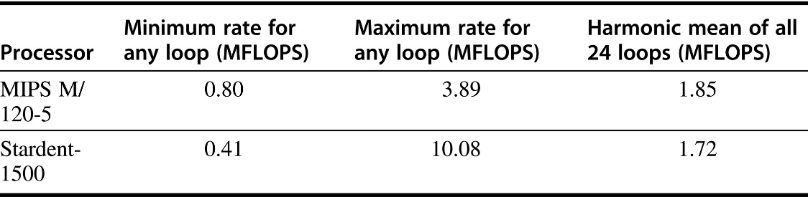
Figure 4.34 Performance measurements for the Livermore Fortran kernels on two different processors. Both the MIPS M/120-5 and the Stardent-1500 (formerly the Ardent Titan-1) use a 16.7 MHz MIPS R2000 chip for the main CPU. The Stardent-1500 uses its vector unit for scalar FP and has about half the scalar performance (as measured by the minimum rate) of the MIPS M/120-5, which uses the MIPS R2010 FP chip. The vector processor is more than a factor of 2.5 × faster for a highly vectorizable loop (maximum rate). However, the lower scalar performance of the Stardent-1500 negates the higher vector performance when total performance is measured by the harmonic mean on all 24 loops.

Slide 149
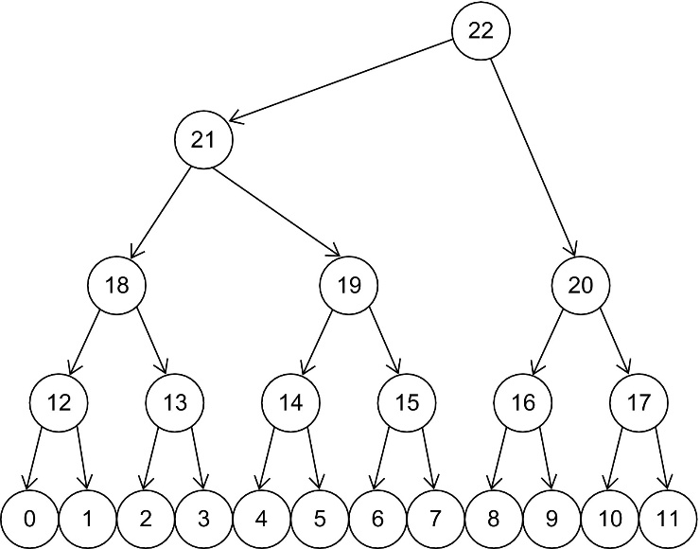
Figure 4.35 Sample tree.

