Slide 1
存储器的层次结构
存储器层次的基本概念
DRAM芯片的持续发展
主存储器组织结构
高速缓存
虚拟存储器
高速缓存的性能优化

Slide 2
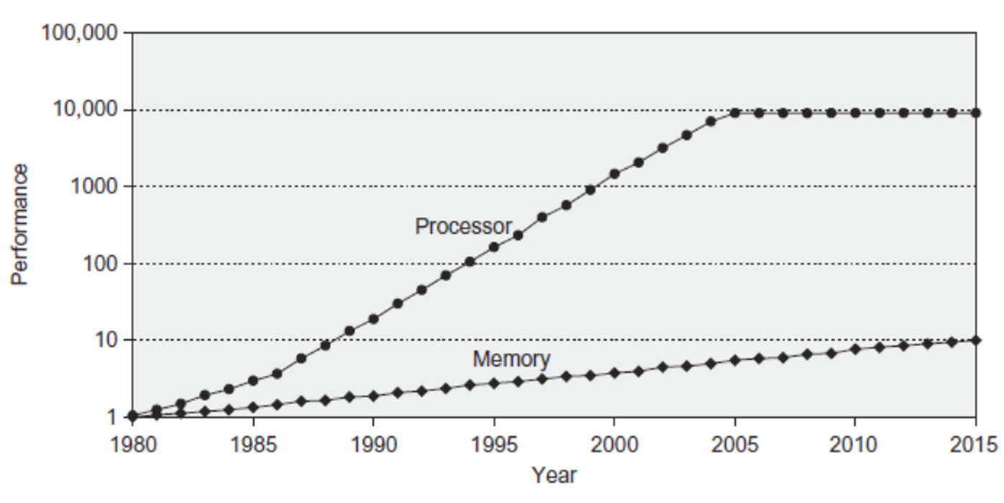
存储器层次结构的缘起
剪刀差
Notes:
Y-axis is performance
X-axis is time
Latency
Clich?
Not e that x86 didn抰 have cache on chip until 1989

Slide 3
Introduction
(OCOSA)
Objective: programmers want unlimited amounts of memory with low latency
CFS: Gives the allusion of a large, fast memory being presented to the processor
Obstacle: fast memory technology is more expensive per bit than slower memory
Strategy: organize memory system into a hierarchy
Entire addressable memory space available in largest, slowest & cheapest memory
Incrementally smaller and faster memories, each containing a subset of the memory below it, proceed in steps up toward the processor
Action Items
How to ensures nearly all references be found in smaller and faster memories
Fully utilize & exploit locality!
Capacity
Processor
Bandwidth
Control
Tertiary
Storage
(Disk/
Tape)
Secondary
Storage
(HDD &
SSD)
Latency
Off-
Chip
Cache
(SRAM)
Main
Memory
(DRAM)
Datapath
On-Chip
Cache
Registers

Slide 4
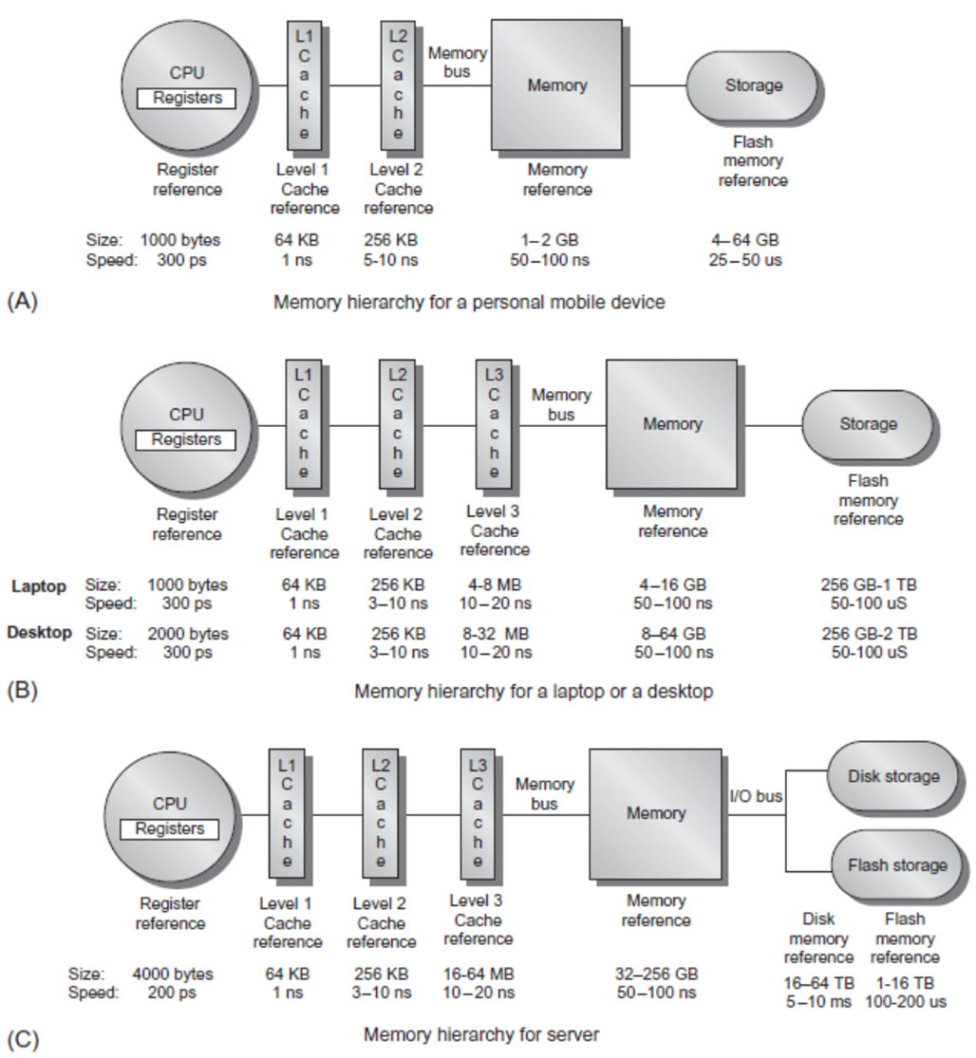
Levels of the Memory Hierarchy
Personal Mobile Device
Smart Phone, Pad
Personal Computer
Laptop, Desktop
Server

Slide 5
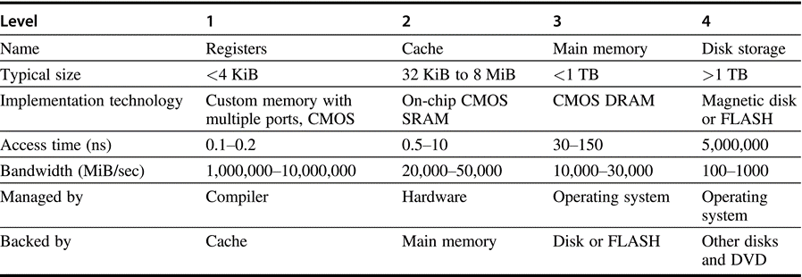
The typical levels in the hierarchy for Desktops

Slide 6
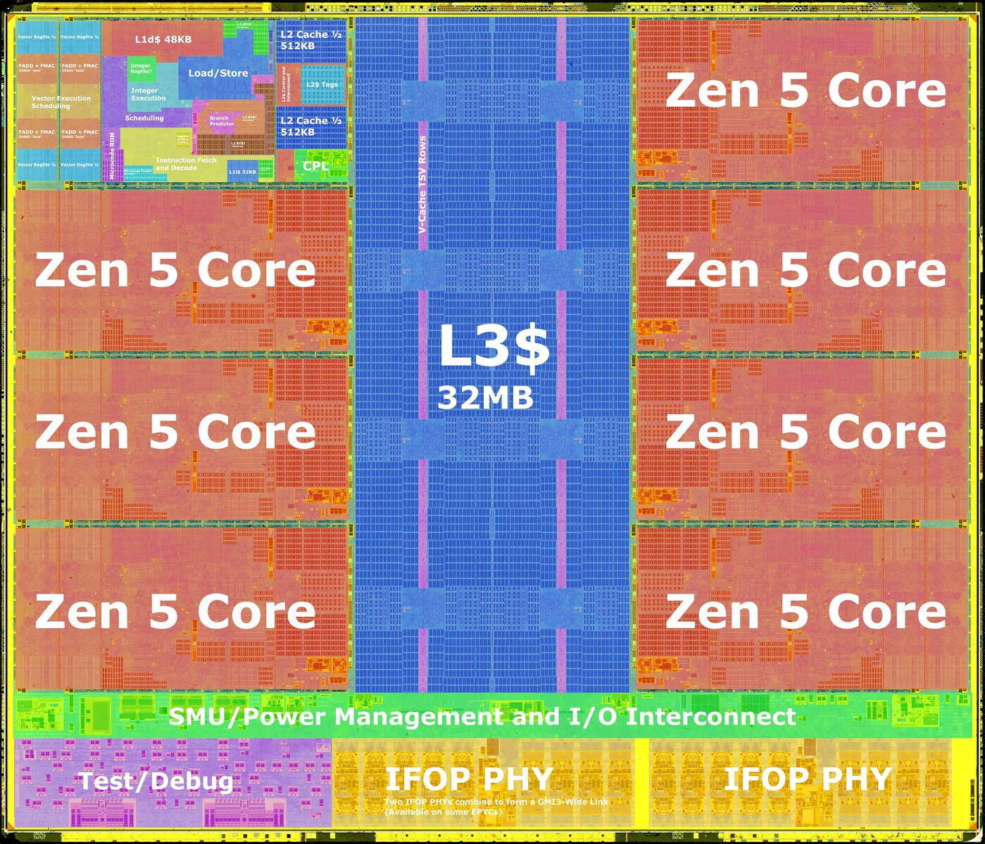
Processor-Memory Performance Gap “Tax”
Processor % Area %Transistors
(­cost) (­power)
Alpha 21164 37% 77%
StrongArm SA110 61% 94%
Pentium Pro 64% 88%
2 dies per package: Proc/I$/D$ + L2$
Caches have no inherent value, only try to close performance gap
Notes:
1/3 to 2/3s of area of processor
386 had 0; successor PPro has second die!

Slide 7
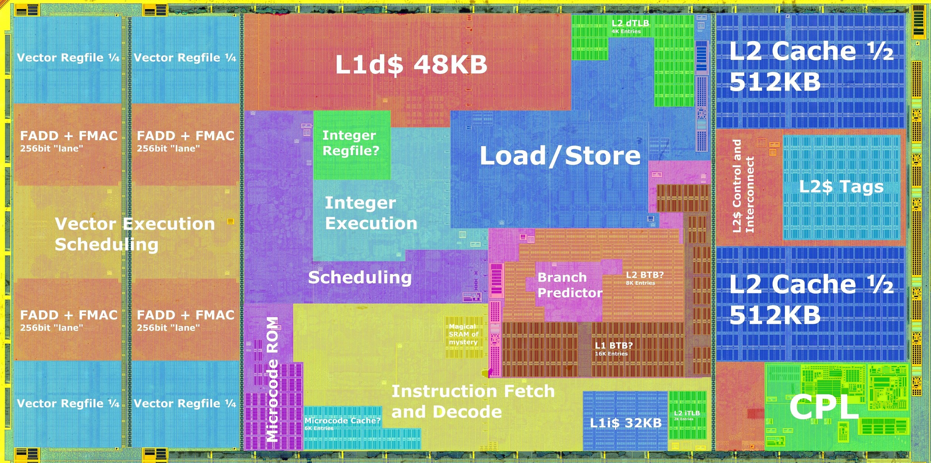
CPU Core of Zen 5

Slide 8
The Principle of Locality
The Principle of Locality:
Program access a relatively small portion of the address space at any instant of time
Two Different Types of Locality:
Temporal Locality (Locality in Time): If an item is referenced, it will tend to be referenced again soon (e.g., loops, reuse)
Spatial Locality (Locality in Space): If an item is referenced, items whose addresses are close by tend to be referenced soon (e.g., straight-line code, array access)
Last 40 years, HW relied on locality for speed
Notes:
The principle of locality states that programs access a relatively small portion of the address space at any instant of time.
This is kind of like in real life, we all have a lot of friends. But at any given time most of us can only keep in touch with a small group of them.
There are two different types of locality: Temporal and Spatial. Temporal locality is the locality in time which says if an item is referenced, it will tend to be referenced again soon.
This is like saying if you just talk to one of your friends, it is likely that you will talk to him or her again soon.
This makes sense. For example, if you just have lunch with a friend, you may say, let抯 go to the ball game this Sunday. So you will talk to him again soon.
Spatial locality is the locality in space. It says if an item is referenced, items whose addresses are close by tend to be referenced soon.
Once again, using our analogy. We can usually divide our friends into groups. Like friends from high school, friends from work, friends from home.
Let抯 say you just talk to one of your friends from high school and she may say something like: 揝o did you hear so and so just won the lottery.
You probably will say NO, I better give him a call and find out more.
So this is an example of spatial locality. You just talked to a friend from your high school days. As a result, you end up talking to another high school friend. Or at least in this case, you hope he still remember you are his friend.
+3 = 10 min. (X:50)

Slide 9
Memory Hierarchy: Terminology
Hit: data appears in some block in the upper level (example: Block X)
Hit Rate: the fraction of memory access found in the upper level
Hit Time: Time to access the upper level which consists of
RAM access time + Time to determine hit/miss
Miss: data needs to be retrieve from a block in the lower level (Block Y)
Miss Rate = 1 - (Hit Rate)
Miss Penalty: Time to replace a block in the upper level + Time to deliver the block the processor
Miss Time: Hit Time + Miss Penalty
Hit Time << Miss Penalty
(500 instructions on Alpha 21264!)
Lower Level
Memory
To Processor
Upper Level
Memory
Blk X
From Processor
Blk Y
Notes:
A HIT is when the data the processor wants to access is found in the upper level (Blk X).
The fraction of the memory access that are HIT is defined as HIT rate.
HIT Time is the time to access the Upper Level where the data is found (X). It consists of:
(a) Time to access this level.
(b) AND the time to determine if this is a Hit or Miss.
If the data the processor wants cannot be found in the Upper level. Then we have a miss and we need to retrieve the data (Blk Y) from the lower level.
By definition (definition of Hit: Fraction), the miss rate is just 1 minus the hit rate.
This miss penalty also consists of two parts:
(a) The time it takes to replace a block (Blk Y to BlkX) in the upper level.
(b) And then the time it takes to deliver this new block to the processor.
It is very important that your Hit Time to be much much smaller than your miss penalty. Otherwise, there will be no reason to build a memory hierarchy.
+2 = 14 min. (X:54)

Slide 10
Cache Impact to Computer Performance
1960-1985: Speed = ƒ(no. operations)
After 1990
Pipelined Execution & Fast Clock Rate
Out-of-Order execution
Superscalar Instruction Issue
Now: Speed = ƒ(# of non-cached memory accesses)
What does this mean for
Compilers? Operating Systems? Algorithms? Data Structures?

Slide 11
Memory Hierarchy Design
Memory hierarchy design becomes more crucial with recent multi-core processors
Aggregate peak bandwidth grows with # cores:
Intel Core i7 can generate two references per core per clock
Four cores and 3.2 GHz clock
25.6 billion 64-bit data references/second +
12.8 billion 128-bit instruction references/second = 409.6 GB/s!
DRAM bandwidth is only 8% of this (34.1 GB/s)
Requires:
Multi-port, pipelined caches
Two levels of cache per core
Shared third-level cache on chip

Slide 12
Main Memory Deep Background
Random Access Memory (vs. Serial Access Memory)
Random: access time is location independent
早期计算机里用作主存的部件
水银延迟线、示波管、磁鼓
Magnetic Core （磁心）
“Out-of-Core”, “In-Core,” “Core Dump”?
“Core memory”?
Non-volatile, magnetic
Access time 750 ns, cycle time 1500-3000 ns
半导体存储器

Slide 13
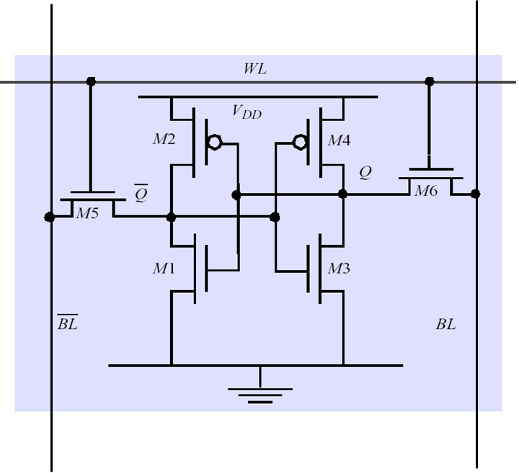
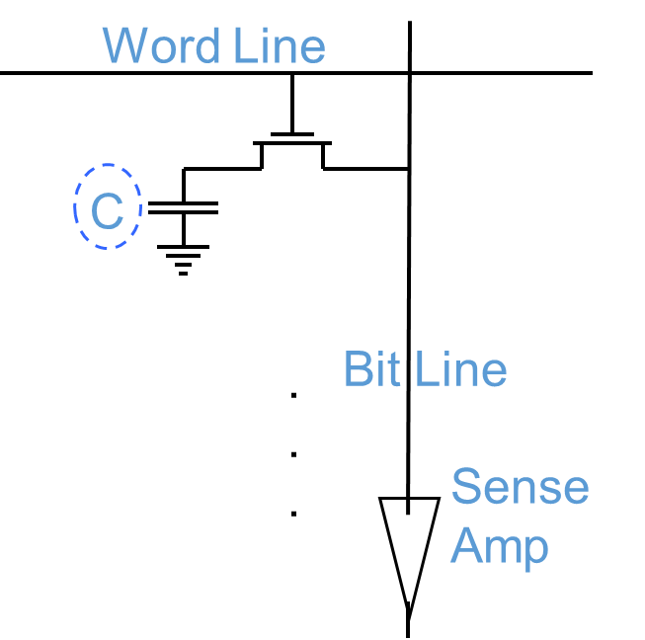
Memory Technology
SRAM has low latency, use for cache
Requires low power to retain bit
Requires 6 transistors/bit
DRAM has high density, use for main mem.
Must be re-written after being read
Must also be periodically refreshed
Every ~ 64 ms (roughly 5% of time)
Each row can be refreshed simultaneously
One transistor/bit
Address lines are multiplexed:
Upper half of address: row access strobe (RAS)
Lower half of address: column access strobe (CAS)

Slide 14
DRAM logical organization (4 Mbit)
Column Decoder
…
Data In
1
Sense
Amps & I/O
D
1
Bit Line
Data Out
A0…A1
Memory
Array
Q
0
Address Buffer
Row Decoder
(2,048 x 2,048)
Storage
W
ord Line
Cell
Square root of bits per RAS/CAS

Slide 15
Weakness of DRAM
By it’s nature, DRAM isn’t built for speed
Response times dependent on capacitive circuit properties which get worse as density increases
DRAM process isn’t easy to integrate into CMOS process
DRAM is off chip
Connectors, wires, etc. introduce slowness
IRAM efforts looking to integrating the two
Memory Architectures are designed to minimize impact of DRAM latency
Low Level: Memory chips
High Level: memory system designs

Slide 16
Memory Technology
Amdahl’s hope for a balanced computer
Memory capacity should grow linearly with processor speed
Unfortunately, memory capacity and speed has not kept pace with processors
Some optimizations to DRAM chips
Multiple accesses to same row
Synchronous DRAM
Added clock to DRAM interface
Burst mode with critical word first
Wider interfaces
Double data rate (DDR)
Multiple banks on each DRAM device

Slide 17
DRAM Performance Indexes
A 60 ns (t_{RAC}) DRAM can
perform a row access only every 110 ns (t_{RC})
perform column access (t_{CAC}) in 15 ns, but time between column accesses is at least 35 ns (t_{PC}).
In practice, external address delays and turning around buses make it 40 to 50 ns
These times do not include the time to drive the addresses off the microprocessor nor the memory controller overhead!
Defined by JEDEC Solid State Technology Association
Joint Electronic Device Engineering Council
Rely on increasing no. of computers & memory per computer (60% market)
Commodity, second source industry => high volume, low profit, conservative
SIMM or DIMM is replaceable unit => computers use any generation DRAM

Slide 18
Fast Memory Systems: DRAM specific
Page mode: All bits on the same ROW (Spatial Locality)
Don’t need to wait for wordline to recharge
Toggle CAS with new column address
Overlap Data output w/ CAS toggle
Extended Data Out (EDO): 30% faster in page mode
Synchronous DRAM: Has a clock input
Data output is in bursts w/ each element clocked
Flavors: SDRAM, DDR (Double Data Rate)
Niche memory or main memory?
e.g., Video RAM for frame buffers, DRAM + fast serial output

Slide 19
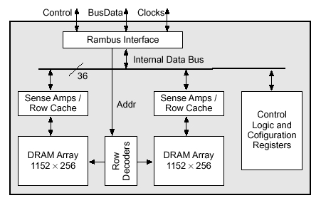
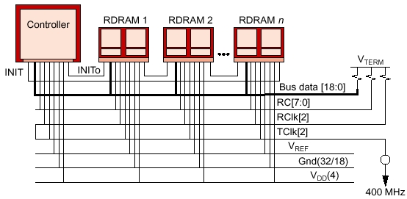
RAMBUS (RDRAM)
RAMBUS: startup company; reinvent DRAM interface
Each Chip a module vs. slice of memory, Short bus between CPU and chips
Does own refresh; Variable amount of data returned
1 byte / 2 ns (500 MB/s per chip); 20% increase in DRAM area
RDRAM Memory System
RAMBUS Bank

Slide 20
DDR and GDDR Memory
DDR, Double Data Rate
DDR2
Lower power (2.5 V -> 1.8 V)
Higher clock rates (266 MHz, 333 MHz, 400 MHz)
DDR3
1.5 V, 800 MHz3
DDR4
1.2 V, 1600 MHz
DDR5
1.1V, 3200MHz, 2 access channels
GDDR5/6 is graphics memory based on DDR3/4

Slide 21
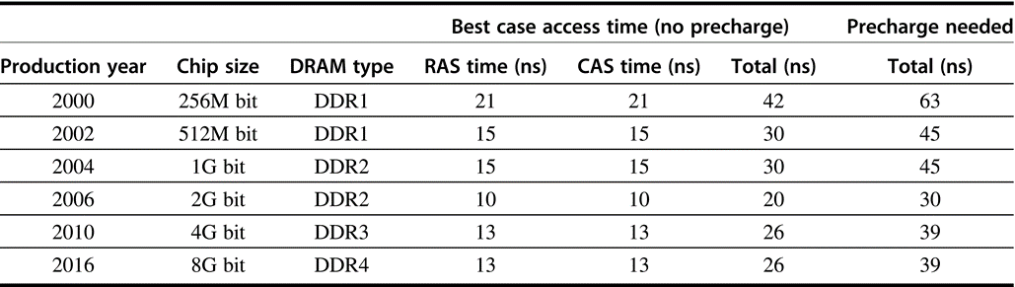
Capacity and access times for DDR
Access time is for a random memory word and assumes a new row must be opened. If the row is in a different bank, we assume the bank is precharged; if the row is not open, then a precharge is required, and the access time is longer. As the number of banks has increased, the ability to hide the precharge time has also increased.

Slide 22
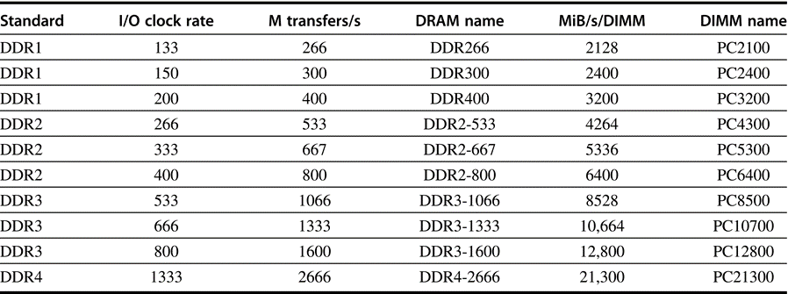
Clock rates, bandwidth, and names of DDR DRAMS and DIMMs in 2016
Note the numerical relationship between the columns. The third column is twice the second, and the fourth uses the number from the third column in the name of the DRAM chip. The fifth column is eight times the third column, and a rounded version of this number is used in the name of the DIMM

Slide 23
Memory Optimizations
Reducing power in SDRAMs:
Lower voltage
Low power mode (ignores clock, continues to refresh)
LPDDR5
0.5-1.05V
Graphics memory:
Achieve 2-5 X bandwidth per DRAM vs. DDR3
Wider interfaces (32 vs. 16 bit)
Higher clock rate
Possible because they are attached via soldering instead of socketed DIMM modules

Slide 24
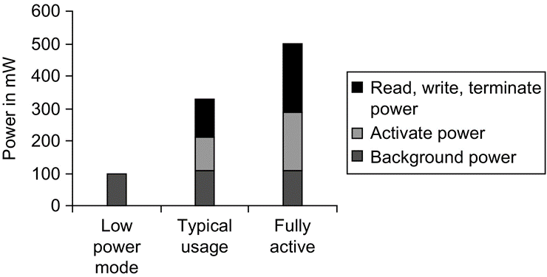
Memory Power Consumption
Power consumption for Micron 1.5V 2GB DDR3-1066
In typical mode, DRAM is active 30% of the time for reads and 15% for writes

Slide 25
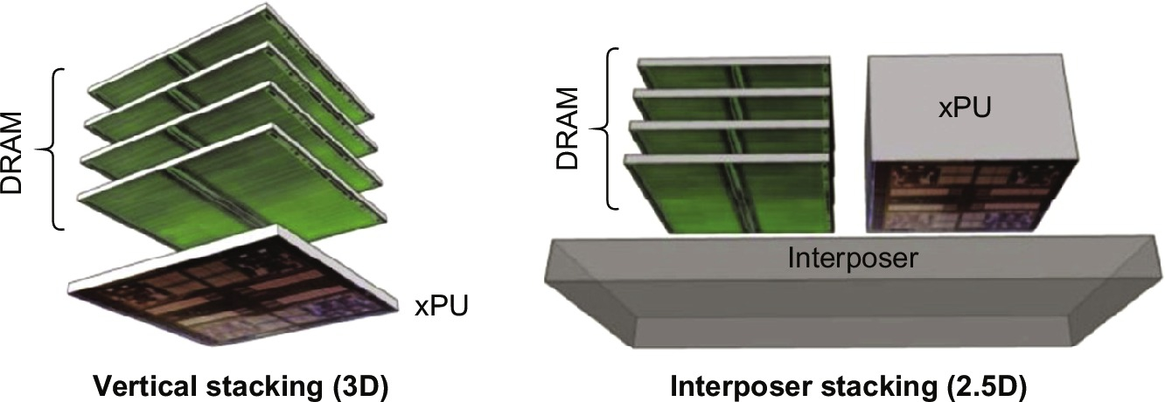
Stacked/Embedded DRAMs
Stacked DRAMs in same package as processor
High Bandwidth Memory (HBM)
3D stacking faces heat management challenges due to the xPU

Slide 26
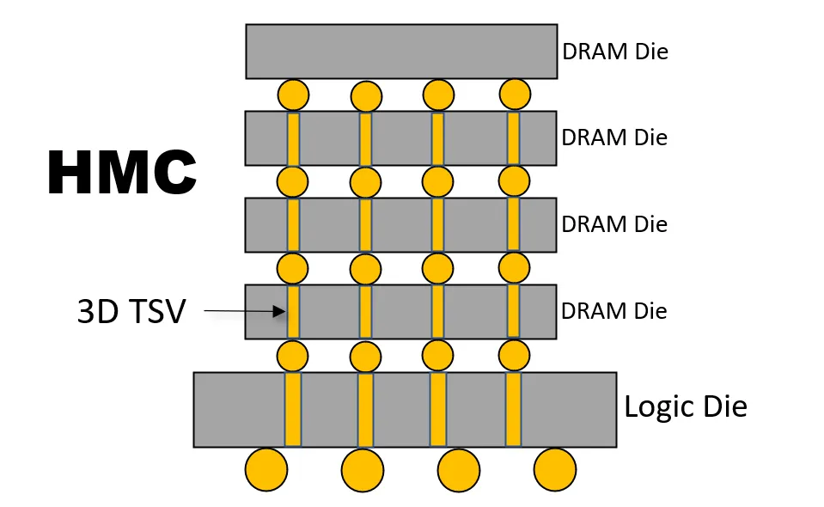
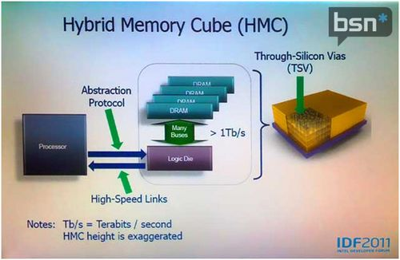
HBM的发展
类别 | HBM1 | HBM2 | HBM2E | HBM3 | HBM3E
带宽(GB/s) | 128 | 307 | 460 | 819 | 1225
堆叠层数 | 4 | 4/8 | 4/8 | 8/12 | 8/12
容量(GB) | 1 | 4/8 | 8/16 | 16/24 | 24/36
IO速率(Gbps) | 1 | 2.4 | 3.6 | 6.4 | 8
主要供应商与GDDR相同
海力士、三星
美光之前主要和Intel一起搞HMC
最近刚加入HBM阵营

Slide 27
Flash Memory
Type of EEPROM: Nonvolatile, can use as little as zero power
Types: NAND (denser) and NOR (faster)
Must be erased (in blocks) before being overwritten
Limited number of write cycles (~100,000)
Phase-Change/Memrister Memory
Possibly 10X improvement in write performance and 2X improvement in read performance
Intel/Micron Xpoint memory chips based on PCM
Hybrid memory system, how to manage?

Slide 28
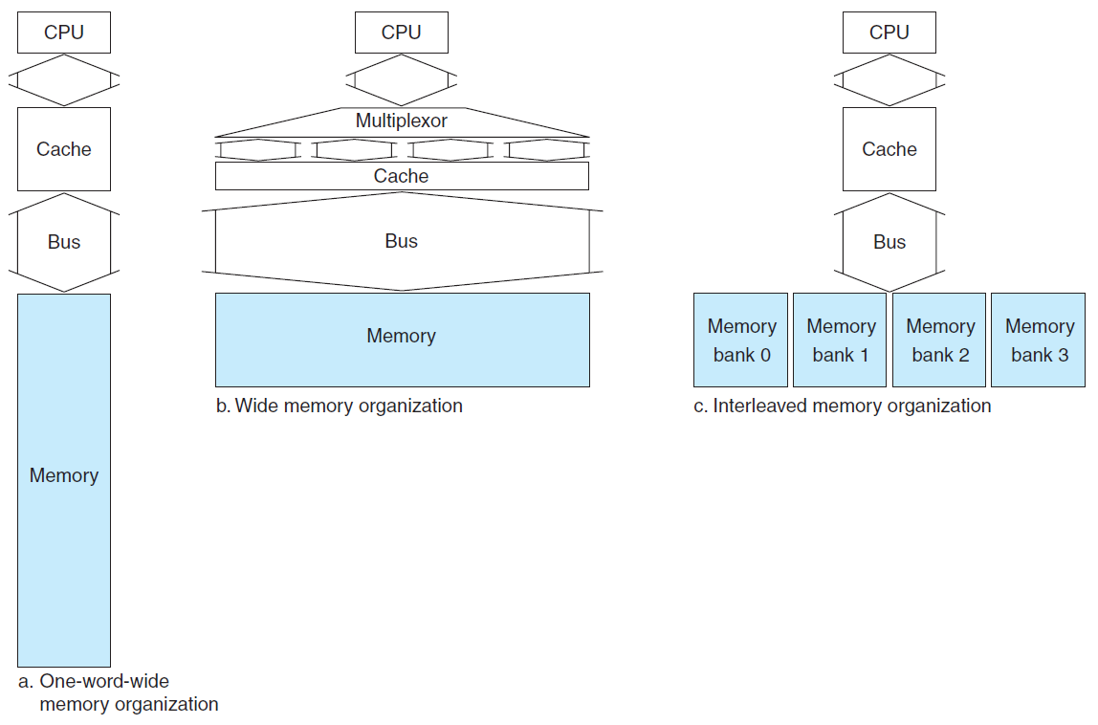
Main Memory Organizations
Simple:
CPU, Cache, Bus, Memory same width (32 or 64 bits)
Wide:
CPU/Mux 1 word; Mux/Cache, Bus, Memory N words (Alpha: 64 bits & 256 bits; UtraSPARC 512)
Interleaved:
CPU, Cache, Bus 1 word: Memory N Modules (4 Modules); example is word interleaved

Slide 29
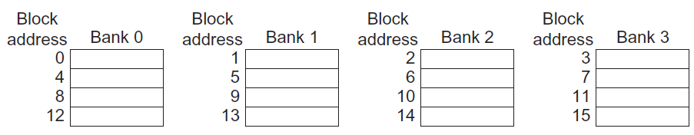
Main Memory Performance
Timing model (word size is 32 bits)
1 to send address,
6 access time, 1 to send data
Cache Block is 4 words
Simple Memory Performance = 4 x (1+6+1) = 32
Wide Memory Performance = 1 + 6 + 1 = 8
Interleaved Memory Performance = 1 + 6 + 4x1 = 11

Slide 30
Independent Memory Banks
Multiple memory banks for independent accesses vs. faster sequential accesses for Multiprocessor & I/O
CPU with Hit under n Misses, Non-blocking Cache
How many banks?
Number banks >= number clocks to access word in bank
For sequential accesses, otherwise will return to original bank before it has next word ready
(like in vector case)
Increasing DRAM => fewer chips => harder to have banks

Slide 31
DRAMs per PC over Time
DRAM Generation
‘86 ‘89 ‘92 ‘96 ‘99 ‘02
1 Mb 4 Mb 16 Mb 64 Mb 256 Mb 1 Gb
4 MB
8 MB
16 MB
32 MB
64 MB
128 MB
256 MB
32
8
16
4
8
2
Minimum Memory Size
4
1
8
2
4
1
8
2

Slide 32
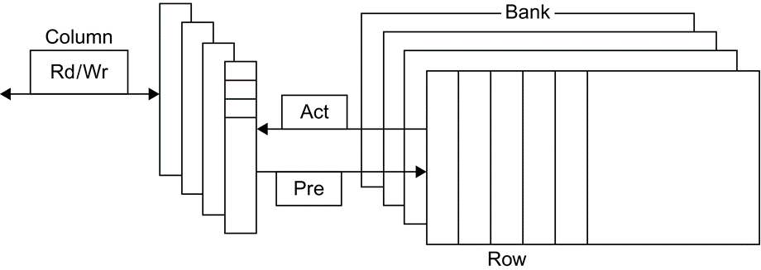
Internal Organization of DRAM
Modern DRAMs are organized in banks, up to 16 for DDR4. Sending an ACT (Activate) command opens a bank and a row and loads the row into a row buffer. When the row is in the buffer, it can be transferred by successive column addresses The Precharge commend (PRE) closes the bank and row and readies it for a new access.

Slide 33
Avoiding Bank Conflicts
Even with 128 banks, since 512 is multiple of 128, conflict on word accesses: # of banks accessed = # of banks / GCD(stride, # of banks)
int x[256][512];
for (j = 0; j < 512; j = j+1)
for (i = 0; i < 256; i = i+1)
x[i][j] = 2 * x[i][j];
SW: loop interchange or declaring array not power of 2 (“array padding”)
HW: Prime number of banks
bank number = address % number of banks
address within bank = address / number of words in bank (seq. interleave)
modulo & divide per memory access with prime no. banks?
address within bank = address % number words in bank (modulo interleave)
bank number? easy if 2^{N} words per bank

Slide 34
Fast Bank Number
Chinese Remainder Theorem As long as two sets of integers ai and bi follow these rules
and that ai and aj are co-prime if i ≠ j, then the integer x has only one solution (unambiguous mapping):
bank number = b₀, number of banks = a₀ (= 3 in example)
address within bank = b₁, number of words in bank = a₁ (= 8 in example)
N word address 0 to N-1, prime no. banks, words power of 2
Seq. Interleaved Modulo Interleaved
Bank Number: 0 1 2 0 1 2 Address within Bank: 0 0 1 2 0 16 8 1 3 4 5 9 1 17 2 6 7 8 18 10 2 3 9 10 11 3 19 11 4 12 13 14 12 4 20 5 15 16 17 21 13 5 6 18 19 20 6 22 14 7 21 22 23 15 7 23

Slide 35
Memory Dependability
Motivation:
Failures/time proportional to number of bits!
As DRAM cells shrink, more vulnerable to cosmic rays
Hard errors (permanent faults)
Use spare rows inside the chip to replace defective rows
Caused due to manufacturing, repaired during testing phase
Soft or dynamic errors (transient faults)
Detected and fixed by error correcting codes (ECC) in runtime
Parity check works for instruction cache since read-only
One parity bit per 8 data bits is a typical ratio
In case multi-bit errors in longer bit strings

Slide 36
Need for Error Correction!
Basic idea: add redundancy through more parity bits
Simple but wasteful version:
Keep three copies of everything, vote to find right value
200% overhead, so not good!
Common configuration: Random error correction
SEC-DED (single error correct, double error detect)
One example: 64 data bits + 8 parity bits (11% overhead)
Papers up on reading list from last term tell you how to do these types of codes
Really want to handle failures of physical components as well
Organization is multiple DRAMs/DIMM, multiple DIMMs
Want to recover from failed DRAM and failed SIMM!
Requires more redundancy to do this
All major vendors thinking about this in high-end machines
Chipkill: a RAID-like error recovery technique

Slide 37
Main Memory Summary
Wider Memory
Interleaved Memory: for sequential or independent accesses
Avoiding bank conflicts: SW & HW
DRAM specific optimizations: page mode & Specialty DRAM
Need Error correction

Slide 38
What is a cache?
Small, fast storage used to improve average access time to slow memory
Exploits spacial and temporal locality
In computer architecture, almost everything is a cache!
Registers a cache on variables
First-level cache a cache on second-level cache
Second-level cache a cache on memory
Memory a cache on disk (virtual memory)
TLB a cache on page table
Branch-prediction a cache on prediction information?

Slide 39
Cache Measures
Hit rate: fraction found in that level
So high that usually talk about Miss rate
Miss rate fallacy: as MIPS to CPU performance, miss rate to average memory access time in memory
Average memory-access time = Hit time + Miss rate x Miss penalty (ns or clocks)
Miss penalty: time to replace a block from lower level, including time to replace in CPU
access time: time to lower level = f(latency to lower level)
transfer time: time to transfer block = f(BW between upper & lower levels)

Slide 40
Simplest Cache: Direct Mapped
Memory Address
Memory
0
4 Byte Direct Mapped Cache
1
Cache Index
2
0
3
1
4
2
5
3
6
7
Location 0 can be occupied by data from:
Memory location 0, 4, 8, ... etc.
In general: any memory location whose 2 LSBs of the address are 0s
Address<1:0> => cache index
Which one should we place in the cache?
How can we tell which one is in the cache?
8
9
A
B
C
D
E
F
Notes:
Let抯 look at the simplest cache one can build. A direct mapped cache that only has 4 bytes.
In this direct mapped cache with only 4 bytes, location 0 of the cache can be occupied by data form memory location 0, 4, 8, C, ... and so on.
While location 1 of the cache can be occupied by data from memory location 1, 5, 9, ... etc.
So in general, the cache location where a memory location can map to is uniquely determined by the 2 least significant bits of the address (Cache Index).
For example here, any memory location whose two least significant bits of the address are 0s can go to cache location zero.
With so many memory locations to chose from, which one should we place in the cache?
Of course, the one we have read or write most recently because by the principle of temporal locality, the one we just touch is most likely to be the one we will need again soon.
Of all the possible memory locations that can be placed in cache Location 0, how can we tell which one is in the cache?
+2 = 22 min. (Y:02)

Slide 41
1 KB Direct Mapped Cache, 32B blocks
For a 2 ** N byte cache:
The uppermost (32 - N) bits are always the Cache Tag
The lowest M bits are the Byte Select (Block Size = 2 ** M)
31
9
4
0
Cache Tag
Example: 0x50
Cache Index
Byte Select
Ex: 0x01
Ex: 0x00
Stored as part
of the cache State
Valid Bit
Cache Tag
Cache Data
Byte 31
:
Byte 1
Byte 0
0
0x50
Byte 63
:
Byte 33
Byte 32
1
2
3
:
:
:
Byte 1023
:
Byte 992
31
Notes:
Let抯 use a specific example with realistic numbers: assume we have a 1 KB direct mapped cache with block size equals to 32 bytes.
In other words, each block associated with the cache tag will have 32 bytes in it (Row 1).
With Block Size equals to 32 bytes, the 5 least significant bits of the address will be used as byte select within the cache block.
Since the cache size is 1K byte, the upper 32 minus 10 bits, or 22 bits of the address will be stored as cache tag.
The rest of the address bits in the middle, that is bit 5 through 9, will be used as Cache Index to select the proper cache entry.
+2 = 30 min. (Y:10)

Slide 42
Two-way Set Associative Cache
N-way set associative: N entries for each Cache Index
N direct mapped caches operates in parallel (N typically 2 to 4)
Cache Index selects a Set from the cache
The N (two) tags in the set are compared in parallel
Data is selected based on the tag result
Cache Index
Valid
Cache Tag
Cache Data
Cache Data
Cache Tag
Valid
Cache Block 0
Cache Block 0
:
:
:
:
:
:
Adr Tag
Compare
1
Mux
0
Compare
Sel1
Sel0
OR
Cache Block
Hit
Notes:
This is called a 2-way set associative cache because there are two cache entries for each cache index. Essentially, you have two direct mapped cache works in parallel.
This is how it works: the cache index selects a set from the cache. The two tags in the set are compared in parallel with the upper bits of the memory address.
If neither tag matches the incoming address tag, we have a cache miss.
Otherwise, we have a cache hit and we will select the data on the side where the tag matches occur.
This is simple enough. What is its disadvantages?
+1 = 36 min. (Y:16)

Slide 43
Disadvantage of Set Associative Cache
N-way Set Associative Cache v. Direct Mapped Cache:
N comparators vs. 1; Extra MUX delay for the data
Data comes AFTER Hit/Miss
Direct mapped cache, Cache Block is available BEFORE Hit/Miss:
Possible to assume a hit and continue. Recover later if miss.
Cache Index
Valid
Cache Tag
Cache Data
Cache Data
Cache Tag
Valid
Cache Block 0
Cache Block 0
:
:
:
:
:
:
Adr Tag
Compare
1
Mux
0
Compare
Sel1
Sel0
OR
Cache Block
Hit
Notes:
First of all, a N-way set associative cache will need N comparators instead of just one comparator (use the right side of the diagram for direct mapped cache).
A N-way set associative cache will also be slower than a direct mapped cache because of this extra multiplexer delay.
Finally, for a N-way set associative cache, the data will be available AFTER the hit/miss signal becomes valid because the hit/mis is needed to control the data MUX.
For a direct mapped cache, that is everything before the MUX on the right or left side, the cache block will be available BEFORE the hit/miss signal (AND gate output) because the data does not have to go through the comparator.
This can be an important consideration because the processor can now go ahead and use the data without knowing if it is a Hit or Miss. Just assume it is a hit.
Since cache hit rate is in the upper 90% range, you will be ahead of the game 90% of the time and for those 10% of the time that you are wrong, just make sure you can recover.
You cannot play this speculation game with a N-way set-associatvie cache because as I said earlier, the data will not be available to you until the hit/miss signal is valid.
+2 = 38 min. (Y:18)

Slide 44
4 Questions for Memory Hierarchy
Q1: Where can a block be placed in the upper level?
(Block placement)
Q2: How is a block found if it is in the upper level?
(Block identification)
Q3: Which block should be replaced on a miss?
(Block replacement)
Q4: What happens on a write?
(Write strategy)

Slide 45
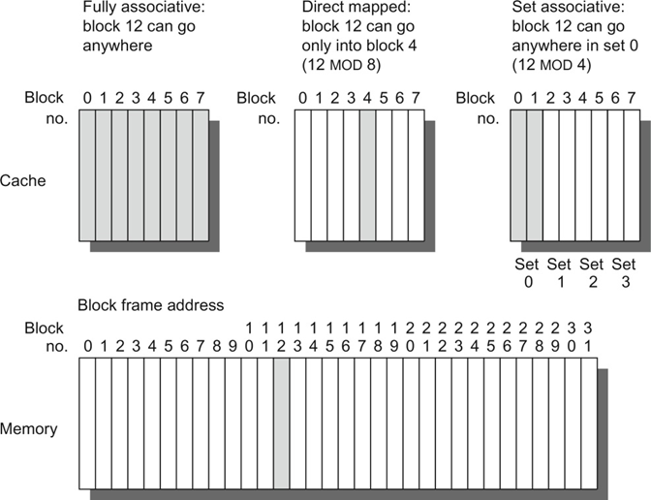
Q1: Where can a block be placed in the upper level?
This example cache has eight block frames and memory has 32 blocks
Block 12 placed in 8 block cache:
Fully associative
Direct mapped
2-way set associative
Set Associative Mapping => Block Number Modulo Number of Sets

Slide 46

Q2: How is a block found if it is in the upper level?
Tag on each block
No need to check index or block offset
Increasing associativity shrinks index, expands tag
The three portions of an address in a set associative or direct-mapped cache

Slide 47
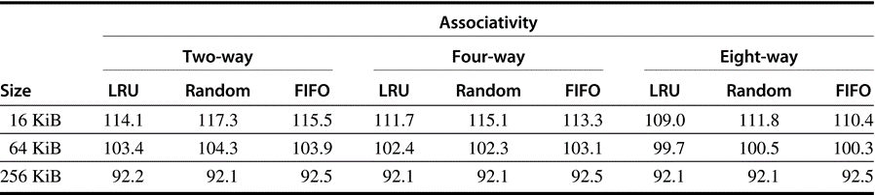
Q3: Which block should be replaced on a miss?
Easy for Direct Mapped
Set Associative or Fully Associative:
Random, FIFO, LRU (Least Recently Used)
Data cache misses per 1000 SPEC2000 instructions on Alpha
There is little difference between LRU and random for the largest size cache, with LRU outperforming the others for smaller caches

Slide 48
Q4: What happens on a write?
Write through The information is written to both the block in the cache and to the block in the lower-level memory.
Write back The information is written only to the block in the cache. The modified cache block is written to main memory only when it is replaced.
Is block clean or modified (dirty)? Need dirty bit in cache Tag
Pros and Cons of each?
WT: read misses cannot result in writes
WB: no repeated writes to same location
WT always combined with write buffers so that don’t wait for lower level memory

Slide 49
Write Buffer for Write Through
Cache
Processor
DRAM
Write Buffer
A Write Buffer is needed between the Cache and Memory
Processor: writes data into the cache and the write buffer
Memory controller: write contents of the buffer to memory
Write buffer is just a FIFO:
Typical number of entries: 4
Works fine if: Store frequency (w.r.t. time) << 1 / DRAM write cycle
Memory system designer’s nightmare:
Store frequency (w.r.t. time) -> 1 / DRAM write cycle
Write buffer saturation
Notes:
You are right, memory is too slow. We really didn't writ e to the memory directly. We are writing to a write buffer.
Once the data is written into the write buffer and assuming a cache hit, the CPU is done with the write. The memory controller will then move the write buffer抯 contents to the real memory behind the scene.
The write buffer works as long as the frequency of store is not too high. Notice here, I am referring to the frequency with respect to time, not with respect to number of instructions.
Remember the DRAM cycle time we talked about last time. It sets the upper limit on how frequent you can write to the main memory.
If the store are too close together or the CPU time is so much faster than the DRAM cycle time, you can end up overflowing the write buffer and the CPU must stop and wait.
+2 = 60 min. (Y:40)

Slide 50
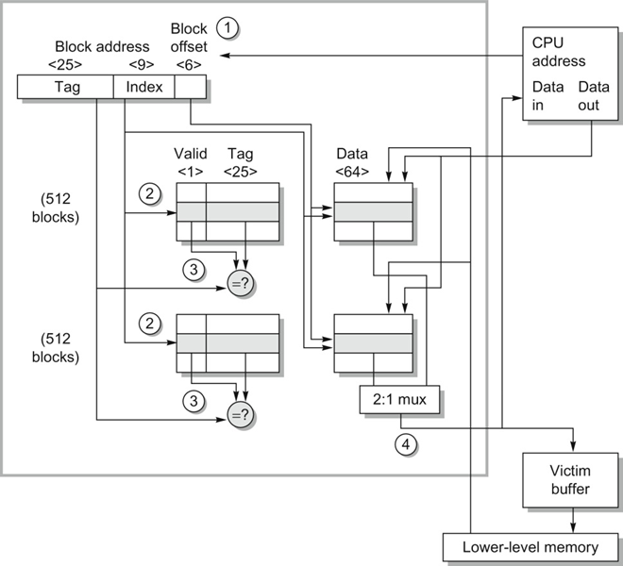
Data cache organization of Opteron
The 64 KiB cache is two-way set associative with 64-byte blocks
Size of address leaving the processor is 40 bits (physical address)
1024 blocks = 512 blocks x 2 ways
9-bit index selects among 512 sets
3 bits of the block offset join the index to supply the RAM address to select the proper 8 bytes of a 64-bit word
命中时的工作步骤
CPU给出访存地址
用地址index部分同时访问两路
用地址的Tag部分同时比较读出的两路Tag
根据比较结果，两个数据块中2先1

Slide 51
Cache performance
Miss-oriented Approach to Memory Access:
CPI_{Execution} includes ALU and Memory instructions
Separating out Memory component entirely
AMAT = Average Memory Access Time
CPI_{ALUOps} does not include memory instructions

Slide 52
Impact on Performance
Suppose a processor executes at
Clock Rate = 200 MHz (5 ns per cycle), Ideal (no misses) CPI = 1.1
50% arith/logic, 30% ld/st, 20% control
Suppose that 10% of memory operations get 50 cycle miss penalty
Suppose that 1% of instructions get same miss penalty
CPI = ideal CPI + average stalls per instruction = 1.1(cycles/ins) + [ 0.30 (DataMops/ins) x 0.10 (miss/DataMop) x 50 (cycle/miss)] + [ 1 (InstMop/ins) x 0.01 (miss/InstMop) x 50 (cycle/miss)] = (1.1 + 1.5 + .5) cycle/ins = 3.1
>60% of the time the processor is stalled waiting for memory!
AMAT=(1/1.3)x[1+0.01x50]+(0.3/1.3)x[1+0.1x50]=2.54

Slide 53
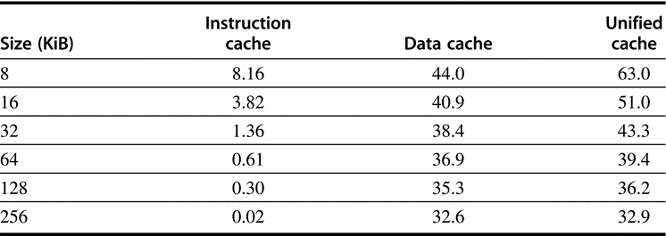
Miss per 1000 instructions
For instruction, data, and unified caches of different sizes
The percentage of instruction references is about 74%

Slide 54
Example: Harvard Architecture
Unified vs Separate I&D (Harvard)
16KB I&D: Inst miss rate=0.64%, Data miss rate=6.47%
32KB unified: Aggregate miss rate=1.99%
Which is better (ignore L2 cache)?
Assume 33% data ops ⇒ 75% accesses from instructions (1.0/1.33)
hit time=1, miss time=50
Note that data hit has 1 stall for unified cache (only one port)
AMAT_{Harvard}=75%x(1+0.64%x50)+25%x(1+6.47%x50) = 2.05
AMAT_{Unified}=75%x(1+1.99%x50)+25%x(1+1+1.99%x50)= 2.24
Proc
Proc
Unified
Cache-1
I-Cache-1
Proc
D-Cache-1
Unified
Cache-2
Unified
Cache-2

Slide 55
Basic Issues in VM System Design
Size of information blocks that are transferred from secondary to main storage (M)
Block of information brought into M, and M is full, then some region of M must be released to make room for the new block --> replacement policy
Which region of M is to hold the new block --> placement policy
Missing item fetched from secondary memory only on the occurrence of a fault --> demand load policy
mem
disk
cache
reg
pages
frame
Paging Organization
virtual and physical address space partitioned into blocks of equal size
pages
page frames

Slide 56
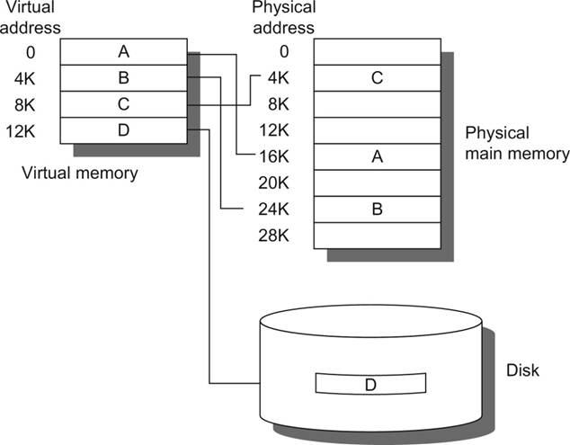
The logical program of virtual memory
Left: contiguous virtual address space
The actual location of three of the blocks is in physical main memory and the other (D) is located on the disk

Slide 57
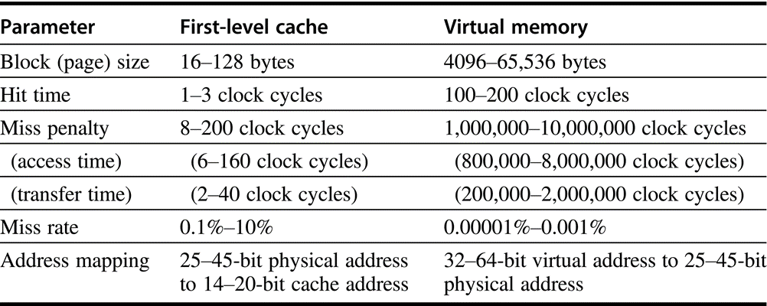
Typical ranges of parameters for caches and virtual memory
Virtual memory parameters represent increases of 10–1,000,000 times over cache parameters. Usually, first-level caches contain at most 1 MiB of data, whereas physical memory contains 256 MiB to 1 TB.

Slide 58
Virtual Memory Address Map
V = {0, 1, . . . , n - 1} virtual address space
M = {0, 1, . . . , m - 1} physical address space
MAP: V --> M U {0} address mapping function
n > m
MAP(a) = a' if data at virtual address a is present in physical
address a' and a' in M
= 0 if data at virtual address a is not present in M
a
missing item fault
Name Space V
fault
handler
Processor
0
Addr Trans
Mechanism
Main
Memory
Secondary
Memory
a
a'
physical address
OS performs
this transfer

Slide 59
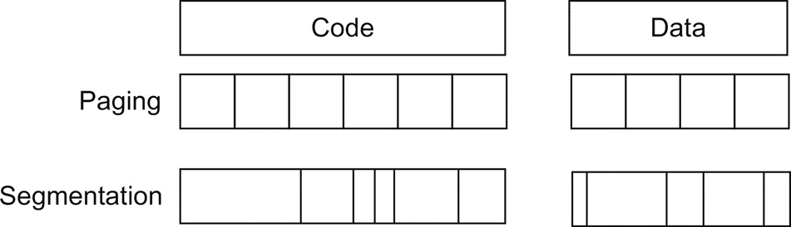
Example of how paging and segmentation divide a program
Page（页）：相同大小的块
Segment（段）：不同大小的块

Slide 60
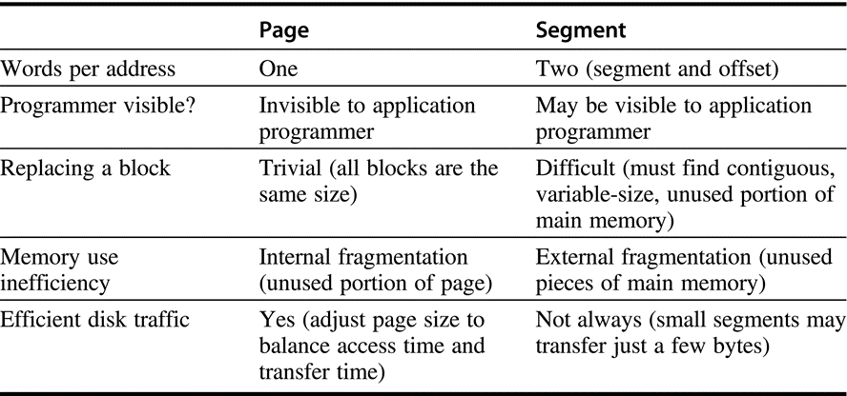
Paging versus Segmentation
A hybrid approach, called paged segments, shoots for the best of both worlds: segments are composed of pages, so replacing a block is easy, yet a segment may be treated as a logical unit.

Slide 61
Paging Organization
V.A.
P.A.
unit of
mapping
0
frame 0
1K
Addr
Trans
MAP
0
page 0
1K
1024
1
1K
1024
1
1K
also unit of
transfer from
virtual to
physical
memory
7168
7
1K
Physical
Memory
Address Mapping
10
31744
31
1K
VA
page no.
disp
Virtual Memory
Page Table
Page Table
Base Reg
V
Access
Rights
PA
+
actually, concatenation
is more likely
index
into
page
table
Page Size通常为2的幂次
table located
in physical
memory
physical
memory
address

Slide 62
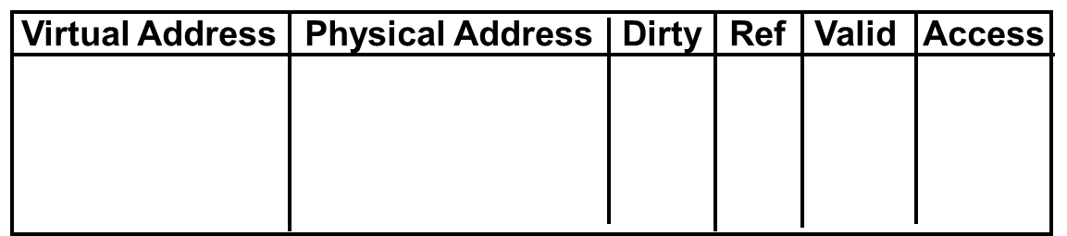
Address translation & Page table lookup
It takes an extra memory access to translate VA to PA，
which makes cache access very expensive
"innermost loop" that you want to go as fast as possible
A way to speed up translation is to use a special cache of recently used page table entries -- Translation Lookaside Buffer or TLB
Really just a cache on the page table mappings, TLB access time comparable to cache access time (much less than main memory access time)
VA
PA
miss
Trans-
lation
Cache
Main
Memory
CPU
hit
data

Slide 63
Translation Look-Aside Buffers
Just like any other cache, the TLB can be organized as fully associative, set associative, or direct mapped
TLBs are usually small, typically not more than 128 - 256 entries even on high end machines. This permits fully associative lookup on these machines. Most mid-range machines use small n-way set associative organizations.
hit
VA
PA
miss
TLB
Lookup
Cache
Main
Memory
CPU
Translation
with a TLB
miss
hit
Trans-
lation
data
1/2 t
t
20 t

Slide 64
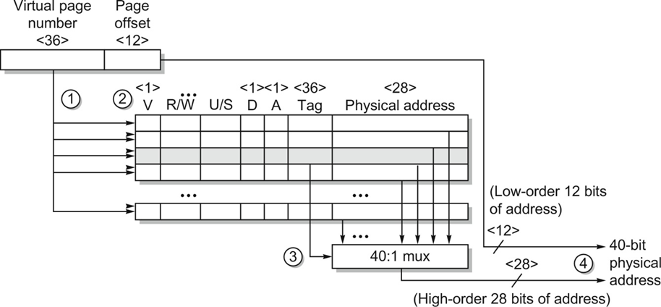
Operation of the Opteron data TLB
This TLB has 40 entries, fully associative
虚页号送往所有entry
V有效时，同时进行Tag比较，并检查保护状态
从Tag匹配的entry送出物理页号（40选1）
28位物理页号与12位页内偏移地址拼成40位物理地址
Memory protection

Slide 65
Summary #1 / 3: The Cache Design Space
Several interacting dimensions
cache size
block size
associativity
replacement policy
write-through vs write-back
write allocation
The optimal choice is a compromise
depends on access characteristics
Workload, use (I-cache, D-cache, TLB)
depends on technology / cost
Simplicity often wins
Cache Size
Associativity
Block Size
Bad
Good
Factor A
Factor B
Less
More
Notes:
No fancy replacement policy is needed for the direct mapped cache.
As a matter of fact, that is what cause direct mapped trouble to begin with: only one place to go in the cache--causes conflict misses.
No fancy replacement policy is needed for the direct mapped cache.
As a matter of fact, that is what cause direct mapped trouble to begin with: only one place to go in the cache--causes conflict misses.
Besides working at Sun, I also teach people how to fly whenever I have time.
Statistic have shown that if a pilot crashed after an engine failure, he or she is more likely to get killed in a multi-engine light airplane than a single engine airplane.
The joke among us flight instructors is that: sure, when the engine quit in a single engine stops, you have one option: sooner or later, you land. Probably sooner.
But in a multi-engine airplane with one engine stops, you have a lot of options. It is the need to make a decision that kills those people.

Slide 66
Summary #2/3: TLB, Virtual Memory
Caches, TLBs, Virtual Memory all understood by examining how they deal with 4 questions: 1) Where can block be placed? 2) How is block found? 3) What block is repalced on miss? 4) How are writes handled?
Page tables map virtual address to physical address
TLBs are important for fast translation
TLB misses are significant in processor performance
funny times, as most systems can’t access all of 2nd level cache without TLB misses!
Notes:
Let’s do a short review of what you learned last time.
Virtual memory was originally invented as another level of memory hierarchy such that programers, faced with main memory much smaller than their programs, do not have to manage the loading and unloading portions of their program in and out of memory.
It was a controversial proposal at that time because very few programers believed software can manage the limited amount of memory resource as well as human.
This all changed as DRAM size grows exponentially in the last few decades.
Nowadays, the main function of virtual memory is to allow multiple processes to share the same main memory so we don抰 have to swap all the non-active processes to disk.
Consequently, the most important function of virtual memory these days is to provide memory protection.
The most common technique, but we like to emphasis not the only technique, to translate virtual memory address to physical memory address is to use a page table.
TLB, or translation lookaside buffer, is one of the most popular hardware techniques to reduce address translation time.
Since TLB is so effective in reducing the address translation time, what this means is that TLB misses will have a significant negative impact on processor performance.
+3 = 3 min. (X:43)

Slide 67
Summary #3/3: Memory Hierarchy
Virtual memory was controversial at the time: can SW automatically manage 64KB across many programs?
1000X DRAM growth removed the controversy
Today VM allows many processes to share single memory without having to swap all processes to disk
VM protection is more important than memory hierarchy
Today CPU time is a function of (ops, cache misses) vs. just f(ops): What does this mean to Compilers, Data structures, Algorithms?
Notes:
Let抯 do a short review of what you learned last time.
Virtual memory was originally invented as another level of memory hierarchy such that programers, faced with main memory much smaller than their programs, do not have to manage the loading and unloading portions of their program in and out of memory.
It was a controversial proposal at that time because very few programers believed software can manage the limited amount of memory resource as well as human.
This all changed as DRAM size grows exponentially in the last few decades.
Nowadays, the main function of virtual memory is to allow multiple processes to share the same main memory so we don抰 have to swap all the non-active processes to disk.
Consequently, the most important function of virtual memory these days is to provide memory protection.
The most common technique, but we like to emphasis not the only technique, to translate virtual memory address to physical memory address is to use a page table.
TLB, or translation lookaside buffer, is one of the most popular hardware techniques to reduce address translation time.
Since TLB is so effective in reducing the address translation time, what this means is that TLB misses will have a significant negative impact on processor performance.
+3 = 3 min. (X:43)

Slide 68
改善Cache性能
降低不命中率
降低不命中损耗
减少命中时间

Slide 69
Reducing Misses
Classifying Misses: 3 Cs
Compulsory—The first access to a block is not in the cache, so the block must be brought into the cache. Also called cold start misses or first reference misses. (Misses in even an Infinite Cache)
Capacity—If the cache cannot contain all the blocks needed during execution of a program, capacity misses will occur due to blocks being discarded and later retrieved. (Misses in Fully Associative Size X Cache)
Conflict—If block-placement strategy is set associative or direct mapped, conflict misses (in addition to compulsory & capacity misses) will occur because a block can be discarded and later retrieved if too many blocks map to its set. Also called collision misses or interference misses. (Misses in N-way Associative, Size X Cache)
More recent, 4th “C”:
Coherence - Misses caused by cache coherence.
Notes:
Intuitive Model by Mark Hill

Slide 70
3Cs Absolute Miss Rate (SPEC92)
Conflict
Compulsory vanishingly
small

Slide 71
3Cs Relative Miss Rate
Conflict
Flaws: for fixed block size
Good: insight => invention

Slide 72
2:1 Cache Rule
miss rate 1-way associative cache size X = miss rate 2-way associative cache size X/2
Conflict

Slide 73
How Can Reduce Misses?
3 Cs: Compulsory, Capacity, Conflict
In all cases, assume total cache size not changed:
What happens if:
1) Change Block Size: Which of 3Cs is obviously affected?
2) Change Associativity: Which of 3Cs is obviously affected?
3) Change Compiler: Which of 3Cs is obviously affected?
Notes:
Ask which affected?
Block size
1) Compulsory
2) More subtle, will change mapping

Slide 74
1. Reduce Misses via Larger Block Size

Slide 75
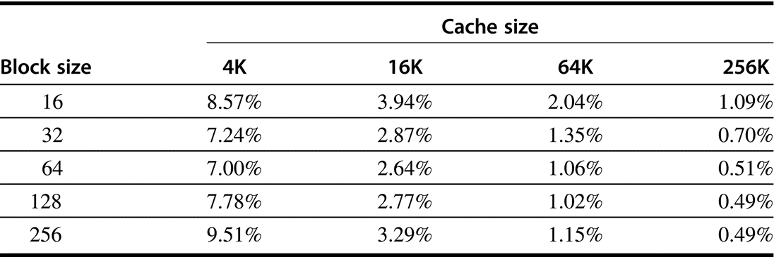
Actual miss rate versus block size
Note that for a 4 KiB cache, 256-byte blocks have a higher miss rate than 32-byte blocks. In this example, the cache would have to be 256 KiB in order for a 256-byte block to decrease misses

Slide 76
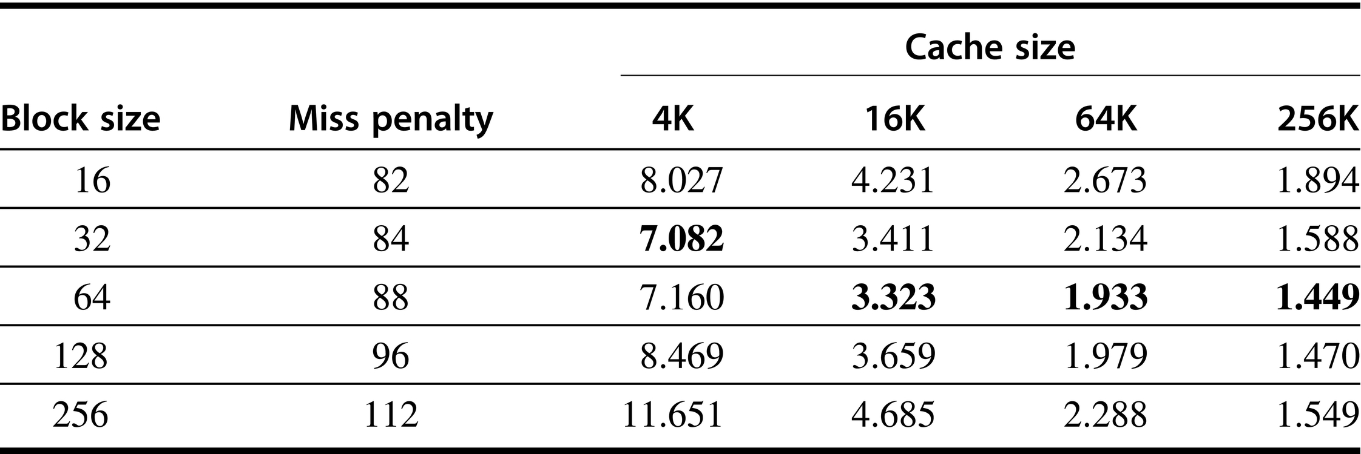
Average memory access time versus block size
Block sizes of 32 and 64 bytes dominate
The smallest average time per cache size is boldfaced

Slide 77
2. Reduce Misses via Higher Associativity
2:1 Cache Rule:
Miss Rate DM cache size N ­= Miss Rate 2-way cache size N/2
Beware: Execution time is only final measure!
Will Clock Cycle time increase?
Hill [1988] suggested hit time for 2-way vs. 1-way: external cache +10%, internal + 2%

Slide 78
Example: Avg. Memory Access Time vs. Miss Rate
Example: assume CCT = 1.10 for 2-way, 1.12 for 4-way, 1.14 for 8-way vs. CCT direct mapped
Cache Size Associativity
(KB) 1-way 2-way 4-way 8-way
1 2.33 2.15 2.07 2.01
2 1.98 1.86 1.76 1.68
4 1.72 1.67 1.61 1.53
8 1.46 1.48 1.47 1.43
16 1.29 1.32 1.32 1.32
32 1.20 1.24 1.25 1.27
64 1.14 1.20 1.21 1.23
128 1.10 1.17 1.18 1.20
(Red means A.M.A.T. not improved by more associativity)

Slide 79
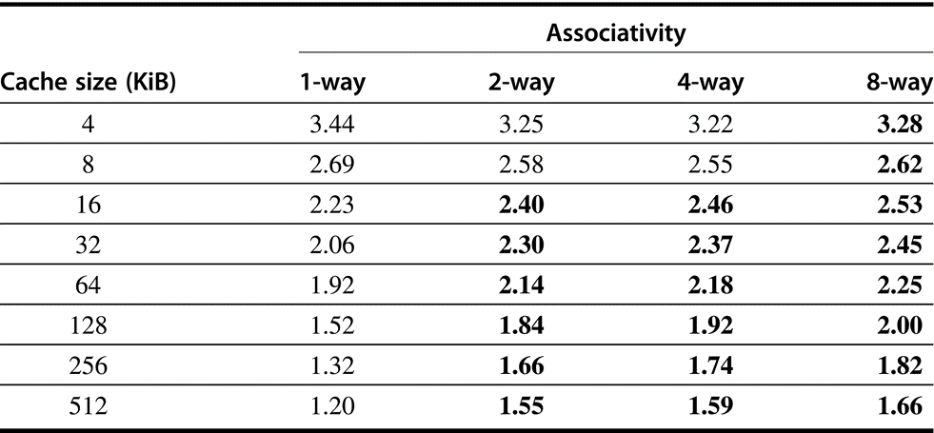
Average memory access time
Boldface type means larger time value than the left
higher associativity increases average memory access time

Slide 80
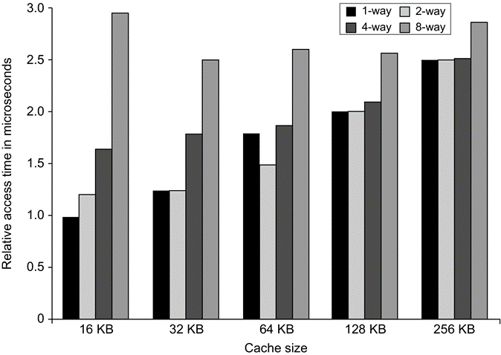
Access times generally increase as cache size and associativity increase
The data assume typical embedded SRAM technology, a single bank, and 64-byte blocks.

Slide 81
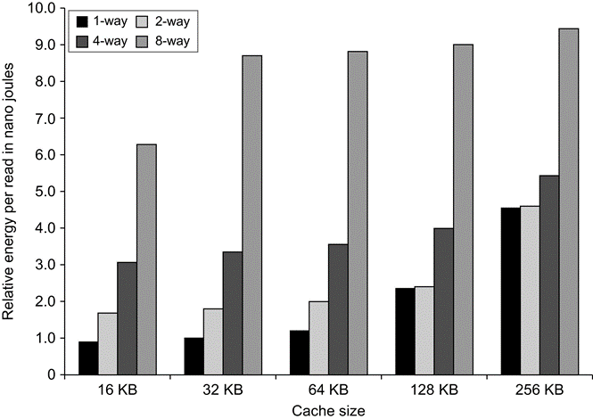
Energy consumption per read increases as cache size and associativity increased
The large penalty for eight-way set associative caches is due to the cost of reading out eight tags and the corresponding data in parallel.

Slide 82
3. Reducing Misses via a “Victim Cache”
How to combine fast hit time of direct mapped yet still avoid conflict misses?
Add buffer to place data discarded from cache
Jouppi [1990]: 4-entry victim cache removed 20% to 95% of conflicts for a 4 KB direct mapped data cache
Used in Alpha, HP machines
TAGS
DATA
Tag and Comparator
One Cache line of Data
Tag and Comparator
One Cache line of Data
Tag and Comparator
One Cache line of Data
Tag and Comparator
One Cache line of Data
To Next Lower Level In
Hierarchy

Slide 83
4. Reducing Misses via “Pseudo-Associativity”
How to combine fast hit time of Direct Mapped and have the lower conflict misses of 2-way SA cache?
Divide cache: on a miss, check other half of cache to see if there, if so have a pseudo-hit (slow hit)
Drawback: CPU pipeline is hard if hit takes 1 or 2 cycles
Better for caches not tied directly to processor (L2)
Used in MIPS R1000 L2 cache, similar in UltraSPARC
Hit Time
Pseudo Hit Time
Miss Penalty
Time

Slide 84
5. Reducing Misses by Hardware Prefetching of Instructions & Data
E.g., Instruction Prefetching
Alpha 21064 fetches 2 blocks on a miss
Extra block placed in “stream buffer”
On miss check stream buffer
Works with data blocks too:
Jouppi [1990] 1 data stream buffer got 25% misses from 4KB cache; 4 streams got 43%
Palacharla & Kessler [1994] for scientific programs for 8 streams got 50% to 70% of misses from 2 64KB, 4-way set associative caches
Prefetching relies on having extra memory bandwidth that can be used without penalty

Slide 85
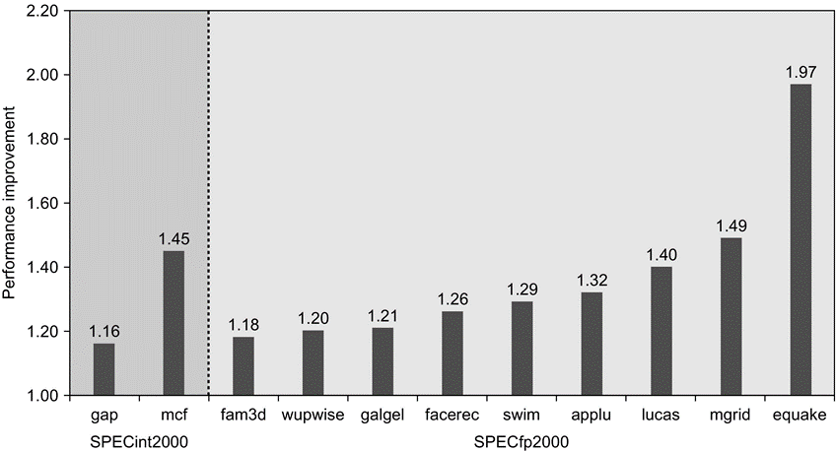
Effects of Hardware Prefetching
Fetch two blocks on miss (include next sequential block)
Speedup because of hardware prefetching on Intel Pentium 4

Slide 86
6. Reducing Misses by Software (Compiler) Prefetching Data
Data Prefetching: Insert prefetch instructions before data is needed
Load data into register (HP PA-RISC loads)
Cache Prefetching: load into cache (MIPS IV, PowerPC, SPARC v. 9)
Special prefetching instructions cannot cause faults; a form of speculative execution
Prefetching comes in two flavors:
Binding prefetching: Requests load directly into register.
Must be correct address and register!
Non-Binding prefetching: Load into cache.
Can be incorrect. Frees HW/SW to guess!
Issuing Prefetching Instructions takes time
Is cost of prefetching issues < savings in reduced misses?
Higher superscalar reduces difficulty of issue bandwidth

Slide 87
7. Reducing Misses by Compiler Optimizations
McFarling [1989] reduced caches misses by 75% on 8KB direct mapped cache, 4 byte blocks in software
Instructions: Reorder procedures in memory so as to reduce conflict misses; Profiling to look at conflicts (using tools they developed)
Data
Merging Arrays: improve spatial locality by single array of compound elements vs. 2 arrays
Loop Interchange: change nesting of loops to access data in stored order
Loop Fusion: Combine 2 independent loops that have same looping and some variables overlap
Blocking: Improve temporal locality by accessing “blocks” of data repeatedly vs. going down whole columns or rows; Requires more memory accesses but improves locality of accesses

Slide 88
Merging Arrays Example
/* Before: 2 sequential arrays */
int val[SIZE];
int key[SIZE];
/* After: 1 array of stuctures */
struct merge {
int val;
int key;
};
struct merge merged_array[SIZE]; Reducing conflicts between val & key; improve spatial locality

Slide 89
Loop Interchange Example
/* Before */
for (k = 0; k < 100; k = k+1)
for (j = 0; j < 100; j = j+1)
for (i = 0; i < 5000; i = i+1)
x[i][j] = 2 * x[i][j];
/* After */
for (k = 0; k < 100; k = k+1)
for (i = 0; i < 5000; i = i+1)
for (j = 0; j < 100; j = j+1)
x[i][j] = 2 * x[i][j];
Sequential accesses instead of striding through memory every 100 words; improved spatial locality

Slide 90
Loop Fusion Example
/* Before */
for (i = 0; i < N; i = i+1)
for (j = 0; j < N; j = j+1)
a[i][j] = 1/b[i][j] * c[i][j];
for (i = 0; i < N; i = i+1)
for (j = 0; j < N; j = j+1)
d[i][j] = a[i][j] + c[i][j];
/* After */
for (i = 0; i < N; i = i+1)
for (j = 0; j < N; j = j+1)
{ a[i][j] = 1/b[i][j] * c[i][j];
d[i][j] = a[i][j] + c[i][j];}
2 misses per access to a & c vs. one miss per access; improve spatial locality

Slide 91
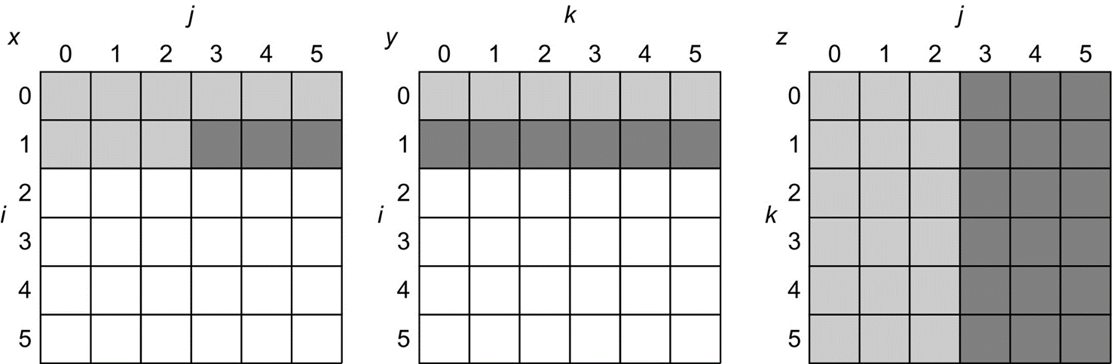
Blocking Example
/* Before */
for (i = 0; i < N; i = i+1)
for (j = 0; j < N; j = j+1)
{r = 0;
for (k = 0; k < N; k = k+1){
r = r + y[i][k]*z[k][j];};
x[i][j] = r;
};

Slide 92
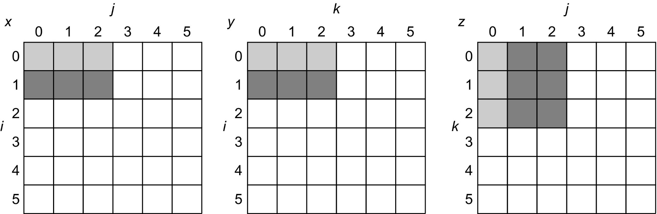
Blocking Example
Two Inner Loops:
Read all NxN elements of z[]
Read N elements of 1 row of y[] repeatedly
Write N elements of 1 row of x[]
Capacity Misses a function of N & Cache Size:
2N³ + N² => (assuming no conflict; otherwise …)
Idea: compute on BxB submatrix that fits

Slide 93
Blocking Example
/* After */
for (jj = 0; jj < N; jj = jj+B)
for (kk = 0; kk < N; kk = kk+B)
for (i = 0; i < N; i = i+1)
for (j = jj; j < min(jj+B-1,N); j = j+1)
{r = 0;
for (k = kk; k < min(kk+B-1,N); k = k+1) {
r = r + y[i][k]*z[k][j];};
x[i][j] = x[i][j] + r;
};
B called Blocking Factor
Capacity Misses from 2N³ + N² to N³/B+2N²
Conflict Misses Too?

Slide 94
Reducing Conflict Misses by Blocking
Conflict misses in caches not FA vs. Blocking size
Lam et al [1991] a blocking factor of 24 had a fifth the misses vs. 48 despite both fit in cache

Slide 95
Summary of Compiler Optimizations to Reduce Cache Misses (by hand)

Slide 96
Summary: Miss Rate Reduction
3 Cs: Compulsory, Capacity, Conflict
1. Reduce Misses via Larger Block Size
2. Reduce Misses via Higher Associativity
3. Reducing Misses via Victim Cache
4. Reducing Misses via Pseudo-Associativity
5. Reducing Misses by HW Prefetching Instr, Data
6. Reducing Misses by SW Prefetching Data
7. Reducing Misses by Compiler Optimizations

Slide 97
Improving Cache Performance
1. Reduce the miss rate,
2. Reduce the miss penalty, or
3. Reduce the time to hit in the cache.

Slide 98
Write Policy: Write-Through vs Write-Back
Write-through: all writes update cache and underlying memory/cache
Can always discard cached data - most up-to-date data is in memory
Cache control bit: only a valid bit
Write-back: all writes simply update cache
Can’t just discard cached data - may have to write it back to memory
Cache control bits: both valid and dirty bits
Other Advantages:
Write-through: memory (or other processors) always have latest data
Simpler management of cache
Write-back: Better tolerance to long-latency memory?
much lower bandwidth, since data often overwritten multiple times

Slide 99
Write Policy 2: Write Allocate vs Non-Allocate
What happens on write-miss?
Write allocate: allocate new cache line in $
Usually means that you have to do a “read miss” to fill in rest of the cache-line!
Alternative: per/word valid bits
Write non-allocate (or “write-around”):
Simply send write data through to underlying memory/cache - don’t allocate new cache line!

Slide 100
1. Reducing Miss Penalty: Read Priority over Write on Miss
CPU
in out
Write Buffer
write
buffer
DRAM
(or lower mem)

Slide 101
1. Reducing Miss Penalty: Read Priority over Write on Miss
Write-through with write buffers offer RAW conflicts with main memory reads on cache misses
If simply wait for write buffer to empty, might increase read miss penalty (old MIPS 1000 by 50% )
Check write buffer contents before read; if no conflicts, let the memory access continue
Write-back also want buffer to hold misplaced blocks
Read miss replacing dirty block
Normal: Write dirty block to memory, and then do the read
Instead copy the dirty block to a write buffer, then do the read, and then do the write
CPU stall less since restarts as soon as do read

Slide 102
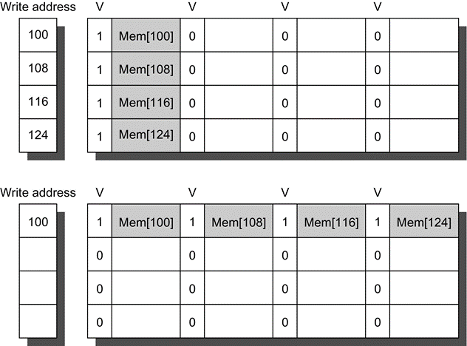
Merging Write Buffer
When storing to a block that is already pending in the write buffer, update write buffer
Without write merging, the words to the right would be used only for instructions that wrote multiple words at the same time
Reduces stalls due to full write buffer
No write merging
Write merging

Slide 103
2. Reduce Miss Penalty: Early Restart and Critical Word First
Don’t wait for full block to be loaded before restarting CPU
Early restart — As soon as the requested word of the block arrives, send it to the CPU and let the CPU continue execution
Critical Word First — Request the missed word first from memory and send it to the CPU as soon as it arrives; let the CPU continue execution while filling the rest of the words in the block. Also called wrapped fetch and requested word first
Generally useful only in large blocks,
Spatial locality a problem; tend to want next sequential word, so not clear if benefit by early restart
block

Slide 104
3.Non-blocking Caches to reduce stalls on misses
Non-blocking cache or lockup-free cache allow data cache to continue to supply cache hits during a miss
requires special control (F/E bits on registers or out-of-order execution)
“hit under miss” reduces the effective miss penalty by working during miss vs. ignoring CPU requests
“hit under multiple miss” or “miss under miss” may further lower the effective miss penalty by overlapping multiple misses
Significantly increases the complexity of the cache controller as there can be multiple outstanding memory accesses
Requires multiple memory banks (otherwise cannot support bandwidth)
Pentium Pro allows 4 outstanding memory misses

Slide 105
Implementing Nonblocking caches
What happens on a cache miss in a blocking cache?
Freeze pipeline in Mem stage (popular early on: SAPRC, R4000)
For nonblocking cahce, arbitration between hit and (multiple) misses
Use Full/Empty bits in registers + MSHR queue (# of outstanding misses)
MSHR = “Miss Status/Handler Registers”, each entry in this queue keeps track of status of outstanding memory requests to one complete memory line
Per cache-line: keep info about memory address; For each word: register (if any) that is waiting for result; Used to “merge” multiple requests to one memory line
New load creates MSHR entry and sets destination register to “Empty”
Load is “released” from pipeline
Attempt to use register before result returns causes instruction to block in decode stage.
Limited “out-of-order” execution with respect to loads Popular with in-order superscalar architectures

Slide 106
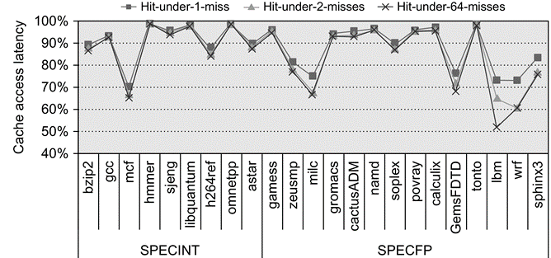
Performance of Nonblocking Caches
Allow hits before previous misses complete
“Hit under miss”, “Hit under multiple miss”
L2 must support this
Allowing one hit under miss reduces the miss penalty by 9% for integer and 12.5% for floating point Allowing a second hit improves these results to 10% and 16%
Allowing 64 results in little additional improvement

Slide 107
4: Add a second-level cache
L2 Equations
AMAT = Hit Time_{L1} + Miss Rate_{L1} x Miss Penalty_{L1} Miss Penalty_{L1} = Hit Time_{L2} + Miss Rate_{L2} x Miss Penalty_{L2}
AMAT = Hit Time_{L1} + Miss Rate_{L1} x (Hit Time_{L2} + Miss Rate_{L2} + Miss Penalty_{L2})
Definitions:
Local miss rate — misses in this cache divided by the total number of memory accesses to this cache (Miss rate_{L2})
Global miss rate —misses in this cache divided by the total number of memory accesses generated by the CPU (Miss Rate_{L1} x Miss Rate_{L2})
Global Miss Rate is what matters

Slide 108
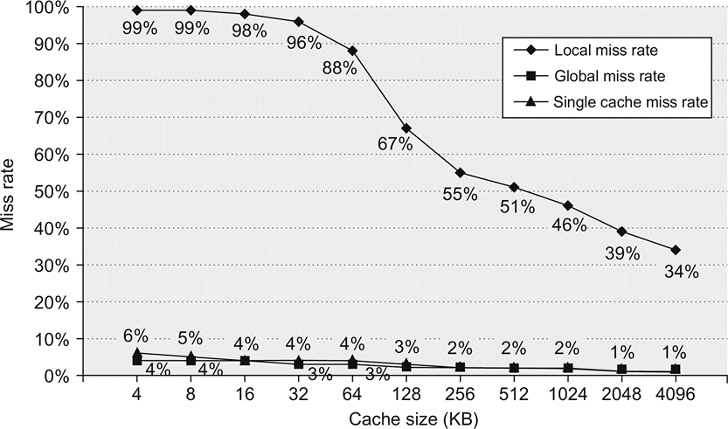
Comparing Local and Global Miss Rates
32 KByte 1st level cache; Increasing 2nd level cache
Global miss rate close to single level cache rate provided L2 >> L1
Don’t use local miss rate
L2 not tied to CPU clock cycle!
Cost & A.M.A.T.
Generally Fast Hit Times and fewer misses
Since hits are few, target miss reduction

Slide 109
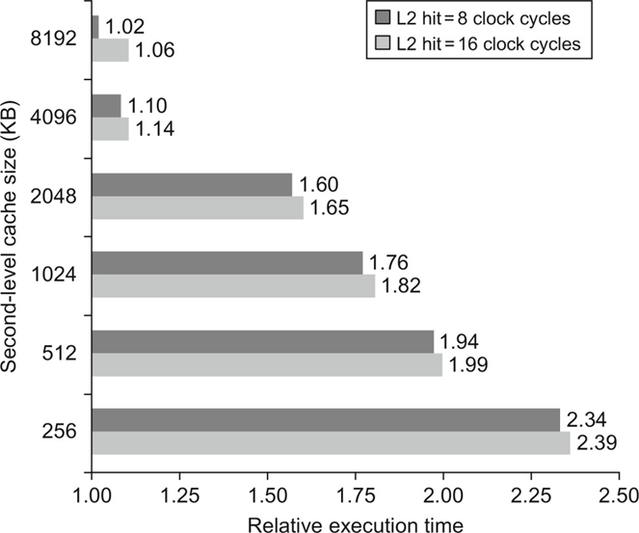
Relative execution time by second-level cache size
The two bars are for different clock cycles for an L2 cache hit
The reference execution time of 1.00 is for an 8192 KiB second- level cache with a 1-clock-cycle latency on a second-level hit

Slide 110
Reducing Misses: Which apply to L2 Cache?
Reducing Miss Rate
1. Reduce Misses via Larger Block Size
2. Reduce Conflict Misses via Higher Associativity
3. Reducing Conflict Misses via Victim Cache
4. Reducing Conflict Misses via Pseudo-Associativity
5. Reducing Misses by HW Prefetching Instr, Data
6. Reducing Misses by SW Prefetching Data
7. Reducing Capacity/Conf. Misses by Compiler Optimizations

Slide 111
L2 cache block size & A.M.A.T.
32KB L1, 8 byte path to memory

Slide 112
Reducing Miss Penalty Summary
Four techniques
Read priority over write on miss
Early Restart and Critical Word First on miss
Non-blocking Caches (Hit under Miss, Miss under Miss)
Second Level Cache
Can be applied recursively to Multilevel Caches
Danger is that time to DRAM will grow with multiple levels in between
First attempts at L2 caches can make things worse, since increased worst case is worse

Slide 113
Improving Cache Performance
1. Reduce the miss rate,
2. Reduce the miss penalty, or
3. Reduce the time to hit in the cache.

Slide 114
1. Fast Hit times via Small and Simple Caches
Why Alpha 21164 has 8KB Instruction and 8KB data cache + 96KB second level cache?
Small data cache and clock rate
Direct Mapped, on chip

Slide 115
Address translation and Cache access
访问cache前，先要做地址 变换，增加一次访存
即便用TLB，也增加了延迟
ASIDE: Why access cache with PA?
VA caches have a problem (synonym/alias problem):
Two different virtual addresses map to same physical address => two different cache entries holding data for the same physical address!
For update: must update all cache entries with same physical address or memory becomes inconsistent
Determining this requires significant hardware, essentially an associative lookup on the physical address tags to see if you have multiple hits; or software enforced alias boundary: same lsb of VA & PA (page coloring)
VA
PA
miss
Trans-
lation
Cache
Main
Memory
CPU
hit
data

Slide 116
2. Fast hits by Avoiding Address Translation
Send virtual address to cache? Called Virtually Addressed Cache or just Virtual Cache vs. Physical Cache
Every time process is switched logically must flush the cache; otherwise get false hits
Cost is time to flush + Compulsory misses from empty cache
Dealing with aliases (sometimes called synonyms); Two different virtual addresses map to same physical address
I/O must interact with cache, so need virtual address
Solution to aliases
HW guarantees, or SW guarantee page coloring
Solution to cache flush
Add process identifier tag that identifies process as well as address within process: can‘t get a hit if wrong process

Slide 117
Virtually Addressed Caches
CPU
CPU
CPU
VA
VA
VA
TB
VA
Tags
$
PA
Tags
$
TB
PA
VA
PA
$
TB
L2 $
PA
PA
MEM
MEM
MEM
Overlap $ access
with VA translation:
requires $ index to
remain invariant
across translation
Conventional
Organization
Virtually Addressed Cache
Translate only on miss
Synonym Problem

Slide 118
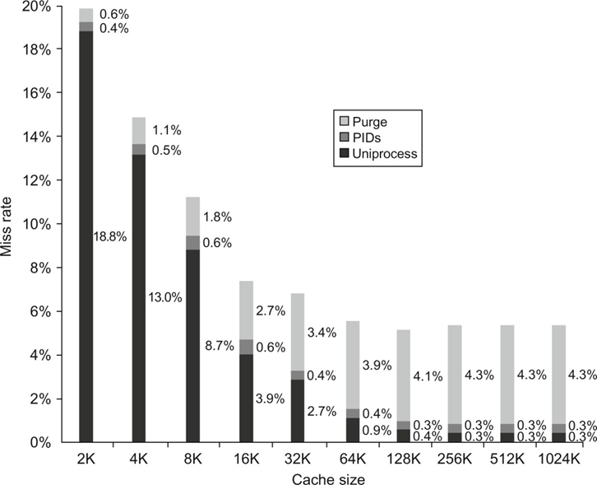
2. Fast Cache Hits by Avoiding Translation: Process ID impact
Black is uniprocess
Light Gray is multiprocess
when flush cache
Dark Gray is multiprocess
when use Process ID tag
Y axis: Miss Rates up to 20%
X axis: Cache size from 2 KB to 1024 KB

Slide 119
2. Fast Cache Hits by Avoiding Translation
Overlap the cache access with the TLB access
High order bits of the VA are used to look in the TLB while low order bits are used as index into cache
If index is physical part of address, can start tag access in parallel with translation so that can compare to physical tag
Limits cache to page size: what if want bigger caches and uses same trick?
Higher associativity moves barrier to right
Page coloring
Page Address
Page Offset
Address Tag
Index
Block Offset

Slide 120
Overlapped Cache & TLB Access
TLB
Cache
assoc
lookup
index
1 K
32
4 bytes
10
2
00
PA
Hit/
Miss
PA
Data
Hit/
Miss
20
12
page #
disp
=
IF cache hit AND (cache tag = PA) then deliver data to CPU
ELSE IF [cache miss OR (cache tag = PA)] and TLB hit THEN
access memory with the PA from the TLB
ELSE do standard VA translation

Slide 121
Problems With Overlapped TLB Access
Overlapped access only works as long as the address bits used to index into the cache do not change as the result of VA translation, which usually limits things to small caches, large page sizes, or high n-way set associative caches if you want a large cache
Example: suppose everything the same except that the cache is increased to 8 K bytes instead of 4 K:
Page coloring
11
2
cache
index
00
This bit is changed
by VA translation, but
is needed for cache
lookup
20
12
virt page #
disp
Solutions:
go to 8K byte page sizes;
go to 2 way set associative cache; or
SW guarantee VA[13]=PA[13]
1K
2 way set assoc cache
10
4
4

Slide 122
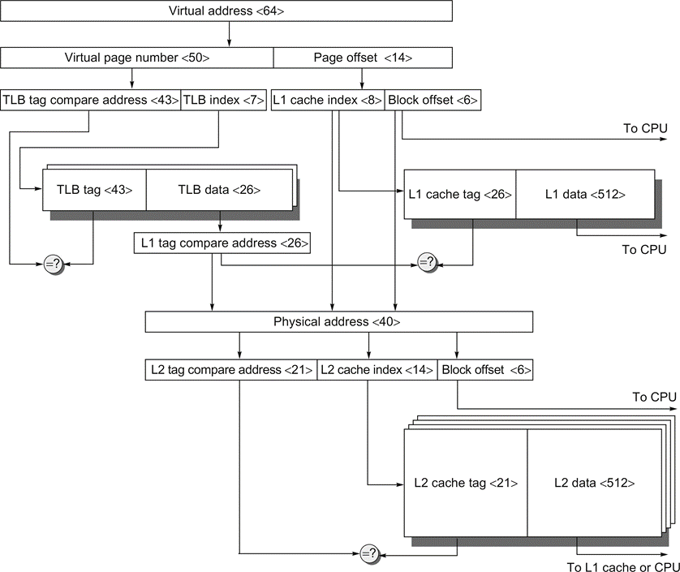
The overall picture of a hypothetical memory hierarchy
Going from virtual address to L2 cache access
The page size is 16 KiB
The TLB is two-way set associative with 256 entries
The L1 cache is a direct-mapped 16 KiB, and the L2 cache is a four-way set associative with a total of 4 MiB
Both use 64-byte blocks. The virtual address is 64 bits and the physical address is 40 bits

Slide 123
3. Fast Hit Times Via Pipelined Writes
Pipeline Tag Check and Update Cache as separate stages; current write tag check & previous write cache update
Only STORES in the pipeline; empty during a miss Store r2, (r1) Check r1 Add -- Sub -- Store r4, (r3) M[r1]<-r2 & check r3
In shade is Delayed Write Buffer? must be checked on reads; either complete write or read from buffer

Slide 124
4. Fast Writes on Misses Via Small Subblocks
If most writes are 1 word, subblock size is 1 word, & write through then always write subblock & tag immediately
Tag match and valid bit already set: Writing the block was proper, & nothing lost by setting valid bit on again.
Tag match and valid bit not set: The tag match means that this is the proper block; writing the data into the subblock makes it appropriate to turn the valid bit on.
Tag mismatch: This is a miss and will modify the data portion of the block. Since write-through cache, no harm was done; memory still has an up-to-date copy of the old value. Only the tag to the address of the write and the valid bits of the other subblock need be changed because the valid bit for this subblock has already been set
Doesn’t work with write back due to last case

Slide 125
Way Prediction
To improve hit time, predict the way to pre-set mux
Mis-prediction gives longer hit time
Prediction accuracy
> 90% for two-way
> 80% for four-way
I-cache has better accuracy than D-cache
First used on MIPS R10000 in mid-90s
Used on ARM Cortex-A8
Extend to predict block as well
“Way selection”
Increases mis-prediction penalty

Slide 126
Pipelined Caches
Pipeline cache access to improve bandwidth
Examples:
Pentium: 1 cycle
Pentium Pro – Pentium III: 2 cycles
Pentium 4 – Core i7: 4 cycles
Increases branch mis-prediction penalty
Makes it easier to increase associativity

Slide 127
Fast Hits by pipelining Cache Case Study: MIPS R4000
8 Stage Pipeline:
IF–first half of fetching of instruction; PC selection happens here as well as initiation of instruction cache access.
IS–second half of access to instruction cache.
RF–instruction decode and register fetch, hazard checking and also instruction cache hit detection.
EX–execution, which includes effective address calculation, ALU operation, and branch target computation and condition evaluation.
DF–data fetch, first half of access to data cache.
DS–second half of access to data cache.
TC–tag check, determine whether the data cache access hit.
WB–write back for loads and register-register operations.
What is impact on Load delay?
Need 2 instructions between a load and its use!
Notes:
Answer is 3 stages between branch and new instruction fetch and 2 stages between load and use (even though if looked at red insertions that it would be 3 for load and 2 for branch)
Reasons:
1) Load: TC just does tag check, data available after DS; thus supply the data & forward it, restarting the pipeline on a data cache miss
2) EX phase does the address calculation even though just added one phase; presumed reason is that since want fast clockc cycle don’t want to sitck RF phase with reading regisers AND testing for zero, so just moved it back on phase

Slide 128
Case Study: MIPS R4000
TWO Cycle
Load Latency
IF
IS
IF
RF
IS
IF
EX
RF
IS
IF
DF
EX
RF
IS
IF
DS
DF
EX
RF
IS
IF
TC
DS
DF
EX
RF
IS
IF
WB
TC
DS
DF
EX
RF
IS
IF
THREE Cycle
Branch Latency
IF
IS
IF
RF
IS
IF
EX
RF
IS
IF
DF
EX
RF
IS
IF
DS
DF
EX
RF
IS
IF
TC
DS
DF
EX
RF
IS
IF
WB
TC
DS
DF
EX
RF
IS
IF
(conditions evaluated
during EX phase)
Delay slot plus two stalls
Branch likely cancels delay slot if not taken

Slide 129
R4000 Performance
Not ideal CPI of 1:
Load stalls (1 or 2 clock cycles)
Branch stalls (2 cycles + unfilled slots)
FP result stalls: RAW data hazard (latency)
FP structural stalls: Not enough FP hardware (parallelism)
Notes:
Integer programs, major delay is branch stalls
FP its structural stalls

Slide 130
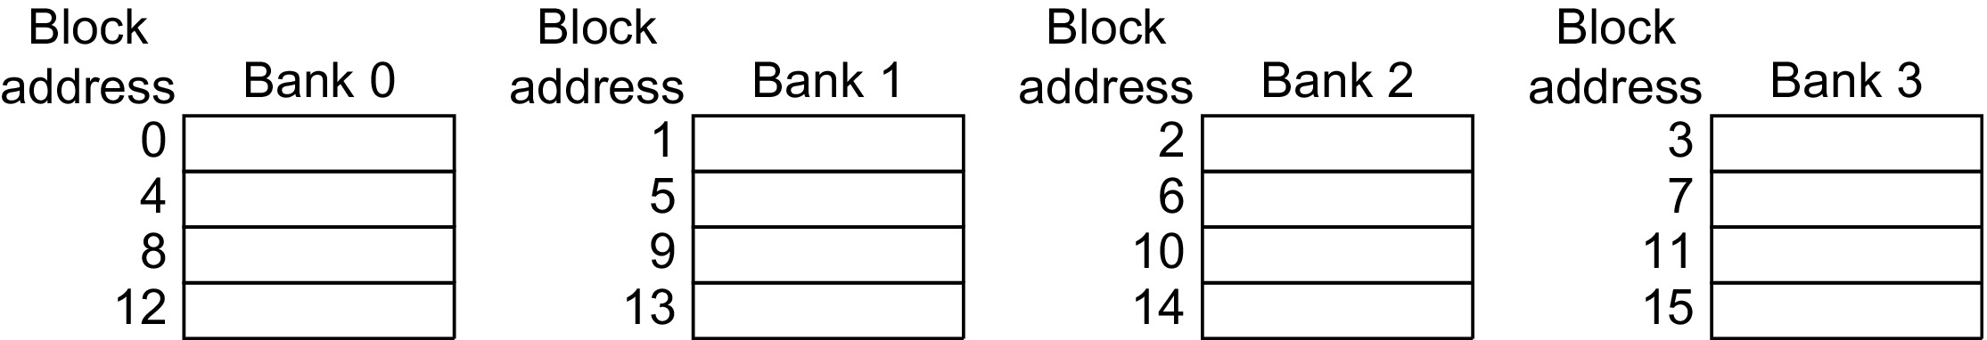
Multibanked Caches
Organize cache as independent banks to support simultaneous access
ARM Cortex-A8 supports 1-4 banks for L2
Intel i7 supports 4 banks for L1 and 8 banks for L2
Interleave banks according to block address
Assuming 64 bytes per block, each of these addresses would be multiplied by 64 to get byte addressing

Slide 131
Use HBM to Extend Hierarchy
Use HBM as off-chip L4 cache: 8GiB to 64 GiB
High bandwidth than DDR5, but still high access latency
Where to store the TAG: use SRAM on the CPU chip
Smaller blocks require substantial tag storage
Larger blocks are potentially inefficient (may prefer subblock)
One approach (L-H):
Each SDRAM row is a block index
Each row contains set of tags and 29 data segments
29-set associative
Hit requires a CAS

Slide 132
Use HBM to Extend Hierarchy
Another approach (Alloy cache):
Mold tag and data together
Use direct mapped mapping
Both schemes require two DRAM accesses for misses
Two solutions:
Use map to keep track of blocks
Predict likely misses

Slide 133
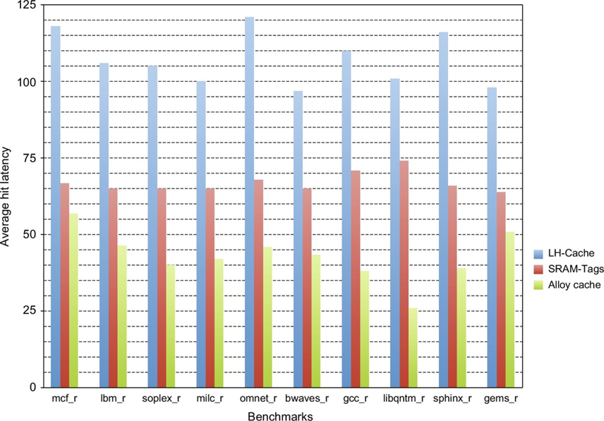
Average hit time latency in clock cycles
For the L-H scheme, a currently-impractical scheme using SRAM for the tags, and the alloy cache organization

Slide 134
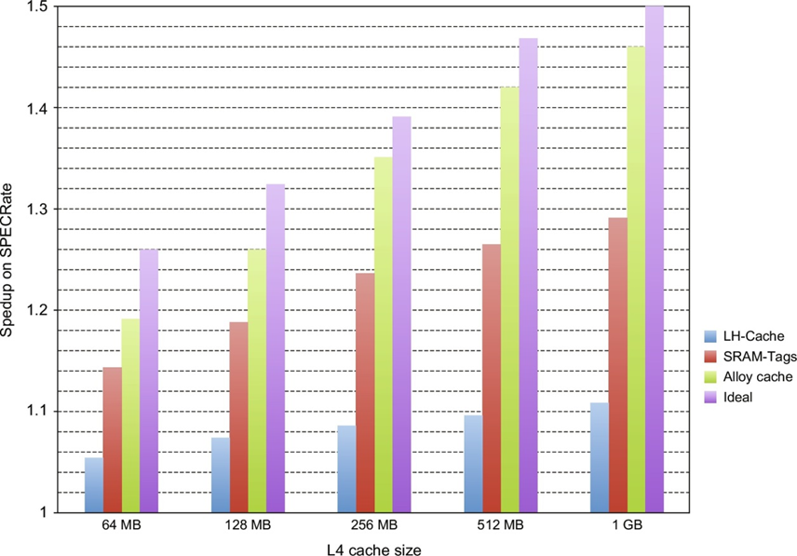
Use HBM to Extend Hierarchy
Performance speedup for the LH scheme, an SRAM tag scheme, and an ideal L4 (Ideal); a speedup of 1 indicates no improvement with the L4 cache, and a speedup of 2 would be achievable if L4 were perfect and took no access time.

Slide 135
Cache Optimization Summary
Technique MR MP HT Complexity
Larger Block Size + - 0 Higher Associativity + - 1 Victim Caches + 2 Pseudo-Associative Caches + 2 HW Prefetching of Instr/Data + 2 Compiler Controlled Prefetching + 3 Compiler Reduce Misses + 0
Priority to Read Misses + 1 Subblock Placement + + 1 Early Restart & Critical Word 1st + 2 Non-Blocking Caches + 3 Second Level Caches + 2
Small & Simple Caches - + 0 Avoiding Address Translation + 2 Pipelining Writes + 1
miss rate
miss
penalty
hit time

Slide 136
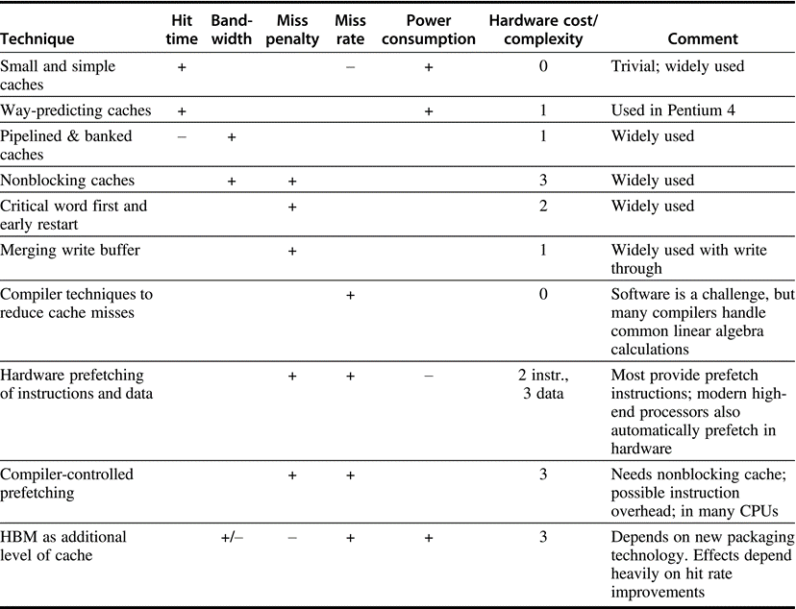
Summary
Although generally a technique helps only one factor, prefetching can reduce misses if done sufficiently early; if not, it can reduce miss penalty. + means that the technique improves the factor, − means it hurts that factor, and blank means it has no impact. The complexity measure is subjective, with 0 being the easiest and 3 being a challenge

