Slide 1
计算机系统设计导论
计算机类型和计算模式的变迁
计算机架构和计算机产业的发展变化
技术趋势和经济规律
计算机系统的性能及其度量
成本、功耗、可靠性

Slide 2
Classes of Computers （外形、尺寸）
Personal Mobile Device (PMD)
e.g. start phones, tablet computers
Emphasis on energy efficiency and real-time
Desktop Computing
Emphasis on price-performance
Servers
Emphasis on availability, scalability, throughput
Clusters / Warehouse Scale Computers
Used for “Software as a Service (SaaS)”
Emphasis on availability and price-performance
Sub-class: Supercomputers, emphasis: floating-point performance and fast internal networks
Internet of Things/Embedded Computers
Emphasis: price
数据中心
服务器集群
企业服务器
工作站、台式机
个人移动设备
物联网终端
巨
Super Computer
Super Server
Mainframe
大
Department Server
Minicomputer
中
Workstation / Server
小
微
PC / Client

Slide 3
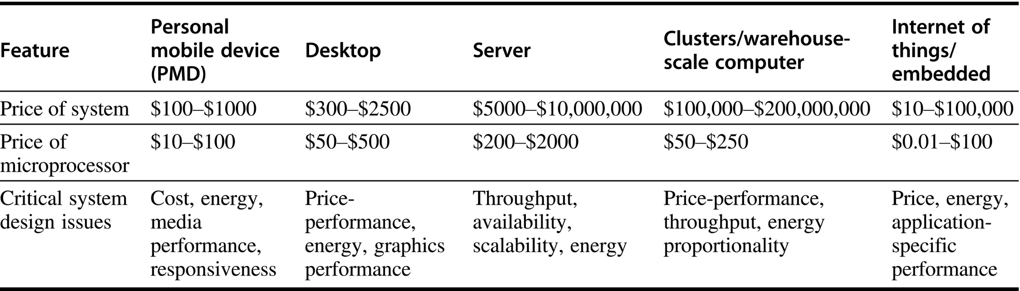
五类计算系统的主要特征
一些销量数据（2015）
1.6 billion PMDs (90% cell phones), 275 million desktop PCs, 15 million servers.
The total number of embedded processors sold was nearly 19 billion.
In total, 14.8 billion ARM-technology-based chips were shipped in 2015.
服务器和嵌入式这两类系统的价格跨度非常大
Embedded system: from USB keys to network routers
For servers, this range arises from the need for very large-scale multiprocessor systems for high-end transaction processing.

Slide 4
Flynn’s Taxonomy （学术、体系结构）
Single instruction stream, single data stream (SISD)
单指令流单数据流，传统单处理机
Single instruction stream, multiple data streams (SIMD)
Vector architectures, Array processors （向量机、数组处理机、阵列机）
Multimedia extensions （多媒体扩展，如MMX, 3DNow, SSE, AVX等）
Graphics processor units （GPGPU, TPU, NPU, SIMT, etc.）
Multiple instruction streams, single data stream (MISD)
No commercial implementation (Systolic array?)
Multiple instruction streams, multiple data streams (MIMD)
Tightly-coupled MIMD，共享存储多处理机（多核CPU，多路服务器）
Loosely-coupled MIMD，分布存储多计算机（MPP，服务器集群，网络计算）

Slide 5
Computer Technology (celebrating 80 years)
Performance improvements:
Improvements in semiconductor technology
Feature size, clock speed
Improvements in computer architectures
Enabled by HLL compilers, complex O/S such as UNIX/Linux
Lead to RISC architectures
Together have enabled:
Lightweight computers
Productivity-based managed/interpreted programming languages

Slide 6
Parallelism
并行，体系结构层面提升性能的最重要途径
Classes of parallelism in applications:
Data-Level Parallelism (DLP)
Task-Level Parallelism (TLP)
Classes of architectural parallelism:
ILP: Instruction-Level Parallelism
DLP: Vector architectures/Graphic Processor Units (GPUs)
Thread-Level Parallelism
Request-Level Parallelism

Slide 7
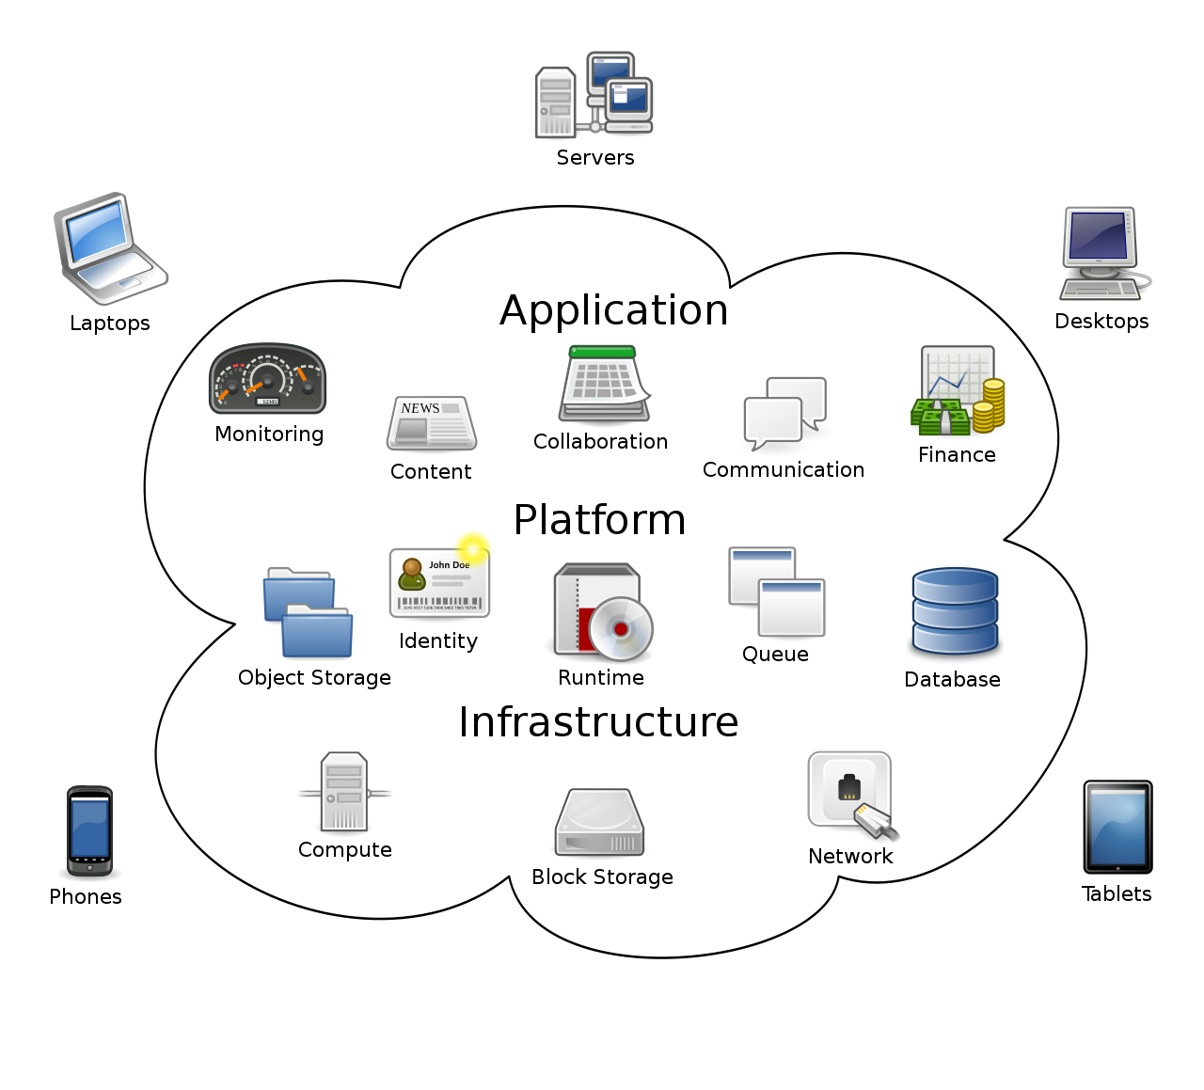

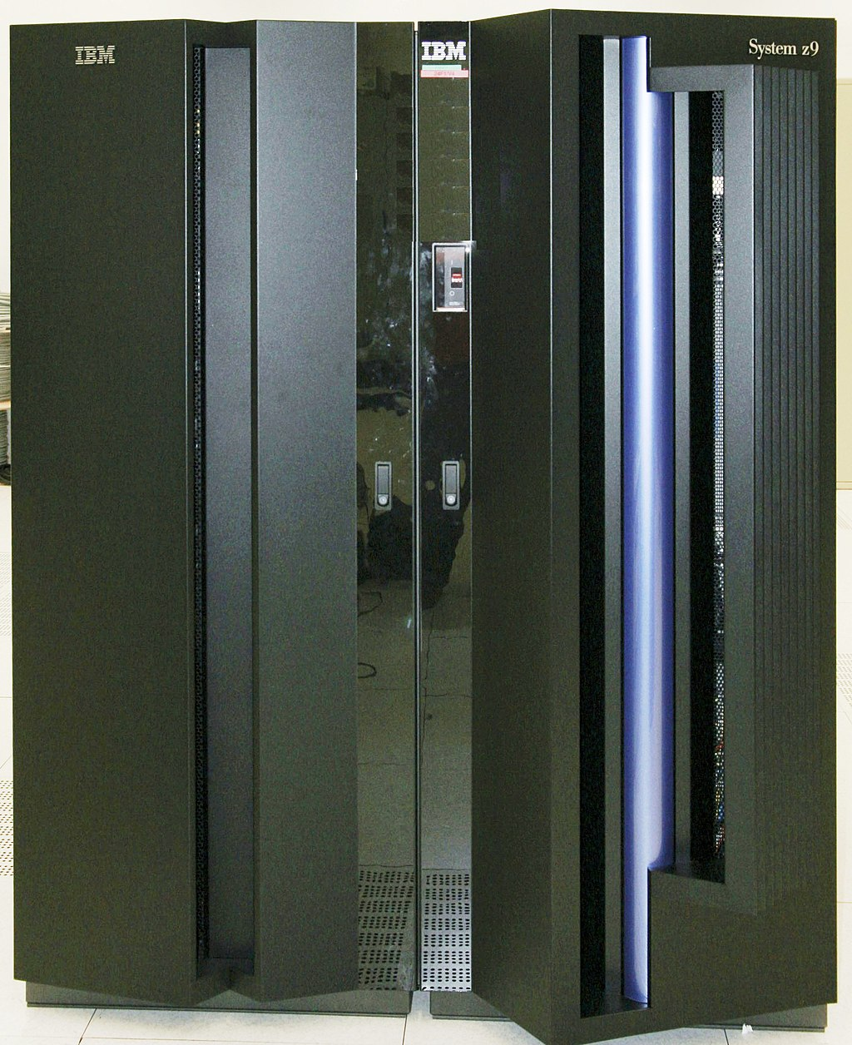
计算模式的变化
以PC为主的
客户机/服务器
分布式计算
1980-90年代
云计算模式
云数据中心的集中
加广域网范围的分布
2000年后
主机/终端
集中式计算
1950-70年代

Slide 8
食物链的例子：生物界
Big Fishes Eating Little Fishes

Slide 9
1988 Computer Food Chain
Mainframe
Work-
station
PC
Mini-
supercomputer
Mini-
computer
Supercomputer
Massively Parallel Processors

Slide 10
1998 Computer Food Chain
Mini-
supercomputer
Mini-
computer
Massively Parallel Processors
Mainframe
Work-
station
PC
Server
Supercomputer
Now who is eating whom?

Slide 11
现实世界中的例子：微处理器的成功
Supercomputer eaten by Workstations
In 1996, Cray Research Inc. was acquired by SGI Corporation
Cray Research: start from 1970’s
SGI成立于1982年，著名产品：图形工作站、MIPS处理器
2009年被不著名的公司并购，开发高性能计算和存储解决方案
Minicomputers eaten by PCs
In 1998, Digital Equipment Corporation was acquired by Compaq
DEC: start from 1960’s，著名产品：PDP 11，VAX 780
Compaq: 康柏，1982年成立的PC公司，2002年被HP并购
A Joke: Definitely Eaten by Compaq
“联想收购IBM”
2005年收购PC业务，2014年收购x86服务器业务

Slide 12



微处理器出现后，计算平台的发展
个人计算机(PC)，不再是专业装备
计算的普及：日常办公、休闲娱乐
智能手机(Smart Phone)
移动性和广泛应用：饮食起居
自主驾驶汽车
可信安全：性命交关

Slide 13








计算平台上CPU架构的三分天下
个人计算机(PC) x86
计算的普及：日常办公、休闲娱乐
智能手机 ARM
移动性和智能应用：饮食起居
自主驾驶汽车 RISC-V ?
可信安全：性命交关

Slide 14
计算机架构的“分久必合”
处理器发展了好几十年，出现了许多各有特色的架构和产品，但大部分都逐渐凋零了
Intel i860/i960, 与HP联合开发的EPIC架构IA-64（安腾）
Motorola 的68000架构，后来跟IBM合作的PowerPC架构
HP的PA-RISC，SUN的SPARC，DEC的Alpha，SGI的MIPS
现在桌面和云端主要采用x86架构，移动端是ARM架构
快速收敛的原因是什么？是必然的吗，还是偶然的？
架构即“指令系统结构”：软件与硬件的接口界面
ISA, Instruction Set Architecture

Slide 15
主要ISA的发展演变
1960年代，IBM 360明确了ISA的概念，为了软件的兼容
系列机：不同性能不同成本的多种机器，使用同样的ISA
1970年代，各种ISA的试验场
从简单的load/store结构到复杂的高级语言机，及x86
1980年代，VLSI出现，CISC/RISC之争
1990年代，超标量SuperScalar RISC设计达到巅峰
Alpha, MIPS, Power(PC), PA-RISC, SPARC，性能都超过x86
2000年后，x86-64完胜
CISC与RISC的融合；Intel/HP合作的EPIC未达成预期目标

Slide 16
关键业务领域里，RISC/EPIC的份额 也在被x86服务器逐步蚕食
RISC/EPIC vs. 4 way+ X86 Server by Industry, Rolling 4 Quarters
Average growth rate: 4 way+ x86 server -7.3%, RISC/EPIC server -25.2%
四路x86服务器的增长率也是负数？
关键业务领域大型主机和RISC服务器一直有优势
后来4路x86服务器大量替代了RISC/EPIC服务器
再后来，8路和4路服务器又被2路服务器替代

Slide 17
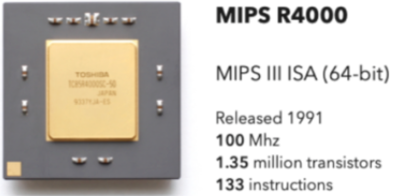
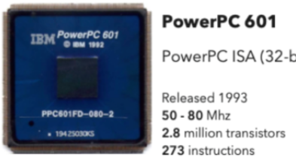
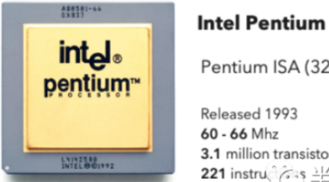
x86如何战胜RISC的？
x86是七〇后，RISC是八〇后
x86长据PC市场，RISC在90年代统治服务器市场
新世纪后，x86替代RISC，一统服务器市场
两个主要因素
x86的持续改进
吸收了高端RISC的实现技术，性能大幅度提高
根据新应用的需求，不断增加新的功能指令集
出货量大，为竞争和发展提供了动力
PC和服务器采用相同的CPU核心架构
大大分摊了服务器CPU的研发成本

Slide 18
为什么会这样？
制约高性能CPU发展的两大因素
已有的软硬件生态系统
存在大量标准或事实标准的接口
如指令系统结构ISA：硬件与汇编程序员的接口
开发新产品的成本逐渐增长
随着工艺的发展，芯片开发的NRE日益增长
技术因素 vs. 经济因素？
重新开发软件、开发新硬件，都有巨大成本
软件重新开发的成本，比开发新硬件的成本还要巨大

Slide 19
Gartner的企业软件市场分析
含企业应用软件、基础设施软件、垂直专用软件
单位：十亿美元 (US$B)
年份 | 2009 | 2010 | 2011 | 2012 | 2013 | 2014 | 2015 | 2016 | 2017 | 2018
X86软件的 市场份额 | 60% | 65% | 70% | 75% | 78% | 83% | 86% | 90% | 92% | 95%
x86软件的 营业收入 | 184 | 214 | 248 | 279 | 310 | 344 | 366 | 290 | 339 | 393
X86软件的 研发费用 | 28 | 32 | 37 | 42 | 46 | 52 | 55 | 44 | 51 | 59
参考：IDC预估2019年全球服务器市场总量为US$ 80B

Slide 20
90年代的超算Startups
既设计自己的CPU，又开发MPP超算系统
nCUBE，Thinking Machines
Kandell Square Research (KSR)
MasPar Computer Corporation
Meiko Scientific，……
KSR提出了名为Allcache的COMA架构
实现了第一个cache-only memory architecture
但其CPU只跑20MHz，同期的486已到50MHz
架构创新敌不过经济规模(律)

Slide 21
经济基础决定上层建筑
Architecture，既译为“建筑”，亦译为“体系结构”
技术上看，x86架构有很多问题
采用不定长指令，指令长度从一个字节到十多个字节
不属于通用寄存器结构，寄存器各有各的用途
寄存器数量太少，定点的、浮点的，都少
用FLAGS专用寄存器记录运算的进位、奇偶、零、正负等状态
微程序设计(microprogramming)技术发挥了关键作用
Intel/AMD的不传之密，微码，可看作是一个RISC指令集
弥补了x86架构在高性能实现方面的缺陷

Slide 22
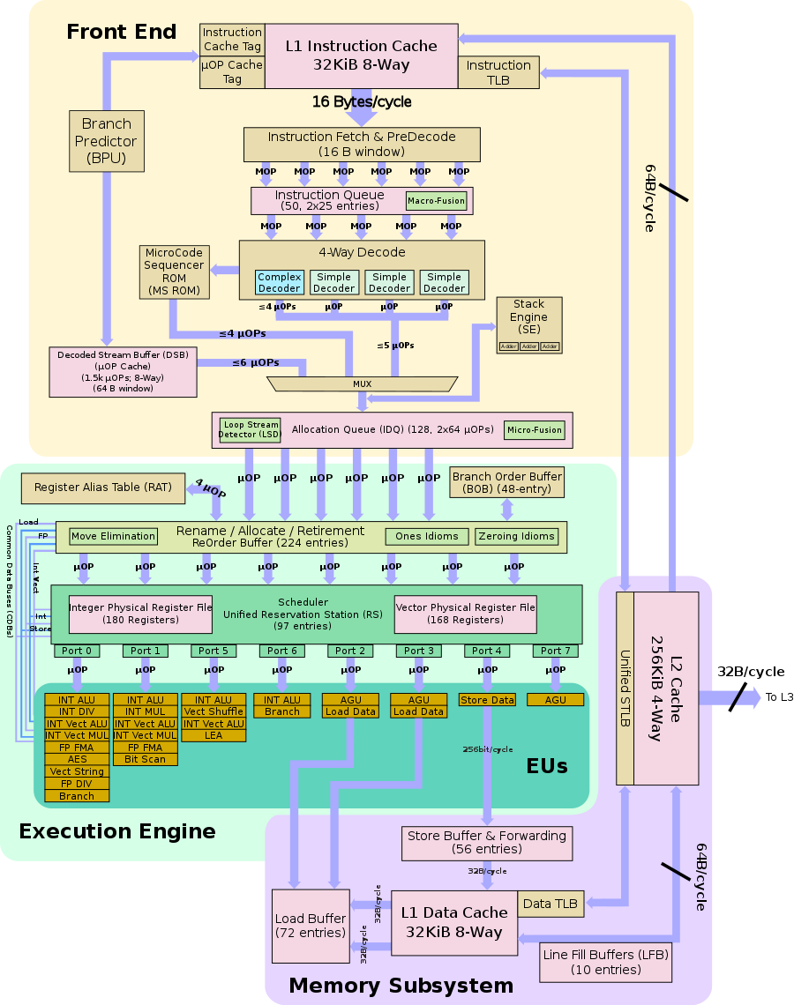
示例：典型x86处理器微架构
前端把复杂的x86指令翻译成微指令串，即微码
72位的微指令
类似于RISC
后端的执行和访存部件是
纯粹的超标量RISC微架构

Slide 23
计算芯片产业模式的螺旋式发展
以前，系统厂商自行开发中央处理器
CPU本身就是计算机系统的最核心内容
VLSI时代曾有：IBM，HP，DEC，SGI，SUN，……
后来，系统厂商逐渐退出
独立的计算芯片供应商脱颖而出：Intel，AMD，NVidia
现在，系统和平台厂商，又开始研发计算芯片了
美国有Apple，Google，Amazon，Microsoft，等等
中国更多：BAT都在搞，TMD跃跃欲试
华为、联想、Oppo、小米

Slide 24
云服务提供商做芯片
似乎成为一个潮流
Google TPU、AWS的ARM架构数据中心CPU
阿里、百度也都在自研芯片
自研自用模式是行得通的
企业盈利的基础在于其增值服务，不在硬件
可能较容易负担起芯片研发的费用
企业掌控全栈软硬件，生态移植的困难较小
对外提供公有云服务，还有待时日
社会其他部分的IT系统，仍需要独立芯片商

Slide 25
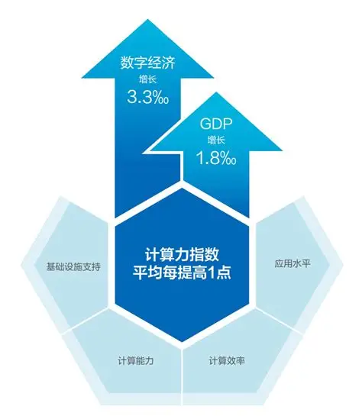
成功和失败的再分析
在自研桌面CPU芯片方面，Apple无疑是成功的
最早联合IBM和Motorola开发PowerPC CPU
后来转向采用Intel CPU，近年来自研ARM架构的CPU
表面看到的现象：Apple产品比同类产品贵很多
不用公版的ARM CPU核，自研的CPU性能高、成本高
配合自研的系统软件，整体达到优化的用户体验
营销体系助力，形成“高大上”，可以卖出高价钱
云服务大厂自研自用模式是行得通的
企业盈利的基础在于其增值服务，不在硬件
可能较容易负担起芯片研发的费用
企业掌控全栈软硬件，生态移植的困难较小
失败者往往只看到了“自研芯片”的表面现象
“做芯片”如果只是为了“用芯片”，未必有价值

Slide 26
为什么会有这样的变化？
Performance
Technology Advances
CMOS VLSI dominates older technologies (TTL, ECL) in cost AND performance
Computer architecture advances improves low-end
RISC, superscalar, RAID, …
Price: Lower costs due to
Simpler system development
CMOS VLSI: smaller systems, fewer components
Higher volumes
CMOS VLSI : same dev. cost 10,000 vs. 10,000,000 units
Lower margins by class of computer, due to fewer services
Function
Rise of networking/local interconnection technology

Slide 27
Technology Trends: Microprocessor Capacity (before 2000)
“Graduation Window”
Alpha 21264: 15 million
Pentium Pro: 5.5 million
PowerPC 620: 6.9 million
Alpha 21164: 9.3 million
Sparc Ultra: 5.2 million
Moore’s Law
CMOS improvements:
Die size: 2X every 3 yrs
Line width: halve / 7 yrs

Slide 28
Memory Capacity before 2000 (Single Chip DRAM)
year size(Mb) cyc time
1980 0.0625 250 ns
1983 0.25 220 ns
1986 1 190 ns
1989 4 165 ns
1992 16 145 ns
1996 64 120 ns
2000 256 100 ns

Slide 29
Technology Trends before 2000 (Summary)
Capacity Speed (latency)
Logic 2x in 3 years 2x in 3 years
DRAM 4x in 3 years 2x in 10 years
Disk 4x in 3 years 2x in 10 years

Slide 30
Processor Performance Trends
1000
100
Supercomputers
Mainframes
10
Minicomputers
1
Microprocessors
0.1
1965
1970
1975
1980
1985
1990
1995
2000
Year

Slide 31
Processor Performance (1.35X before, 1.55X @ 2000)
1.54X/yr

Slide 32
Performance Trends (Summary)
Workstation performance (measured in Spec Marks) improves roughly 50% per year (2X every 18 months)
Improvement in cost performance estimated at 70% per year

Slide 33
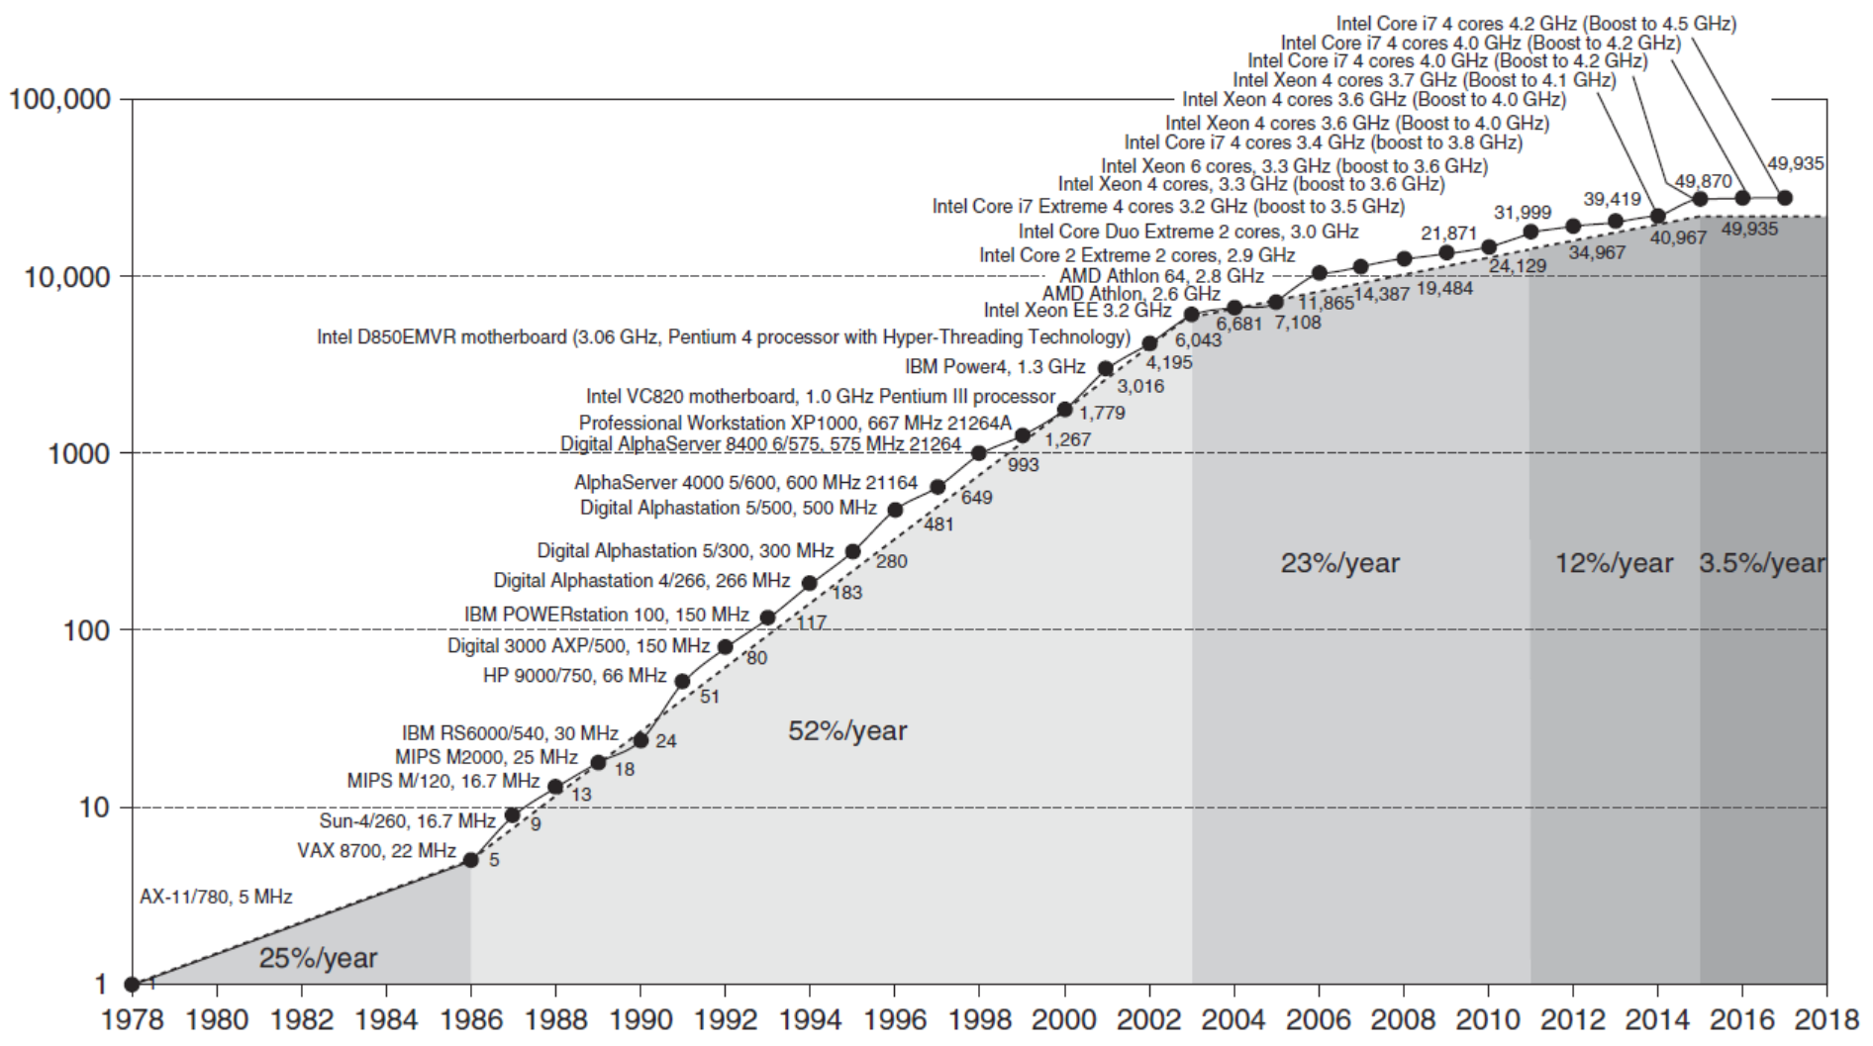
Growth in processor performance over 40 years
以VAX 11/780 的SPECint性能为基准，测试的是串行程序（多核系统里打开了自动并行化选项）
80年代中期以前，年平均增长22%（3.5年翻一番），主要由工艺技术驱动
86年后，增长率为52%（约2年翻一番），主要由于先进体系结构如RISC的采用
2003开始Dennard scaling失效，加上ILP有限，增长率又降至23%
2011 to 2015, 增长率降至12%, 即使用了多核，Amdahl定律的影响，并行性不够
2015后，Moore定律越来越慢，增长率降至3.5% （约20年翻一番）

Slide 34
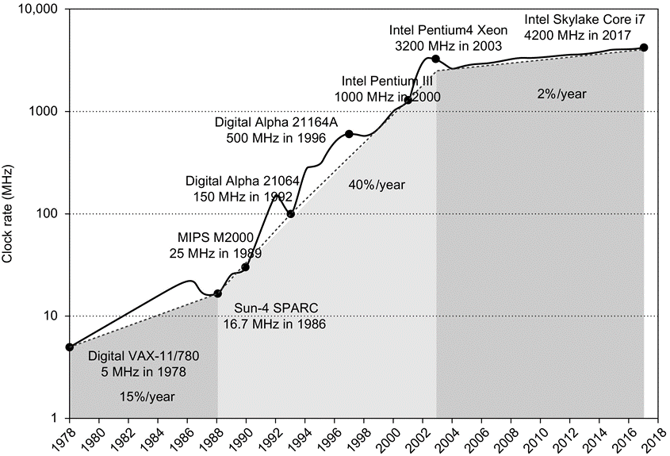
典型处理器时钟频率的变化
对比上一页的性能增长
时钟频率
主要跟工艺相关
也跟体系结构有关
当前处理器的时钟频率
桌面CPU最高
服务器CPU次高
GPU最低
跟算力性能恰恰相反
性能vs.应用
频率vs.功耗

Slide 35
Trends in Technology
Integrated circuit technology (Moore’s Law)
Transistor density: 35%/year
Die size: 10-20%/year
Integration overall: 40-55%/year
DRAM capacity: 25-40%/year (slowing)
8 Gb (2014), 16 Gb (2019), possibly no 32 Gb
Flash capacity: 50-60%/year
8-10X cheaper/bit than DRAM
Magnetic disk capacity: recently slowed to 5%/year
Density increases may no longer be possible, maybe increase from 7 to 9 platters
8-10X cheaper/bit then Flash
200-300X cheaper/bit than DRAM

Slide 36
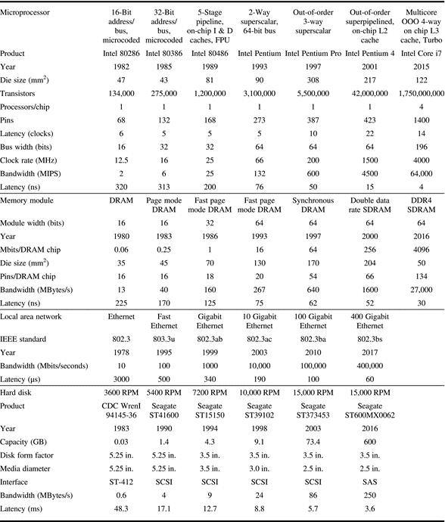
部分典型计算机 部件的性能指标

Slide 37
Transistors and Wires
Feature size
Minimum size of transistor or wire in x or y dimension
10 microns in 1971 to .011 microns in 2017
Transistor performance scales linearly
Wire delay does not improve with feature size!
Integration density scales quadratically
Moore’s Law: number of transistors integrated in a single die
Dennard observed in1974: voltage and current should be proportional to the linear dimensions of a transistor
So, as the size of the transistors shrunk, and the voltage was reduced, circuits could operate at higher frequencies at the same power
Dennard’s scaling ends at 0.13μm, stopped by threshold voltage
Two versions of Pentium 4

Slide 38
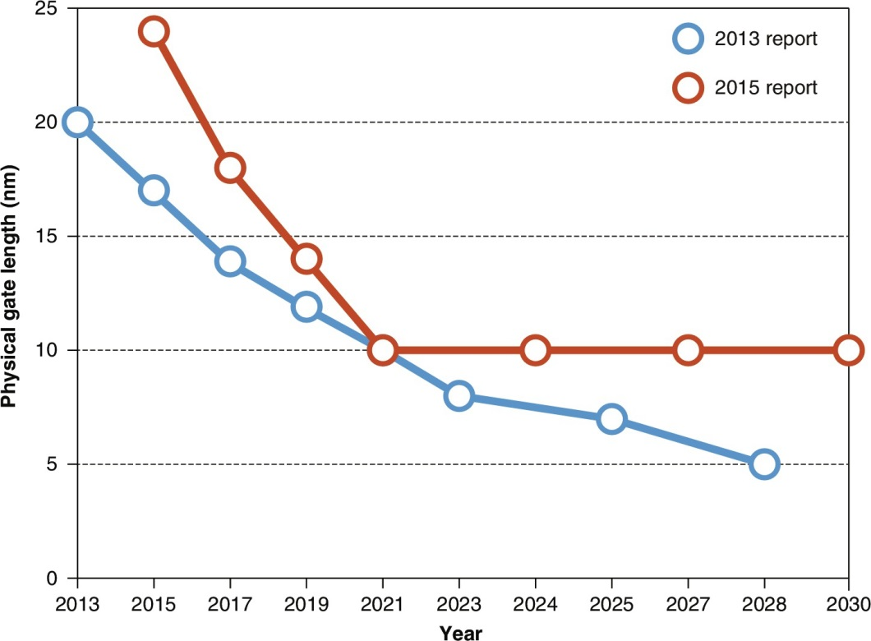
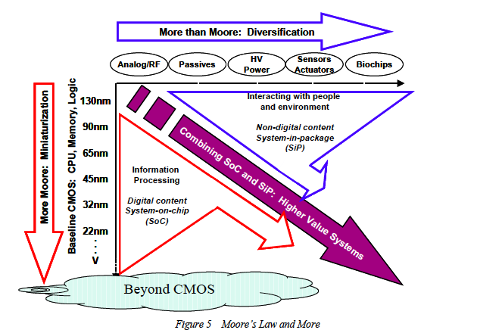
From ITRS to IRDSTM
ITRS: International Technology Roadmap for Semiconductors
具备先进制程的公司：GlobalFoundaries, Intel, Samsung, and TSMC
IRDS: International Roadmap for Devices and Systems™
一个IEEE的下属机构
Predictions of logic transistor dimensions from two editions of the ITRS report

Slide 39
半导体工艺与芯片设计成本
半导体工艺线的建设与开发成本
32/28纳米的工艺开发成本是12亿美元
22/20纳米的成本规模将增加30亿美元
14纳米的工艺开发成本已达100亿美元？！
台积电3nm生产线的建设成本，高达200亿美元
集成电路芯片的设计成本
32纳米节点所需的5000万至9000万美元
在14纳米节点后增加至1.2亿至5亿美元
芯片产品如何收回成本，实现盈利？
量特别大，或者，毛利率比较高

Slide 40
Computer Engineering Methodology
Technology
Trends

Slide 41
Computer Engineering Methodology
Evaluate Existing
Systems for
Bottlenecks
Benchmarks
Technology
Trends
Notes:
Where to start: existing systems bottlenecks

Slide 42
Computer Engineering Methodology
Evaluate Existing
Systems for
Bottlenecks
Benchmarks
Technology
Trends
Simulate New
Designs and
Organizations
Workloads

Slide 43
Computer Engineering Methodology
Evaluate Existing
Systems for
Bottlenecks
Implementation
Complexity
Benchmarks
Technology
Trends
Implement Next
Generation System
Simulate New
Designs and
Organizations
Workloads
Notes:
How hard to build
Importance of simplicity (wearing a seat belt); avoiding a personal disaster
Theory vs. practice

Slide 44
Current Trends in Architecture
Cannot continue to leverage Instruction-Level parallelism (ILP)
Single processor performance improvement ended in 2003
New models for performance:
Data-level parallelism (DLP)
Thread-level parallelism (TLP)
Request-level parallelism (RLP)
These require explicit restructuring of the application

Slide 45
Defining Computer Architecture
Architecture (ISA), Organization, Implementation
The structure of a computer that a machine language programmer must understand to write correct (timing independent) programs for that machine (Amdahl 1964) ==> Instruction Set Architecture
“Old” view of computer architecture:
Instruction Set Architecture (ISA) design
i.e. decisions regarding:
registers, memory addressing, addressing modes, instruction operands, available operations, control flow instructions, instruction encoding

Slide 46
Instruction Set Architecture
Memory addressing
RISC-V: byte addressed, aligned accesses faster
Addressing modes
RISC-V: Register, immediate, displacement (base+offset)
Other examples: autoincrement, indexed, PC-relative
Types and size of operands
RISC-V: 8-bit, 32-bit, 64-bit

Slide 47
Instruction Set Architecture
Operations
RISC-V: data transfer, arithmetic, logical, control, floating point
See Fig. 1.5 in text
Control flow instructions
Use content of registers (RISC-V) vs. status bits (x86, ARMv7, ARMv8)
Return address in register (RISC-V, ARMv7, ARMv8) vs. on stack (x86)
Encoding
Fixed (RISC-V, ARMv7/v8 except compact instruction set) vs. variable length (x86)

Slide 48
Defining Computer Architecture
“Real” computer architecture:
Specific requirements of the target machine
Design to maximize performance within constraints: cost, power, and availability
Includes ISA, microarchitecture, and hardware implementation
The structure of a computer that a machine language programmer must understand to write a best programs for that machine ==> New definition of Computer Architecture
Best: shortest execution time, lowest energy consumption, … …
Architectural Support for Programming Language and Operating Systems

Slide 49
体系结构：决定硬件与软件的分工
激进的结构（完全动态优化，aggressive CPU）
硬件试图做充分的动态优化, 如COMA
认为软件在动态分析和优化方面能力有限
导致硬件过分复杂、功耗过高
保守的结构（静态优化，GPU、NPU等）
硬件仅提供必需的设施, 如大量的寄存器/SRAM
高性能能否最终达到, 完全依赖软件
硬件简化、编程不便、性能没有保障
折衷的结构（动静态相结合的优化，普通CPU）
硬件做一些动态的优化, 如高速缓存
软件仍有优化的余地
软硬件协同解决性能和编程方面的问题
应用软件
高级语言
汇编语言层
操作系统层
BIOS层次
微程序机器
数据通路控制
功能部件
门电路、触发器
晶体管和连线
指令系统结构

Slide 50
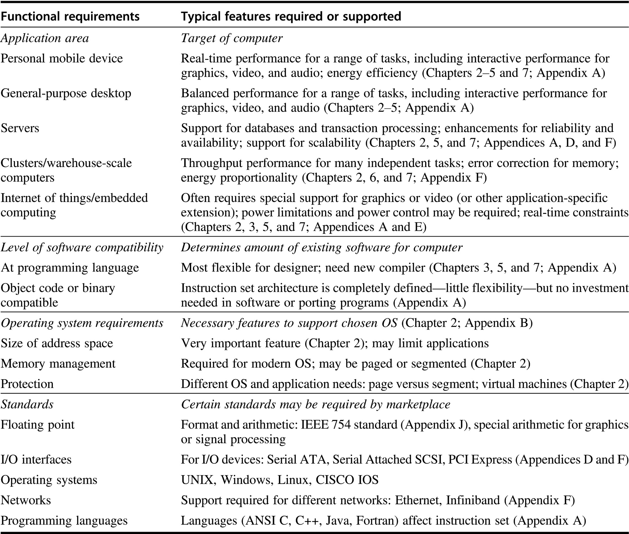
体系结构 设计者 面临的各种 功能需求

Slide 51
Measurement and Evaluation
Architecture is an iterative process:
Searching the space of possible designs
At all levels of computer systems
Creativity
Cost /
Performance
Analysis
Good Ideas
Mediocre Ideas
Bad Ideas

Slide 52
Measurement Tools
Benchmarks, Traces, Mixes
Hardware: Cost, delay, area, power estimation
Simulation (many levels)
ISA, RT, Gate, Circuit
Queuing Theory
Rules of Thumb
Fundamental Laws & Principles

Slide 53
Metrics of Performance
Application
Answers per month
Operations per second
Transactions per minute
Programming
Language
Compiler
Billions, Trillions
(millions) of Instructions per second: MIPS
(millions) of (FP) operations per second: MFLOP/s
ISA
Datapath
Transactions per second
Control
Megabytes per second
Function Units
Transistors
Wires
Pins
Cycles per second (clock rate)

Slide 54
Bandwidth and Latency
Bandwidth or throughput
Total work done in a given time
32,000-40,000X improvement for processors
300-1200X improvement for memory and disks
Latency or response time
Time between start and completion of an event
50-90X improvement for processors
6-8X improvement for memory and disks

Slide 55
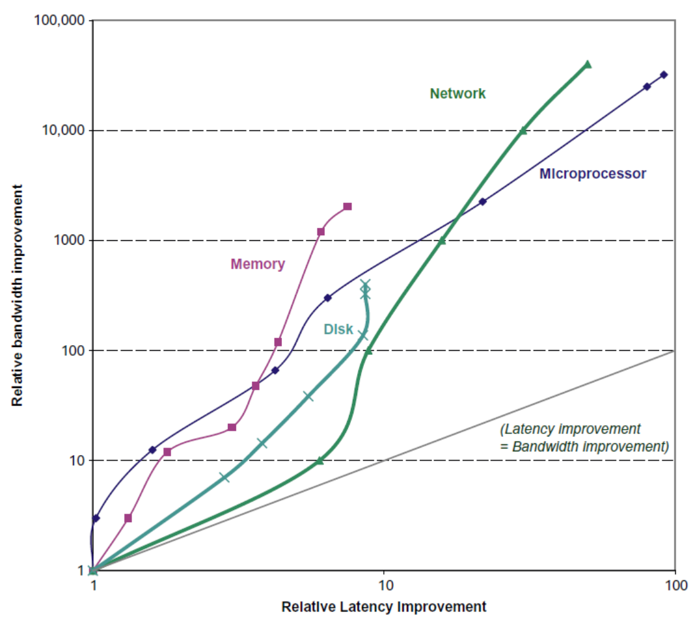
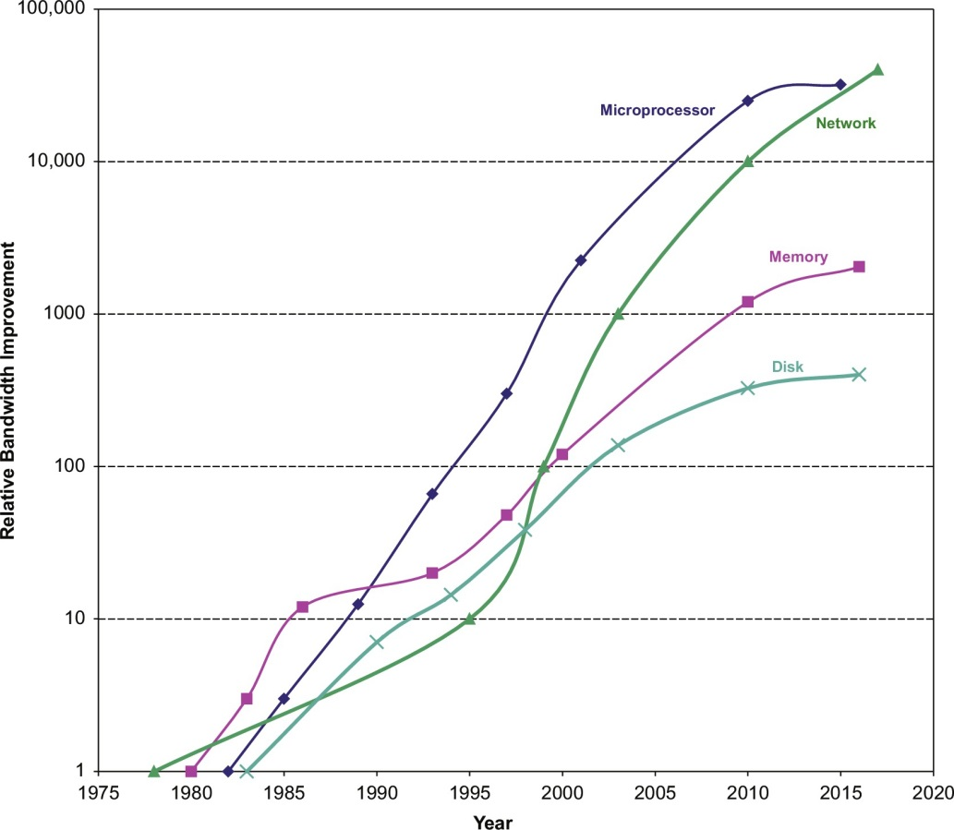
Bandwidth and Latency
Relative bandwidth improvement over time
Log-log plot of bandwidth and latency milestones： latency improved 8–91 ×, while bandwidth improved about 400–32,000 ×.

Slide 56
The Bottom Line: Performance (and Cost)
Plane
DC to Paris
Speed
Passengers
Throughput (pmph)
Boeing 747
6.5 hours
610 mph
470
286,700
BAD/Sud Concodre
3 hours
1350 mph
132
178,200
Time to run the task (ExTime)
Execution time, response time, latency
Tasks per day, hour, week, sec, ns ?(Performance)
Throughput, bandwidth
Notes:
Fastest for 1 person?
Which takes less time to transport 470 passengers?

Slide 57
The Bottom Line: Performance (and Cost)
"X is n times faster than Y" means
ExTime(Y) Performance(X)
--------- = ---------------
ExTime(X) Performance(Y)
Speed of Concorde vs. Boeing 747
Throughput of Boeing 747 vs. Concorde
Notes:
1350 / 610 = 2.2X
286,700/ 178,200 1.6X

Slide 58

Principles of Computer Design
Take Advantage of Parallelism
e.g. multiple processors, disks, memory banks, pipelining, multiple functional units
Principle of Locality
Reuse of data and instructions
Focus on the Common Case
Amdahl’s Law：改进某个部件所产生的效益，取决于该部件的使用频度

Slide 59
Amdahl's Law
Speedup due to enhancement E:
Speedup(E) =
ExTime w/o E Performance w/ E
------------- = -------------------
ExTime w/ E Performance w/o E
Suppose that enhancement E accelerates a fraction F of the task by a factor S, and the remainder of the task is unaffected

Slide 60
Amdahl’s Law
Floating point instructions improved to run 2X; but only 10% of actual instructions are FP
ExTime_{new} =
Speedup_{overall}
=

Slide 61
Amdahl’s Law
Floating point instructions improved to run 2X; but only 10% of actual instructions are FP
Make the most common case Fast!
ExTime_{new} = ExTime_{old} x (0.9 + .1/2) = 0.95 x ExTime_{old}
1
Speedup_{overall}
=
=
1.053
0.95

Slide 62


Principles of Computer Design
The Processor Performance Equation

Slide 63


Principles of Computer Design
Different instruction types have different CPIs
Different programs may have different CPIs too
Suppose there are totally n instructions in the ISA

Slide 64
Aspects of CPU Performance
CPU time = Seconds = Instructions x Cycles x Seconds
Program Program Instruction Cycle
Inst Count CPI Clock Rate
Program X
Compiler X (X)
Inst. Set. X X
Organization X X
Technology X

Slide 65
Cycles Per Instruction
Average Cycles per Instruction
CPI = (CPU Time * Clock Rate) / Instruction Count
= Cycles / Instruction Count
n
CPU time = CycleTime * Σ CPI * I
RISC的缘起
i
i
i = 1
Instruction Frequency
n
CPI = Σ CPI * F where F = I
i
i
i
i
i = 1
Instruction Count
Invest Resources where time is Spent!

Slide 66
Example: Calculating CPI
Base Machine (Reg / Reg)
Op Freq Cycles CPI(i) (% Time)
ALU 50% 1 .5 (33%)
Load 20% 2 .4 (27%)
Store 10% 2 .2 (13%)
Branch 20% 2 .4 (27%)
1.5
Typical Mix

Slide 67
Measuring Performance
Typical performance metrics:
Response time
Throughput
Speedup of X relative to Y
Execution time_{Y} / Execution time_{X}
Execution time
Wall clock time: includes all system overheads
CPU time: only computation time
Benchmarks
Kernels (e.g. matrix multiply)
Toy programs (e.g. sorting)
Synthetic benchmarks (e.g. Dhrystone)
Benchmark suites (e.g. SPEC06fp, TPC-C)

Slide 68
SPEC: System Performance Evaluation Cooperative
First Round 1989
10 programs yielding a single number (SPECmarks)
Second Round 1992
SPECInt92 (6 integer programs) and SPECfp92 (14 floating point programs)
Compiler Flags unlimited. March 93 of DEC 4000 Model 610:
spice: unix.c:/def=(sysv,has_bcopy,bcopy(a,b,c)= memcpy(b,a,c)
wave5: /ali=(all,dcom=nat)/ag=a/ur=4/ur=200
nasa7: /norecu/ag=a/ur=4/ur2=200/lc=blas
Third Round 1995
new set of programs: SPECint95 (8 integer programs) and SPECfp95 (10 floating point)
Benchmarks useful for 3 years
Single flag setting for all programs: SPECint_base95, SPECfp_base95

Slide 69
SPEC: System Performance Evaluation Cooperative
Fourth Round 2000: SPEC CPU2000
12 Integer
14 Floating Point
2 choices on compilation; “aggressive” (SPECint2000,SPECfp2000), “conservative” (SPECint_base2000,SPECfp_base); flags same for all programs, no more than 4 flags, same compiler for conservative, can change for aggressive
multiple data sets so that can train compiler if trying to collect data for input to compiler to improve optimization

Slide 70
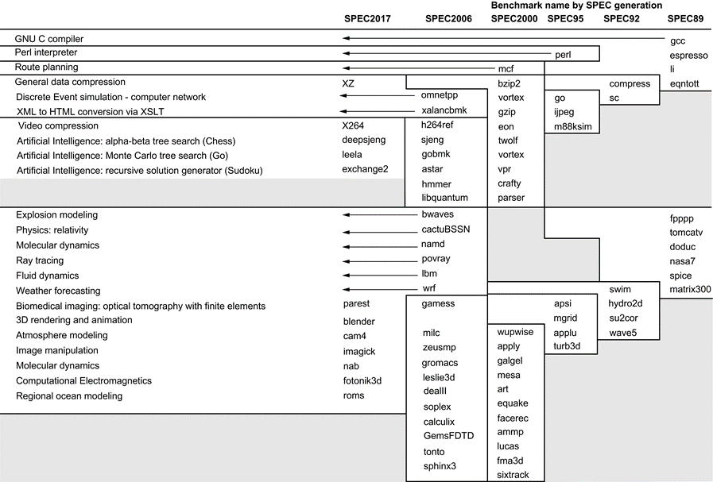
Evolution of SPEC CPU Benchmark
10 SPEC2017 integer programs,
5 are written in C, 4 in C++., and 1 in Fortran
13 floating-point programs,
3 in Fortran, 2 in C++, 2 in C, and 6 in mixed C, C++, and Fortran.
6代基准共82个程序
Gcc is the senior citizen of the group.
Only 3 integer programs and 3 floating-point programs survived three or more generations.
Although a few are carried over from generation to generation, the version of the program changes and either the input or the size of the benchmark is often expanded to increase its running time and to avoid perturbation in measurement or domination of the execution time by some factor other than CPU time.
Integer
Floating-Point

Slide 71
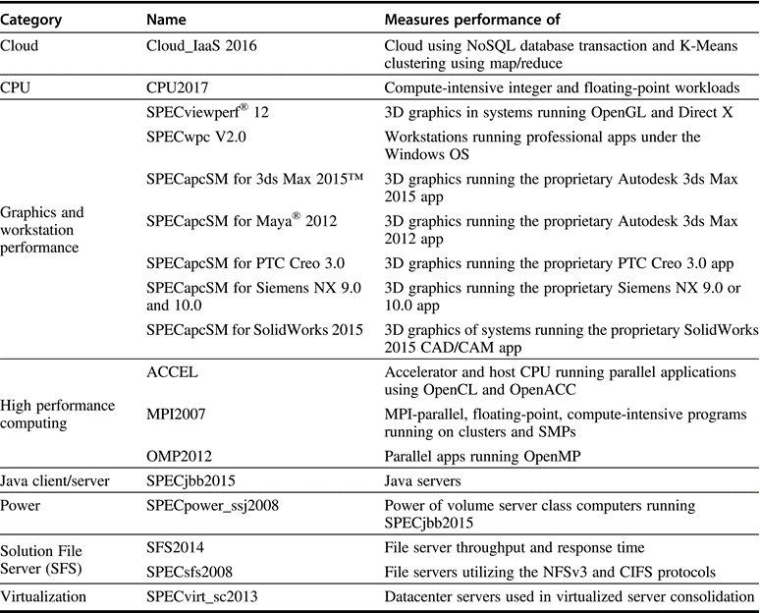
其它SPEC基准程序

Slide 72
How to Summarize Performance
Arithmetic mean (weighted arithmetic mean) tracks execution time: Σ(Ti)/n or Σ(Wi*Ti)
Harmonic mean (weighted harmonic mean) of rates (e.g., MFLOPS) tracks execution time: n/Σ(1/Ri) or n/Σ(Wi/Ri)
Normalized execution time is handy for scaling performance (e.g., X times faster than SPARCstation 10)
But do not take the arithmetic mean of normalized execution time, use the geometric mean: ( Π Tj / Nj )^{1/n}
几何平均值的难点：一个程序算不出结果，总性能就是零！

Slide 73
SPEC First Round
One program: 99% of time in single line of code
New front-end compiler could improve dramatically

Slide 74
Impact of Means on SPECmark89 for IBM 550
Ratio to VAX: Time: Weighted Time:
Program Before After Before After Before After
gcc 30 29 49 51 8.91 9.22
espresso 35 34 65 67 7.64 7.86
spice 47 47 510 510 5.69 5.69
doduc 46 49 41 38 5.81 5.45
nasa7 78 144 258 140 3.43 1.86
li 34 34 183 183 7.86 7.86
eqntott 40 40 28 28 6.68 6.68
matrix300 78 730 58 6 3.43 0.37
fpppp 90 87 34 35 2.97 3.07
tomcatv 33 138 20 19 2.01 1.94
Mean 54 72 124 108 54.42 49.99
Geometric Arithmetic Weighted Arith
Ratio 1.33 Ratio 1.16 Ratio 1.09

Slide 75
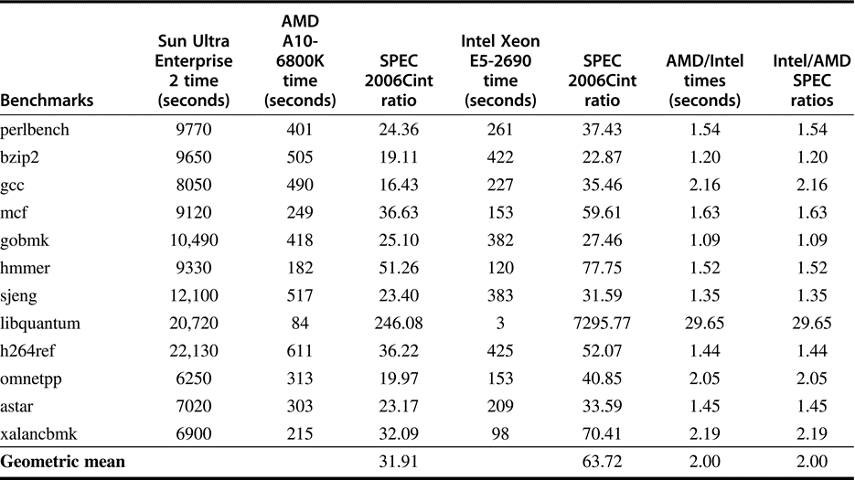
SPEC2006Cint execution times
参考机：Sun Ultra 5
评测机：AMD A10 and Intel Xeon E5-2690
当对比两台机器时，可以直接把它们的执行时间相除，再算出几何平均值
与参考机无关

Slide 76
Performance Evaluation
Better or worse, benchmarks shape a field
Good products created when have:
Good benchmarks
Good ways to summarize performance
If benchmarks/summary inadequate, then choose between improving product for real programs vs. improving product to get more sales; Sales almost always wins!
Execution time is the measure of computer performance!

Slide 77
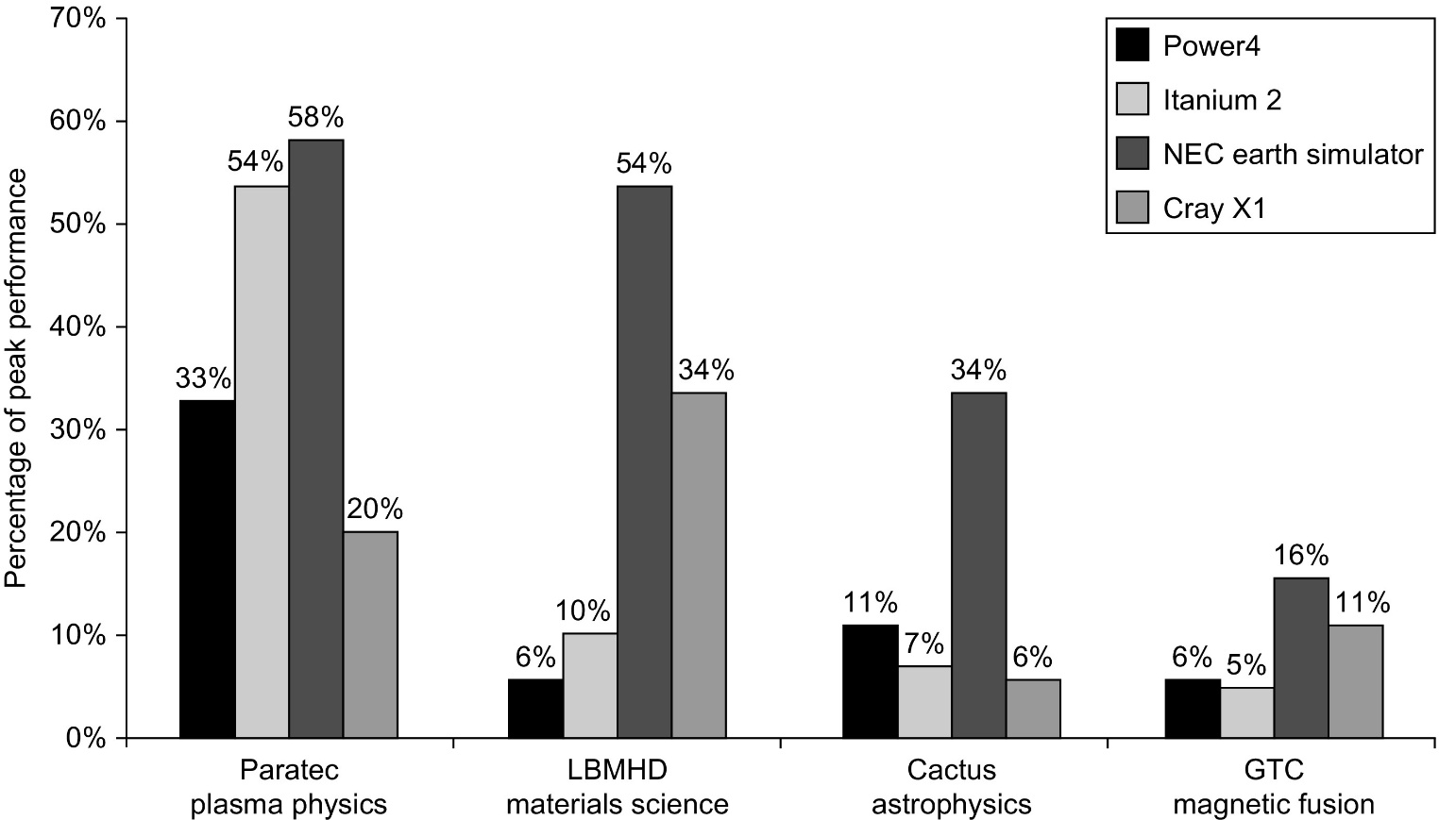
Gaps between Peak with Real Performance
4 multiprocessors scaled to 64 processors
The Earth Simulator and Cray X1 are vector processors. Not only did they deliver a higher fraction of peak performance, but they also had the highest peak performance and the lowest clock rates
Except for the Paratec program, the Power 4 and Itanium 2 systems delivered between 5% and 10% of their peak.

Slide 78
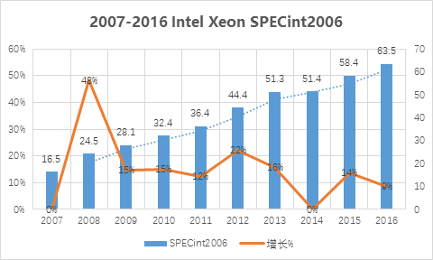
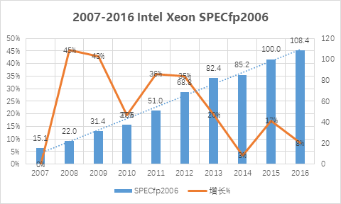
研究与工程的不同方向
2000年以后，提高单核性能已不再是学术界的研究热点
2005年，计算所的973项目，开始把方向转到众核
但单核性能提高，仍是工程师们的努力方向

Slide 79
观察到的一些现象
十年之间，单核定点性能4X，单核浮点性能7X
CPU的主频没有提高（虽然工艺在不断改进），所以性能的改进主要归功于微架构的改进
有了多核，为什么仍要改进单核？
发挥多核性能，需要把串行程序改成并行程序
易改，且效率不打折扣
能改，但效率要打折扣，串行程序自动并行化的效果不尽如意
老旧的应用、无源码的应用，基本上改不了
大量企业关键应用，按CPU核数计算License数量
如Oracle数据库、SAP（ERP软件）、EDA工具等
单核性能差一倍，为了达到同样效能，购买License数量就要翻一番，成本太高

Slide 80
为什么对单核的改进主要在企业中进行？
原理和方法上的创新点相对少一些，不容易写Paper
多级高速缓存
动态多发射和乱序执行
动态分支预测、猜测执行
稳定、精确、可预测的性能模型、方法、工具
基于大量真实工作负荷的测量和分析（耗时）
RTL级的快速原型装置（昂贵）
一批有经验的微架构、逻辑设计及物理设计工程师
大学和科研机构的评价标准不同，难以支持

Slide 81
Trends in Cost
Cost driven down by learning curve
Yield improves with time
DRAM: price closely tracks cost
Microprocessors: price depends on volume
10% less for each doubling of volume

Slide 82
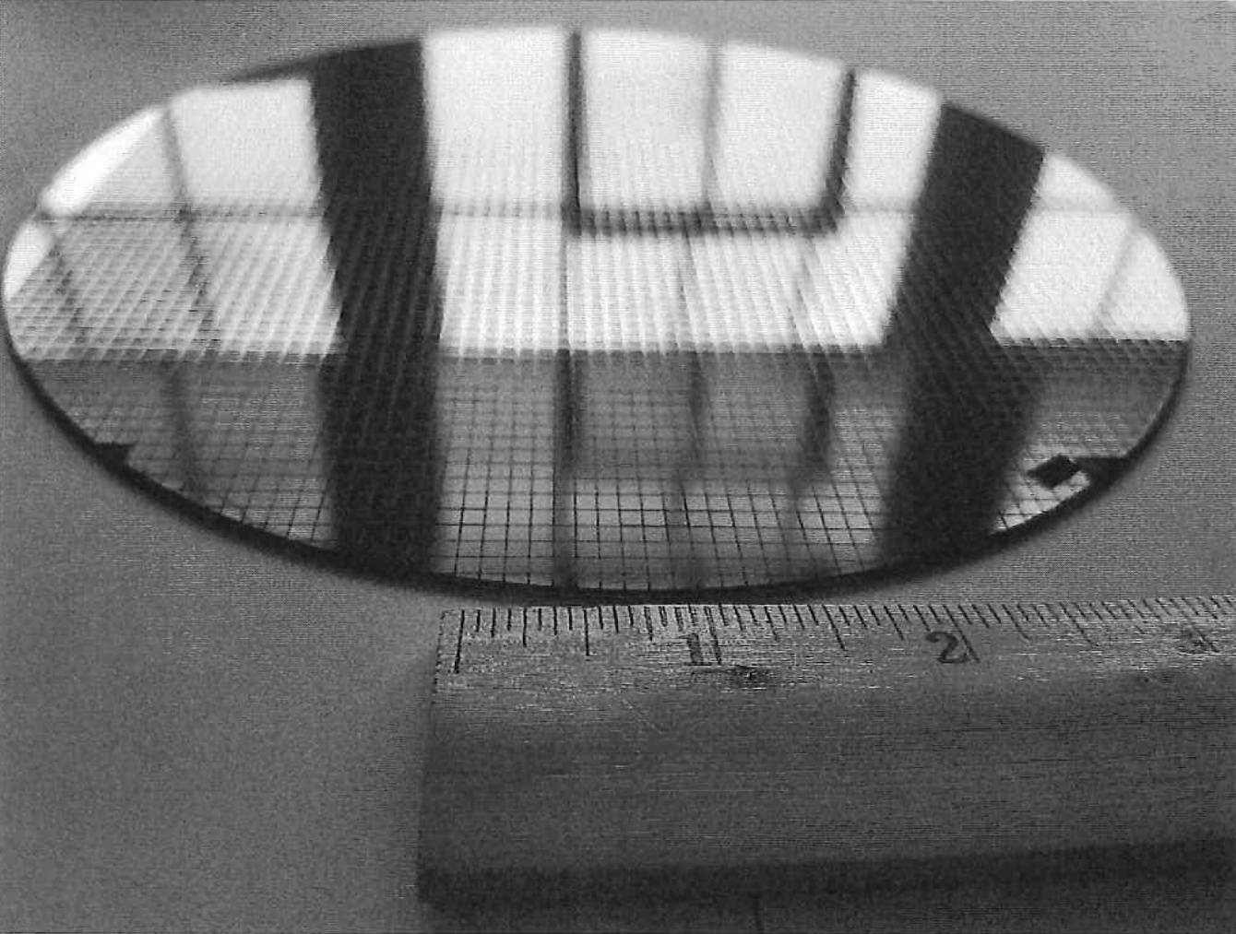
Wafer和die的例子
This 200 mm diameter wafer of RISC-V dies was designed by SiFive
It has two types of RISC-V dies using an older, larger processing line
An FE310 die is 2.65 mm × 2.72 mm
An SiFive test die that is 2.89 mm × 2.72 mm.
The wafer contains 1846 FE310 dies, and 1866 test dies
totaling 3712 chips

Slide 83
Integrated Circuits Costs
Die Cost goes roughly with die area⁴

Slide 84

Integrated Circuit Cost
Integrated circuit
Bose-Einstein formula:
Defects per unit area = 0.016-0.057 defects per square cm (2010)
N = process-complexity factor = 11.5-15.5 (40 nm, 2010)

Slide 85
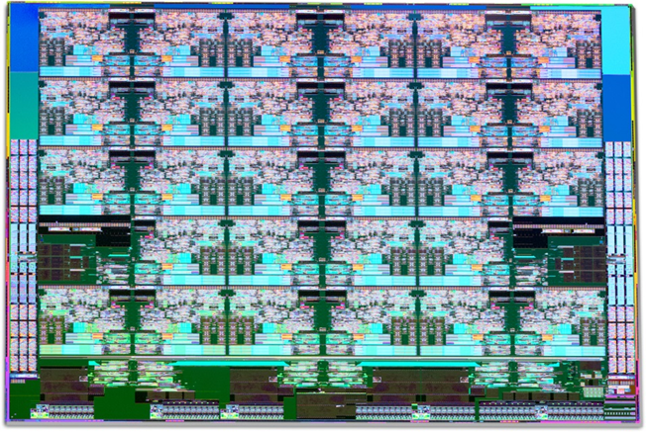
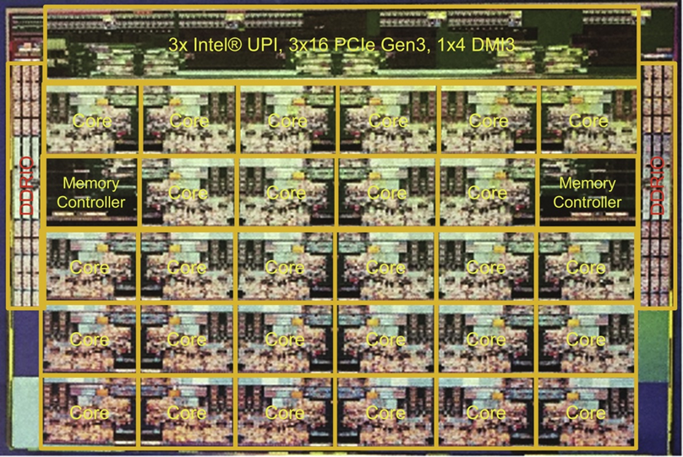
Photograph of an Intel Skylake microprocessor die

Slide 86
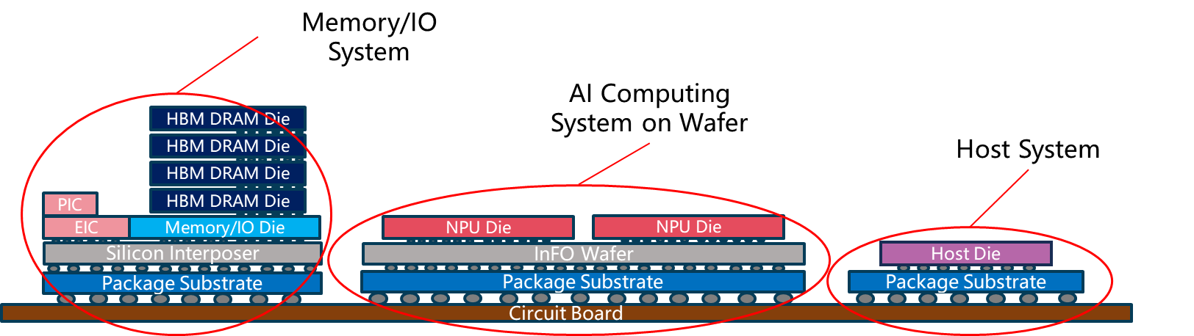
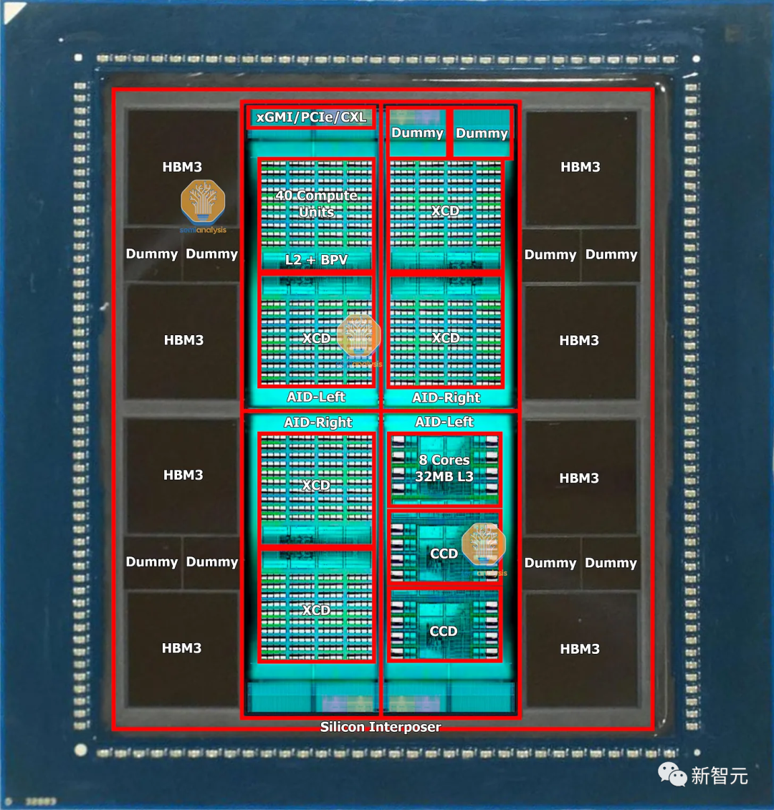
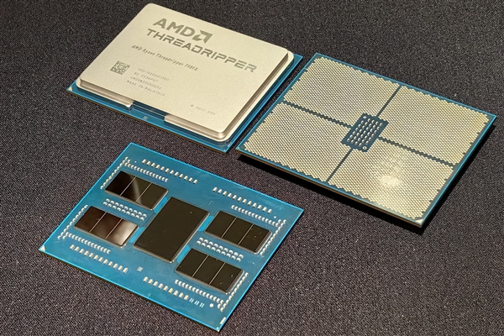
采用先进封装，芯片成本构成更为复杂

Slide 87
Real World Examples
Chip Metal Line Wafer Defect Area Dies/ Yield Die Cost layers width cost /cm² mm² wafer
386DX 2 0.90 $900 1.0 43 360 71% $4
486DX2 3 0.80 $1200 1.0 81 181 54% $12
PowerPC 601 4 0.80 $1700 1.3 121 115 28% $53
HP PA 7100 3 0.80 $1300 1.0 196 66 27% $73
DEC Alpha 3 0.70 $1500 1.2 234 53 19% $149
SuperSPARC 3 0.70 $1700 1.6 256 48 13% $272
Pentium 3 0.80 $1500 1.5 296 40 9% $417
From "Estimating IC Manufacturing Costs,” by Linley Gwennap, Microprocessor Report, August 2, 1993, p. 15

Slide 88
Cost/Performance What is Relationship of Cost to Price?
Component Costs
Direct Costs (add 25% to 40%) recurring costs: labor, purchasing, scrap, warranty
Gross Margin (add 82% to 186%) nonrecurring costs: R&D, marketing, sales, equipment maintenance, rental, financing cost, pretax profits, taxes
Average Discount to get List Price (add 33% to 66%): volume discounts and/or retailer markup
List Price
Average
Discount
25% to 40%
Avg. Selling Price
Gross
Margin
34% to 39%
Direct Cost
6% to 8%
Component
Cost
15% to 33%

Slide 89
Chip Prices (August 1993)
Assume purchase 10,000 units
Chip Area Mfg. Price Multi- Comment
mm² cost plier
386DX 43 $9 $31 3.4 Intense Competition
486DX2 81 $35 $245 7.0 No Competition
PowerPC 601 121 $77 $280 3.6
DEC Alpha 234 $202 $1231 6.1 Recoup R&D?
Pentium 296 $473 $965 2.0 Early in shipments

Slide 90
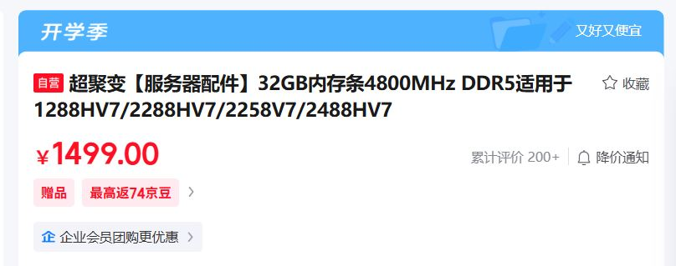

Summary: Price vs. Cost

Slide 91
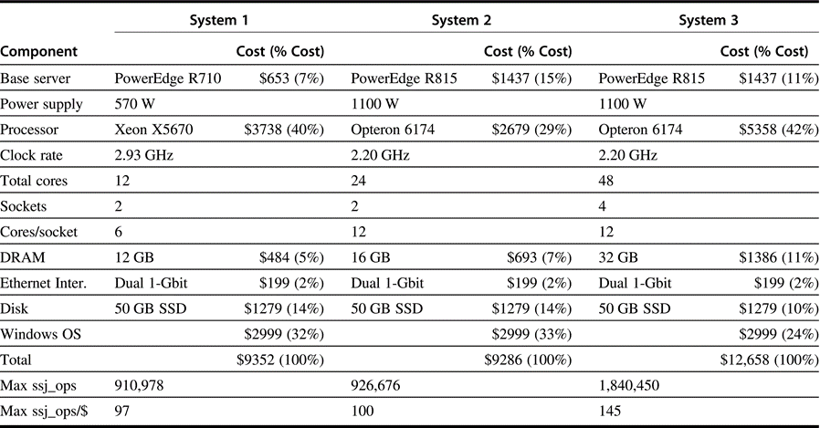
三台DELL服务器的性能和价格

Slide 92
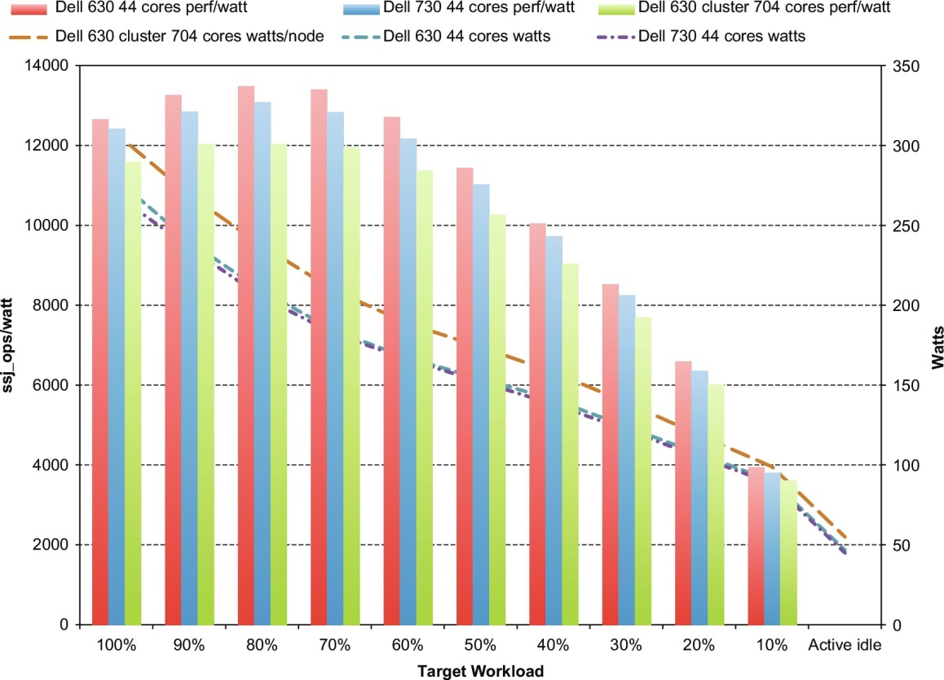
三台DELL服务器的性能功耗比
SPECpower_ssj2008 is the first industry-standard benchmark for measuring both the performance and the power consumption of servers (SSJ: Server Side Java SSJ)
An SSJ run consists of two main phases:
The calibration phase is used to determine the maximum throughput that a system is capable of sustaining.
Once this calibrated throughput is established, the system runs at a series of target loads. Each load runs at some percentage of the calibrated throughput.
Ssj_ops: the number of operations finished during this measurement interval divided by the number of seconds defined for this interval, showing the throughput (workload operations per second) for this period.
Ssj_ops/watt values are on the left axis, with the three columns associated with it, and watts are on the right axis, with the three lines associated with it. The horizontal axis shows the target workload, as it varies from 100% to Active Idle. The single node R630 has the best ssj_ops/watt at each workload level, but R730 consumes the lowest power at each level.

Slide 93
Power and Energy
Problem: Get power in, get power out
Thermal Design Power (TDP)
Characterizes sustained power consumption
Used as target for power supply and cooling system
Lower than peak power (1.5X higher), higher than average power consumption
Clock rate can be reduced dynamically to limit power consumption
Energy per task is often a better measurement

Slide 94
Dynamic Energy and Power
Dynamic energy
Transistor switch from 0 -> 1 or 1 -> 0
½ x Capacitive load x Voltage²
Dynamic power
½ x Capacitive load x Voltage² x Frequency switched
Reducing clock rate reduces power, not energy

Slide 95
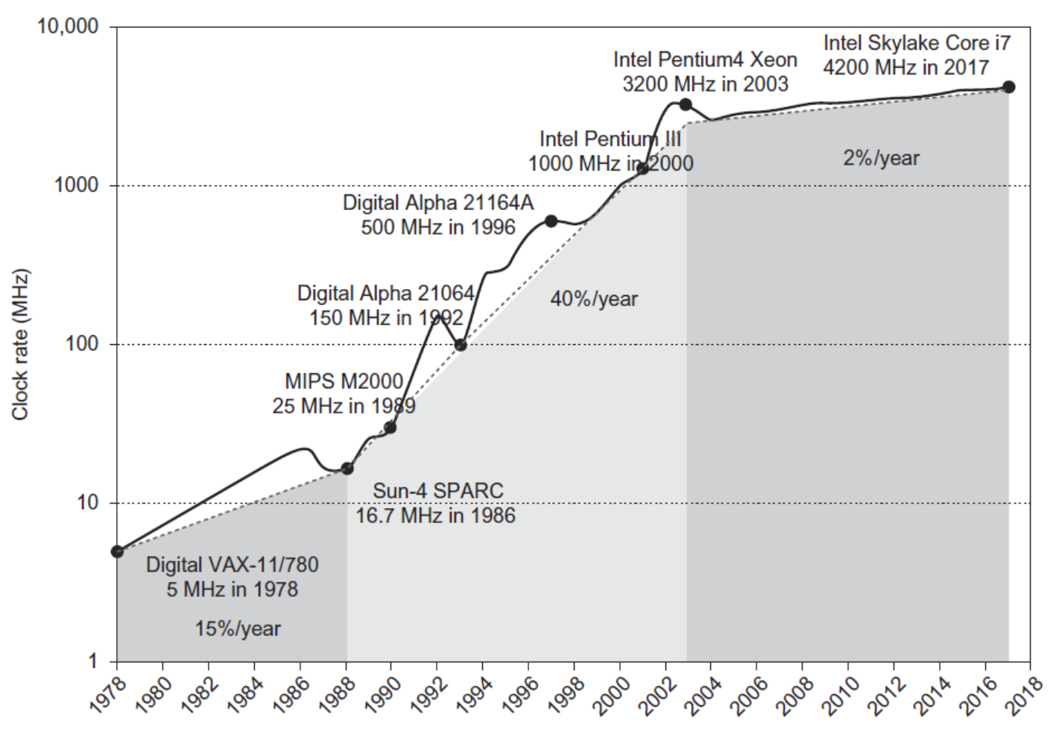
Power
Intel 80386 consumed ~ 2 W
3.3 GHz Intel Core i7 consumes 130 W
Heat must be dissipated from 1.5 x 1.5 cm chip
This is the limit of what can be cooled by air

Slide 96
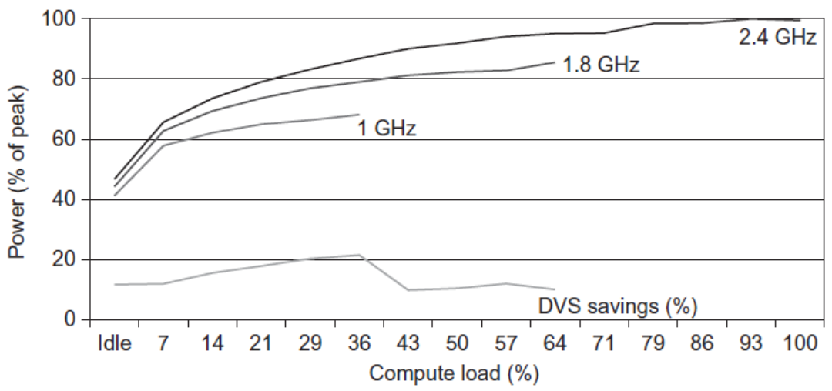
Techniques for Reducing Power
Do nothing well, or Clock Gating
Dynamic Voltage-Frequency Scaling (DVFS, AVFS)
Energy savings for a server using an AMD Opteron CPU, 8 GB of DRAM, and 1 ATA disk
At 1.8 GHz, the server can handle at most up to two-thirds of the workload without causing service- level violations
At 1 GHz, it can safely handle only one-third of the workload
Low power state for DRAM, disks
Overclocking some cores (Turbo mode), and turning off other cores

Slide 97
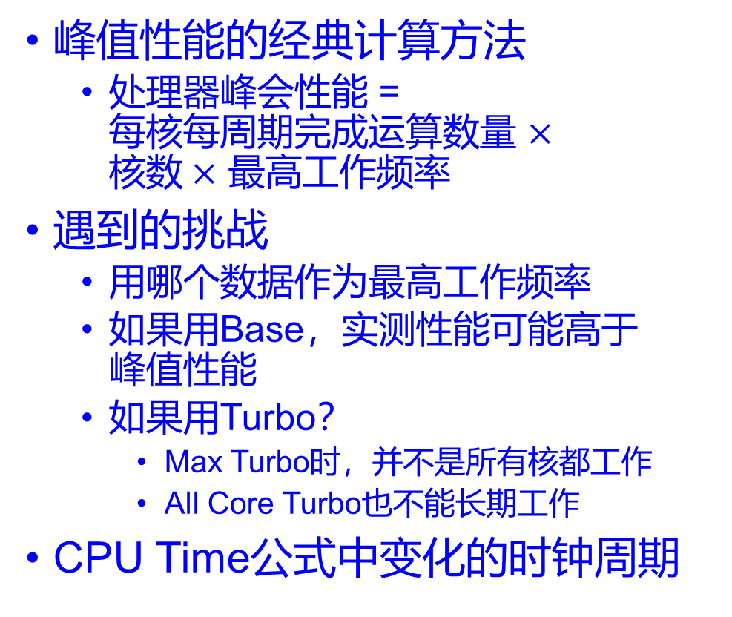
动态功耗控制带来的性能分析难题
峰值性能的经典计算方法
处理器峰会性能 = 每核每周期完成运算数量 $×$ 核数$×$ 最高工作频率
遇到的挑战
用哪个数据作为最高工作频率
如果用Base，实测性能可能高于 峰值性能
如果用Turbo？
Max Turbo时，并不是所有核都工作
All Core Turbo也不能长期工作
CPU Time公式中变化的时钟周期
Intel® Xeon® 6 Server Processor Specification
Total Cores | 32
Total Threads | 64
Max Turbo Frequency | 4.3 GHz
All Core Turbo Frequency | 4.2 GHz
Processor Base Frequency | 3.8 GHz
Cache | 144 MB
Intel® UPI Speed | 24 GT/s
Max # of UPI Links | 4
TDP | 350 W

Slide 98
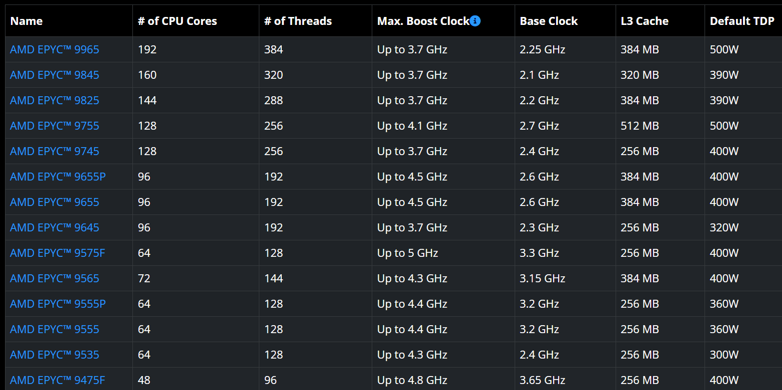
AMD Zen 5 Server Processors

Slide 99
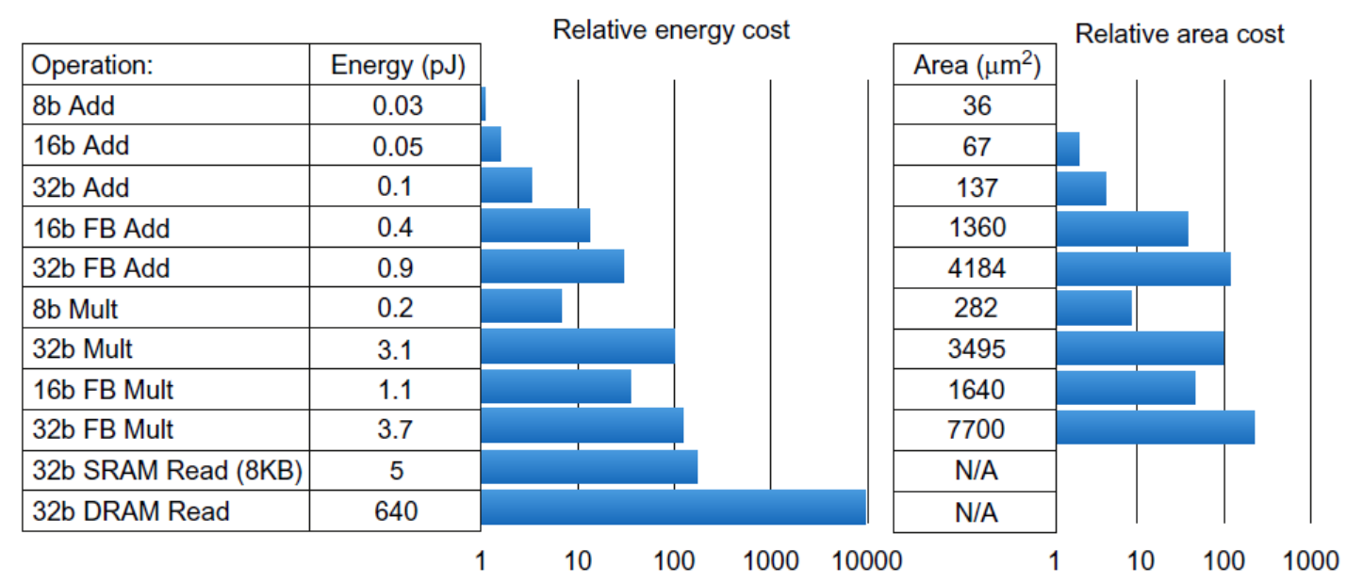
Static Power
Static power consumption
25-50% of total power; to reduce: power gating
Current_{static} x Voltage, scales with number of transistors
Comparison of the energy and die area of arithmetic operations and energy cost of accesses to SRAM and DRAM
Area is for TSMC 45 nm technology node.

Slide 100
Dependability
开始使用 首次失效 修复 再次失效 修复
MTTF MTTR MTBF MTTR
Module reliability
Mean time to failure (MTTF)
Mean time to repair (MTTR)
Mean time between failures (MTBF) = MTTF + MTTR
Availability = MTTF / MTBF
Terminology
Reliability vs. dependability; safety vs. security
Fault 故障, error 差错, and failure 失效
Fault-tolerant computing, trusted computing, dependable computing

Slide 101
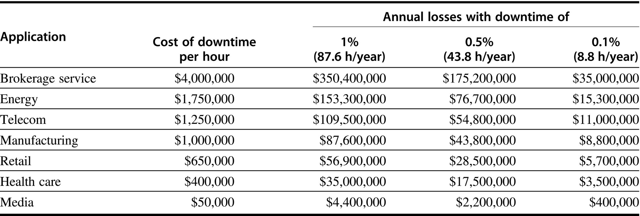
系统不可靠带来的影响
Figure 1.3 Costs rounded to nearest $100,000 of an unavailable system are shown by analyzing the cost of downtime (in terms of immediately lost revenue), assuming three different levels of availability, and that downtime is distributed uniformly. These data are from Landstrom (2014) and were collected and analyzed by Contingency Planning Research.

Slide 102
Summary
Amdahl’s Law:
CPI Law:
Execution time is the real measure of computer performance!
Good products created when have:
Good benchmarks, good ways to summarize performance
Die Cost goes roughly with die area⁴
1
ExTime_{old}
ExTime_{new}
Speedup_{overall} =
=
(1 - Fraction_{enhanced}) + Fraction_{enhanced}
Speedup_{enhanced}
CPU time = Seconds = Instructions x Cycles x Seconds
Program Program Instruction Cycle

