Slide 1
指令系统结构（ISA）
指令系统结构的定义和分类
访问存储器的方式
数据类型和大小
控制转移类指令
指令格式和编码
编译器和指令系统的关系
RISC-V指令系统概述

Slide 2
Computer Organization
All computers consist of five components
Processor: (1) datapath（运算器） and (2) control （控制器）
(3) Memory
(4) Input devices and (5) Output devices
Not all Memory are created equal
Cache: fast (expensive) memory are placed closer to the processor
Main memory: less expensive memory--we can have more
Input and output (I/O) devices have the messiest organization
Wide range of speed: graphics vs. keyboard
Wide range of requirements: speed, standard, cost ...
Least amount of research (so far)
Notes:
Let me summarize what I have said so far.
The most important thing I want you to remember is that: all computers, no matter how complicated or expensive, can be divided into five components:
(1) The datapath and (2) control that make up the processor.
(3) The memory system that supplies data to the processor.
And last but not least, the (4) input and (5) output devices that get data in and out of the computer.
One thing about memory is that Not all 搈emory?are created equally.
Some memory are faster but more expensive and we place them closer to the processor and call them 揷ache.
The main memory can be slower than the cache so we usually use less expensive parts so we can have more of them.
Finally as you can see from the last few slides, the input and output devices usually has the messiest organization. There are several reasons for it:
(1) First of all, I/O devices can have a wide range of speed.
(2) Then I/O devices also have a wide range of requirements.
(s) Finally to make matters worse, historically I/O has attracted the least amount of research interest. But hopefully this is changing.
In this class, you will learn about all these five components and we will try to make this as enjoyable as possible. So have fun.

Slide 3
Computer System Components
Proc
Caches
Busses
adapters
Memory
Controllers
Disks
Displays
Keyboards
I/O Devices:
Networks
All have interfaces & organizations

Slide 4
Computer Architecture Is
the attributes of a [computing] system as seen by the programmer, i.e., the conceptual structure and functional behavior, as distinct from the organization of the data flows and controls the logic design, and the physical implementation.
Amdahl, Blaaw, and Brooks, 1964
时值IBM正式发布System/360
在此之前，IBM的计算机产品有5个不同的ISA
The System/360 unified a family of computers under a single architecture
System/360有6个不同的型号
For the first time, software written for one machine could run on any other machine in the line （系列机、软件兼容性）
SOFTWARE

Slide 5
Computer Architecture’s Changing Definition
1950s to 1960s: Computer Architecture Course Computer Arithmetic
1970s to mid 1980s: Computer Architecture Course Instruction Set Design, especially ISA appropriate for compilers
1990s: Computer Architecture Course Design of CPU, memory system, I/O system, Multiprocessors

Slide 6
Instruction Set Architecture (ISA)
传统的计算机体系结构，即ISA
software
instruction set
hardware

Slide 7
Interface Design
A good interface:
Lasts through many implementations (portability, compatibility)
Is used in many different ways (generality)
Provides convenient functionality to higher levels
Permits an efficient implementation at lower levels
use
imp 1
time
Interface
use
imp 2
use
imp 3

Slide 8
Instruction Set Architecture
Instruction
Fetch
Instruction Format or Encoding, how to decode
Location of operands and result
Where other than memory, how many explicit operands?
How are memory operands located?
Data type and Size of Operands
What kinds of Operations are supported
How to determine the successive instruction
jumps, conditions, branches, call/returns
Other Programmer Visible Machine Status
Program Status Word (PSW), Other special registers (Flags)
Performance counters, System registers (e.g., page size)
Instruction
Decode
Operand
Fetch
Execute
Result
Store
Next
Instruction

Slide 9
Evolution of Instruction Sets
Single Accumulator (EDSAC 1950)
Accumulator + Index Registers
(Manchester Mark I, IBM 700 series 1953)
Separation of Programming Model
from Implementation
High-level Language Based
Concept of a Family
(B5000 1963)
(IBM 360 1964)
General Purpose Register Machines
Complex Instruction Sets
Load/Store Architecture
(Vax, Intel 432 1977-80)
(CDC 6600, Cray 1 1963-76)
RISC
(Mips,Sparc,HP-PA,IBM RS6000, . . .1987)

Slide 10
Evolution of Instruction Sets
Major advances in computer architecture are typically associated with landmark instruction set designs
Ex: Stack vs GPR (System 360)
Design decisions must take into account:
technology
machine organization
programming langauges
compiler technology
operating systems
And they in turn influence these

Slide 11
A "Typical" RISC
32-bit fixed format instruction (3 formats)
32 32-bit GPR (R0 contains zero, DP take pair)
3-address, reg-reg arithmetic instruction
Single address mode for load/store: base + displacement
no indirection
Simple branch conditions
Delayed branch
see: SPARC, MIPS, HP PA-Risc, DEC Alpha, IBM PowerPC,
CDC 6600, CDC 7600, Cray-1, Cray-2, Cray-3

Slide 12
Example: MIPS
Register-Register
31
26
25
21
20
16
15
11
10
6
5
0
Op
Rs1
Rs2
Rd
Opx
Register-Immediate
31
26
25
21
20
16
15
0
Op
Rs1
Rd
immediate
Branch
31
26
25
21
20
16
15
0
Op
Rs1
Rs2/Opx
immediate
Jump / Call
31
26
25
0
Op
target

Slide 13
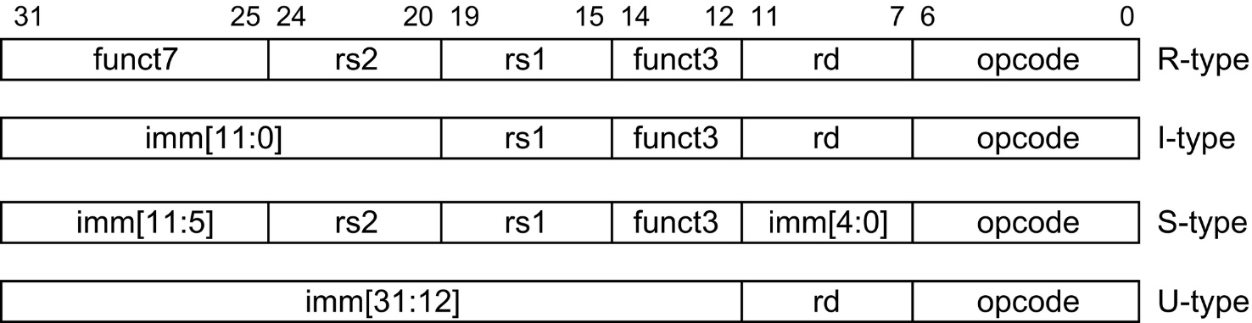
Example: RISC-V

Slide 14
Basic ISA Classes
Accumulator (1 register):
1 address add A acc = acc + mem[A]
1+x address addx A acc = acc + mem[A + x]
Stack:
0 address add tos = tos + next
General Purpose Register:
2 address add A B EA(A) = EA(A) + EA(B)
3 address add A B C EA(A) = EA(B) + EA(C)
Load/Store:
3 address add Ra Rb Rc Ra = Rb + Rc
load Ra Rb Ra = mem[Rb]
store Ra Rb mem[Rb] = Ra
Comparison:
Bytes per instruction? Number of Instructions? Cycles per instruction?
Notes:
Invented index register
Reverse polish stack = HP calculator
GPR = last 20 years
L/S variant = last 10 years

Slide 15
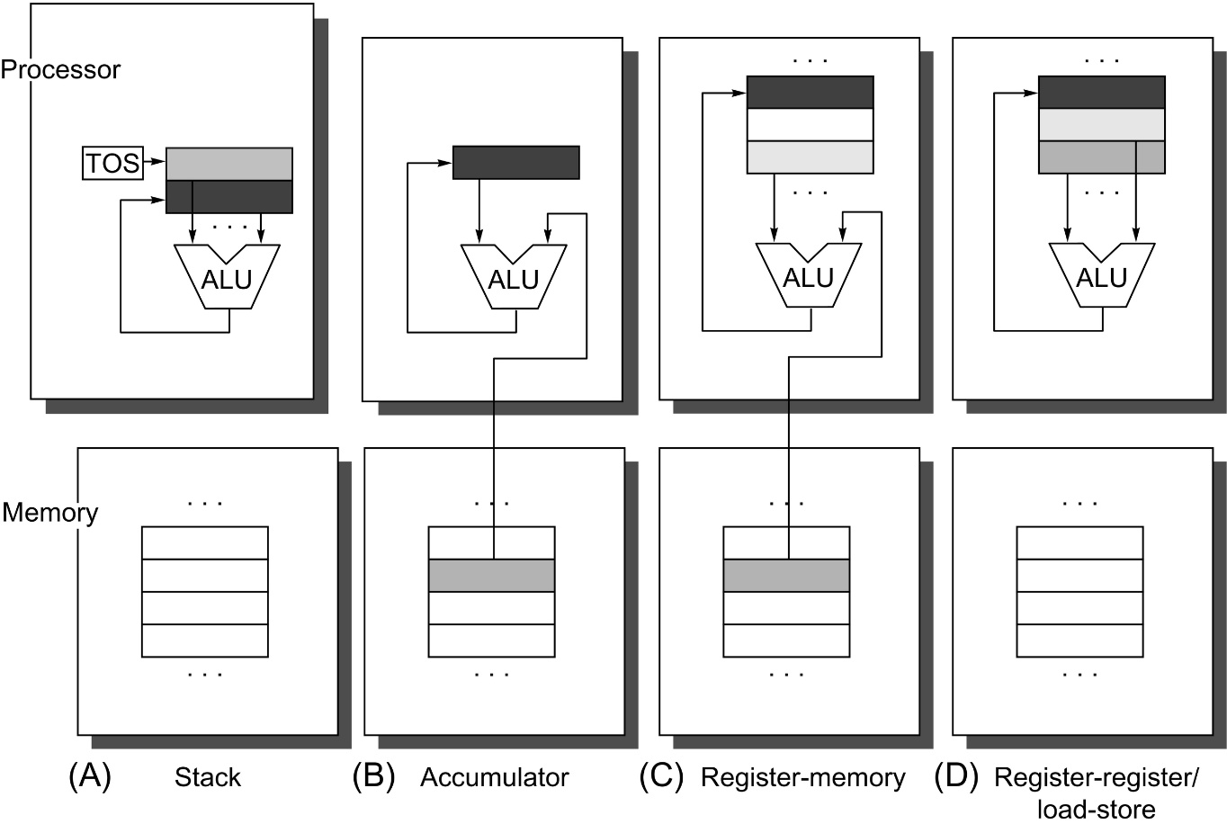
Operand locations for 4 ISA classes
箭头表示数据流动方向，灰色表示源操作数，黑色表示结果
(A) TOS (top of stack) 为栈顶指针，顶部两个数据为源操作数，运算后抹去栈顶数据，结果存入另一个源操作数位置， TOS改为指向结果位置
(B) 累加器既是一个隐含的操作数，又 存放运算的结果
(C) 一个操作数在寄存器中，另一个在 存储器中，结果放在寄存器中
(D) 操作数和结果都在寄存器中
(A)和(D)中，需要专门的指令把数据 传输到存储器
(A) push or pop
(D) load or store

Slide 16
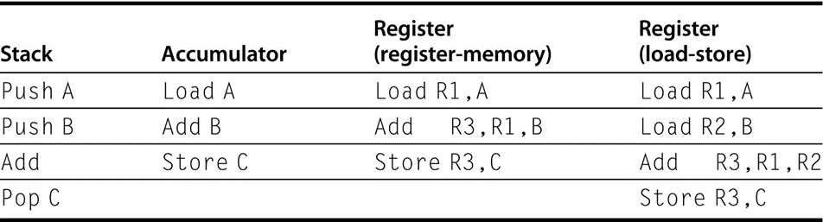
指令数的比较
四类机器上C=A+B的代码序列
Note that the Add instruction has implicit operands for stack and accumulator architectures and explicit operands for register architectures. It is assumed that A, B, and C all belong in memory and that the values of A and B cannot be destroyed

Slide 17
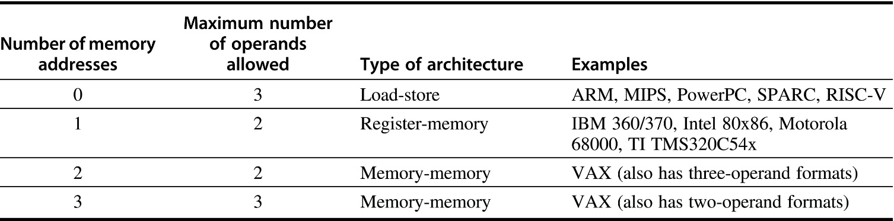
两地址 vs. 三地址
Typical combinations of memory operands and total operands per typical ALU instruction with examples of computers
Load-store or register-register computer：Computers with no memory reference per ALU instruction
Register-memory or memory-memory computer: ALU Instructions with memory operands

Slide 18
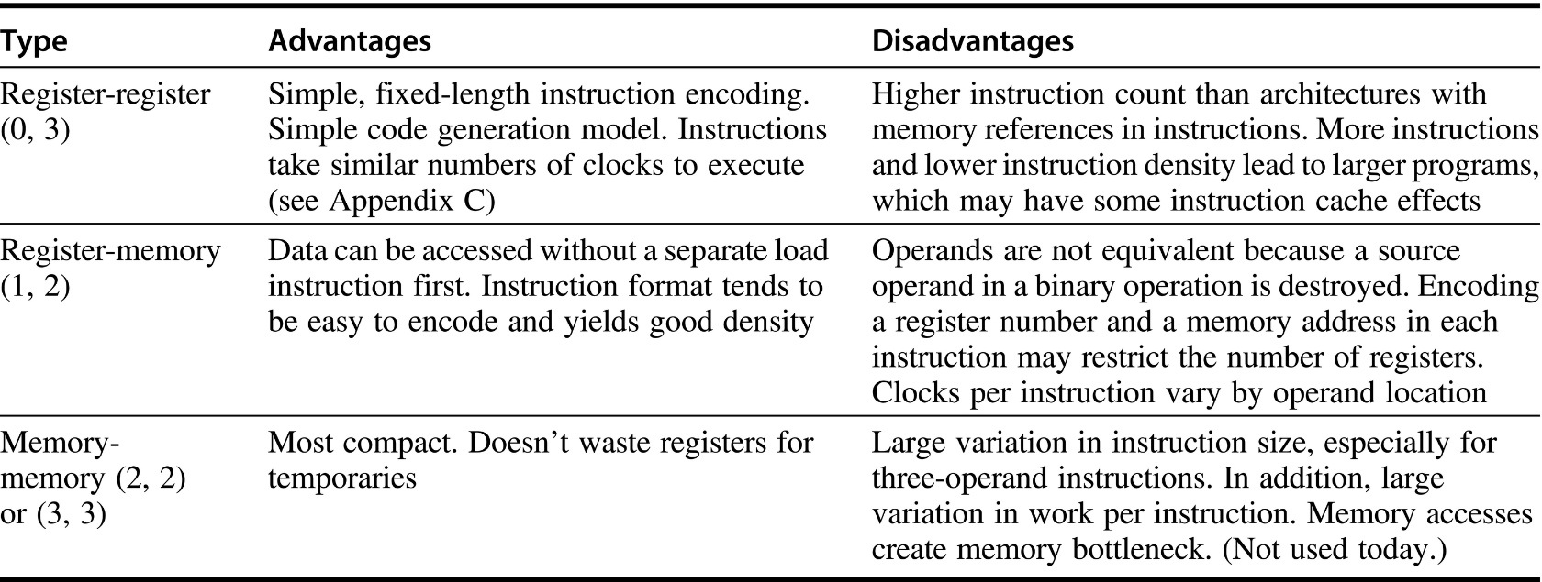
Comparisons
The notation (m, n) means m memory operands and n total operands.
Computers with fewer alternatives simplify the compiler’s task because there are fewer decisions for the compiler to make
Computers with a wide variety of flexible instruction formats reduce the number of bits required to encode the program.

Slide 19
General Purpose Registers Dominate
Nowadays all machines use general purpose registers
All registers are created equal
The number of registers affects the instruction size because you need log₂ (number of registers) for each register specifier in an instruction. Thus, doubling the number of registers takes three extra bits for a register-register architecture, or about 10% of a 32-bit instruction.
Advantages of registers
Registers are faster than memory
Registers are easier for a compiler to use
e.g., (A*B) +(C*D) -(E*F) can do multiplies in any order vs. stack
registers can hold variables
memory traffic is reduced, so program is sped up (since registers are faster than memory)
code density improves (since register named with fewer bits than memory location)

Slide 20
Summary on Instruction Classes
Expect new instruction set architecture to use general purpose register
Pipelining => Expect it to use load store variant of GPR ISA

Slide 21
MIPS I Registers
Programmable storage
2^32 x bytes of memory
31 x 32-bit GPRs (R0 = 0)
32 x 32-bit FP regs (paired DP)
HI, LO, PC

Slide 22
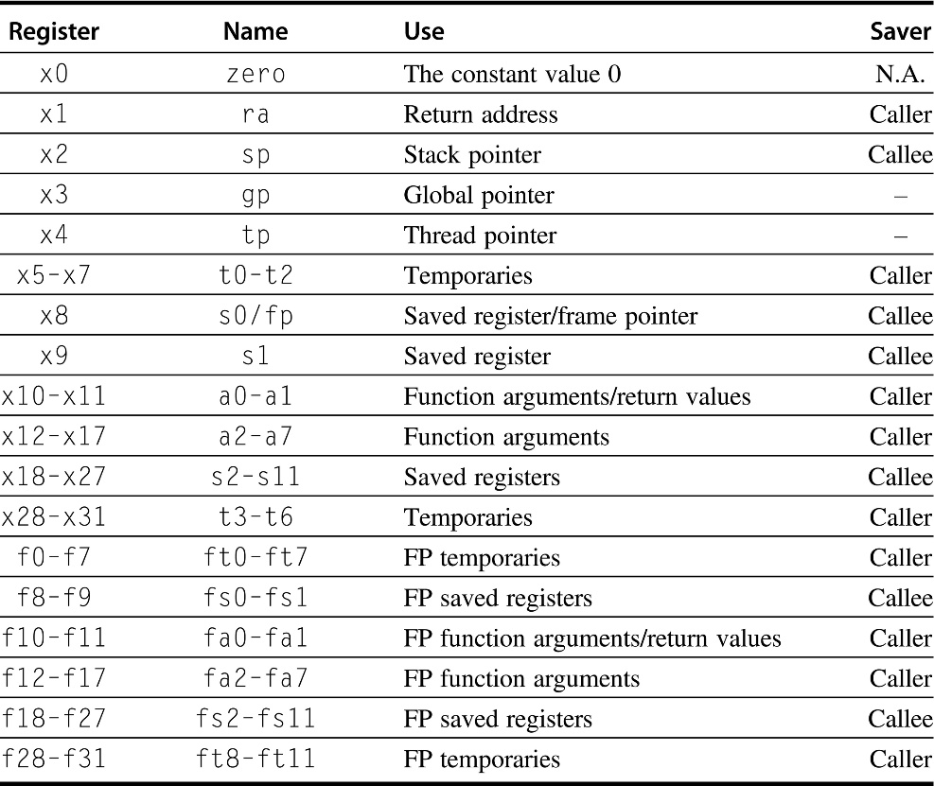
RISC-V Registers
32 general-purpose registers (x0–x31)
32 floating-point registers (f0–f31)
that can hold either a 32-bit single-precision number or a 64-bit double-precision number

Slide 23
Memory Addressing
Since 1980 almost every machine uses addresses to level of 8-bits (byte)
2 questions for design of ISA:
Since could read a 32-bit word as four loads of bytes from sequential byte addresses or as one load word from a single byte address, how do byte addresses map onto words?
Can a word be placed on any byte boundary?

Slide 24
Addressing Objects: Endianess and Alignment
Big Endian: address of most significant byte
IBM 360/370, Motorola 68k, MIPS, SPARC, HP PA-RISC
Little Endian: address of least significant byte
Intel x86, DEC VAX, DEC Alpha (Windows NT)
3 2 1 0
little endian byte 0
msb
lsb
0 1 2 3
0 1 2 3
big endian byte 0
Aligned
Alignment: require that objects fall on address that is multiple of their size.
Not
Aligned

Slide 25
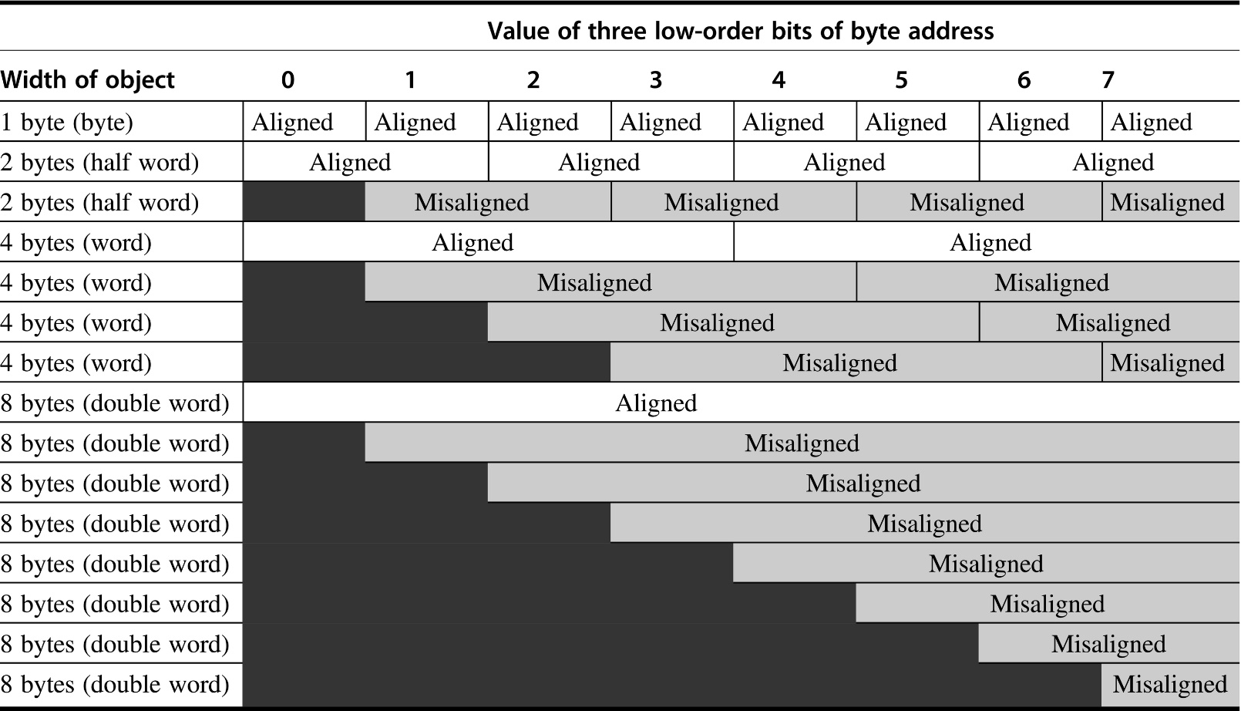
Aligned and misaligned addresses
For each misaligned example some objects require two memory accesses to complete. Every aligned object can always complete in one memory access, as long as the memory is as wide as the object.
The figure shows the memory organized as 8 bytes wide.
The byte offsets that label the columns specify the low-order three bits of the address.

Slide 26
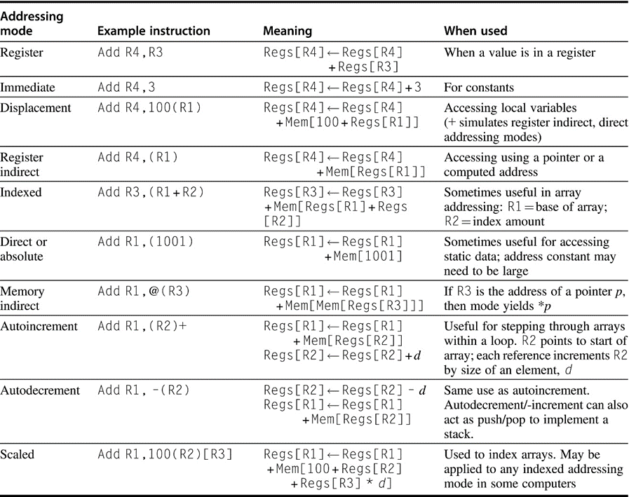
Addressing Modes (寻址方式)
In autoincrement/-decrement and scaled addressing modes, the variable d designates the size of the data item being accessed (i.e., whether the instruction is accessing 1, 2, 4, or 8 bytes). These addressing modes are only useful when the elements being accessed are adjacent in memory
RISC computers use displacement addressing to simulate register indirect with 0 for the address and to simulate direct addressing using 0 in the base register
Notes:
Autoinc/dec change source register!
Why auto inc/dec
Why reverse order of inc/dec?
Scaled multiples by d, a small constant
Why? Hint: byte addressing

Slide 27
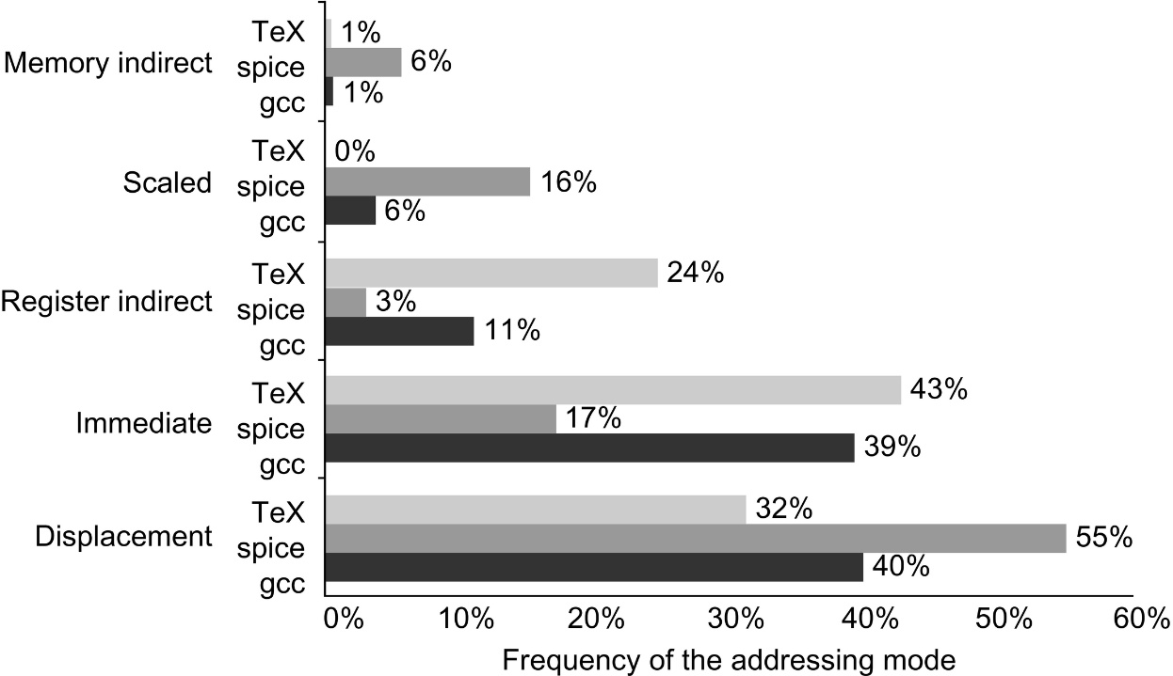
Summary of use of memory addressing modes
These major addressing modes account for >97% of the memory accesses.
Register modes, which are not counted, account for one-half of the operand references
memory addressing modes (including immediate) account for the other half
Of course, the compiler affects what addressing modes are used
Only the addressing modes with an average frequency of over 1% are shown
Data collected on VAX 11/780
85%
75%

Slide 28
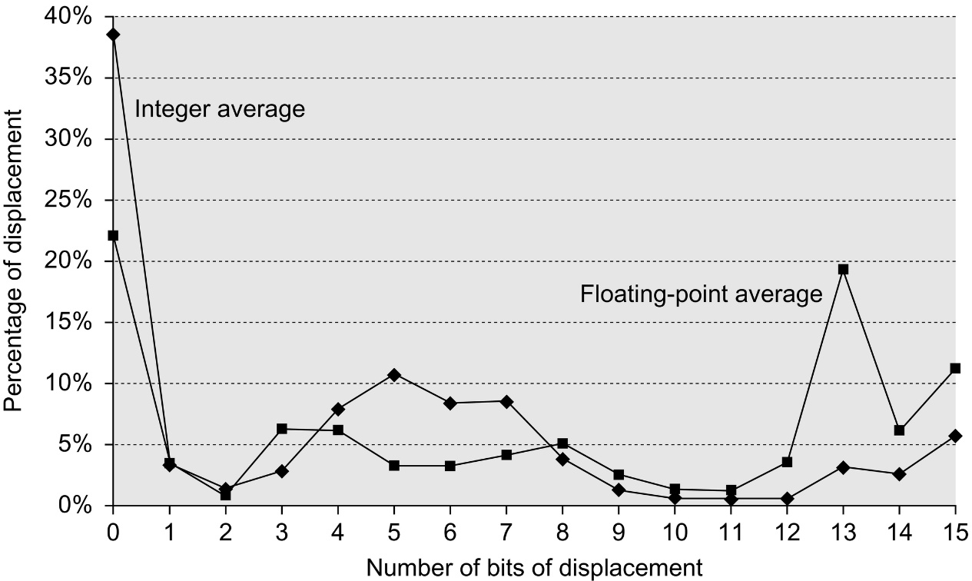
Displacement values are widely distributed
There are both a large number of small values and a fair number of large values.
The wide distribution of displacement values is due to multiple storage areas for variables and different displacements to access them as well as the overall addressing scheme the compiler uses.
The graph does not include the sign bit, which is heavily affected by the storage layout. Most displacements are positive, but a majority of the largest displacements (14 + bits) are negative.
Data collected on Alpha CPU with only 16 bit displacement

Slide 29
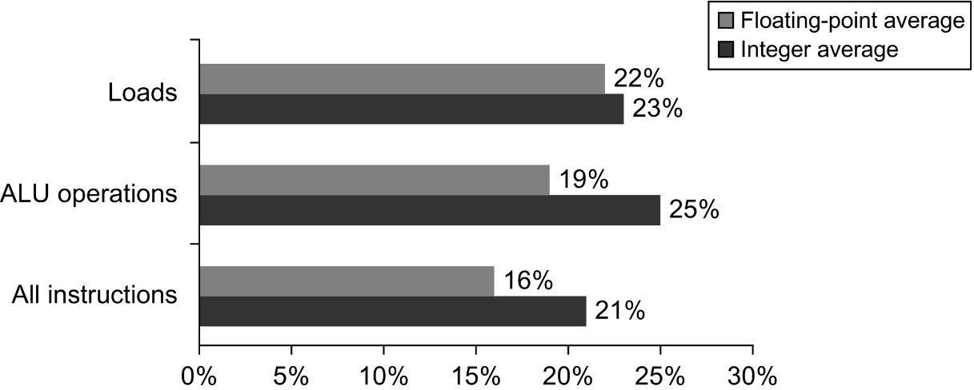
1/4 of data transfers and ALU operations have an immediate operand
The bottom bars show that integer programs use immediates in about 1/5 of the instructions, while floating-point programs use immediates in about 1/6 of the instructions

Slide 30
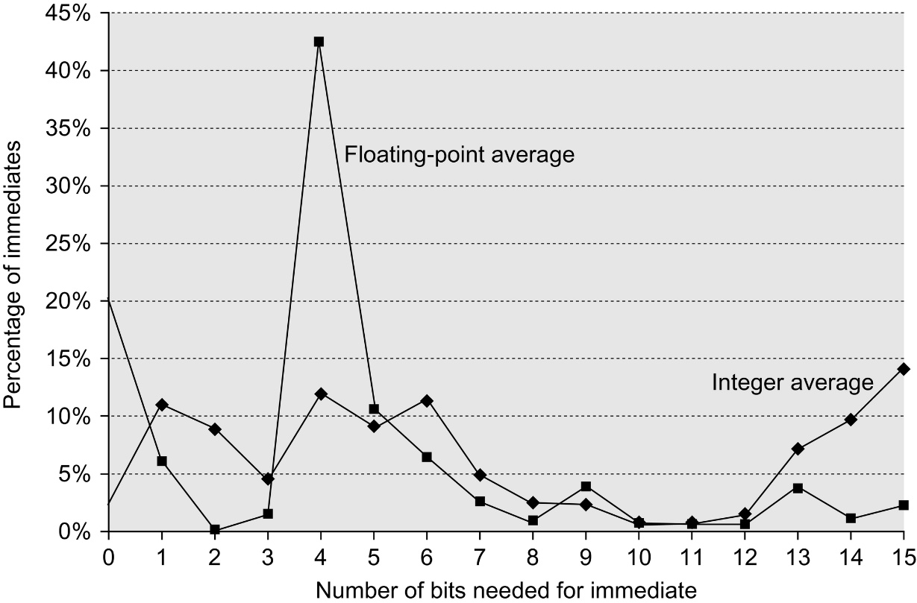
The distribution of immediate values
The x-axis shows the number of bits needed to represent the magnitude of an immediate value
0 means the immediate field value was 0
The majority of the immediate values are positive
About 20% were negative for CINT2000
About 30% were negative for CFP2000
These measurements were taken on an Alpha with 16 bit immediate
A similar measurement on VAX with 32-b immediates showed that about 20%–25% of immediates were longer than 16 bits
Thus, 16 bits would capture about 80% and 8 bits about 50%

Slide 31
Addressing Summary
Data Addressing modes that are important:
Displacement, Immediate, Register Indirect
Displacement size should be 12 to 16 bits
Immediate size should be 8 to 16 bits

Slide 32
Data Types
Bit: 0, 1
Bit String: sequence of bits of a particular length
4 bits is a nibble 8 bits is a byte
16 bits is a half-word 32 bits is a word
64 bits is a double-word
Character:
ASCII 7 bit code
Decimal:
digits 0-9 encoded as 0000b thru 1001b
two decimal digits packed per 8 bit byte
Integers:
2's Complement
Floating Point:
Single Precision
Double Precision
Extended Precision
exponent
E
How many +/- #'s?
Where is decimal pt?
How are +/- exponents
represented?
M x R
base
mantissa

Slide 33
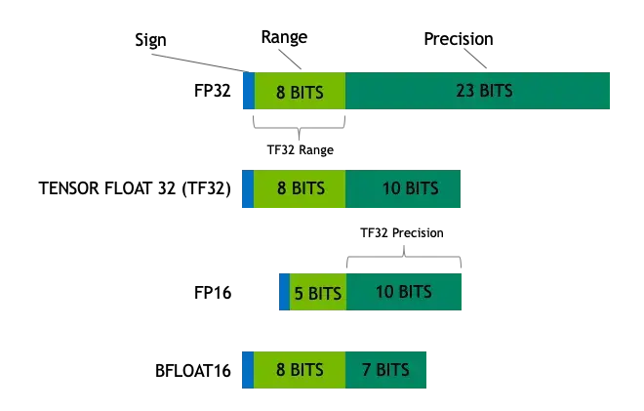
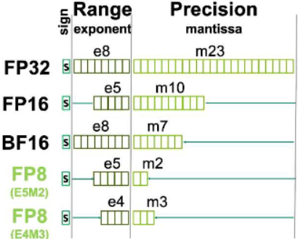
模型量化新增的浮点数据类型
减少数据位数，节省存储空间，减少对内存带宽的占用
降低硬件需求，单位面积集成更多运算器
尽可能增大峰值算力
FP4 (E2M1)

Slide 34
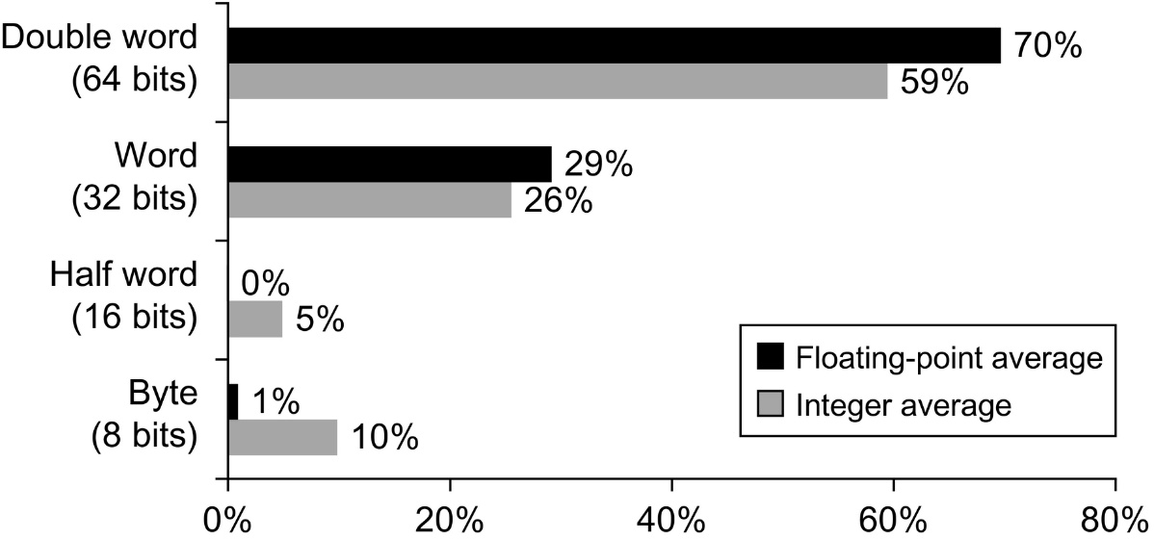
Distribution of data accesses by size
The double-word data type is used for double-precision floating point in floating-point programs and for addresses, because the computer uses 64-bit addresses

Slide 35
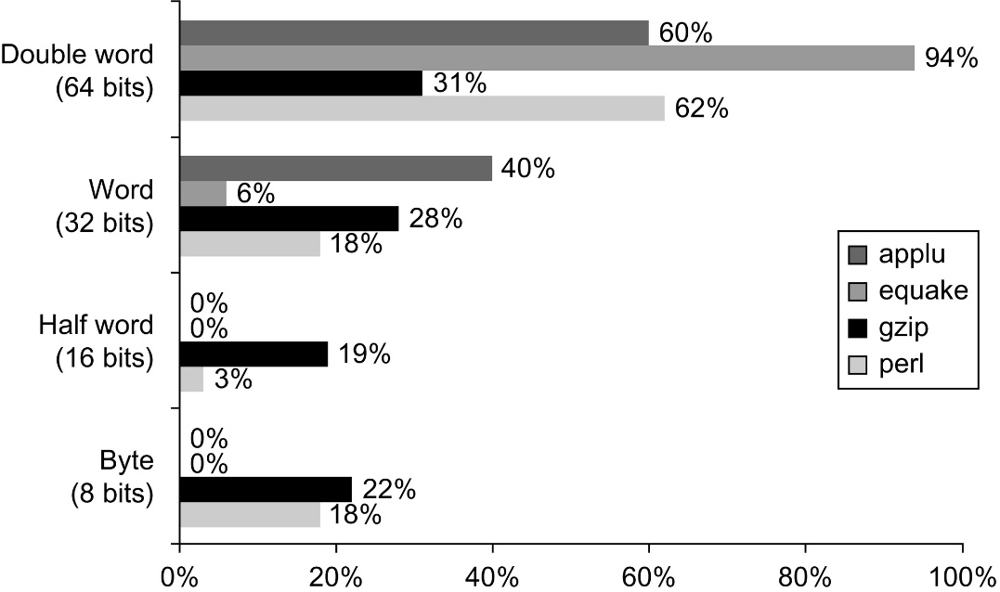
Data reference size
From four programs from SPEC2000
Although you can calculate an average size, it would be hard to claim the average is typical of programs.

Slide 36
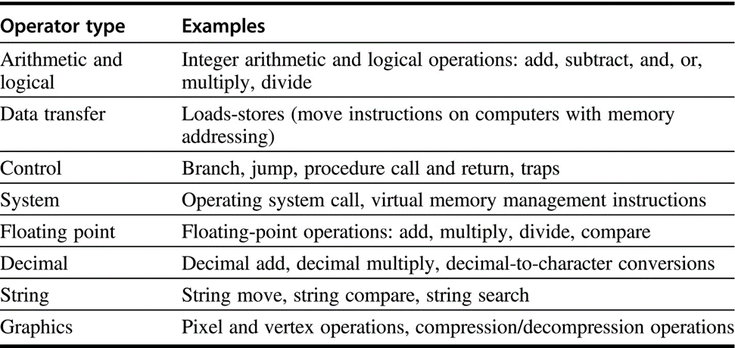
Typical Operations (little change since 1960)
All computers generally provide the first three categories
All computers must have more or less support for basic system functions
The amount of support for the last four categories vary from none to many
Floating-point instructions will be provided in computer used for computation; These instructions are sometimes part of an optional instruction set
Decimal and string instructions are sometimes primitives as in the VAX or the IBM 360 or synthesized by the compiler from simpler instructions
Graphics instructions typically operate on many smaller data items in parallel—for example, performing eight 8-bit additions on two 64-bit operands.

Slide 37
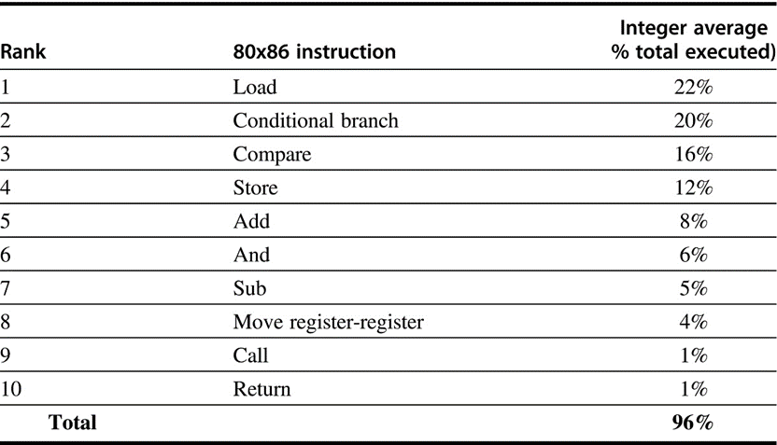
Top 10 80x86 Instructions
Simple instructions dominate this list and are responsible for 96% of the instructions executed
These percentages are the average of the five SPECint92 programs.

Slide 38
MIPS I Operation Overview
Arithmetic logical
Add, AddU, Sub, SubU, And, Or, Xor, Nor, SLT, SLTU
AddI, AddIU, SLTI, SLTIU, AndI, OrI, XorI, LUI
SLL, SRL, SRA, SLLV, SRLV, SRAV
Memory Access
LB, LBU, LH, LHU, LW, LWL,LWR
SB, SH, SW, SWL, SWR

Slide 39

Multiply / Divide
Start multiply, divide
MULT rs, rt
MULTU rs, rt
DIV rs, rt
DIVU rs, rt
MFHI rd
MFLO rd
Move to HI or LO
MTHI rd
MTLO rd
Why not Third field for destination? (Hint: how many clock cycles for multiply or divide vs. add?)
Registers
$$×/÷$$
HI
LO

Slide 40
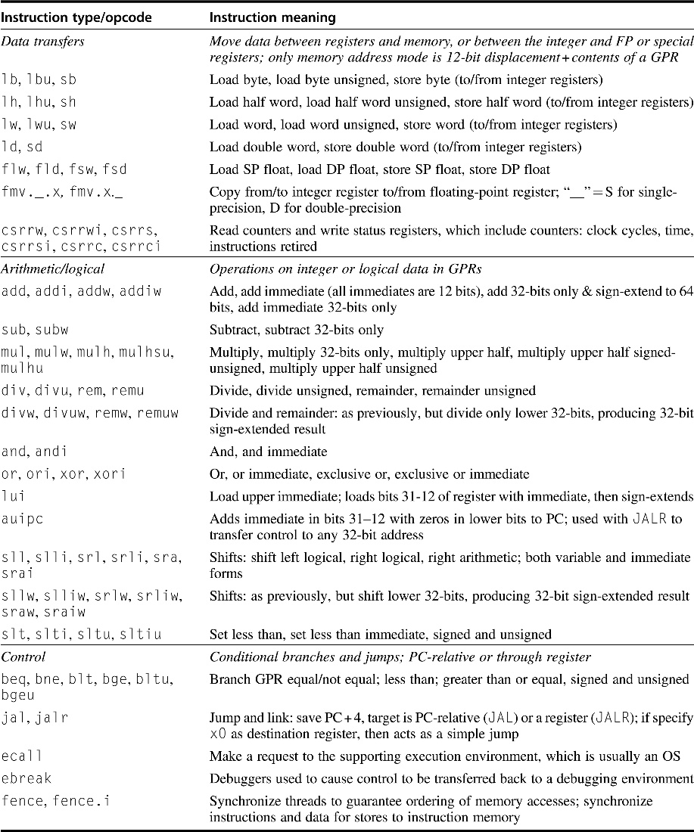
Subset of the instructions in RISC-V
RISC-V has a base set of instructions (R64I) and offers optional extensions
Multiply-divide (RVM)
Single-precision floating point (RVF)
Double-precision floating point (RVD)
This figure includes RVM

Slide 41
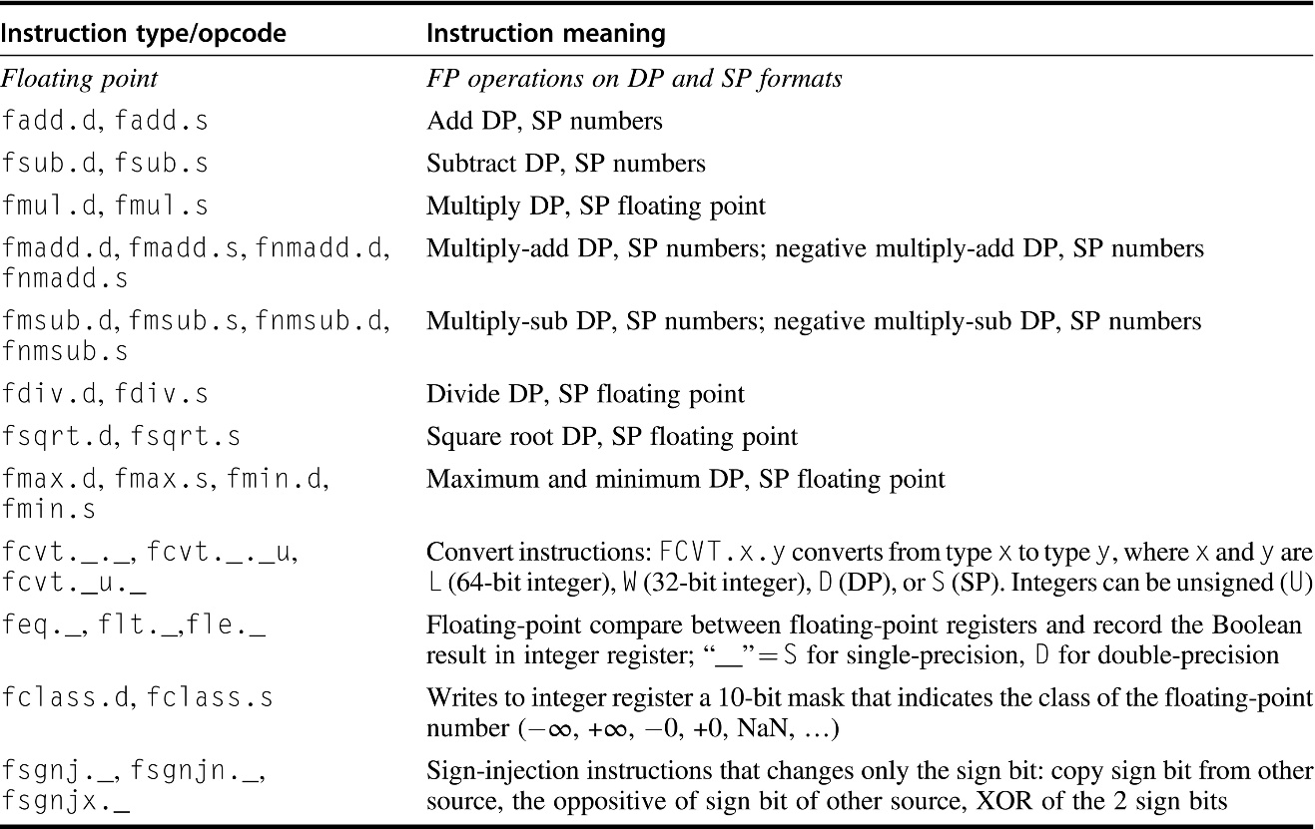
Floating point instructions for RISC-V
RISC-V extensions for single-precision floating point (RVF) and double-precision floating point (RVD)
SP = single precision
DP = double precision

Slide 42
Operation Summary
Support these simple instructions, since they will dominate the number of instructions executed:
load, store, add, subtract,
move register-register,
and, shift,
compare equal, compare not equal,
branch, jump,
call,
return;
The basic idea of reduced instruction set computer

Slide 43
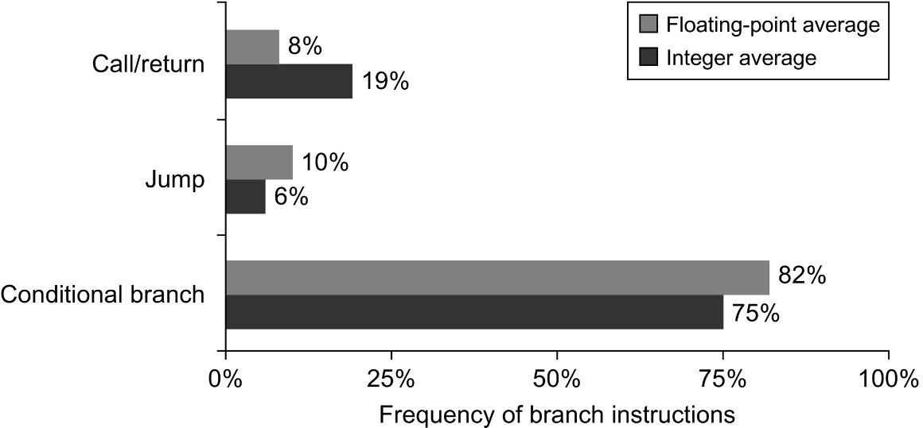
Breakdown of control flow instructions
3 classes: calls or returns, jumps, and conditional branches
Conditional branches clearly dominate

Slide 44
确定转移目标地址的两种主要方式
相对当前指令的偏移量(PC-relative)
统计表明，大部分情况下，分支目标与当前指令离得不远
二进制代码的运行可以独立于其装载位置
如单独编译的某个函数
直接给出转移目标地址：因编译时不能确定具体地址，通常是通过寄存器间址实现
从子程序（函数）返回
便于实现case或switch语句，许多语言都需要
面向对象语言中的虚函数或方法，根据参数类型调用不同的例程
高级函数或函数指针，函数可以作为别的函数的参数进行传递
运行时动态装入的共享库，程序运行前不知道它会被装载到哪个位置

Slide 45
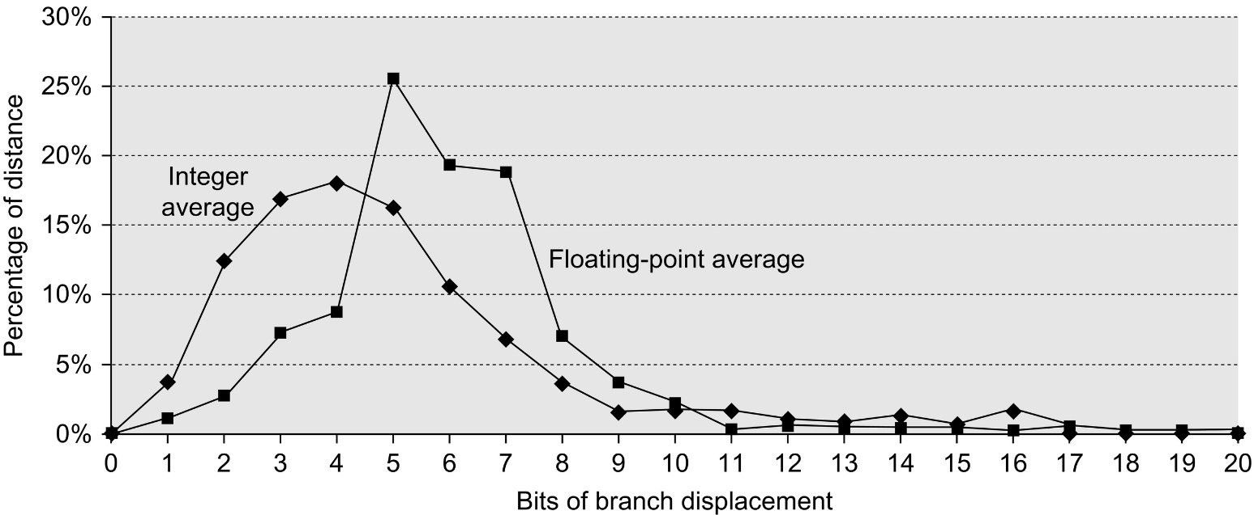
Branch distances in terms of number of instructions
The most frequent branches in the integer programs are to targets that can be encoded in 4–8 bits.
This result tells us that short displacement fields often suffice for branches and that the designer can gain some encoding density by having a shorter instruction with a smaller branch displacement.

Slide 46
Methods of Testing Condition
Condition Codes
Processor status bits are set as a side-effect of arithmetic instructions (possibly on Moves) or explicitly by compare or test instructions.
Ex: add r1, r2, r3
bz label
Condition Register
Ex: cmp r1, r2, r3
bgt r1, label
Compare and Branch
Ex: bgt r1, r2, label

Slide 47
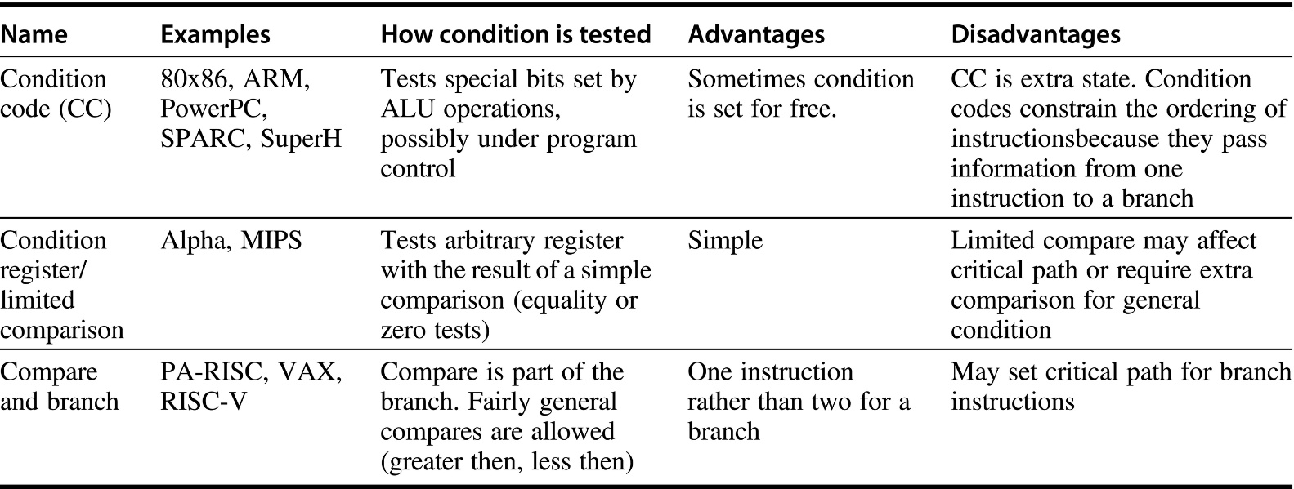
三种分支条件的比较
Conditional code (条件码)
理论上运算指令设置的条件码可用于分支外的其它用途，但实际很少发生
主要问题：其设置取决于一个大而随机的指令子集，而非由指令中某个比特位明确控制
Compare and branch：通常采用精简的比较指令集
对复杂比较则采用独立的运算单元和专属寄存器。
基于浮点数比较的分支实际上用得比较少

Slide 48
Condition Codes
Setting CC as side effect can reduce the # of instructions
X: .
SUB r0, #1, r0
BRP X
X: .
SUB r0, #1, r0
CMP r0, #0
BRP X
vs.
But also has disadvantages:
- not all instructions set the condition codes; which do and which do not often confusing! e.g., shift instruction sets the carry bit
- dependency between the instruction that sets the CC and the one that tests it: to overlap their execution, may need to separate them with an instruction that does not change the CC
ifetch
read
compute
write
Old CC read
New CC computed
ifetch
read
compute
write

Slide 49
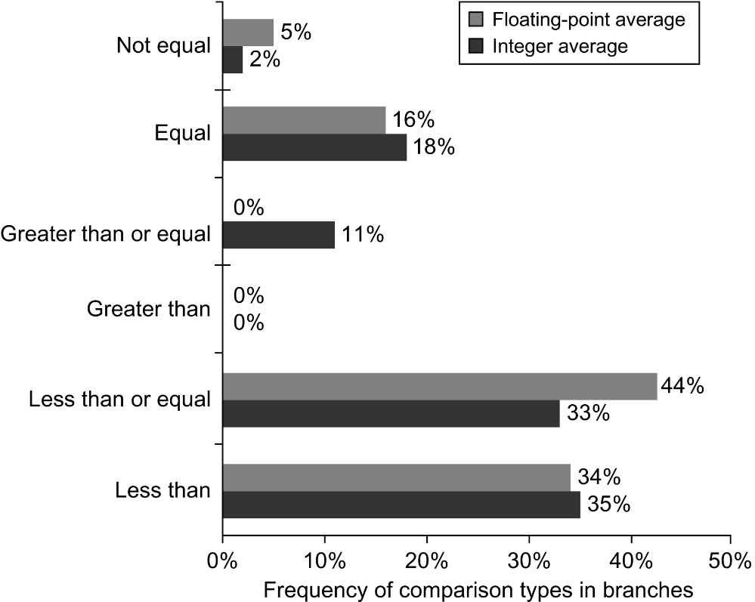

Types of compares in conditional branches
Less than $<$(or equal $≤$) branches dominate
These measurements include both the integer and floating-point compares in branches

Slide 50
Calls: Why Are Stacks So Great?
Stacking of Subroutine Calls & Returns and Environments:
A:
CALL B
CALL C
C:
RET
RET
A
B:
A
B
A
B
C
A
B
A
Some machines provide a memory stack as part of the architecture (e.g., VAX and x86)
Sometimes stacks are implemented via software convention (e.g., MIPS and other RISCs)

Slide 51
Memory Stacks
Useful for stacked environments/subroutine call & return
Stacks that Grow Up vs. Stacks that Grow Down:
SP: Stack Pointer
Next
Empty?
inf. Big
0 Little
grows
up
grows
down
Memory
Addresses
c
Last
Full?
b
SP
a
0 Little
inf. Big
How is empty stack represented?
Little --> Big/Last Full
POP: Read from Mem(SP)
Decrement SP
PUSH: Increment SP
Write to Mem(SP)
Little --> Big/Next Empty
POP: Decrement SP
Read from Mem(SP)
PUSH: Write to Mem(SP)
Increment SP

Slide 52
Call-Return Linkage: Stack Frames
High Mem
ARGS
Reference args and
local variables at
fixed (positive) offset
from FP
FP: Frame Pointer
RA: Return Address
Callee Save
Registers
(old FP, RA)
Local Variables
FP
Grows and shrinks during
expression evaluation
SP
Low Mem
Many variations on stacks possible (up/down, last pushed / next );
Block structured languages contain link to lexically enclosing frame
Compilers normally keep scalar variables in registers, not memory!

Slide 53
Software conventions for MIPS Registers
0 zero constant 0
1 at reserved for assembler
2 v0 expression evaluation &
3 v1 function results
4 a0 arguments
5 a1
6 a2
7 a3
8 t0 temporary: caller saves
. . . (callee can clobber)
15 t7
16 s0 callee saves
. . . (caller can clobber)
23 s7
24 t8 temporary (cont’d)
25 t9
26 k0 reserved for OS kernel
27 k1
28 gp Pointer to global area
29 sp Stack pointer
30 fp frame pointer
31 ra Return Address (HW)

Slide 54
RISC-V Register Calling Conventions
The registers that are preserved across a procedure call are labeled “Callee” saved
Otherwise, “Caller” saved
Part of ABI, Application Binary Interface
OS, compiler, linker, library, and application

Slide 55
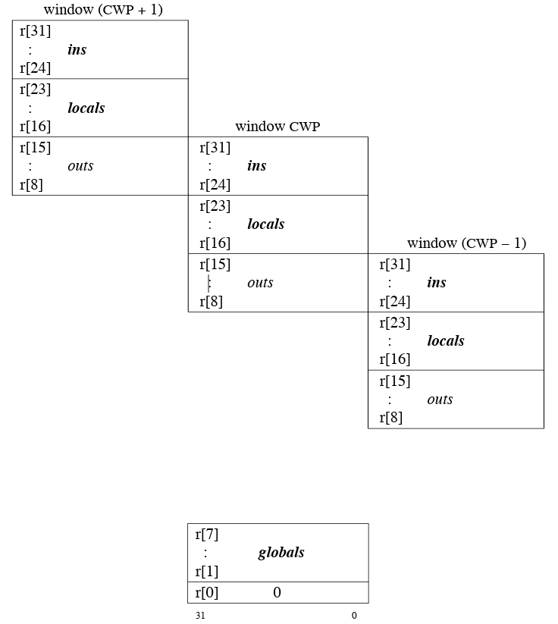
Overlapped SPARC Register Window
SPARC may contain from 40 through 520 general-purpose 32-bit r registers
8 global registers, plus an implementation-dependent number of 16-register sets
A register set is further partitioned into 8 in registers and 8 local registers
An instruction can access
8 global registers and a 24-register window
A register window comprises the 8 in and 8 local registers of a particular register set, together with the 8 in registers of an adjacent register set, which are addressable from the current window as out registers

Slide 56
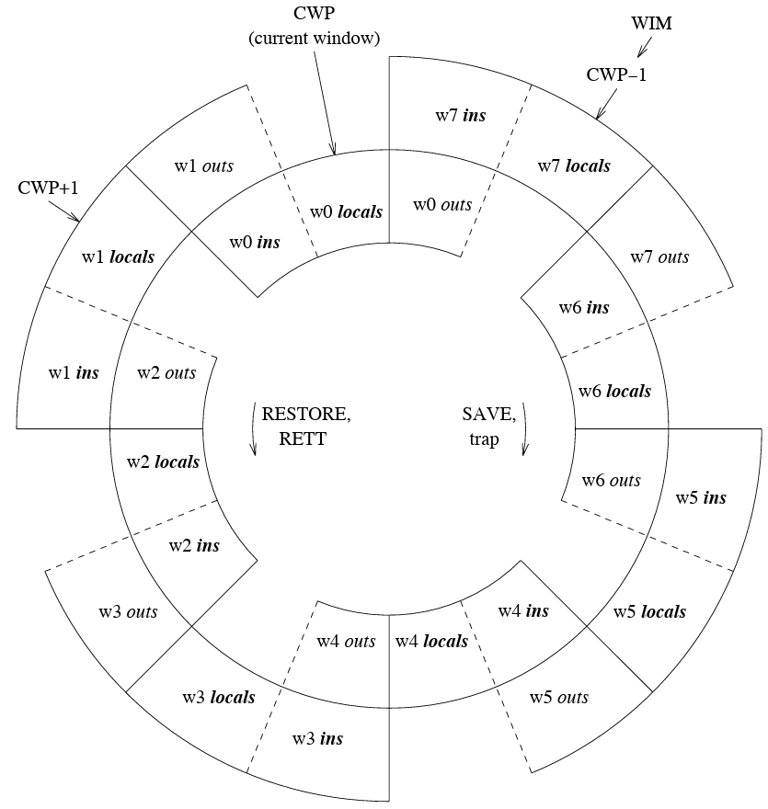
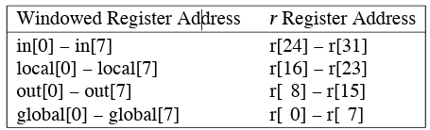
Windowed r Registers The register sets are indicated in bold face
NWINDOWS = 8, CWP = 0, WIM[7] = 1
The 8 global registers are not illustrated
CWP: current window pointer
WIM: window invalid mask
If the procedure using window w0 executes a RESTORE, window w1 will become the current window
If the procedure using window w0 executes a SAVE, a window_overflow trap will occur
The overflow trap handler uses the w7 locals.

Slide 57
Instruction Format
If have many memory operands per instructions and many addressing modes, =>Address Specifier per operand
If have load-store machine with 1 address per instr. and one or two addressing modes, => encode addressing mode in the opcode
If code size is most important, use variable length instructions
If performance is most important, use fixed length instructions
Some embedded ISAs (ARM, MIPS) added optional mode to execute subset of 16-bit wide instructions (Thumb, MIPS16)

Slide 58
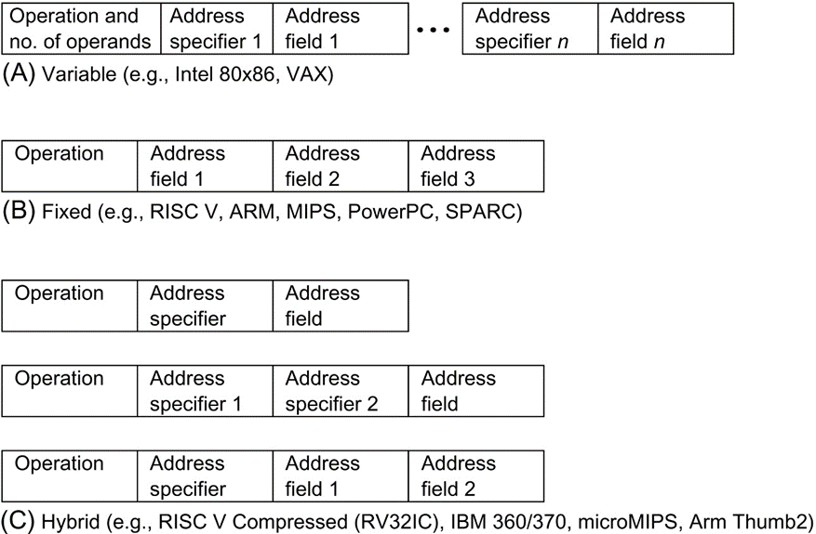
Generic Examples of Instruction Format Widths
The variable format can support any number of operands, with each address specifier determining the addressing mode and the length of the specifier for that operand
It generally enables the smallest code representation, because unused fields need not be included
The fixed format always has the same number of operands, with the addressing modes (if options exist) specified as part of the opcode. It generally results in the largest code size
The hybrid approach has multiple formats specified by the opcode, adding one or two fields to specify the addressing mode and one or two fields to specify the operand address

Slide 59
MIPS Instruction Formats
All instructions 32 bits wide
Register (direct)
op
rs
rt
rd
register
Immediate
op
rs
rt
immed
Base+index
op
rs
rt
immed
Memory
register
+
PC-relative
op
rs
rt
immed
Memory
PC
+
Register Indirect?

Slide 60
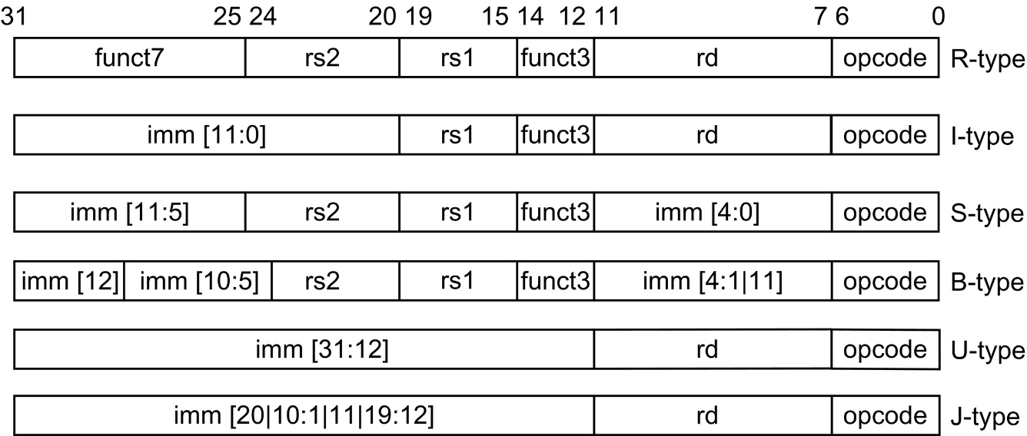
The base RISC-V instruction formats
All instructions are 32 bits long
R format is for integer register-to-register operations, such as ADD, SUB
I format is for loads and immediate operations, such as LD and ADDI
B format is for branches and the J format is for jumps and link
S format is for stores. Having a separate format for stores allows the three register specifiers (rd, rs1, rs2) to always be in the same location in all formats
U format is for the wide immediate instructions (LUI, AUIPC)

Slide 61
Compilers and ISA
Ease of compilation
Orthogonality: no special registers, few special cases, all operand modes available with any data type or instruction type
Completeness: support for a wide range of operations and target applications
Regularity: no overloading for the meanings of instruction fields
Streamlined: resource needs easily determined
Register Assignment is critical too
Easier if there are lots of registers

Slide 62
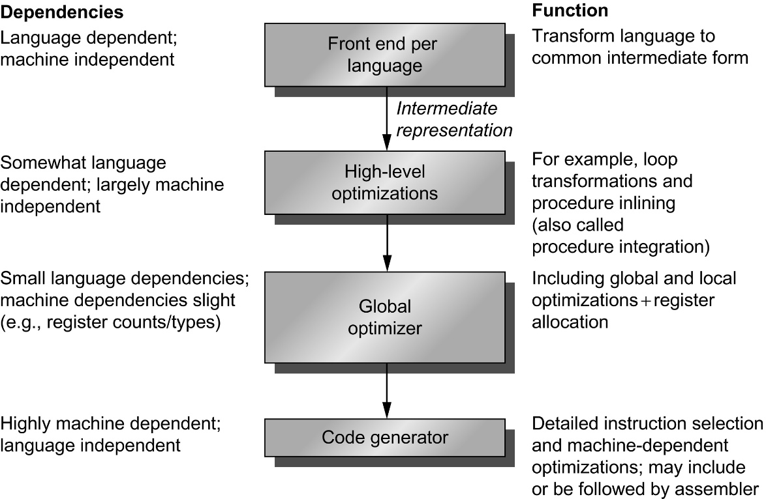
Compilers typically 2 to 4 passes
More highly optimizing compilers having more passes
Pass: one phase the compiler reads and transforms the entire program
The optimizing passes are be optional and may be skipped
Faster compilation (for debugging)
Multiple languages can use the same optimizing and code generation passes
Optimization pass is seperated
Only a new front end is required for a new language

Slide 63
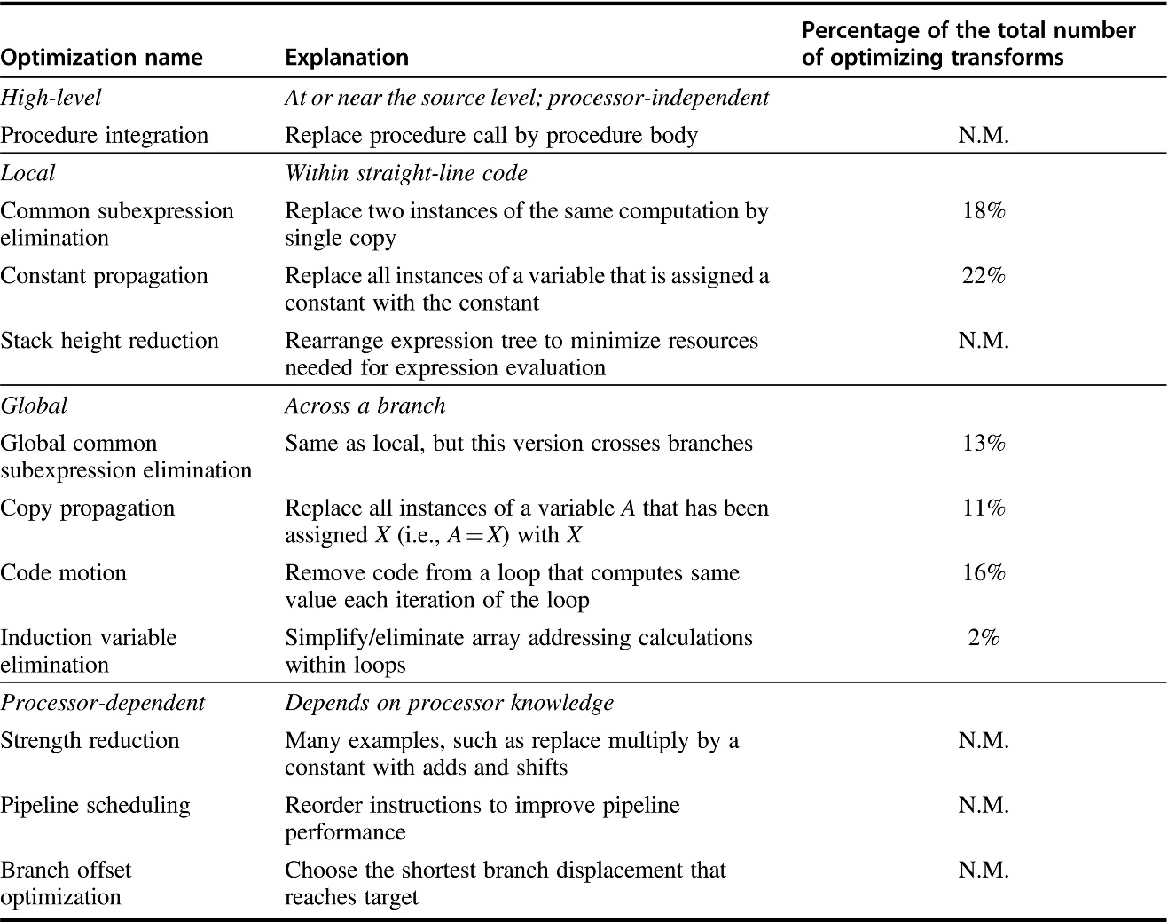
Major types of classical optimizations
These data tell us about the relative frequency of occurrence of various optimizations.
Six measured optimizations account for 82%
Other unmeasured accounts for 18%
N.M. = Not Measured
Some nontrivial optimizations
Loop transformation
Software pipelining
Value prediction

Slide 64
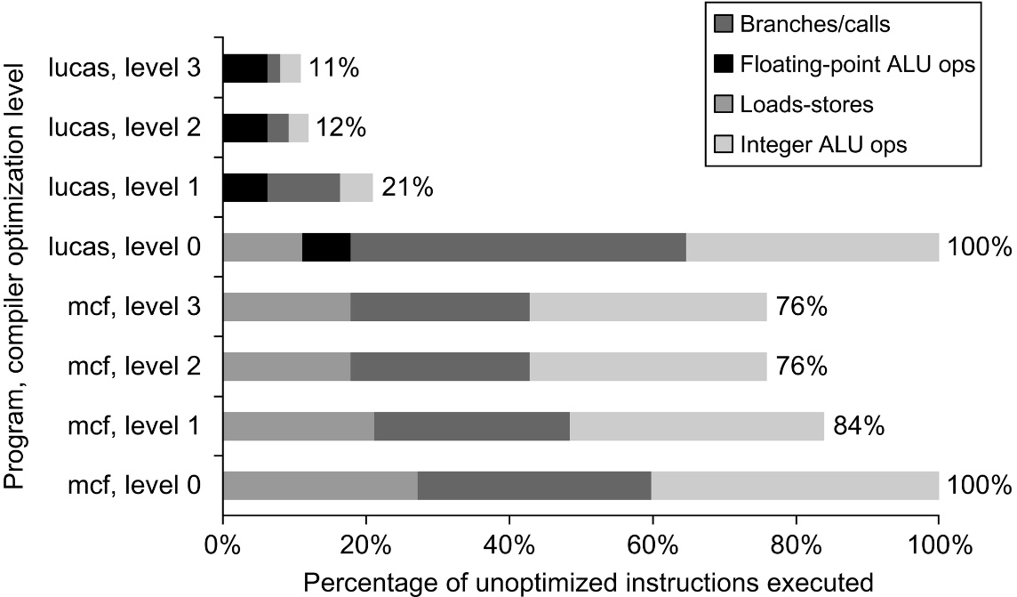
Effects of different optimization level
Change in instruction count for the programs lucas and mcf from the SPEC2000 as compiler optimization levels vary
Level 0 is the same as unoptimized code
Level 1 includes local optimizations, code scheduling, and local register allocation
Level 2 includes global optimizations, loop transformations (software pipelining), and global register allocation
Level 3 adds procedure integration
These experiments were performed on Alpha compilers

Slide 65
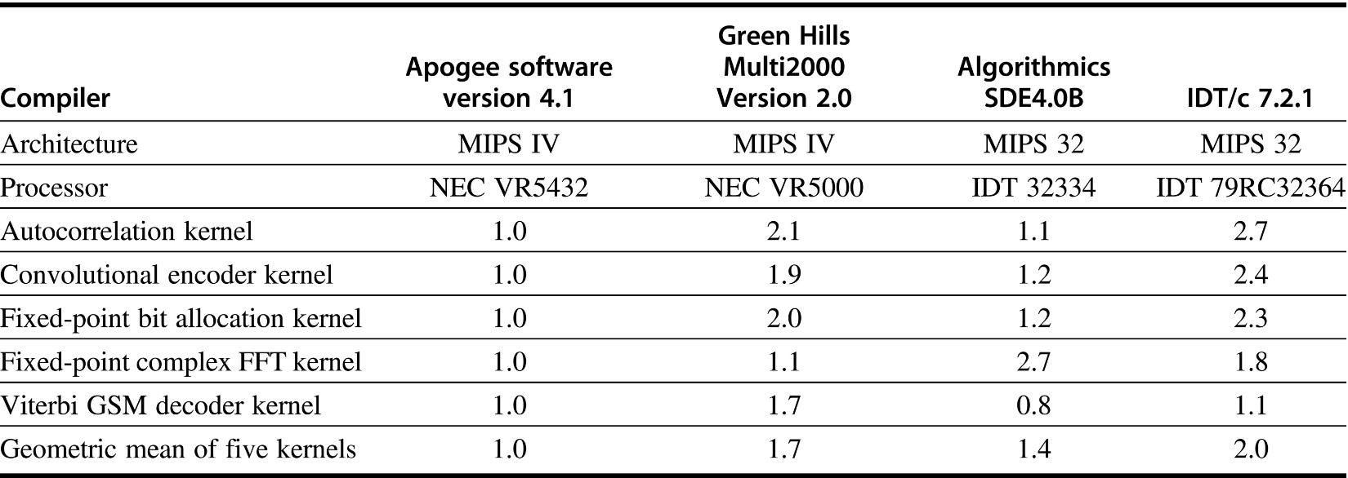
Code size comparison
Relative to Apogee Software Version 4.1 C compiler
5 kernels from Telecom application of EEMBC benchmarks
The instruction set architectures are virtually identical, yet the code sizes vary by factors of 2. These results reported February–June 2000.

Slide 66
Summary of Compiler Considerations
Provide at least 16 general purpose registers plus separate floating-point registers
Be sure all addressing modes apply to all data transfer instructions
Aim for a minimalist instruction set

Slide 67
Details of the MIPS instruction set
Register zero always has the value zero (even if you try to write it)
Branch/jump and link put the return addr. PC+4 into the link register (R31)
All instructions change all 32 bits of the destination register (including lui, lb, lh) and all read all 32 bits of sources (add, sub, and, or, ?

Slide 68
Details of the MIPS instruction set
Immediate arithmetic and logical instructions are extended as follows:
logical immediates ops are zero extended to 32 bits
arithmetic immediates ops are sign extended to 32 bits (including addu)
The data loaded by the instructions lb and lh are extended as follows:
lbu, lhu are zero extended
lb, lh are sign extended
Overflow can occur in these arithmetic and logical Instructions:
add, sub, addi
it cannot occur in addu, subu, addiu, and, or, xor, nor, shifts, mult, multu, div, divu

Slide 69
Delayed Branches
li r3, #7
sub r4, r4, 1
bz r4, LL
addi r5, r3, 1
subi r6, r6, 2
LL: slt r1, r3, r5
In the Raw MIPS the instruction after the branch is executed even when the branch is taken
This is hidden by the assembler for the MIPS Virtual machine
allows the compiler to better utilize the instruction pipeline (discussed later)

Slide 70
Branch & Pipelines
Time
li r3, #7
execute
sub r4, r4, 1
ifetch
execute
bz r4, LL
ifetch
execute
Branch
addi r5, r3, 1
ifetch
execute
Delay Slot
LL: slt r1, r3, r5
ifetch
execute
Branch Target
By the end of Branch instruction, the CPU knows
whether or not the branch will take place.
However, it will have fetched the next instruction by then,
regardless of whether or not a branch will be taken.
Why not execute it?

Slide 71
Filling Delayed Branches
Branch:
Inst Fetch
Op Fetch
Execute
execute successor
even if branch taken!
Inst Fetch
Op Fetch
Execute
Then branch target
or continue
Inst Fetch
Single delay slot
impacts the critical path
add r3, r1, r2
sub r4, r4, 1
bz r4, LL
NOP
...
LL: add rd, ...
Compiler can fill a single delay slot with a useful instruction 50% of the time.
try to move down from above jump
move up from target, if safe
Is this violating the ISA abstraction?

Slide 72
Miscellaneous MIPS I instructions
Break: A breakpoint trap occurs, transfers control to exception handler
syscall: A system trap occurs, transfers control to exception handler
coprocessor instrs: Support for floating point
TLB instructions: Support for virtual memory: discussed later
restore from exception: Restores previous interrupt mask & kernel/user Mode bits into status register
load word left/right: Supports misaligned word loads
store word left/right: Supports misaligned word stores

Slide 73
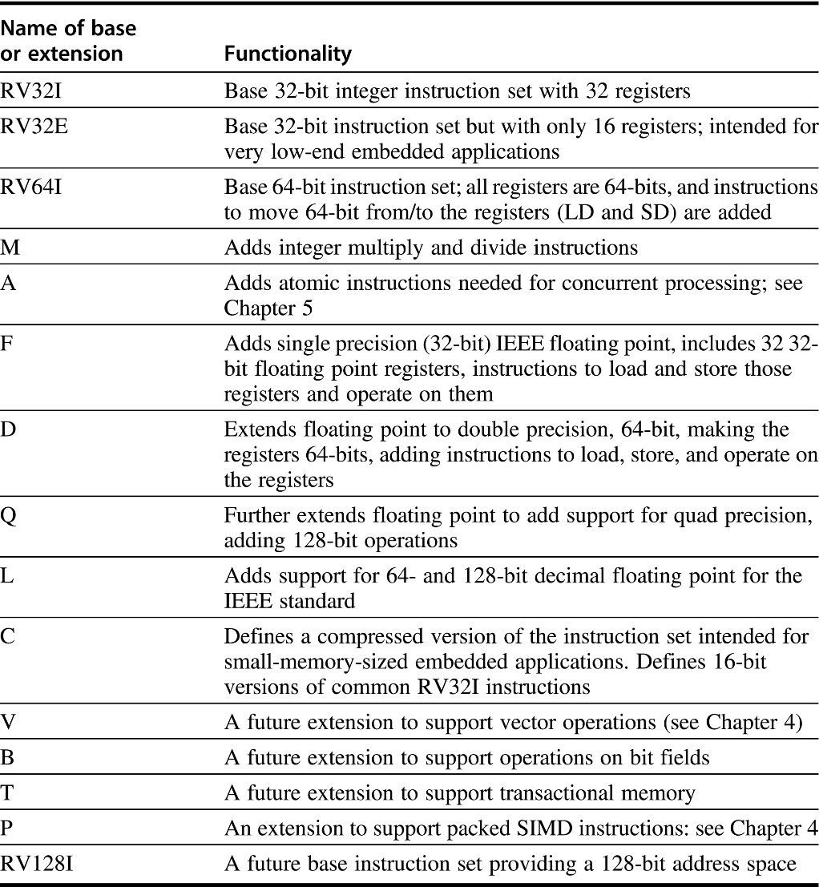
RISC-V ISA details
RISC-V has three base instruction sets (and a reserved spot for a future fourth)
All the extensions extend one of the base instruction sets
An instruction set is named by the base name followed by the extensions
For example, RISC-V64IMAFD refers to the base 64-bit instruction set with extensions M, A, F, and D
For consistency of naming and software, this combination is given the abbreviated name: RV64G.

Slide 74
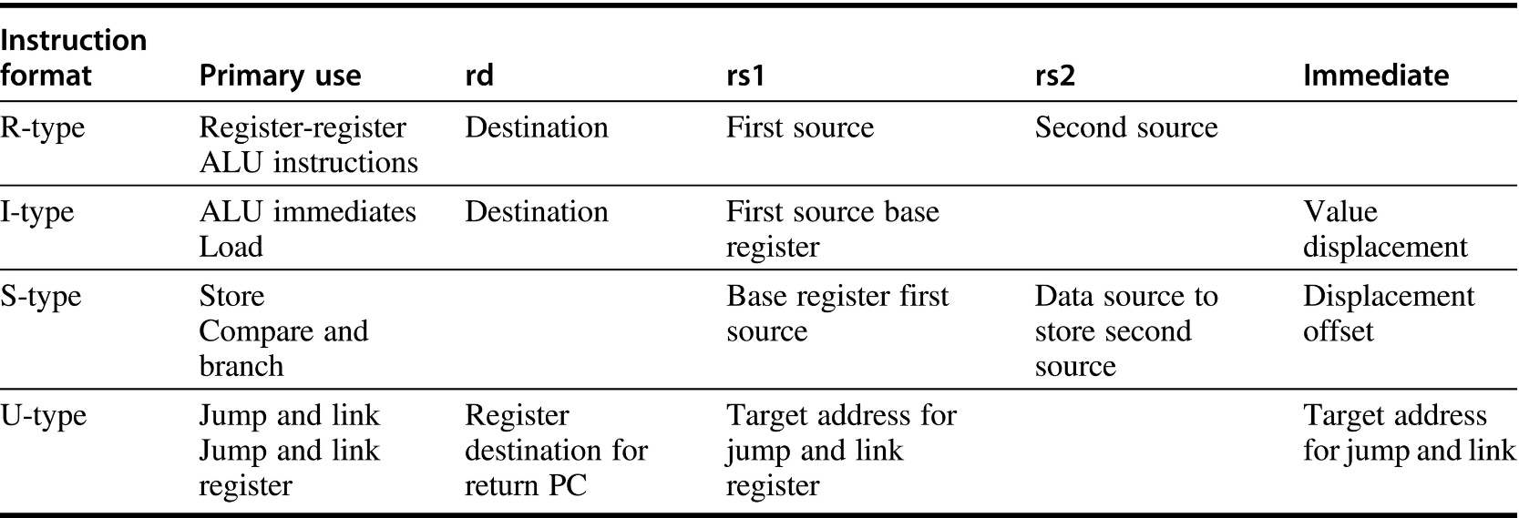
Instruction types and fields in RISC-V
Primary use shows the major instructions that use the format.
A blank indicates that the corresponding field is not present
I-format is used for both loads and ALU immediates
The 12-bit immediate holding an immediate or the displacement
S-format encodes both store instructions and compare and branch instructions
SB and UJ
Similar to S and U, but slightly modify the interpretation of the immediate fields

Slide 75
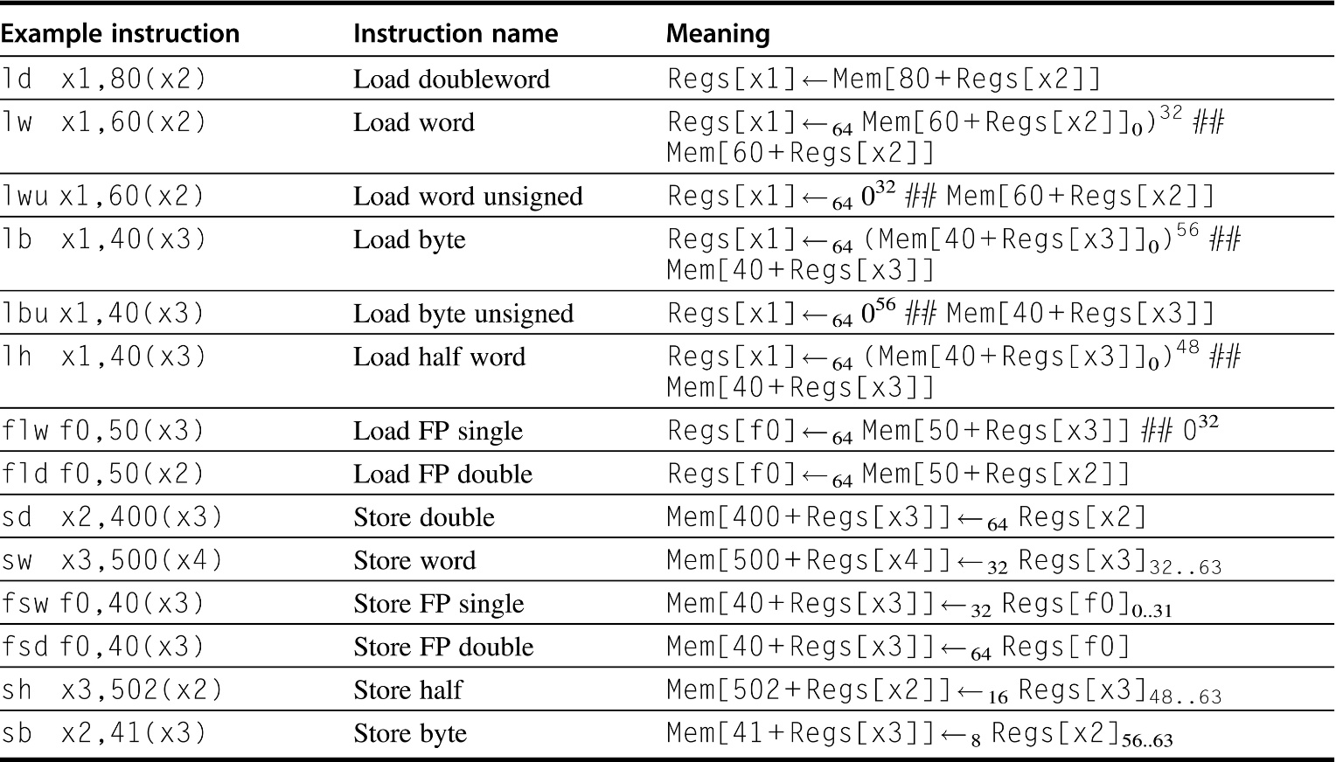
The load and store instructions in RISC-V
Loads shorter than 64 bits are available in both sign-extended and zero-extended forms
All memory references use a single addressing mode
Both loads and stores are available for all the data types
RV64G supports double precision floating point, all single precision floating point loads must be aligned in the FP register, which are 64-bits wide

Slide 76
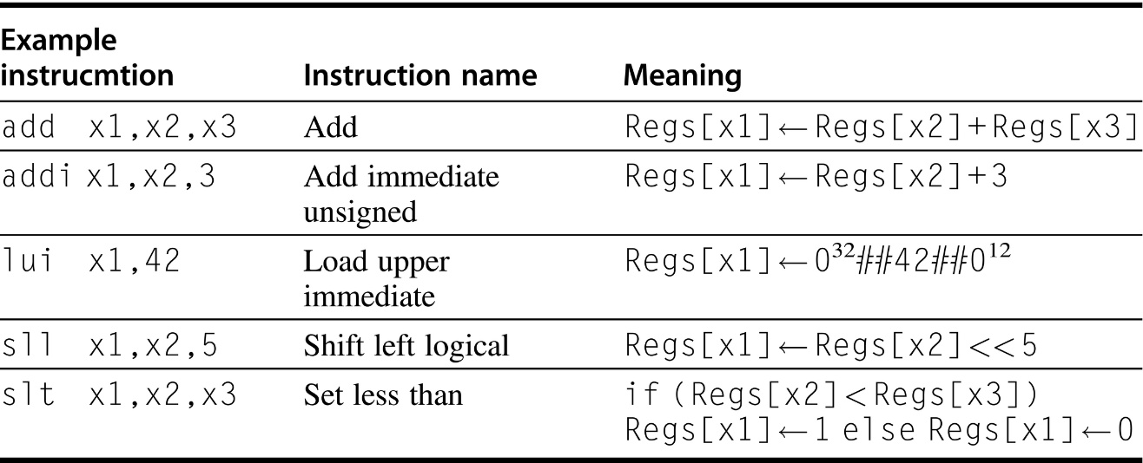
Basic ALU instructions in RISC-V
Two formats available
Register-register operands and with one immediate operand
LUI uses the U-format that employs the rs1 field as part of the immediate, yielding a 20-bit immediate

Slide 77
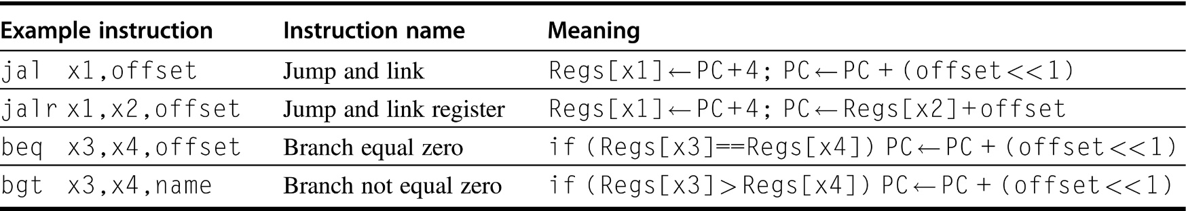
Typical control flow instructions
All control instructions, except jumps to an address in a register, are PC-relative

Slide 78
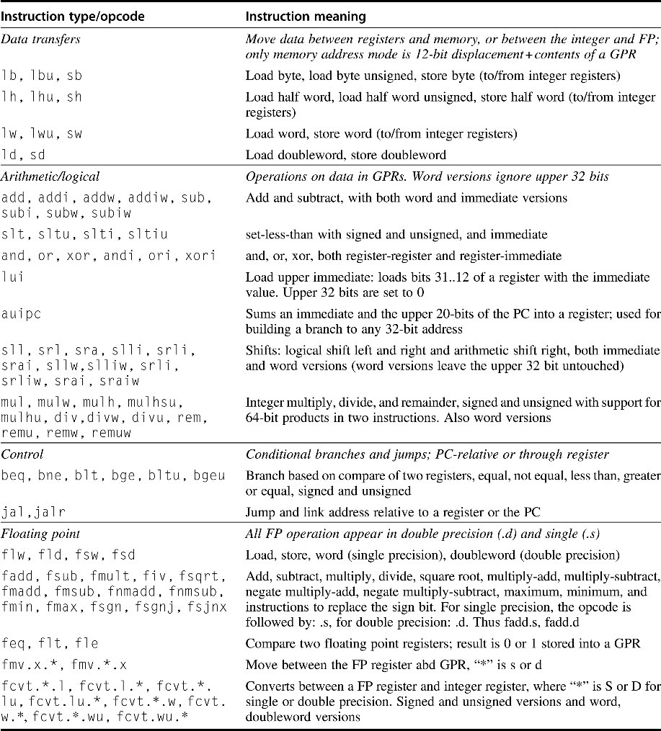
RV64G主要指令列表
This table omits system instructions, synchronization and atomic instructions, configuration instructions, instructions to reset and access performance counters, about 10 instructions in total.

Slide 79
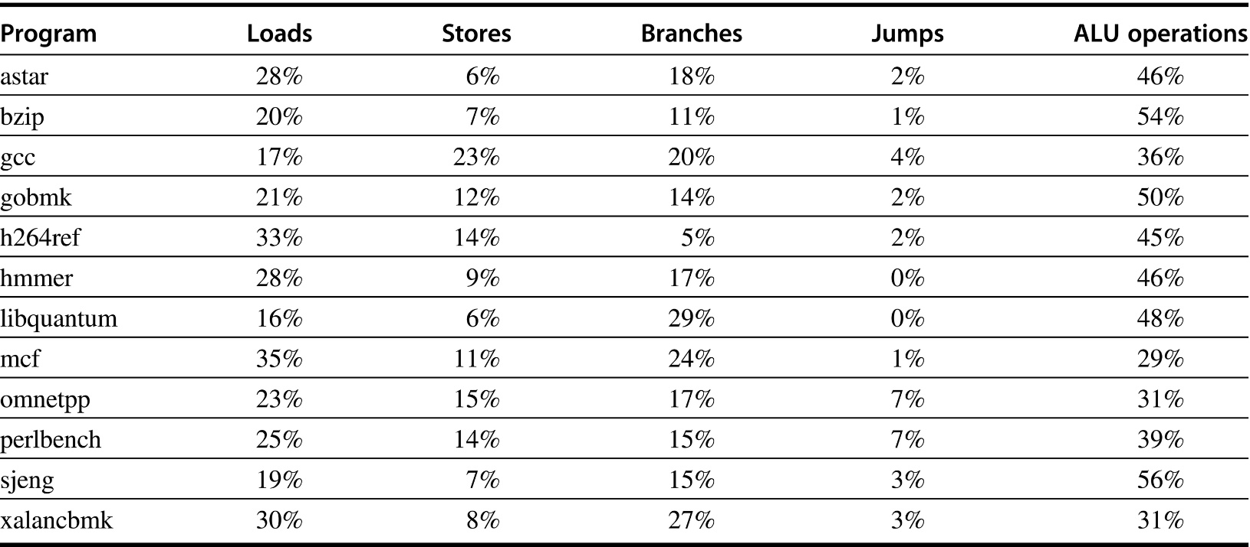
RISC-V dynamic instruction mix (SPECint2006)
Omnetpp includes 7% of the instructions that are floating point loads, stores, operations, or compares; no other program includes even 1% of other instruction types
A change in gcc in SPECint2006, creates an anomaly in behavior. Typical integer programs have load frequencies that are 3x the store frequency. In gcc, the store frequency is actually higher than the load frequency!
This arises because a large fraction of the execution time is spent in a loop that clears memory by storing x0
A store instruction that stores a register pair, which some other RISC ISAs have included, would address this issue.

Slide 80
Summary: Instruction set design
Use general purpose registers with a load-store architecture: YES
Provide at least 16 general purpose registers plus separate floating-point registers: 31 GPR & 32 FPR
Support basic addressing modes: displacement (with an address offset size of 12 to 16 bits), immediate (size 8 to 16 bits), and register deferred; : YES: 16 bits for immediate, displacement (disp=0 => register deferred)
All addressing modes apply to all data transfer instructions : YES
Use fixed instruction encoding if interested in performance and use variable instruction encoding if interested in code size : Fixed

Slide 81
Summary: Evaluating Instruction Sets
Design-time metrics:
Can it be implemented, in how long, at what cost?
Can it be programmed? Ease of compilation?
Static Metrics:
How many bytes does the program occupy in memory?
Dynamic Metrics:
How many instructions are executed?
How many bytes does the processor fetch to execute the program?
How many clocks are required per instruction?
How "lean" a clock is practical?
Best Metric: Time to execute the program!
CPI
Inst. Count
Cycle Time
NOTE: this depends on instructions set, processor organization, and
compilation techniques.

