Slide 1







WEEKLY RESEARCH REPORT
Week | Week 10 / From 12/7/2026 - 30/7/2026
Member | AKIRA, SHUICHI
Research Theme | Building a Railway Terminology Training Dataset
Mentor | Dr. BUI QUOC BAO
1
Notes:
1

Slide 2

01 – WEEKLY WORK OBJECTIVES
02 – TASKS COMPLETED
03 – ACHIEVEMENTS / RESULTS
04 – CHALLENGES / LIMITATIONS
05 – PLAN FOR NEXT WEEK
06 – SUGGESTIONS / NOTES
2

Slide 3
01 – WEEKLY WORK OBJECTIVES
3

Slide 4

WEEKLY WORK OBJECTIVES
Problem From Last Week
The review workflow was functional, but there were lingering issues with UI reliability and data quality for fine-tuning. Main issues identified:
  PDF source verification depended heavily on browser rendering behavior, and text highlighting was inconsistent.
  The human-reviewed dataset was still too small for meaningful model fine-tuning.
  The boundary between accepted, rejected, and uncertain labels needed clearer definitions for reviewers.
4
Notes:
4

Slide 5
WEEKLY WORK OBJECTIVES
Goal of this week
This week focused on improving system reliability and preparing higher-quality reviewed data for Supervised Fine-Tuning (SFT).
  Improve PDF evidence rendering and term highlighting.
  Scale up the review process with more railway manuals.
  Refine criteria for human validation labels.
  Finalize the dataset format (CSV/JSONL) for future Qwen fine-tuning.
5
Notes:
4

Slide 6
02 – TASKS COMPLETED
6

Slide 7

System Optimization & Data Processing
Reviewer-Facing Web Workflow Implemented
The focus was on refining both the web application interface and the data extraction rules. Implemented tasks:
  Optimized PDF evidence rendering to ensure more stable term highlighting inside the viewer.
  Uploaded and processed new railway manuals through the web workflow to test system stability.
  Refined and documented clear review criteria for accepted, rejected, and uncertain terms.
  Adjusted extraction rules to improve the quality of new candidate terms generated by the baseline.
  Server Deployment: 50% complete; further feature and UX refinements are required before release.
7
Notes:
1.7.2013
3
‹#›

Slide 8
03 – ACHIEVEMENTS / RESULTS
9

Slide 9
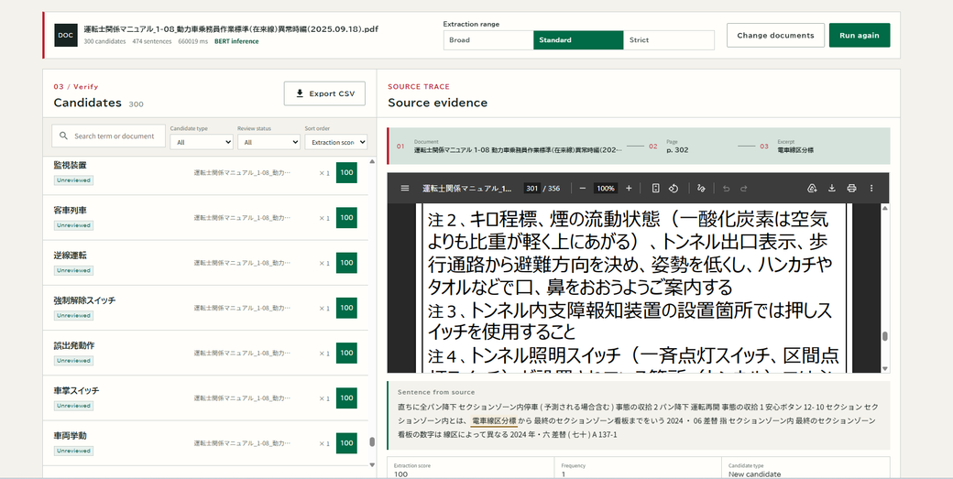
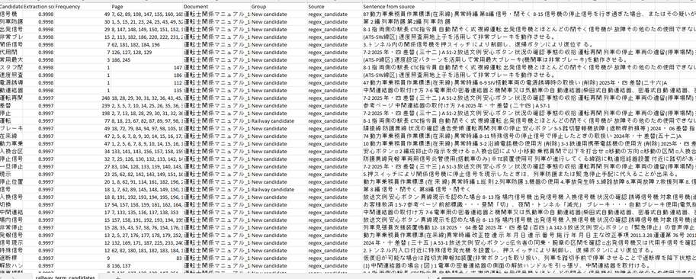
Reviewed Terminology Catalog
Structured Dataset Preparation Completed
The output from the web system has been successfully transformed into a dataset ready for the next phase.
  Increased Dataset Size: Significantly increased the total number of reviewed terminology records.
  Export Validation: Successfully validated the CSV and JSONL export formats, ensuring they meet the requirements for SFT dataset construction.
  Baseline Evaluation: Completed the comparison between the baseline extraction output and the human-reviewed results.
  Data Readiness: Prepared a cleaner, high-quality dataset version ready for future Qwen fine-tuning.
10
Notes:
8

Slide 10
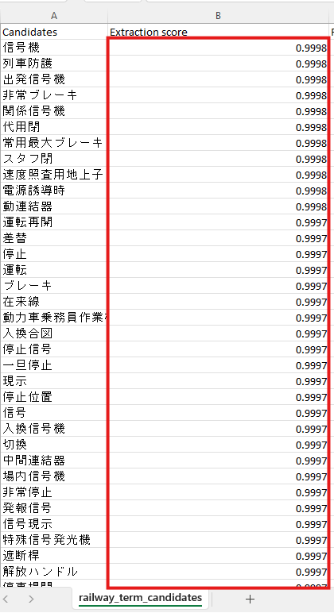
How is the BERT Score Calculated?
GiNZA proposes candidates; BERT calculates the score from the source sentence and candidate pair.
1. INPUT
Sentence + candidate
2. BERT
Two raw logits
3. SOFTMAX
Normalizes logits
4. OUTPUT
Score = P(TERM)
→
→
→
SOFTMAX FORMULA
score = P(TERM) = exp(z_TERM) / [exp(z_TERM) + exp(z_NOT_TERM)]
0.9998 means the TERM logit was far higher than NOT_TERM for this sentence–candidate pair.
The model learned this distinction from labelled TERM / NOT_TERM examples. The score ranks candidates; a human reviewer makes the final decision.
10
Notes:
Speaker notes:
This slide explains the number itself. GiNZA proposes candidate phrases, but it does not calculate the BERT score. For each source-sentence and candidate pair, BERT produces two unnormalized values: a NOT_TERM logit and a TERM logit. Softmax converts those two values into probabilities that add up to one. The application stores the TERM probability, rounded to four decimal places. Therefore, a score of 0.9998 means the TERM logit was far higher than the NOT_TERM logit for that pair. It does not mean the term is 99.98 percent guaranteed to be correct; the score is used to rank and filter candidates. When a term occurs more than once, the displayed score is the highest score across its occurrences. The reviewer remains responsible for the final JR-specific, not-JR, or discussion decision.

Slide 11
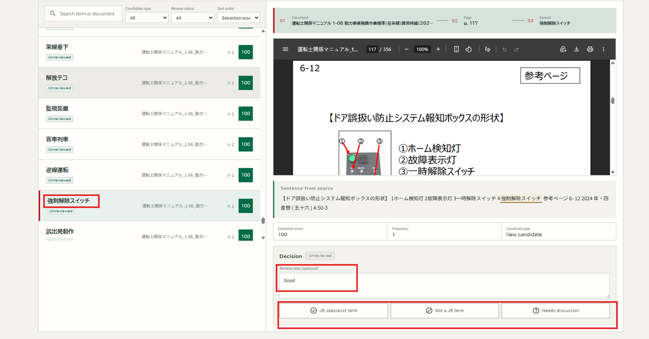
Reviewed Terminology Catalog
Structured Draft Terminology Records Generated
Reviewed Terminology Management
A reviewed terminology catalog was added to manage human decisions after candidate extraction.
The catalog supports:
  Viewing approved, rejected, uncertain, and reviewed terms.
  Searching reviewed terms.
  Checking source occurrences.
  Viewing review notes.
  Viewing reviewer name and review time.
  Checking review history for auditability.
  Exporting reviewed data as CSV and JSONL
11
Notes:
8

Slide 12
04 – CHALLENGES / LIMITATIONS
14

Slide 13
CHALLENGES / LIMITATIONS
  Even with refined criteria, determining the correct label for highly specific "uncertain" terms still requires deep domain knowledge from railway experts.
  Comparing baseline output with reviewed results shows that handling abbreviations and compound Japanese terms is still a challenge for the initial extractor.
  Transitioning from data preparation to the actual Supervised Fine-Tuning (SFT) phase requires setting up proper evaluation metrics for the upcoming model.
15
Notes:
15

Slide 14
05 – PLAN FOR NEXT WEEK
16

Slide 15
PLAN FOR NEXT WEEK
Next week, the priority will be completing the web release and enabling client review, while preparing for initial model training and continued data expansion. Planned tasks:
  Complete server deployment by Sunday, August 2, and enable the client to begin reviewing terms in the web system.
  Run the first experimental fine-tuning job with the newly prepared JSONL dataset.
  Define evaluation metrics to measure the fine-tuned model's performance against the current baseline.
  Continue reviewing terms from newly added manuals to further expand the training dataset.
  Analyze edge cases in the "uncertain" category to improve extraction guidelines.
17
Notes:
17

Slide 16
06 – SUGGESTIONS / NOTES
18

Slide 17
SUGGESTIONS / NOTES
Currently, we do not have additional suggestions.
19
Notes:
19

Slide 18
THANK YOU FOR YOUR ATTENTION!
20

