Slide 1






Free Software
What a malfunctioning printer can do

Slide 2
Intro
1. For want of a printer
2. Free software and licenses
3. GNU/Linux marriage

Slide 3

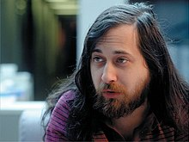
1. For want of a printer
In 1985 the MIT recieved from XEROX an industrial laser printer.
At that time Richard Stallman was a Researcher in that University.

Slide 4


1. For want of a printer
The killer feature of the printer was an integrated e-mail server so you could print your files by just sending them to the machine.

Slide 5

1. For want of a printer
The printer frequently had paper jams.
Stallman thought to embed for free a function to notificate people if printer ever got stuck.

Slide 6



1. For want of a printer
Requested the source code of the printer to XEROX which denied the access to it.
Stallman got very frustrated by this decision and created the Free Software Foudation.

Slide 7
2. Free software and licenses
Main pillars of free software:
00. The freedom to run the program. [USE]
01. The freedom to study how the program works. [STUDY]
10. The freedom to redistribute copies. [SHARE]
11. The freedom to distribute copies of your modified versions. [MODIFY]

Slide 8

2. Free software and licenses
In 1989 FSF created GPL (Gnu Public License) to protect the free and open source operating system they where creating, GNU.
Today we have:
GNUv3
GNU Affero
GNU FDL (Free Documentation)

Slide 9
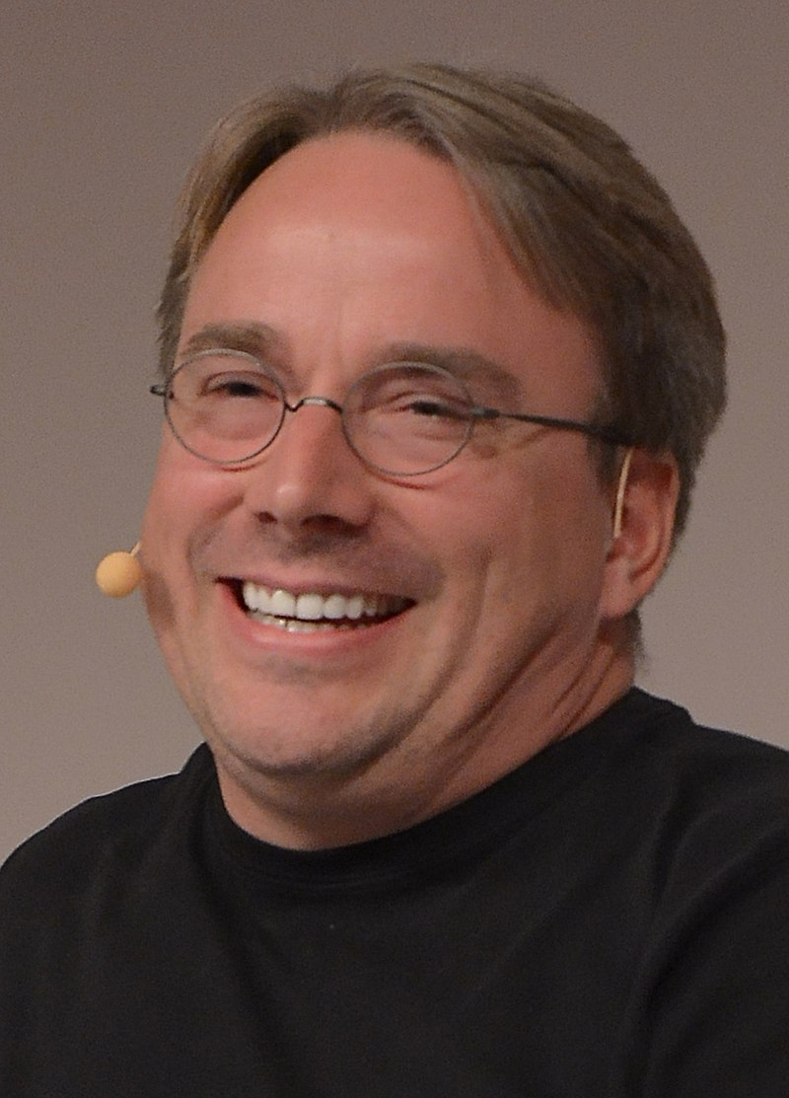

3. GNU/Linux marriage
Linus torvalds in 1991 started developing a kernel called Linux, just for fun.
Only a year later he decided to release the code under the GPL license.

Slide 10
Conlusion
If we take the first million more used servers the 96.3% of them is running Linux.

Slide 11
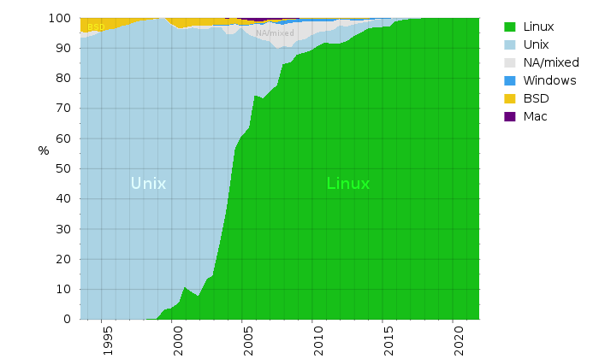
Conlusion
The first 500 supercomputers are equipped with Linux.
https://www.oreilly.com/content/open-by-design

Slide 12
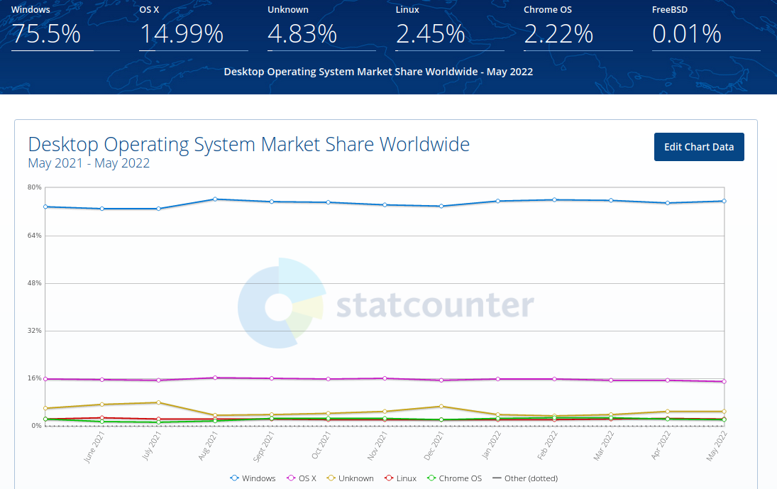
Conlusion
Linux desktop market share.
https://gs.statcounter.com/os-market-share/desktop/worldwide

Slide 13



Conlusion
The main reason for this is just that when you buy a PC it has Windows or MacOS pre-installed including proprietary paid softwares.
Instead this presentation was made using Libre Office.

Slide 14

This work is licensed under a Creative Commons Attribution-ShareAlike 4.0 Unported License.
CREDITS
Mateus Machado Luna (for the theme)
Sam Williams - Free as In freedom (https://www.oreilly.com/openbook/freedom/ch01.html)
MorroLinux – GNU/Linux history(https://youtu.be/watch?v=VT4A4efdheo)
gnu.org – Licenses (https://www.gnu.org/licenses/licenses.html)
fsf.org – What is FS (https://www.fsf.org/resources/what-is-fs/index_html)
Wikipedia – The Free Software definition (https://en.wikipedia.org/wiki/The_Free_Software_Definition)
Illustrations such as the printer, the mail, etc... are taken from Flaticon.com
The property of the logos such the FSF, GNU, etc... appartains to the respective owners
The graphs taken from websites have the link to the source which is also considered the owner
Davide Antonio Amodio

