Slide 1
Unsupervised Learning: Clustering
Huijun Di
ajon@bit.edu.cn

Slide 2
Outline
Basic concepts of clustering
Types of clusters
Types of clusterings
K-means
Hierarchical clustering
DBSCAN
Cluster Validity
Spectral Clustering
Summary

Slide 3
Basic concepts of clustering
Supervised learning vs. unsupervised learning
What is clustering?
What is clustering for?
The Clustering Process

Slide 4
Supervised learning vs. unsupervised learning
Supervised learning used labeled data pairs (x, y) to learn a function f : X→Y.
But, what if we don’t have labels?
No labels = unsupervised learning
Clustering is the unsupervised grouping of data points. It can be used for knowledge discovery.
Only some points are labeled = semi-supervised learning
Labels may be expensive to obtain, so we only get a few.

Slide 5
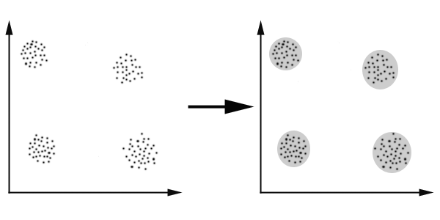
What is clustering
Clustering is a technique for finding similarity groups in data, called clusters. I.e.,
it groups data instances that are similar to (near) each other in one cluster and data instances that are very different (far away) from each other into different clusters.

Slide 6
What is clustering for?
Let us see some real-life examples
Example 1: groups people of similar sizes together to make “small”, “medium” and “large” T-Shirts.
Tailor-made for each person: too expensive
One-size-fits-all: does not fit all.
Example 2: In marketing, segment customers according to their similarities
To do targeted marketing.

Slide 7
What is clustering for? (cont…)
In fact, clustering is one of the most utilized data mining techniques.
It has a long history, and used in almost every field, e.g., medicine, psychology, botany, sociology, biology, archeology, marketing, insurance, libraries, etc.
Understanding
Group genes and proteins that have similar functionality
Summarization
Reduce the size of large data sets

Slide 8
The Clustering Process
Pattern representation
Feature selection and extraction
Definition of pattern proximity measure
A distance (similarity, or dissimilarity) function
Clustering : algorithm
Cluster validation: the quality
Inter-clusters distance ⇒ maximized
Intra-clusters distance ⇒ minimized
The quality of a clustering result depends on the algorithm, the distance function, and the application.

Slide 9
Outline
Basic concepts of clustering
Types of clusters
Types of clusterings
K-means
Hierarchical clustering
DBSCAN
Cluster Validity
Spectral Clustering
Summary

Slide 10
Types of Clusters
Well-separated clusters
Center-based clusters
Contiguous clusters
Density-based clusters
Property or Conceptual
Described by an Objective Function

Slide 11
Types of Clusters: Well-Separated
Well-Separated Clusters:
A cluster is a set of points such that any point in a cluster is closer (or more similar) to every other point in the cluster than to any point not in the cluster.
3 well-separated clusters

Slide 12
Types of Clusters: Center-Based
Center-based
A cluster is a set of objects such that an object in a cluster is closer (more similar) to the “center” of a cluster, than to the center of any other cluster
The center of a cluster is often a centroid, the average of all the points in the cluster, or a medoid, the most “representative” point of a cluster
4 center-based clusters

Slide 13
Types of Clusters: Contiguity-Based
Contiguous Cluster (Nearest neighbor or Transitive)
A cluster is a set of points such that a point in a cluster is closer (or more similar) to one or more other points in the cluster than to any point not in the cluster.
8 contiguous clusters

Slide 14
Types of Clusters: Density-Based
Density-based
A cluster is a dense region of points, which is separated by low-density regions, from other regions of high density.
Used when the clusters are irregular or intertwined, and when noise and outliers are present.
6 density-based clusters

Slide 15
Types of Clusters: Conceptual Clusters
Shared Property or Conceptual Clusters
Finds clusters that share some common property or represent a particular concept.
.
2 Overlapping Circles

Slide 16
Outline
Basic concepts of clustering
Types of clusters
Types of clusterings
K-means
Hierarchical clustering
DBSCAN
Cluster Validity
Spectral Clustering
Summary

Slide 17
Types of Clusterings
Partitional Clustering
A division data objects into non-overlapping subsets (clusters) such that each data object is in exactly one subset
K-means
Hierarchical clustering
A set of nested clusters organized as a hierarchical tree
Density-based clustering
DBSCAN
Graph-based clustering
Spectral Clustering
Others

Slide 18
Partitional Clustering
Original Points
A Partitional Clustering

Slide 19
Hierarchical Clustering
Traditional Hierarchical Clustering
Traditional Dendrogram

Slide 20
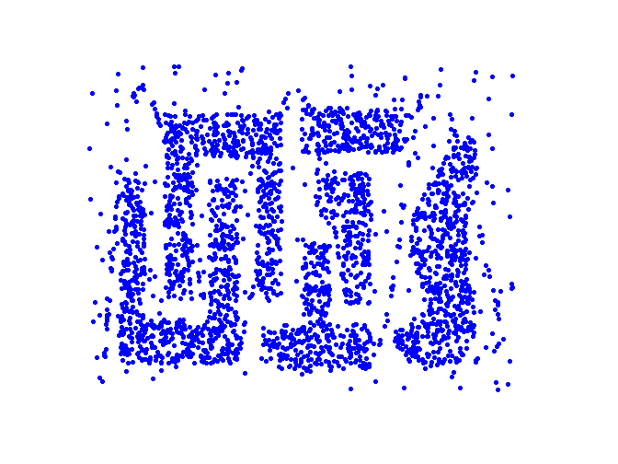
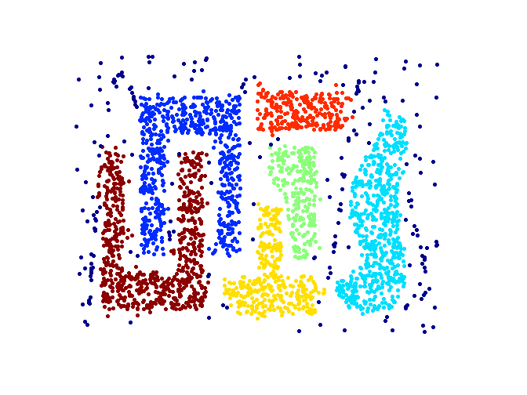
Density-based clustering
Original Points
Clusters

Slide 21
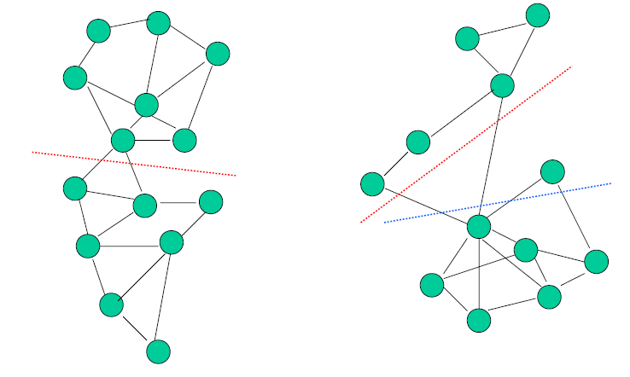
Graph-based clustering

Slide 22
Outline
Basic concepts of clustering
Types of clusters
Types of clusterings
K-means
Hierarchical clustering
DBSCAN
Cluster Validity
Spectral Clustering
Summary

Slide 23
K-means Clustering
K-means algorithm
Limitations and weaknesses of K-means
Their solutions
Summary of K-means

Slide 24
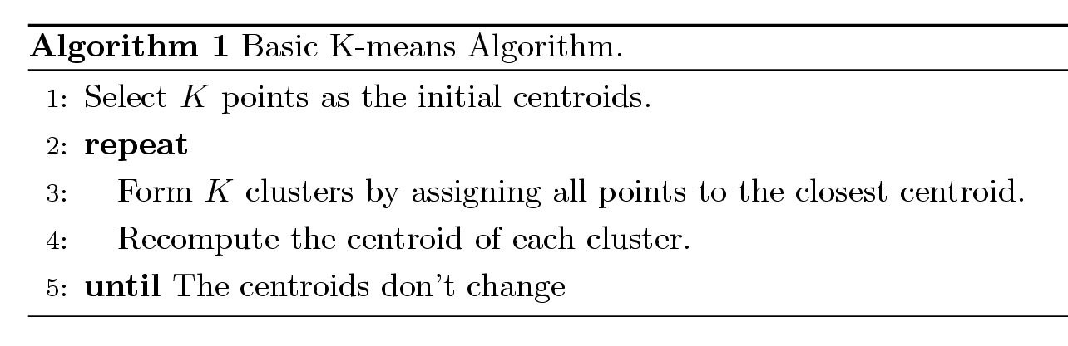
K-means Clustering
Partitional clustering approach
Each cluster is associated with a centroid (center point)
Each point is assigned to the cluster with the closest centroid
Number of clusters, K, must be specified
The basic algorithm is very simple

Slide 25
Illustration

Slide 26
Illustration

Slide 27
Limitations of k-means
The algorithm is only applicable if the mean is defined.
For categorical data, k-mode - the centroid is represented by most frequent values.
The user needs to specify K
The number of clusters (K) is difficult to determine
Hypothesis testing on K

Slide 28
Weaknesses of k-means
W1: Initial Centroids Problem
W2: K-means has problems when clusters are of differing
W2.1: Sizes
W2.2: Densities
W2.3: Non-globular shapes
W3: The algorithm is sensitive to outliers
Outliers are data points that are very far away from other data points.
Outliers could be errors in the data recording or some special data points with very different values.

Slide 29
W1: Initial Centroids Problem
Original Points
Clustering #1 (optimal)
Clustering #2 (sub-optimal)

Slide 30
Solutions to Initial Centroids Problem
Multiple runs
Helps, but probability is not on your side
Sample and use hierarchical clustering to determine initial centroids
Select more than k initial centroids and then select among these initial centroids
Select most widely separated

Slide 31
Weaknesses of k-means
W1: Initial Centroids Problem
W2: K-means has problems when clusters are of differing
W2.1: Sizes
W2.2: Densities
W2.3: Non-globular shapes
W3: The algorithm is sensitive to outliers
Outliers are data points that are very far away from other data points.
Outliers could be errors in the data recording or some special data points with very different values.

Slide 32
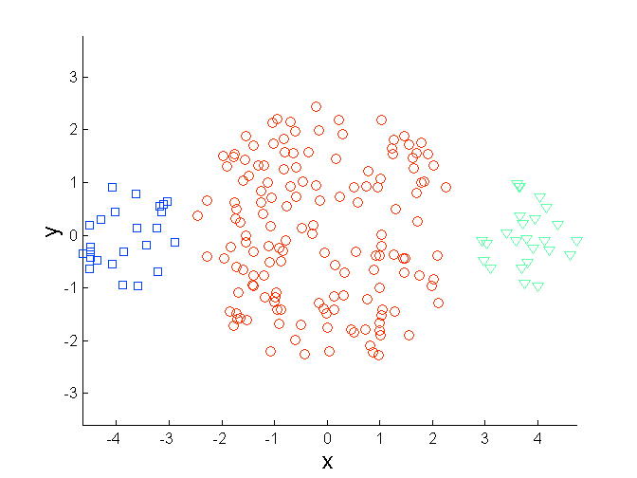
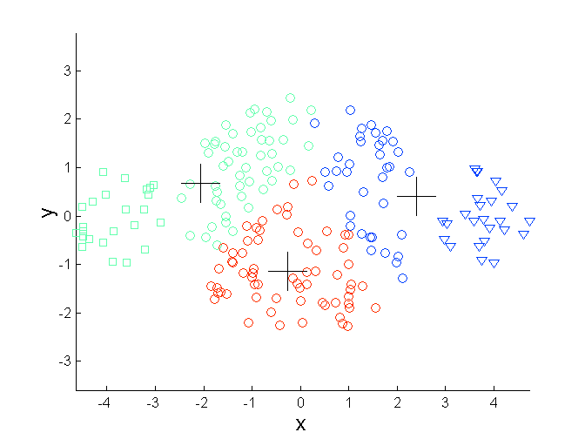
W2.1: Differing Sizes
Original Points
K-means (3 Clusters)

Slide 33
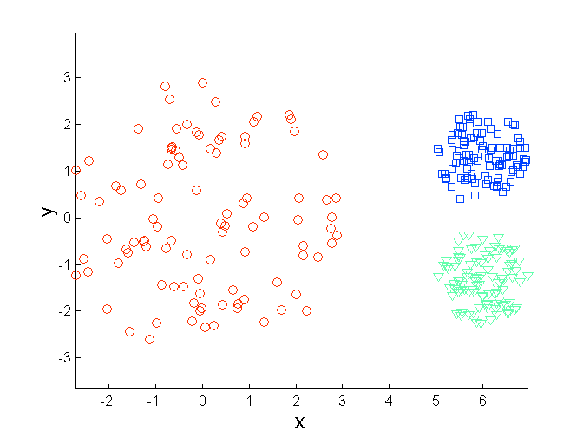
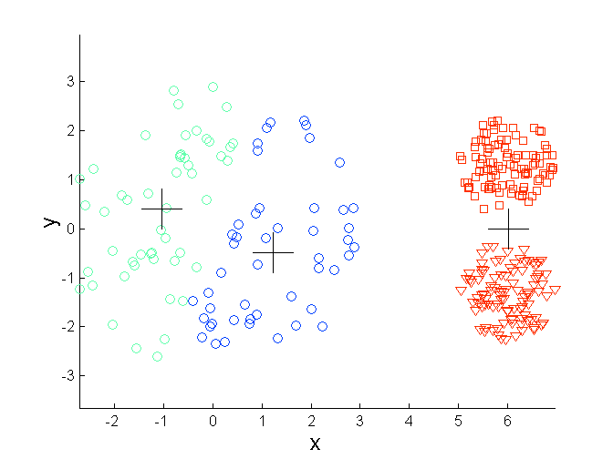
W2.2: Differing Density
Original Points
K-means (3 Clusters)

Slide 34
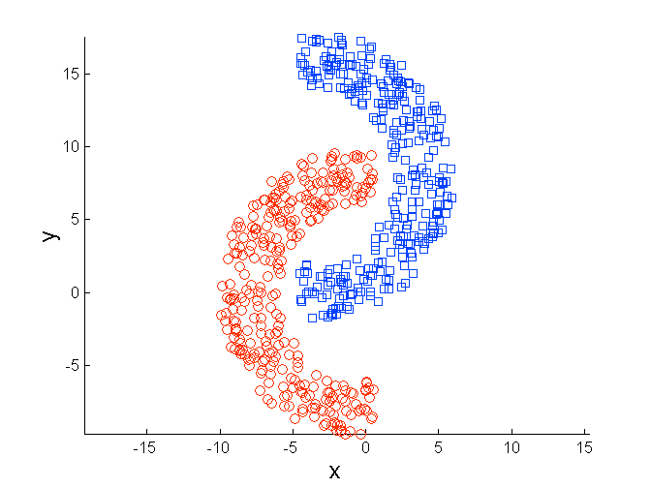
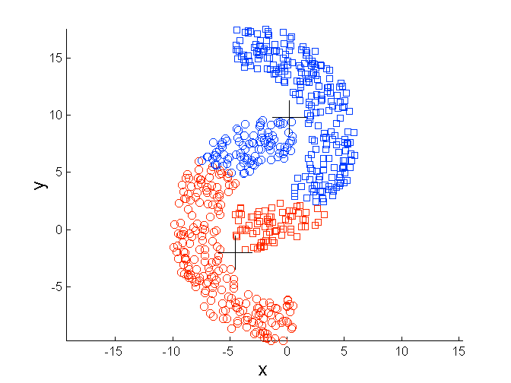
W2.3: Non-globular Shapes
Original Points
K-means (2 Clusters)

Slide 35
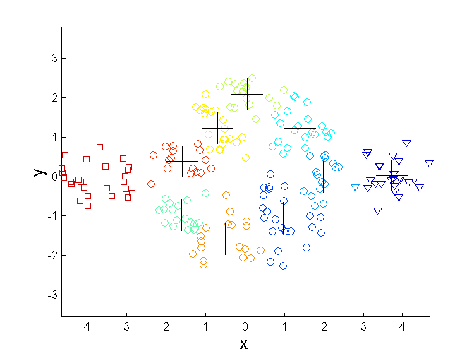
Overcoming K-means Weaknesses #2
Original Points K-means Clusters
One solution is to use many clusters.
Find parts of clusters, but need to put together.

Slide 36
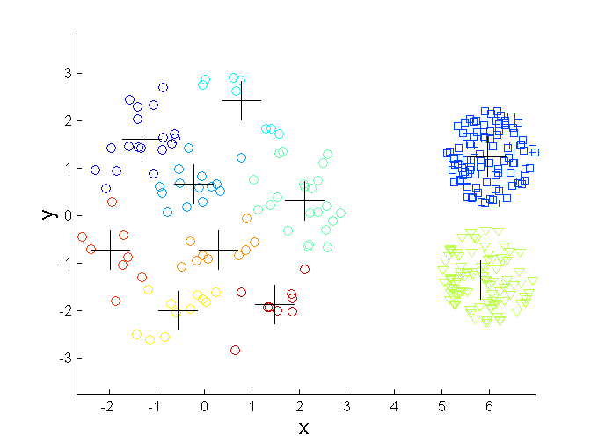
Overcoming K-means Weaknesses #2
Original Points K-means Clusters

Slide 37
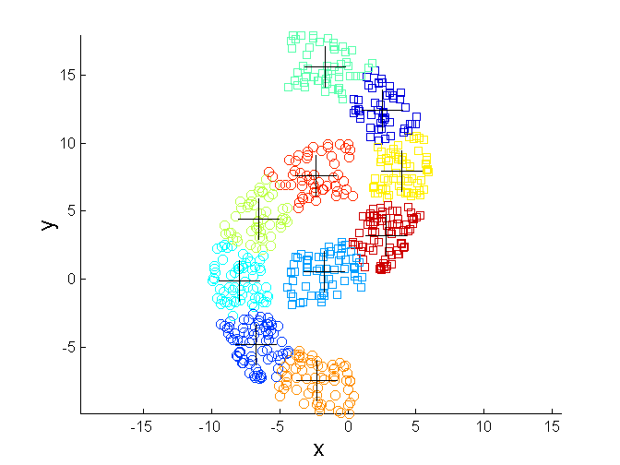
Overcoming K-means Weaknesses #2
Original Points K-means Clusters

Slide 38
Weaknesses of k-means
W1: Initial Centroids Problem
W2: K-means has problems when clusters are of differing
W2.1: Sizes
W2.2: Densities
W2.3: Non-globular shapes
W3: The algorithm is sensitive to outliers
Outliers are data points that are very far away from other data points.
Outliers could be errors in the data recording or some special data points with very different values.

Slide 39
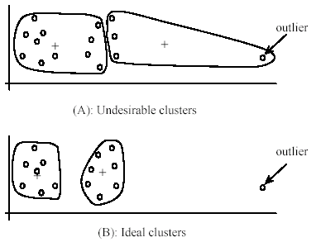
W3: Problems with outliers

Slide 40
To deal with outliers
One method is to remove some data points in the clustering process that are much further away from the centroids than other data points.
To be safe, we may want to monitor these possible outliers over a few iterations and then decide to remove them.
Another method is to perform random sampling. Since in sampling we only choose a small subset of the data points, the chance of selecting an outlier is very small.
Assign the rest of the data points to the clusters by distance or similarity comparison, or classification

Slide 41
K-means summary
Despite limitations and weaknesses, k-means is still the most popular algorithm due to its simplicity, efficiency and
other clustering algorithms have their own lists of weaknesses.
No clear evidence that any other clustering algorithm performs better in general
although they may be more suitable for some specific types of data or applications.

Slide 42
Outline
Basic concepts of clustering
Types of clusters
Types of clusterings
K-means
Hierarchical clustering
DBSCAN
Cluster Validity
Spectral Clustering
Summary

Slide 43
Hierarchical Clustering
Basic concept
Agglomerative clustering
Divisive clustering

Slide 44
Hierarchical Clustering
Produces a set of nested clusters organized as a hierarchical tree
Can be visualized as a dendrogram
A tree like diagram that records the sequences of merges or splits

Slide 45
Strengths of Hierarchical Clustering
Do not have to assume any particular number of clusters
Any desired number of clusters can be obtained by ‘cutting’ the dendogram at the proper level
They may correspond to meaningful taxonomies
Example in biological sciences (e.g., animal kingdom, phylogeny reconstruction, …)

Slide 46
Types of hierarchical clustering
Agglomerative (bottom up) clustering: It builds the dendrogram (tree) from the bottom level, and
merges the most similar (or nearest) pair of clusters
stops when all the data points are merged into a single cluster (i.e., the root cluster).
Divisive (top down) clustering: It starts with all data points in one cluster, the root.
Splits the root into a set of child clusters. Each child cluster is recursively divided further
stops when only singleton clusters of individual data points remain, i.e., each cluster with only a single point

Slide 47
Hierarchical Clustering
Basic concept
Agglomerative clustering
Algorithm
How to Define Inter-Cluster Similarity
Limitations
Divisive clustering

Slide 48
Agglomerative Clustering Algorithm
It is more popular then divisive methods.
Basic algorithm is straightforward
Compute the proximity matrix
Let each data point be a cluster
Repeat
Merge the two closest clusters
Update the proximity matrix
Until only a single cluster remains

Slide 49
Starting Situation
Start with clusters of individual points and a proximity matrix
p1
p2
p3
p4
p5
. . .
p1
p2
p3
p4
p5
.
.
.
Proximity Matrix

Slide 50
Intermediate Situation
After some merging steps, we have some clusters
C1
C2
C3
C4
C5
C1
C2
C3
C3
C4
C4
C5
Proximity Matrix
C1
C2
C5

Slide 51
Intermediate Situation
We want to merge the two closest clusters (C2 and C5) and update the proximity matrix.
C1
C2
C3
C4
C5
C1
C2
C3
C4
C3
C5
C4
Proximity Matrix
C1
C2
C5

Slide 52
After Merging
The question is “How do we update the proximity matrix?”
C2 U C5
C1
C3
C4
C1
?
C2 U C5
? ? ? ?
C3
C3
?
C4
C4
?
Proximity Matrix
C1
C2 U C5

Slide 53
How to Define Inter-Cluster Similarity
p1
p2
p3
p4
p5
. . .
p1
Similarity?
p2
p3
p4
p5
MIN
MAX
Group Average
Distance Between Centroids
Other methods driven by an objective function
Ward’s Method uses squared error
.
.
.
Proximity Matrix

Slide 54
How to Define Inter-Cluster Similarity
p1
p2
p3
p4
p5
. . .
p1
p2
p3
p4
p5
MIN
MAX
Group Average
Distance Between Centroids
Other methods driven by an objective function
Ward’s Method uses squared error
.
.
.
Proximity Matrix

Slide 55
How to Define Inter-Cluster Similarity
p1
p2
p3
p4
p5
. . .
p1
p2
p3
p4
p5
MIN
MAX
Group Average
Distance Between Centroids
Other methods driven by an objective function
Ward’s Method uses squared error
.
.
.
Proximity Matrix

Slide 56
How to Define Inter-Cluster Similarity
p1
p2
p3
p4
p5
. . .
p1
p2
p3
p4
p5
MIN
MAX
Group Average
Distance Between Centroids
Other methods driven by an objective function
Ward’s Method uses squared error
.
.
.
Proximity Matrix

Slide 57
How to Define Inter-Cluster Similarity
p1
p2
p3
p4
p5
. . .
p1
×
×
p2
p3
p4
p5
MIN
MAX
Group Average
Distance Between Centroids
Other methods driven by an objective function
Ward’s Method uses squared error
.
.
.
Proximity Matrix

Slide 58
Cluster Similarity: MIN or Single Link
Similarity of two clusters is based on the two most similar (closest) points in the different clusters
Determined by one pair of points, i.e., by one link in the proximity graph.

Slide 59
Agglomerative Clustering: MIN
5
1
3
5
2
1
2
3
6
4
4
Nested Clusters
Dendrogram

Slide 60
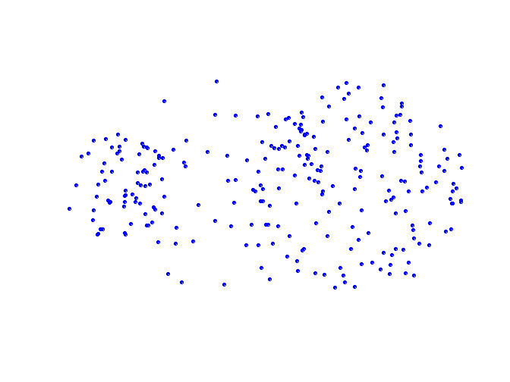
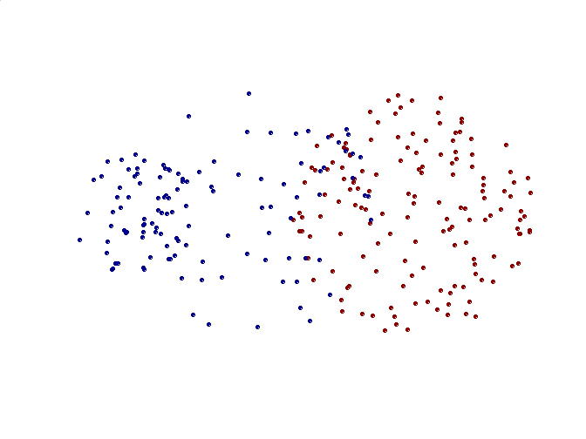
Limitations of MIN
Original Points
Two Clusters
Sensitive to noise and outliers

Slide 61
Cluster Similarity: MAX or Complete Linkage
Similarity of two clusters is based on the two least similar (most distant) points in the different clusters
Determined by all pairs of points in the two clusters

Slide 62
Agglomerative Clustering: MAX
4
1
2
5
5
2
3
6
3
1
4
Nested Clusters
Dendrogram

Slide 63
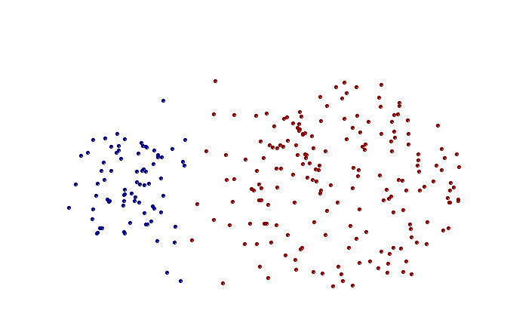
Strength of MAX
Original Points
Two Clusters
Less susceptible to noise and outliers

Slide 64
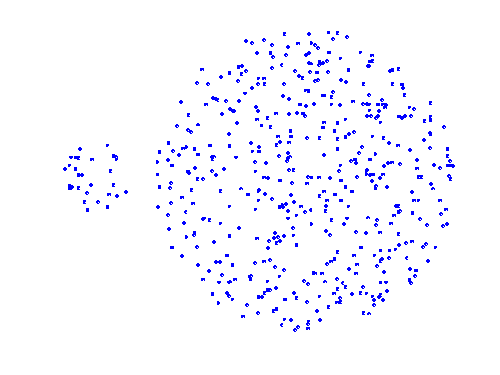
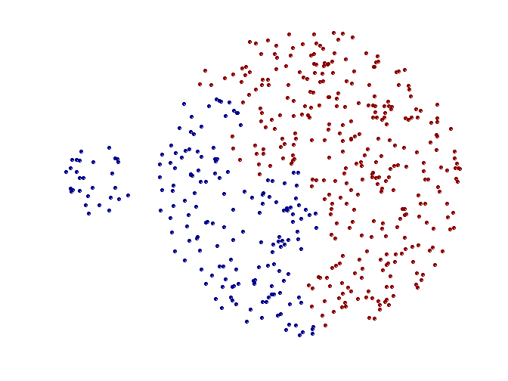
Limitations of MAX
Original Points
Two Clusters
Tends to break large clusters
Biased towards globular clusters

Slide 65
Cluster Similarity: Group Average
Proximity of two clusters is the average of pairwise proximity between points in the two clusters.
Need to use average connectivity for scalability since total proximity favors large clusters

Slide 66
Cluster Similarity: Group Average
Compromise between Single and Complete Link
Strengths
Less susceptible to noise and outliers
Limitations
Biased towards globular clusters

Slide 67
Agglomerative Clustering: Comparison
5
1
4
1
3
2
5
5
5
2
1
MIN
2
MAX
2
3
6
3
3
6
1
4
4
4
5
1
2
5
2
3
6
Group Average
3
1
4
4

Slide 68
Agglomerative Clustering: Problems and Limitations
Once a decision is made to combine two clusters, it cannot be undone
No objective function is directly minimized
Different schemes have problems with one or more of the following:
Sensitivity to noise and outliers (MIN)
Difficulty handling different sized clusters and non-convex shapes (Group average, MAX)
Breaking large clusters (MAX)

Slide 69
Hierarchical Clustering
Basic concept
Agglomerative clustering
Algorithm
How to Define Inter-Cluster Similarity
Limitations
Divisive clustering

Slide 70
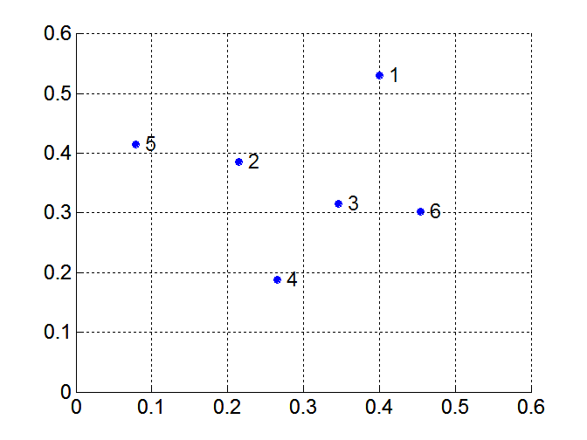
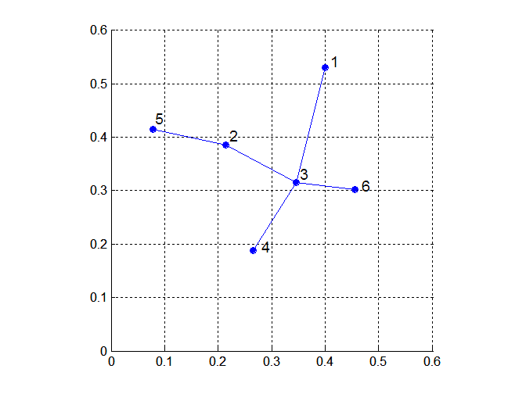
MST: Divisive Hierarchical Clustering
Build MST (Minimum Spanning Tree)
Start with a tree that consists of any point
In successive steps, look for the closest pair of points (p, q) such that one point (p) is in the current tree but the other (q) is not
Add q to the tree and put an edge between p and q

Slide 71
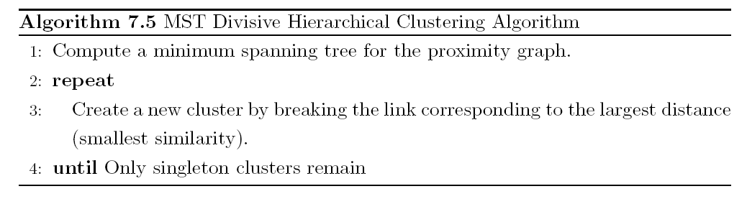
MST: Divisive Hierarchical Clustering
Use MST for constructing hierarchy of clusters

Slide 72
Outline
Basic concepts of clustering
Types of clusters
Types of clusterings
K-means
Hierarchical clustering
DBSCAN
Cluster Validity
Spectral Clustering
Summary

Slide 73
DBSCAN
DBSCAN is a density-based algorithm.
Density = number of points within a specified radius (Eps)
A point is a core point if it has more than a specified number of points (MinPts) within Eps
These are points that are at the interior of a cluster
A border point has fewer than MinPts within Eps, but is in the neighborhood of a core point
A noise point is any point that is not a core point or a border point.

Slide 74
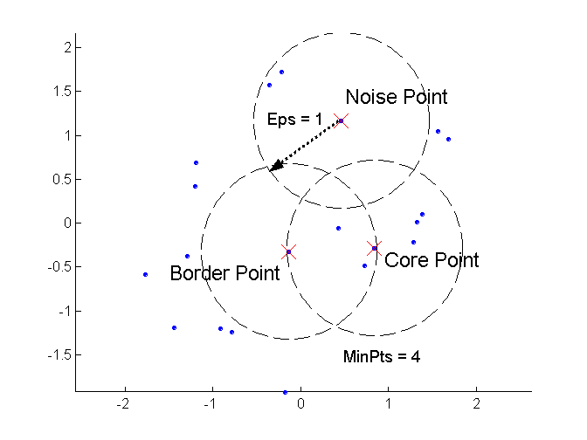
DBSCAN: Core, Border, and Noise Points

Slide 75
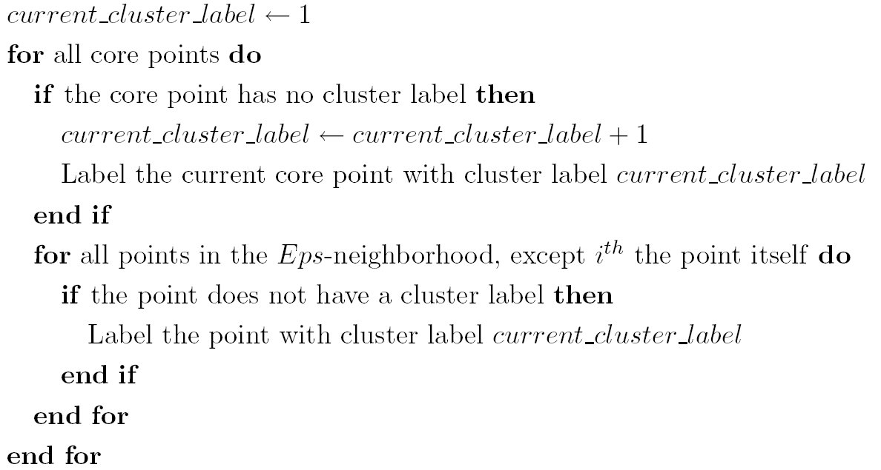
DBSCAN Algorithm
Eliminate noise points
Perform clustering on the remaining points

Slide 76
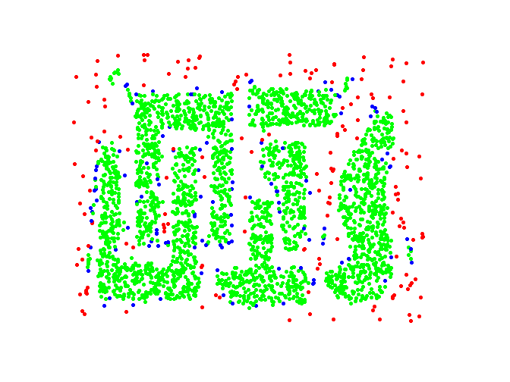
DBSCAN: Core, Border and Noise Points
Original Points
Point types: core, border and noise
Eps = 10, MinPts = 4

Slide 77
When DBSCAN Works Well
Original Points
Clusters
Resistant to Noise
Can handle clusters of different shapes and sizes

Slide 78
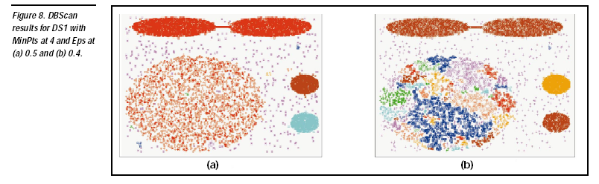

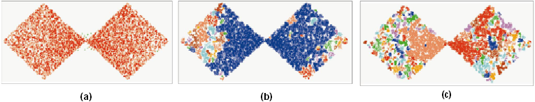
When DBSCAN Does NOT Work Well
Sensitive to parameters, Varying densities, High-dimensional data

Slide 79
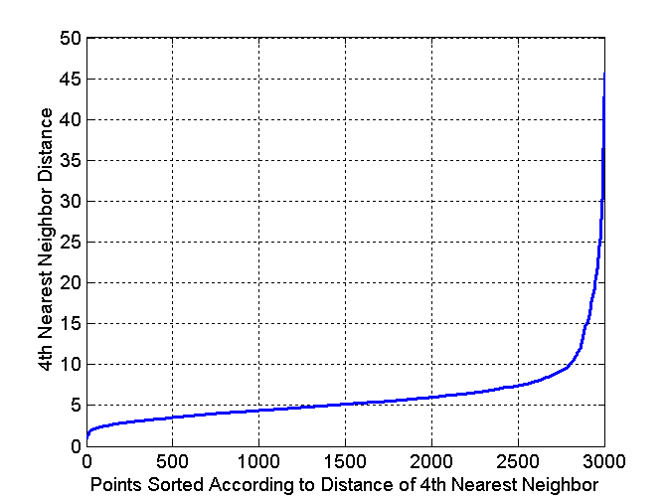
DBSCAN: Determining EPS and MinPts
Idea is that for points in a cluster, their k^{th} nearest neighbors are at roughly the same distance
Noise points have the k^{th} nearest neighbor at farther distance
So, plot sorted distance of every point to its k^{th} nearest neighbor

Slide 80
Outline
Basic concepts of clustering
Types of clusters
Types of clusterings
K-means
Hierarchical clustering
DBSCAN
Cluster Validity
Spectral Clustering
Summary

Slide 81
Cluster Validity
For supervised classification we have a variety of measures to evaluate how good our model is
Precision, recall
For cluster analysis, the analogous question is how to evaluate the “goodness” of the resulting clusters?
But “clusters are in the eye of the beholder”!
Then why do we want to evaluate them?
To avoid finding patterns in noise
To compare clustering algorithms
To compare two sets of clusters
To compare two clusters

Slide 82
Clusters found in Random Data
Random Points
DBSCAN
K-means
Complete Link

Slide 83
Different Aspects of Cluster Validation
Determining the clustering tendency of a set of data, i.e., distinguishing whether non-random structure actually exists in the data.
Comparing the results of a cluster analysis to externally known results, e.g., to externally given class labels.
Evaluating how well the results of a cluster analysis fit the data without reference to external information.
- Use only the data
Comparing the results of two different sets of cluster analyses to determine which is better.
Determining the ‘correct’ number of clusters.
For 2, 3, and 4, we can further distinguish whether we want to evaluate the entire clustering or just individual clusters.

Slide 84
Measures of Cluster Validity
Numerical measures that are applied to judge various aspects of cluster validity, are classified into the following three types.
External Index: Used to measure the extent to which cluster labels match externally supplied class labels.
Entropy
Internal Index: Used to measure the goodness of a clustering structure without respect to external information.
Sum of Squared Error (SSE)
Relative Index: Used to compare two different clusterings or clusters.
Often an external or internal index is used for this function, e.g., SSE or entropy
Sometimes these are referred to as criteria instead of indices
However, sometimes criterion is the general strategy and index is the numerical measure that implements the criterion.

Slide 85
Measuring Cluster Validity Via Correlation
Two matrices
Proximity Matrix
“Incidence” Matrix
One row and one column for each data point
An entry is 1 if the associated pair of points belong to the same cluster
An entry is 0 if the associated pair of points belongs to different clusters
Compute the correlation between the two matrices
Since the matrices are symmetric, only the correlation between n(n-1) / 2 entries needs to be calculated.
High correlation indicates that points that belong to the same cluster are close to each other.
Not a good measure for some density or contiguity based clusters.

Slide 86
Measuring Cluster Validity Via Correlation
Correlation of incidence and proximity matrices for the K-means clusterings of the following two data sets.
Corr = 0.9235
Corr = 0.5810

Slide 87
Using Similarity Matrix for Cluster Validation
Order the similarity matrix with respect to cluster labels and inspect visually.

Slide 88
Using Similarity Matrix for Cluster Validation
Clusters in random data are not so crisp
DBSCAN

Slide 89
Using Similarity Matrix for Cluster Validation
Clusters in random data are not so crisp
K-means

Slide 90
Using Similarity Matrix for Cluster Validation
Clusters in random data are not so crisp
Complete Link

Slide 91
Using Similarity Matrix for Cluster Validation
DBSCAN

Slide 92
Internal Measures: SSE
Clusters in more complicated figures aren’t well separated
Internal Index: Used to measure the goodness of a clustering structure without respect to external information
SSE
SSE is good for comparing two clusterings or two clusters (average SSE).
Can also be used to estimate the number of clusters

Slide 93
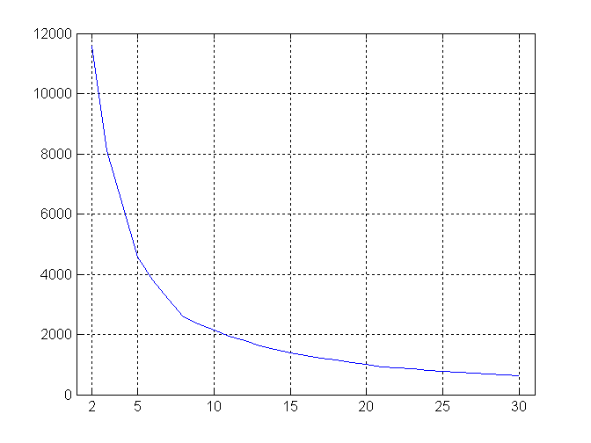
Internal Measures: SSE
SSE curve for a more complicated data set
SSE of clusters found using K-means

Slide 94
Framework for Cluster Validity
Need a framework to interpret any measure.
For example, if our measure of evaluation has the value, 10, is that good, fair, or poor?
Statistics provide a framework for cluster validity
The more “atypical” a clustering result is, the more likely it represents valid structure in the data
Can compare the values of an index that result from random data or clusterings to those of a clustering result.
If the value of the index is unlikely, then the cluster results are valid
These approaches are more complicated and harder to understand.
For comparing the results of two different sets of cluster analyses, a framework is less necessary.
However, there is the question of whether the difference between two index values is significant

Slide 95
Statistical Framework for SSE
Example
Compare SSE of 0.005 against three clusters in random data
Histogram shows SSE of three clusters in 500 sets of random data points of size 100 distributed over the range 0.2 – 0.8 for x and y values

Slide 96
Internal Measures: Cohesion and Separation
Cluster Cohesion: Measures how closely related are objects in a cluster
Example: SSE
Cluster Separation: Measure how distinct or well-separated a cluster is from other clusters
Example: Squared Error
Cohesion is measured by the within cluster sum of squares (SSE)
Separation is measured by the between cluster sum of squares
Where |C_{i}| is the size of cluster i

Slide 97
Internal Measures: Cohesion and Separation
Example: SSE
BSS + WSS = constant
m
×
×
×
1
m₁
2
3
4
m₂
5
K=1 cluster:
K=2 clusters:

Slide 98
Internal Measures: Cohesion and Separation
A proximity graph based approach can also be used for cohesion and separation.
Cluster cohesion is the sum of the weight of all links within a cluster.
Cluster separation is the sum of the weights between nodes in the cluster and nodes outside the cluster.
cohesion
separation

Slide 99
Internal Measures: Silhouette Coefficient
Silhouette Coefficient combine ideas of both cohesion and separation, but for individual points, as well as clusters and clusterings
For an individual point, i
Calculate a = average distance of i to the points in its cluster
Calculate b = min (average distance of i to points in another cluster)
The silhouette coefficient for a point is then given by s = 1 – a/b if a < b, (or s = b/a - 1 if a ≥ b, not the usual case)
Typically between 0 and 1.
The closer to 1 the better.
Can calculate the Average Silhouette width for a cluster or a clustering

Slide 100
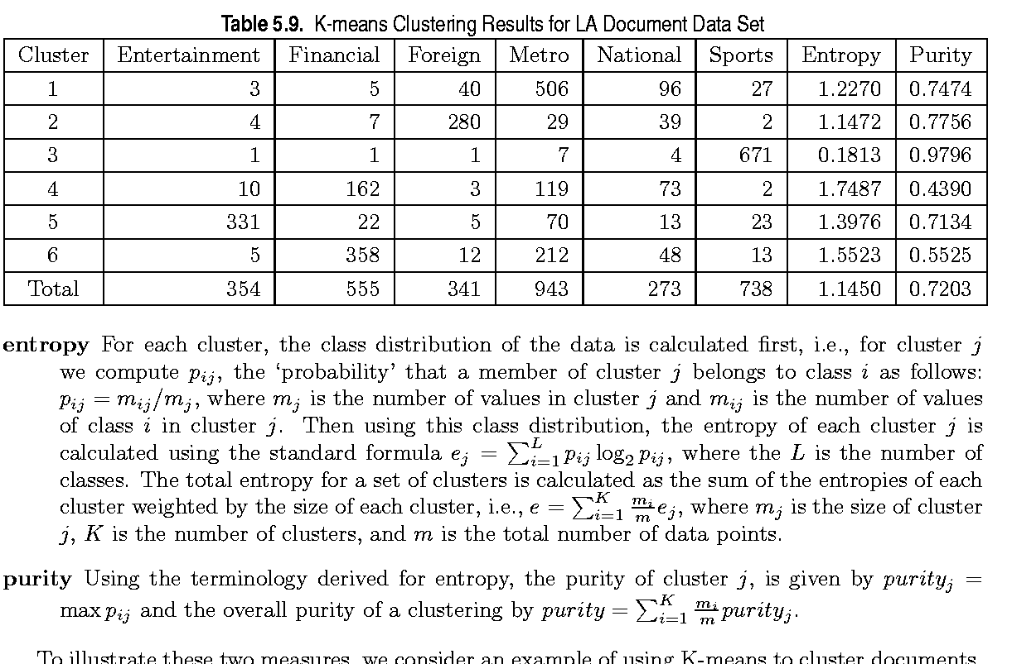
External Measures of Cluster Validity: Entropy and Purity

Slide 101
Final Comment on Cluster Validity
“The validation of clustering structures is the most difficult and frustrating part of cluster analysis.
Without a strong effort in this direction, cluster analysis will remain a black art accessible only to those true believers who have experience and great courage.”
Algorithms for Clustering Data, Jain and Dubes

Slide 102
Summary
Clustering is has along history and still active
There are a huge number of clustering algorithms
More are still coming every year.
We only introduced several main algorithms. There are many others, e.g.,
sub-space clustering, scale-up methods, neural networks based methods, fuzzy clustering, co-clustering, etc.
Clustering is hard to evaluate, but very useful in practice. This partially explains why there are still a large number of clustering algorithms being devised every year.
Clustering is highly application dependent and to some extent subjective.

