Slide 1

作业1：参数估计与优化
Suppose random variable x obeys Laplace distribution , with pdf defined as
Assume that we have a number of examples X={x₁, x₂, …, x_{N}} drawn independently from the distribution, where the scale parameter λ is known, what is the Maximum Likelihood estimate of the location parameter μ?

Slide 2




作业2：基于EM的GMM参数估计
Gaussian Mixture Models (GMM)
parameters of GMM
Assume that we have a number of examples X={x₁, x₂, …, x_{N}} drawn independently from the GMM, use EM algorithm to estimate the parameters of GMM.

Slide 3

作业3
In the large sample limit (N→∞), prove that the error of 1‐NN classification

Slide 4
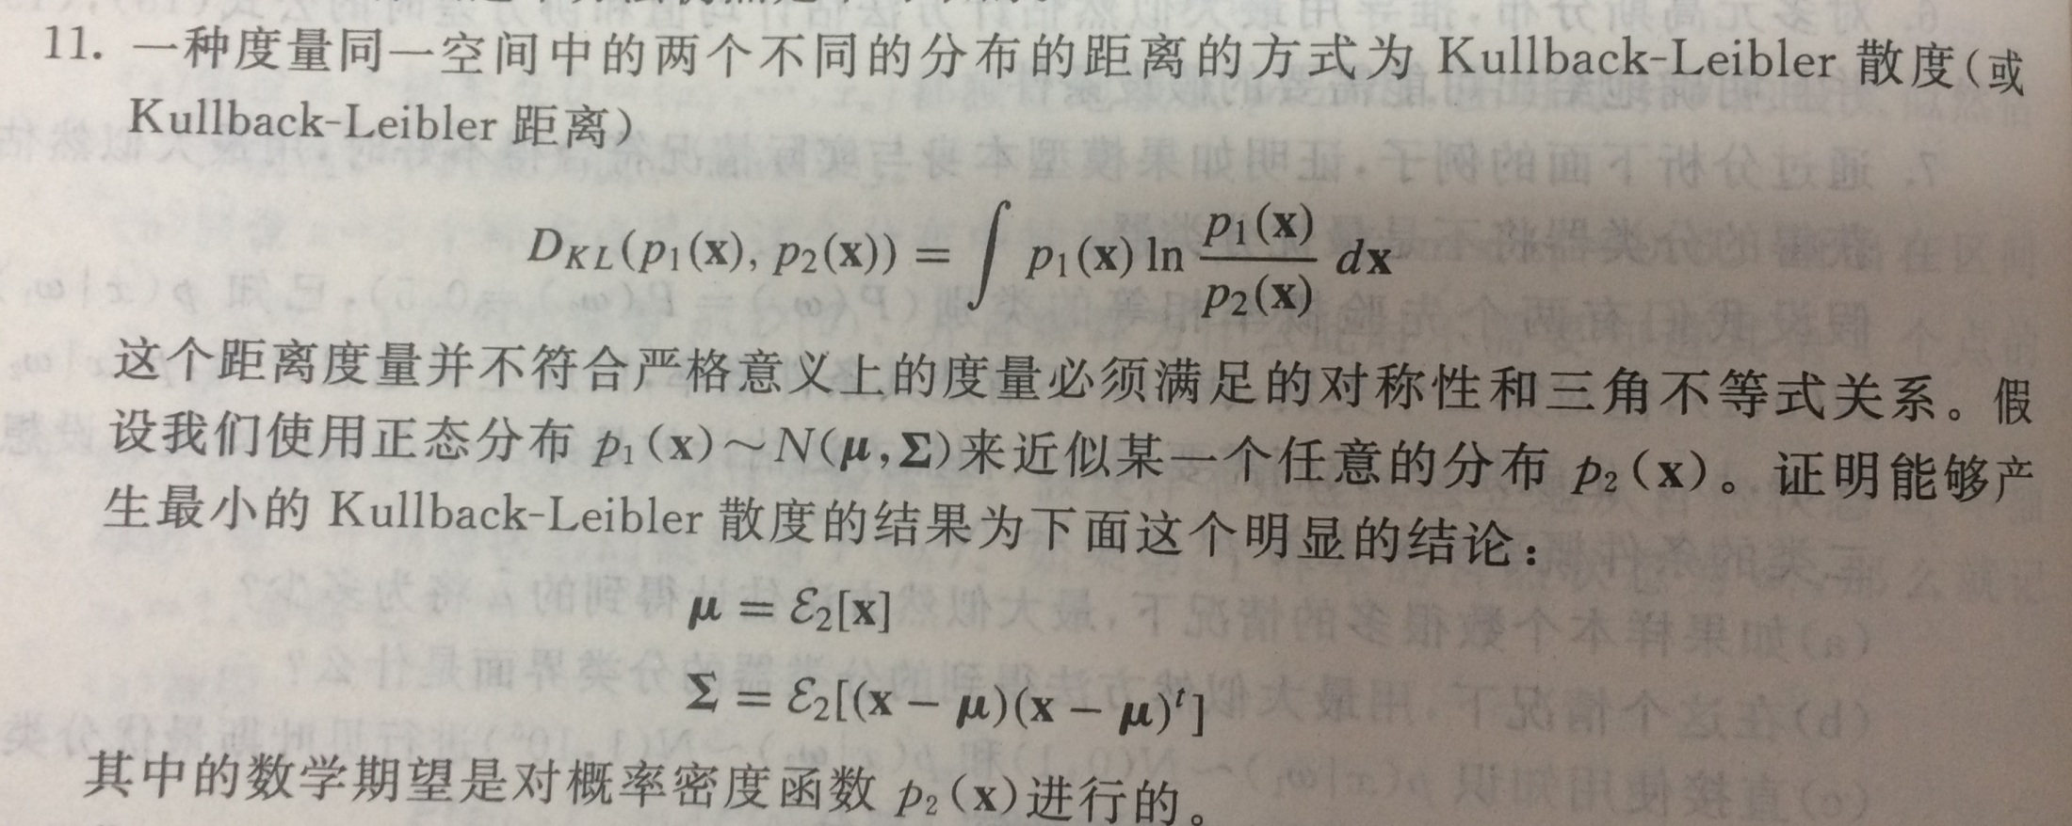
作业4

