Slide 1

Project:” WebServer + API (Веб-приложение)”
Created by: Zarubin michail

Slide 2
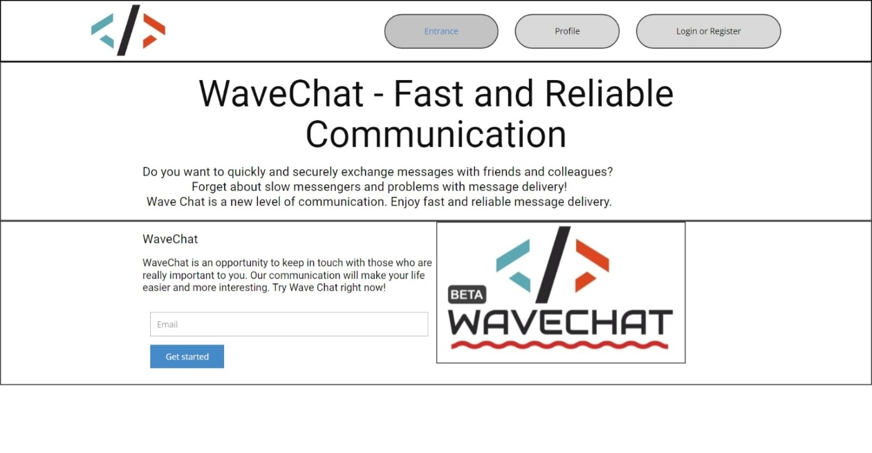
WaveChat - Fast and Reliable Communication
Do you want to quickly and securely exchange messages with friends and colleagues? Forget about slow messengers and problems with message delivery! Wave Chat is a new level of communication. Enjoy fast and reliable message delivery.

Slide 3
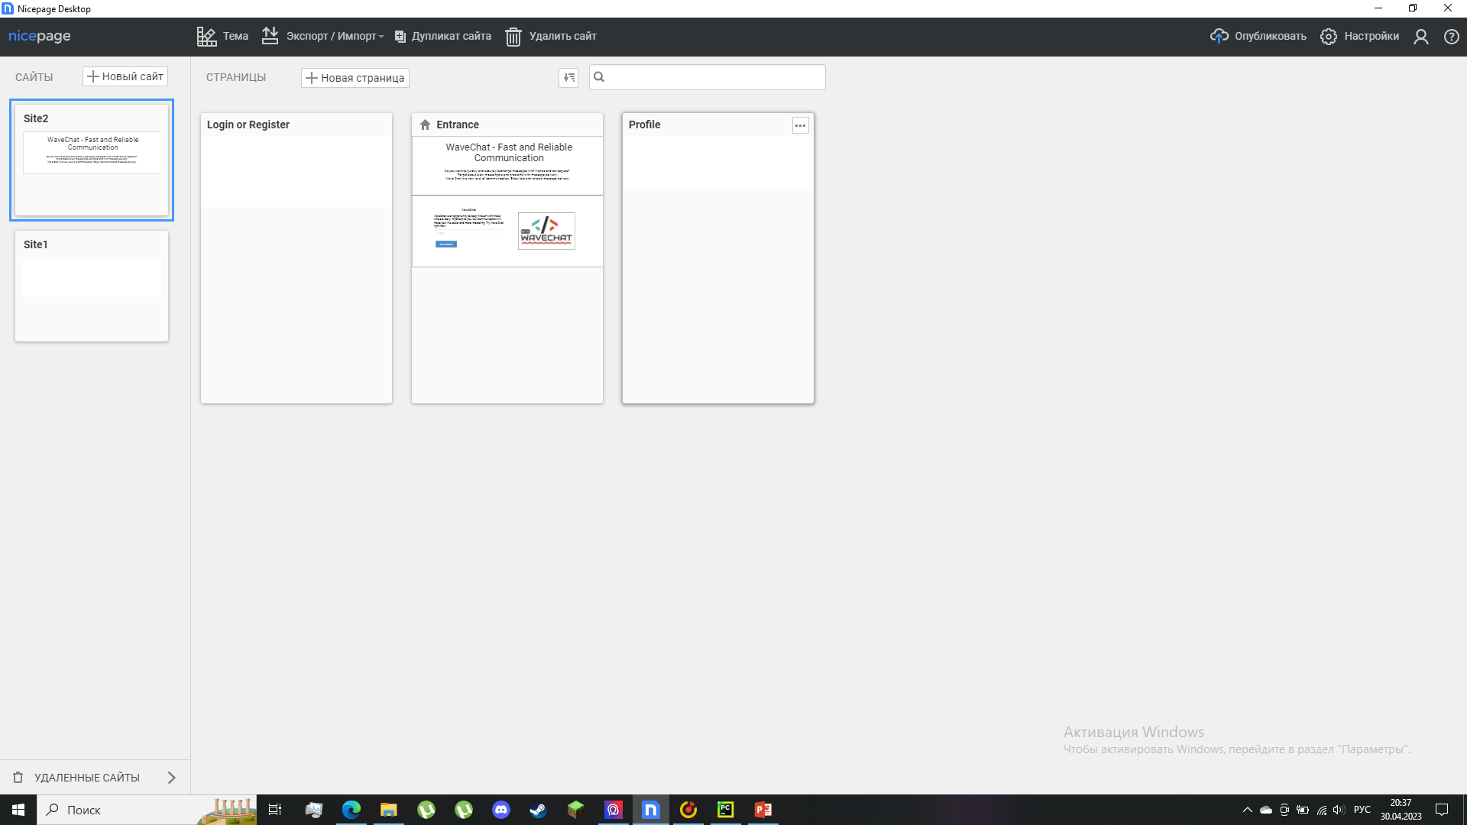
Wavechat
To date, the site has only 3 pages, but it is under development. However, the presence of only a few windows will be justified by the functionality and the presence of floating windows.
*Some windows are not shown because they are made manually or templates are not added in this editor.

Slide 4
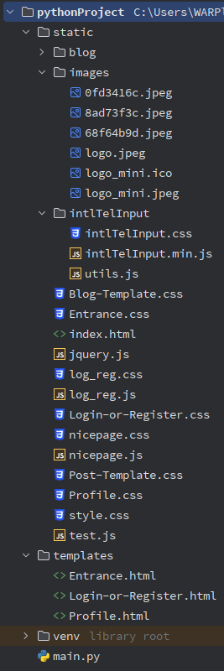
Wavechat
Many but not all files are shown here, the rest will be in the final version.

