Slide 1
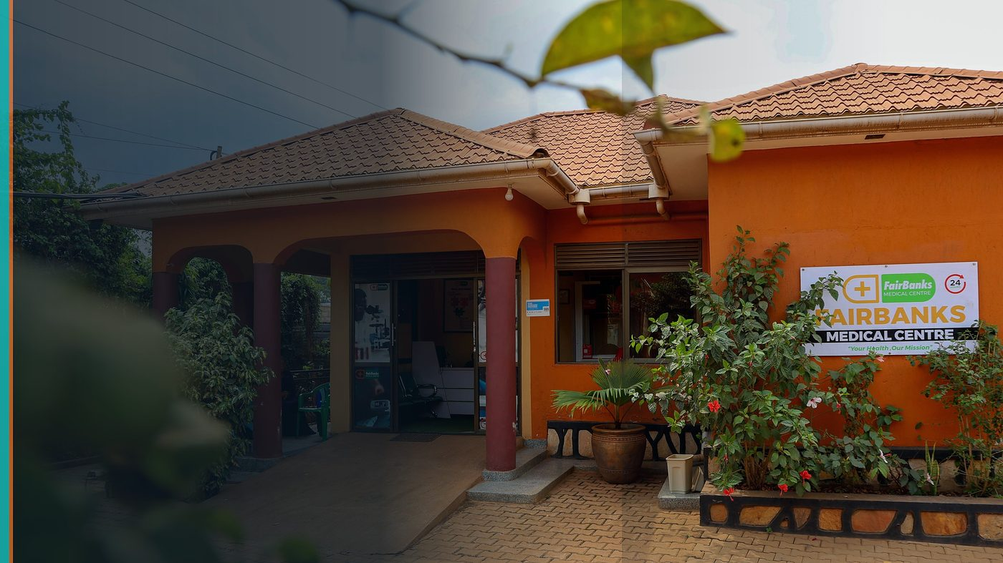
Africa CDC African Epidemic Services (AES) Epidemiology Fellowship 2026–2028
Fellowship Nomination — Surveillance Science for Community Health
FairBanks Community Health Intelligence Platform (FCHIP)
Your health, our mission.
3 months training in Addis Ababa · 21 months field placement · fully funded

Slide 2
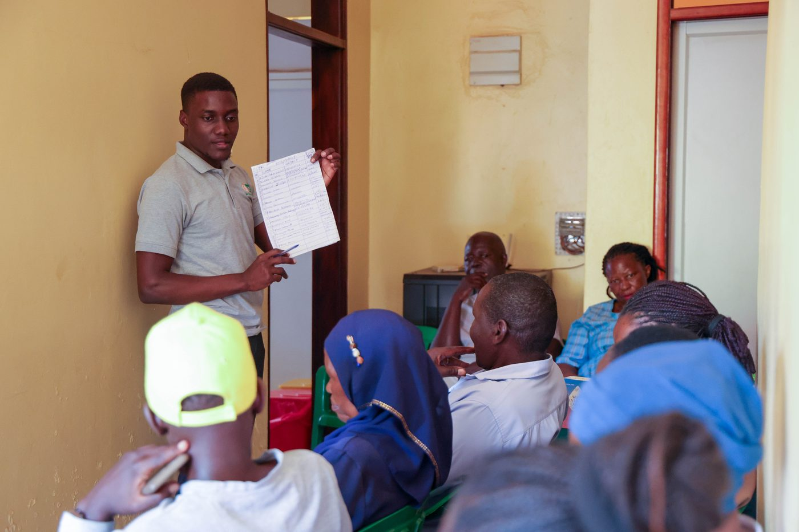
AES FELLOWSHIP
Two years — training, placement, fully funded
• 3 months core training in Addis Ababa
• 21 months field placement with employer support
• Epidemiology or Public Health Informatics track
• Stipend, travel, insurance, hardware, software
• African Union citizens under 35 in public health
FairBanks FCHIP | Africa CDC AES Fellowship | Your health, our mission.
2

Slide 3
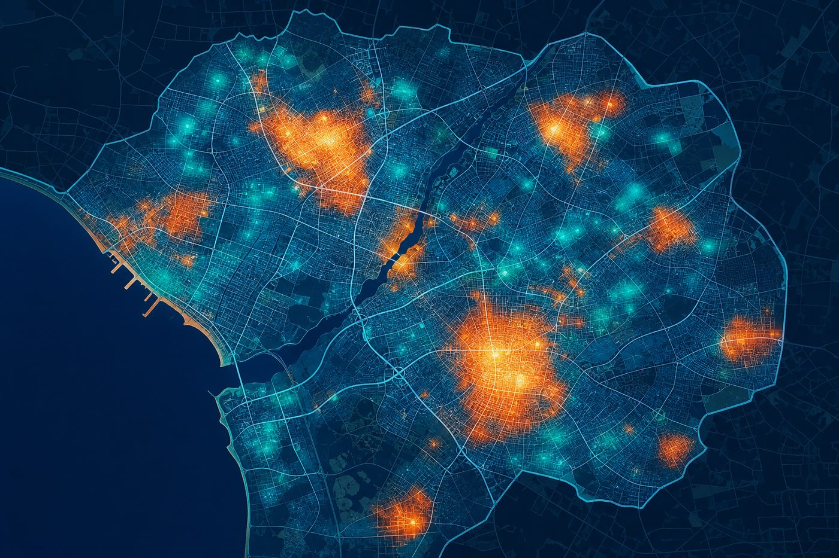
SURVEILLANCE SCIENCE
Platforms need trained epidemiologists — not only code
Community signals from CHWs only become action with investigation discipline, trend analysis, and informatics pipelines.
FairBanks lives inside primary care — the right place to grow Africa's epidemic readiness.
FairBanks FCHIP | Africa CDC AES Fellowship | Your health, our mission.
3

Slide 4
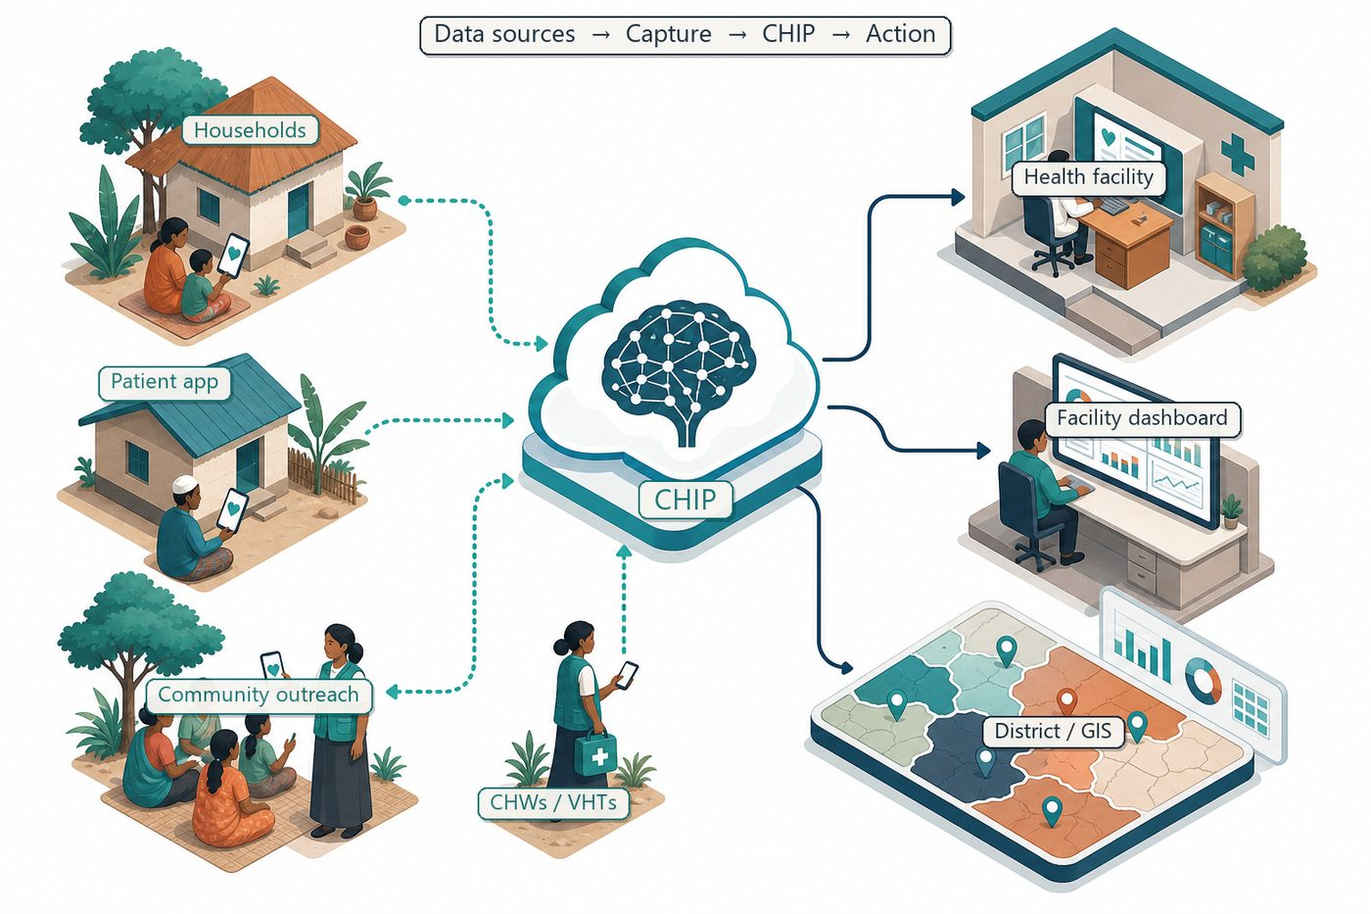
RETURN PATHWAY
Training → field → FCHIP → communities
Standardise outbreak workflows
Improve CHW data quality
Cascade training to supervisors
Validate FCHIP alerts with surveillance methods
FairBanks FCHIP | Africa CDC AES Fellowship | Your health, our mission.
4

Slide 5
SHARED VALUE
Africa CDC ↔ FairBanks ↔ communities
FairBanks gains
Africa CDC gains
World-class epidemiology training; stronger surveillance modules; stipend, travel, insurance, hardware, and software covered; continental AES network access.
Fellow employed in live community health work; field placement linked to real CHW and facility data; Uganda contribution to Africa's epidemic readiness; informatics track aligned with digital community health tools.
FairBanks FCHIP | Africa CDC AES Fellowship | Your health, our mission.
5

Slide 6
APPLICATION AREAS
Where fellowship skills meet FCHIP
Outbreak workflows: community fever reports trigger structured investigation and pharmacy pre-stocking before surges spread.
Informatics: validation rules and data-quality pipelines for offline CHW capture feeding FCHIP.
Training cascade: teach CHW supervisors better data use and early-warning interpretation.
FairBanks FCHIP | Africa CDC AES Fellowship | Your health, our mission.
6

Slide 7
24-MONTH PATHWAY
Addis Ababa training → Uganda field placement
Months 1–3
Core epidemiology and informatics training in Addis Ababa
Months 4–12
Field placement — outbreak workflows and CHW data quality at FairBanks sites
Months 13–24
Advanced surveillance modules; district partner engagement; FCHIP alert validation
Throughout
Monthly learning reports; Africa CDC network participation; community feedback loops
FairBanks FCHIP | Africa CDC AES Fellowship | Your health, our mission.
7

Slide 8
ELIGIBILITY FIT
Nominee meets AES criteria through FairBanks employment
AU citizen under 35
Ugandan staff candidate within eligibility range
Employed in public health
FairBanks clinical / community health employment
Degree + 3 years' experience
Nominee will meet stated requirements
Epidemiology / Informatics tracks
Direct fit to FCHIP surveillance and data-quality goals
FairBanks FCHIP | Africa CDC AES Fellowship | Your health, our mission.
8

Slide 9
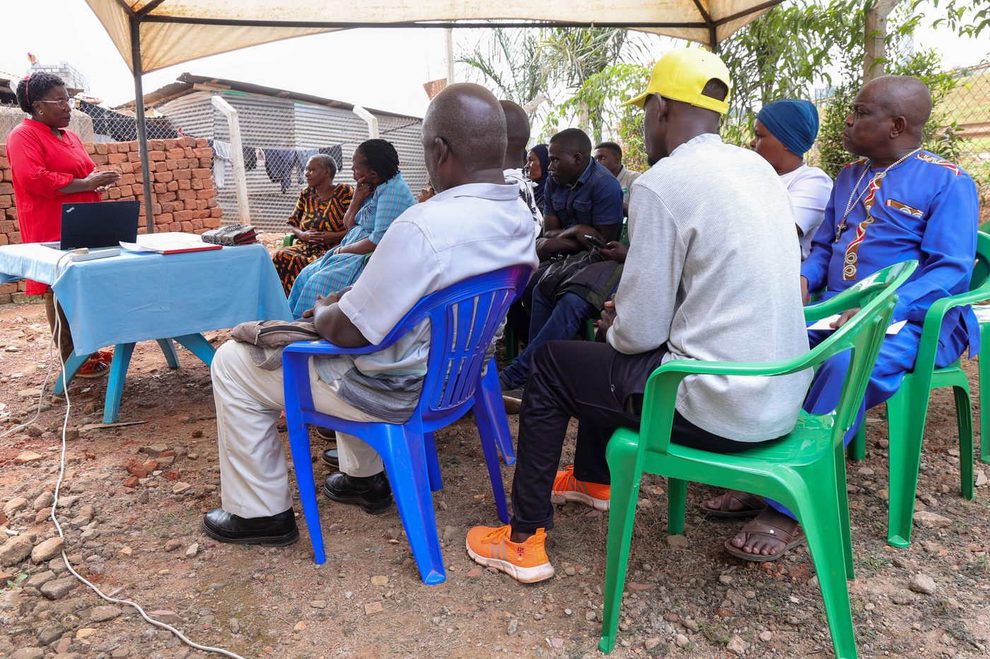
FIELD FOUNDATION
Live community health ecosystem in Uganda
• FairBanks Medical Centre + Community Reach
• CHW/VHT networks in Kampala catchments
• Maternal, child, chronic, and outreach programmes
• FCHIP intelligence layer in development
• Employer ready to host field placement
FairBanks FCHIP | Africa CDC AES Fellowship | Your health, our mission.
9

Slide 10
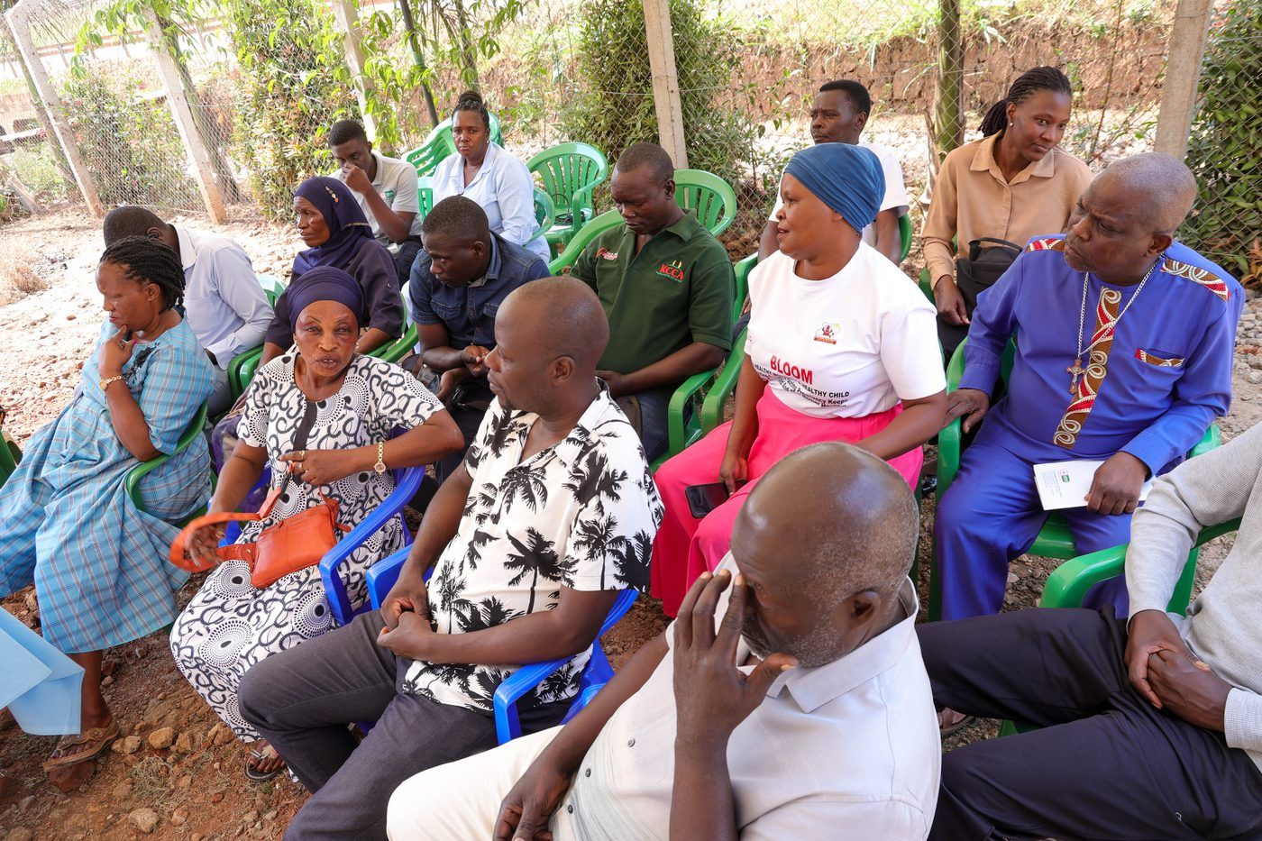
Select our fellow — skills that return to FCHIP and Uganda's communities.
Your health, our mission.
Apply by 26 August 2026

