Slide 1
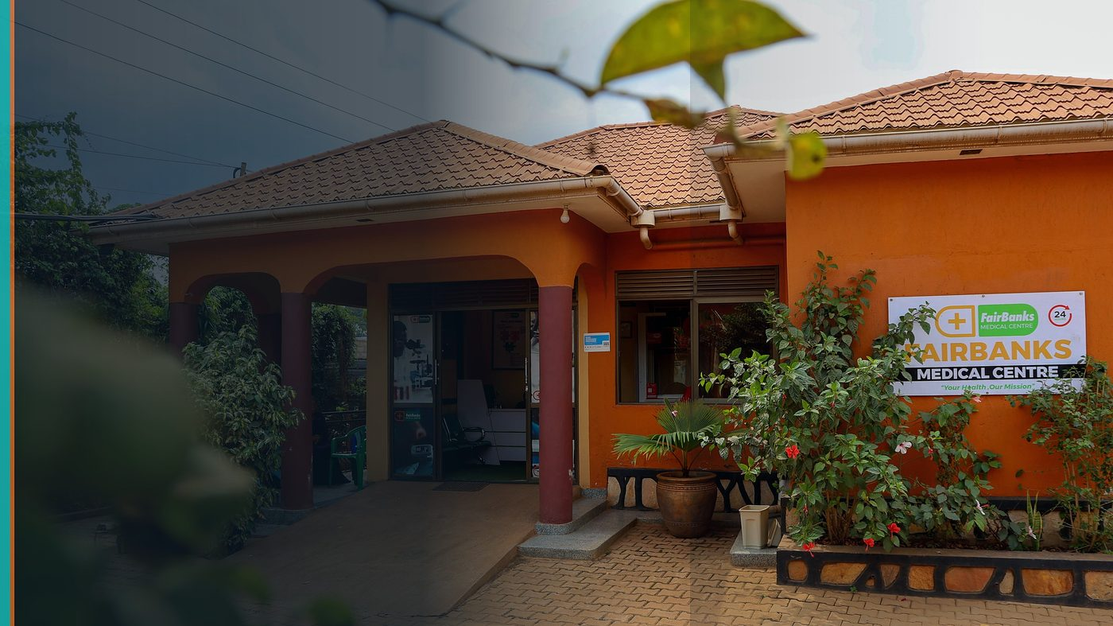
AUC Venture Lab Women Innovation Fellowship 2026
Fellowship Application — Women-Led HealthTech Leadership
FairBanks Community Health Intelligence Platform (FCHIP)
Your health, our mission.
Cairo, Egypt · 1 September – 31 October 2026

Slide 2
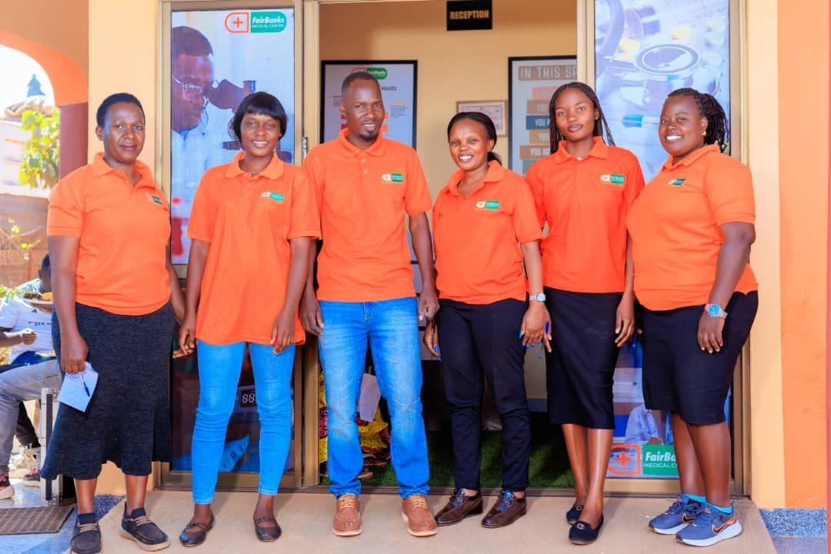
FELLOWSHIP FIT
Cross-regional leadership for women in HealthTech
HealthTech that serves Africa needs leadership training and cross-regional networks — not code alone.
AUC Venture Lab is Africa’s top accelerator heritage (440+ startups). Cairo connects North and East Africa.
I bring live community health operations from Uganda; I seek mentor access and investor-ready discipline.
FairBanks FCHIP | AUC Women Innovation Fellowship | Your health, our mission.
2

Slide 3
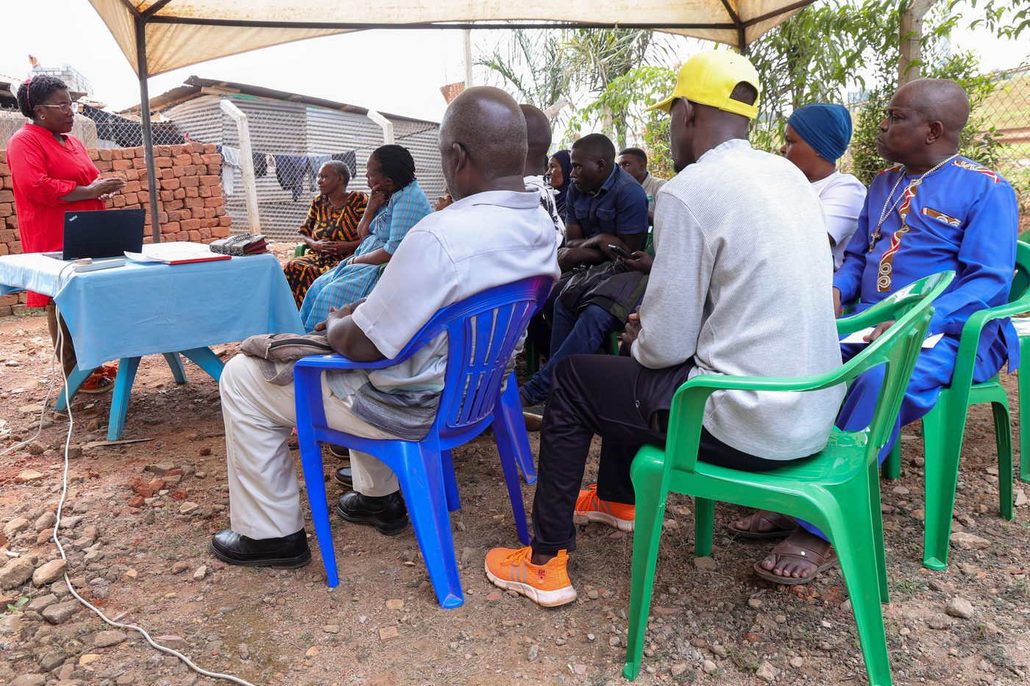
LEADERSHIP
Communities first — building trust before scale
• CHW/VHT partnerships in Kampala communities
• Maternal, adolescent, and chronic-care programmes
• Clinical + community + product leadership combined
• Decisions shaped by people who need care first
FairBanks FCHIP | AUC Women Innovation Fellowship | Your health, our mission.
3

Slide 4
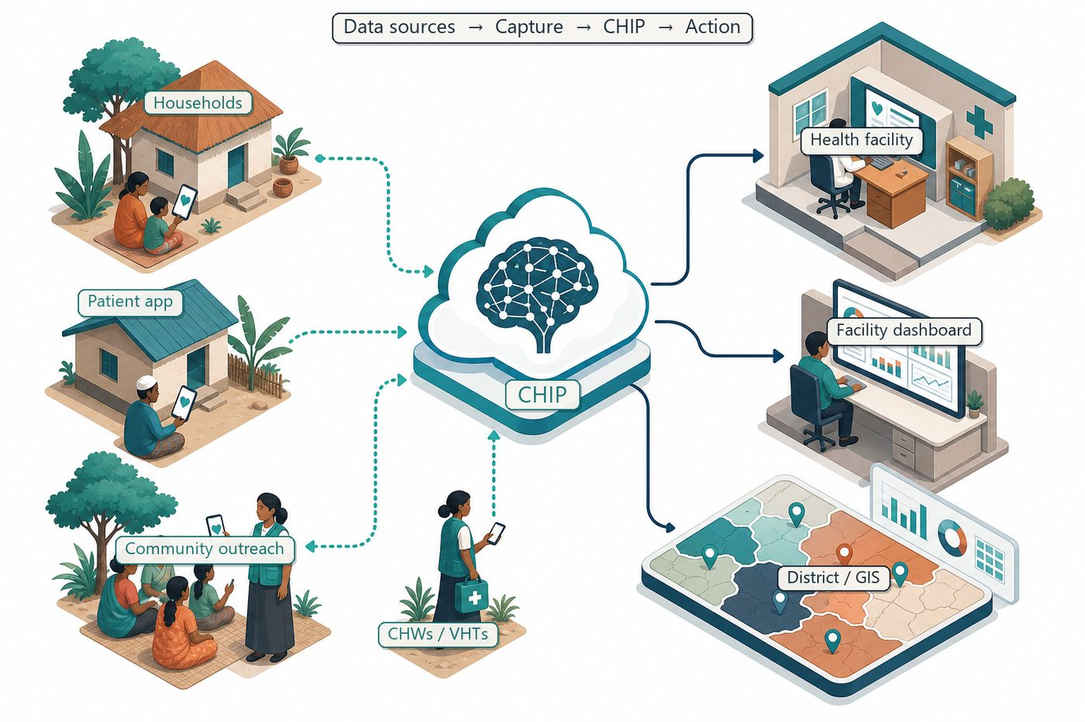
INNOVATION
Women-led intelligence on a live community health cascade
Offline capture → cloud intelligence → alerts to CHWs, clinics, districts.
Predict outbreaks, maternal risk, NCD hotspots, child health gaps, stock-outs.
FairBanks FCHIP | AUC Women Innovation Fellowship | Your health, our mission.
4

Slide 5
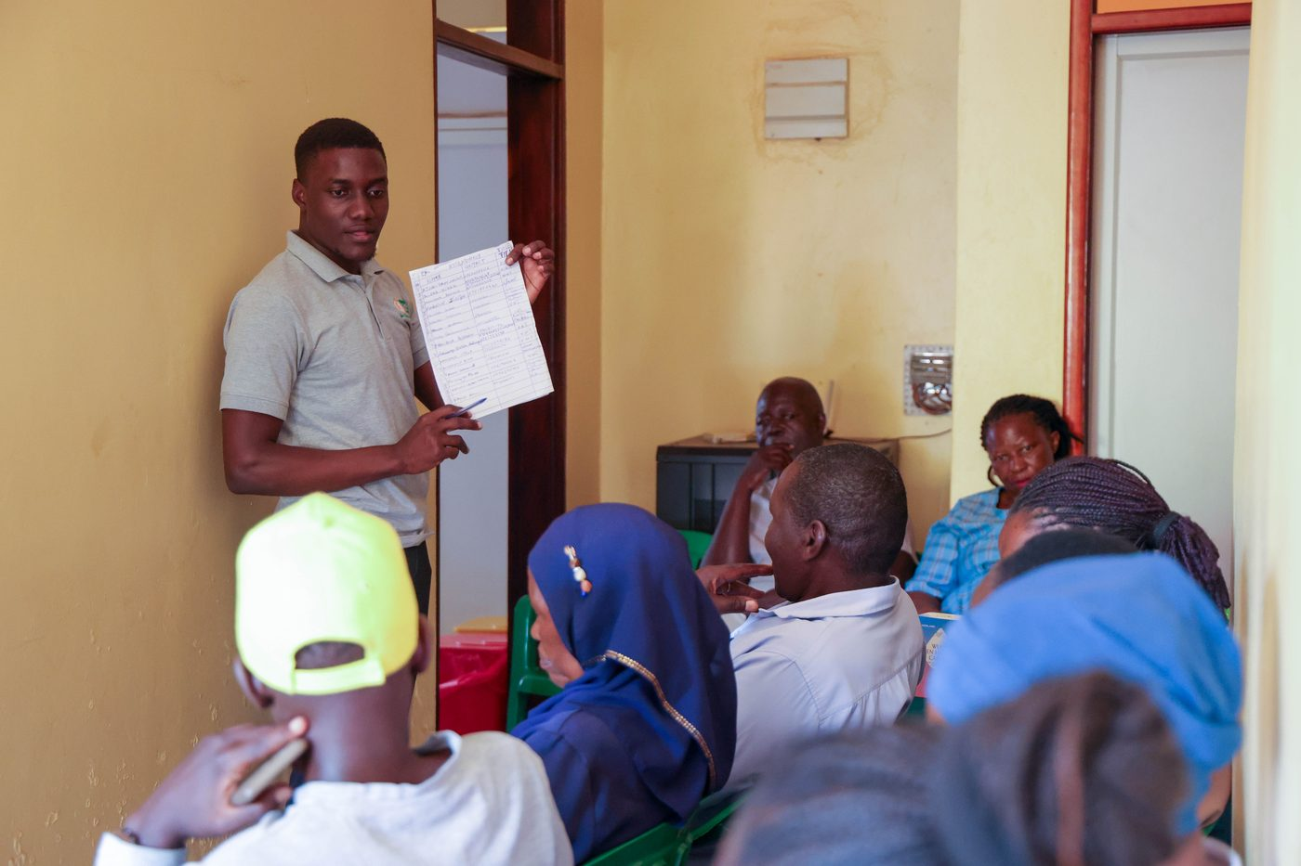
GROWTH
Mentorship, ecosystem, investor readiness
Leadership development · Mentor hours · Ecosystem engagement · Cross-cultural collaboration
From live pilot toward investment-ready venture across East Africa.
FairBanks FCHIP | AUC Women Innovation Fellowship | Your health, our mission.
5

Slide 6
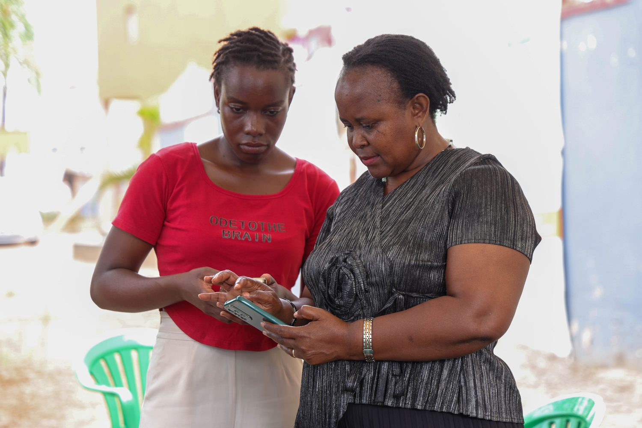
COHORT VALUE
Field validation Egypt–Africa cohorts can learn from
• Functioning medical centre + pharmacy
• Live outreach data pipelines
• Trusted community relationships
• FCHIP field validation
• Grassroots ↔ continental bridge
FairBanks FCHIP | AUC Women Innovation Fellowship | Your health, our mission.
6

Slide 7
SEP–OCT 2026
September–October 2026 — concrete outcomes
Leadership labs: decision-making under uncertainty in community health markets
Mentor hours with HealthTech founders and investors in AUC’s ecosystem
Cross-cultural collaboration with fellows from Egypt, Denmark links, and beyond
Pitch refinement for FCHIP as a women-led, Africa-rooted intelligence company
FairBanks FCHIP | AUC Women Innovation Fellowship | Your health, our mission.
7

Slide 8
SHARED OUTCOME
Stronger founder, stronger continental HealthTech story
FairBanks gains
AUC Venture Lab gains
World-class accelerator training, continental visibility, and mentor networks that help FCHIP scale beyond Uganda.
A fellow bringing live HealthTech field validation, CHW data pipelines, and a compelling women-innovation story from East Africa.
FairBanks FCHIP | AUC Women Innovation Fellowship | Your health, our mission.
8

Slide 9
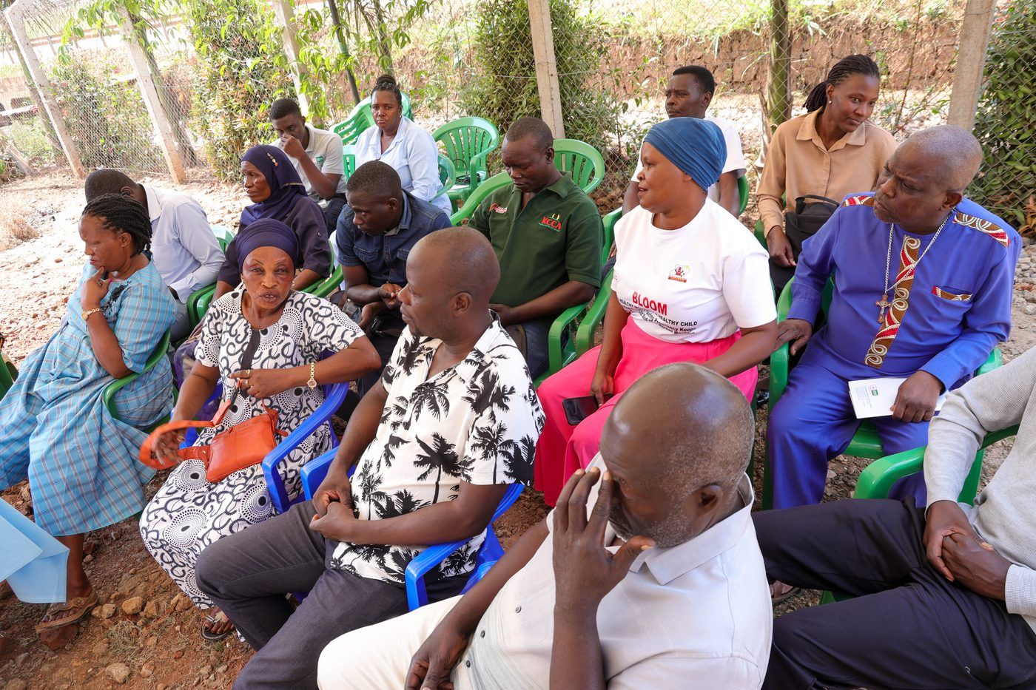
Ready for Cairo — women-led HealthTech with community roots.
Your health, our mission.
Application deadline: 25 July 2026

