Slide 1
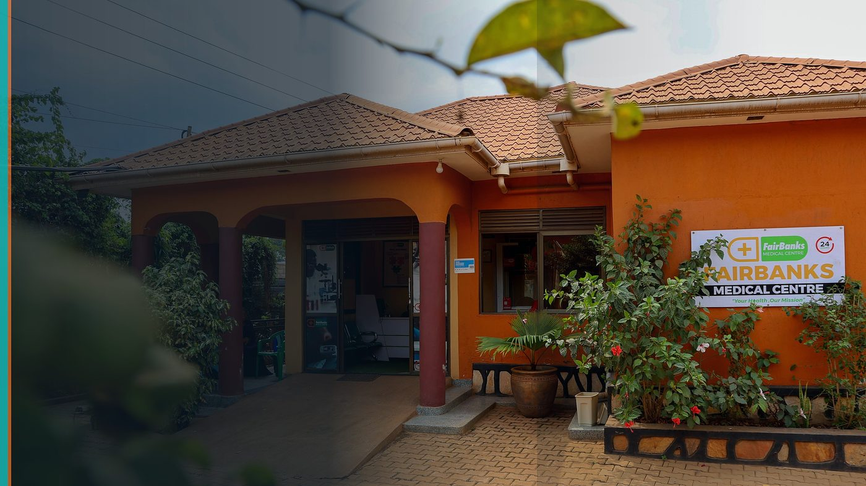
AUDA-NEPAD Youth SRH Ambassadors Initiative 2026
Ambassador Nomination — Advocacy & Community Mobilisation
FairBanks Community Health Intelligence Platform (FCHIP)
Your health, our mission.
Application deadline: 17 July 2026

Slide 2
NOMINATION
Grassroots mobiliser → continental SRH voice
FairBanks Community Reach runs maternal & adolescent programmes with CHWs/VHTs.
Ambassadors must connect field truth to policy — that is already my work.
FCHIP adds evidence on where SRH gaps cluster.
FairBanks | AUDA-NEPAD Youth SRH Ambassador | Your health, our mission.
2

Slide 3
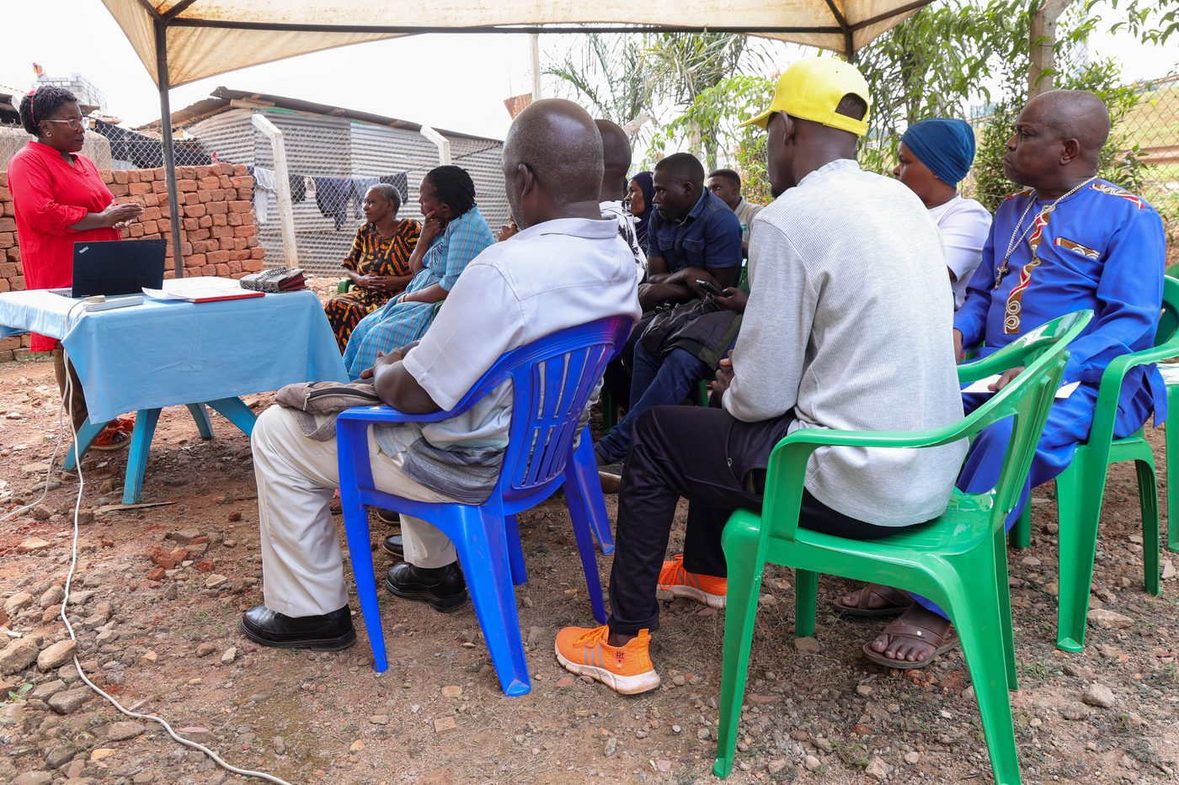
ADVOCACY
SRH through FairBanks outreach
• School and community dialogues on adolescent SRH through FairBanks outreach
• Maternal health education linking ANC uptake, safe pregnancy, and partner involvement
• Digital content that meets young people where they are — without shame or jargon
• Peer mobilisation through CHWs/VHTs who already hold community trust
FairBanks | AUDA-NEPAD Youth SRH Ambassador | Your health, our mission.
3

Slide 4
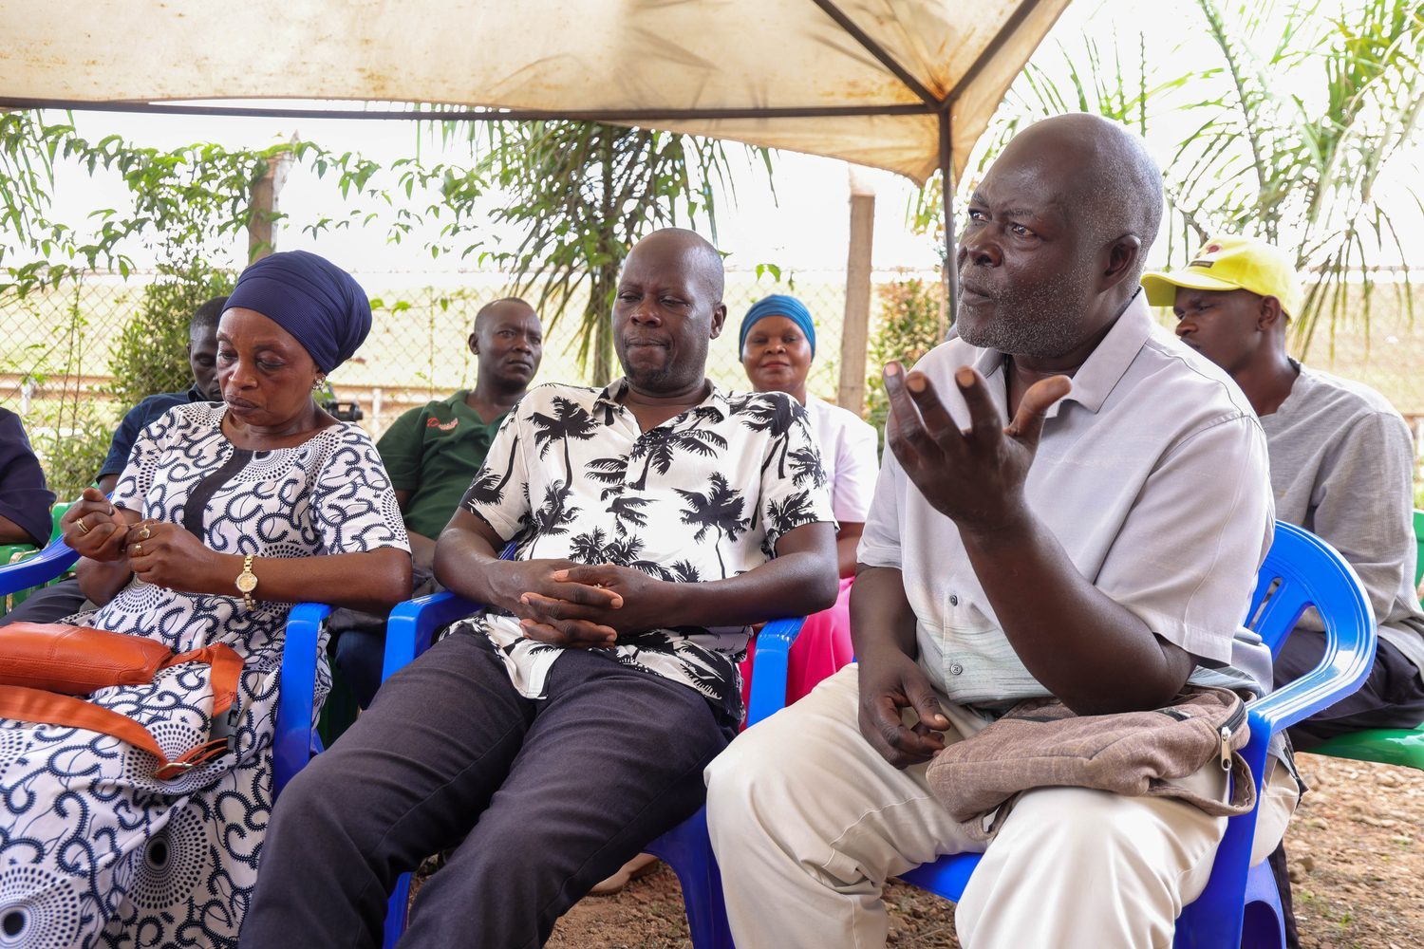
MOBILISATION
Kampala communities — dialogue first
Bukoto · Kyebando · Kisaasi · Kamwokya · Kikaaya
CHWs translate SRH into trusted local action
Digital + in-person — no shame, no jargon
FairBanks | AUDA-NEPAD Youth SRH Ambassador | Your health, our mission.
4

Slide 5
ALIGNMENT
Energize Africa · Agenda 2063 Goal 18
Youth as co-creators — not passive beneficiaries — in SRH programming
Grassroots realities from Kampala communities informing continental advocacy
Linking SRH to livelihoods, education, and the demographic dividend
Amplifying AUDA-NEPAD frameworks through lived FairBanks field experience
FairBanks | AUDA-NEPAD Youth SRH Ambassador | Your health, our mission.
5

Slide 6
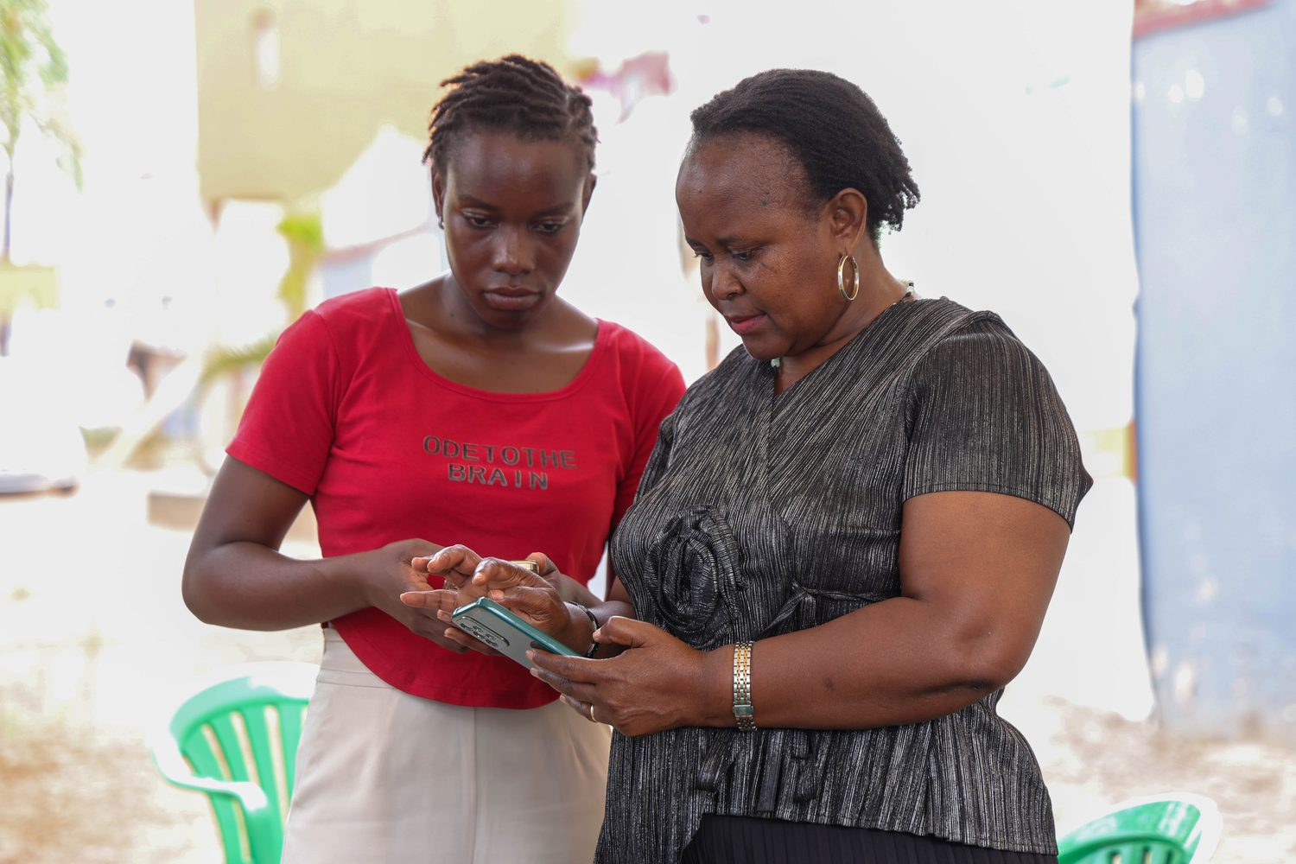
IF SELECTED
Ambassador commitments
• Monthly advocacy content tied to outreach calendars and adolescent/maternal programmes
• Report anonymised community insights upward — what youth actually ask in the field
• Support A2DSRH and Energize Africa messaging with honest, local-language examples
• Mentor younger peer advocates through FairBanks Community Reach volunteer pathways
FairBanks | AUDA-NEPAD Youth SRH Ambassador | Your health, our mission.
6

Slide 7
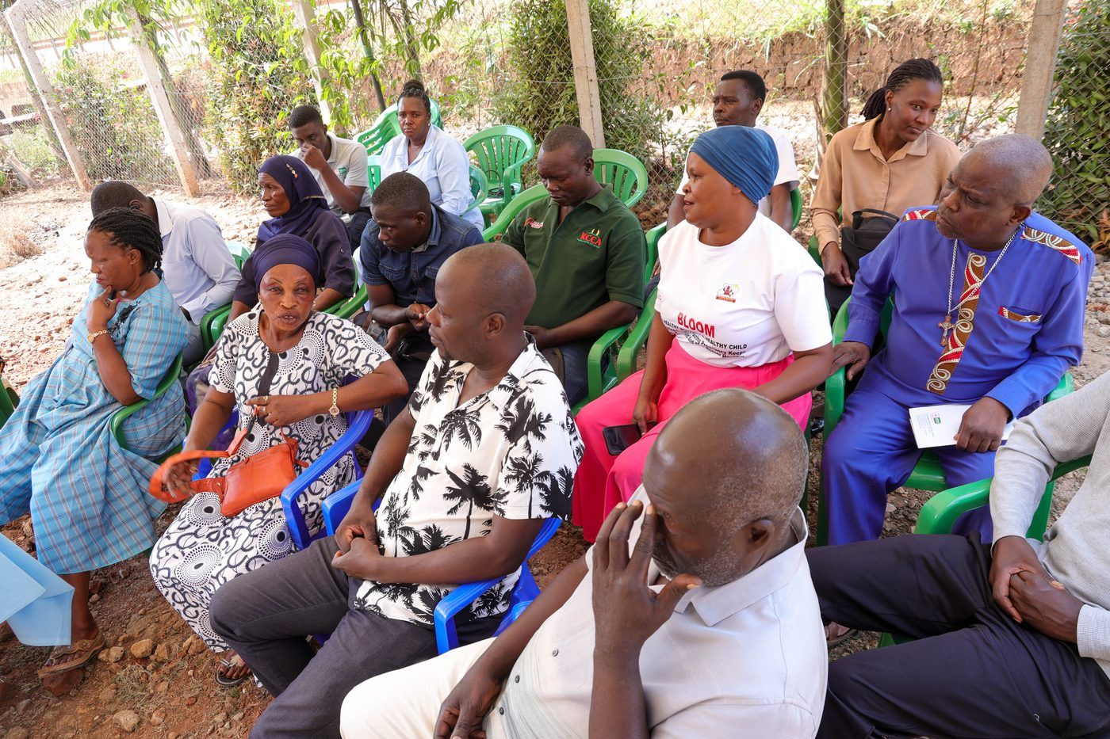
AMPLIFICATION
What the ambassador platform adds
• Official ambassador recognition and continental SRH platforms
• Training, mentorship, and networking with policy and youth leaders
• Visibility to translate Kampala outreach lessons into Africa-wide dialogue
• Sponsored participation in selected AUDA-NEPAD engagements where appropriate
FairBanks | AUDA-NEPAD Youth SRH Ambassador | Your health, our mission.
7

Slide 8
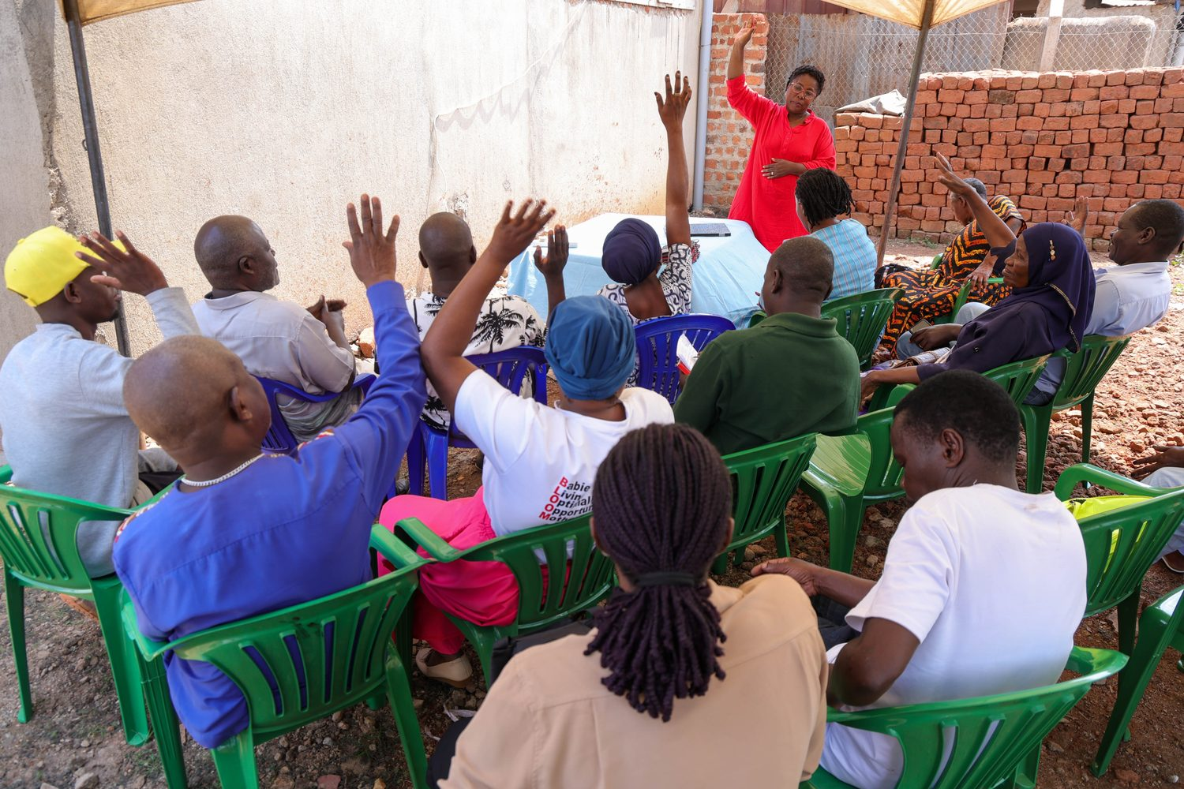
Youth SRH advocacy rooted in community — ready to serve continentally.
Your health, our mission.
Application deadline: 17 July 2026

