Slide 1
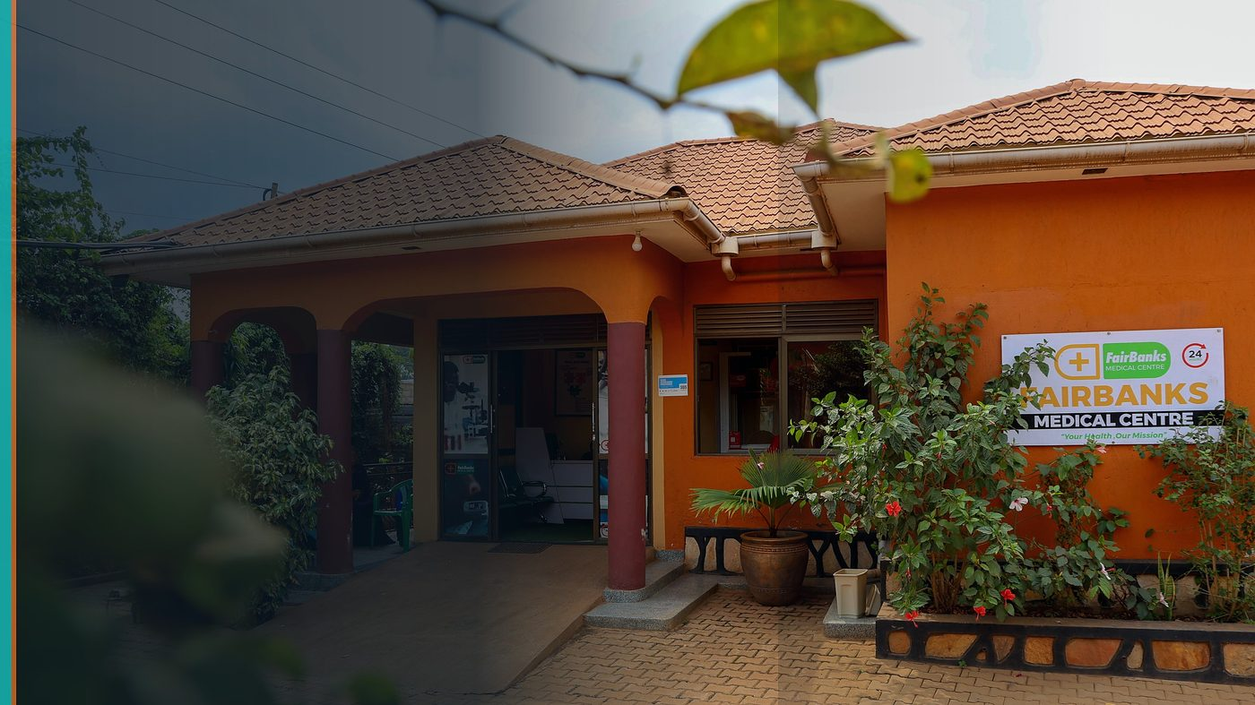
Young Feminist AI School 2026 — UN Women
Learning Plan & Gender-Responsive AI Project
FairBanks Community Health Intelligence Platform (FCHIP)
Your health, our mission.

Slide 2
CURRICULUM MAP
Four learning blocks I will complete
Foundations of feminist AI
Responsible ML for community health
Bias in health datasets; who is missing from training data; participatory design with women and girls.
Explainable alerts, consent, and offline-first capture for CHWs in low-bandwidth settings.
Gender-responsive product design
Policy & advocacy
Interfaces and workflows that work for mothers, adolescents, and CHWs — not only engineers.
Translating model outputs into action without stigmatising vulnerable groups.
FairBanks FCHIP | Young Feminist AI School | Your health, our mission.
2

Slide 3
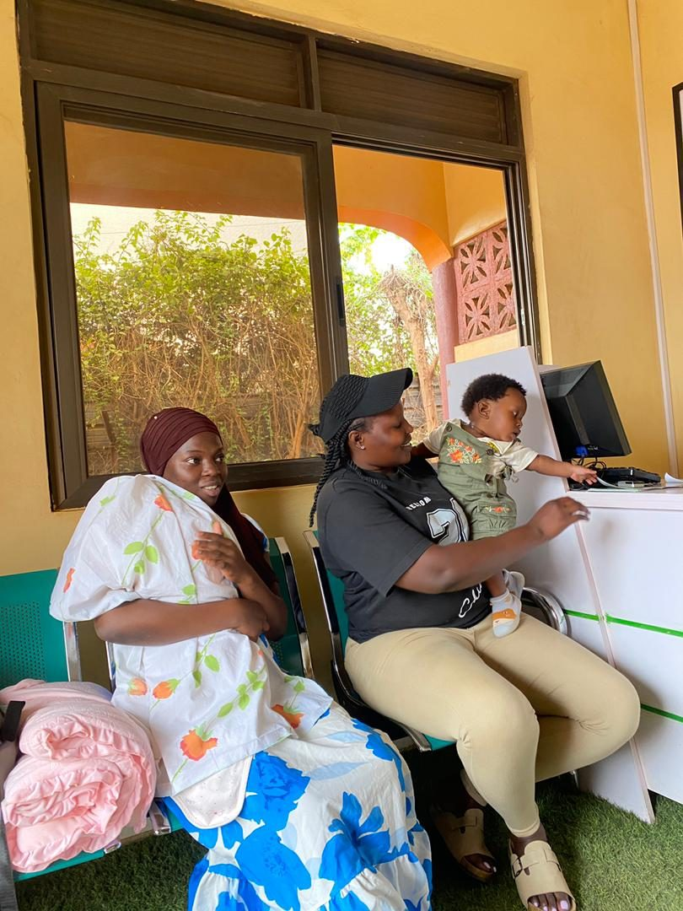
PROBLEM
Health AI often ignores women and girls
Missing data → biased models → harmful or useless alerts
Maternal & adolescent programmes need participatory design
FairBanks outreach is where ethics meets engineering
FairBanks FCHIP | Young Feminist AI School | Your health, our mission.
3

Slide 4
PROJECT
Safe Signals — maternal & adolescent support flags
Discover
Co-design with adolescent girls and mothers in FairBanks outreach — what questions are safe and useful?
Prototype
Lightweight risk flags for missed ANC and adolescent SRH education gaps using anonymised community signals.
Validate
Compare alerts against clinical outcomes and CHW feedback; document bias checks and corrections.
Share back
Open learning brief for UN Women cohort — methods, failures, and ethical guardrails.
FairBanks FCHIP | Young Feminist AI School | Your health, our mission.
4

Slide 5
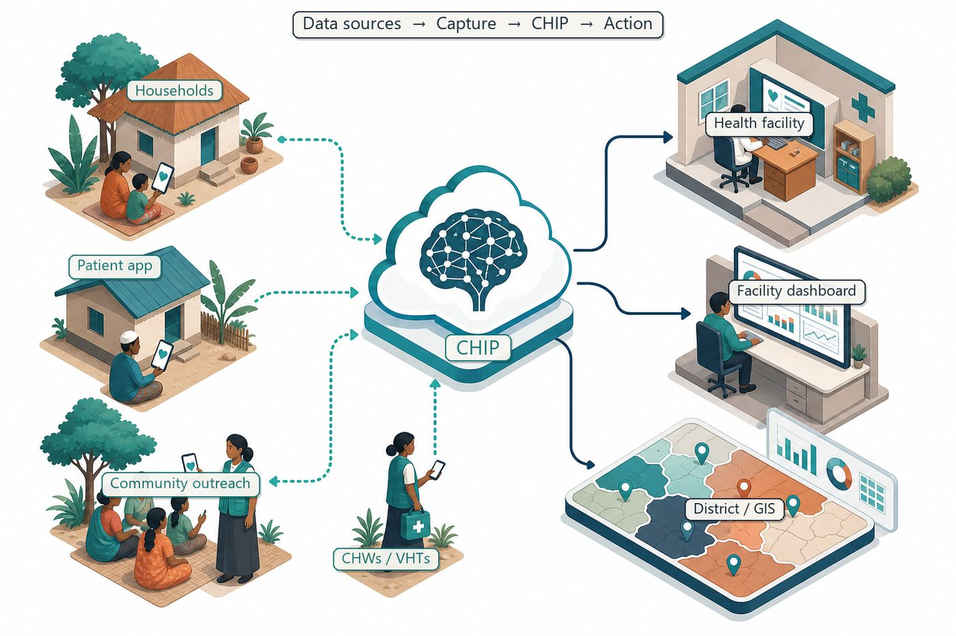
FIELD LAB
FCHIP — community data with feminist guardrails
CHW-led follow-up
Consent & anonymisation
Auditable dashboards
No stigma by design
FairBanks FCHIP | Young Feminist AI School | Your health, our mission.
5

Slide 6
EXCHANGE
School ↔ FairBanks — mutual learning
Cohort & faculty receive
I receive
• A real HealthTech field site with maternal and adolescent programmes
• Documented gender-responsive AI design process from Uganda
• Case material linking feminist AI principles to community health
• Structured feminist AI curriculum and peer changemakers
• Mentorship on bias, safety, and inclusive model design
• Continental network to stress-test FCHIP ethics and narrative
FairBanks FCHIP | Young Feminist AI School | Your health, our mission.
6

Slide 7
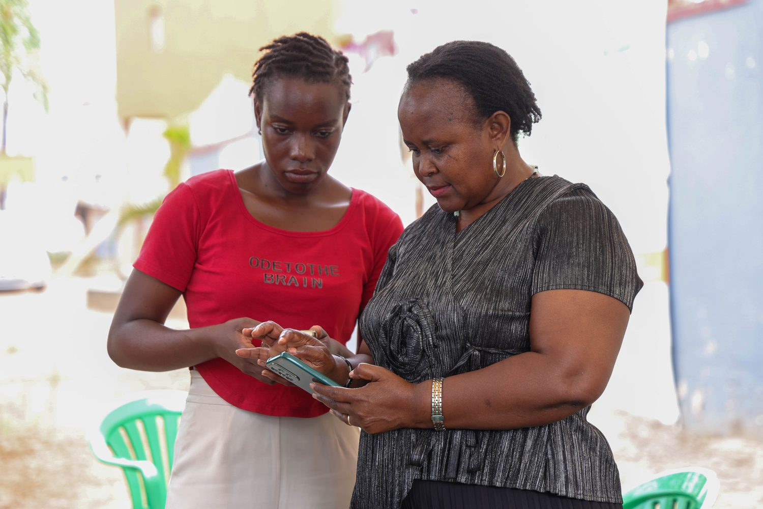
TIMELINE
From classroom to community pilot
Weeks 1–4: Feminist AI foundations + dataset audit
Weeks 5–8: Prototype Safe Signals with CHWs
Weeks 9–12: Validate, document bias checks, share open brief
FairBanks FCHIP | Young Feminist AI School | Your health, our mission.
7

Slide 8
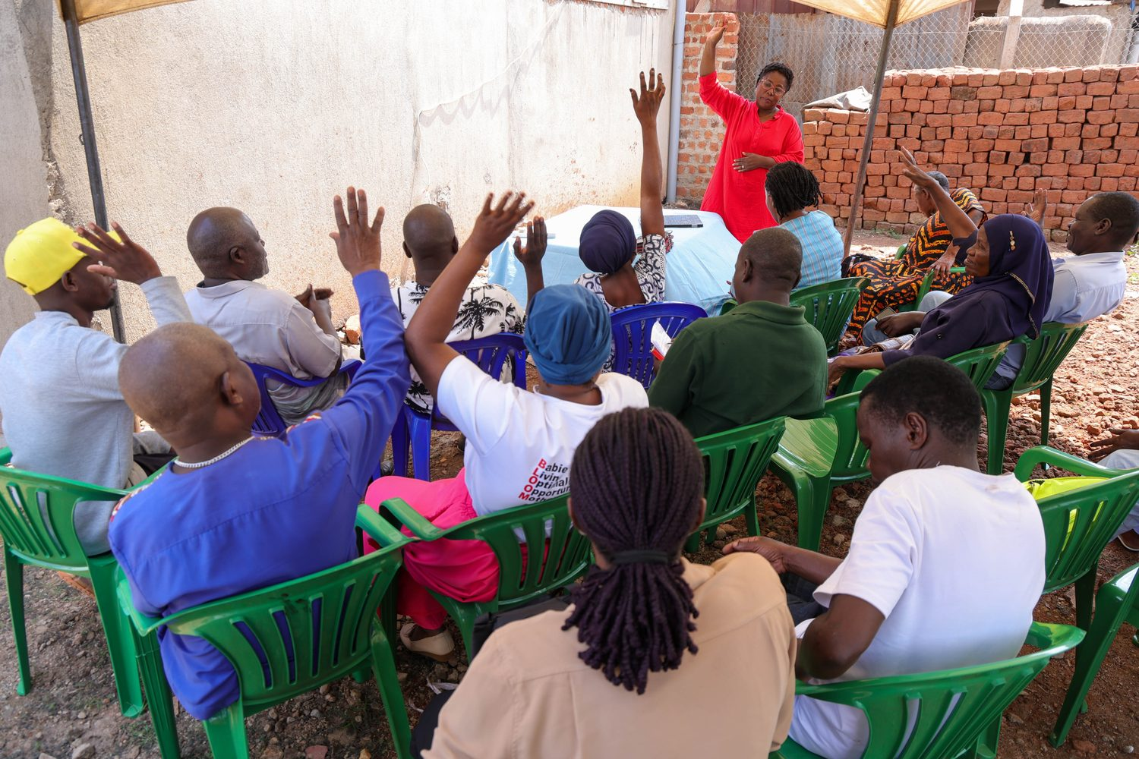
Gender-responsive AI — learned with UN Women, tested with communities.
Your health, our mission.

