Slide 1
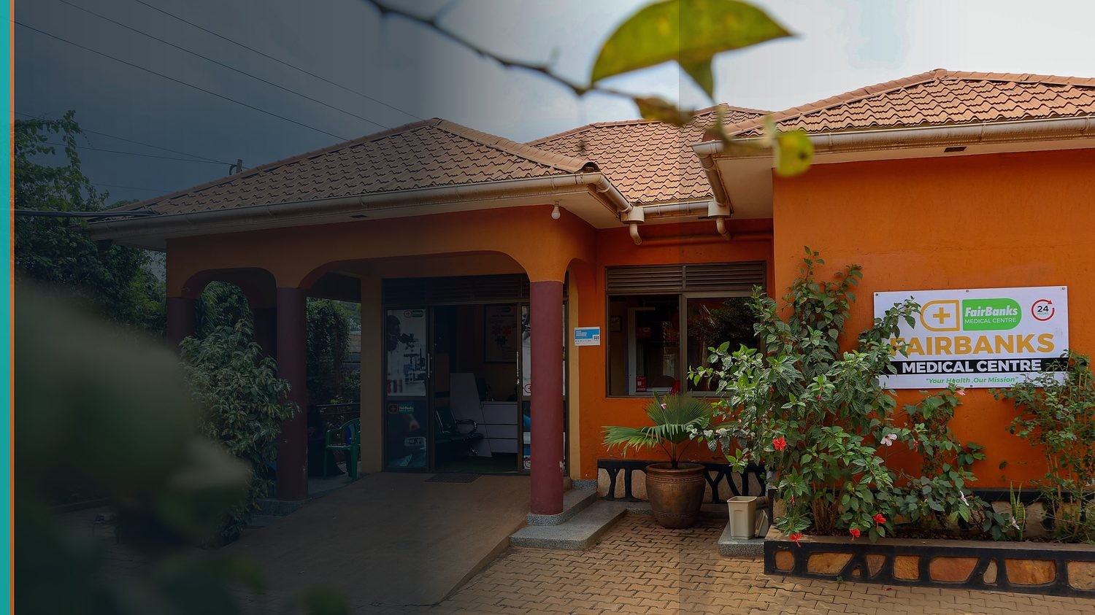
Fund for Innovation in Development (FID) — Call for Proposals 2026
FairBanks Community Health Intelligence Platform
(FCHIP)
Predictive community health that keeps families out of poverty
Your health, our mission.
Requested stage: Pilot Grant (up to €200,000) — pathway to Impact Evaluation & Scale-Up

Slide 2
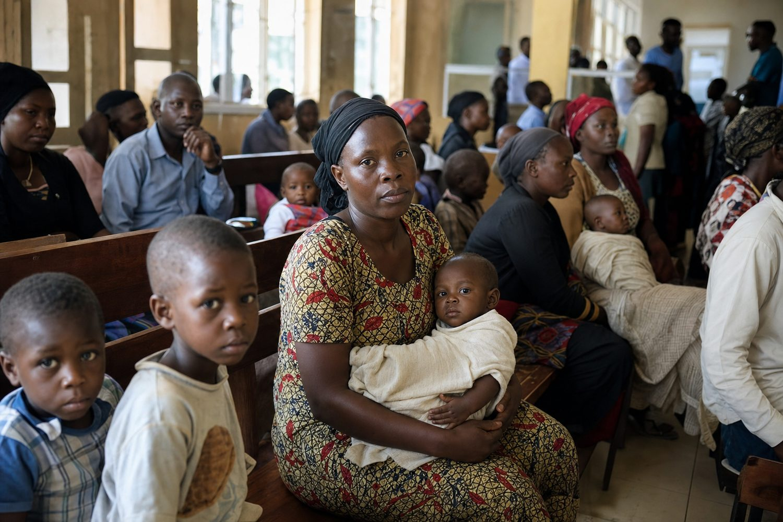
THE PROBLEM
When illness strikes, poverty follows
• Care starts only after people fall sick — outbreaks caught late
• Community data trapped in paper registers and silos
• High-risk pregnancies and NCDs identified too late
• Medicine stock-outs during seasonal surges
• Health shocks push poor families into catastrophic spending
FairBanks FCHIP | FID Call for Proposals 2026 | Your health, our mission.
2

Slide 3
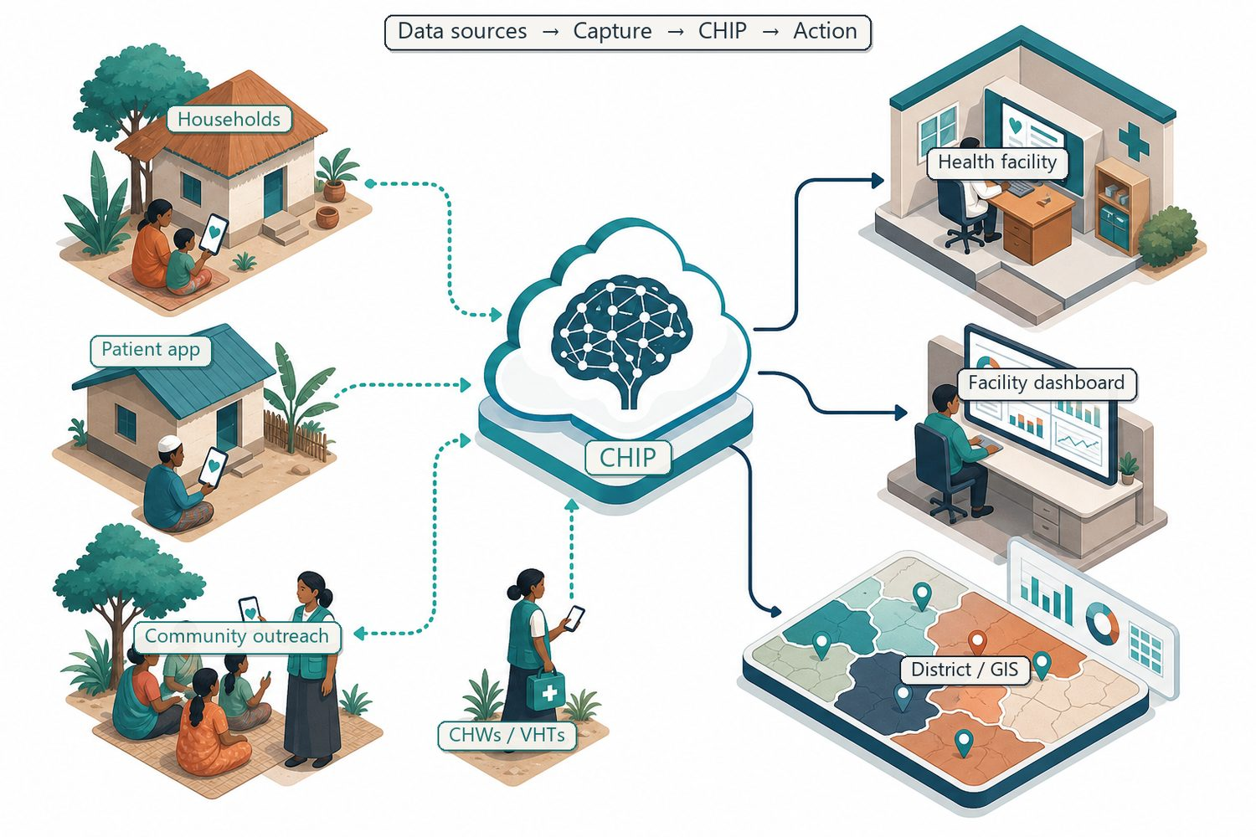
THE INNOVATION
FCHIP: community data becomes prediction
Capture
Offline CHW/VHT mobile tools at the household level
Intelligence
AI/ML risk scoring, GIS hotspots, decision support
Action
Alerts to CHWs, clinics, districts, insurers, partners
FairBanks FCHIP | FID Call for Proposals 2026 | Your health, our mission.
3

Slide 4

DEEP TECHNOLOGY CORE
Substantial engineering, not a light app
Artificial Intelligence
Outbreak early warning; maternal and NCD risk scoring
Machine Learning
Pattern learning from community data, seasonal trends, outreach outcomes
GIS Mapping
Disease distribution, hotspots, and resource-gap visualisation
Mobile Data Collection
Offline-capable CHW/VHT capture at household level
Cloud Computing
Secure sync across facilities, partners, administrative levels
Analytics & NLP
Live dashboards; local-language symptom capture where useful
FairBanks FCHIP | FID Call for Proposals 2026 | Your health, our mission.
4

Slide 5
THEORY OF CHANGE
From data to poverty reduction
Inputs
Activities
Outputs
Outcomes
Impact
FID Pilot Grant; FairBanks live operations; CHW/VHT networks; mobile + cloud + AI stack.
Build offline capture app, cloud pipeline, AI risk models, GIS layer, and dashboards; train CHWs; run pilot.
Structured community health data; predictive alerts; facility/district dashboards; referrals triggered.
Earlier detection and referral; fewer missed high-risk cases; fewer stock-outs; better-targeted outreach.
Reduced preventable illness and health-driven poverty; lower inequality for underserved communities.
FairBanks FCHIP | FID Call for Proposals 2026 | Your health, our mission.
5

Slide 6
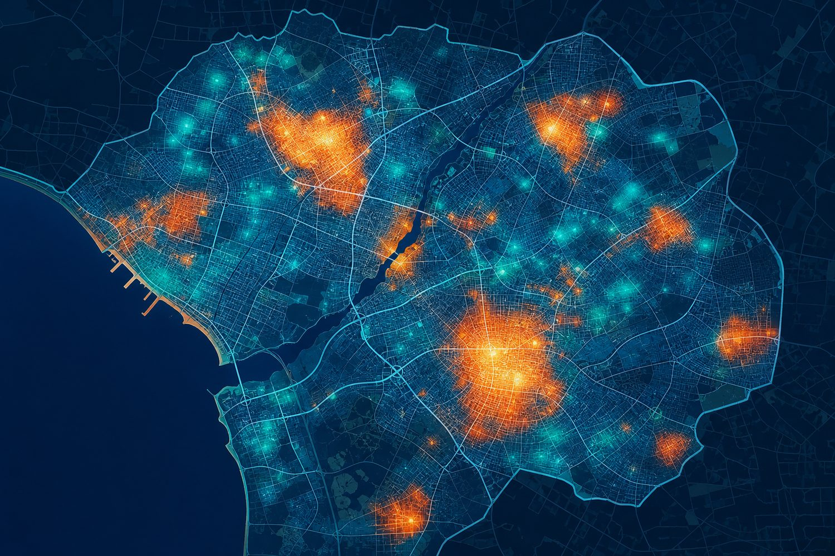
EVIDENCE OF IMPACT
Built to be measured and evaluated
• Existing evidence: CHW/mHealth programmes and community-based early warning have documented gains in maternal, child, and communicable-disease outcomes across sub-Saharan Africa; FCHIP builds on this base by adding predictive intelligence across multiple data sources.
• Baseline data: FairBanks outreach screening, maternal programmes, pharmacy dispensing, and facility encounters already generate the signals needed to establish a credible pre-intervention baseline.
• Measurable outcomes: alert accuracy, time-to-referral, proportion of high-risk pregnancies identified early, immunisation and screening coverage, and stock-out frequency.
• Evaluation pathway: the pilot is designed so that a subsequent counterfactual impact evaluation (comparison communities) can rigorously test effect sizes — the qualifying step toward FID's Impact Evaluation and Scale-Up stages.
FairBanks FCHIP | FID Call for Proposals 2026 | Your health, our mission.
6

Slide 7
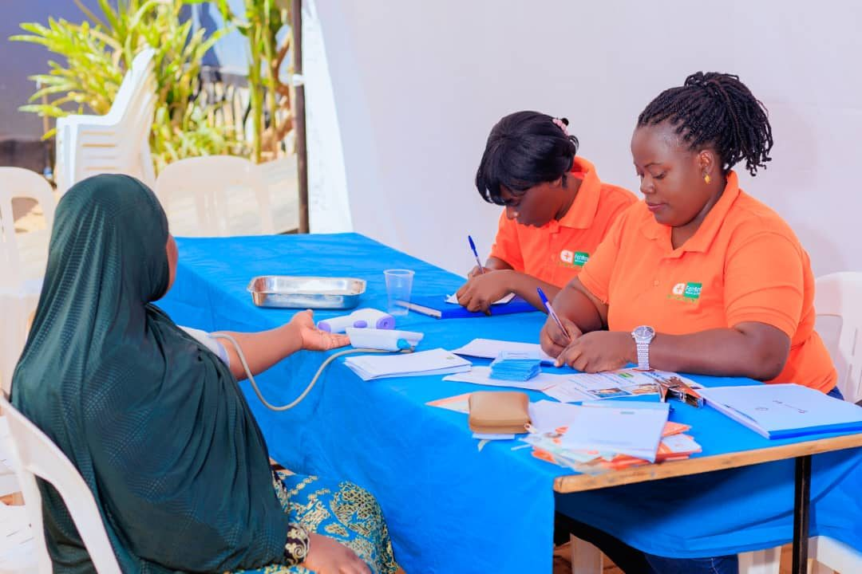
COST & COST-EFFECTIVENESS
Prevention costs less than late treatment
• Builds on assets that already exist — a live medical centre, trained CHW/VHT networks, and outreach programmes — so the pilot avoids the cost of standing up field operations from scratch.
• Offline-first, mobile-based capture keeps hardware and connectivity costs low and works in low-bandwidth settings.
• Prevention is cheaper than late treatment: early detection of outbreaks, maternal risk, and NCDs reduces costly emergency care and lost livelihoods.
• A shared platform serves many users (CHWs, clinics, districts, insurers), spreading cost and improving cost per beneficiary as coverage grows.
FairBanks FCHIP | FID Call for Proposals 2026 | Your health, our mission.
7

Slide 8
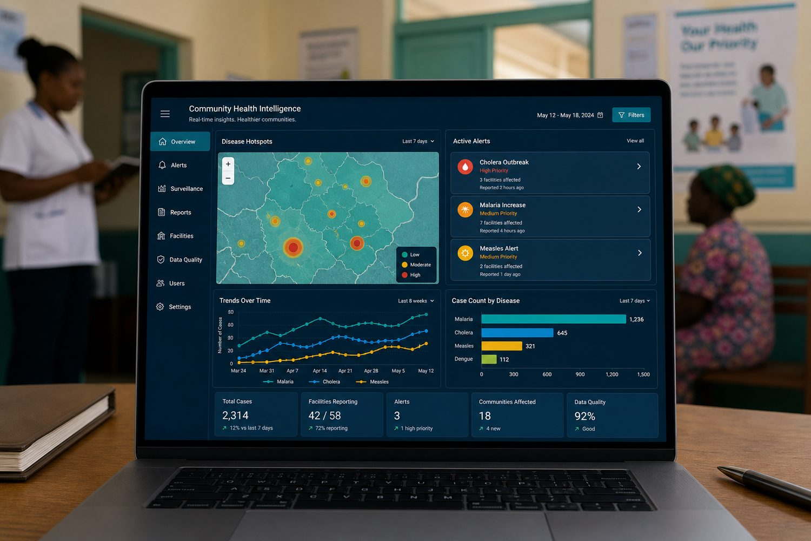
SCALE & SUSTAINABILITY
A portable model with diversified revenue
• Technical scalability: cloud architecture and standard mobile tools extend from one catchment to many districts without redesign.
• Model portability: CHW/VHT systems exist across Uganda and much of Africa, so the approach transfers to other ODA-eligible markets.
• Financial sustainability: diversified revenue — clinic/hospital subscriptions, district and Ministry of Health deployments, NGO programme monitoring, insurer analytics, and partner APIs — reduces reliance on grants over time.
• Policy pathway: evidence generated in the pilot supports integration into public health planning and district decision-making, aligning with FID's public-policy funding streams.
FairBanks FCHIP | FID Call for Proposals 2026 | Your health, our mission.
8

Slide 9
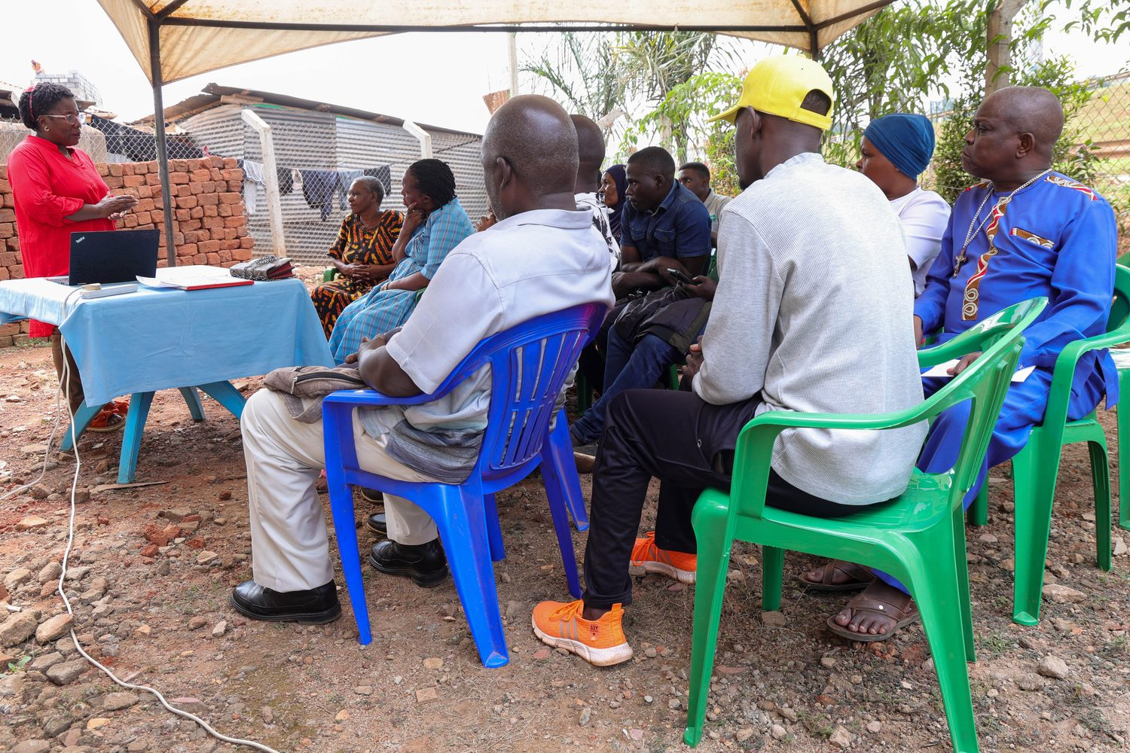
WHY FAIRBANKS
A live venture, ready to pilot
• Functioning FairBanks Medical Centre with direct patient and community access
• Active Community Reach outreach in Bukoto, Kyebando, Kisaasi, Kamwokya, Kikaaya, and surrounding areas
• Established CHW and VHT relationships and trust in target communities
• Live programmes: maternal & child health, Gericare, chronic-disease screening, corporate & school health
• Digital health records foundation and pharmacy operations already generating data signals
• Research and community partnerships that support ethical data use and evaluation
FairBanks FCHIP | FID Call for Proposals 2026 | Your health, our mission.
9

Slide 10
PLAN & BUDGET
Pilot first, then evaluate and scale
Roadmap
Indicative pilot budget
Phase 1 — Pilot (0–12 mo)
Product & engineering
€70,000
MVP live with FairBanks CHWs/VHTs; validate 3 use cases; establish baseline
Field pilot & CHW training
€45,000
Phase 2 — Impact evaluation prep (12–18 mo)
Counterfactual design; comparison communities; measurement framework
Data, evaluation & M&E
€35,000
Phase 3 — District scale (18–36 mo)
Data governance & compliance
€15,000
Partner clinics and district structures; NGO/insurer modules; APIs
Project management & operations
€35,000
Phase 4 — Scale-up (Year 3+)
Multi-district Uganda; East Africa entry; policy integration
Total (indicative Pilot Grant)
€200,000
FairBanks FCHIP | FID Call for Proposals 2026 | Your health, our mission.
10

Slide 11
WHY IT FITS FID
Evidence, cost-effectiveness, scale
Evidence of impact
Clear theory of change, baseline data, and a pathway to counterfactual evaluation
SDG alignment
• SDG 1 — No Poverty: Prevents health-shock-driven catastrophic spending and lost income
• SDG 3 — Good Health & Well-Being: Predictive community health; maternal/child/NCD focus
• SDG 5 — Gender Equality: Women-led venture; maternal health intelligence
• SDG 10 — Reduced Inequalities: Intelligence and care for underserved communities
• SDG 17 — Partnerships: Government, NGO, insurer, and academic collaboration
Cost & cost-effectiveness
Builds on existing assets; prevention reduces costly late treatment
Scale & sustainability
Portable model; diversified revenue; policy-integration pathway
Poverty & inequality focus
Targets underserved communities where health shocks drive poverty
FairBanks FCHIP | FID Call for Proposals 2026 | Your health, our mission.
11

Slide 12
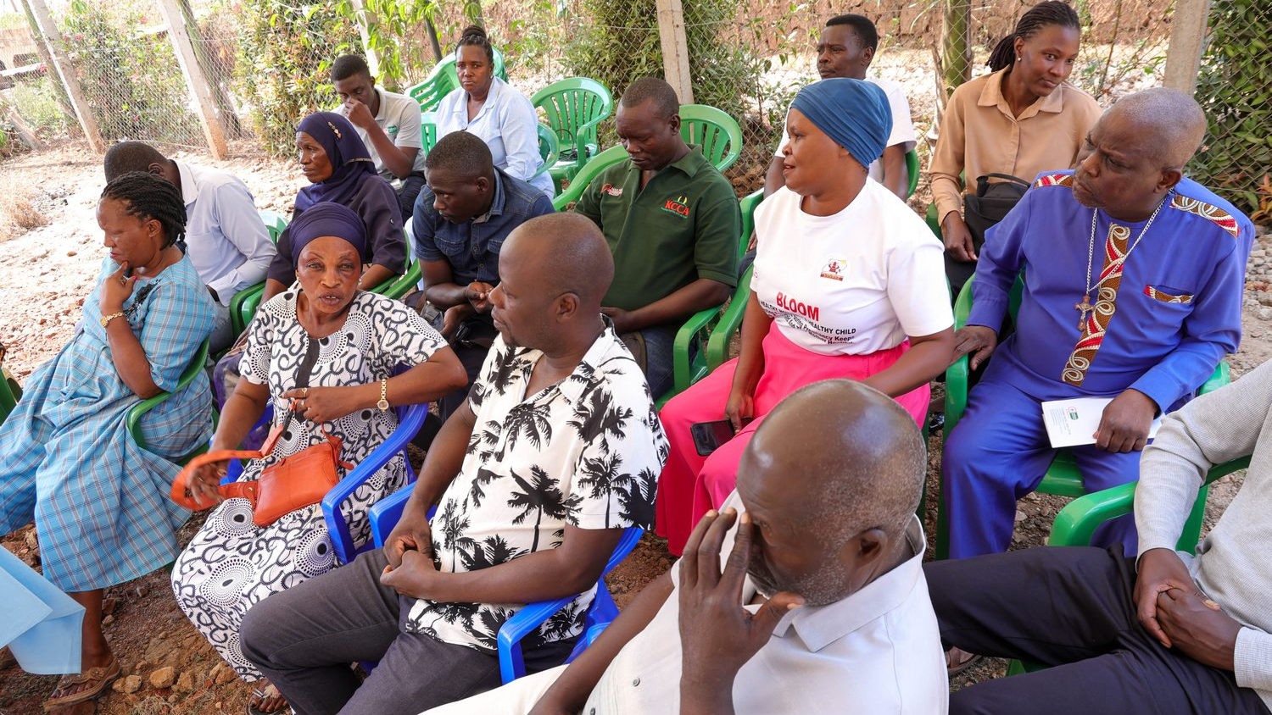
The ask
A Pilot Grant to validate FCHIP in FairBanks' live catchment —
and prove the pathway to evaluation and scale.
Predictive community health that keeps families out of poverty.
Your health, our mission.

