Slide 1
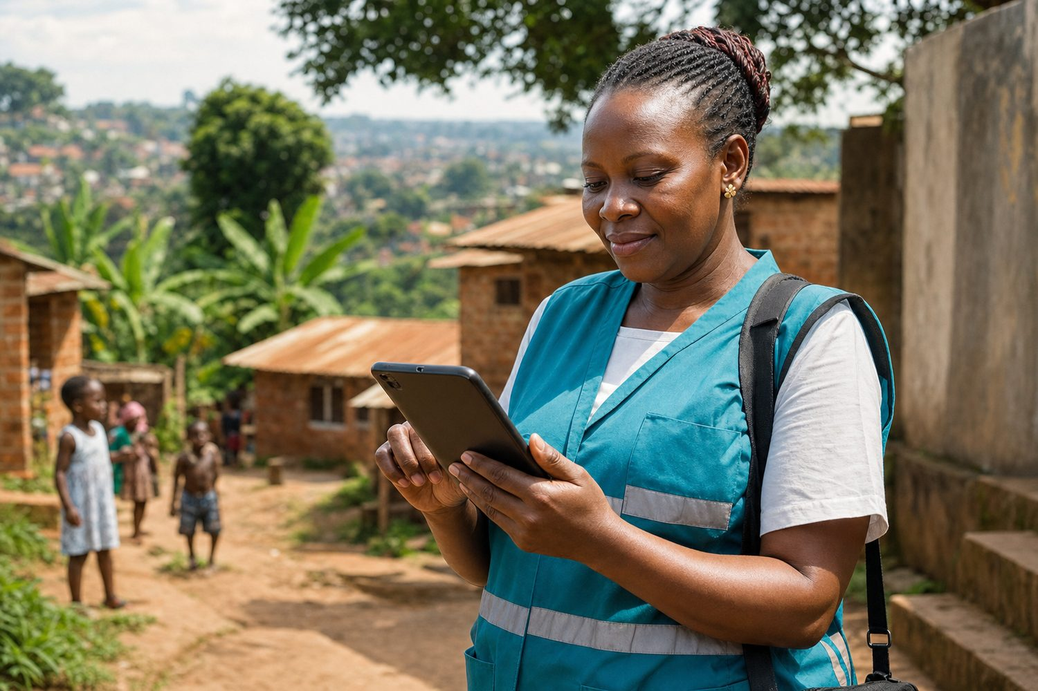
The Gadfly Project — Custom Web Application Grant 2026
FCHIP Pilot Build — Community Health Data Platform
In-kind engineering scope for CHW capture, sync, and dashboards
Your health, our mission.

Slide 2
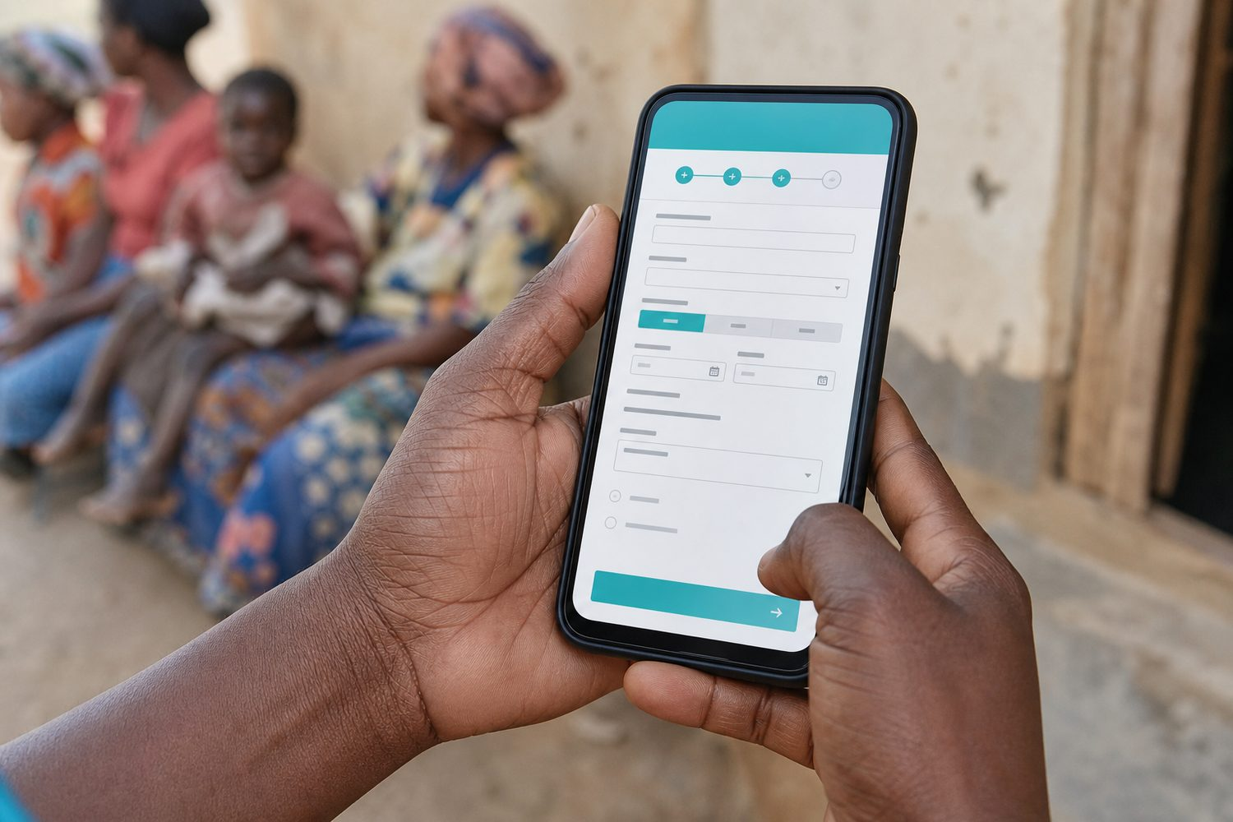
THE ASK
In-kind engineering, not a cash grant
Gadfly builds the pilot product.
FairBanks runs it in live CHW outreach.
Both sides get a measurable community-health case study.
FairBanks FCHIP | Gadfly Grant 2026 | Your health, our mission.
2

Slide 3
PRODUCT SCOPE
Three modules that complete the loop
CHW Field Capture
Sync & Data Layer
Operations Dashboard
Offline-first mobile web forms for household visits: vitals, maternal flags, immunisation, NCD screening, referrals. Works on low-end Android phones; queues submissions when connectivity drops.
Secure API, role-based access, conflict handling, and audit trail from device to cloud. Structured records ready for analytics and export.
Live view of submissions by area and programme; alert queue for high-risk cases; basic GIS map of activity hotspots; export for reporting.
FairBanks FCHIP | Gadfly Grant 2026 | Your health, our mission.
3

Slide 4
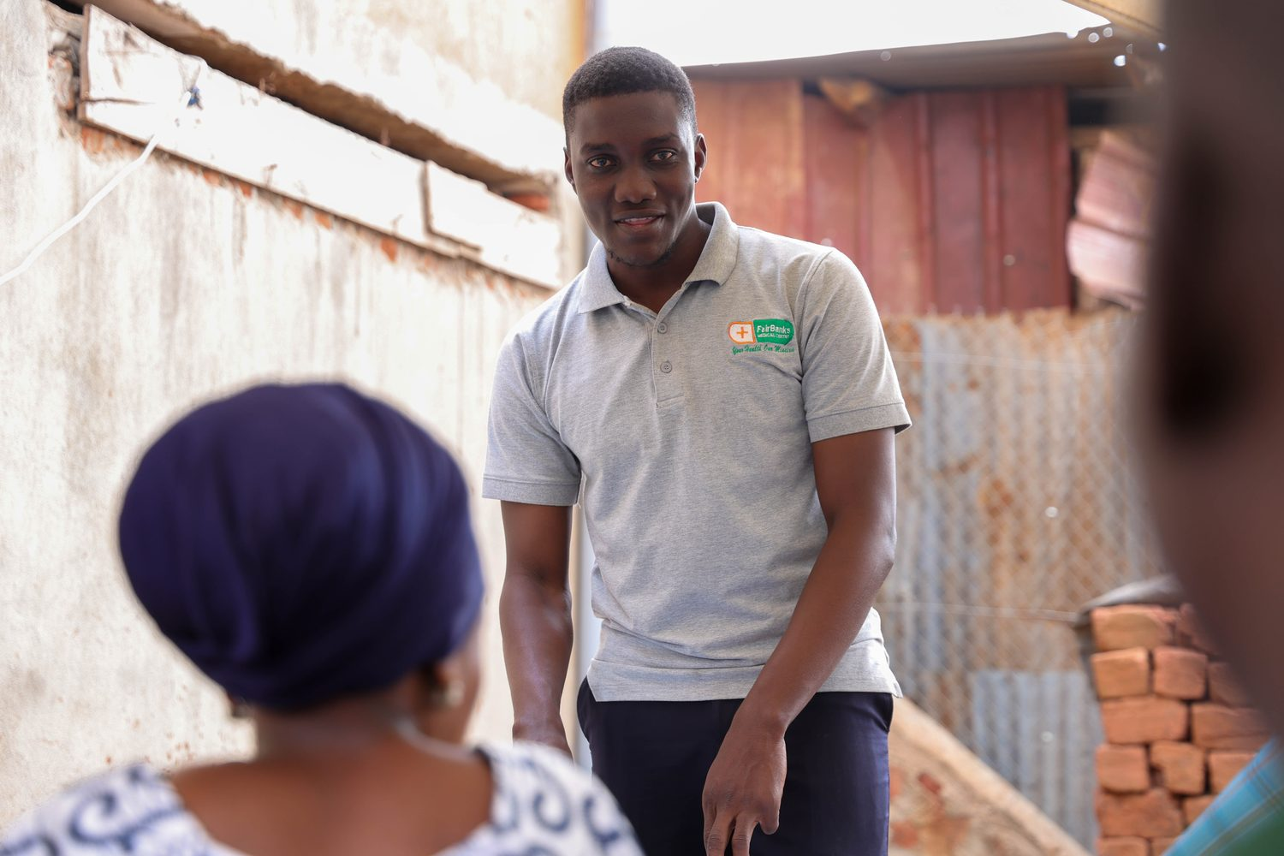
USERS SERVED
Real people, real weekly workflows
• 40+ Community Health Workers and VHTs in Bukoto, Kyebando, Kisaasi, Kamwokya, Kikaaya
• FairBanks clinic nurses and outreach coordinators who triage referrals
• Programme managers tracking maternal, child, geriatric (Gericare), and NCD outreach
• Future district and NGO partners who need interoperable community data feeds
FairBanks FCHIP | Gadfly Grant 2026 | Your health, our mission.
4

Slide 5
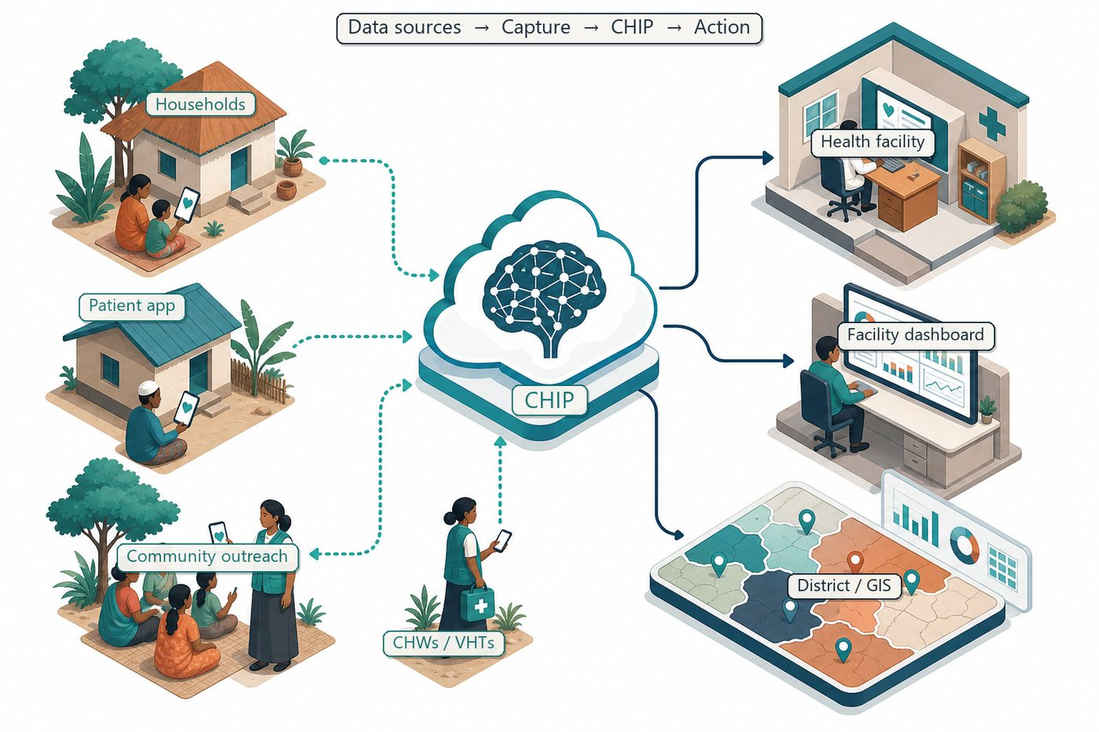
STACK
Pragmatic, maintainable, FairBanks-owned
Presentation
Responsive mobile web (PWA-style) for CHW devices
Offline
Local queue + retry sync when network returns
Backend
REST API, PostgreSQL, role-based auth
Dashboard
Web admin for alerts, maps, and CSV export
Hosting
Documented deploy; FairBanks-operated cloud account
FairBanks FCHIP | Gadfly Grant 2026 | Your health, our mission.
5

Slide 6
DELIVERY
Discovery → build → hardening → handover
Discovery & UX
Weeks 1–3
Field shadowing with CHWs; form design; acceptance criteria
Core build
Weeks 4–10
Capture app, API, sync, dashboard MVP
Pilot hardening
Weeks 11–14
Bug fixes, performance, training materials
Handover
Week 15+
Source repo, docs, admin guide, knowledge transfer sessions
FairBanks FCHIP | Gadfly Grant 2026 | Your health, our mission.
6

Slide 7
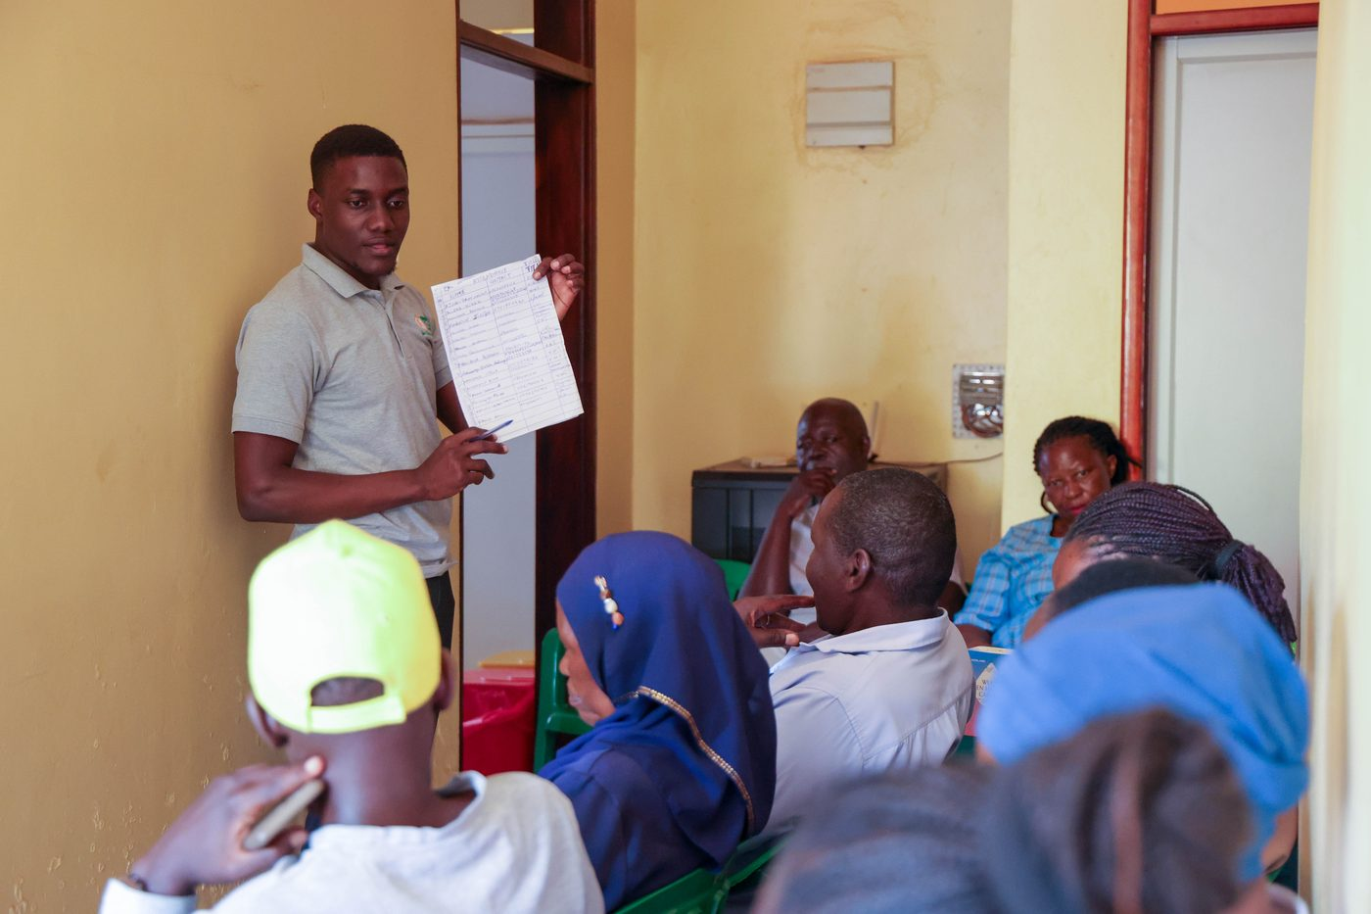
HANDOVER
FairBanks owns the code and the operations
• Full source code in FairBanks-owned repository with clear README and environment setup
• Architecture diagram and API documentation for future developers
• Admin and CHW user guides (simple language, screenshots)
• Two live knowledge-transfer sessions with FairBanks technical lead
FairBanks FCHIP | Gadfly Grant 2026 | Your health, our mission.
7

Slide 8
WIN-WIN
Engineering impact both sides can measure
For FairBanks
For Gadfly
A production-ready pilot: CHW capture app, sync pipeline, and operations dashboard — validated in live outreach, not a slide deck.
A mission-aligned build with real users (CHWs, clinic staff, programme managers), measurable community impact, and a portfolio case in African primary care.
Your health, our mission.
FairBanks FCHIP | Gadfly Grant 2026 | Your health, our mission.
8

