Slide 1
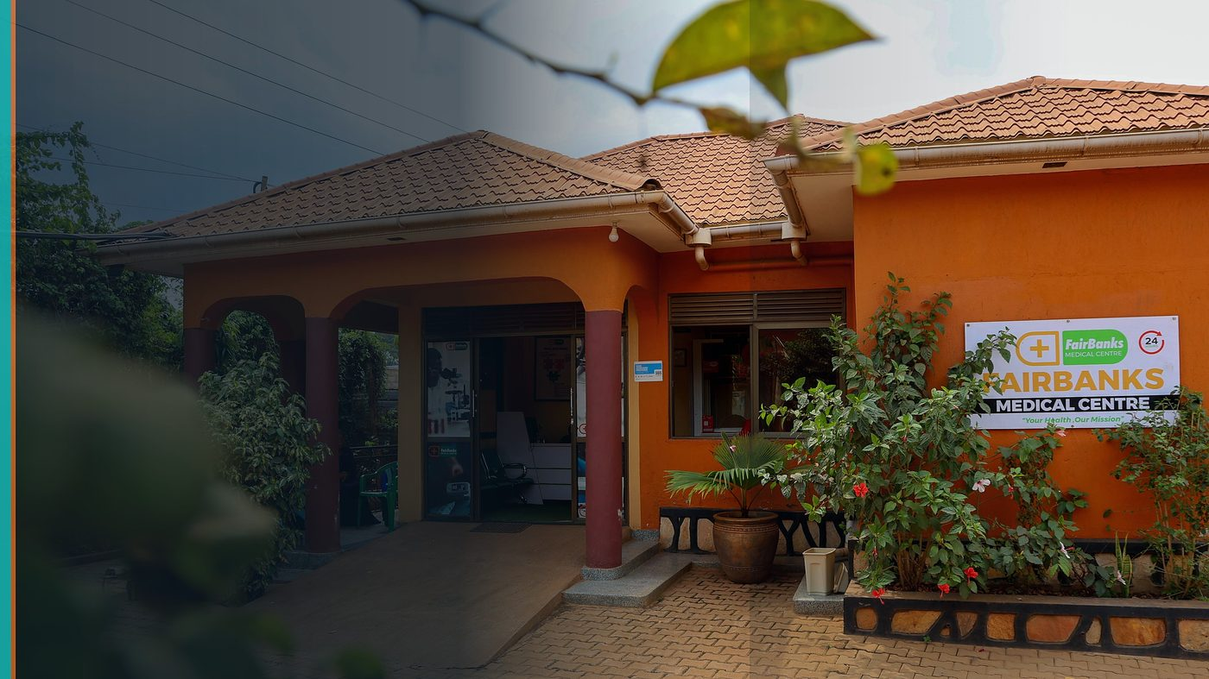
GirlCode Hackathon 2026 — Kampala
Challenge Brief & Mentorship Offer
FairBanks Community Health Intelligence Platform (FCHIP)
30-hour build sprint · UICT Nakawa · 5–6 September 2026
Your health, our mission.

Slide 2
HACKATHON
Build on real community health problems
FairBanks = medical centre + outreach + CHWs + FCHIP intelligence
30 hours · women builders · Kampala · UICT Nakawa
We provide problem statements, sample schemas, and mentor hours.
FairBanks FCHIP | GirlCode Kampala 2026 | Your health, our mission.
2

Slide 3
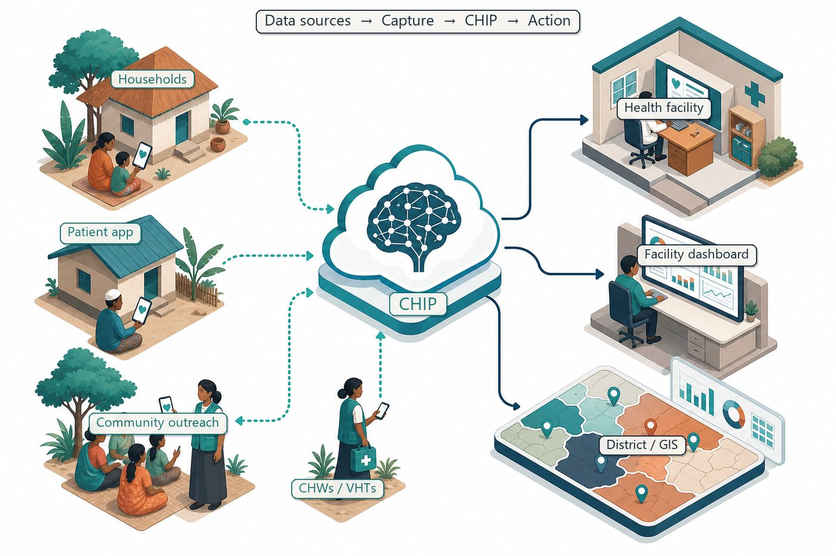
PLATFORM
FCHIP — what you are extending
Offline capture → predictions → alerts
Outbreak · maternal · NCD · child health · stock-outs
FairBanks FCHIP | GirlCode Kampala 2026 | Your health, our mission.
3

Slide 4
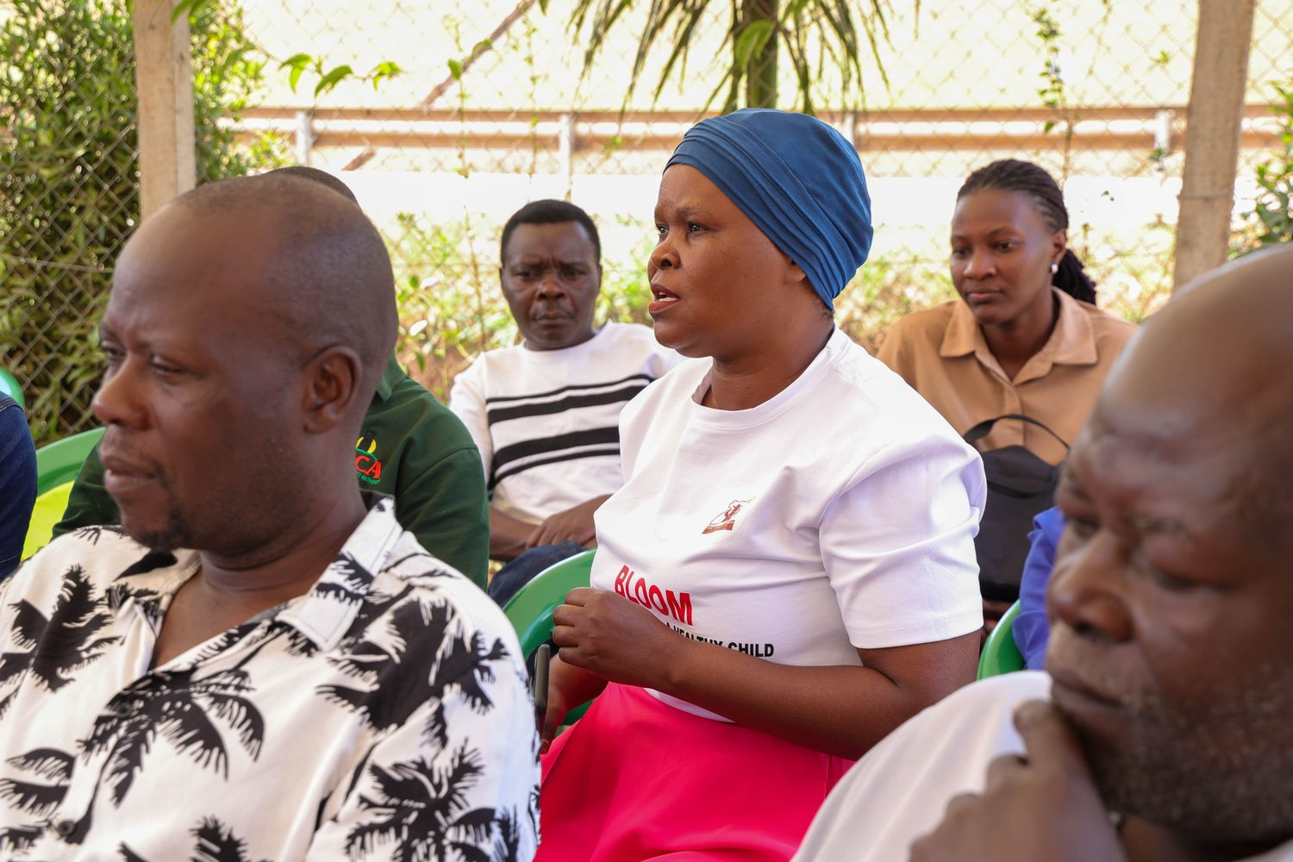
TRACK A
Maternal risk early warning
High-risk pregnancies are often found late. Can your team turn outreach-style signals (missed ANC, BP patterns, anaemia proxies) into timely CHW alerts?
Stretch: Explainable scores · offline-first · no stigma
FairBanks FCHIP | GirlCode Kampala 2026 | Your health, our mission.
4

Slide 5
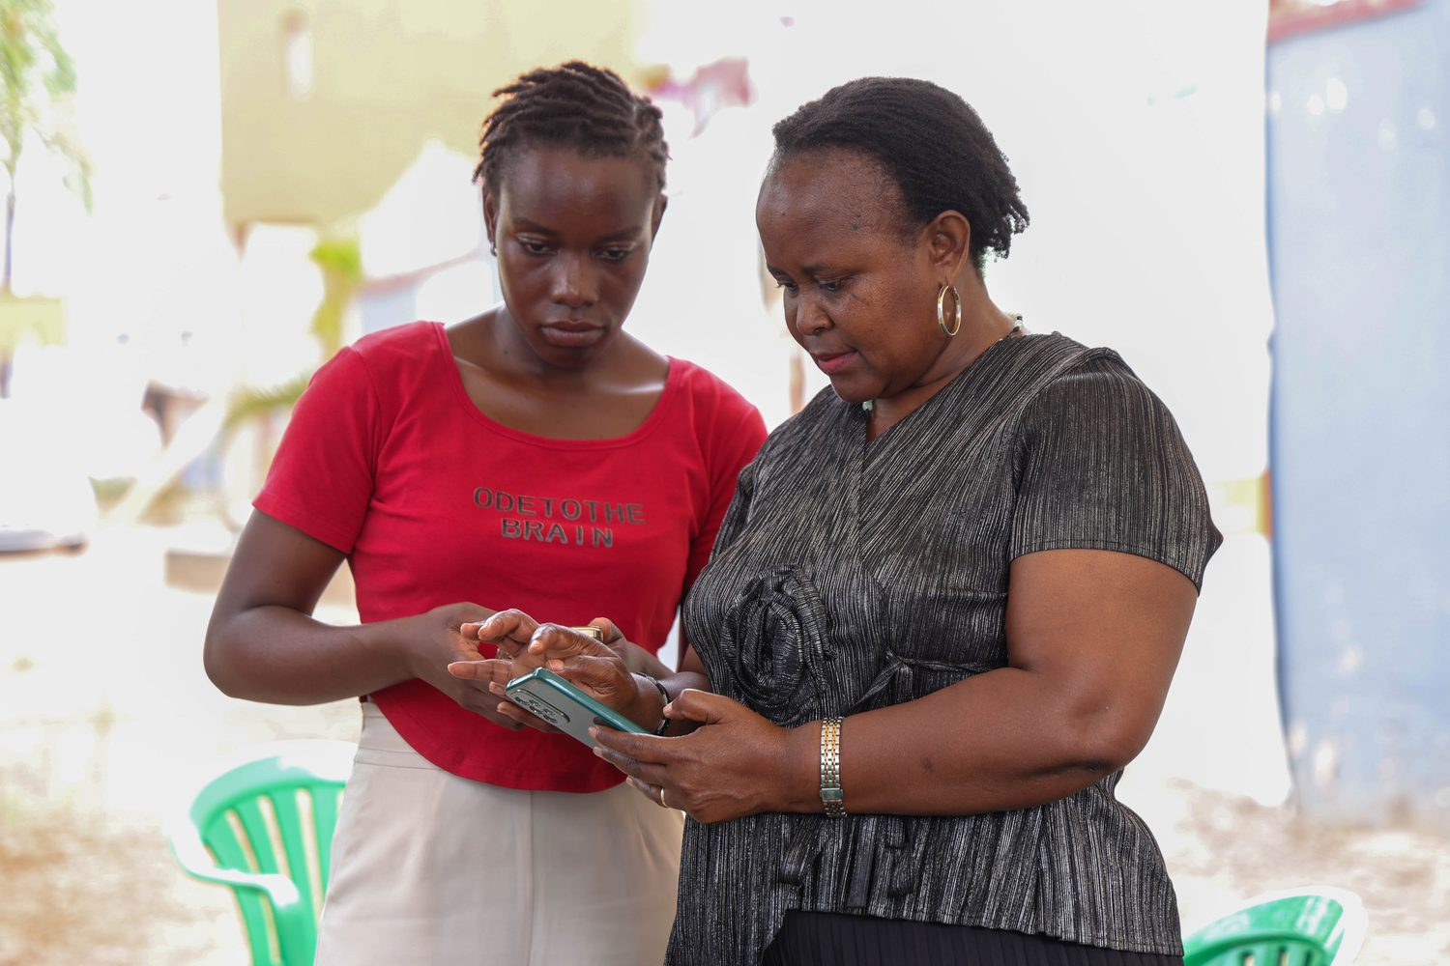
TRACK B
Adolescent SRH companion
Adolescents need private, trusted SRH information and referral paths. Build a lightweight companion that works with school and community outreach — not against parents and CHWs.
Stretch: Local languages · consent · safe escalation to FairBanks outreach
FairBanks FCHIP | GirlCode Kampala 2026 | Your health, our mission.
5

Slide 6
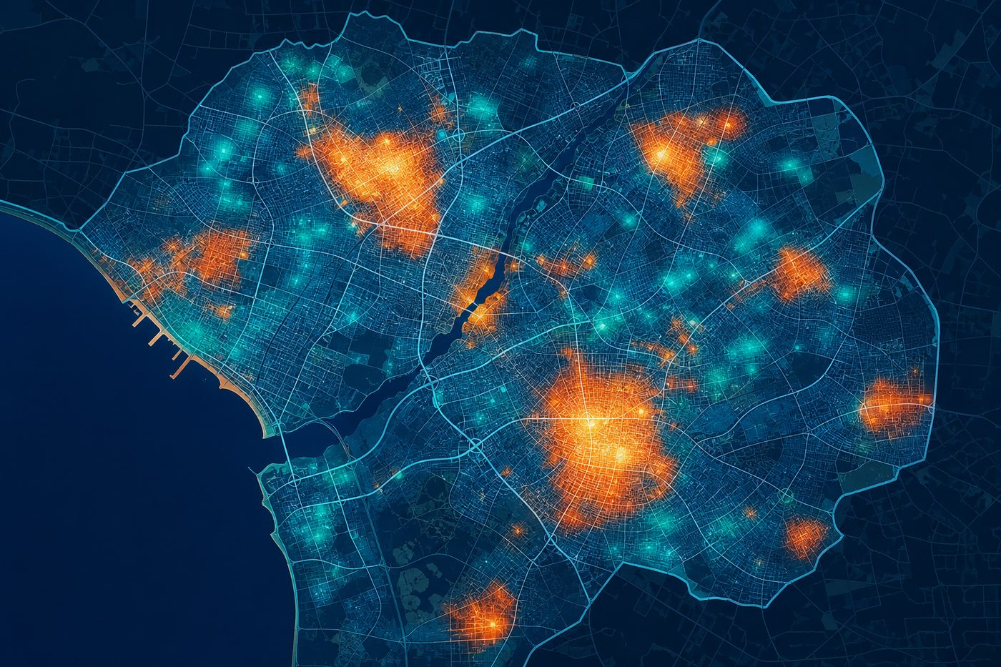
TRACK C
Outbreak early signal
When fever reports rise across neighbouring villages, clinics react too late. Can you cluster community reports and flag a possible surge before the pharmacy runs dry?
Stretch: GIS view · simple rules + optional ML · stock-out prevention
FairBanks FCHIP | GirlCode Kampala 2026 | Your health, our mission.
6

Slide 7
MENTORSHIP
FairBanks office hours during the sprint
FairBanks clinicians and outreach leads on realistic workflows
Sample (anonymised) data schemas from CHW capture — not raw patient records
Office hours during the hackathon on UX for low-literacy and offline settings
Path to continue building with FairBanks if your MVP wins locally or regionally
FairBanks FCHIP | GirlCode Kampala 2026 | Your health, our mission.
7

Slide 8
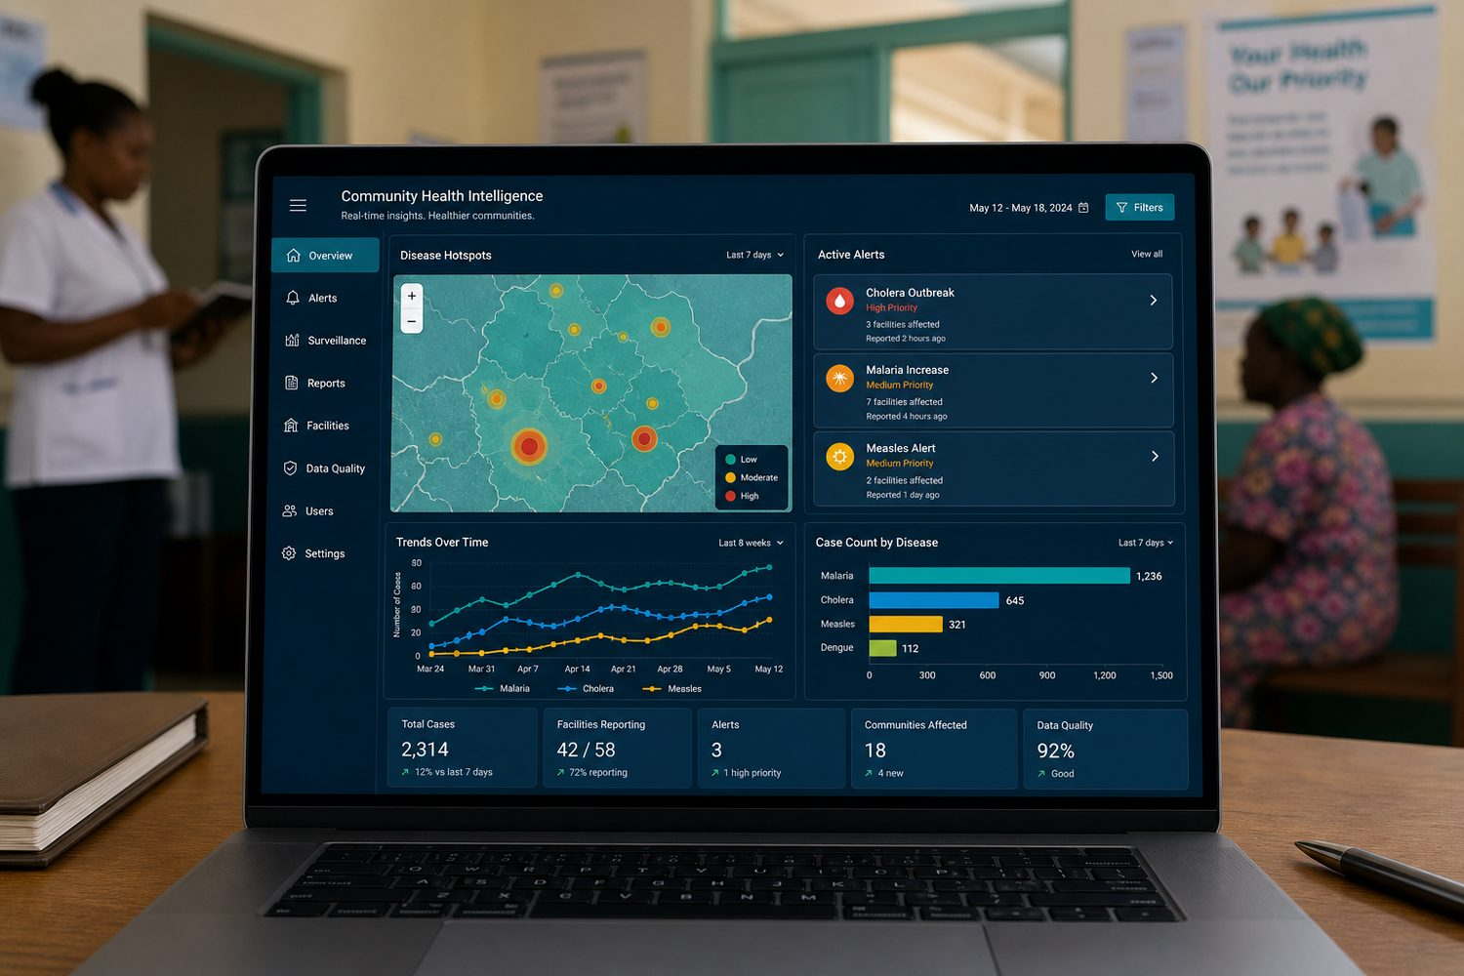
OUTCOMES
Why teams should pick a FairBanks track
• Real community health problem statements grounded in Kampala outreach
• Mentorship from an operating medical centre — not a fictional case study
• Portfolio project with social impact narrative for jobs and investors
• Visibility with FairBanks partners in maternal, adolescent, and NCD work
FairBanks FCHIP | GirlCode Kampala 2026 | Your health, our mission.
8

Slide 9
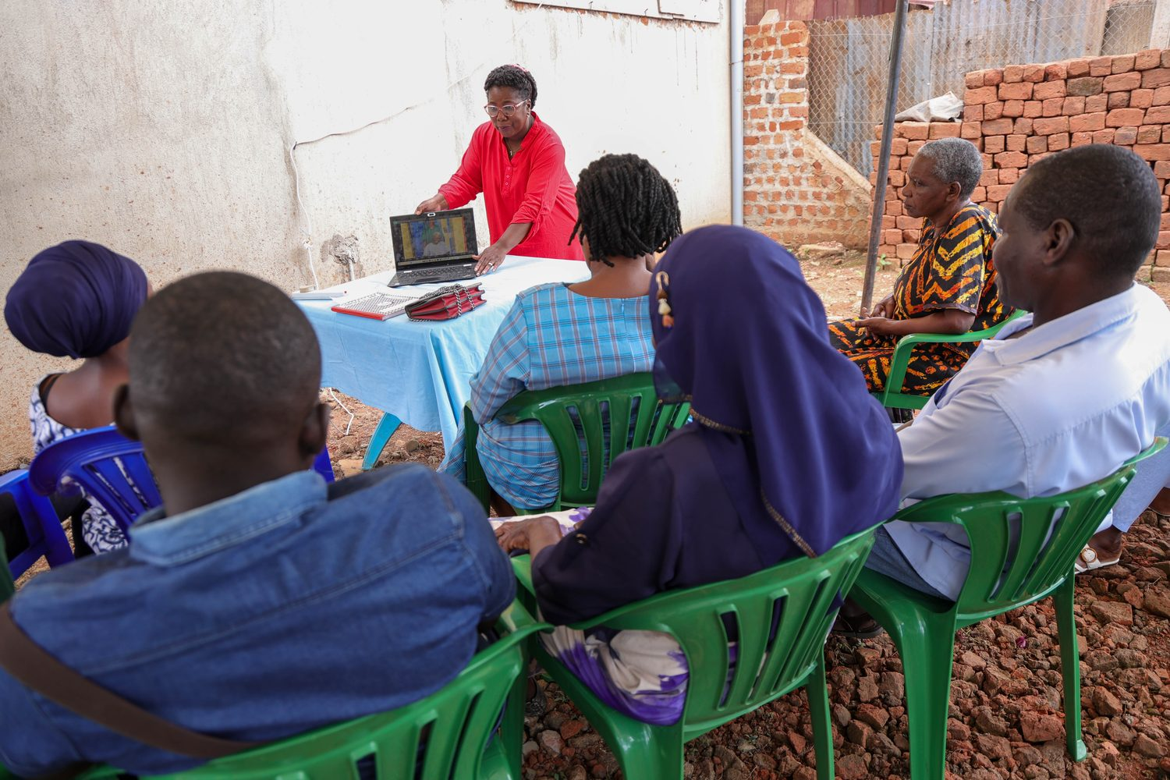
See you at UICT Nakawa — 5–6 September 2026.
Your health, our mission.

