Slide 1
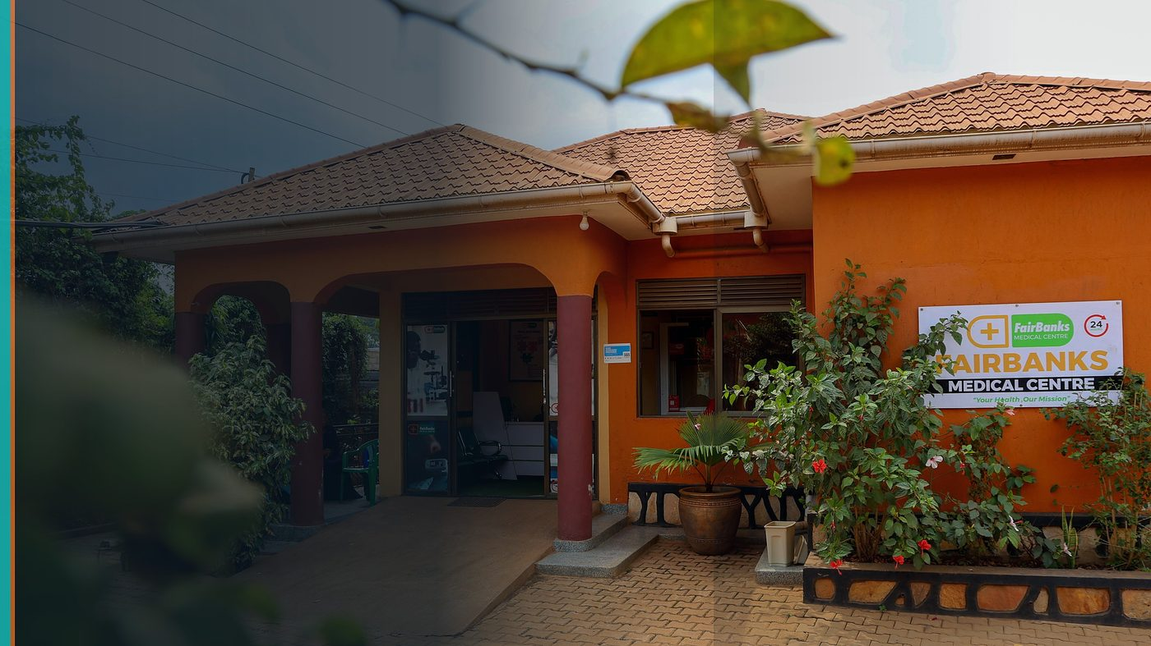
World Bank GovTech Innovation Challenge 2026
GovTech Readiness Brief — District Health Intelligence
FairBanks Community Health Intelligence Platform (FCHIP)
Your health, our mission.
Challenge deadlines vary — we submit only for health / Africa-aligned use cases

Slide 2
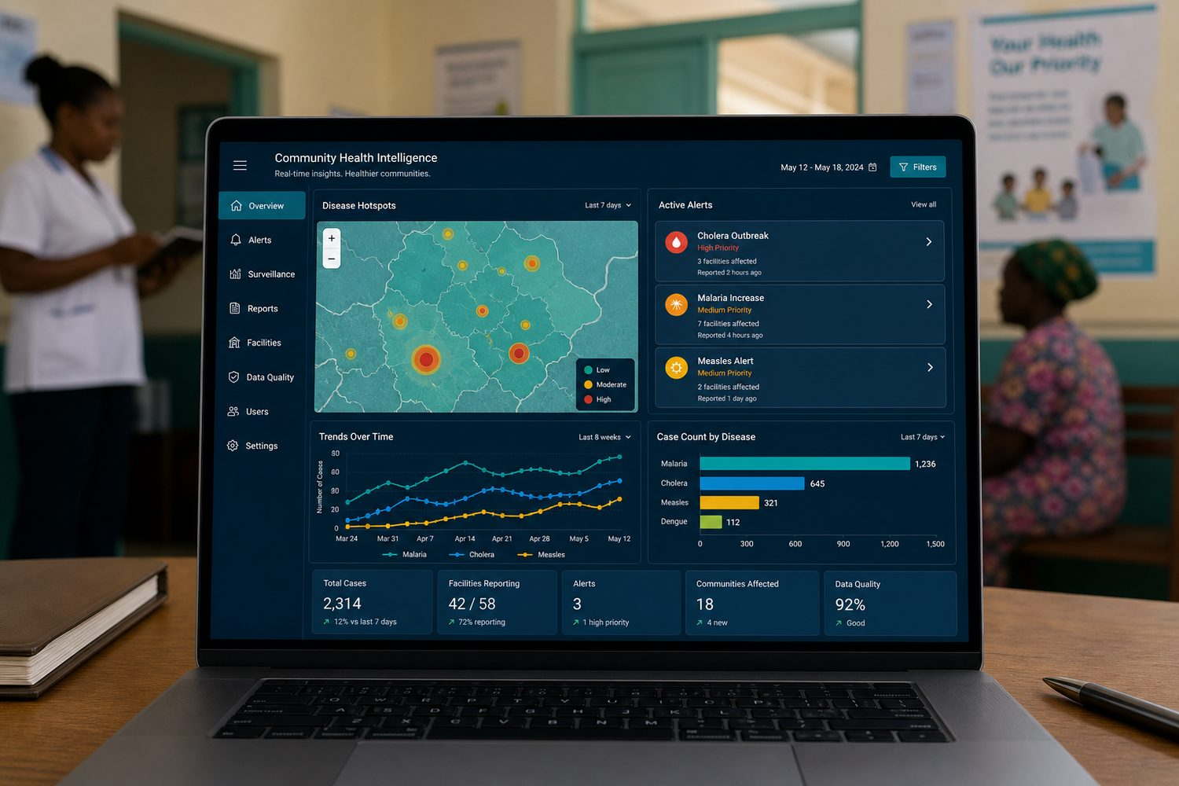
READINESS BRIEF
Ready PoC partner — not a blind submitter
GovTech connects tech firms with government digitalisation needs.
Capacity building · Switzerland bootcamp · government PoC
We maintain this pack and submit only when health / Africa challenges match.
FairBanks FCHIP | GovTech Readiness | Your health, our mission.
2

Slide 3
CHALLENGE MONITORING
Weekly scan · match gate · tailored submit
Weekly
Scan GovTech challenge pages for health / Africa digital-government calls
Match gate
Submit only when use case aligns with district health intelligence PoC
If selected
Attend capacity building / Switzerland bootcamp as offered
FairBanks FCHIP | GovTech Readiness | Your health, our mission.
3

Slide 4
HONEST SCOPE
Moroccan audit challenges are not our target
Current open public-finance audit use cases are outside FairBanks' domain.
We will not stretch a community health story to fit unrelated software requirements.
Our lane: district health intelligence from a live clinic + CHW operator.
FairBanks FCHIP | GovTech Readiness | Your health, our mission.
4

Slide 5
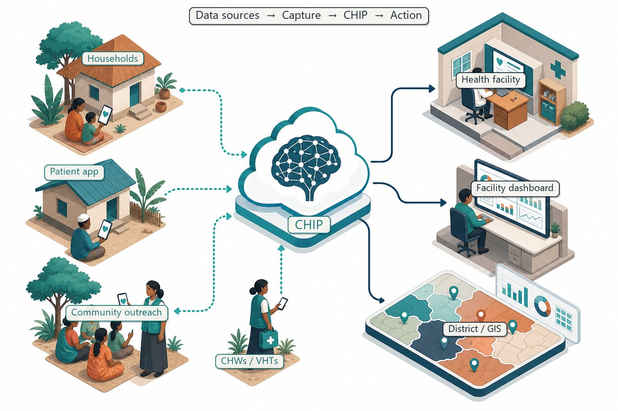
POC PATTERN
District health intelligence for government partners
Capture → sync → GIS → dashboards → alerts
Measure decision-cycle gains and CHW data quality for reporting.
FairBanks FCHIP | GovTech Readiness | Your health, our mission.
5

Slide 6
POC STACK
Five components co-designed with district users
Community capture
Offline CHW/VHT forms with validation rules
Data pipeline
Secure sync, anonymisation, and quality dashboards
GIS layer
Hotspot maps for managers and partners
Alerts
Configurable early warnings aligned to local protocols
Handover
Documentation and training for sustained use
FairBanks FCHIP | GovTech Readiness | Your health, our mission.
6

Slide 7

DECISION SUPPORT
Managers see hotspots and coverage gaps
• Population risk views
• Early-warning alerts
• CHW validation rules
• Export hooks for national systems where permitted
FairBanks FCHIP | GovTech Readiness | Your health, our mission.
7

Slide 8
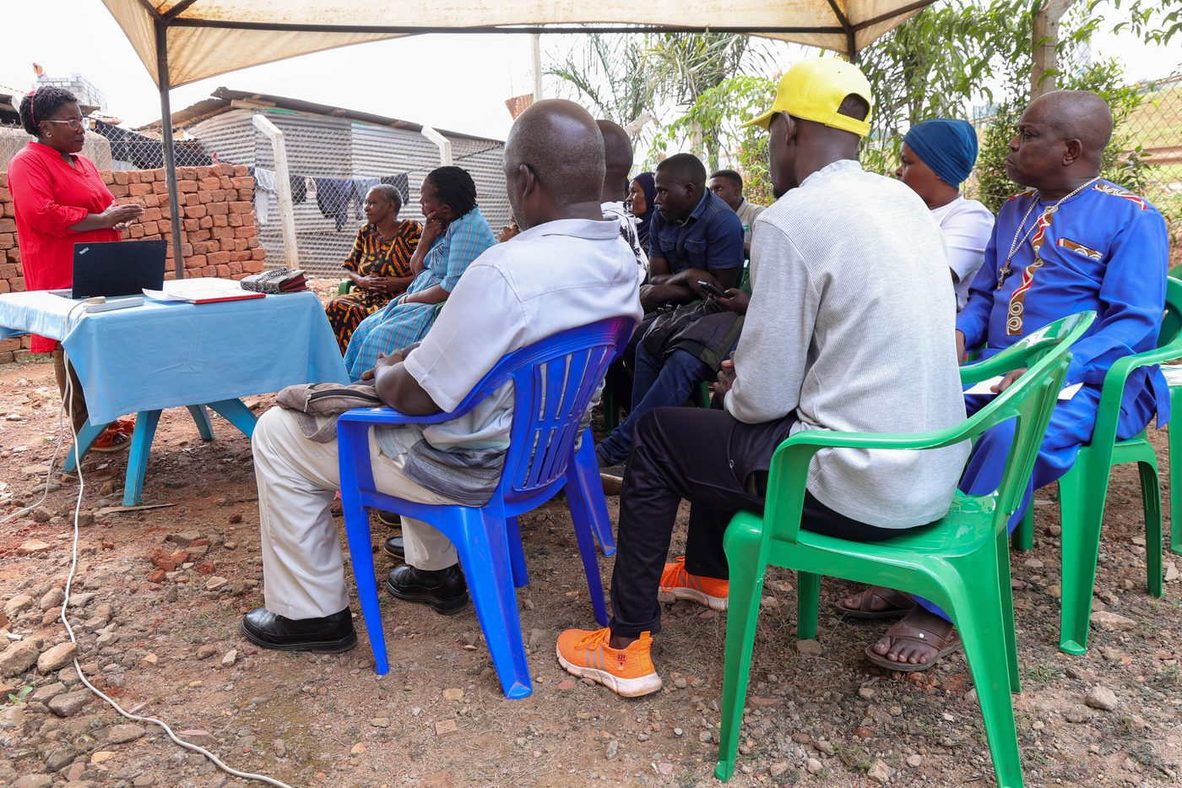
OPERATOR ADVANTAGE
Clinic + community — not software alone
• FairBanks Medical Centre + Community Reach
• CHW/VHT networks and outreach programmes
• Team ready for bootcamp if selected
• PoC measured in real manager workflows
FairBanks FCHIP | GovTech Readiness | Your health, our mission.
8

Slide 9
WIN-WIN
GovTech ↔ FairBanks ↔ districts
FairBanks gains
GovTech gains
Government PoC pathways; World Bank / SECO ecosystem visibility; learning that hardens FCHIP for public-sector deployment; bootcamp access if selected.
Vendor that runs clinic and community operations — not only software; health intelligence use cases governments need; African implementer ready for co-design; reusable PoC patterns for district health offices.
FairBanks FCHIP | GovTech Readiness | Your health, our mission.
9

Slide 10
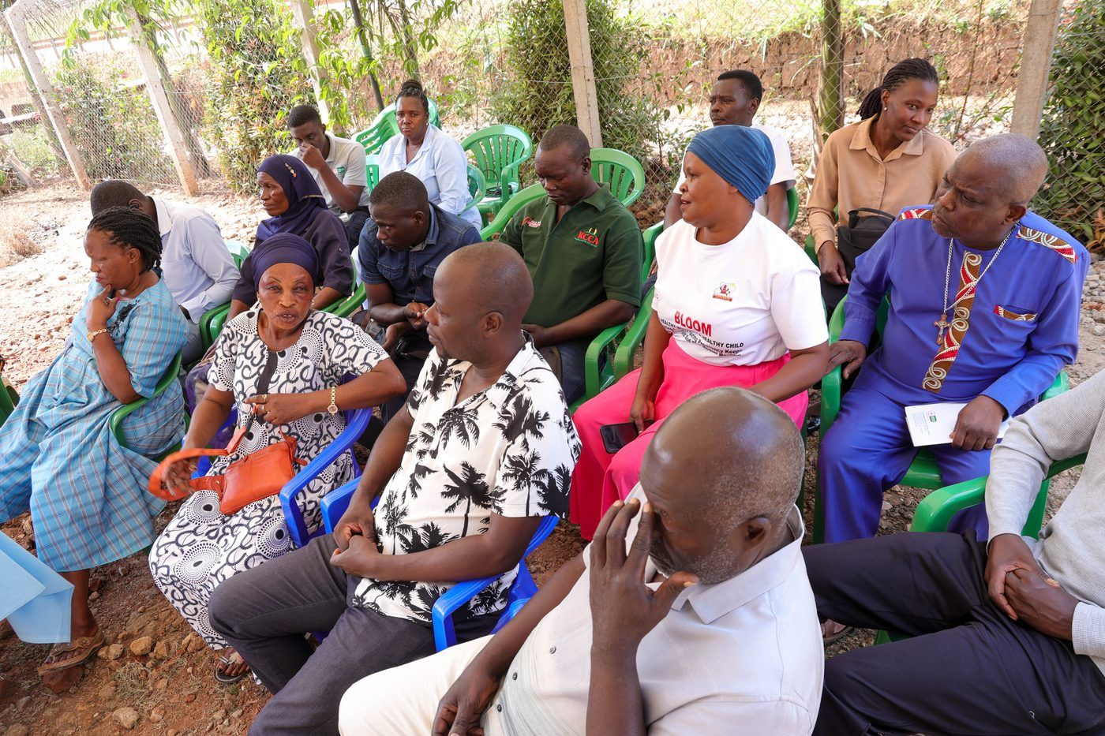
Ready when the right health or Africa GovTech challenge opens.
Your health, our mission.

