Slide 1
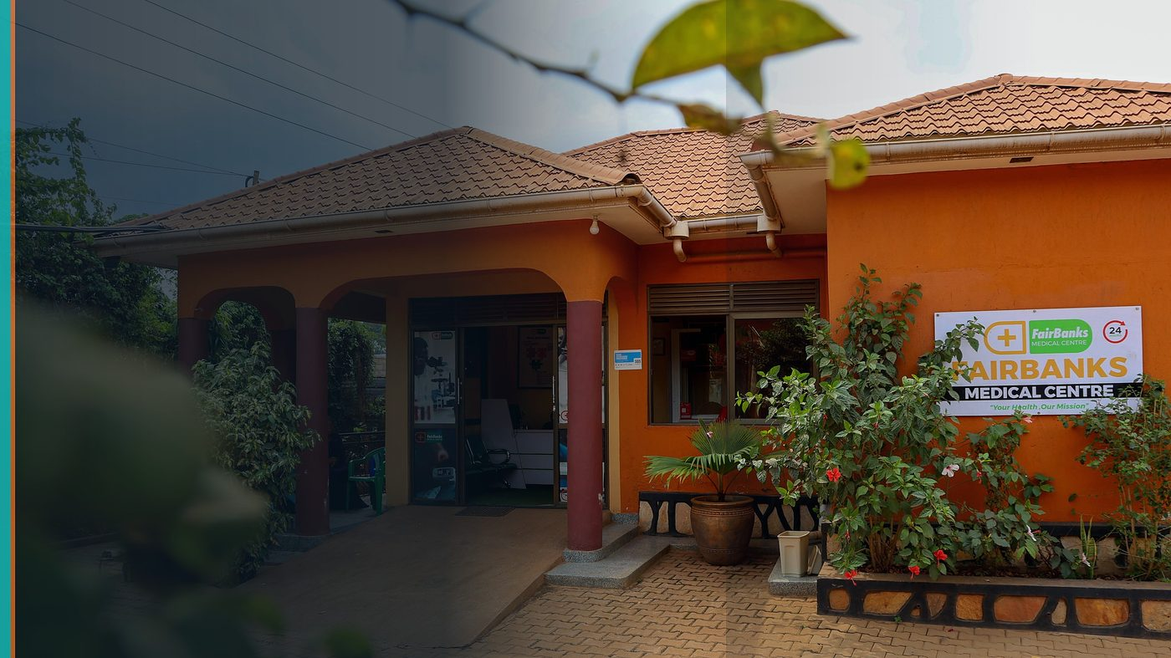
IFAD Grant — Rural Sector Performance Assessment (up to US$1.2M)
Concept Note — Health–Livelihood Intelligence for Rural Policy
FairBanks Community Health Intelligence Platform (FCHIP)
Your health, our mission.
Optional non-binding Expression of Interest by 31 July 2026 · Full proposal by 4 September 2026 (12:00 CET)

Slide 2
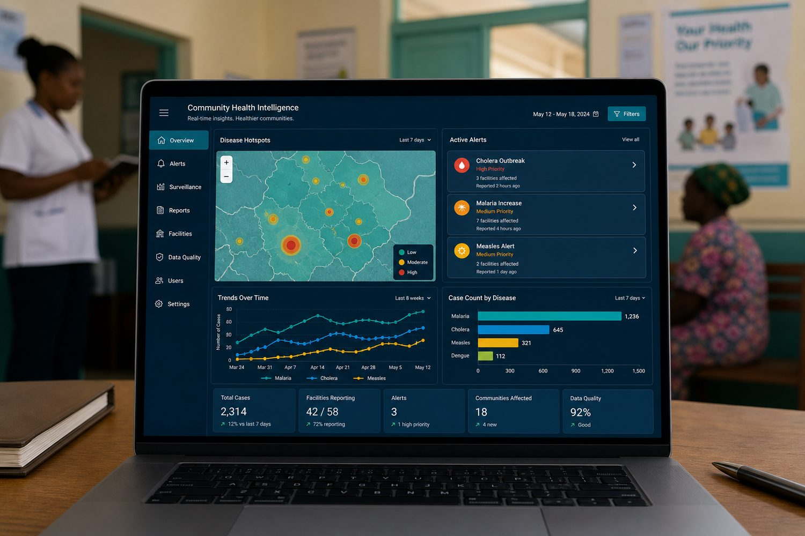
CONCEPT NOTE
Health–livelihood intelligence for rural policy
IFAD grant up to US$1.2M for Rural Sector Performance Assessment.
FairBanks links health shocks to rural livelihoods through FCHIP and the community cascade.
We proceed carefully — EOI first, full proposal only if thematic fit is confirmed.
FairBanks FCHIP | IFAD Rural Performance | Your health, our mission.
2

Slide 3
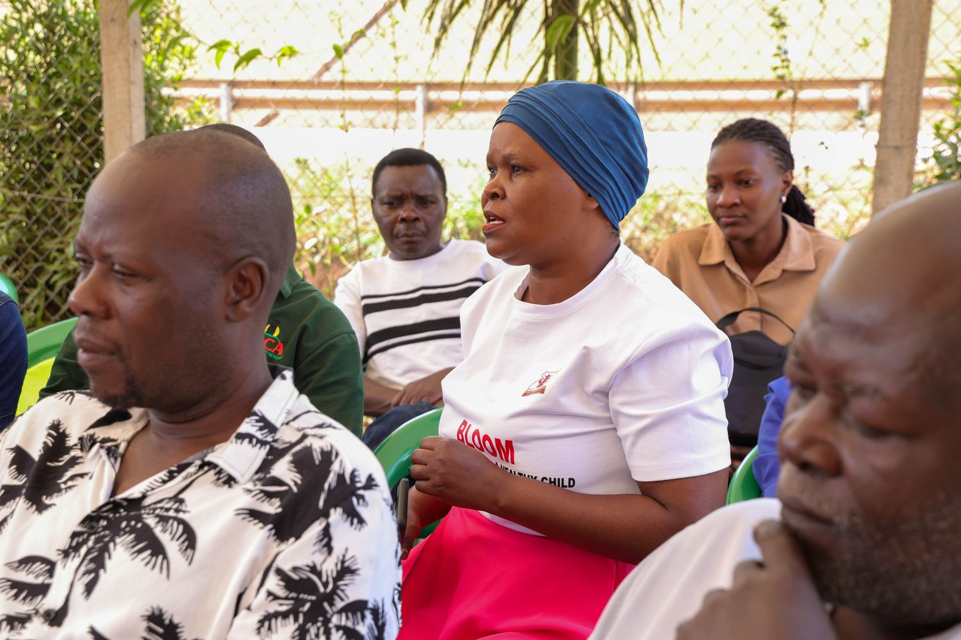
THE GAP
Health shocks wipe out rural household gains
• Illness erases farm income and savings
• Performance assessments under-weight health
• Community data could make policy human-centred
• Prevention protects livelihoods and food security
FairBanks FCHIP | IFAD Rural Performance | Your health, our mission.
3

Slide 4
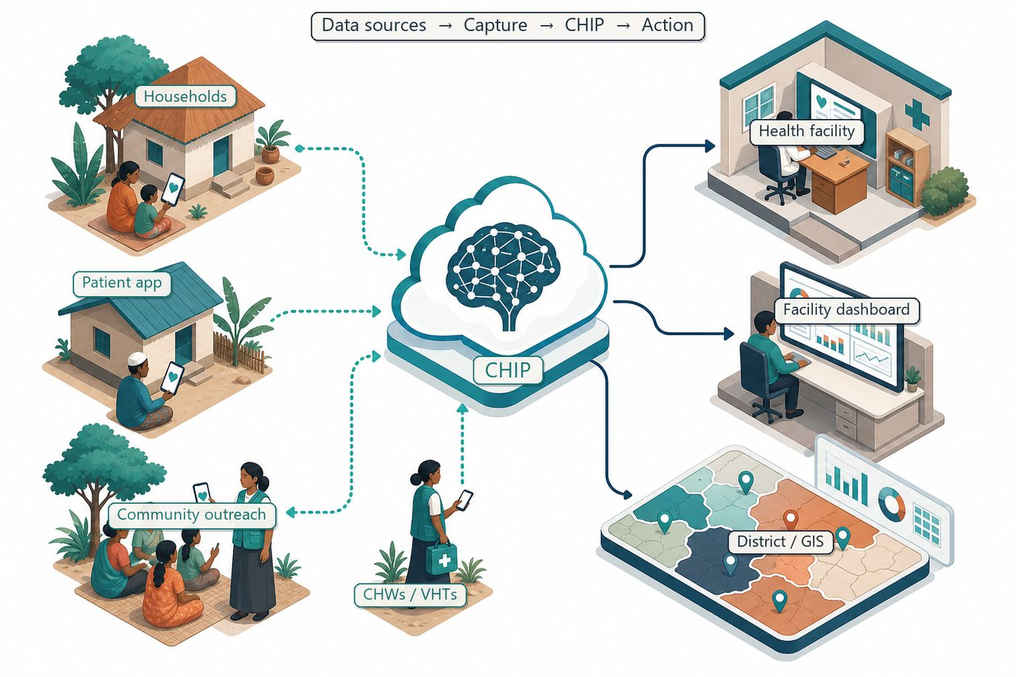
FCHIP LAYER
Community signals → rural performance dashboards
CHWs → outreach → clinic → research → empowerment.
FCHIP adds illness clusters, maternal risk, missed care, and stock-out signals for policy briefs and investment priorities.
FairBanks FCHIP | IFAD Rural Performance | Your health, our mission.
4

Slide 5
WORKSTREAMS
What we would implement with partners
Health-shock markers linked to livelihood stress in rural performance dashboards
Community-generated indicators from CHW outreach and clinic encounters
Policy briefs translating FCHIP signals into rural investment priorities
Partner-led evaluation design with academic / think-tank co-authorship
FairBanks FCHIP | IFAD Rural Performance | Your health, our mission.
5

Slide 6
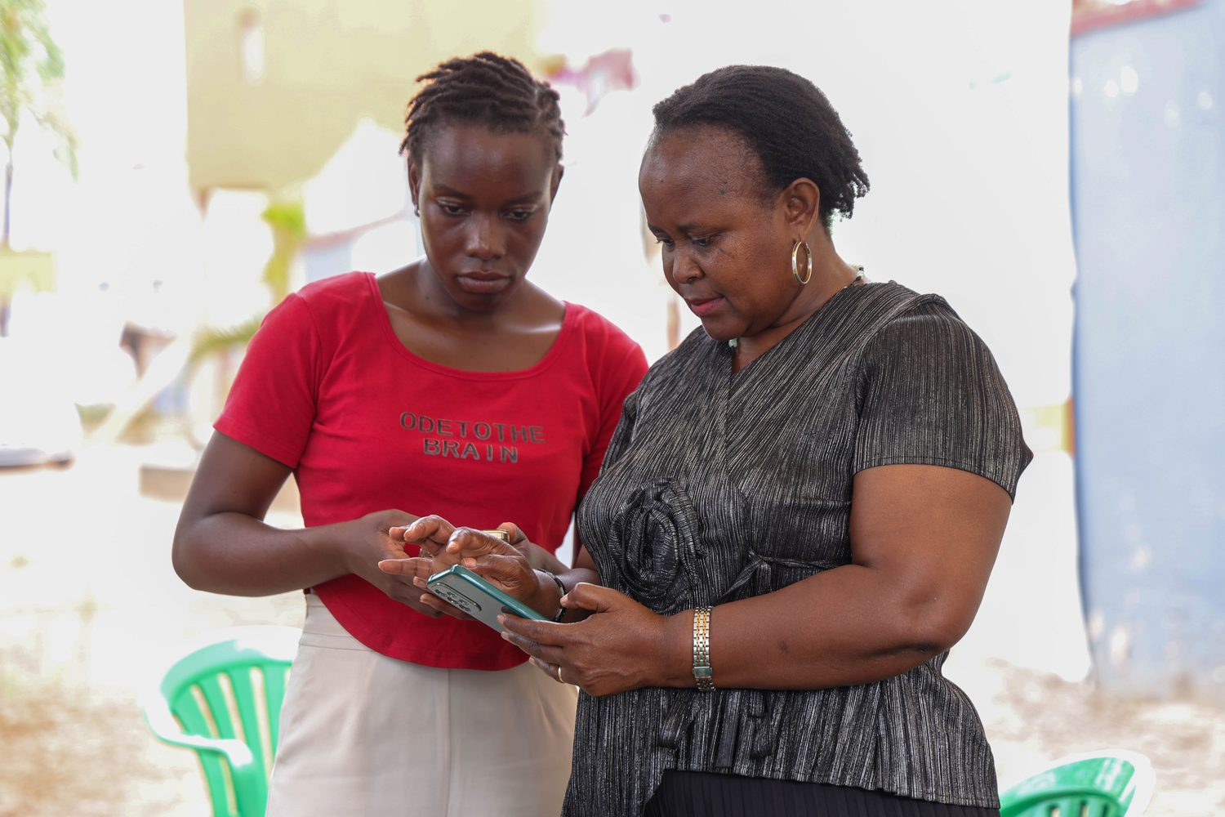
COUNTERPART
20–25% in-kind from FairBanks operations
FairBanks meets IFAD counterpart through:
• Field operations and CHW supervision • Outreach infrastructure and staff time • Data stewardship and existing digital foundations • Partner university / think tank for research design
FairBanks FCHIP | IFAD Rural Performance | Your health, our mission.
6

Slide 7
EOI → PROPOSAL → LEARNING
Gated by thematic fit verification
By 31 Jul 2026
Optional non-binding Expression of Interest to test thematic fit
Review
Confirm alignment with IFAD Rural Sector Performance Assessment guidance
By 4 Sep 2026
Full proposal only if thematic fit is confirmed
Year 1–2
Pilot health–livelihood indicators in FairBanks / partner rural catchments
Learning
Policy notes for IFAD, national stakeholders, and rural investment planners
FairBanks FCHIP | IFAD Rural Performance | Your health, our mission.
7

Slide 8
RESOURCES
Indicative allocation — up to US$1.2M ceiling
Research & assessment design
Methods, partner contracts, ethics
Share of grant
Community data & FCHIP modules
Indicators, dashboards, data quality
Share of grant
Policy engagement
Briefs, stakeholder dialogues, learning events
Share of grant
FairBanks counterpart
Field ops, CHW supervision, outreach, staff time
20–25% in-kind
Ceiling
Per IFAD call
Up to US$1.2M
FairBanks FCHIP | IFAD Rural Performance | Your health, our mission.
8

Slide 9
WIN-WIN
FairBanks ↔ IFAD ↔ rural families
FairBanks gains
IFAD gains
Resources to connect health intelligence with rural livelihood policy; university partnerships; evidence that prevention protects income and food security.
Ground-level health and vulnerability data from community programmes; social-enterprise implementer with field access; SDG-aligned health-shock narrative; counterpart contribution via live operations.
FairBanks FCHIP | IFAD Rural Performance | Your health, our mission.
9

Slide 10
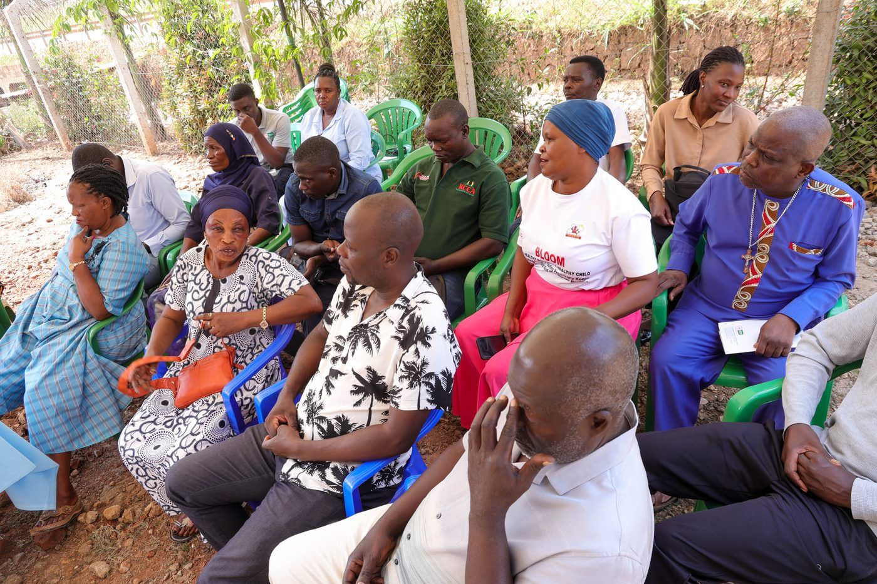
EOI first — full proposal only where IFAD guidance confirms fit.
Your health, our mission.

