Slide 1
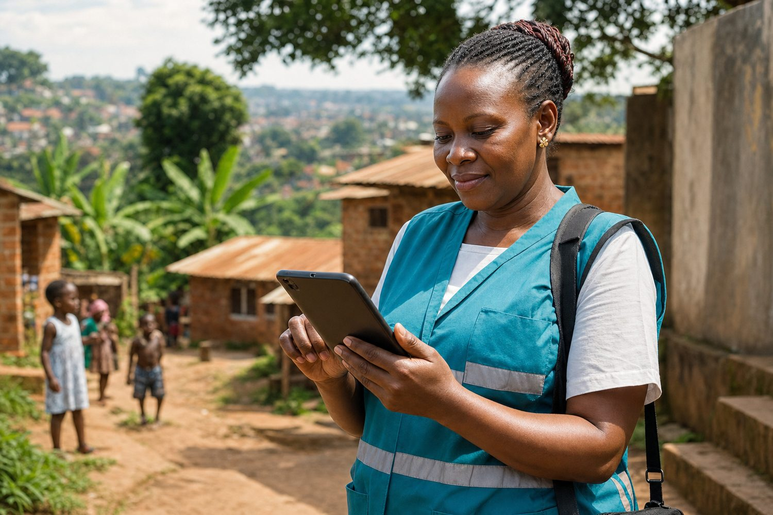
Brandtech Group AI for Good Scholarship 2026 — One Young World
Nominee Profile — Responsible AI for Community Health
FairBanks Community Health Intelligence Platform (FCHIP)
From Kampala outreach to Cape Town — AI that serves communities first
Your health, our mission.

Slide 2
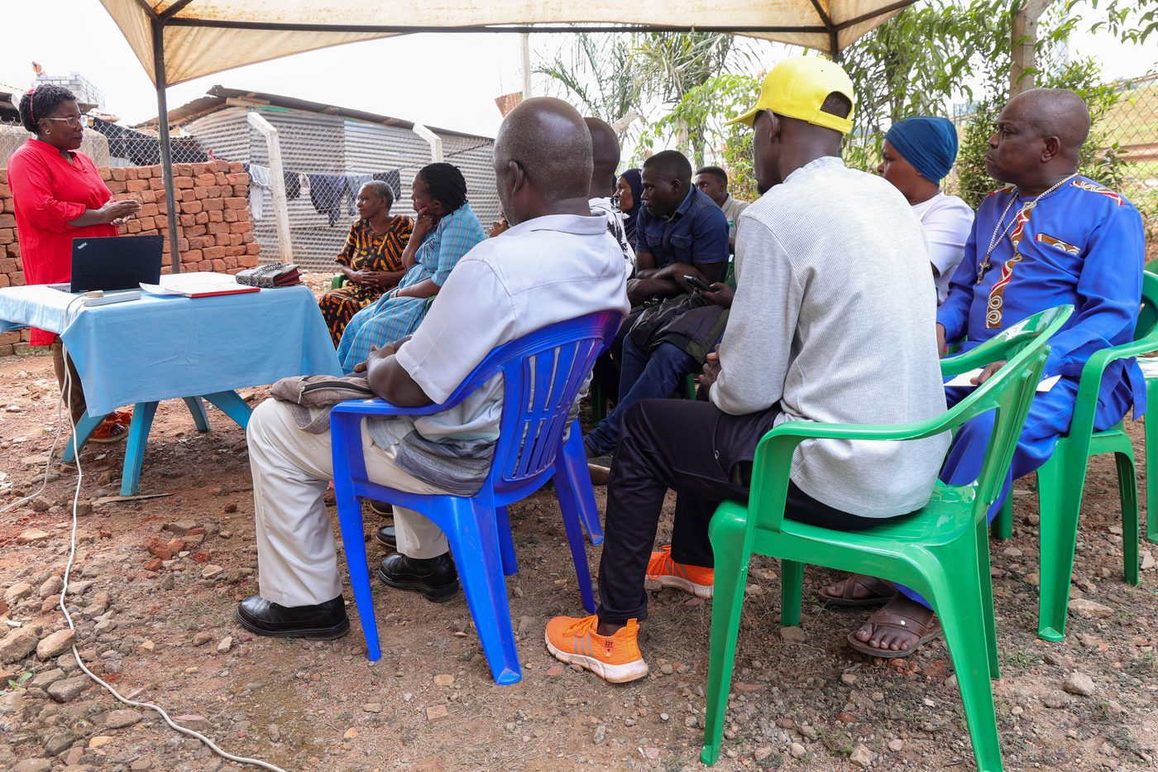
The journey
I grew up seeing neighbours wait until illness became an emergency. At FairBanks Community Reach I work where care actually starts — in streets, schools, and home visits with Community Health Workers — not only inside a clinic building. That experience shaped why I build: technol…
FairBanks FCHIP | OYW Cape Town 2026 | Your health, our mission.
2

Slide 3
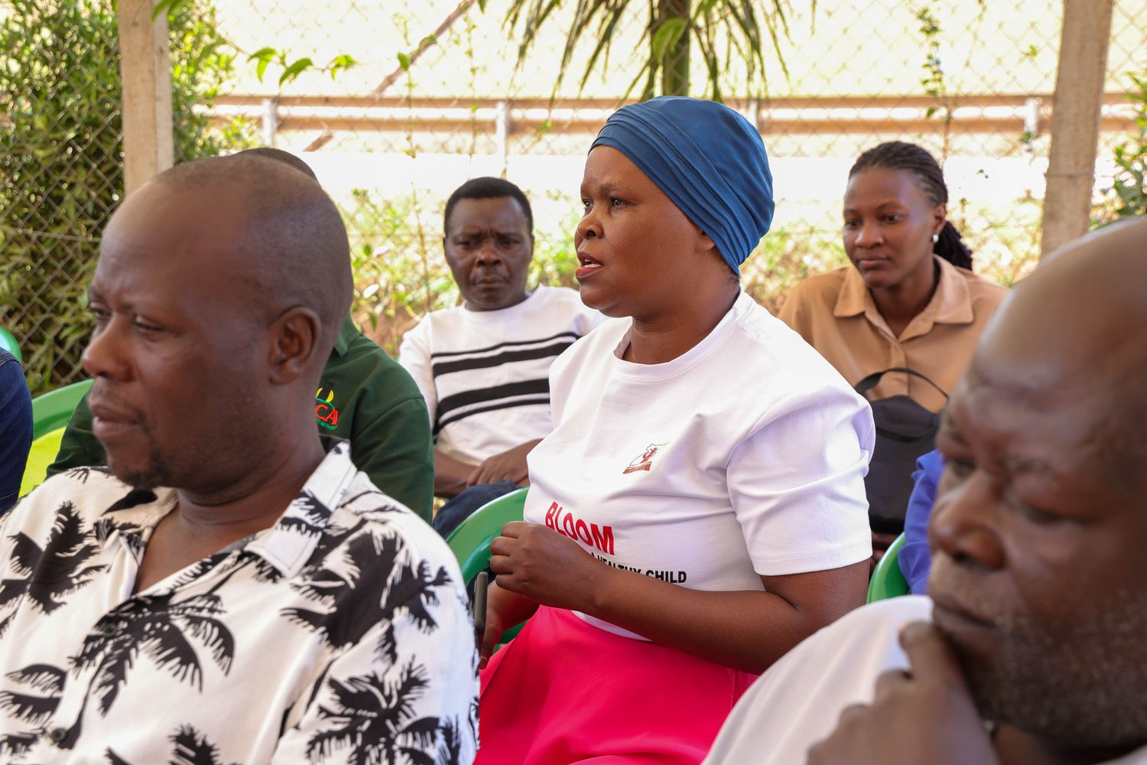
Problem on the ground
CHWs see warning signs weeks before emergencies. FCHIP closes that gap.
FairBanks FCHIP | OYW Cape Town 2026 | Your health, our mission.
3

Slide 4

Responsible AI
• Human-in-the-loop: CHWs and nurses validate alerts — AI supports, neve…
• Offline-first design for low-bandwidth communities; no dependency on c…
• Consent and anonymisation aligned with Uganda Data Protection principl…
• Local-language symptom capture where it improves trust and accuracy
FairBanks FCHIP | OYW Cape Town 2026 | Your health, our mission.
4

Slide 5
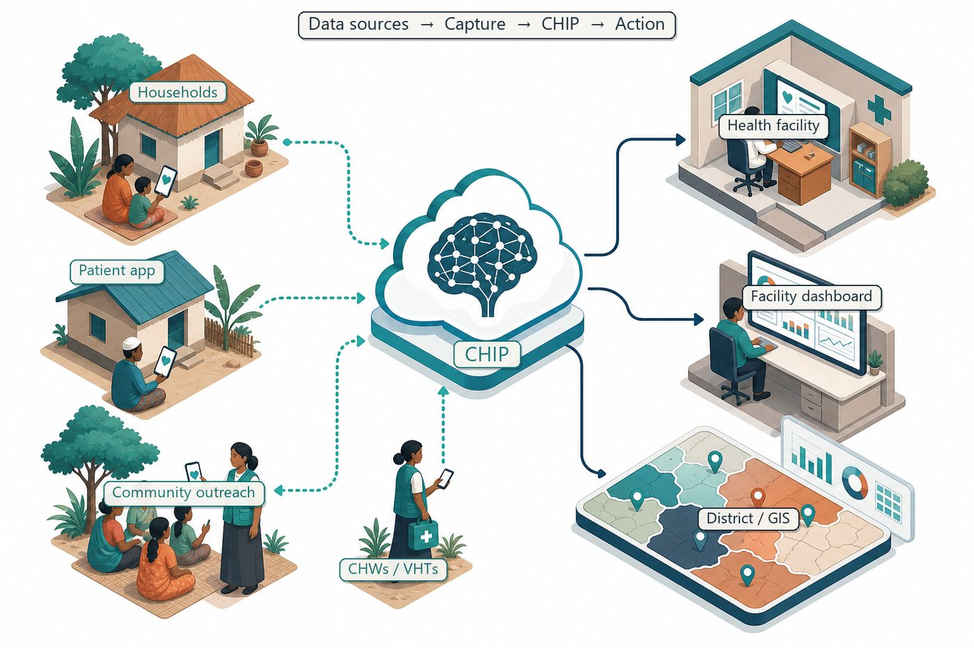
Community cascade
AI sits between CHW capture and clinic action — not above communities.
FairBanks FCHIP | OYW Cape Town 2026 | Your health, our mission.
5

Slide 6
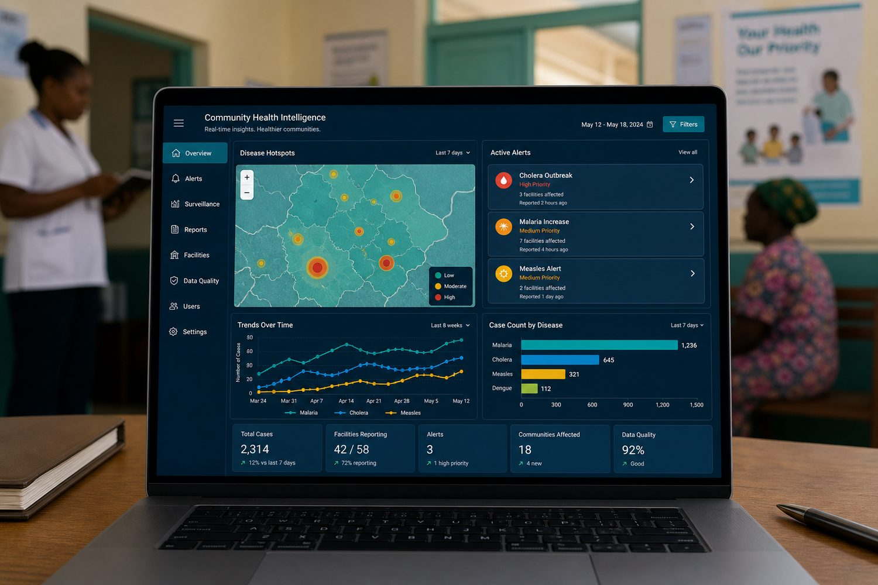
Proof
• Live outreach in Bukoto, Kyebando, Kisaasi, Kamwokya, Kikaaya
• Maternal, child, Gericare, and NCD screening programmes generating real field data
• Functioning medical centre anchoring referrals and quality assurance
• CHW/VHT relationships built on trust — essential for ethical AI adoption
FairBanks FCHIP | OYW Cape Town 2026 | Your health, our mission.
6

Slide 7
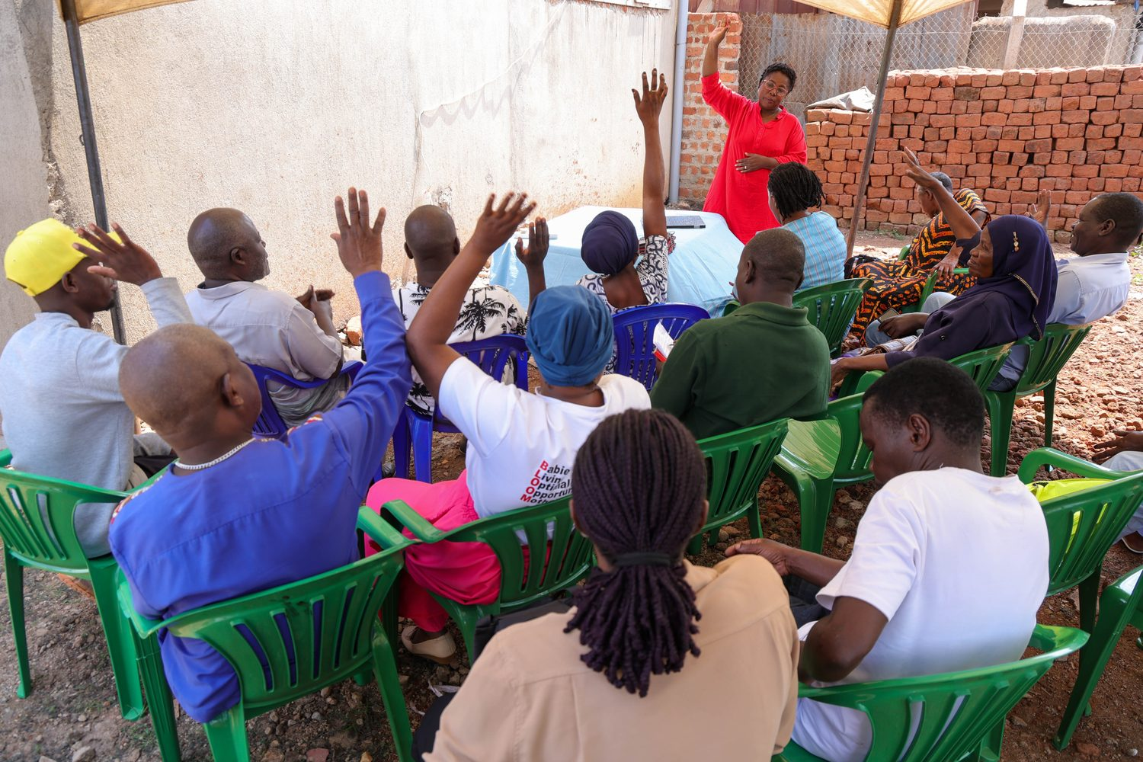
Cape Town
Share a practitioner story: how AI can strengthen — not bypass — community health workers
FairBanks FCHIP | OYW Cape Town 2026 | Your health, our mission.
7

Slide 8
Ethics
Privacy: Household consent; minimum necessary data; secure storage
Equity: Design for users with low digital literacy and basic phones
FairBanks FCHIP | OYW Cape Town 2026 | Your health, our mission.
8

Slide 9
Communities first.
AI second.
Impact always.
Your health, our mission.
FairBanks FCHIP | OYW Cape Town 2026 | Your health, our mission.
9

