Slide 1
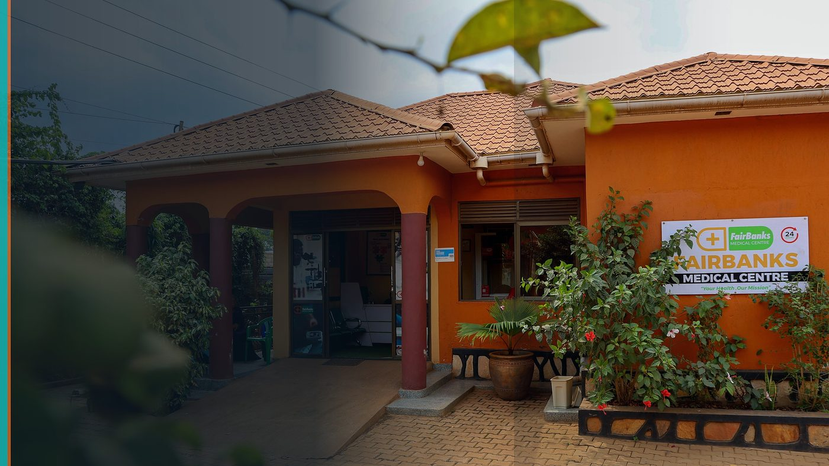
World Health Summit 2026 — Youth Group Opportunity (Berlin)
FairBanks Youth Delegation Application
FairBanks Community Health Intelligence Platform (FCHIP)
Learning global prevention practice to strengthen community health at home
Your health, our mission.

Slide 2
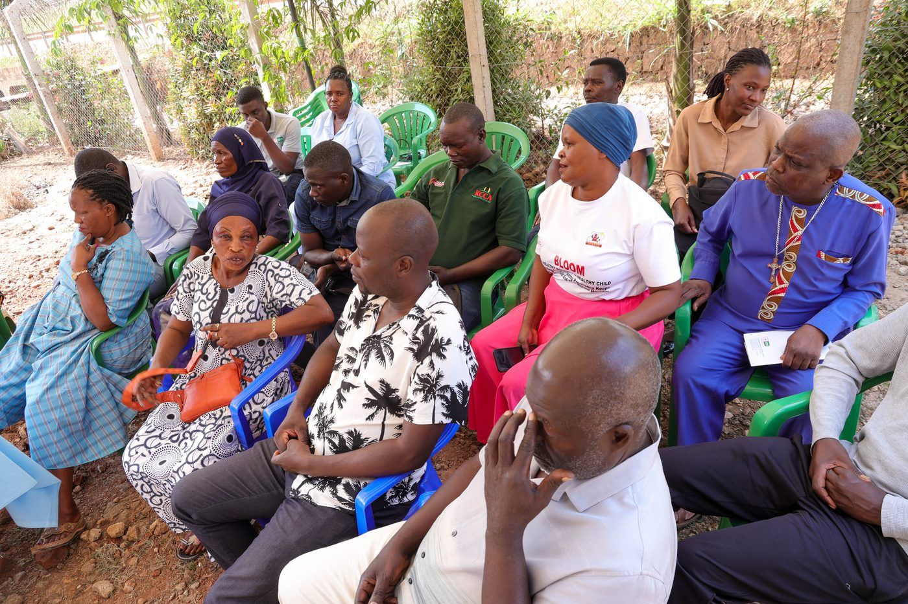
Youth-led health in Uganda
FairBanks Community Reach is a youth-led community health initiative rooted in Kampala, Uganda. We work alongside Community Health Workers and Village Health Teams in neighbourhoods including Bukoto, Kyebando, Kisaasi, Kamwokya, and Kikaaya — running outreach, screening, maternal support, and health education where clinics alone cannot reach.
FairBanks Youth Delegation | WHS 2026 Berlin | Your health, our mission.
2

Slide 3
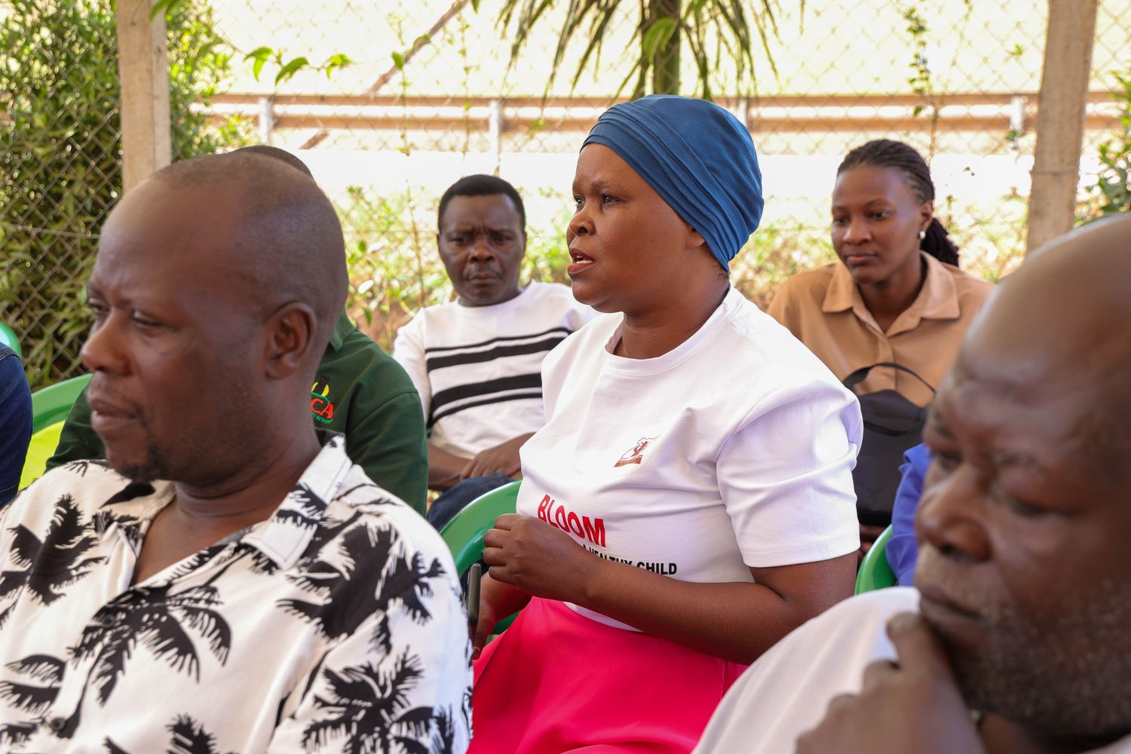
Why Berlin
Learn how leading health systems, researchers, and youth networks approach prevention, digital health governance, and pandemic preparedness — then translate lessons for our CHWs.
FairBanks Youth Delegation | WHS 2026 Berlin | Your health, our mission.
3

Slide 4
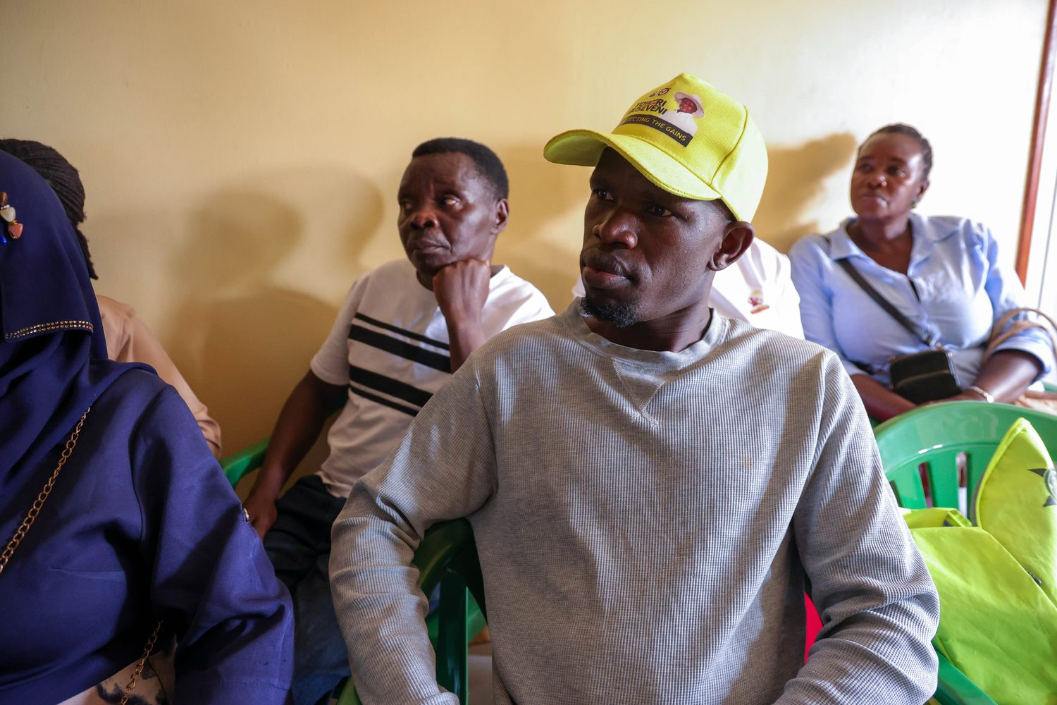
Learning agenda
• Prevention & primary care
• Digital health & ethics
• Youth leadership in health
• Maternal & child health
FairBanks Youth Delegation | WHS 2026 Berlin | Your health, our mission.
4

Slide 5
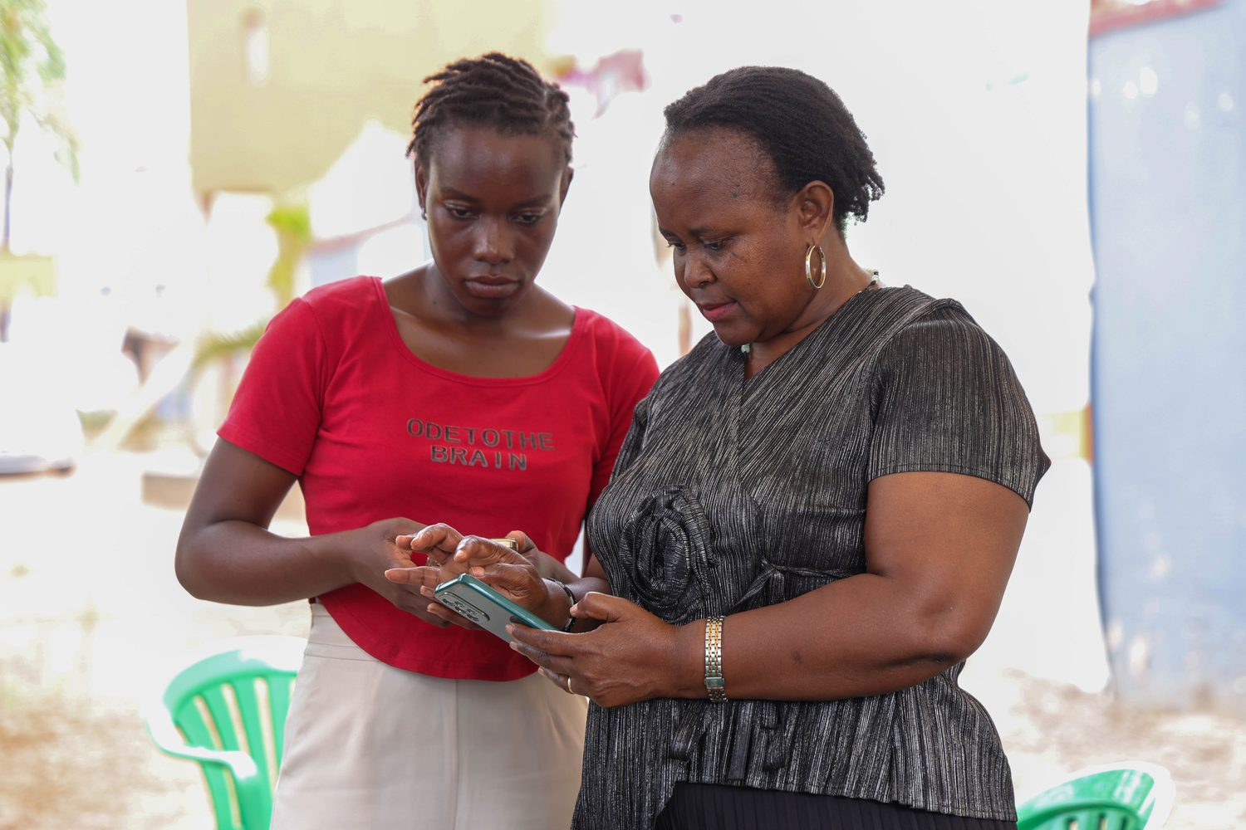
We bring lived practice
Stories from real outreach — what works and what fails in last-mile Uganda
FairBanks Youth Delegation | WHS 2026 Berlin | Your health, our mission.
5

Slide 6
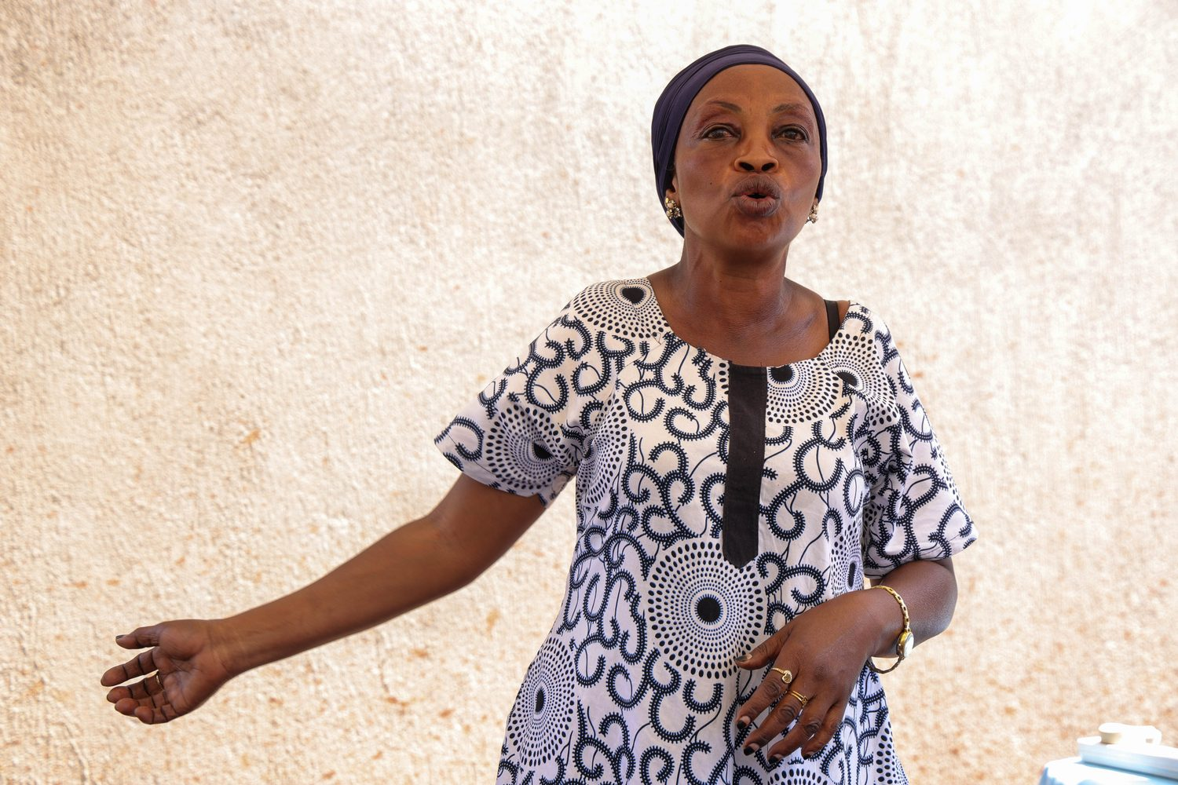
After the summit
Within 30 days of return: host a community briefing for CHWs, VHTs, and FairBanks staff
Integrate at least three summit insights into FairBanks outreach plans for Q4 2026
FairBanks Youth Delegation | WHS 2026 Berlin | Your health, our mission.
6

Slide 7
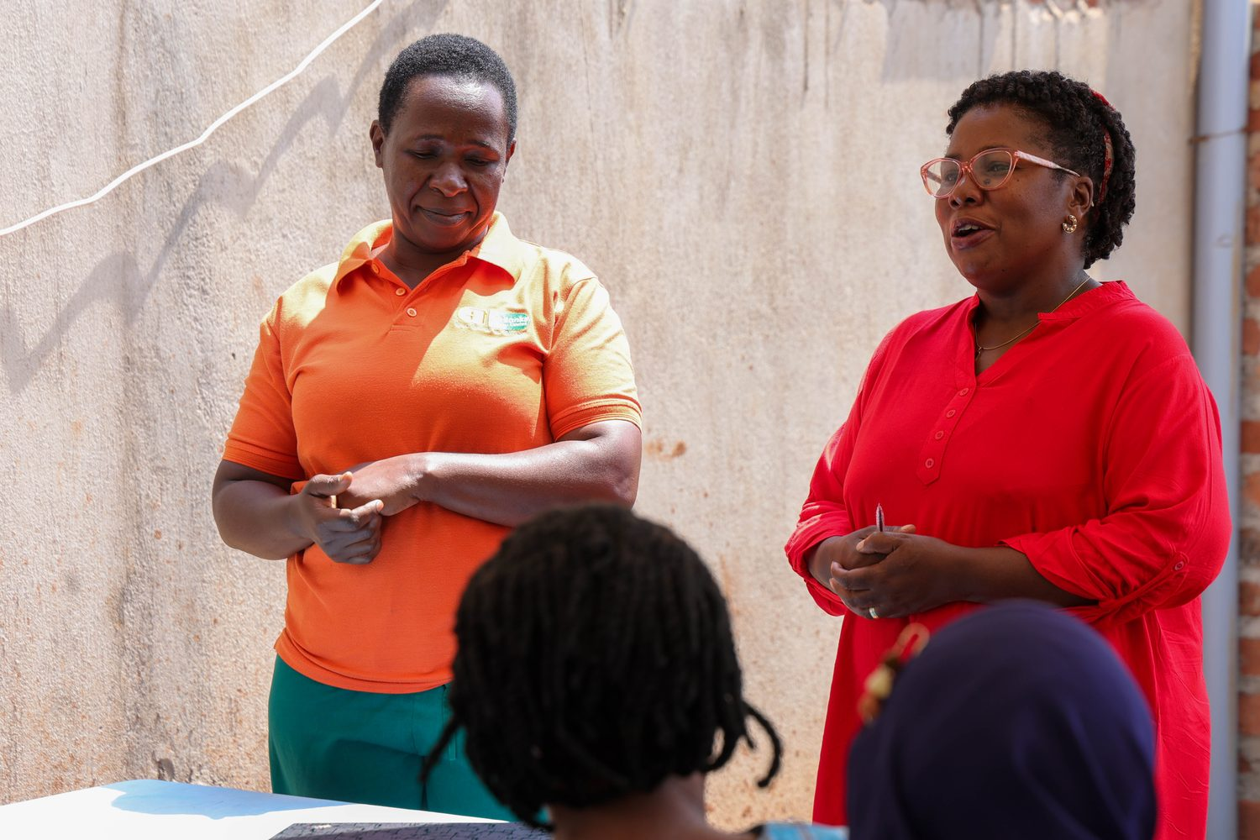
Travel note
We understand that complimentary WHS tickets cover summit registration only. FairBanks will self-fund travel, visa, and accommodation for nominated delegates aged 28 or under, as required by the programme. This commitment is documented here — not on the cover page.
FairBanks Youth Delegation | WHS 2026 Berlin | Your health, our mission.
7

