Slide 1
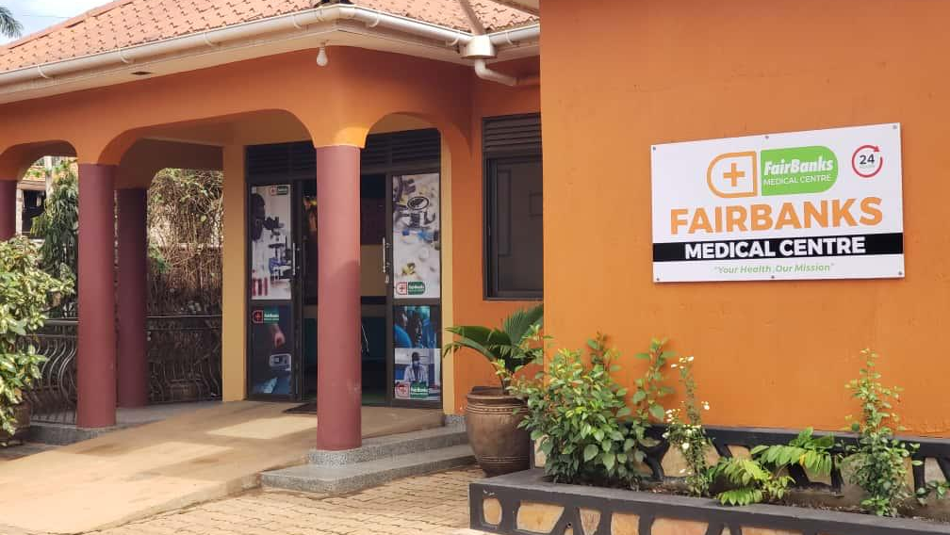

INSTITUTIONAL PARTNERSHIP PROPOSAL
FairBanks Medical Centre
University–Community Health
Partnership Proposal
Building the FairBanks Community Health Intelligence Platform
(FCHIP) with Victoria University
Your health, our mission.
Prepared for Victoria University leadership
Kyebando–Kisalosalo, Kampala · Institutional briefing

Slide 2
Slide Contents
01
Executive summary
02
About FairBanks Medical Centre
03
What FCHIP is
04
How we work together
05
Why Victoria University
06
Partnership network and outcomes
07
Roadmap and long-term vision
08
Invitation to partner
FairBanks Medical Centre · Your health, our mission.
2 / 17

Slide 3
EXECUTIVE SUMMARY
A partnership for health, learning, and impact
FairBanks Medical Centre proposes a partnership with Victoria University to integrate healthcare service delivery, academic excellence, research, innovation, and community engagement.
FCHIP at the centre
The FairBanks Community Health Intelligence Platform is the deep-tech platform for predictive community health — using community and facility data to support prevention, outreach, research, skills development, and partnerships.
Shared strengths
Victoria University brings education, innovation, and research. FairBanks brings a practical healthcare platform and community presence.
Shared goal
Build a replicable University–Community Health Partnership Model that advances healthcare, education, innovation, and sustainable development in Uganda.
FairBanks Medical Centre · Your health, our mission.
3 / 17

Slide 4
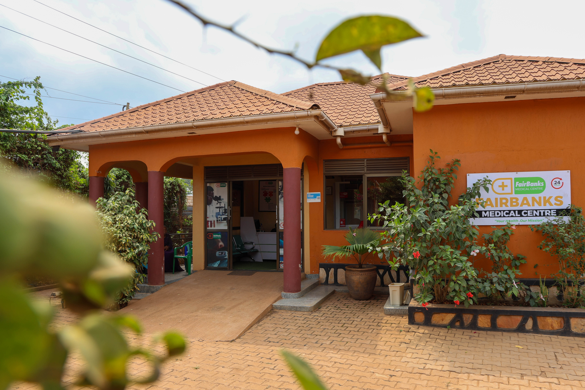
WHO WE ARE
About FairBanks Medical Centre
Community-based primary healthcare
Your health, our mission.
• Located in Kyebando–Kisalosalo, Kampala
• Accessible, affordable, quality healthcare
• Strong focus on preventive health and community well-being
• Committed to social determinants of health through partnerships
• Active in innovation, research, and community engagement
FairBanks Medical Centre
A trusted community health home — care close to where families live.
FairBanks Medical Centre · Your health, our mission.
4 / 17

Slide 5
What is FCHIP?
FCHIP stands for
FairBanks Community Health Intelligence Platform
FCHIP is a deep-technology platform that turns community and facility health data into useful predictions. It connects community members, CHWs and VHTs, schools, outreach programmes, clinics, and hospitals — and uses AI, GIS mapping, and climate signals to spot risks early so partners can act before crises escalate.
What FCHIP focuses on
Disease early warning
Maternal health risk
NCD hotspots
Child health signals
Medicine demand forecasts
CHW / VHT mobile tools
GIS risk mapping
Climate–health fusion
EMR / HMS data APIs
Facility dashboards
FairBanks Medical Centre · Your health, our mission.
5 / 17

Slide 6
How we work together
Five key areas of collaboration between Victoria University and FairBanks Medical Centre.
A
Student Experiential Learning
Structured placements across health and related fields
B
Research and Innovation
Joint studies, publications, and evidence for policy
C
Community Engagement
Camps, schools, screening, and volunteer programmes
D
Digital Health & Innovation
AI, EMRs, telemedicine, and predictive analytics
E
Resource Mobilisation
Shared pursuit of grants and development partnerships
FairBanks Medical Centre · Your health, our mission.
6 / 17

Slide 7
Why Victoria University?
Victoria University is committed to practical learning, innovation, entrepreneurship, and community transformation — values that closely align with FairBanks Medical Centre.
What the University contributes
What the University gains
Proposed role
• Academic expertise
• Research capacity
• Student engagement
• Innovation culture
• Real-world experiential learning
• Applied research environment
• Community impact pathways
• Visible institutional leadership
• Founding academic partner for FCHIP
• Co-shaper of a national partnership model
• Bridge between campus and community
• Partner in grants and innovation
FairBanks Medical Centre · Your health, our mission.
7 / 17

Slide 8
COLLABORATION A
Student experiential learning
Students gain practical experience while contributing to community healthcare.
Nursing
Public Health
Human Resource Management
Business Administration
Information Technology
Social Work
Community Development
Marketing and Communications
FairBanks Medical Centre · Your health, our mission.
8 / 17

Slide 9
COLLABORATION B
Research and innovation
Joint programmes, publications, conferences, and evidence-based policy development.
Community Health
Health Systems Strengthening
Artificial Intelligence in Healthcare
Digital Health
Occupational Burnout
Maternal and Child Health
Non-Communicable Diseases
Preventive Healthcare
Healthcare Quality Improvement
FairBanks Medical Centre · Your health, our mission.
9 / 17

Slide 10
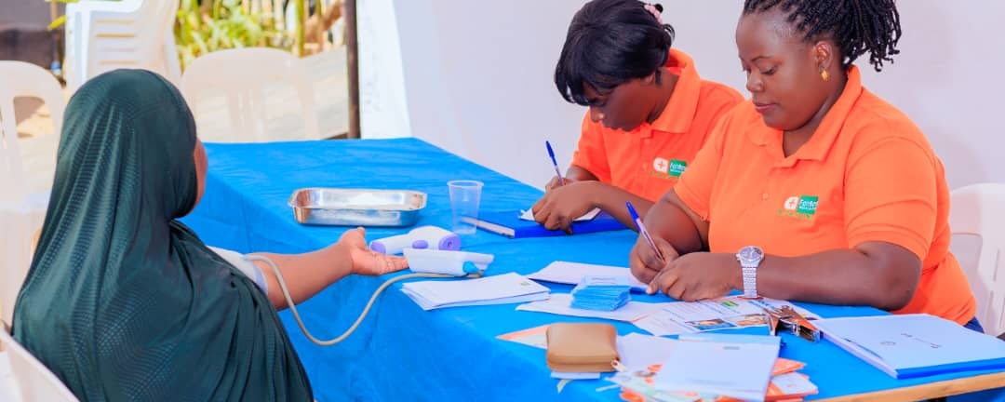
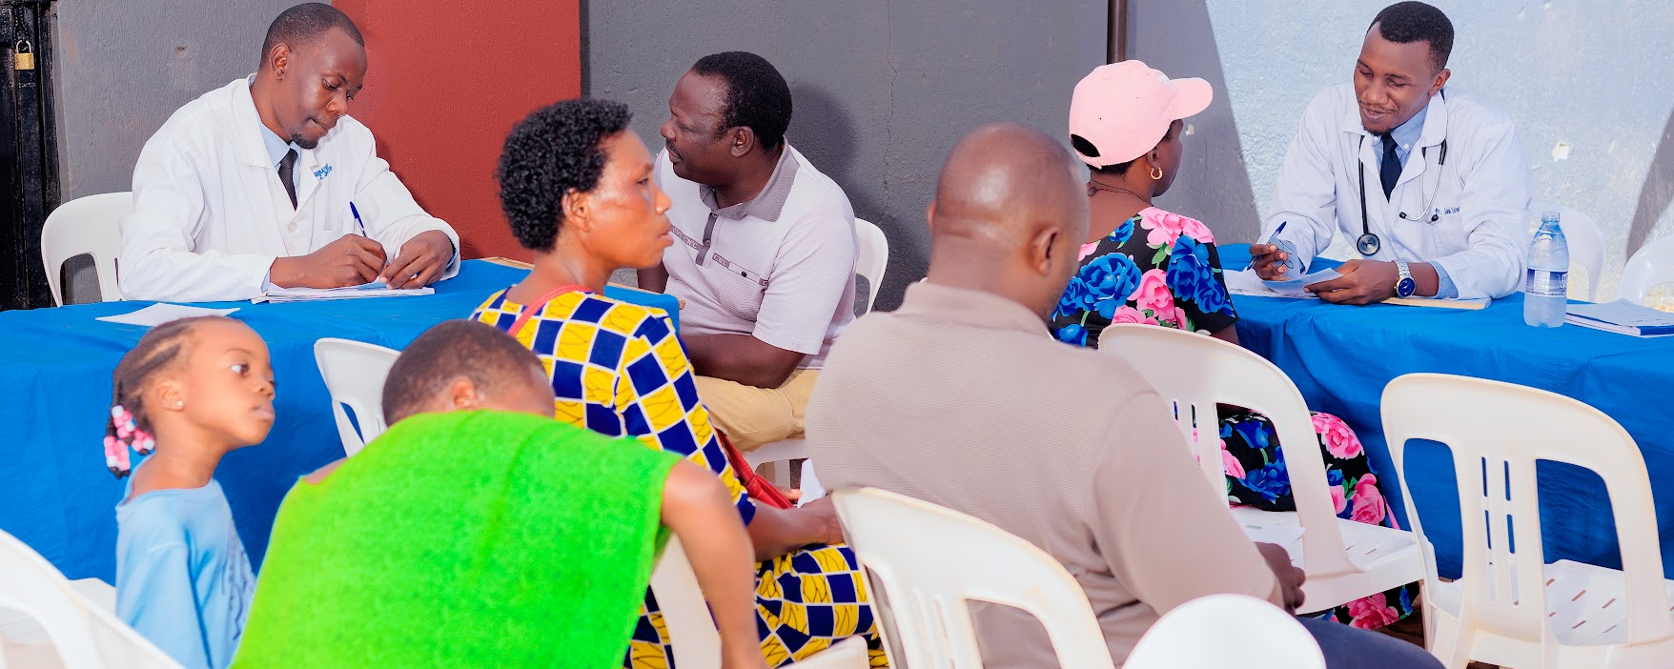
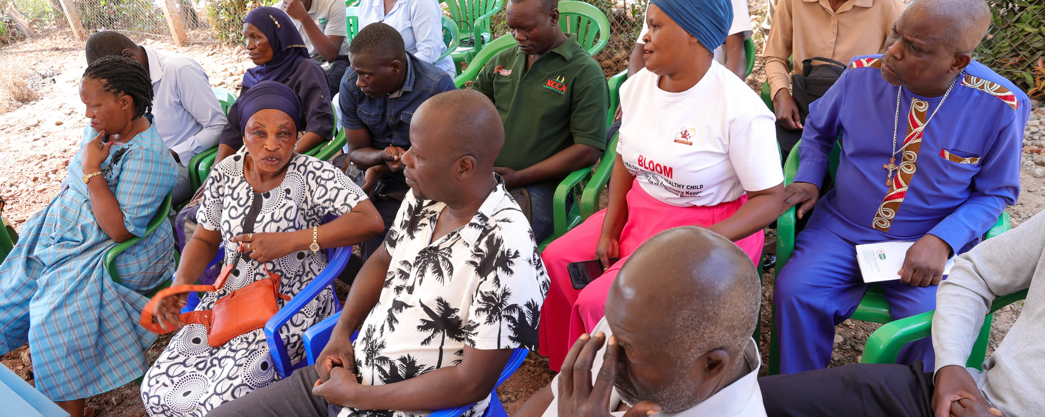
COLLABORATION C
Community engagement through FCHIP
Measurable social impact with meaningful practical learning.
Community medical camps
School health programmes
Corporate wellness initiatives
Community disease screening
Health promotion campaigns
Maternal and child health outreach
Elderly care programmes
Student volunteer programmes
Community-based research
FairBanks Medical Centre · Your health, our mission.
10 / 17

Slide 11
COLLABORATION D
Digital health and innovation
Developing practical healthcare solutions together.
Artificial Intelligence
Electronic Medical Records
Telemedicine
Applications that support smarter clinical and community decisions
Stronger continuity of care and better clinical information
Care and advice that reach people beyond the facility walls
Community Health Information Systems
Predictive analytics
Digital patient engagement
Better visibility of community health activity and needs
Earlier insight for planning and prevention
Clearer communication and follow-up with patients and families
FairBanks Medical Centre · Your health, our mission.
11 / 17

Slide 12
COLLABORATION E
Resource mobilisation
Collaborative proposals improve competitiveness for local and international funding.
01
02
03
Research grants
Development funding
Innovation grants
04
05
06
Corporate Social Responsibility partnerships
International development partnerships
Capacity-building programmes
FairBanks Medical Centre · Your health, our mission.
12 / 17

Slide 13
ECOSYSTEM
Partnerships and collaborative network
Victoria University as the flagship academic and research partner.
Government ministries and public health institutions
Local government leadership and Village Health Teams
Health insurance providers
Specialist healthcare professionals
Schools and educational institutions
Faith-based and community organisations
Corporate organisations
Media partners
National and international development partners
Philanthropic foundations and research institutions
FairBanks Medical Centre · Your health, our mission.
13 / 17

Slide 14
IMPACT
Expected outcomes of the partnership
01
02
03
Improve access to quality primary healthcare
Strengthen preventive healthcare programmes
Expand experiential learning opportunities
04
05
06
Increase community-based research
Promote healthcare innovation
Strengthen graduate employability
07
08
09
Enhance institutional visibility
Mobilise sustainable development partnerships
Improve health outcomes in surrounding communities
FairBanks Medical Centre · Your health, our mission.
14 / 17

Slide 15
IMPLEMENTATION
Proposed roadmap
Phase I
Phase II
Phase III
Phase IV
Foundation
Formalisation
Delivery
Learning and scale
• Introductory planning meeting
• Joint Technical Working Group
• Sign Memorandum of Understanding
• Identify priority pilot projects
• Student placements
• Joint research and outreach
• Innovation and grant development
• Monitoring and evaluation
• Document lessons
• Expand and replicate
FairBanks Medical Centre · Your health, our mission.
15 / 17

Slide 16
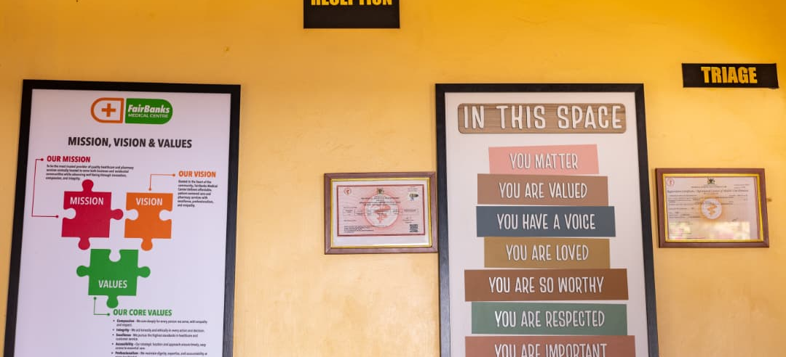
LOOKING AHEAD
Long-term vision
Establish FCHIP as Uganda's leading University–Community Health Partnership Model — showing how academia, healthcare providers, government, development partners, and communities can work together to improve lives.
For FairBanks Medical Centre
For Victoria University
A living laboratory for education, research, innovation, and community service.
Stronger leadership in experiential learning, applied research, and social impact — with lessons that can be replicated across Uganda.
FairBanks Medical Centre · Your health, our mission.
16 / 17

Slide 17
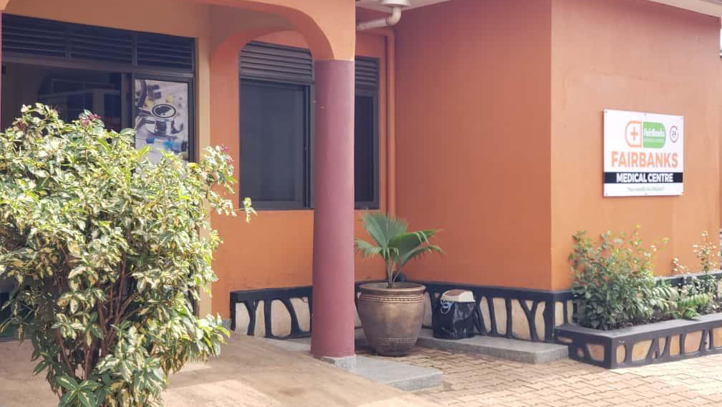
INVITATION TO PARTNER
FairBanks Medical Centre
Together, we can build
healthier communities
and stronger professionals.
FairBanks Medical Centre invites Victoria University to join as a
partner in advancing FCHIP.
Your health, our mission.
Institutional contact
Kyebando–Kisalosalo, Tirupati Road, Kampala
info@fairbanksmedicalcentre.org
fairbanksmedicalcentre.org

