Slide 1
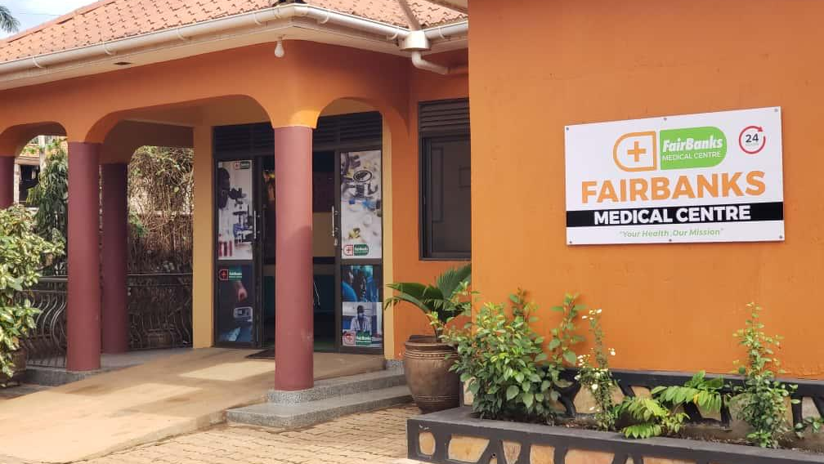

UNIVERSITY PARTNERSHIP PROPOSAL
FairBanks Medical Centre
Working with MUST
for community health,
research, and grants
Introducing FCHIP
FairBanks Community Health Intelligence Platform
Your health, our mission.
Prepared for Mbarara University of Science and Technology
Kyebando–Kisalosalo, Kampala · fairbanksmedicalcentre.org

Slide 2
Purpose: Why we are here
FairBanks Medical Centre seeks a practical partnership with MUST —
linking a working clinic and community programmes with university teaching,
research, innovation, and grant writing.
Share a living field site
A licensed medical centre and active community work in Kampala peri-urban areas.
Grow FCHIP together
Build and test the Community Health Intelligence Platform with MUST scholars and students.
Win stronger grants
Joint proposals that combine academic depth with real community and facility data.
FairBanks Medical Centre · Your health, our mission.
2 / 10

Slide 3
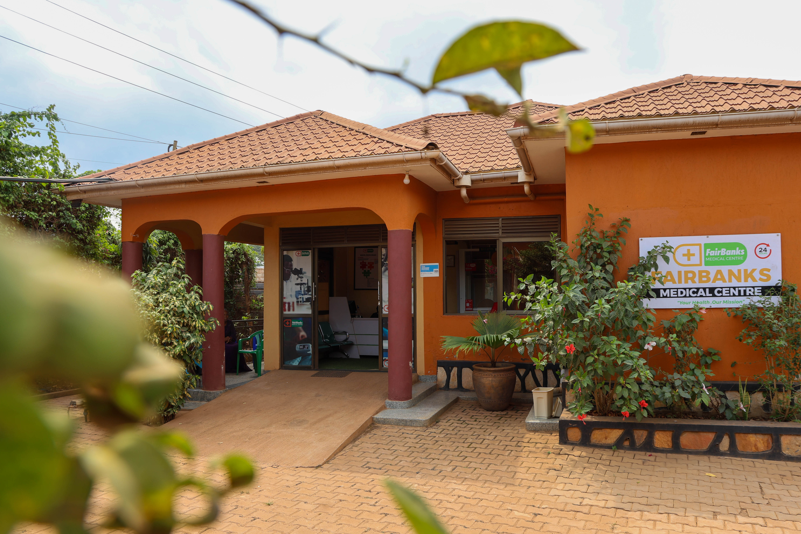
Who we are: About FairBanks Medical Centre
A community medical centre in Kampala
Your health, our mission.
• Located in Kyebando–Kisalosalo, Kampala
• Outpatient & inpatient care, emergency, diagnostics, pharmacy
• Maternal and child health, chronic care, prevention
• Community Reach with CHWs / VHTs nearby
• Building FCHIP as our health intelligence layer
FairBanks Medical Centre
Care close to where families live —
and a base for learning and research.
FairBanks Medical Centre · Your health, our mission.
3 / 10

Slide 4
Operating model: FairBanks Community Reach
How care, learning, and empowerment connect. FCHIP supports Data & Feedback.
1
2
Community members
CHWs / VHTs
Communities name needs and own solutions
The bridge — outreach, referrals, and data
3
4
Community programmes
Medical Centre
Screening, education, maternal & child care
Clinical care, diagnostics, pharmacy, follow-up
5
6
Research & skills
Empowerment & CHIS
Evidence, partners, training, and learning
Livelihoods and affordable shared protection
FairBanks Medical Centre · Your health, our mission.
4 / 10

Slide 5
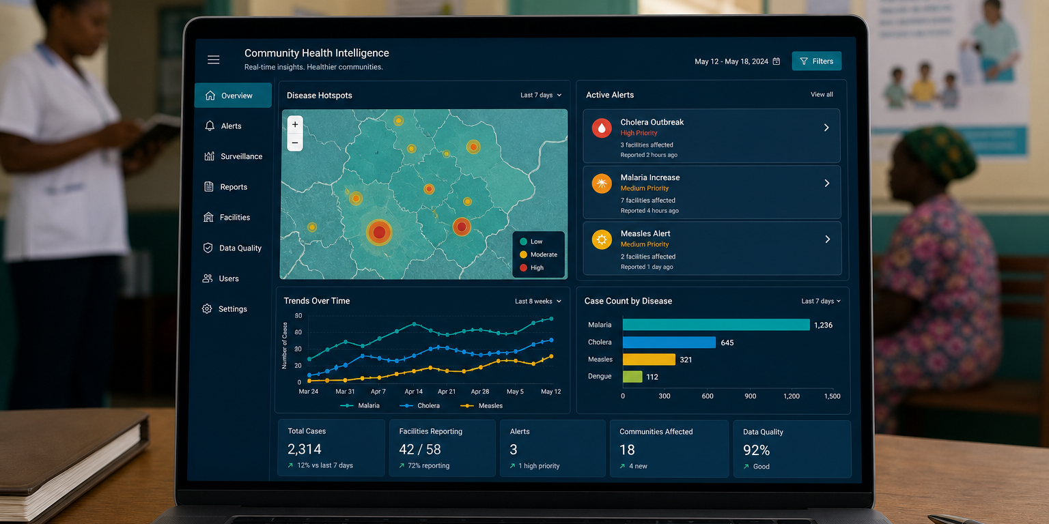
What is FCHIP?
FCHIP stands for
FairBanks Community Health Intelligence Platform
FCHIP brings community and facility health data together.
It uses AI, GIS maps, and climate signals to spot risks early —
so CHWs, clinics, and partners can act sooner.
Disease early warning
Maternal health risk
NCD & child health
CHW mobile tools
GIS & climate links
Facility dashboards
FairBanks Medical Centre · Your health, our mission.
5 / 10

Slide 6
Fit with MUST: Why MUST is a strong partner
Drawn from MUST’s published faculties, programmes, and innovation units.
Faculty of Health Sciences
Department of Community Health
Doctors, nurses, pharmacists, lab scientists, and physiotherapists — with COBERS community learning since 1989.
MPH, epidemiology, maternal and child health, NCDs, and health systems research.
Computing & innovation
Grant and research culture
Faculty of Computing and Informatics, CITT, and CAMTech Uganda — a natural home for FCHIP.
Long record of partnered research with MoH, districts, and global universities.
FairBanks Medical Centre · Your health, our mission.
6 / 10

Slide 7
How we can work together
A
Teaching & placements
COBERS-style learning, clinical attachments, and supervised field work
B
Joint research
Community health, digital health, climate–health, MCH, and NCDs
C
Community programmes
Camps, school health, screening, and VHT-linked outreach
D
FCHIP co-development
AI, GIS, mobile tools, and dashboards with Computing & CITT
E
Joint grants
Shared concept notes, MoUs, and competitive funding bids
FairBanks Medical Centre · Your health, our mission.
7 / 10

Slide 8
Funding & science: Joint research and grants
Together we write stronger proposals — clinic + community + university science.
What we can pursue
Why funders listen
• Community health intelligence research
• Climate–health and early warning pilots
• Maternal, child, and NCD studies
• Digital health / AI innovation awards
• Partner M&E and capacity-building grants
MUST brings research quality, ethics, and student power.
FairBanks brings a licensed facility, Community Reach, and a working FCHIP MVP.
That mix lowers risk and raises impact for grant reviewers.
FairBanks Medical Centre · Your health, our mission.
8 / 10

Slide 9
Next steps: Roadmap and invitation
Phase I
Phase II
Phase III
Phase IV
Meet & plan
Formalise
Deliver
Grow
Briefing · shared priorities · working group
MoU · 2–3 pilots · ethics & data rules
Placements · research · first grant bids
Review · publish · scale what works
What we invite MUST to do
• Host a planning meeting with Health Sciences, Community Health, and Computing / CITT
• Agree a partnership MoU with clear roles for teaching, research, and FCHIP
• Pick first pilots: one teaching track, one research track, one grant concept
FairBanks Medical Centre · Your health, our mission.
9 / 10

Slide 10
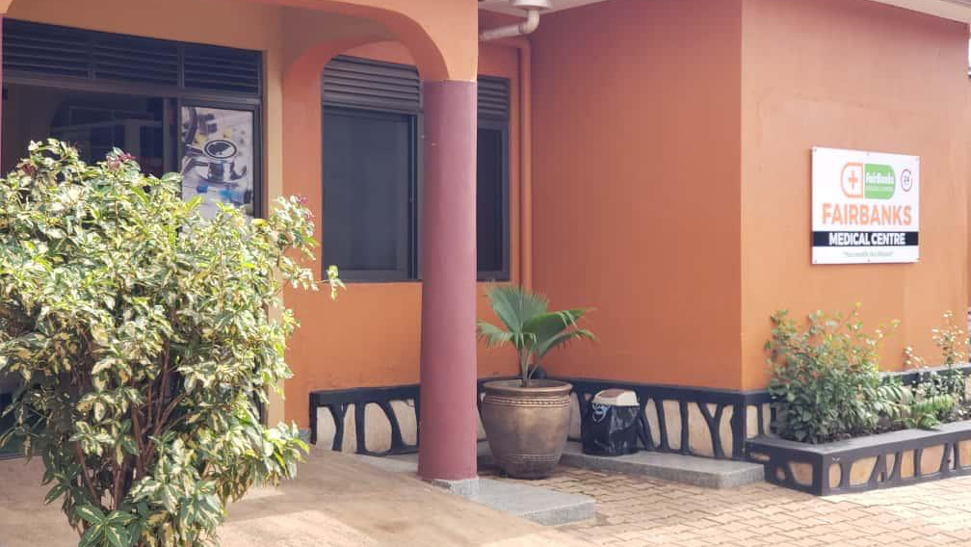
INVITATION TO PARTNER
FairBanks Medical Centre
Let us build healthier
communities — and stronger
science — together.
FairBanks Medical Centre invites Mbarara University of Science and Technology
to partner on Community Reach, FCHIP, and joint grants.
Your health, our mission.
Institutional contact
Kyebando–Kisalosalo, Tirupati Road, Kampala
info@fairbanksmedicalcentre.org · +256 748 319 052
fairbanksmedicalcentre.org

