Slide 1
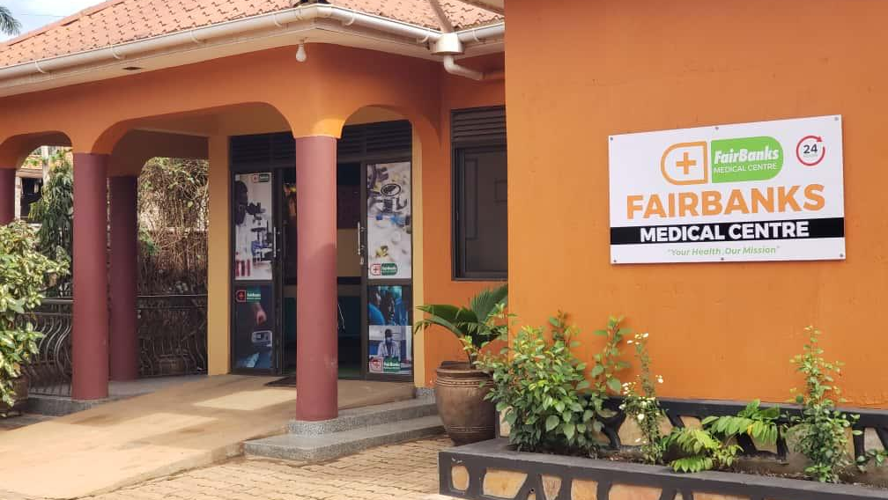

INSTITUTIONAL PARTNERSHIP PROPOSAL
FairBanks Medical Centre
Working with IDI
for infectious disease
intelligence and impact
Introducing FCHIP
FairBanks Community Health Intelligence Platform
Your health, our mission.
Prepared for Infectious Diseases Institute
Kyebando–Kisalosalo, Kampala · fairbanksmedicalcentre.org

Slide 2
Purpose: Why we are here
FairBanks Medical Centre seeks a practical partnership with IDI —
linking community and clinic signals to IDI’s research, training,
health systems, and global health security work.
Add a community field node
CHW/VHT and peri-urban clinic data that complements IDI’s research platforms.
Strengthen early warning
Use FCHIP with IDI expertise to spot infectious-disease risk earlier.
Co-write stronger grants
Pair IDI’s national reach with FairBanks’ live Community Reach site.
FairBanks Medical Centre · Your health, our mission.
2 / 10

Slide 3
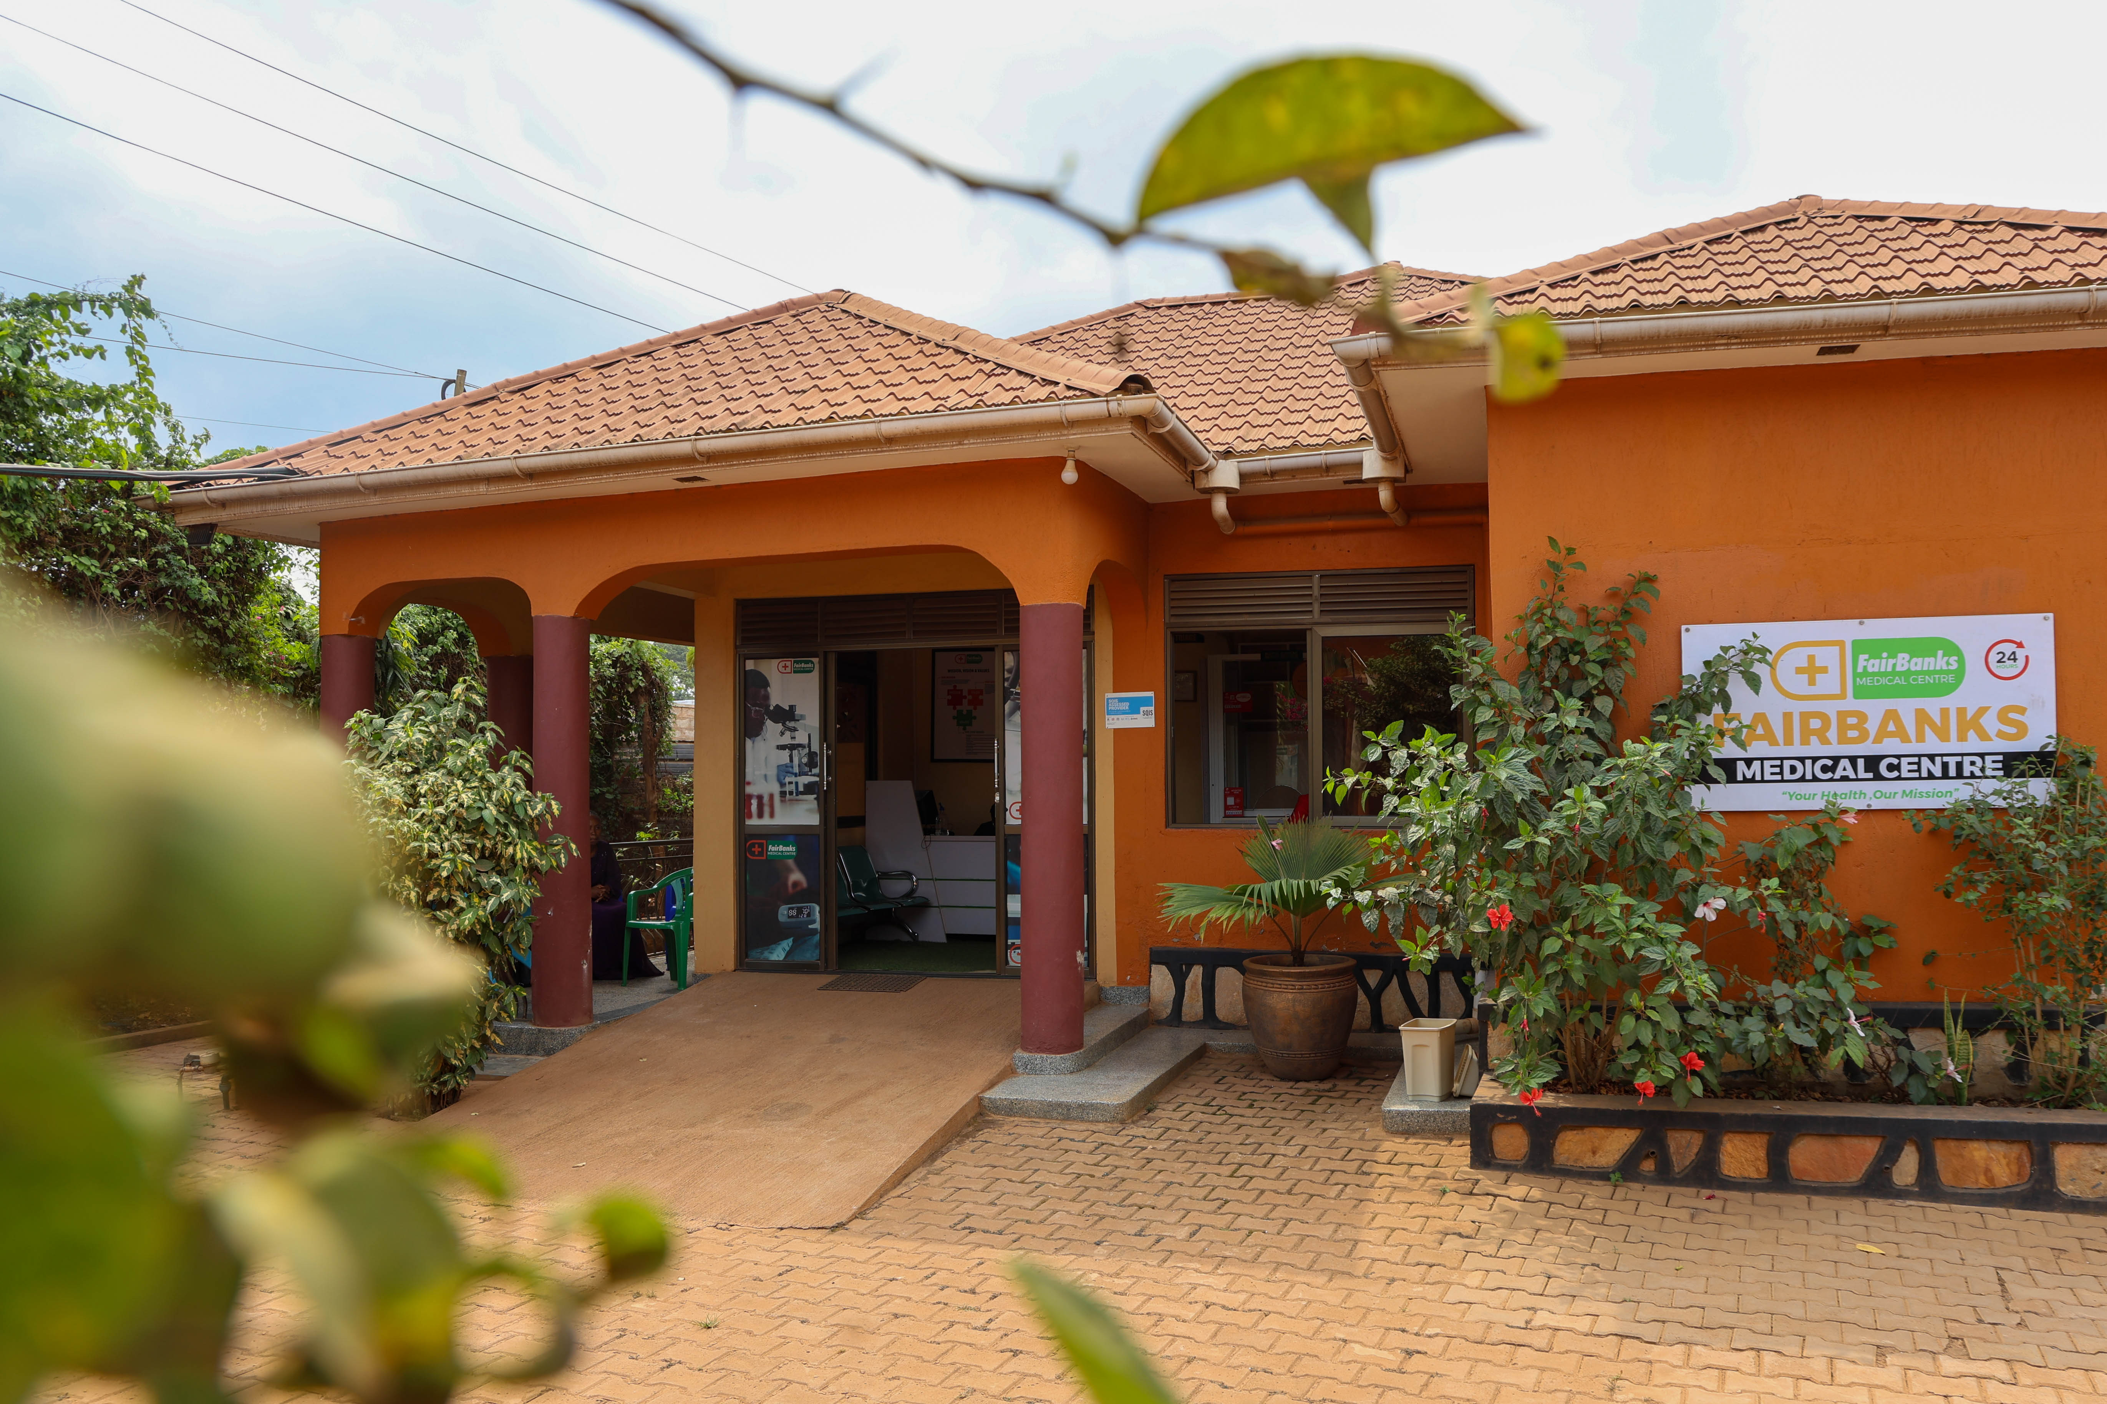
Who we are: About FairBanks Medical Centre
A community medical centre in Kampala
Your health, our mission.
• Located in Kyebando–Kisalosalo, Kampala
• Outpatient & inpatient care, emergency, diagnostics, pharmacy
• Maternal and child health, chronic care, prevention
• Community Reach with CHWs / VHTs nearby
• Building FCHIP as our health intelligence layer
FairBanks Medical Centre
Care close to where families live —
and a base for learning and research.
FairBanks Medical Centre · Your health, our mission.
3 / 10

Slide 4
Operating model: FairBanks Community Reach
How care, learning, and empowerment connect. FCHIP supports Data & Feedback.
1
2
Community members
CHWs / VHTs
Communities name needs and own solutions
The bridge — outreach, referrals, and data
3
4
Community programmes
Medical Centre
Screening, education, maternal & child care
Clinical care, diagnostics, pharmacy, follow-up
5
6
Research & skills
Empowerment & CHIS
Evidence, partners, training, and learning
Livelihoods and affordable shared protection
FairBanks Medical Centre · Your health, our mission.
4 / 10

Slide 5
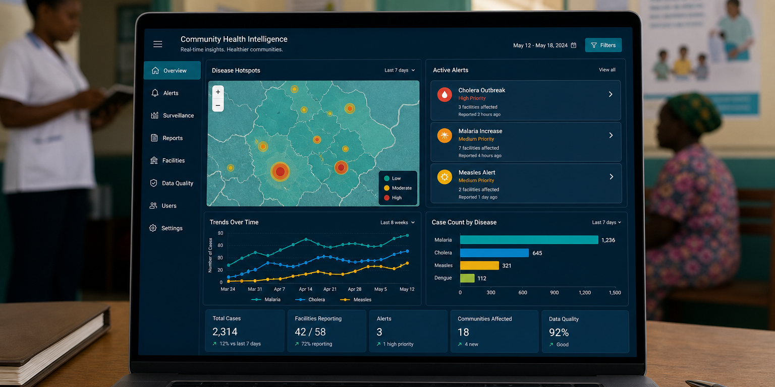
What is FCHIP?
FCHIP stands for
FairBanks Community Health Intelligence Platform
FCHIP brings community and facility health data together.
It uses AI, GIS maps, and climate signals to spot risks early —
so CHWs, clinics, and partners can act sooner.
Infectious disease alerts
Outbreak clustering
CHW symptom signals
Facility EMR APIs
GIS risk mapping
Partner dashboards
FairBanks Medical Centre · Your health, our mission.
5 / 10

Slide 6
Fit with IDI: Why IDI is a strong partner
Drawn from IDI’s published programmes, district reach, and Makerere ownership.
Six core programmes
National HIV & ID footprint
Prevention & treatment, training, research, labs, health systems strengthening, and global health security.
IDI supports a large share of Uganda’s ART effort and works across most districts.
Innovation & data science
Training at scale
Academy for Health Innovation and African Centre of Excellence in Bioinformatics & Big Data.
Tens of thousands of health workers trained — a natural path for FCHIP skills transfer.
FairBanks Medical Centre · Your health, our mission.
6 / 10

Slide 7
How we can work together
A
Research platforms
Community and clinic cohorts linked to IDI infectious-disease studies
B
Global health security
Community early warning feeds for outbreak preparedness and response
C
Training & capacity
Placements and short courses for CHWs, clinicians, and data users
D
FCHIP + data science
Join FCHIP with IDI bioinformatics, dashboards, and digital health work
E
Joint grants
Shared proposals for HIV, TB, emerging infections, and health systems
FairBanks Medical Centre · Your health, our mission.
7 / 10

Slide 8
Funding & science: Joint research and grants
IDI science + FairBanks community site — stronger bids for infectious disease funders.
What we can pursue
Why funders listen
• Community early warning for infectious diseases
• HIV / TB / emerging infection field studies
• Digital surveillance and dashboard innovation
• Health systems strengthening and M&E grants
• Training and capacity-building awards
IDI brings national reach, research depth, and MoH partnership.
FairBanks brings a licensed facility, Community Reach, and a working FCHIP MVP.
Together we offer funders both community last-mile data and institutional science.
FairBanks Medical Centre · Your health, our mission.
8 / 10

Slide 9
Next steps: Roadmap and invitation
Phase I
Phase II
Phase III
Phase IV
Meet & plan
Formalise
Deliver
Grow
Briefing · shared priorities · working group
MoU · 2–3 pilots · ethics & data rules
Joint work starts · first grant bids
Review · publish · scale what works
What we invite IDI to do
• Host a planning meeting with Research, Global Health Security, and Academy leads
• Agree an MoU covering research, training, community surveillance, and FCHIP
• Pick first pilots: one research track, one GHS early-warning track, one grant concept
FairBanks Medical Centre · Your health, our mission.
9 / 10

Slide 10
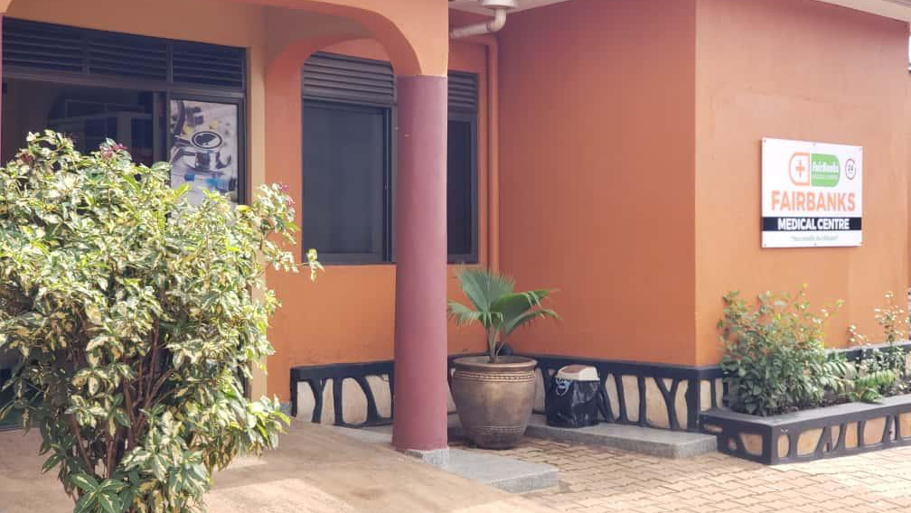
INVITATION TO PARTNER
FairBanks Medical Centre
Let us build healthier
communities — and stronger
science — together.
FairBanks Medical Centre invites the Infectious Diseases Institute
to partner on Community Reach, FCHIP, and joint grants.
Your health, our mission.
Institutional contact
Kyebando–Kisalosalo, Tirupati Road, Kampala
info@fairbanksmedicalcentre.org · +256 748 319 052
fairbanksmedicalcentre.org

