Slide 1
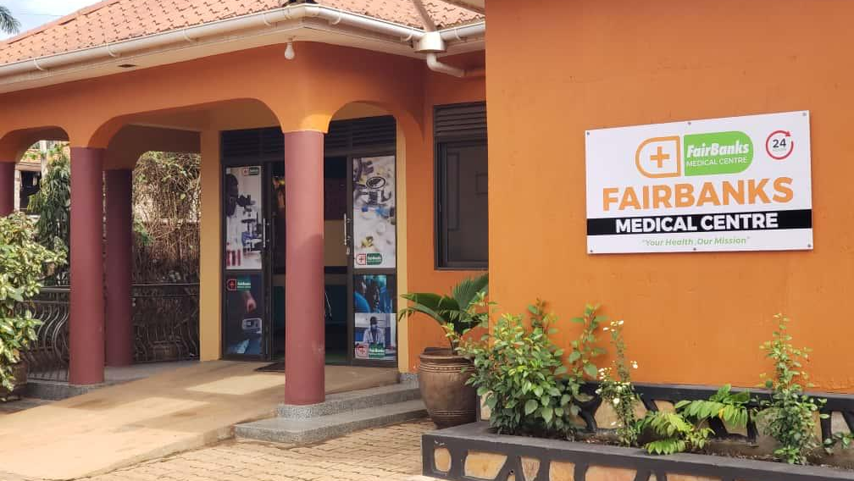

UNIVERSITY PARTNERSHIP PROPOSAL
FairBanks Medical Centre
Working with Makerere
for community health,
research, and grants
Introducing FCHIP
FairBanks Community Health Intelligence Platform
Your health, our mission.
Prepared for Makerere University
Kyebando–Kisalosalo, Kampala · fairbanksmedicalcentre.org

Slide 2
Purpose: Why we are here
FairBanks Medical Centre seeks a practical partnership with Makerere University —
linking a Kampala clinic and Community Reach work with MakCHS teaching,
MakSPH research, and joint grant writing.
Share a Kampala field site
A licensed medical centre and peri-urban Community Reach near Makerere’s catchment.
Grow FCHIP with Mak scholars
Validate community health intelligence with MakSPH, MakCHS, and computing teams.
Win stronger grants together
Combine Makerere’s research depth with real facility and community data.
FairBanks Medical Centre · Your health, our mission.
2 / 10

Slide 3
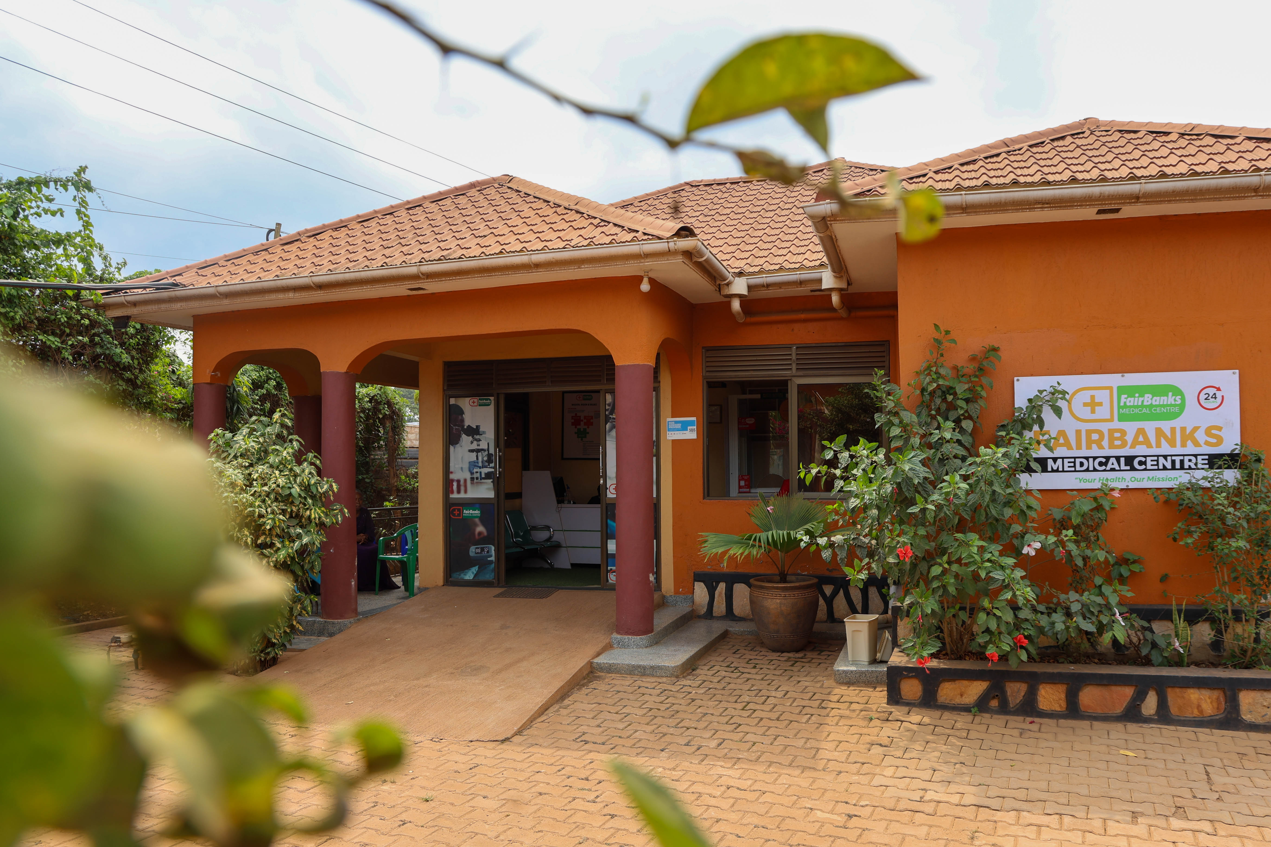
Who we are: About FairBanks Medical Centre
A community medical centre in Kampala
Your health, our mission.
• Located in Kyebando–Kisalosalo, Kampala
• Outpatient & inpatient care, emergency, diagnostics, pharmacy
• Maternal and child health, chronic care, prevention
• Community Reach with CHWs / VHTs nearby
• Building FCHIP as our health intelligence layer
FairBanks Medical Centre
Care close to where families live —
and a base for learning and research.
FairBanks Medical Centre · Your health, our mission.
3 / 10

Slide 4
Operating model: FairBanks Community Reach
How care, learning, and empowerment connect. FCHIP supports Data & Feedback.
1
2
Community members
CHWs / VHTs
Communities name needs and own solutions
The bridge — outreach, referrals, and data
3
4
Community programmes
Medical Centre
Screening, education, maternal & child care
Clinical care, diagnostics, pharmacy, follow-up
5
6
Research & skills
Empowerment & CHIS
Evidence, partners, training, and learning
Livelihoods and affordable shared protection
FairBanks Medical Centre · Your health, our mission.
4 / 10

Slide 5
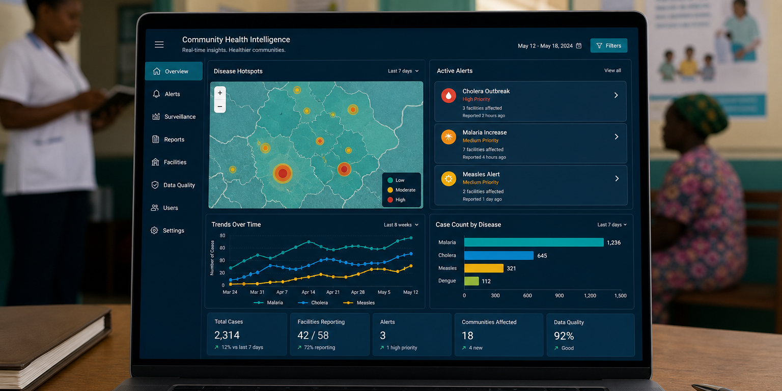
What is FCHIP?
FCHIP stands for
FairBanks Community Health Intelligence Platform
FCHIP brings community and facility health data together.
It uses AI, GIS maps, and climate signals to spot risks early —
so CHWs, clinics, and partners can act sooner.
Disease early warning
Maternal health risk
NCD & child health
CHW mobile tools
GIS & climate links
Facility dashboards
FairBanks Medical Centre · Your health, our mission.
5 / 10

Slide 6
Fit with Makerere: Why Makerere is a strong partner
Based on Makerere College of Health Sciences, MakSPH, and published research programmes.
College of Health Sciences
School of Public Health
Medicine, nursing, pharmacy, and related programmes — with Mulago teaching links and strong clinical training.
MakSPH leads epidemiology, health systems, HIV surveys, METS, and climate–health research such as Cities of Youth.
Digital & data capacity
Grant track record
Computing, health informatics, and partner platforms that fit FCHIP’s AI, GIS, and dashboard work.
Long history of MoH, CDC, DANIDA, and global university partnerships — ideal for joint proposals.
FairBanks Medical Centre · Your health, our mission.
6 / 10

Slide 7
How we can work together
A
Student placements
Community and clinic attachments for MakCHS and MakSPH learners
B
Joint research
Urban community health, climate–health, MCH, NCDs, and digital health
C
Community programmes
Outreach, school health, screening, and VHT-linked work in Kampala
D
FCHIP co-development
AI, GIS, mobile tools, and dashboards with Makerere researchers
E
Joint grants
Shared concept notes, ethics, MoUs, and competitive funding bids
FairBanks Medical Centre · Your health, our mission.
7 / 10

Slide 8
Funding & science: Joint research and grants
Clinic + Community Reach + Makerere science — a strong package for funders.
What we can pursue
Why funders listen
• Urban community health intelligence studies
• Climate–health and early warning pilots
• Maternal, child, and NCD community research
• Digital health / AI innovation awards
• Health systems M&E and capacity-building grants
Makerere brings research quality, ethics, and student power.
FairBanks brings a licensed facility, Community Reach, and a working FCHIP MVP.
That mix lowers risk and raises impact for grant reviewers.
FairBanks Medical Centre · Your health, our mission.
8 / 10

Slide 9
Next steps: Roadmap and invitation
Phase I
Phase II
Phase III
Phase IV
Meet & plan
Formalise
Deliver
Grow
Briefing · shared priorities · working group
MoU · 2–3 pilots · ethics & data rules
Joint work starts · first grant bids
Review · publish · scale what works
What we invite Makerere to do
• Host a planning meeting with MakCHS, MakSPH, and computing / informatics leads
• Agree a partnership MoU for teaching, research, community work, and FCHIP
• Pick first pilots: one teaching track, one research track, one grant concept
FairBanks Medical Centre · Your health, our mission.
9 / 10

Slide 10
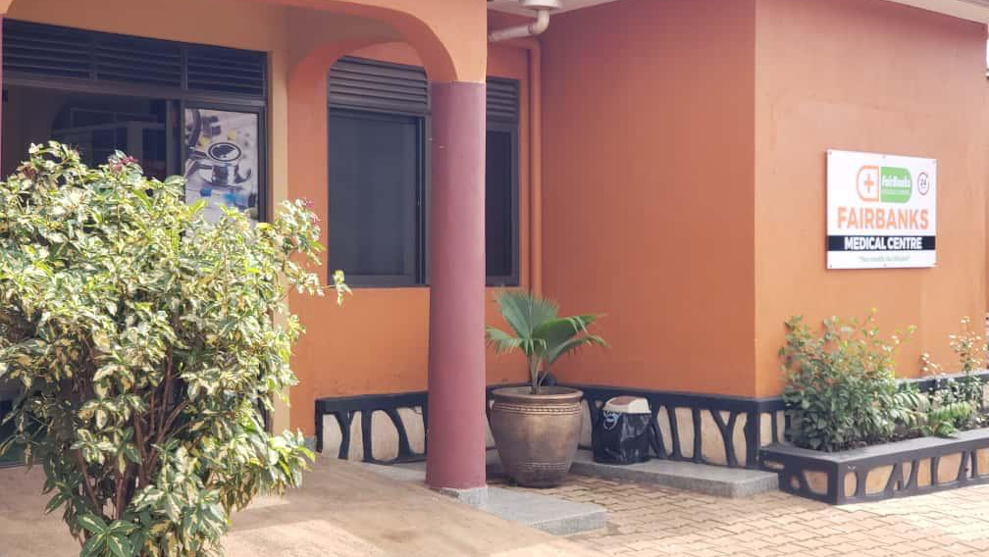
INVITATION TO PARTNER
FairBanks Medical Centre
Let us build healthier
communities — and stronger
science — together.
FairBanks Medical Centre invites Makerere University
to partner on Community Reach, FCHIP, and joint grants.
Your health, our mission.
Institutional contact
Kyebando–Kisalosalo, Tirupati Road, Kampala
info@fairbanksmedicalcentre.org · +256 748 319 052
fairbanksmedicalcentre.org

