Slide 1
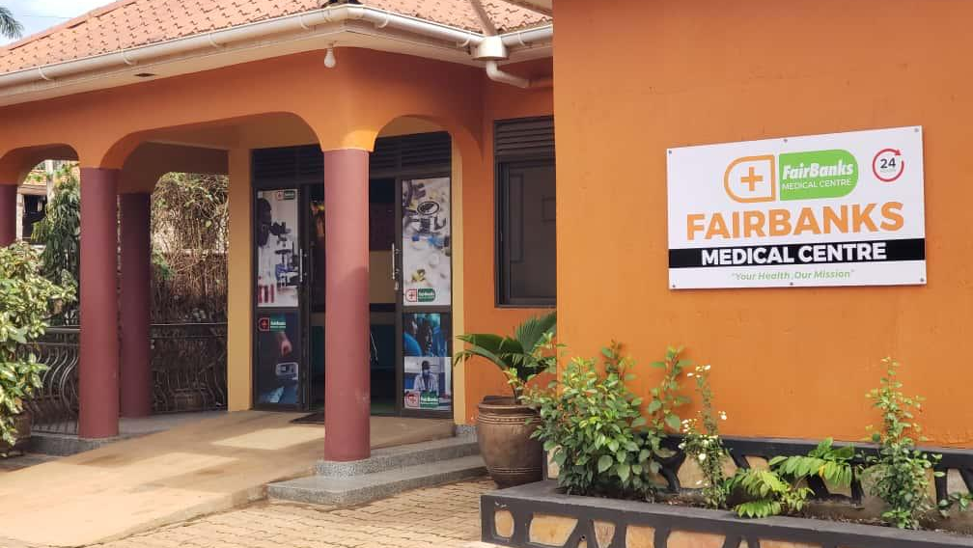

INSTITUTIONAL PARTNERSHIP PROPOSAL
FairBanks Medical Centre
Working with UVRI
for viral research,
surveillance, and grants
Introducing FCHIP
FairBanks Community Health Intelligence Platform
Your health, our mission.
Prepared for Uganda Virus Research Institute
Kyebando–Kisalosalo, Kampala · fairbanksmedicalcentre.org

Slide 2
Purpose: Why we are here
FairBanks Medical Centre seeks a practical partnership with UVRI —
linking community and clinic health signals to viral surveillance,
epidemiology, and climate-aware early detection.
Connect last-mile signals
CHW/VHT and clinic reports that can complement UVRI surveillance networks.
Fuse climate and health
Use FCHIP GIS and climate feeds with UVRI arbovirus and outbreak science.
Co-develop grant concepts
Pair Entebbe laboratory excellence with a live Kampala community site.
FairBanks Medical Centre · Your health, our mission.
2 / 10

Slide 3
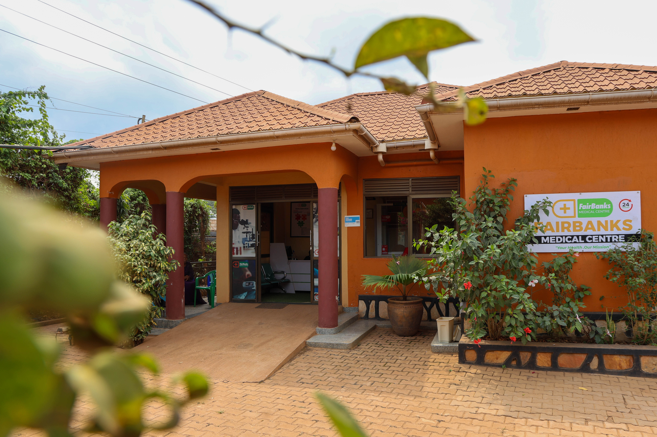
Who we are: About FairBanks Medical Centre
A community medical centre in Kampala
Your health, our mission.
• Located in Kyebando–Kisalosalo, Kampala
• Outpatient & inpatient care, emergency, diagnostics, pharmacy
• Maternal and child health, chronic care, prevention
• Community Reach with CHWs / VHTs nearby
• Building FCHIP as our health intelligence layer
FairBanks Medical Centre
Care close to where families live —
and a base for learning and research.
FairBanks Medical Centre · Your health, our mission.
3 / 10

Slide 4
Operating model: FairBanks Community Reach
How care, learning, and empowerment connect. FCHIP supports Data & Feedback.
1
2
Community members
CHWs / VHTs
Communities name needs and own solutions
The bridge — outreach, referrals, and data
3
4
Community programmes
Medical Centre
Screening, education, maternal & child care
Clinical care, diagnostics, pharmacy, follow-up
5
6
Research & skills
Empowerment & CHIS
Evidence, partners, training, and learning
Livelihoods and affordable shared protection
FairBanks Medical Centre · Your health, our mission.
4 / 10

Slide 5
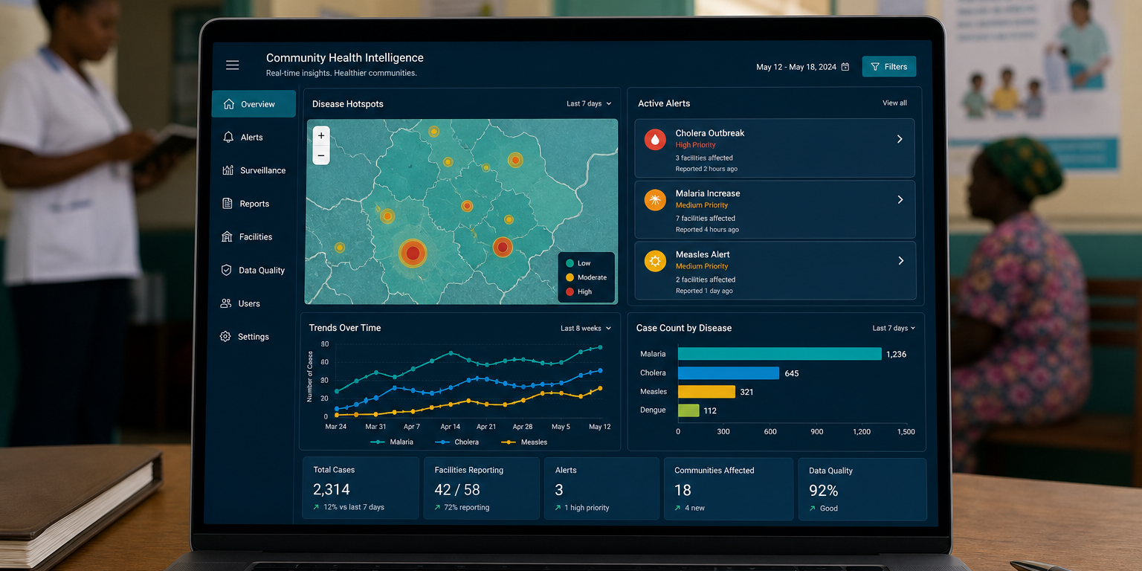
What is FCHIP?
FCHIP stands for
FairBanks Community Health Intelligence Platform
FCHIP brings community and facility health data together.
It uses AI, GIS maps, and climate signals to spot risks early —
so CHWs, clinics, and partners can act sooner.
Fever cluster alerts
Arbovirus risk maps
Climate–virus links
CHW field signals
Outbreak dashboards
Partner reporting
FairBanks Medical Centre · Your health, our mission.
5 / 10

Slide 6
Fit with UVRI: Why UVRI is a strong partner
Based on UVRI’s public mandate, departments, and MoH / WHO-linked roles.
Viral research excellence
Surveillance & epidemiology
Government biomedical institute in Entebbe focused on viral diseases and public health labs.
Outbreak investigation, sentinel surveillance, risk assessment, and public health analytics.
Arbovirology & climate links
Policy & capacity role
Strong fit for climate-sensitive viral risk mapped through FCHIP’s GIS and climate APIs.
WHO-linked reference work, training, and advice that help turn evidence into practice.
FairBanks Medical Centre · Your health, our mission.
6 / 10

Slide 7
How we can work together
A
Surveillance linkage
Community fever and symptom clusters feeding viral risk assessment
B
Joint research
Arbovirus, outbreak, and climate–health studies with field validation
C
Diagnostics pathway
Clear referral and sample pathways from clinic/outreach to UVRI expertise
D
FCHIP early warning
GIS, climate, and AI risk scores aligned to UVRI surveillance needs
E
Joint grants
Shared proposals for viral surveillance, capacity building, and innovation
FairBanks Medical Centre · Your health, our mission.
7 / 10

Slide 8
Funding & science: Joint research and grants
UVRI viral science + FairBanks community capture — ready for surveillance funders.
What we can pursue
Why funders listen
• Community-linked viral early warning pilots
• Climate-sensitive arbovirus risk mapping
• Outbreak preparedness and response studies
• Surveillance data systems and analytics grants
• Training and research capacity awards
UVRI brings laboratory excellence, epidemiology, and national viral mandate.
FairBanks brings a licensed facility, Community Reach, and a working FCHIP MVP.
Funders get both deep viral science and real community signal capture.
FairBanks Medical Centre · Your health, our mission.
8 / 10

Slide 9
Next steps: Roadmap and invitation
Phase I
Phase II
Phase III
Phase IV
Meet & plan
Formalise
Deliver
Grow
Briefing · shared priorities · working group
MoU · 2–3 pilots · ethics & data rules
Joint work starts · first grant bids
Review · publish · scale what works
What we invite UVRI to do
• Host a planning meeting with Epidemiology, Arbovirology, and partnerships leads
• Agree an MoU for surveillance linkage, joint research, and FCHIP early warning
• Pick first pilots: one surveillance track, one climate–arbovirus track, one grant concept
FairBanks Medical Centre · Your health, our mission.
9 / 10

Slide 10
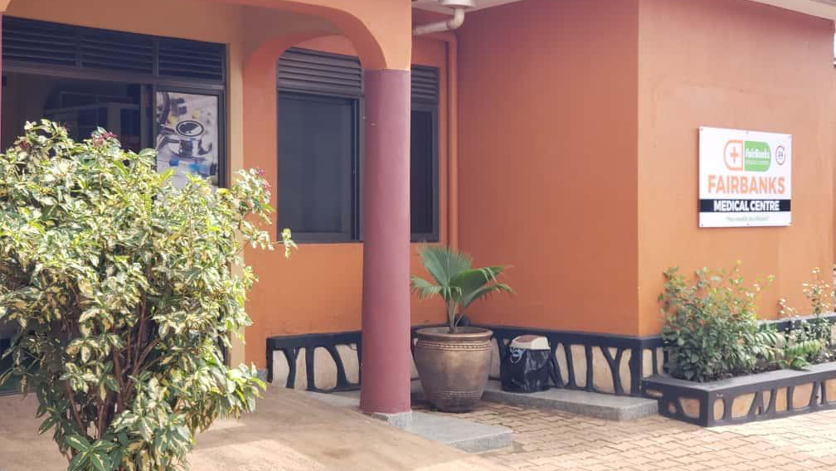
INVITATION TO PARTNER
FairBanks Medical Centre
Let us build healthier
communities — and stronger
science — together.
FairBanks Medical Centre invites Uganda Virus Research Institute
to partner on Community Reach, FCHIP, and joint grants.
Your health, our mission.
Institutional contact
Kyebando–Kisalosalo, Tirupati Road, Kampala
info@fairbanksmedicalcentre.org · +256 748 319 052
fairbanksmedicalcentre.org

