Slide 1
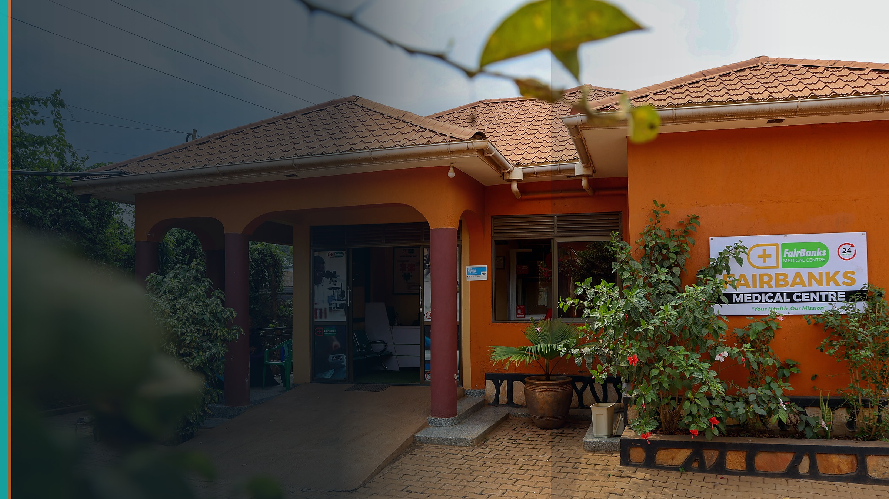

COMMUNITY HEALTH INTELLIGENCE
FairBanks Medical Centre
FCHIP
FairBanks Community Health Intelligence Platform
From reactive treatment to proactive prevention —
powered by community data, AI, GIS, and climate signals.
Your health, our mission.
A FairBanks platform component
Kampala, Uganda · fairbanksmedicalcentre.org/fchip

Slide 2
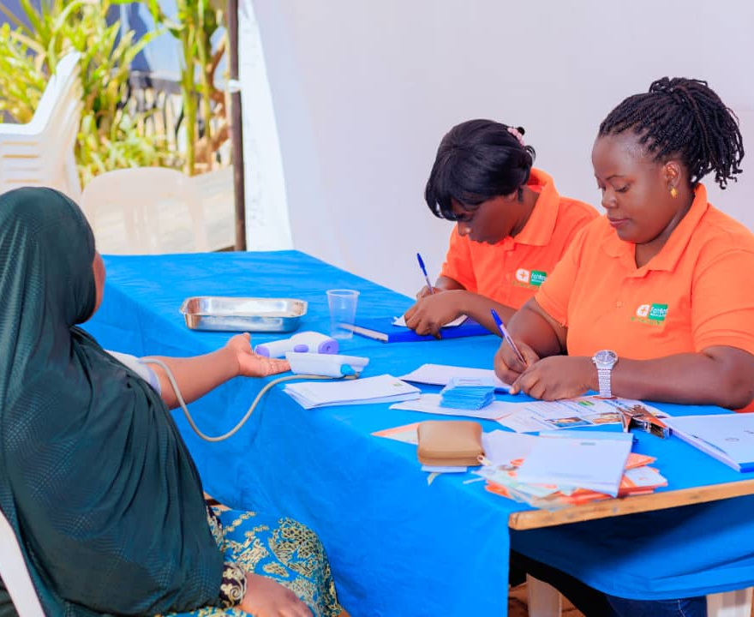
The gap: Healthcare still waits for people to get sick
Community signals stay fragmented — so outbreaks, maternal risk, and stock-outs arrive late.
Late detection
Facilities treat illness after it appears
Siloed data
CHW, school, clinic, and EMR records stay separate
Climate blind
Weather and place signals rarely join health data
Guesswork stock
Medicine orders follow history, not early risk
FairBanks Medical Centre · Your health, our mission.
2 / 10

Slide 3
Operating model: How we care for your community
The simple Community Reach journey — FCHIP supports the Data & Feedback loop.
1
Community members
2
CHWs / VHTs — the bridge
3
Community Reach programmes
4
FairBanks Medical Centre
5
Research · partnerships · skills
6
Empowerment · CHIS · livelihoods
FairBanks Medical Centre · Your health, our mission.
3 / 10

Slide 4
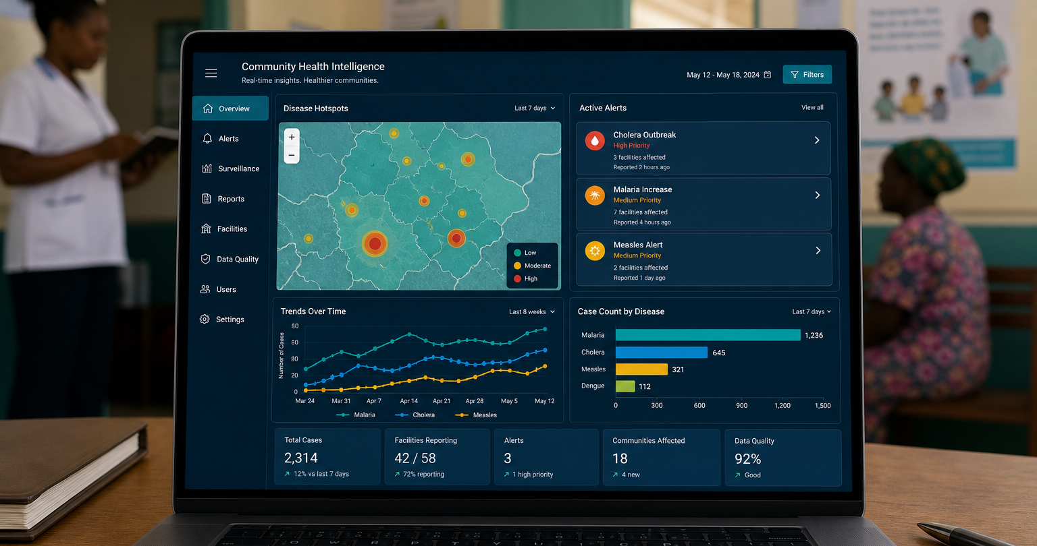
Solution: FCHIP — the intelligence layer
What FCHIP does
Connects communities, CHWs/VHTs, schools, clinics, and hospitals into one intelligent network.
Fuses community signals with GIS maps and climate APIs.
Safely exposes data APIs to existing EMR/HMS — without replacing systems clinics already use.
Predict
Map
Risk before crisis
Hotspots by place
Alert
Learn
CHWs & facilities
Close the loop
FairBanks Medical Centre · Your health, our mission.
4 / 10

Slide 5
Deep tech: More than an app — an intelligence stack
AI · ML · GIS · climate APIs · secure EMR/HMS APIs · mobile edge · cloud
AI / ML
GIS mapping
Climate APIs
Disease risk, maternal flags, NCD hotspots
Village and parish risk geography
Rainfall, heat, and flood-linked warning
EMR / HMS APIs
Mobile capture
Dashboards
Real-time clinical ingest, consent-aware
Offline CHW/VHT forms and worklists
Facility, programme, and partner views
FairBanks Medical Centre · Your health, our mission.
5 / 10

Slide 6
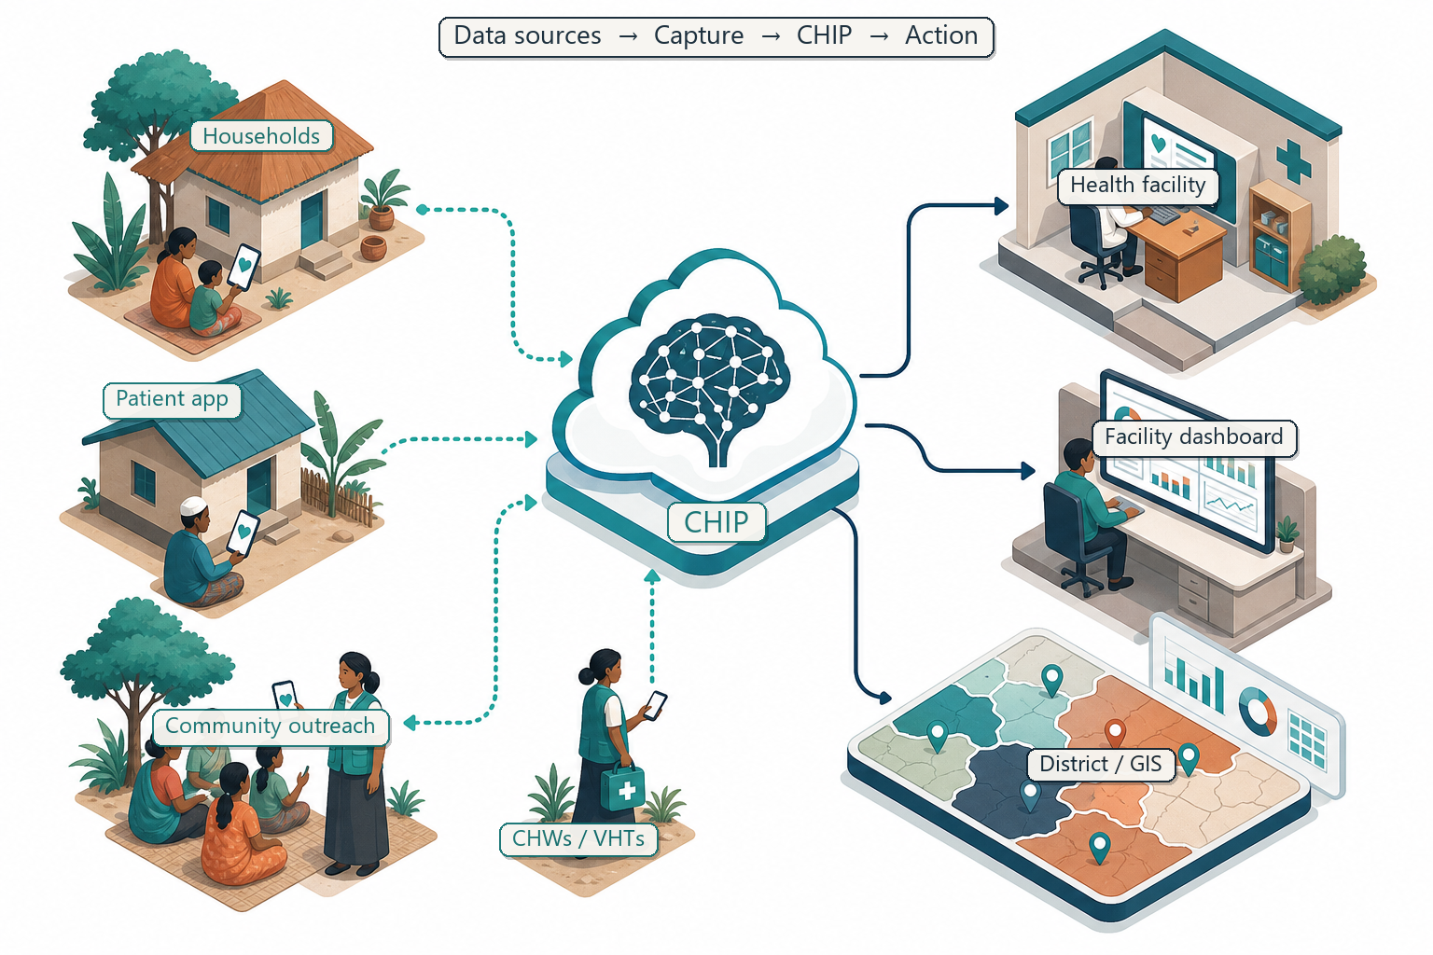
Architecture: From last-mile capture to action
Data in → FCHIP intelligence → alerts, maps, and referrals back to the field.
1
Capture
CHWs, clinics, EMR/HMS, climate feeds
2
Analyse
AI, GIS, climate fusion, risk scores
3
Act
Alerts, dashboards, outreach, stock
FairBanks Medical Centre · Your health, our mission.
6 / 10

Slide 7
Proof cases: What FCHIP helps predict and prevent
Disease surveillance
Maternal health
Fever clusters + rainfall → early malaria / outbreak flags
Home-visit signals → high-risk pregnancy alerts to CHWs
NCDs
Child health
BP and glucose trends → hypertension and diabetes hotspots
Growth, immunisation, diarrhoea → community flags
Medicine demand
Cascade metrics
Disease + climate + history → pharmacy pre-stocking
Referrals, CHIS, school sessions → close the feedback loop
FairBanks Medical Centre · Your health, our mission.
7 / 10

Slide 8
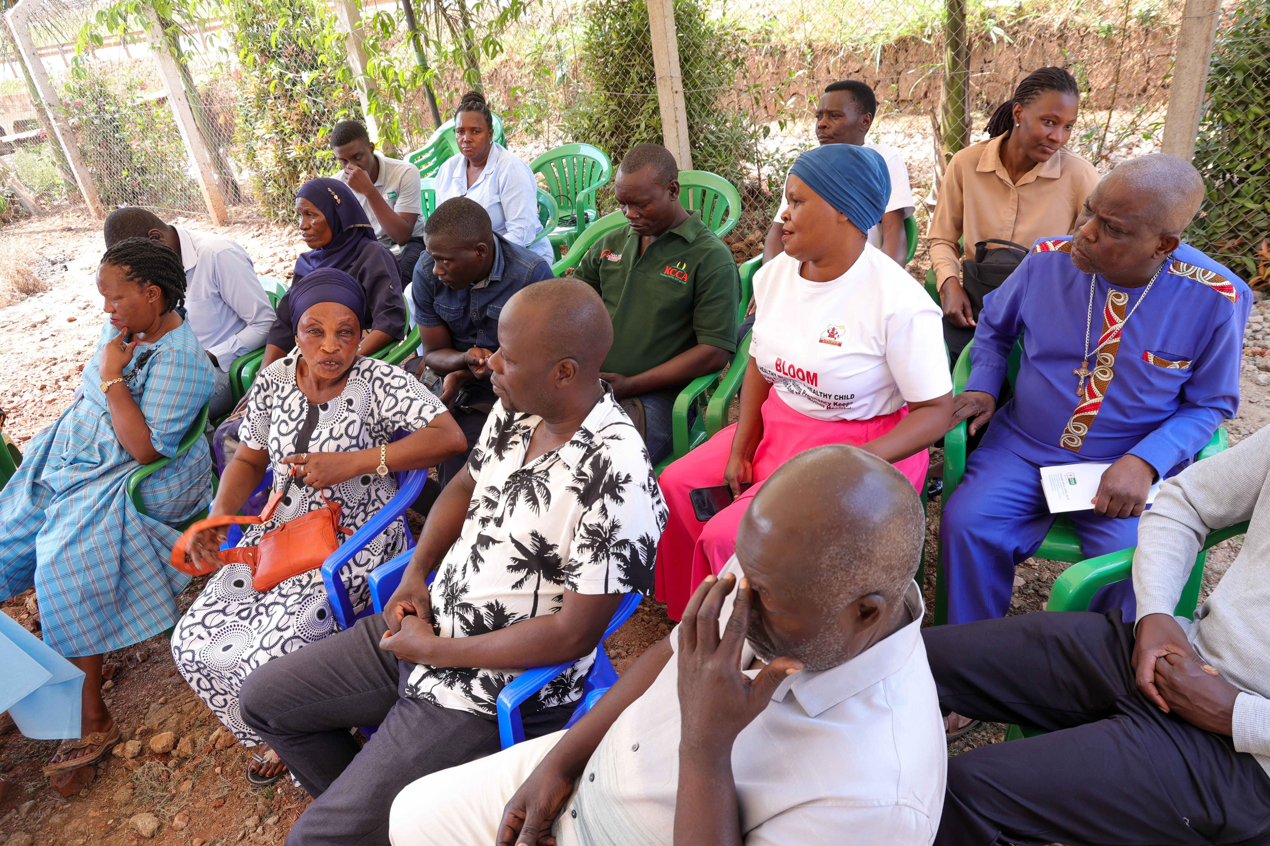
Why FairBanks: Live field base + working FCHIP MVP
Design, pilot, validate, and refine inside a real Community Reach ecosystem.
• Licensed medical centre in Kampala
• Active CHW / VHT Community Reach
• Maternal, child, Gericare, NCD programmes
• CHIS and livelihood pathways
• Working FCHIP MVP — validating now
• Secure EMR/HMS API path planned
Bukoto · Kyebando · Kisaasi
Kamwokya · Kikaaya & nearby
FairBanks Medical Centre · Your health, our mission.
8 / 10

Slide 9
Roadmap: Validate → district → regional scale
Working MVP exists. Phase 1 proves value in the live FairBanks catchment.
Phase 1
Phase 2
Phase 3
Phase 4
Validate
District
Regional
Platform
0–12 mo
12–24 mo
24–36 mo
Year 3+
CHW tools, GIS + climate, EMR APIs, 3 use cases
Partner clinics, Kampala structures, NGO M&E
Multi-district Uganda · East Africa entry
Clinical support, NLP, research modules
FairBanks Medical Centre · Your health, our mission.
9 / 10

Slide 10
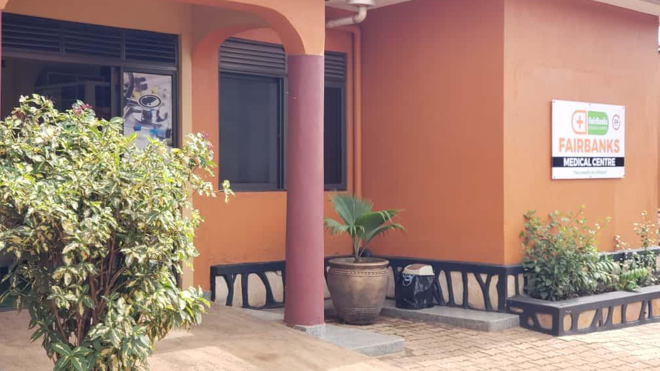
LET'S BUILD TOGETHER
FCHIP
Africa's community health intelligence —
rooted in FairBanks Community Reach.
Your health, our mission.
Health for All — Obulamu eri Bonna
Afya kwa Wote · Oburamu bwa Boona
Contact
Racheal Nabukeera · Managing Director & Co-founder
info@fairbanksmedicalcentre.org · +256 772 849 258
fairbanksmedicalcentre.org · /fchip

