Slide 1
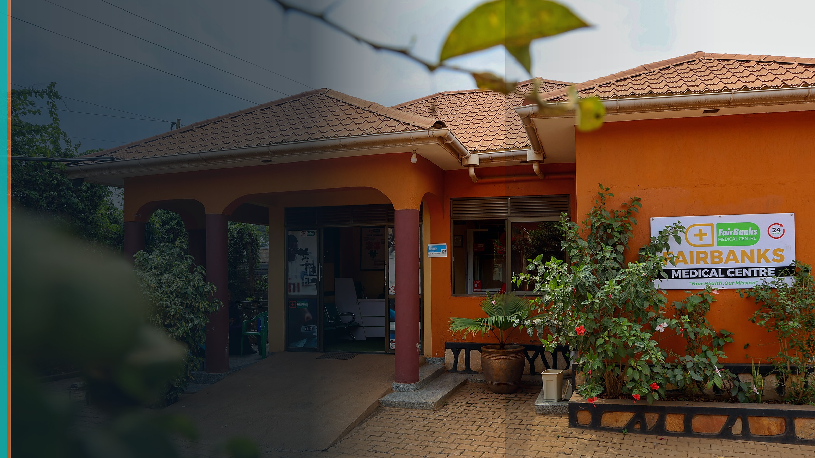
DPI Safeguards Accelerator 2026
Safeguards for community health data tools in Uganda
We will embed consent rules, offline-friendly inclusion, and a community grievance path into FairBanks' live FCHIP platform (Capture, Analyse, Alert, Act), with KCCA Central Division health and VHTs at the table.
NGO Pathway · Uganda · USD 70,000 · 9 months
Stage 1 deadline: 30 July 2026
Your health, our mission.

Slide 2
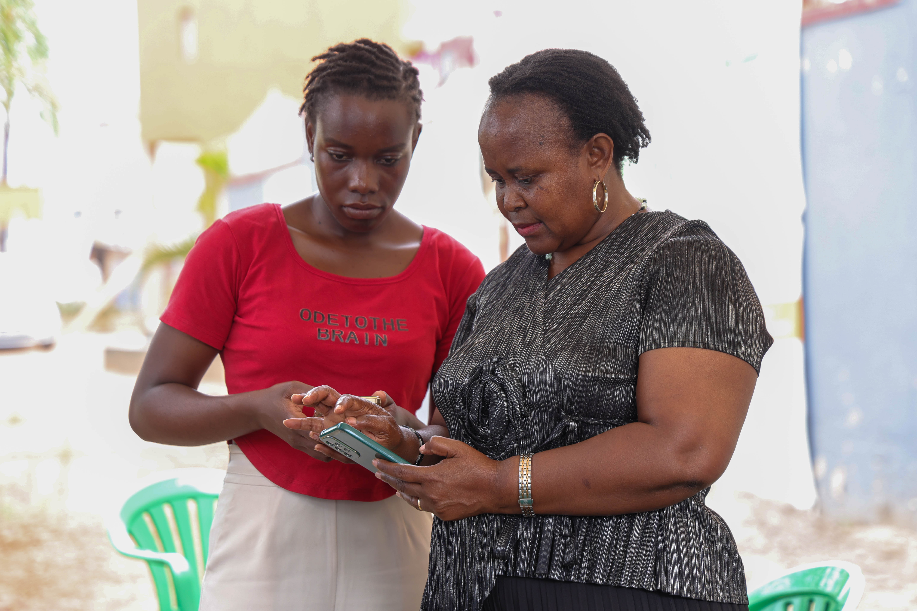
WHY NOW
Safeguards before scale hardens bad habits
FCHIP MVP is entering field validation — the right moment for guardrails.
100+ countries advancing DPI; digital health is a sectoral use case
2026–2028 window: embed safeguards in live deployments
FCHIP already connects CHWs, clinics, and EMR/HMS APIs
Consent, inclusion, and recourse must ship with the data — not later
Your health, our mission.
2 / 10

Slide 3
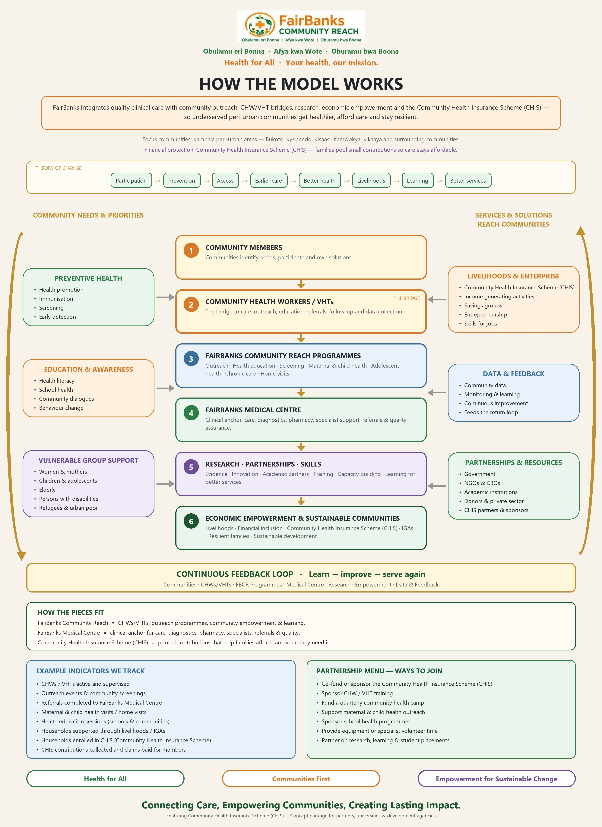
OPERATING MODEL
Community Reach + FCHIP as sectoral health DPI
Safeguards sit on Data & Feedback — not as a separate brochure.
Communities → CHWs/VHTs → programmes
Medical centre anchors clinical action
Research, skills, partners strengthen learning
CHIS and livelihoods support access
FCHIP powers Data & Feedback with GIS and alerts
Your health, our mission.
3 / 10

Slide 4
THE GAP
Digital health without operational safeguards
Community and clinic health data are going digital in Kampala, but consent, offline access, and a simple way to challenge mistakes are still thin — so trust can fail just as the tools scale.
Privacy risk
Exclusion risk
Accountability gap
Data moves across CHW, clinic, and API layers without clear consent scopes
Offline and low-literacy users drop out of digital pathways
People lack a simple recourse when alerts or records go wrong
Your health, our mission.
4 / 10

Slide 5
PROPOSAL
Three issue-specific safeguards in a live DPI deployment
Issue-specific safeguards work
01
Responsible data use
Consent + least-privilege EMR/HMS APIs + audit
02
Offline inclusion
CHW tools and UX that work without always-on internet
03
Grievance pathway
Named recourse for data and alert-related concerns
Your health, our mission.
5 / 10

Slide 6
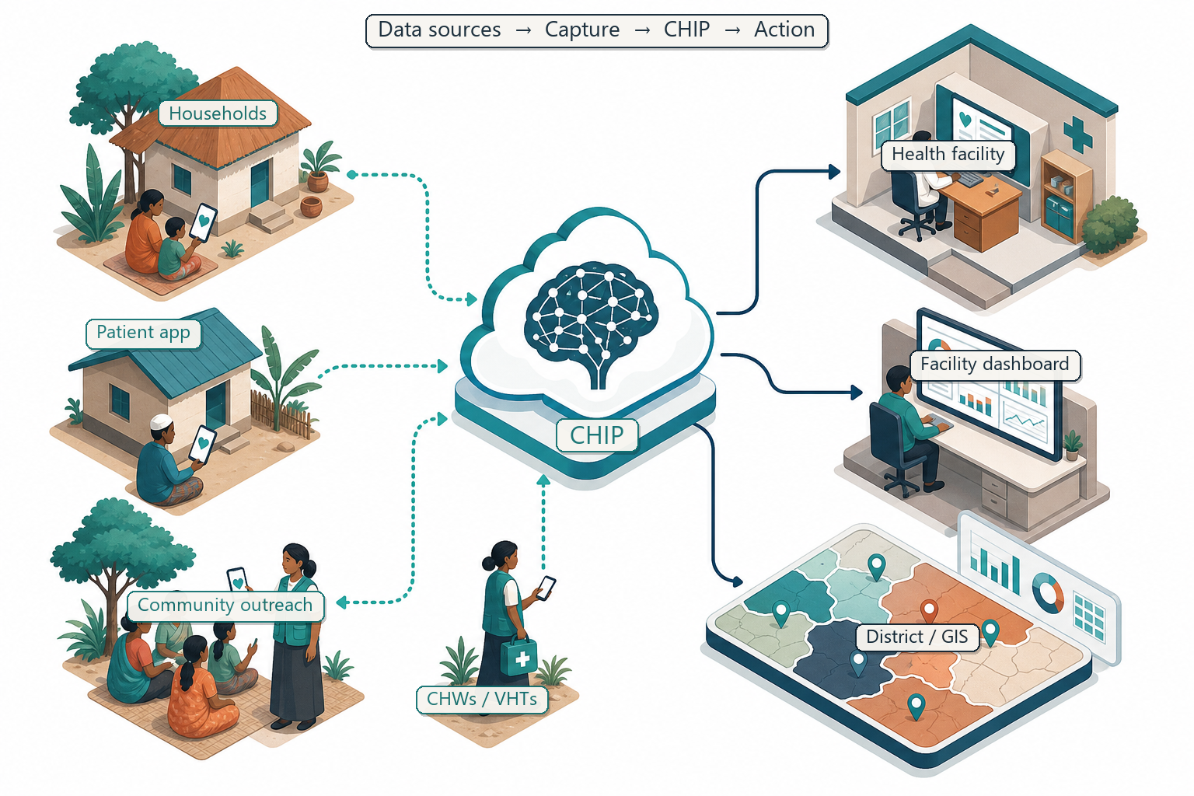
WHERE SAFEGUARDS LAND
Capture → FCHIP intelligence → action — with guardrails
APIs to existing EMR/HMS expand coverage without ripping out systems.
CHW/VHT offline capture
Secure EMR/HMS data APIs
Consent and purpose limits
Role-based access and audit
Alerts back to field and facility
Your health, our mission.
6 / 10

Slide 7
6–9 MONTH OUTPUTS
Operational assets, not paper only
Draft catalytic ask: USD 70,000
1
Safeguards risk & gap brief (Framework-mapped)
2
Consent & data-sharing protocol for APIs
3
Inclusion playbook (offline + vulnerable groups)
4
Community grievance / recourse pathway
5
Multistakeholder working group (live cadence)
6
Public learning note for the Resource Hub
Your health, our mission.
7 / 10

Slide 8
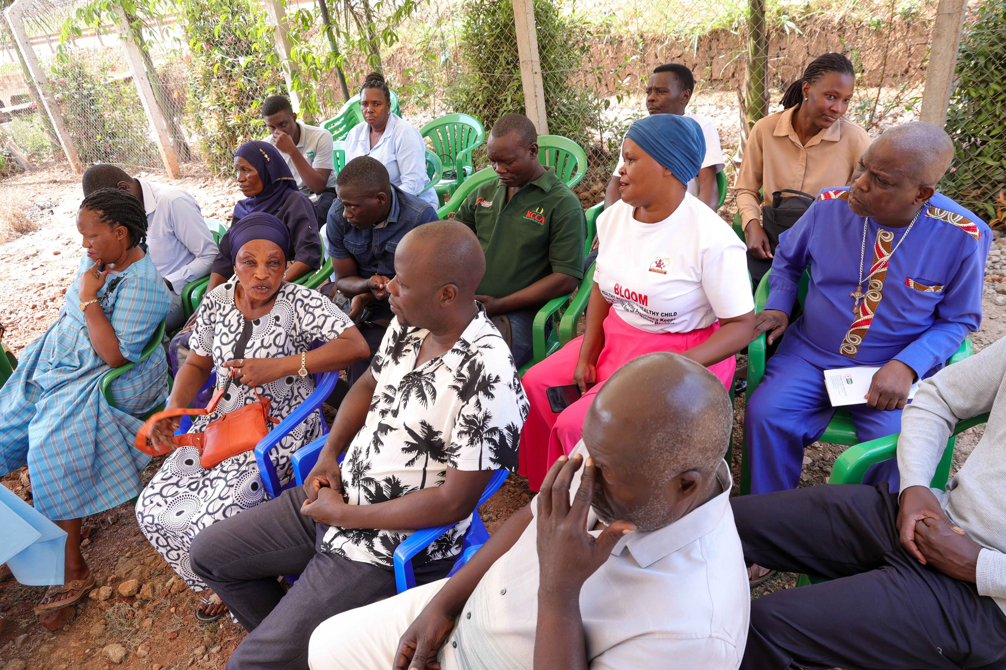
COORDINATION
Government · FairBanks · civil society
Meaningful integration — defined roles in co-design, validation, monitoring
Government counterpart validates priorities and joins the working group
FairBanks implements protocols inside FCHIP and Community Reach
VHTs and community champions co-design consent and grievance language
Facility/EMR contacts advise on least-privilege API scopes
Monthly reviews + quarterly listening sessions
Your health, our mission.
8 / 10

Slide 9
CATALYTIC ASK
USD 70,000 over 9 months
Accelerates safeguards mobilisation — does not replace existing Community Reach financing
Staff time, VHT/community stipends, safeguards facilitation
USD 28,000
Technical work (consent, access controls, offline UX, grievance tooling)
USD 21,000
Workshops, local travel, translation, printing
USD 10,500
Monitoring, documentation, learning note, cohort participation
USD 10,500
Total
USD 70,000
Your health, our mission.
9 / 10

Slide 10
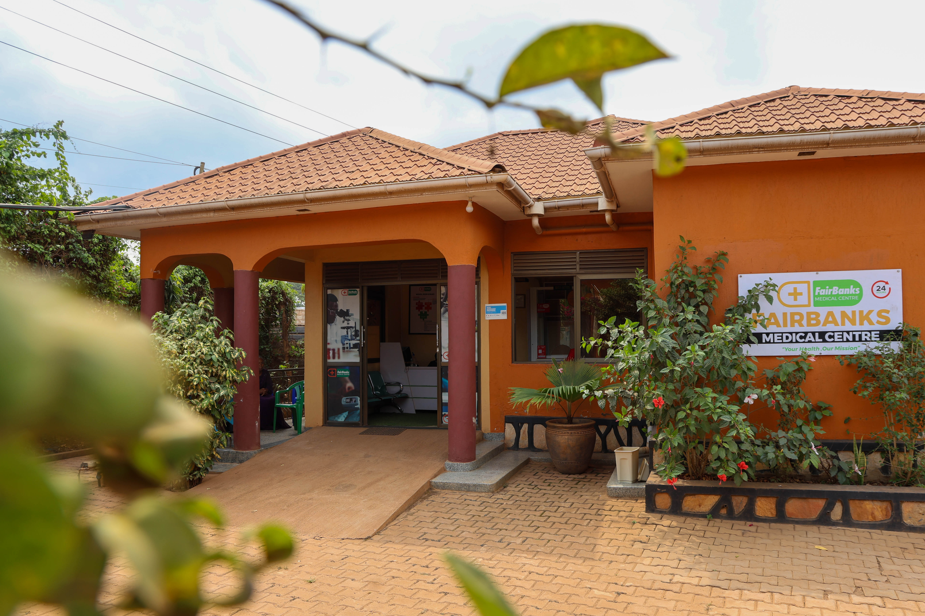
READY FOR STAGE 1
Submit the NGO pathway form before Wave 3 closes.
Use FAIRBANKS MEDICAL CENTRE LIMITED; counterpart KCCA Central Division health
Paste Stage 1 answers from stage1_airtable_answers.md
Same day: start the KCCA support-letter request
https://airtable.com/appcltTa6tzGwskOA/pagJNFsEqox4M5WAU/form
Your health, our mission.

