Slide 1
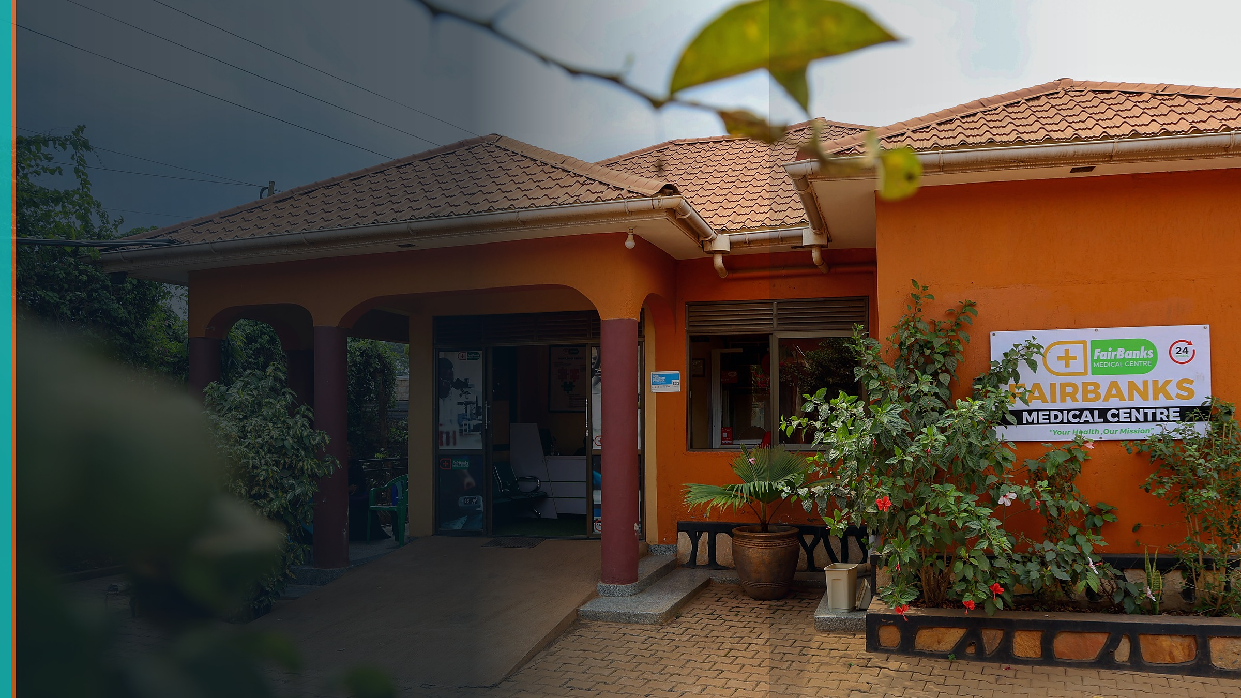
CDC · Uganda GHS
A local partner for earlier detection — shared win for Uganda and the U.S.
FairBanks Medical Centre · FCHIP component
Your health, our mission.
CDC-RFA-JG-26-0056 · Due 14 August 2026, 11:59 p.m. ET

Slide 2
The shared win
CDC / United States: Earlier containment at source - Safer, Stronger, More Prosperous
Uganda / MoH: Last-mile signals into NISS pathways; trained CHWs; 7-1-7 practice
FairBanks: Local partner with live clinic, Community Reach, and FCHIP that feeds government
Communities: Earlier alerts and clearer referral paths when something looks wrong
Your health, our mission.
2 / 12

Slide 3
The opportunity
Strengthen Uganda GHS capacities from the 2023 JEE (surveillance, labs, response, workforce, border health).
Cooperative agreement · 5 years · apply for all five funding components.
Year 1 Component 1 ask: $3,000,000 (NOFO estimate / full ceiling) · local partner preference +10 points.
Scoring: Approach 35 · EPMP 30 · Capacity 35 - we lead with measurable last-mile surveillance.
Must work in Uganda · English · USD · no research · clinical care not the award purpose.
Submit on Grants.gov by 14 August 2026, 11:59 p.m. ET.
Your health, our mission.
3 / 12

Slide 4
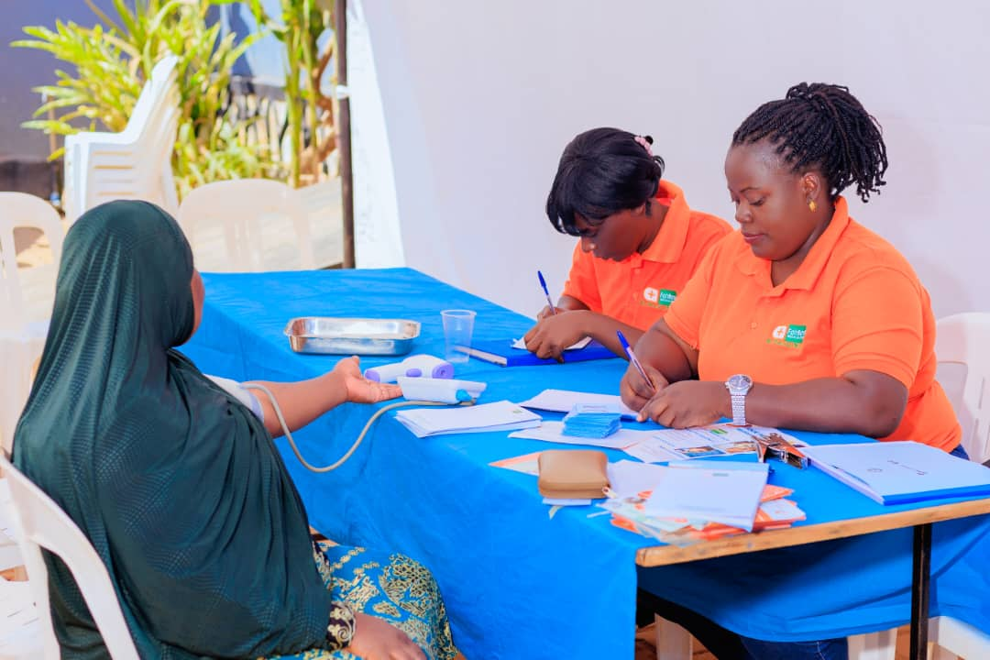
The last-mile gap
Outbreaks grow when community signals stay on paper.
CHWs, clinics, labs, and EOCs still share information too slowly.
JEE gaps: data sharing, surge staffing, forecasting, NISS links.
FairBanks already works where the gap shows up first.
Your health, our mission.
4 / 12

Slide 5
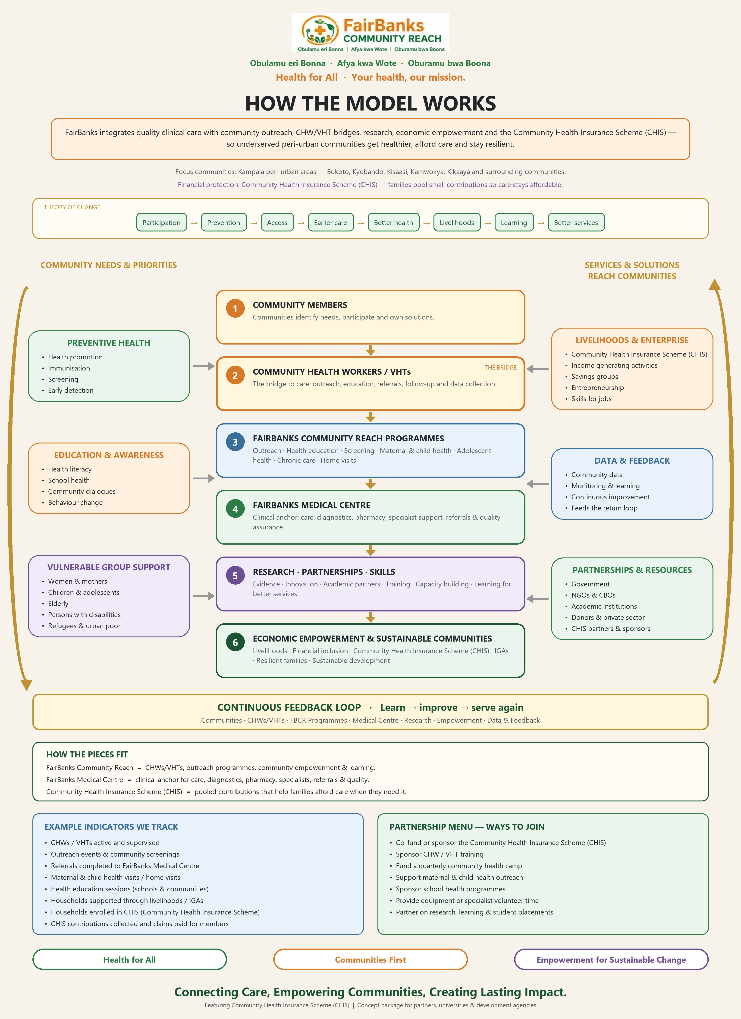
How FairBanks works
Your health, our mission.
5 / 12

Slide 6
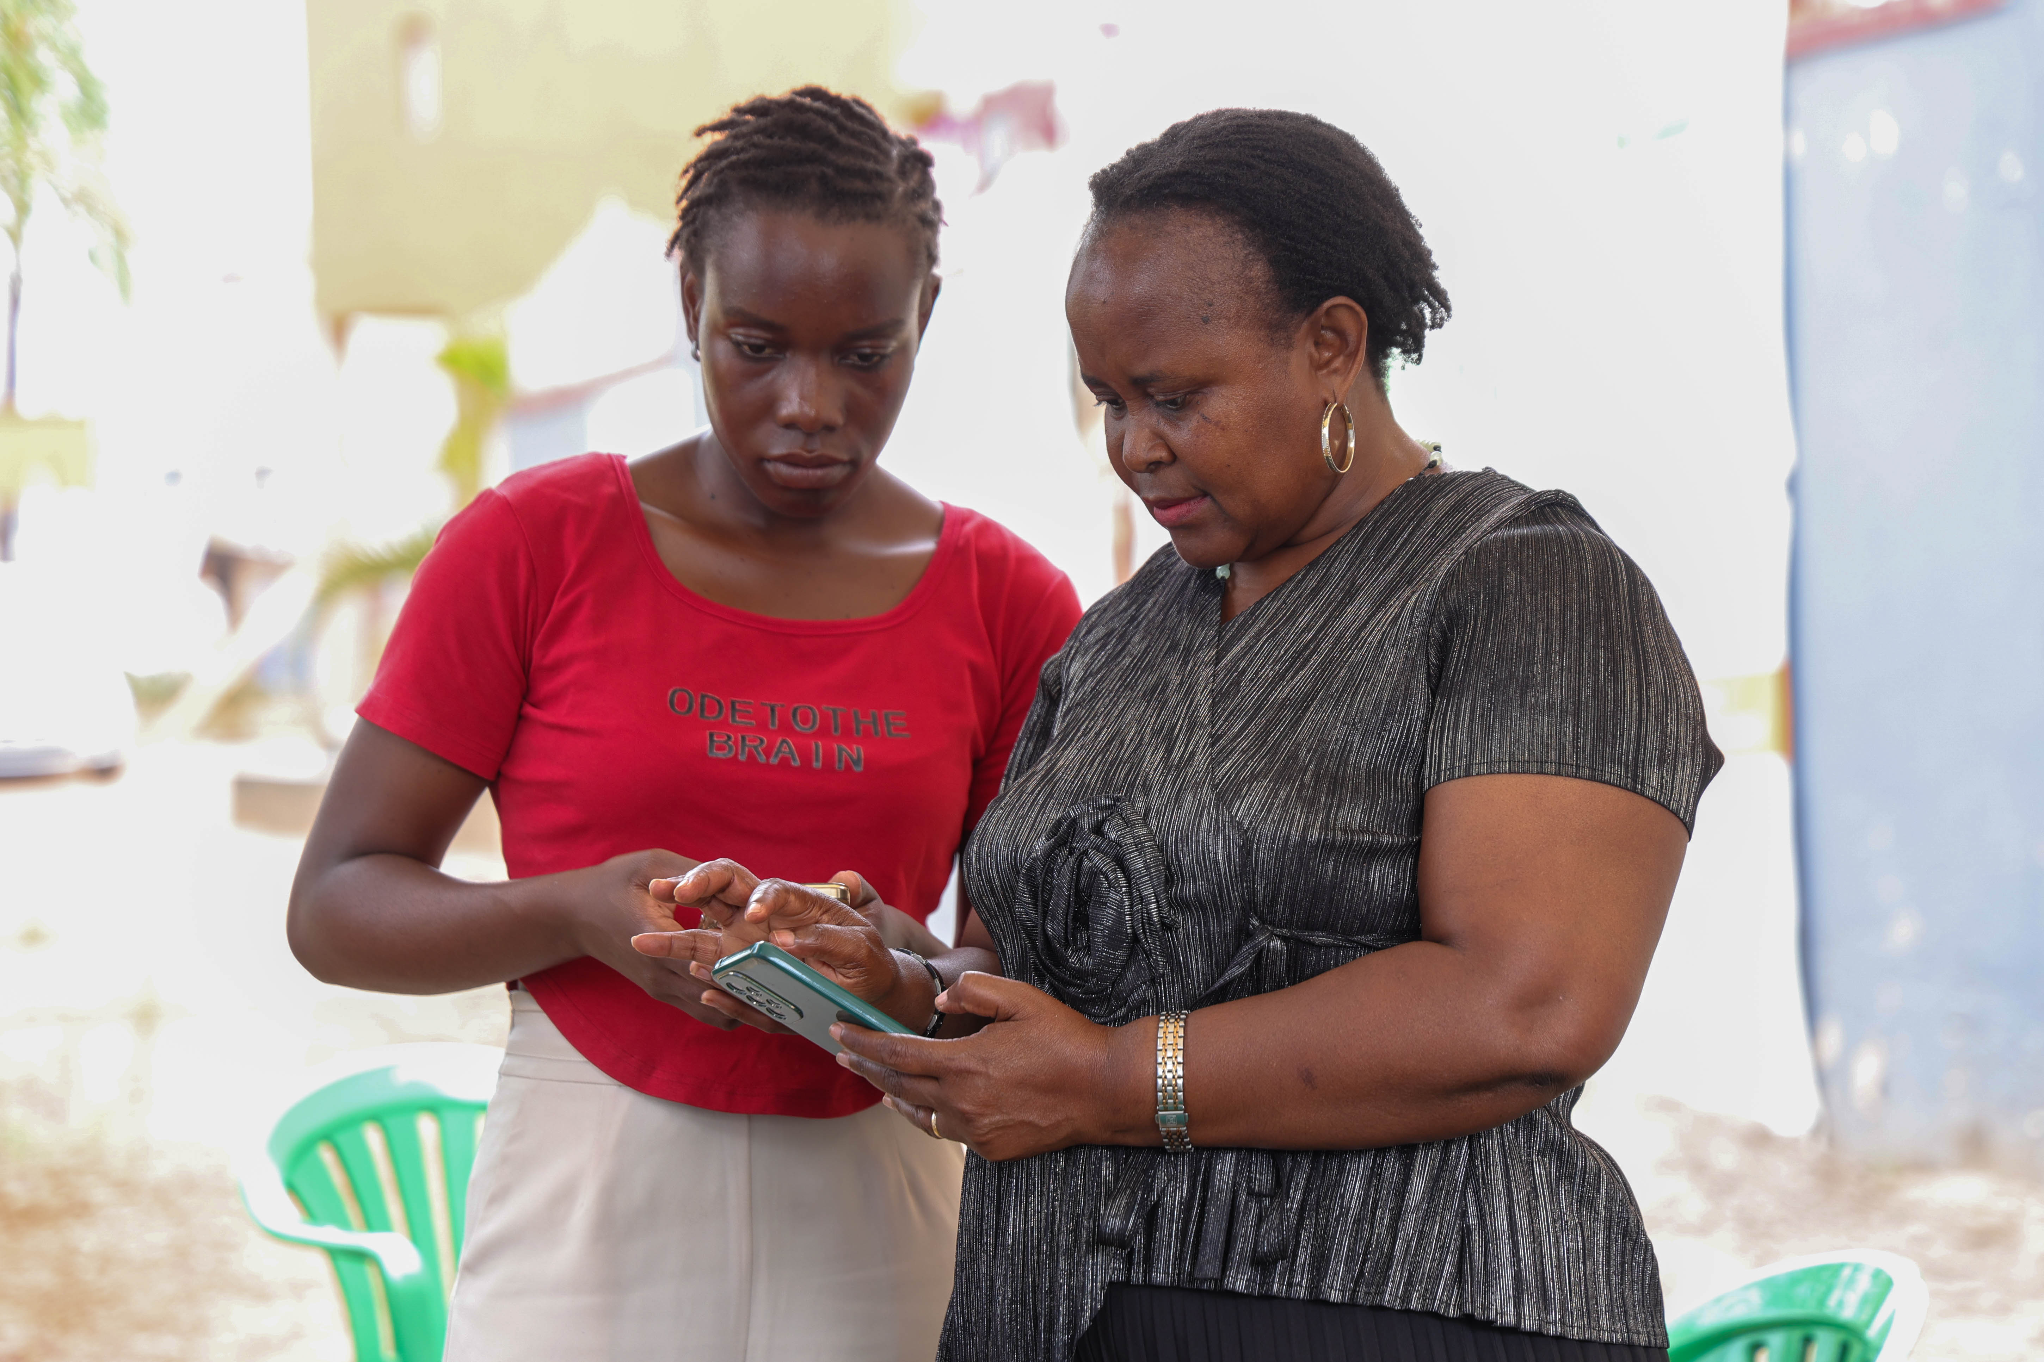
Our offer under MoH leadership
Community + facility surveillance into MoH/NISS pathways via FCHIP.
7-1-7 style drills with districts.
CHW/VHT workforce and surge roster.
Priority-disease community-facility links.
Lab and border modules with specialised partners — not a parallel system.
Your health, our mission.
6 / 12

Slide 7
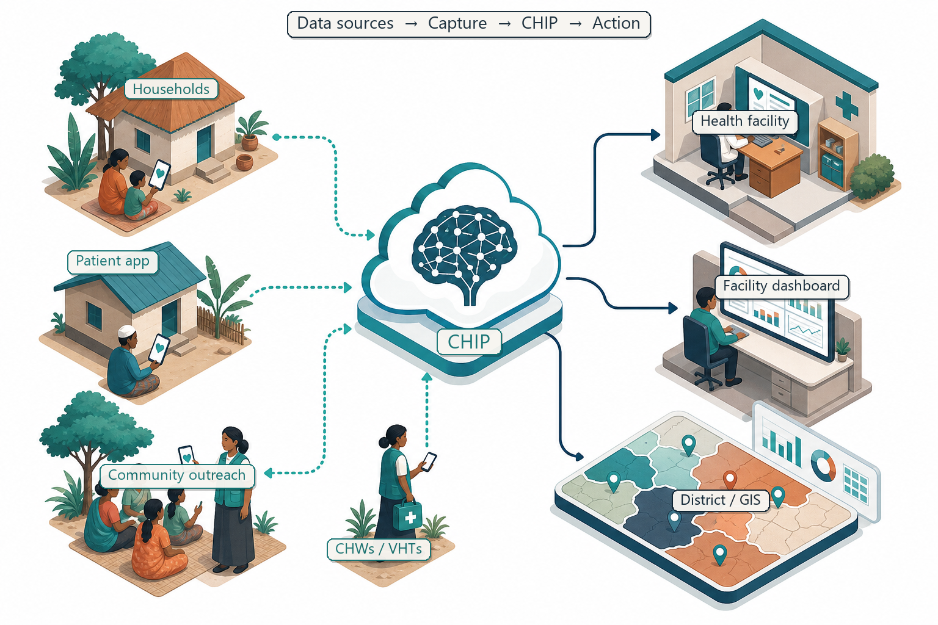
FCHIP on the Data & Feedback loop
Your health, our mission.
7 / 12

Slide 8
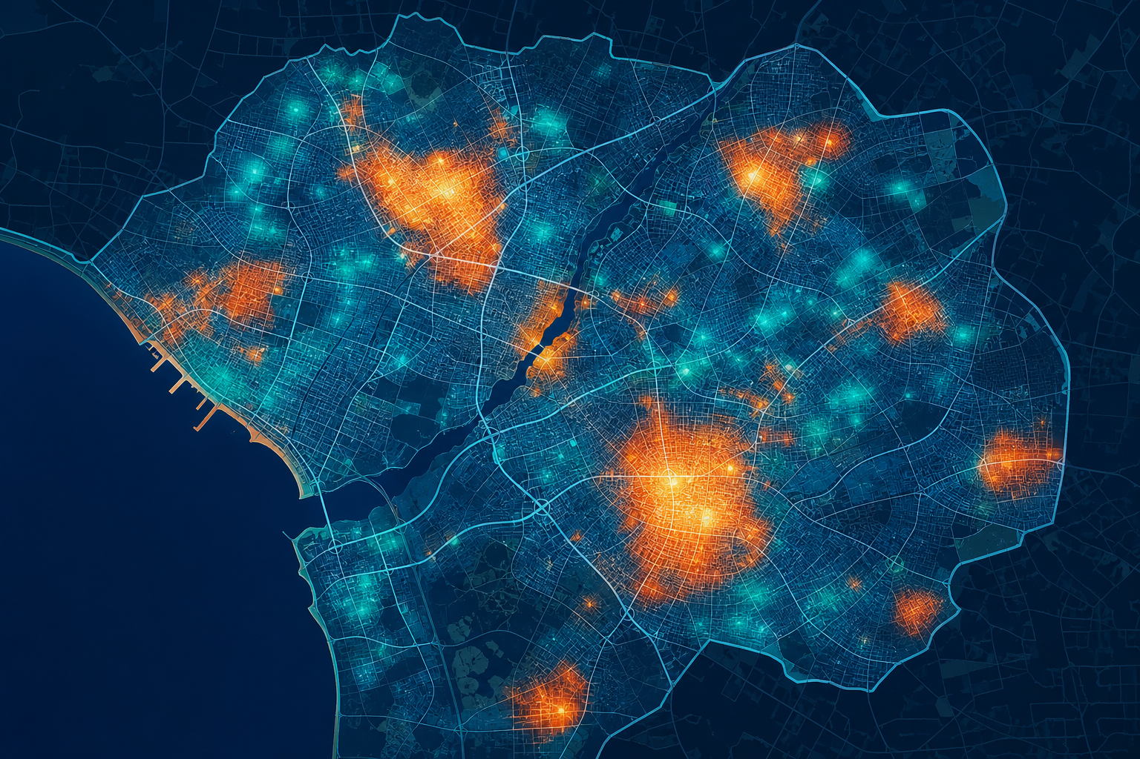
What success looks like
Faster detection & response — Shorter time from community signal to district notification (7-1-7 style)
Stronger surveillance — Weekly community reports and successful MoH/NISS-aligned data tests
Ready workforce — Trained CHWs/VHTs and surge roster exercised in drills
Better community-facility links — Documented referral outcomes for priority disease flags
Government use — Tools, SOPs, and data access handed for MoH/CDC use
Your health, our mission.
8 / 12

Slide 9
Five components — one application
Component 1 Core GHS: $3,000,000 draft (ceiling $3,000,000) — Expected initial funding (full ceiling)
Component 2 Small-scale response: $1,000,000 draft (ceiling $5,000,000) — Contingency ABU
Component 3 Large-scale response: $1,500,000 draft (ceiling $10,000,000) — Contingency ABU
Component 4 Small emerging threats: $1,000,000 draft (ceiling $15,000,000) — Contingency ABU
Component 5 Large emerging threats: $1,000,000 draft (ceiling $20,000,000) — Contingency ABU
Component TOTAL Year 1 (feasible C1-C5): $7,500,000 draft (ceiling ) — Equals Box 18a / 18g
Your health, our mission.
9 / 12

Slide 10
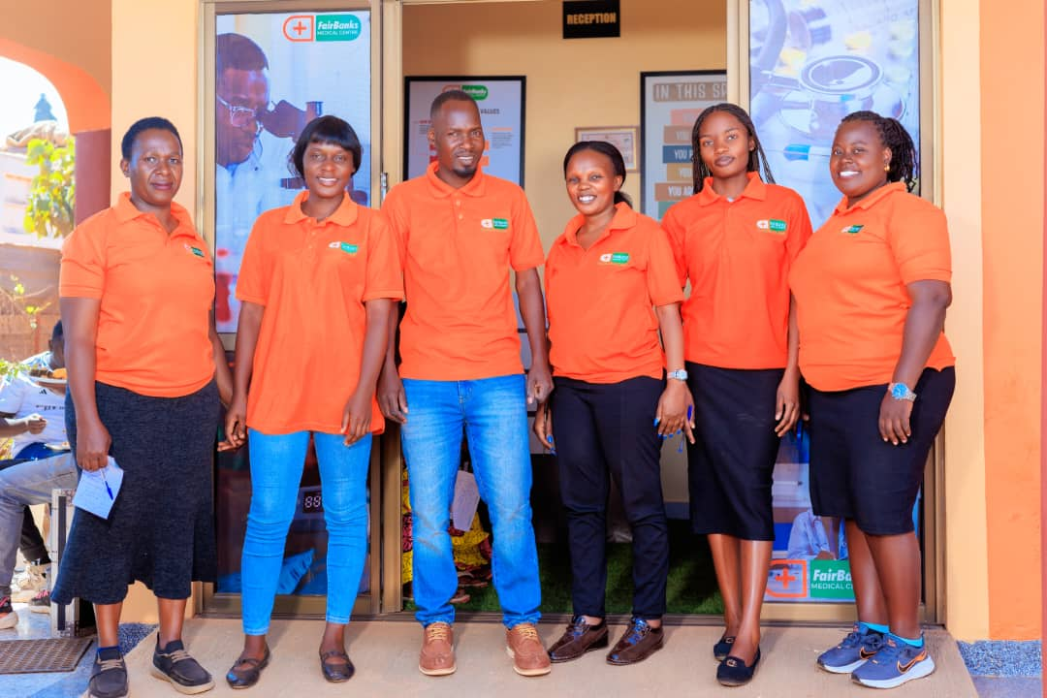
Why FairBanks — local partner
Uganda-incorporated company with Kampala operations.
Live clinic + Community Reach + working FCHIP MVP.
Named catchments already in motion.
Documented company standing (TIN, NSSF, licences) ready to attach.
Contact: info@fairbanksmedicalcentre.org · +256 772 849 258
Your health, our mission.
10 / 12

Slide 11
Before you submit — Grants.gov
SAM.gov first - get UEI (can take weeks).
Login.gov + Grants.gov organisation profile with the same email as SAM EBiz POC.
Create a workspace for CDC-RFA-JG-26-0056; AOR must Sign and Submit.
CONFIRM local partner citizenship percentages before signing the preference letter.
Deadline: 14 August 2026, 11:59 p.m. ET · Quick start: grants.gov/quick-start-guide/applicants
Your health, our mission.
11 / 12

Slide 12
Ready to help Uganda detect and respond faster — so threats stop closer to source
Feasible Year 1 Component 1: $3,000,000 · Local partner · MoH-aligned · Contingency surge plans ready
Racheal Nabukeera · info@fairbanksmedicalcentre.org · +256 772 849 258 Your health, our mission.

