Slide 1
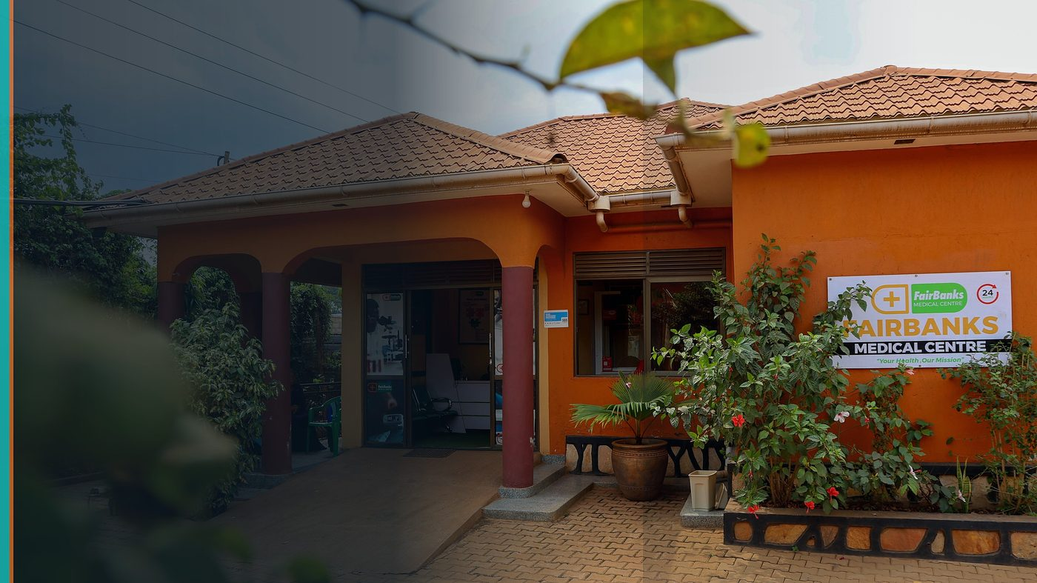
U.S. Department of State / GHSD — Advancing Global Health (DFOP0017890)
Statement of Interest — Phase 1
FairBanks Medical Centre · FairBanks Community Reach · FCHIP
Objective 4 - Helping community visit data reach eCHIS, clinic records, and DHIS2/eIDSR
Phase 1 Statement of Interest | $1,850,000 | 36 months | Due 31 July 2026
Your health, our mission.

Slide 2
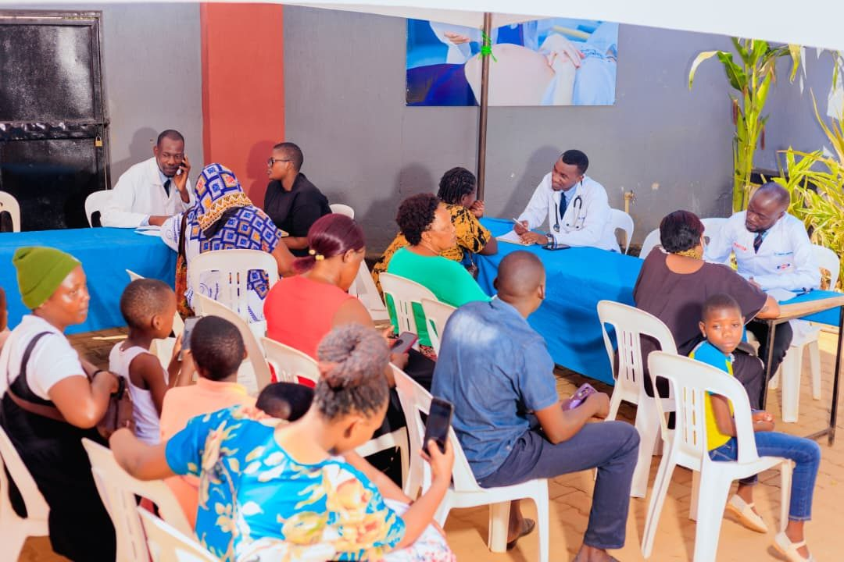
I
The Problem
Uganda is moving through a five-year health transition (April 2026 to December 2030). Clinics, districts, and communities must keep HIV, TB, malaria, maternal and child health, immunisation, and outbreak services running well while more work shifts to government-led programmes. That only works if leaders can see what is happening in communities in time to act - not weeks later from paper books.
Community Health Workers and Village Health Teams already visit homes and send people for care. Too often, what they record never reaches eCHIS, clinic records, DHIS2/eIDSR, or the National Data Warehouse in a form people can use. Then national systems miss rising fever cases, missed antenatal visits, gaps in immunisation, and medicine pressure. Care stays reactive, follow-up is weak, and hard-won gains can slip.
FairBanks SOI | DFOP0017890 Objective 4 | Your health, our mission.
2

Slide 3
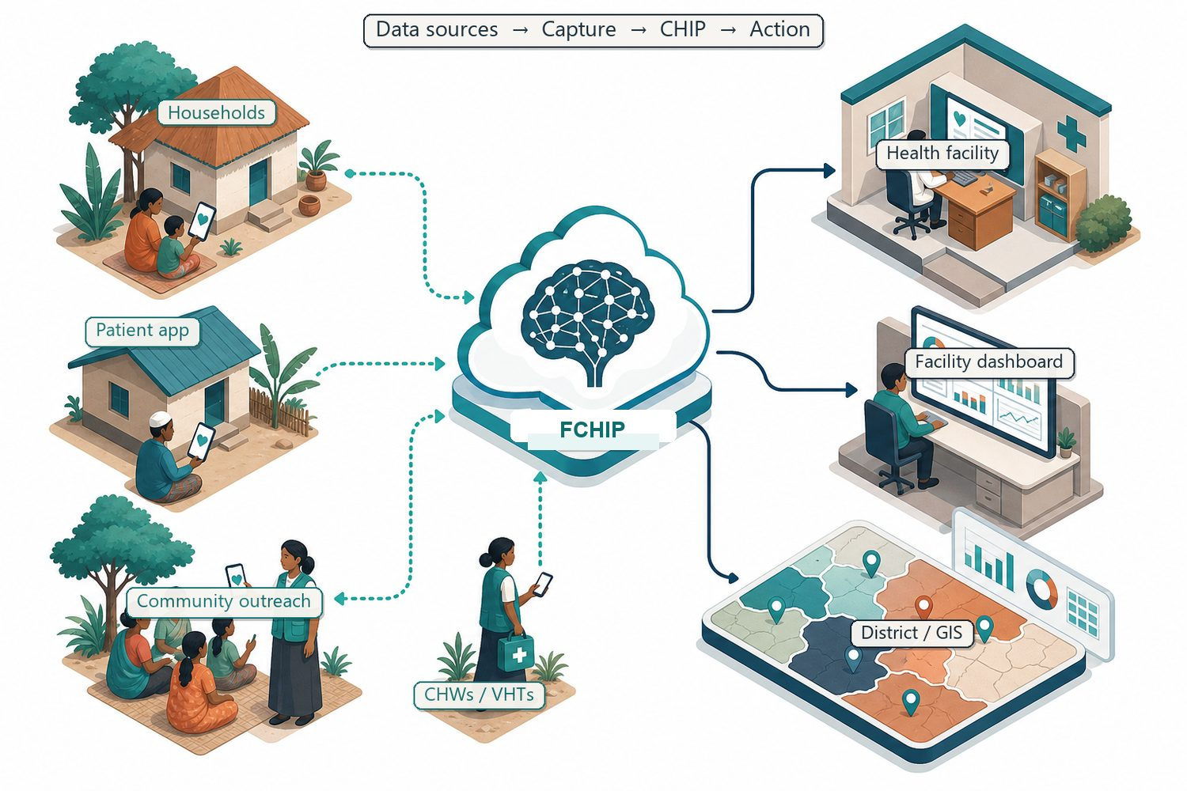
II
What We Propose
We want to trial, then hand over, a practical tool - the FairBanks Community Health Intelligence Platform (FCHIP) - that lets CHWs and VHTs record household and visit information on phones even offline, sync it safely, match it to national reporting needs, and help the clinic and district act. FCHIP is not meant to replace Uganda's national systems or duplicate existing U.S.-supported digital health work. It is a complementary bridge so community work shows up where it should and helps prevent problems earlier - without creating a parallel silo.
FairBanks SOI | DFOP0017890 Objective 4 | Your health, our mission.
3

Slide 4
III
Who Gains What
• Uganda / Ministry of Health: More complete community data in eCHIS, DHIS2/eIDSR, and related national systems; clearer proof...
• U.S. Department of State / GHSD: A Ugandan partner with a working clinic and community network that keeps essential services goi...
• Districts & facilities: Simple screens to plan outreach, follow referrals, and track programmes; maps that show hotspot...
• Communities & CHWs/VHTs: Easy tools that work offline, quicker support from the medical centre, and care that reaches mo...
• FairBanks / FCHIP: A real place to test and write down a working data-sharing approach, then share the guides, tra...
FairBanks SOI | DFOP0017890 Objective 4 | Your health, our mission.
4

Slide 5
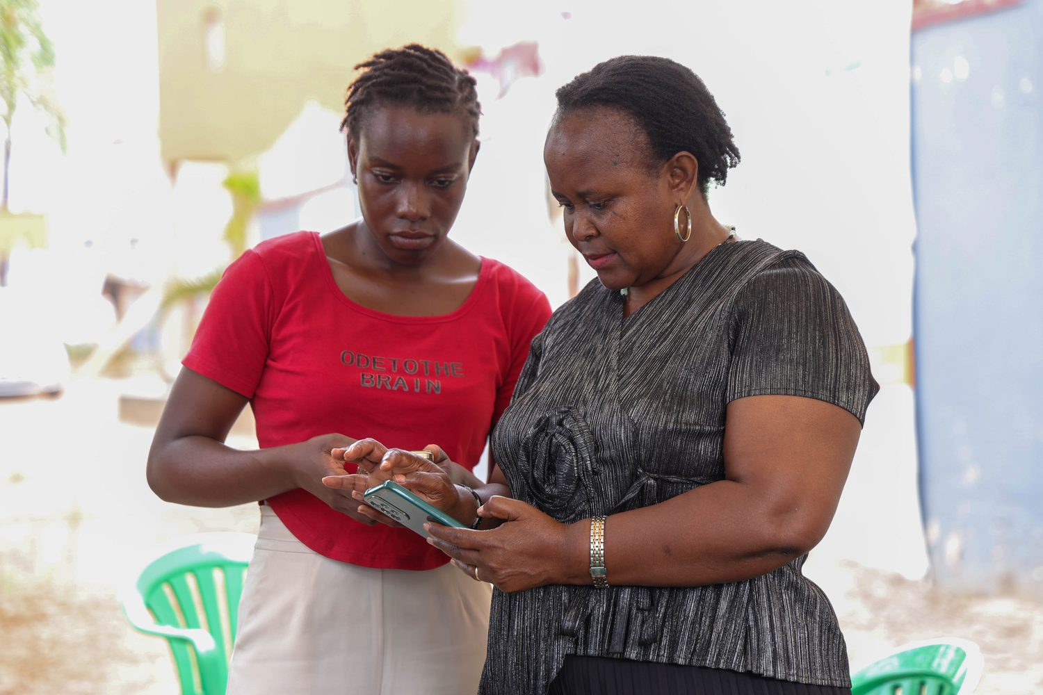
IV
What We Will Do
• A1. Put simple offline phone tools in the hands of CHWs and VHTs so household and visit records match eCHIS ideas a...
• A2. Set up safe syncing and clear access rules so community records reach FairBanks Medical Centre work and authori...
• A3. Match community indicators to DHIS2 reports and show how summary data can move for maternal and child health, i...
• A4. Give clinics and programmes clear dashboards and hotspot maps that help trigger outreach, referrals, and supply...
FairBanks SOI | DFOP0017890 Objective 4 | Your health, our mission.
5

Slide 6
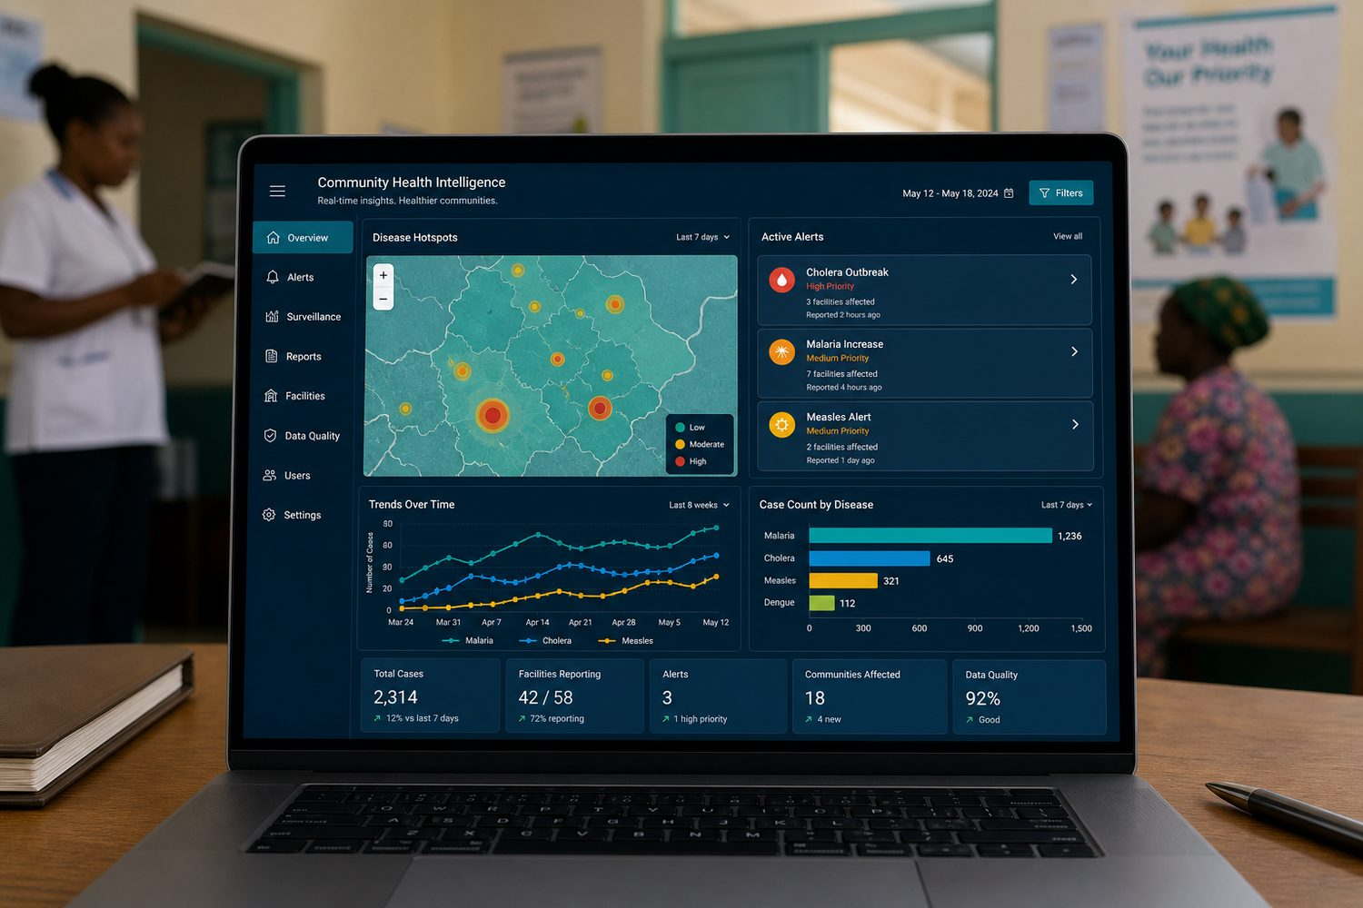
V
How We Will Work
Community visits → safe sync → links to eCHIS, clinic records, and DHIS2/eIDSR → dashboards and maps → clear handoff plan for the Ministry of Health.
FairBanks SOI | DFOP0017890 Objective 4 | Your health, our mission.
6

Slide 7
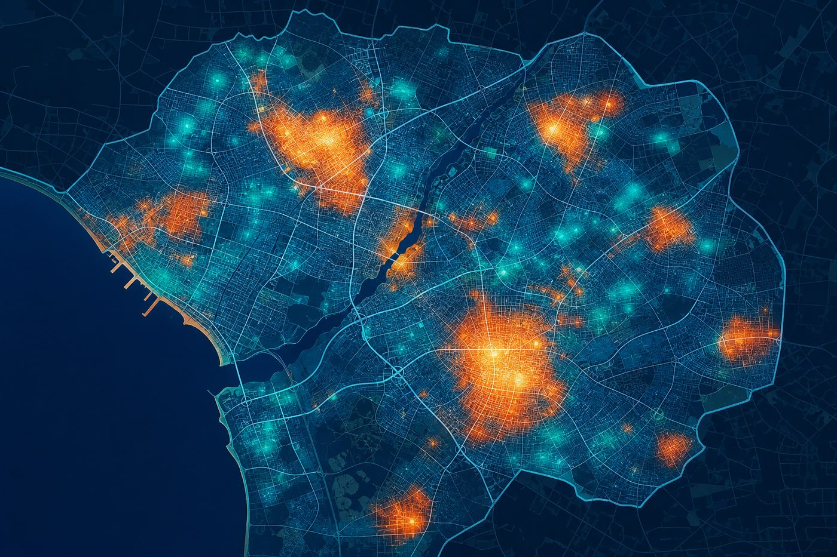
VI
What Success Looks Like
• Save lives — Earlier notice of missed antenatal visits, immunisation gaps, fever clusters, and los
• Strengthen systems — Working links and sample exports for eCHIS-style records and DHIS2/eIDSR summaries, w
• Work more efficiently — Less double entry and less waiting on paper; screens that help teams move from a comm
• Build self-reliance — Documented transition of staffing and recurrent operating costs to the Ministry of He
• Support U.S. interest — A clear contribution to the MOU digital shift: community data that connects under gov
FairBanks SOI | DFOP0017890 Objective 4 | Your health, our mission.
7

Slide 8
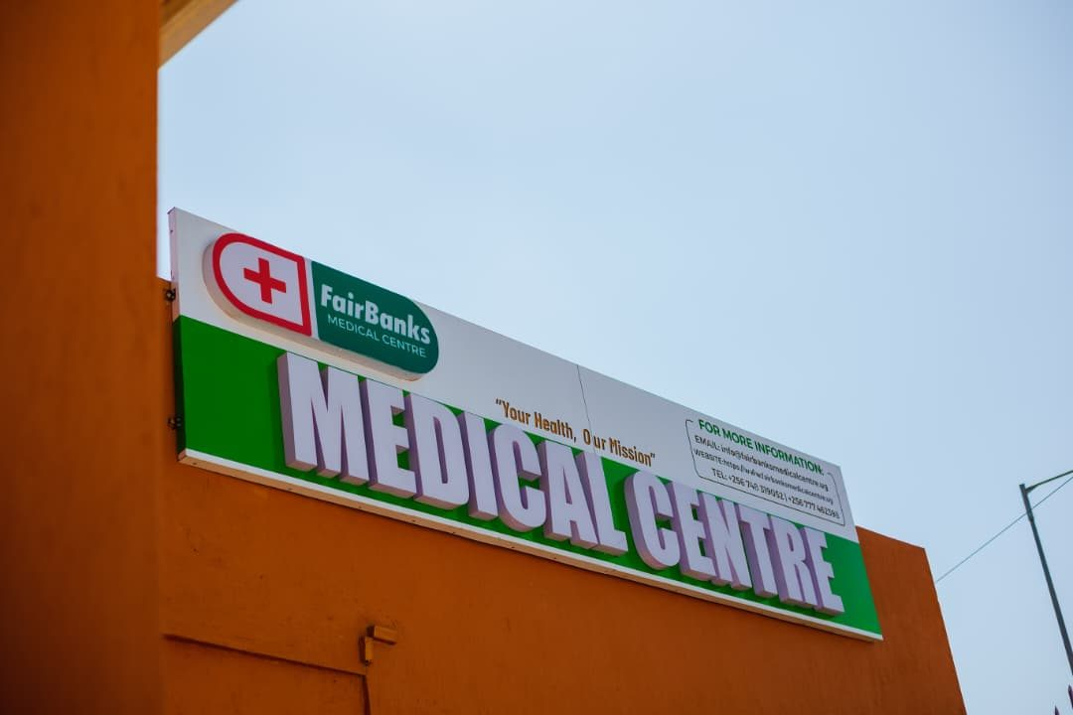
VII
Our Capacity
• We are a Ugandan organisation with a working medical centre - clinic care, tests, pharmacy, and referrals already running every day.
• FairBanks Community Reach is active in maternal and child health, Gericare, chronic disease screening, and school and workplace outreach.
• We already work with CHWs and VHTs in the Kampala-area communities named above. This is not starting from zero.
• We already keep digital clinic records and pharmacy dispensing data that support day-to-day facility work.
FairBanks SOI | DFOP0017890 Objective 4 | Your health, our mission.
8

Slide 9
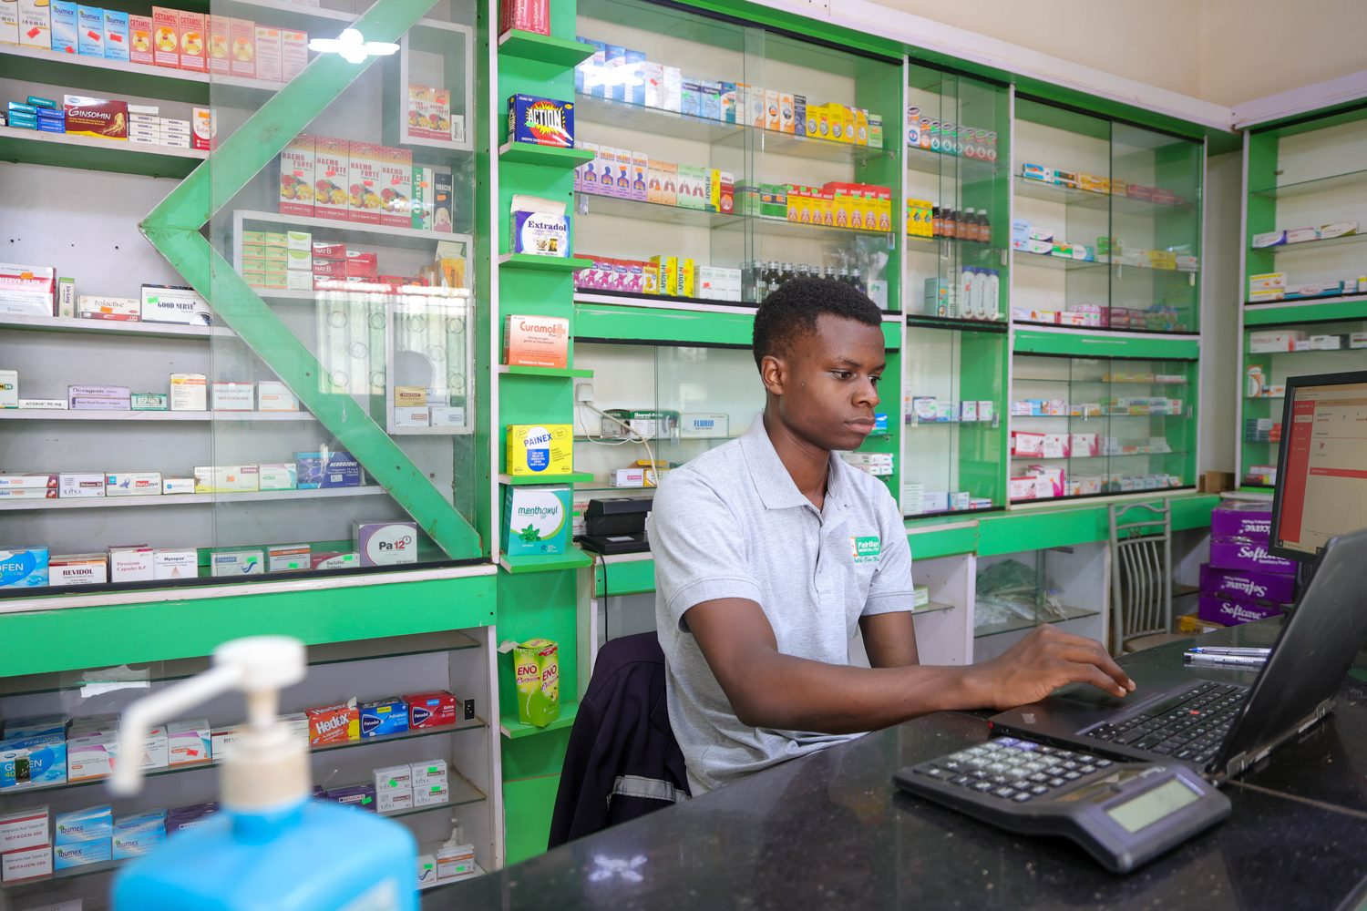
VIII
How Systems Connect
Phone tools for eCHIS-style household visits → clinic records (eAfya/ClinicMaster) → DHIS2/eIDSR summaries → National Data Warehouse when ready → CHW/VHT lists that can align with iHRIS. A bridge — not a replacement. Built to follow NDHA / OpenHIE sharing rules.
FairBanks SOI | DFOP0017890 Objective 4 | Your health, our mission.
9

Slide 10
IX
Ownership Over Time
By project close, write down how staff roles and running costs move to government ownership.
Train Ugandan developers, CHW supervisors, and data staff.
The clinic and outreach keep running as FairBanks work. The grant helps connect the data and prepare the handoff.
FairBanks SOI | DFOP0017890 Objective 4 | Your health, our mission.
10

Slide 11
X
Ready for Phase 2
With this Statement of Interest, FairBanks asks to move Track 2, Objective 4 forward through a digital health approach rooted in community work, built to connect with government systems, and designed for Ugandan ownership. We hope to be invited to Phase 2 (full proposal) or joint programme design, where we will set out workplans, budgets, monitoring, partner letters, and a clear plan to hand over staffing and running costs.
FairBanks SOI | DFOP0017890 Objective 4 | Your health, our mission.
11

